Slide 1

HI-TECH INSTITUTE OF ENGINEERING & TECHNOLOGY
PRESENTATION ON
(Hate2Wait)
SESSION 2018-19
MEMBER OF PROJECT -:
ADITYA MISHRA
MOHIT GARG
ROHIT BISWAS
TABISH JAMAL
Presented to
Manish Chhabra Sir

Slide 2
CONTENT
INTRODUCTION
FEATURES
TECHNOLOGIES INVOLVED
ADVANTAGES
SAMPLE CODE

Slide 3

INTRODUCTION
In modern era we are all so busy that we don’t have enough time to waste , so this is a initiative to save time .
Customer can generate their tokens online so that they can save some time .
Also the customer will receive the notification that their turn is about to come , this surely will save time(hope so)…

Slide 4
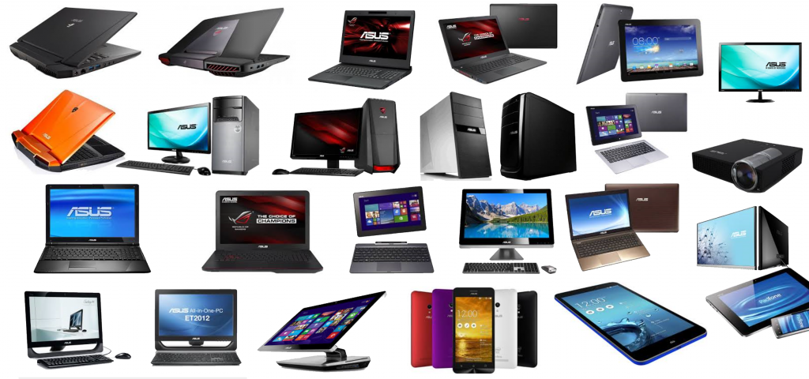
Features
As told earlier our main concern is to save as time as possible , our features include the two main thing –
The tokens will be generated online with just a matter of some clicks.
Secondly , the customer will be notified that their turn is about to come.
Also this releases some amount of pressure from the staff they only have to click two three buttons to head to the current customer as well as to get the upcoming customers notified .

Slide 5
technologies Involved
Android Application build using Android Studio(XML, JAVA)
Website using Frontend Technologies like-HTML , CSS , Javascript , Jquery , Bootstrap and Backend Technologies like –Django Framework
Database- SQLite
Programming languages like –Java , Python

Slide 6
ADVANTAGES
Time reducing
Saves paper work
Releases pressure up to some extent from both the customers and the staff
Reduces mechanical work
Website with a full fledged Android Application

Slide 7
THANK YOU

