Slide 1
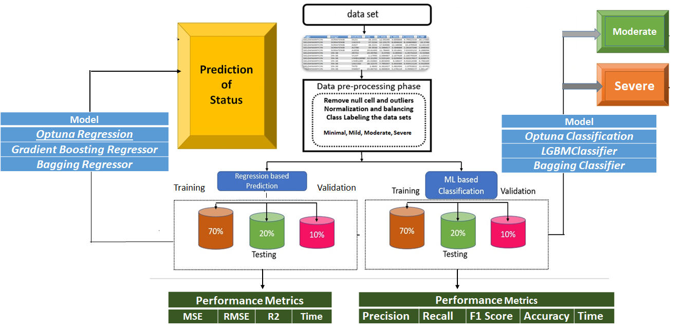
Normal
Abnormal
Optimized optuna Regressor
Three Deep Learning Regressors
Three Deep Learning Regressors
Optimized optuna Classifier
Three Deep Learning Classifiers
Three Deep Learning Classifiers

Slide 2
Normal
Abnormal
Model
Optimized optuna Regressor
Three Deep Learning Regressors
Three Deep Learning Regressors
Optimized optuna Classifier
Three Deep Learning Classifiers
Three Deep Learning Classifiers

