Slide 1
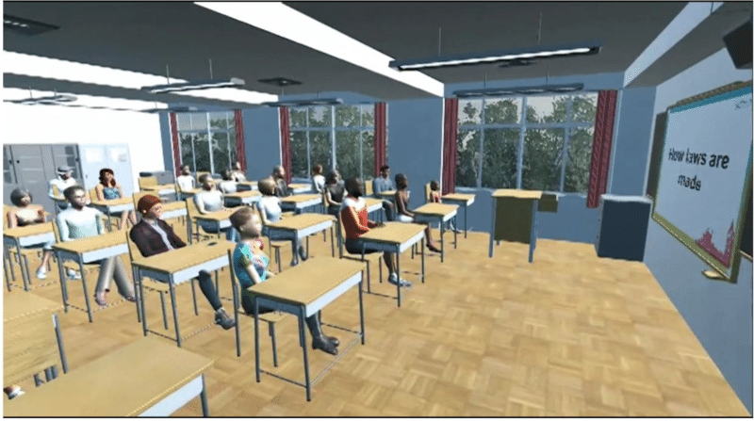
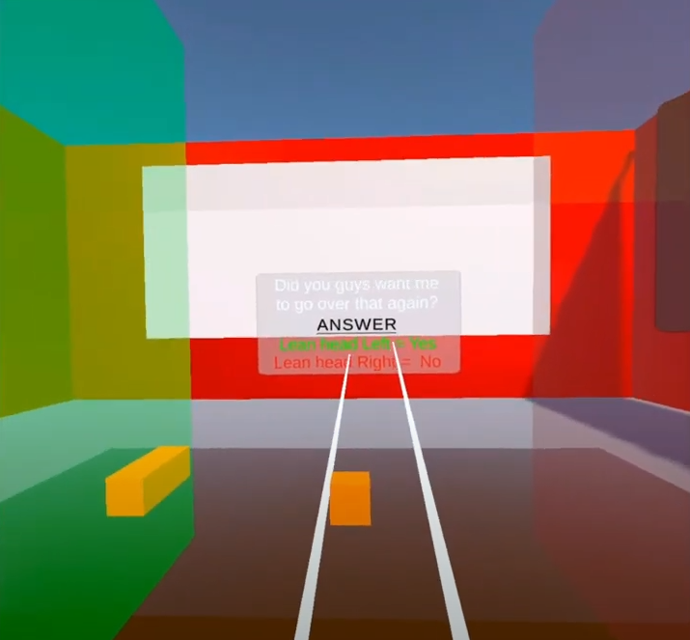
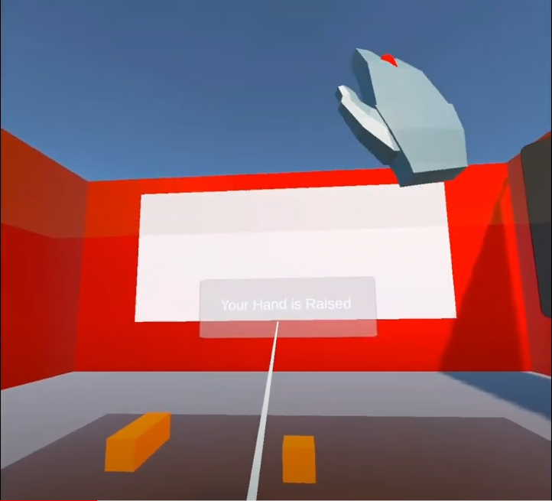

Natural Motion Controls for a Virtual Learning Environment
Notes:
○ Introduce presenters
○ What is the project
○ Problem being addressed
○ Why is this problem relevant to address?
○ What has been done so far by others?
○ How does your solution tackle the problem?
○ Takeaways.
○ Project progression in comparison to the first assignment.
○ Next steps.
○ Demo (2mins)

Slide 2
Appendices
GitHub link: https://github.com/RoyWales/EmergingTechnologies
Demo Video: https://youtu.be/1d3pTZMICIc
Gantt chart (next slide)
Notes:
hey

Slide 3
