Slide 1
The Duality between PCA and Quantum Mechanics
Based on arXiv: 2006.04379
Ziming Liu

Slide 2
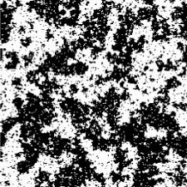
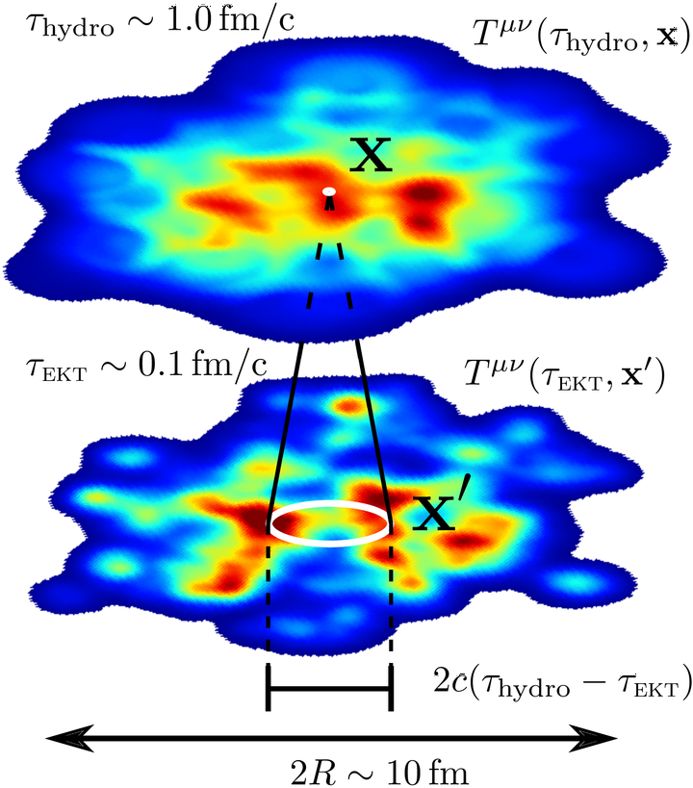
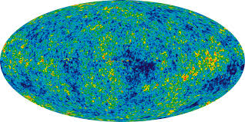
Field in physics
Local correlation is an important and prevalent feature in physics.
Ising model
Vacuum fluctuation
Heavy-Ion collisions
Cosmological Microwave
Background

Slide 3
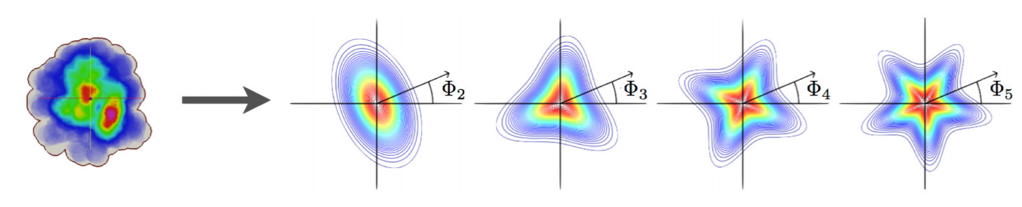
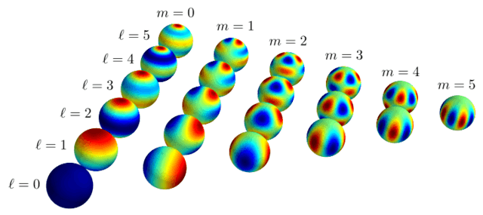
From real space to spectral space
In what sense, they are optimal ?
Relativistic Heavy-Ion collisions:
The initial profiles can be decomposed via Fourier bases.
Why?
Cosmological Microwave Background:
Temperature anisotropy can be studied with spherical harmonics.
Why?

Slide 4
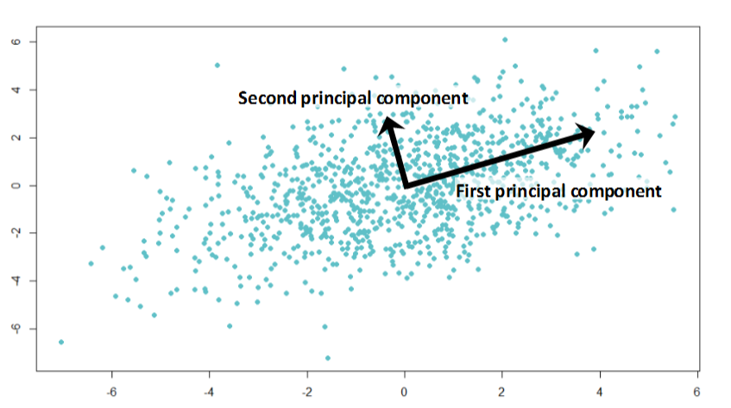
“Optimal” bases for decomposition
Definition of “Optimal” bases:
For an ensemble of field configurations,
the averaged reconstruction residue/error is minimized.
If we consider mutually orthogonal bases…
then Principal Component Analysis is the answer!
PCA aims to explain
most variance in data

Slide 5
Goal:
Fourier bases/ Spherical Harmonics …
should be emergent from
?
principal components of

Slide 6
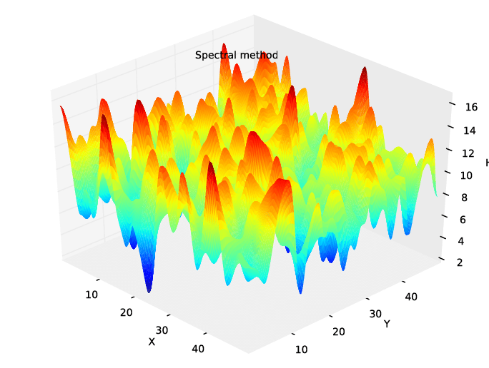
Goal:
Fourier bases/ Spherical Harmonics …
should be emergent from
principal components of
Gaussian Process/
Gaussian Random Field

Slide 7
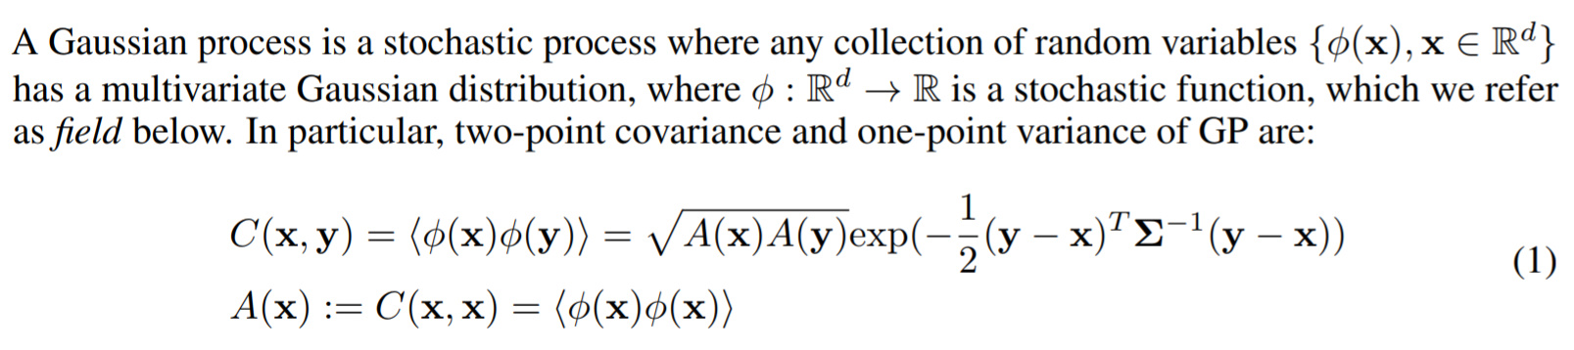
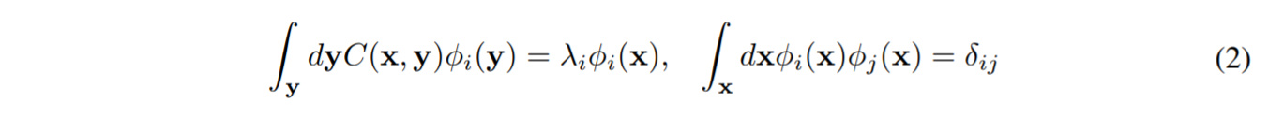
Gaussian Process
Note: $C(x,y)$ field covariance, $A(x)$: field variance, $Σ$: correlation kernel
PCA (Eigenvalue) problem of Gaussian Process:

Slide 8
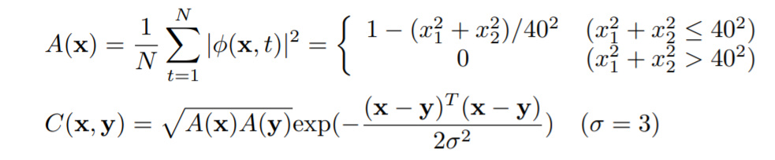
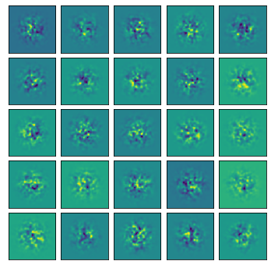
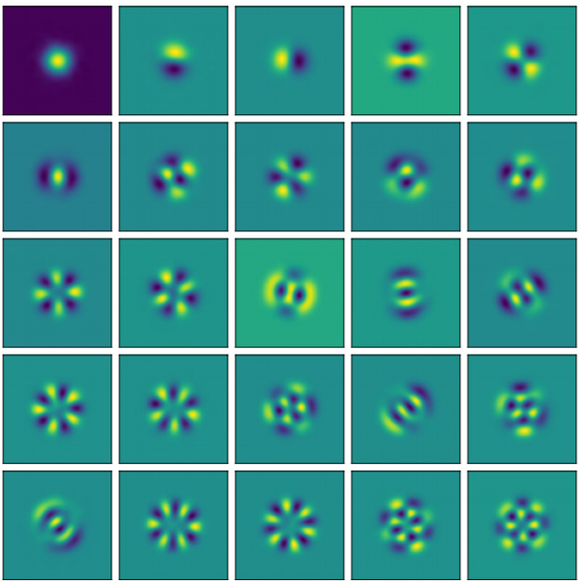
PCA results of Gaussian Process
1
Staircase structure
Why?
2
Eigenvalue
3
4
5
Index of PC
Random process: different realizations
Principal Components

Slide 9
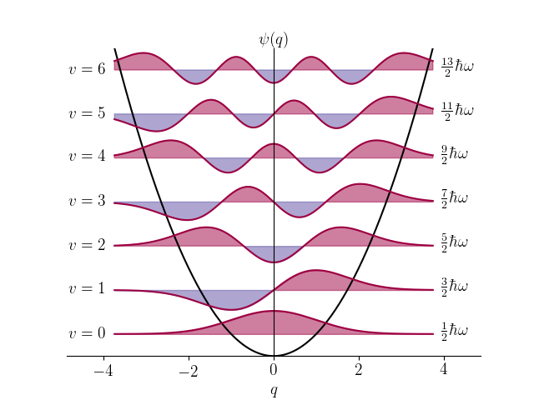
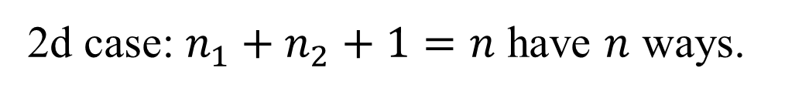

Same degeneracy in Quantum mechanics!
$$E_{n}∝n+\frac{1}{2}$$
Eigenvalue in PCA
(Minus) Energy in 2d harmonic oscillator
1
1
2
2
3
3
4
4
5
5
Index of PC
Index of Eigenstates
2d case: $n_{1}+n_{2}+1=n$ have $n$ ways.

Slide 10
Duality between QM and PCA ? Yes!
PCA eigenvalue Problem:
Steady-State Schrodinger Equation:
Note: (1) $Σ_{m}Δ≔(Σ_{m}∇)⋅∇)$; (2) $Σ_{m}=M^{−1}$, inverse of the particle mass

Slide 11
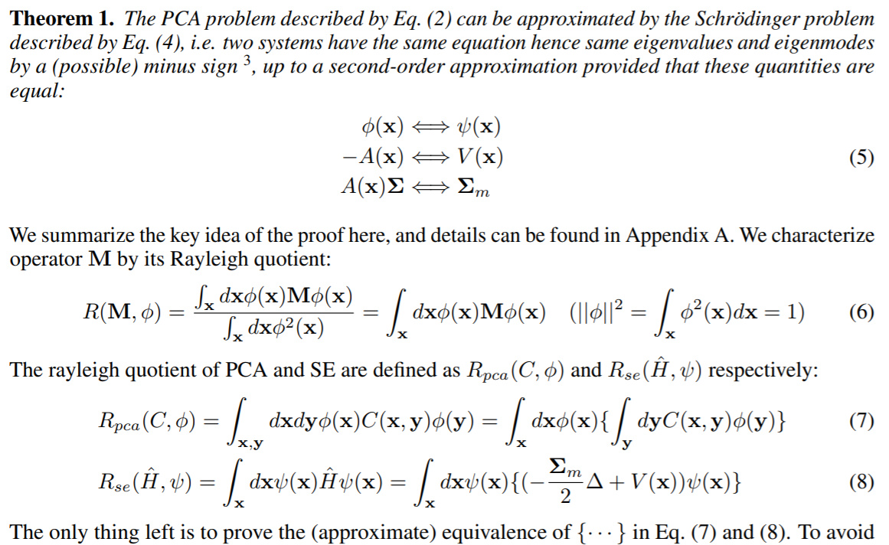
Details in paper.

Slide 12
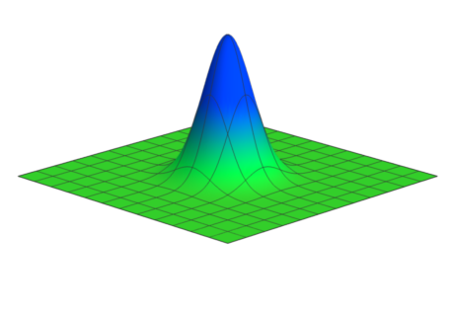
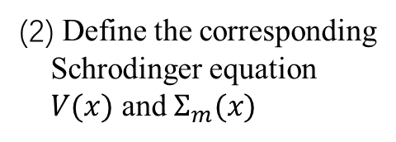
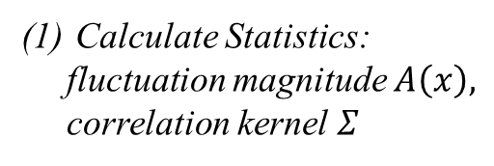
Schrodinger PCA: Solving PCA with Schrodinger Equation
PCA of Spatial data
Schrodinger Equation
Schrodinger PCA:
Calculate Statistics:
fluctuation magnitude $A\left(x\right),$
correlation kernel $Σ$
(2) Define the corresponding Schrodinger equation $V(x)$ and $Σ_{m}(x)$
(3) Solve the Schrodinger equation

Slide 13
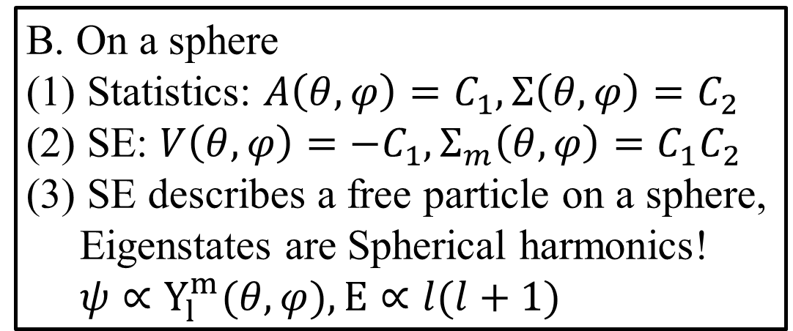

Examples
A. On a ring
(1) Statistics: $A\left(φ\right)=C_{1}, Σ\left(φ\right)=C_{2}$
(2) SE: $V\left(φ\right)=−C_{1}, Σ_{m}\left(φ\right)=C_{1}C_{2}$
(3) SE describes a free particle on a ring, Eigenstates are Fourier bases! $ψ∝\sin\left(nφ\right)or\cos\left(nφ\right), E∝n^{2}$
B. On a sphere
(1) Statistics: $A\left(θ,φ\right)=C_{1}, Σ\left(θ,φ\right)=C_{2}$
(2) SE: $V\left(θ,φ\right)=−C_{1}, Σ_{m}\left(θ,φ\right)=C_{1}C_{2}$
(3) SE describes a free particle on a sphere, Eigenstates are Spherical harmonics! $ψ∝Y_{l}^{m}(θ,φ), E∝l(l+1)$

Slide 14
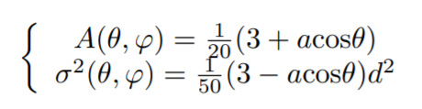
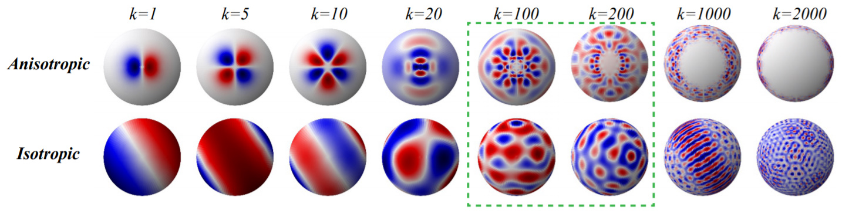

Examples
Global Climate: we consider two earths: isotropic ($a=0$) and anisotropic ($a=2.9$).
$$Σ(θ,φ)=σ^{2}(θ,φ)I$$
(Top View)

Slide 15
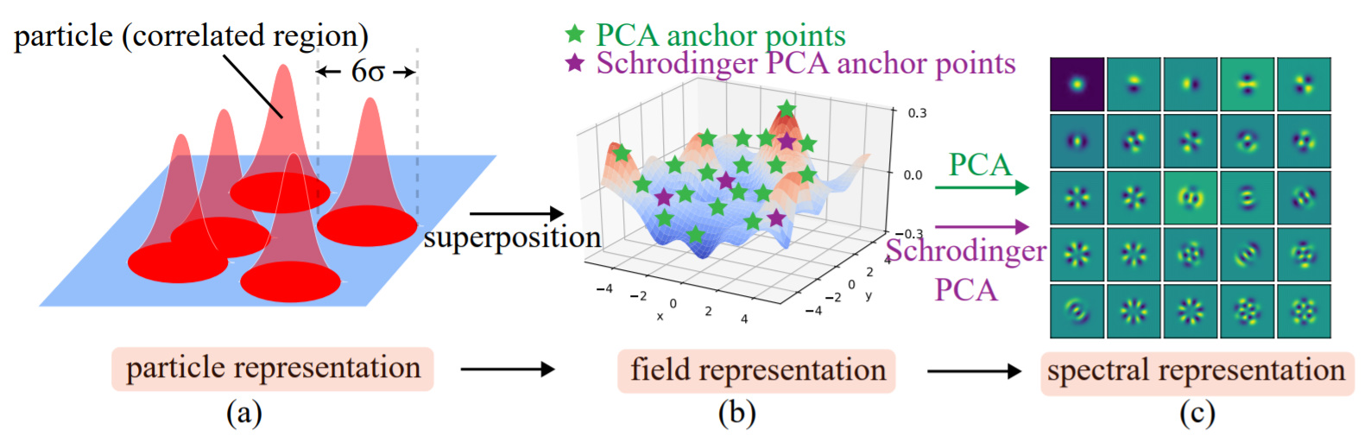
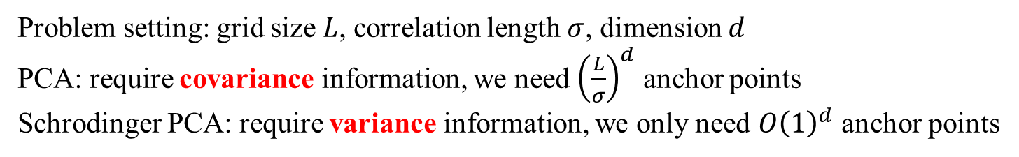
Numerical benefits
Problem setting: grid size $L$, correlation length $σ$, dimension $d$
PCA: require covariance information, we need ${\left(\frac{L}{σ}\right)}^{d}$ anchor points
Schrodinger PCA: require variance information, we only need $O{\left(1\right)}^{d}$ anchor points

Slide 16
Conclusion & Discussion
(1) We also extend the duality between PCA and QM to “Laplace process”
(2) Why Fourier bases/ spherical harmonics are powerful mathematical tools? We provide the perspective of optimal compression.
(3) For more complicated datasets, Schrodinger PCA can provide physically interpretable modes very efficiently, while PCA requires dense anchor points.
(4) Possible applications in physics: Cosmological Microwave Background (CMB),
Condensed matter physics, fluid mechanics etc.

Slide 17
Welcome collaboration!
Please visit my webpage at
kindxiaoming.github.io

