Slide 1
XML and Web Services
for Astronomers
Roy Williams
California Institute of Technology
roy@caltech.edu
Robert Brunner
University of Illinois
bigdog@uiuc.edu
ASASS 2002, 13 October 2002, Baltimore
© Roy Williams, Robert Brunner

Slide 2
XML and Structured Data
XML Syntax
VOTable and other formats
Transformation, Parsing, Binding

Slide 3
What is Markup?
Markup in a document means extra tags to define the meaning of the text.
<b>Memorandum</b>
<hr>
From: <i>Antonio Stradivarius</i><br>
To: <i>Domenico Scarlatti</i><br>
Date: 13 April 1723<br>
Message: Io bisogno una appartamento acoglienti a Cremona …
<hr>
Rendering
This markup is HTML
Memorandum
From: Antonio Stradivarius
To: Domenico Scarlatti
Date: 13 April 1723
Message: Io bisogno una appartamento acoglienti a Cremona …

Slide 4
Structure with XML
<Memo>
<From>Antonio Stradivarius</From>
<To>Domenico Scarlatti</To>
<Date>
<Day>13</Day>
<Month>4</Month>
<Year>1723</Year>
</Date>
<Body>
Io bisogno una appartamento acoglienti a Cremona …
</Body>
</Memo>
Separation of structure from presentation
Rendering
4/13/23
April 13, 1723
17.iv.1723
Processing
The computer can read the document:
“Find all memos from April 1723”

Slide 5
Why XML?
XML is a standard way to represent structured documents,
including metadata and data
Platform neutral / Open
Vendor supported / Vendor neutral
Proven -- decades with SGML
Extensible
Syntax checking -- Explicit Schema
Industry convergence
Web friendly

Slide 6
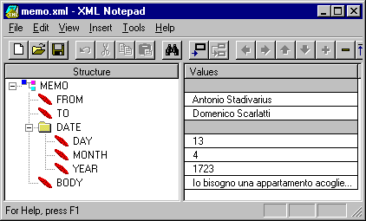
Why XML?
Documents and data
Human readable, editable, mailable
Can encode many data models
Can encode program too
Many tools
Parsers in Java, C, C++, Perl, Python, ...
Browsers and editors
XML databases
Style sheets, formatting, transformation

Slide 7
What is Markup?
Markup is everywhere
  Latex, Postscript, FITS, ….
From here we consider only XML dialects:
XML
VOTable
HTML
XDF

Slide 8
XML Usage Model
Web
Services
GET, POST, SOAP
XML
DB
Interoperability
SQL
Structured
Data storage
XSLT
presentation
forms
queries
HTML

Slide 9
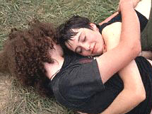
Service Workflow
Catalog
Service
Query Check
Service
Query
Estimator
Archive
Service
User’s code
Crossmatch
Service
Archive
Service
Storage
Service
SOAP envelopes of
XML: VOTable and other VO dialects
AND
broadband binary

Slide 10
XML and Structured Data
XML Syntax
VOTable and other formats
Transformation, Parsing, Binding

Slide 11
XML Syntax
Start tag
<From>
Antonio Stradivarius
</From>
Content
Element
End tag
White space is part of the content
-- Many applications ignore it
Element names are case-sensitive
<From> is not <from>

Slide 12
XML Syntax
Empty element:
<From/>
is equivalent to
<From><From/>
Note that the HTML constructions <br> and <hr>
Are not proper: should be <br/> and <hr/>
<Date>
<Day>13</Day>
<Month>4</Month>
<Year>1723</Year>
</Date>
parent-child
siblings
One element has no parent
Root
or Document element

Slide 13
Attributes
An attribute is a name-value pair inside the start tag.
<From born=“1648” died=“1737”>
Antonio Stradivarius
</From>
Don’t forget the quotes!
Name must be unique in element
<From value=“Antonio Stradivarius”/>
Can use an empty element with attributes

Slide 14
Element Names
Names can have a-Z 0-9 _ - . :
Colon is reserved for namespaces
Names cannot have “ ‘ ` $ ^ % ; <>
<Φρομ> Σοκρατεσ </Φρομ>
This is good XML
<téléphone> 011 33 91 55 46 23 98 </téléphone>

Slide 15
Text in XML
Must escape five symbols
< &lt;
> &gt;
& &amp;
“ &quot;
‘ &apos;
Symbol escapes
This is Greek theta &#x03B8;
Fran&#xE7;ois not Francois!
See http://www.unicode.org
Bulk escape through CDATA
<![CDATA[
H < 3 & K > 4
Patrick O’Reilly
]]>
H &lt; 3 &amp; K &gt; 4
Patrick O&apos;Reilly

Slide 16
Other stuff
Comments
<!-- This is a comment -->
Processing Instructions
<?myprinter color="purple" ?>
<?robots ignore="yes" ?>
<?xml-stylesheet type="text/xsl" href="http://us-vo.org/xml/VOTable-basic.xsl"?>

Slide 17
Well-formed XML
Every start tag must have an end tag match
Elements may nest, but not overlap
  (<a><b>this is wrong</a></b>)
There must be exactly one root element
Attribute values must be quoted
An element cannot have 2 attributes of the same name
No comments inside tags
No unescaped <, >, & in element text or attibute text
Etc etc

Slide 18
Validation (DTD/Xschema)
XML dialects
    Applications accept particular types of data
      Adobe Illustrator takes Scalable Vector Graphics ML
      VO applications take VOTable
      Browser takes Platform for Privacy Preferences ML
Validation checks the XML file
    Against DTD (Document Type Definition>
    Against Xschema
Validation is Optional
Checks if Instance is member of Class

Slide 19
DTD
Inherited from past, not XML
Example from VOTable.dtd
<!-- RESOURCEs can contain other RESOURCES,
together with TABLEs and other stuff -->
<!ELEMENT RESOURCE (DESCRIPTION?, INFO*, COOSYS*, PARAM*, LINK*,
TABLE*, RESOURCE*)>
<!ATTLIST RESOURCE
name CDATA #IMPLIED
ID ID #IMPLIED
type (results | meta) "results"
>

Slide 20
XSchema
XML-based document definition
    Elements can be more complex
      Type derivation and inheritance
    Occurrence constraints
        Eg a marriage has exactly two people
    Simple data types
      For Character data and attributes
      string, integer, dateTime, etc
      Patterns
        Eg a US phone number is xxx-xxx-xxxx
  Namespaces!

Slide 21
Xschema fragment
<!-- RESOURCES can contain DESCRIPTION, (INFO|PARM|LINK), (TABLE|RESOURCE) -->
<xs:element name="RESOURCE">
<xs:complexType>
<xs:sequence>
<xs:element ref="DESCRIPTION" minOccurs="0"/>
<xs:element ref="INFO" minOccurs="0" maxOccurs="unbounded"/>
<xs:element ref="COOSYS" minOccurs="0" maxOccurs="unbounded"/>
<xs:element ref="PARAM" minOccurs="0" maxOccurs="unbounded"/>
<xs:element ref="LINK" minOccurs="0" maxOccurs="unbounded"/>
<xs:element ref="TABLE" minOccurs="0" maxOccurs="unbounded"/>
<xs:element ref="RESOURCE" minOccurs="0" maxOccurs="unbounded"/>
</xs:sequence>
<xs:attribute name="name" type="xs:token"/>
<xs:attribute name="ID" type="xs:ID"/>
<xs:attribute name="type" default="results">
<xs:simpleType>
<xs:restriction base="xs:NMTOKEN">
<xs:enumeration value="results"/>
<xs:enumeration value="meta"/>
</xs:restriction>
</xs:simpleType>
</xs:attribute>
</xs:complexType>
</xs:element>

Slide 22

Namespaces
“We took the table and chair dimensions,
and wrote them in a table.”
Namespace =
mydomain.com/furniture
Namespace =
mydomain.com/word-processing
This is a URI (NOT a URL).
A URI is a unique string.
A URL is an address on the Internet.
FITS keywords have no namespace!

Slide 23
Namespaces
For reusing document definitions
<furniture:table material="oak"/>
<word-processing:table columns="5"/>

Slide 24
Xschema Example
<?xml version="1.0">
<Date>
<Day>13</Day>
<Month>4</Month>
<Year>1723</Year>
</Date>
Instance
<?xml version="1.0">
<xs:schema xmlns:xsd="http://www.w3.org/2001/XMLSchema">
<xs:element name="Date">
<xs:complexType>
<xs:choice>
<xs:element name="Day">
<xs:element name="Month">
<xs:element name="Year">
</xs:choice>
</xs:complexType>
</xs:element>
Class

Slide 25
Xschema Example
<xs:element name="Day" type="dayType">
<xs:complexType name="dayType">
<xs:simpleContent>
<xs:restriction base="xs:positiveInteger">
<xs:maxInclusive value="31"/>
</xs:restriction>
</xs:simpleContent>
</xs:complexType>
<xs:element name="Month" type="monthType">
<xs:complexType name="monthType">
<xs:simpleContent>
<xs:restriction base="xs:NMTOKEN">
<xs:enumeration value="January"/>
<xs:enumeration value="February"/>
</xs:restriction>
</xs:simpleContent>
</xs:complexType>

Slide 26
XML and Structured Data
XML Syntax
VOTable and other formats
Transformation, Parsing, Binding

Slide 27
VOTable
VOTable = hierarchy of Metadata + Tables
Metadata = Parameters + Infos + Descriptions + Links + Fields
Table = list of Fields + Data
Data = stream of Rows
Row = list of Cells
Cell = Primitive
  or variable-length list of Primitives
  or multidimensional array of Primitives
Primitive = integer, character, float, floatComplex, etc

Slide 28
Data in VOTable
Data expressed in XML
  <TABLEDATA> <TR><TD>
Or FITS binary table
  <FITS><STREAM>
Or BINARY format
  simple format, can seek, parallelize
  <BINARY><STREAM>

Slide 29
VOTable Stream
STREAM can use different protocols:
<STREAM href="ftp://server.com/mydata.dat"/>
<STREAM href="ftp://server.com/mydata.dat" expires="2002-02-22"/>
<STREAM href="httpg://server.com/mydata.dat" actuate="onLoad"/>
<STREAM file="file:///usr/home/me/mydata.dat"/>

Slide 30
Data in VOTable
Table cell is array of primitives
datatype
Meaning
FITS
Bytes
"boolean"
Logical
"L"
1
"bit"
Bit
"X"
*
"unsignedByte"
Byte (0 to 255)
"B"
1
"short"
Short Integer
"I"
2
"int"
Integer
"J"
4
"long"
Long integer
"K"
8
"char"
ASCII Character
"A"
1
"unicodeChar"
Unicode Character
2
"float"
Floating point
"E"
4
"double"
Double
"D"
8
"floatComplex"
Float Complex
"C"
8
"doubleComplex"
Double Complex
"M"
16

Slide 31
Metadata in VOTable
Column header == FIELD
Has name, ID, unit, accuracy, etc
Has datatype, arraysize
Has UCD
  PHOT_INT-MAG_B Integrated total blue magnitude
  ORBIT_ECCENTRICITY Orbital eccentricity
  STAT_MEDIAN Statistics Median Value
  INST_QE Detector's Quantum Efficiency

Slide 32
VOTable Example
<!DOCTYPE VOTABLE SYSTEM "http://us-vo.org/xml/VOTable.dtd">
<VOTABLE version="1.0">
<DEFINITIONS>
<COOSYS ID="myJ2000" equinox="2000." epoch="2000." system="eq_FK5"/>
</DEFINITIONS>
<RESOURCE>
<PARAM name="Observer" datatype="char" arraysize="*" value="William Herschel">
<DESCRIPTION>This parameter is designed to store the observer's name
</DESCRIPTION>
</PARAM>
<TABLE name="Stars">
<DESCRIPTION>Some bright stars</DESCRIPTION>
<FIELD name="Star-Name" ucd="ID_MAIN" datatype="char" arraysize="10"/>
<FIELD name="RA" ucd="POS_EQ_RA" ref="myJ2000" unit="deg"
datatype="float" precision="F3" width="7"/>
<FIELD name="Dec" ucd="POS_EQ_DEC" ref="myJ2000" unit="deg"
datatype="float" precision="F3" width="7"/>
<FIELD name="Counts" ucd="NUMBER" datatype="int" arraysize="2x3x*"/>

Slide 33
VOTable Example
<DATA>
<TABLEDATA>
<TR>
<TD>Procyon</TD><TD>114.827</TD><TD> 5.227</TD>
<TD>4 5 3 4 3 2 1 2 3 3 5 6</TD>
</TR>
<TR>
<TD>Vega</TD><TD>279.234</TD>
<TD>38.782</TD><TD>8 7 8 6 8 6</TD>
</TR>
</TABLEDATA>
</DATA>
</TABLE>
</RESOURCE>
</VOTABLE>
Whitespace separated tokens
for array of primitives

Slide 34
VOTable Example
<VOTABLE version="1.0">
<RESOURCE ID="Stars">
<PARAM ID="Mass" datatype="float" unit="solMass" value="1"/>
<RESOURCE ID="BigStars">
<PARAM ID="Mass-big" datatype="float" unit="solMass" value="10"/>
</RESOURCE>
<RESOURCE ID="SmallStars">
<PARAM ID="Mass-small" datatype="float" unit="solMass" value="0.2"/>
<RESOURCE ID="VerySmallStars">
<PARAM ID="Mass-tiny" datatype="float" unit="solMass" value="0.05"/>
</RESOURCE>
</RESOURCE>
</RESOURCE>
</VOTABLE>

Slide 35
XDF (NASA Goddard)
N-dimensional blocks
  Spatial information
  Scalar, vector fields on grid
  Tables of multidimensional
Spectra with their wavelength scales,
images with coordinate axes,
vector fields with unitDirection,
data cubes in complicated spaces,
tables with column headers, and
series of tables with each table having a unique name

Slide 36
XDF Example
<XDF>
<parameter name="date" > <units><unitless/></units>
<value>01-12-99</value>
</parameter>
<structure name="2_vector_spaces">
<array name="LoRes">
<units><unit>m/s</unit></units>
<axis name="vector components" axisId="comps-lo">
<axisUnits><unitless/></axisUnits>
<unitDirection axisIdRef="x-lo" name="x-hat" />
<unitDirection axisIdRef="y-lo" name="y-hat" />
<unitDirection axisIdRef="z-lo" name="z-hat" />
</axis>
<axis name="x" …
<axis name="y" …
<axis name="z" …

Slide 37
XDF Example
<for axisIdRef="comps-lo">
<for axisIdRef="x-lo">
<for axisIdRef="y-lo">
<for axisIdRef="z-lo">
<asciiFormat>
<repeat count="4">
<ascii type="fixed" width="8" precision="3"/>
<skipChar count="1"/>
</repeat>
<ascii type="fixed" width="8" precision="3"/>
</asciiFormat>
</for>
</for>
</for>
</for>
<data>
<![CDATA[
2432.234 2345.432 2333.553 5234.737 5234.220 5234.334 5234.220
2432.234 2345.432 2333.553 2345.432 2333.553 5234.334 5234.220
. . .
]]></data>
</array>
</XDF>

Slide 38
AML: Astronomical Markup Language'
Standard exchange format for metadata in astronomy
    astronomical object
    article
    table
    set of tables
    image
    person
    project

Slide 39
AML Example
<AML>
<AOBJECT>
<IDENTS>
<IDENT> UGC 6 </IDENT>
<IDENT> MCG+04-01-013 </IDENT>
</IDENTS>
<COORD coosystem="equatorial">
<RA>000309.55</RA> <DEC>+215736.4</DEC>
</COORD>
<OBJTYPE> Seyfert_2 </OBJTYPE>
<MORPHO> Sc </MORPHO>
<RADVELO unit="z"> 0.02226 </RADVELO>
<DIM unit="arcmin"> 1.1 x 0.8 </DIM>
<MAG filter="B"> 14.62 </MAG>
<ORIANGL unit="deg"> 105 </ORIANGL>
<REFS>
<REF> 1997ApJS..108..155G </REF>
<REF> 1997ApJS..108..229H </REF>
</REFS>
</AOBJECT>
</AML>

Slide 40
XML and Structured Data
XML Syntax
VOTable and other formats
Transformation, Parsing, Binding

Slide 41
XPath and XSLT
XSL
    Extensible Style Language
XSLT
    Extensible Style Language Transformation
XML
document
XSLT
engine
Output
(HTML, Latex,
Excel, ...)
XSL
stylesheet

Slide 42
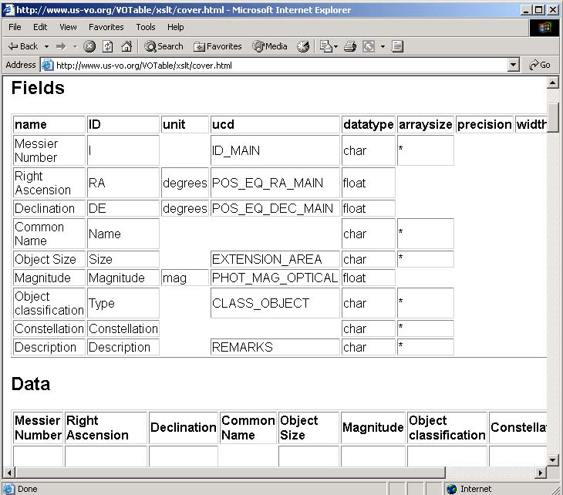
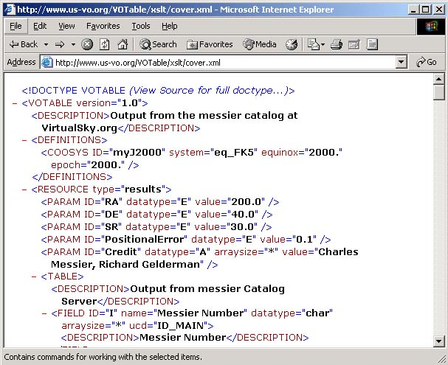
XSLT example
see http://us-vo.org/VOTable
for details

Slide 43
XSLT in the browser
<?xml-stylesheet type="text/xsl" href="http://us-vo.org/xml/VOTable-basic.xsl"?>
First line of XML document
?xml-stylesheet is a processing instruction
Works with Netscape 7
And IE 6 -- set security to medium-low
see http://us-vo.org/VOTable
for details

Slide 44
Building XSLT
This document is a stylesheet
<xsl:stylesheet version="1.0" xmlns:xsl="http://www.w3.org/1999/XSL/Transform">
<xsl:template match="/memo/date/day">
<h1> The Memo Day is: <xsl:apply-templates/></h1>
</xsl:template>
</xsl:stylesheet>
When you see this Xpath template
Copy this text
Then the text of the relevant element

Slide 45
XML Parsing with SAX
SAX: Event-Based
Handlers for StartElement, Text, EndElement, etc.
startElement Memo
startElement From
characters Antonio Stradivarius
endElement From
startElement Date
startElement Day
characters 13
….

Slide 46
XML Parsing with SAX
try {
XMLReader parser = XMLReaderFactory.createXMLReader();
parser.setContentHandler(new myHandler());
parser.parse("http://musicalmemos.org/strad.xml");
}
catch(SAXParseException e) {
// Well-formed error
}
catch(SAXException e) {
// Could not find XMLReader
}
catch(IOException e) {
// could not read file from net
}

Slide 47
XML Parsing with SAX
public class myHandler implements ContentHandler {
public void startElement(…, String elementName,…, Attributes atts){
}
public void endElement(…, String elementName, …){
}
public void characters(char[] test, int start, int length){
}
+ some other methods…
}

Slide 48
XML Parsing with DOM
DOM: Document Object Model
Returns a tree-like Document object with data attached
Memo
Body
From
Date
Antonio Stradivarius
To
Day
13
Io bisogno una appartamento acoglienti a Cremona …
Domenico Scarlatti
Month
4
Year
1723

Slide 49
Parsing XML with DOM
DOMParser dp = new DOMParser();
dp.parse(("http://musicalmemos.org/strad.xml");
Node nd = dp.getDocument().getDocumentElement();
int count = numberOfNodes(nd);
public int numberOfNodes(Node nd){
int number = 1;
Nodelist nl = nd.getChildNodes();
for(int i=0; i<nl.getLength(); i++)
if(nl.item(i).getNodeType() == Node.ELEMENT_NODE)
number += numberOfNodes(nl.item(i));
}

Slide 50
XML Binding
Automatically makes code from DTD/XSchema
  eg. Element <Date> generates
    getDay(), setDay()
    getMonth(), setMonth()
    getYear(), setYear()
  Much easier than building it with DOM

Slide 51
XML Binding
Votable v = votw.getVotable();
// just get the first resource -- there may be more that we ignore
Resource r = null;
if(v.getResourceCount() > 0)
r = (Resource)v.getResourceAt(0);
else …
// just get the first table -- there may be more that we ignore
Table table = null;
if(r.getTableCount() > 0)
table = (Table)r.getTableAt(0);
else …

Slide 52
XML Binding
Parsing VOTable
  Finding the RA, dec columns by UCD
for(int i=0; i<table.getFieldCount(); i++){
f = (Field)table.getFieldAt(i);
String s = f.getUcd(); …
if(s.equals(“POS_RA_EQ_MAIN”)
// this field contains right ascension
if(s.equals(“POS_DEC_EQ_MAIN”)
// this field contains declination

Slide 53
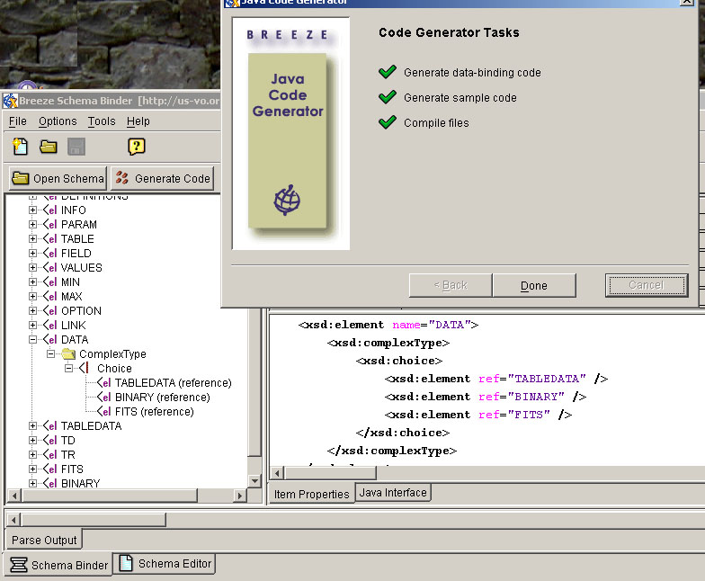
XML Binding Tools
Can use binder from breezefactory.com
Also soon
JAXB
java.sun.com/xml/jaxb/

Slide 54
Web Services for Astronomers
What are Web Services
Web Service Architecture
Building Web Services
The Future of Web Services

Slide 55
What are Web Services?
Web (From Dictionary.com)
  A latticed or woven structure
  Something intricately contrived, especially something that ensnares or entangles.
  A complex, interconnected structure or arrangement
  Shorthand for the World Wide Web

Slide 56
What are Web Services?
Service (From Dictionary.com)
  The performance of work or duties for a superior or as a servant
  An act or a variety of work done for others, especially for pay
  Assistance; help
  Slang terms not suitable for print.

Slide 57
What are Web Services?
Web Service
  Distributed Computing Model
  Self-Contained Modular Applications
  Platform Independent
  Language Independent
Or
  An unpaid act of performing intricately contrived work for others that ensnares all?

Slide 58
Hello World
public class HelloWorld {
public java.lang.String getMessage() {
return "Hello World!" ;
}
public static void main(String[] args) {
HelloWorld hw = new HelloWorld() ;
System.out.print(hw.getMessage()) ;
}
}

Slide 59
What are Web Services?
A Service that is accessed via the Web!

Slide 60
Who is in Control?
W3C (www.w3c.org)
  WSDL
  SOAP/XML Protocol
  Web Service Activity
Oasis (www.oasis-open.org)
  ebXML
  UDDI
WS-I (www.ws-i.org)

Slide 61
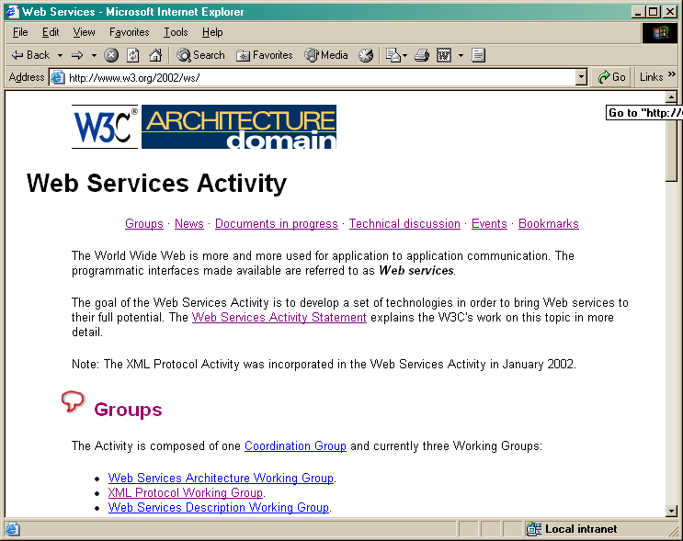
W3C Web Services Activity

Slide 62
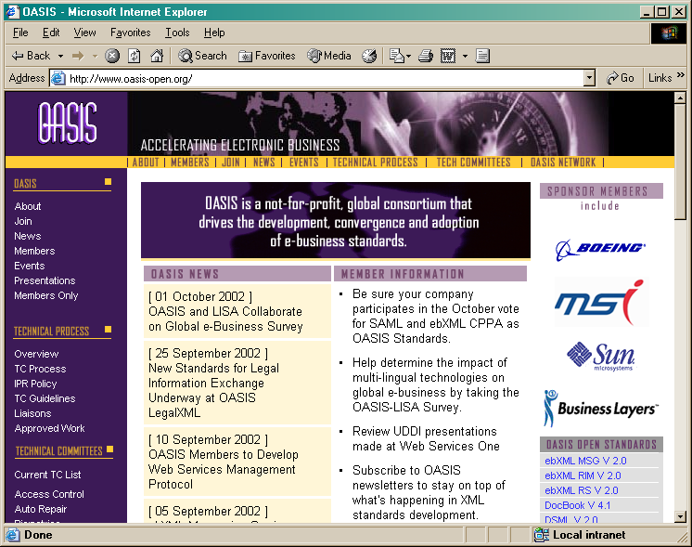
OASIS

Slide 63
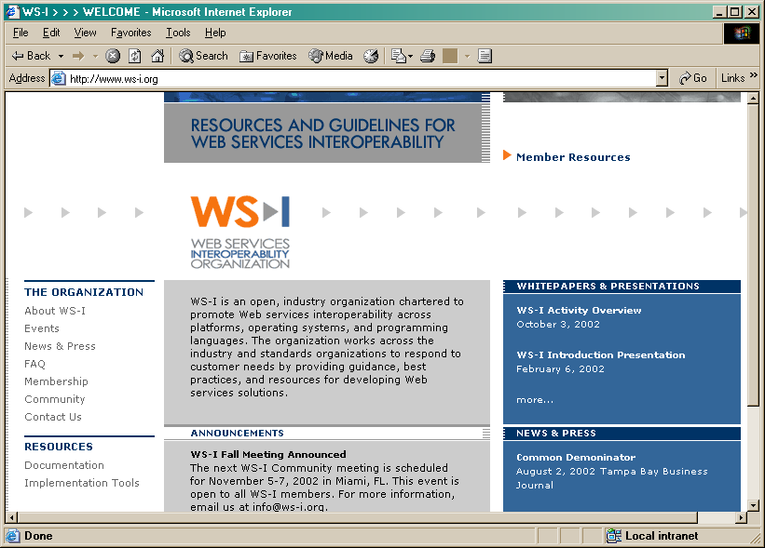
WS-I

Slide 64
How is this different?
RPC Model Exists!
  CORBA
  COM/DCOM
  RMI
  …
Web Services use XML!!!!!

Slide 65
Practical Examples
Business to Business
  Inventory Records
  Bill of Laden
  Purchase Orders
Business to Consumer
  Financial Data
  Spelling/Searching
  Product Listings
  Airline Reservations

Slide 66
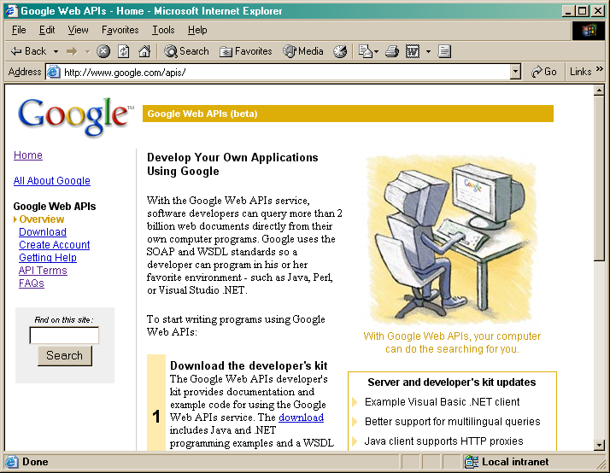
Google

Slide 67
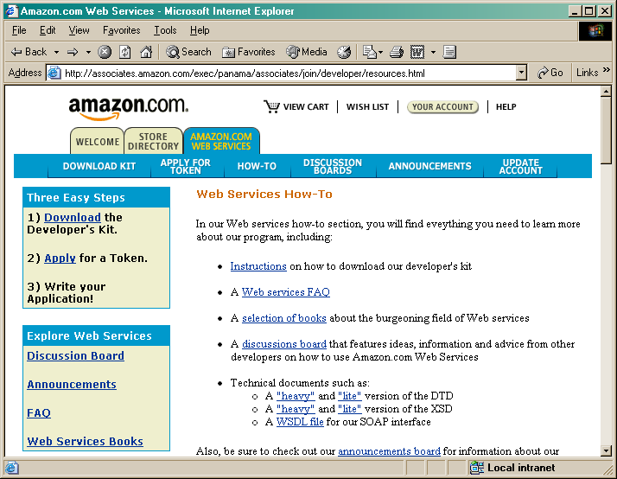
Amazon

Slide 68
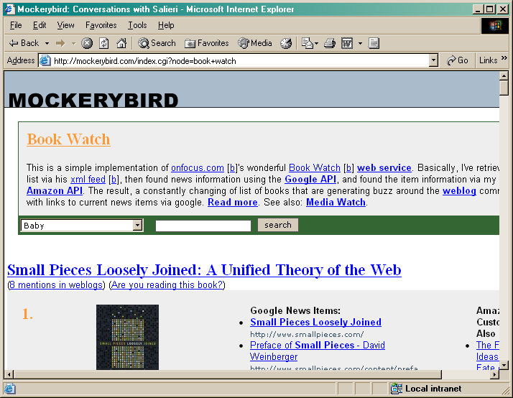
Multiple Invocations

Slide 69
Practical Benefits
Programmatic Access
Platform/Language Independent
Compose/Distribute

Slide 70
What about Astronomy
Name Resolution
  NED/SIMBAD Models
Image Access
  virtualsky
Catalog Access
  Intelligent Archive Queries
Catalog Joins
  Cross Identification Servers

Slide 71
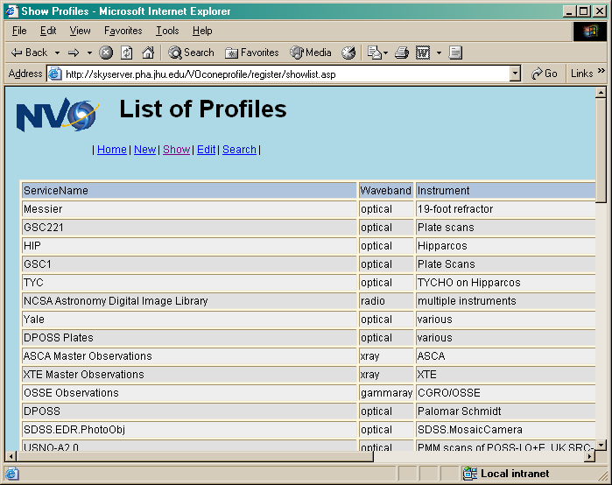
Cone Search Profiles

Slide 72
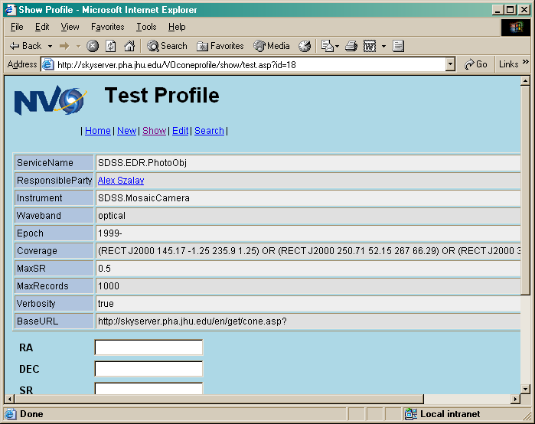
SDSS EDR Cone Search

Slide 73
Web Service Paradigm
Service Oriented Programming
  Dynamically Locate Services
  Services are “ON” the Network
  Services can be coupled
Multiple Transport Protocols
  HTTP, SMTP, FTP, …
Multiple Message Encodings
  SOAP, XML-RPC, XP(?), …

Slide 74
Web Services for Astronomers
What are Web Services
Web Service Architecture
Building Web Services
The Future of Web Services

Slide 75
Web Service Architecture
Three Primary Roles
  Service provider
  Service requester
  Service broker
Provider
Broker
Requestor

Slide 76
Web Service Architecture
Framework must support
  Publishing Service
  Finding a Service
  Binding a Service

Slide 77
Web Service Lifecycle
Service Must be Created
Service Must Be Published
Service Must be Easily Located
Service Must be Invoked/Called
Service must be Unpublished

Slide 78
Service Provider
Creates the Service
  New Service
  Wrap Legacy Service
  Wrap “Other” Services
Publishes the Service
  Registries
  Standard Hierarchies
Supports the Web Service
Unpublishes the Service

Slide 79
Service Broker
Maintains Service Registry
Simplifies Service Location
  Categorization
  Query Support

Slide 80
Service Requestor
Locates Service
Invokes Service
  Direct Request
  Indirect Request

Slide 81
The Big Three
Service Description – WSDL
  The most important, everything else derives from this
Service Invocation – SOAP
  Dominant Communication Protocol (XML Protocol)
Service Publication – UDDI
  Being Pushed Hard, but future not clear. (OGSA)

Slide 82
Describing a Service
Web Services Description Language (WSDL)
  http://www.w3.org/2002/ws/desc/
  XML Document that provides the public interface to a Web Service
    Public Methods
    Data Type Information (IN/OUT)
    Transport Protocol Binding Information
    Service Location
  The What, Where, and How!

Slide 83
Invoking a Service
Simple Object Access Protocol (SOAP)
  Although as of V1.2 SOAP is no longer an acronym
  http://www.w3.org/2000/xp/Group/
XML protocol for exchanging messages
  Platform/Language Independent
Different Transport Protocols (General Case)
  HTTP/HTTPR
  SMTP
  FTP
  BEEP
  …

Slide 84
Publishing a Service
Universal Description, Discovery, and Integration (UDDI)
  http://www.uddi.org (Now under OASIS)
Technical specification for building WSDL document repositories
  Documents can be published
  Document can be searched
  Formal Hierarchy
UDDI Registry implements the specification
  IBM, Microsoft, SAP, etc. have public Registries
  astrouddi.org (?)

Slide 85
Hello World (WSDL Style)
<?xml version="1.0" encoding="UTF-8"?>
<wsdl:definitions
targetNamespace="http://localhost:8080/axis/HelloWorld.jws"
xmlns:impl="http://localhost:8080/axis/HelloWorld.jws"
xmlns:intf="http://localhost:8080/axis/HelloWorld.jws"
xmlns:apachesoap="http://xml.apache.org/xml-soap"
xmlns:wsdlsoap="http://schemas.xmlsoap.org/wsdl/soap/"
xmlns:soapenc="http://schemas.xmlsoap.org/soap/encoding/"
xmlns:xsd="http://www.w3.org/2001/XMLSchema"
xmlns:wsdl="http://schemas.xmlsoap.org/wsdl/"
xmlns="http://schemas.xmlsoap.org/wsdl/">
<wsdl:types>
<schema xmlns="http://www.w3.org/2001/XMLSchema"
targetNamespace="http://localhost:8080/axis/HelloWorld.jws">
<import namespace="http://schemas.xmlsoap.org/soap/encoding/"/>
<complexType name="ArrayOf_xsd_string">
<complexContent>
<restriction base="soapenc:Array">
<attribute ref="soapenc:arrayType" wsdl:arrayType="xsd:string[]"/>
</restriction>
</complexContent>
</complexType>
<element name="ArrayOf_xsd_string" nillable="true" type="impl:ArrayOf_xsd_string"/>
</schema>
</wsdl:types>
<wsdl:message name="mainRequest">
<wsdl:part name="args" type="impl:ArrayOf_xsd_string"/>
</wsdl:message>
<wsdl:message name="getMessageResponse">
<wsdl:part name="getMessageReturn" type="xsd:string"/>
</wsdl:message>
<wsdl:message name="getMessageRequest">
</wsdl:message>
<wsdl:message name="mainResponse">
</wsdl:message>
<wsdl:portType name="HelloWorld">
<wsdl:operation name="main" parameterOrder="args">
<wsdl:input name="mainRequest" message="impl:mainRequest"/>
<wsdl:output name="mainResponse" message="impl:mainResponse"/>
</wsdl:operation>
<wsdl:operation name="getMessage">
<wsdl:input name="getMessageRequest" message="impl:getMessageRequest"/>
<wsdl:output name="getMessageResponse" message="impl:getMessageResponse"/>
</wsdl:operation>
</wsdl:portType>
<wsdl:binding name="HelloWorldSoapBinding" type="impl:HelloWorld">
<wsdlsoap:binding style="rpc" transport="http://schemas.xmlsoap.org/soap/http"/>
<wsdl:operation name="main">
<wsdlsoap:operation soapAction=""/>
<wsdl:input name="mainRequest">
<wsdlsoap:body use="encoded"
encodingStyle="http://schemas.xmlsoap.org/soap/encoding/"
namespace="http://localhost:8080/axis/HelloWorld.jws"/>
</wsdl:input>
<wsdl:output name="mainResponse">
<wsdlsoap:body use="encoded"
encodingStyle="http://schemas.xmlsoap.org/soap/encoding/"
namespace="http://localhost:8080/axis/HelloWorld.jws"/>
</wsdl:output>
</wsdl:operation>
<wsdl:operation name="getMessage">
<wsdlsoap:operation soapAction=""/>
<wsdl:input name="getMessageRequest">
<wsdlsoap:body use="encoded"
encodingStyle="http://schemas.xmlsoap.org/soap/encoding/"
namespace="http://localhost:8080/axis/HelloWorld.jws"/>
</wsdl:input>
<wsdl:output name="getMessageResponse">
<wsdlsoap:body use="encoded"
encodingStyle="http://schemas.xmlsoap.org/soap/encoding/"
namespace="http://localhost:8080/axis/HelloWorld.jws"/>
</wsdl:output>
</wsdl:operation>
</wsdl:binding>
<wsdl:service name="HelloWorldService">
<wsdl:port name="HelloWorld" binding="impl:HelloWorldSoapBinding">
<wsdlsoap:address location="http://localhost:8080/axis/HelloWorld.jws"/>
</wsdl:port>
</wsdl:service>
</wsdl:definitions>

Slide 86
WSDL Definitions Element
<?xml version="1.0" encoding="UTF-8"?>
<wsdl:definitions
targetNamespace="http://localhost:8080/axis/HelloWorld.jws"
xmlns:impl="http://localhost:8080/axis/HelloWorld.jws"
xmlns:intf="http://localhost:8080/axis/HelloWorld.jws"
xmlns:apachesoap="http://xml.apache.org/xml-soap"
xmlns:wsdlsoap="http://schemas.xmlsoap.org/wsdl/soap/"
xmlns:soapenc="http://schemas.xmlsoap.org/soap/encoding/"
xmlns:xsd="http://www.w3.org/2001/XMLSchema"
xmlns:wsdl="http://schemas.xmlsoap.org/wsdl/"
xmlns="http://schemas.xmlsoap.org/wsdl/">
…
</wsdl:definitions>

Slide 87
WSDL Document Elements
<wsdl:types>
  The datatypes used by the Web Service
<wsdl:message>
  The abstract definition of the data being transmitted
<wsdl:portType>
  The abstract operations that constitute the Web service
<wsdl:binding>
  The concrete protocol and data format used by the Web service
<wsdl:port>
  The address for a single communication endpoint
<wsdl:service>
  An aggregation of related ports

Slide 88
WSDL Types
Define the datatypes used as arguments to the Web service as well as the return values from a Web service
Preferably XML Schema
  XSD namespace
Must Handle nillable (Java Wrapper Classes)
SOAP

Slide 89
WSDL Types
Map WSDL (XSD) to Language (e.g., Java)
xsd:boolean | boolean
xsd:byte | byte
xsd:double | double
xsd:float | float
xsd:int | int
xsd:long | long
xsd:short | short
xsd:dateTime | java.util.Calendar
xsd:decimal | java.math.BigDecimal
xsd:hexBinary | byte[]
xsd:base64Binary | byte[]
xsd:QName | javax.xml.namespace.QName
xsd:integer | java.math.BigInteger
xsd:string | java.lang.String

Slide 90
WSDL Types
Recommended approach
  Use Elements not Attributes
  Only define types that refer to abstract content of messages (not protocols)
  Array types should extend the SOAP Array type
    Name scheme: ArrayOfXXX
  Xsd:anyType used to represent any type.

Slide 91
<wsdl:types>
<wsdl:types>
<schema xmlns="http://www.w3.org/2001/XMLSchema"
targetNamespace="http://localhost:8080/axis/HelloWorld.jws">
<import namespace="http://schemas.xmlsoap.org/soap/encoding/"/>
<complexType name="ArrayOf_xsd_string">
<complexContent>
<restriction base="soapenc:Array">
<attribute ref="soapenc:arrayType" wsdl:arrayType="xsd:string[]"/>
</restriction>
</complexContent>
</complexType>
<element name="ArrayOf_xsd_string" nillable="true" type="impl:ArrayOf_xsd_string"/>
</schema>
</wsdl:types>

Slide 92
Web service Messages
Interactions between Web service client and server are called messages
Message element describes the messages that can be exchanged
Logical definition of a type of message that may be used by operations listed in portType element
  Input
  Output
  Fault Message
Components
  Message must have a local name

Slide 93
Web service Messages
Components (wsdl:message element)
  Message must have a local name
  Use WSDL Namespace
  Zero or more Part descriptions
    part name
    part type
    Arguments or return parameters.
    Should follow XML Schema
Message element Future?

Slide 94
<wsdl:message>
<wsdl:message name="mainRequest">
<wsdl:part name="args" type="impl:ArrayOf_xsd_string"/>
</wsdl:message>
<wsdl:message name="getMessageResponse">
<wsdl:part name="getMessageReturn" type="xsd:string"/>
</wsdl:message>
<wsdl:message name="getMessageRequest">
</wsdl:message>
<wsdl:message name="mainResponse">
</wsdl:message>

Slide 95
WSDL Port Types
WSDL defines four transmission primitives (or operations) that an endpoint can support
One-way (input element)
  The endpoint receives a request, but does not send a response.
Request-response (input then output element)
  The endpoint receives a request, and sends a correlated response.
Solicit-response (output then input element)
  The endpoint sends a response, and receives a correlated response.
Notification (output element)
  The endpoint sends a response, but does not receive a request.

Slide 96
WSDL portType
A portType element defines the interfaces that a Web service exposes.
Similar to a
  Class
  Module
  or Function Library
The operations are the class/module/library methods.

Slide 97
<wsdl:portType>
<wsdl:portType name="HelloWorld">
<wsdl:operation name="main" parameterOrder="args">
<wsdl:input name="mainRequest"
message="impl:mainRequest"/>
<wsdl:output name="mainResponse"
message="impl:mainResponse"/>
</wsdl:operation>
<wsdl:operation name="getMessage">
<wsdl:input name="getMessageRequest"
message="impl:getMessageRequest"/>
<wsdl:output name="getMessageResponse"
message="impl:getMessageResponse"/>
</wsdl:operation>
</wsdl:portType>

Slide 98
WSDL Binding
Defines message format
For a given portType, defines protocol
  for operations
  for messages
Requires unique name attribute
Type attribute is portType Qname

Slide 99
<wsdl:binding>
<wsdl:binding name="HelloWorldSoapBinding" type="impl:HelloWorld">
<wsdlsoap:binding style="rpc"
transport="http://schemas.xmlsoap.org/soap/http"/>
…
<wsdl:operation name="getMessage">
<wsdlsoap:operation soapAction=""/>
<wsdl:input name="getMessageRequest">
<wsdlsoap:body use="encoded"
encodingStyle="http://schemas.xmlsoap.org/soap/encoding/"
namespace="http://localhost:8080/axis/HelloWorld.jws"/>
</wsdl:input>
<wsdl:output name="getMessageResponse">
<wsdlsoap:body use="encoded"
encodingStyle="http://schemas.xmlsoap.org/soap/encoding/"
namespace="http://localhost:8080/axis/HelloWorld.jws"/>
</wsdl:output>
</wsdl:operation>
</wsdl:binding>

Slide 100
WSDL Services
A port defines a single endpoint
The port can then be used for binding
Multiple ports can reference the same address with different protocols
A Service consists of one or more ports
A service defines a single serviceType

Slide 101
<wsdl:service> & <wsdl:port>
<wsdl:service name="HelloWorldService">
<wsdl:port
name="HelloWorld"
binding="impl:HelloWorldSoapBinding">
<wsdlsoap:address
location="http://localhost:8080/axis/HelloWorld.jws"/>
</wsdl:port>
</wsdl:service>

Slide 102
Invoking a Service
Use SOAP to communicate messages
  SOAP Sender to SOAP Receiver
  Potential SOAP Intermediaries
Essentially a one-way communication between SOAP nodes.
  RPC style
  Document style

Slide 103
SOAP Basics
Message is wrapped in the Envelope
Envelope consists of
  Header (Optional) used by intermediaries
  Body contains the actual message
    Document
    Service Call
Fault Handling
  Child element of body
  Contains Reason and Code elements

Slide 104
SOAP Basics
Fault Handling (V1.2)
  Fault Element is a child element of body
    No other elements in the body
  Contains
    Reason element (Mandatory)
    Code element (Mandatory)
      Standard List
    Detail element (Optional)
    Node element (Optional)
    Role element (Optional)

Slide 105
SOAP Request (HelloWorld)
POST /axis/HelloWorld.jws HTTP/1.0
Content-Type: text/xml; charset=utf-8
Accept: application/soap+xml, application/dime, multipart/related, text/*
User-Agent: Axis/1.0
Host: localhost
Cache-Control: no-cache
Pragma: no-cache
SOAPAction: ""
Content-Length: 407
<?xml version="1.0" encoding="UTF-8"?>
<soapenv:Envelope
xmlns:soapenv="http://schemas.xmlsoap.org/soap/envelope/"
xmlns:xsd="http://www.w3.org/2001/XMLSchema"
xmlns:xsi="http://www.w3.org/2001/XMLSchema-instance">
<soapenv:Body>
<ns1:getMessage
soapenv:encodingStyle="http://schemas.xmlsoap.org/soap/encoding/"
xmlns:ns1="http://localhost:8080/axis/HelloWorld.jws"/>
</soapenv:Body>
</soapenv:Envelope>

Slide 106
SOAP Response (HelloWorld)
HTTP/1.1 200 OK
Content-Type: text/xml; charset=utf-8
Connection: close
Date: Wed, 09 Oct 2002 21:34:47 GMT
Server: Apache Tomcat/4.0.6 (HTTP/1.1 Connector)
Set-Cookie: JSESSIONID=8A6802F3136B882A53BC0E8E1E30F8CC;Path=/axis
<?xml version="1.0" encoding="UTF-8"?>
<soapenv:Envelope
xmlns:soapenv="http://schemas.xmlsoap.org/soap/envelope/"
xmlns:xsd="http://www.w3.org/2001/XMLSchema"
xmlns:xsi="http://www.w3.org/2001/XMLSchema-instance">
<soapenv:Body>
<ns1:getMessageResponse
soapenv:encodingStyle="http://schemas.xmlsoap.org/soap/encoding/"
xmlns:ns1="http://localhost:8080/axis/HelloWorld.jws">
<getMessageReturn xsi:type="xsd:string">Hello World!</getMessageReturn>
</ns1:getMessageResponse>
</soapenv:Body>
</soapenv:Envelope>

Slide 107
Web Service Registries
UDDI Currently Dominant
  Public Registries
    IBM, MS, SAP, etc.
  Private Registries
  UDDI Functions
    Describe services
    Discover businesses
    Integrate business services
The MetaData Problem

Slide 108
UDDI Registry
  Business Entity
    Can have multiple Services
  Business Service
    Has an associated specification
  Specification Pointers
    Detailed information on service
  Service Types
    Defined by a tModel
    tModel and WSDL

Slide 109
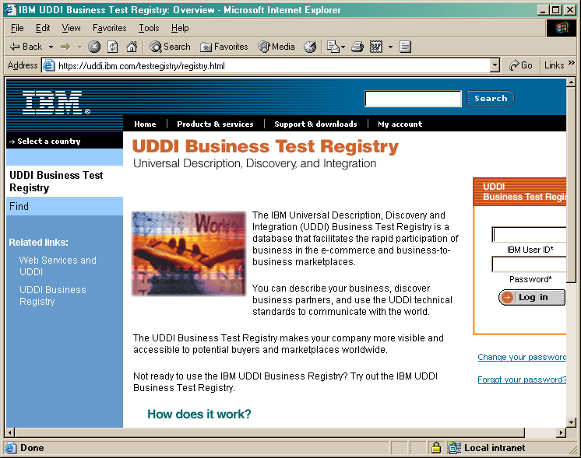
UDDI Registry

Slide 110
UDDI Private Registry
Some development tools or products provide private UDDI registry server
  Java WS Developer pack.
  Oracle JDeveloper
  IBM WS toolkit
  MS VS .NET
Greater control, no registration!

Slide 111
Web Services for Astronomers
What are Web Services
Web Service Architecture
Building Web Services
The Future of Web Services

Slide 112
Building Web Services
Simple Demonstration of Deploying a Web service
  Use Java (but other options exist: .NET, Perl, python, etc.)

Slide 113
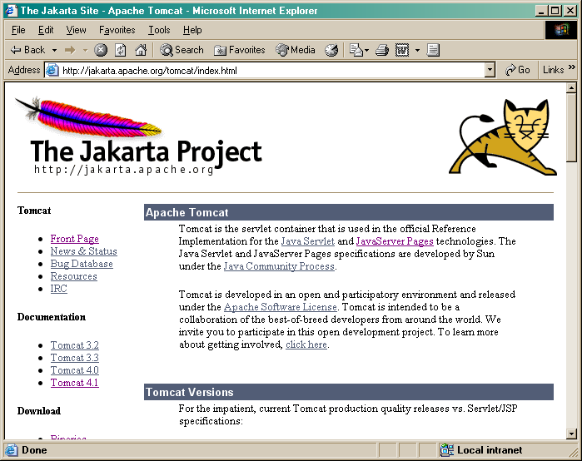
Tomcat Server

Slide 114
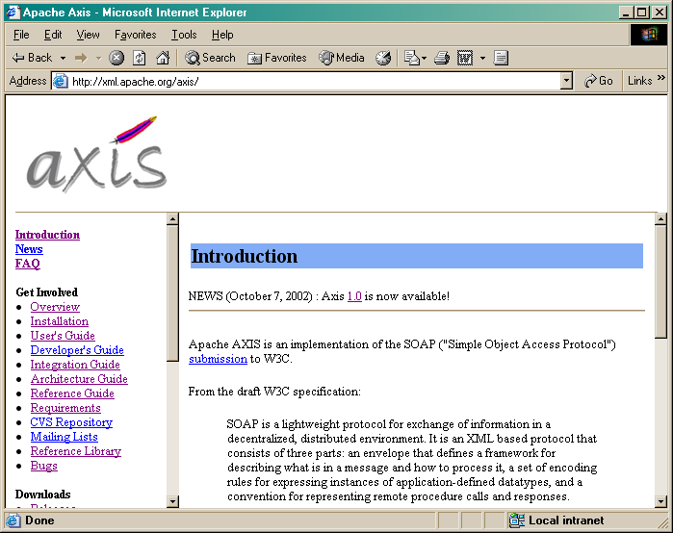
AXIS SOAP Server

Slide 115
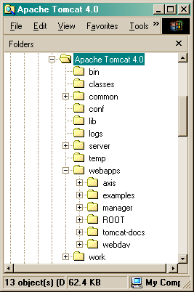
Installation & Setup
Install Tomcat
Deploy Axis web apps into Tomcat webapps directory.
Start Tomcat Server
Validate AXIS Installation

Slide 116
Web Service Deployment
Simple Technique (JWS)
  Copy Java Source file containing the method(s) to be exposed to axis directory
    HelloWorld.java -> HelloWorld.jws
Complex Technique (WSDD)
  AXIS solution
  Web Service Deployment Descriptor
Annotations (.NET approach)
  [WebMethod]

Slide 117
Hello World (Java)
public class HelloWorld {
public java.lang.String getMessage() {
return "Hello World!" ;
}
}

Slide 118
Hello World (CSharp)
using System.Web.Services ;
public class HelloWorld : WebService {
[WebMethod]
public string getMessage() {
return "Hello World!" ;
}
}

Slide 119
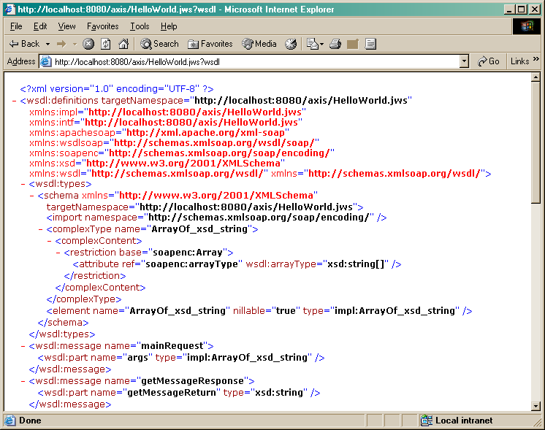
View WSDL

Slide 120
Web Service Client
Generate Client Stub from WSDL
  wsdl2java tool included with AXIS
>java org.apache.axis.wsdl.WSDL2Java http://localhost:8080/axis/HelloWorld.jws?wsdl
  Generates
    localhost\HelloWorld.java
    localhost\HelloWorldService.java
    localhost\HelloWorldServiceLocator.java
    localhost\HelloWorldSoapBindingStub.java

Slide 121
Utilizing the Stub Classes
HelloWorldClient.java
package localhost ;
public class HelloWorldClient
{
public static void main(String[] args) throws Exception {
// Make a service
HelloWorldService service = new HelloWorldServiceLocator();
// Now use the service to get a stub
HelloWorld port = service.getHelloWorld();
System.out.println(port.getMessage());
}
}

Slide 122
AXIS Extras
Generate Server Skeleton Stub from WSDL
>java org.apache.axis.wsdl.WSDL2Java –s http://localhost:8080/axis/HelloWorld.jws?wsdl
  Generates
    localhost\HelloWorldSoapBindingImpl.java
More arguments for additional functionality

Slide 123
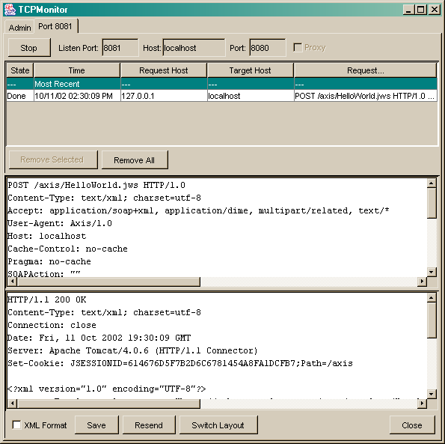
AXIS TCP Monitor

Slide 124
Web Services for Astronomers
What are Web Services
Web Service Architecture
Building Web Services
The Future of Web Services

Slide 125
Roadblocks or Speedbumps?
Reliable Protocol Needed (HTTPR, BEEP)
Lack of State
Implementation Inconsistencies
  unsigned
  multipart/structures
Security!

Slide 126
Reliable Protocols
HTTP – Reliable HTTP
  IBM Initiative
  http://www-106.ibm.com/developerworks/library/ws-phtt/
  Adds Persistence to HTTP
BEEP (Blocks Extensible Exchange Protocol
  http://www.ietf.org/rfc/rfc3080.txt
  Connection-oriented
  Asynchronous interactions

Slide 127
DIME (Direct Internet Message Encapsulation)
General purpose binary message format
Enable Web services to efficiently handle multiple attachments
  Encrypted messages
  Graphics
  Multimedia content
  General Documents
DIME Message (application/dime)
  1+ records to deliver payload
  Chunking
  http://www.ietf.org/internet-drafts/draft-nielsen-dime-02.txt

Slide 128
BPEL4WS
Business Process Execution Language for Web Services
  Implementing executable business processes.
  Describing non-executable abstract processes.
Merging of WSFL and Xlang
  Ugliest WS Acronym award
Define new Web service as a composition of existing Web services

Slide 129
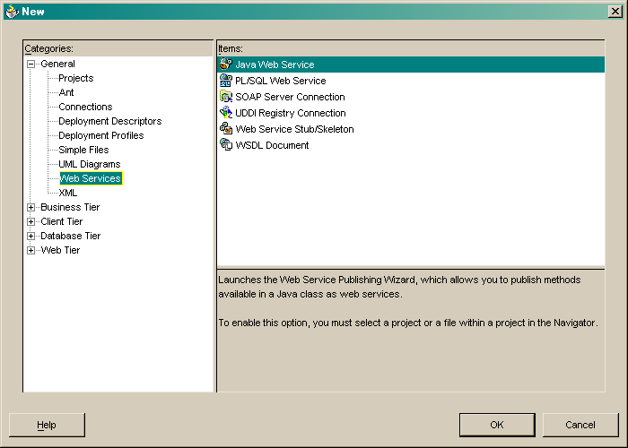
Simplify Development/Deployment

Slide 130
J2EE Web Services
Java APIs for XML
  JAX-RPC
  JAXM (SAAJ)
  JAXR
JSR 109 - Implementing Enterprise Web Services
JSR 110 - Java APIs for WSDL

Slide 131
Security
Issues include
  Message Integrity
  Message Confidentiality
  Authentication
Technologies include
  Secure Sockets Layer (SSL)
  Transport Layer Security (TLS)
  Message Encryption
  Digital Signatures
But Standards !!!!!

Slide 132
Summary
Web services provide a powerful programming paradigm
Mucho Hype
Looking for Real Applications (NVO)
Open Grid Services Architecture (OGSA)

