Slide 1
X-SHOT: Learning to Rank Voice Applications via Cross-Locale Shard-based Co-Training
Zheng Gao
Applied Scientist
Alexa AI
Presented at ASRU 2021

Slide 2
Research Question
Challenges:
customer utterances handled in a popular locale (i.e. en-US) may be going unclaimed in another locale (i.e. en-IN) .
locales with smaller skill ecosystems also suffer from limited labeled data for training systems to route utterances to skills. i.e. customers only provide feedbacks for the suggested skill, without seeing the rest skills.
Goal: retrieve relevant skills in a source locale for unclaimed utterances in a target locale
Keywords: co-training, transfer learning, pseudo labeling, semi-supervised learning

Slide 3
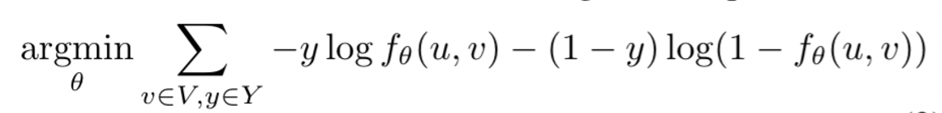
Method
XSHOT model is a two-step approach with Shortlisting and Reranking.
Input: source/target locale utterances with labeled skills
Output: predicted positive source locales skills for target locale utterances.
Model Formulation:
A two-step listwise approach to firstly apply Shortlisting to retrieve the top K most relevant skills, then leverage Reranking to rank the filtered skills. We only need to minimize the prediction discrepancy for each utterance u and its filtered Shortlisting skill sequence V:

Slide 4
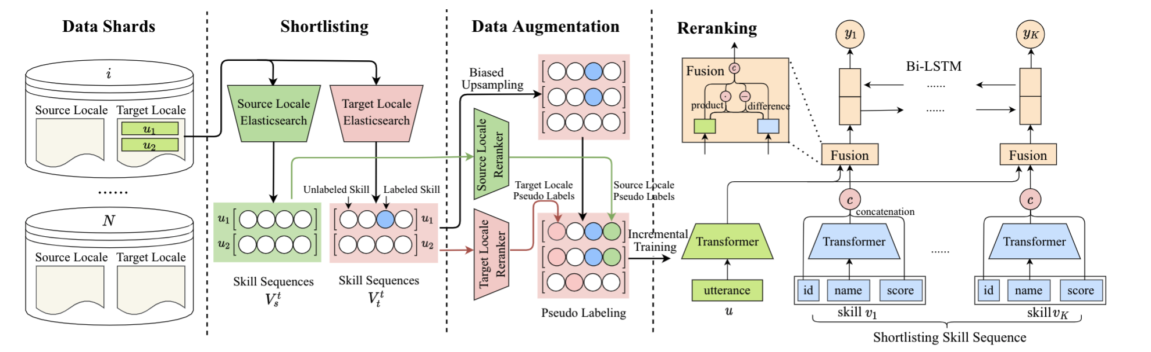
Framework Diagram
The diagram shows the model training in one data shard in the target locale.

Slide 5
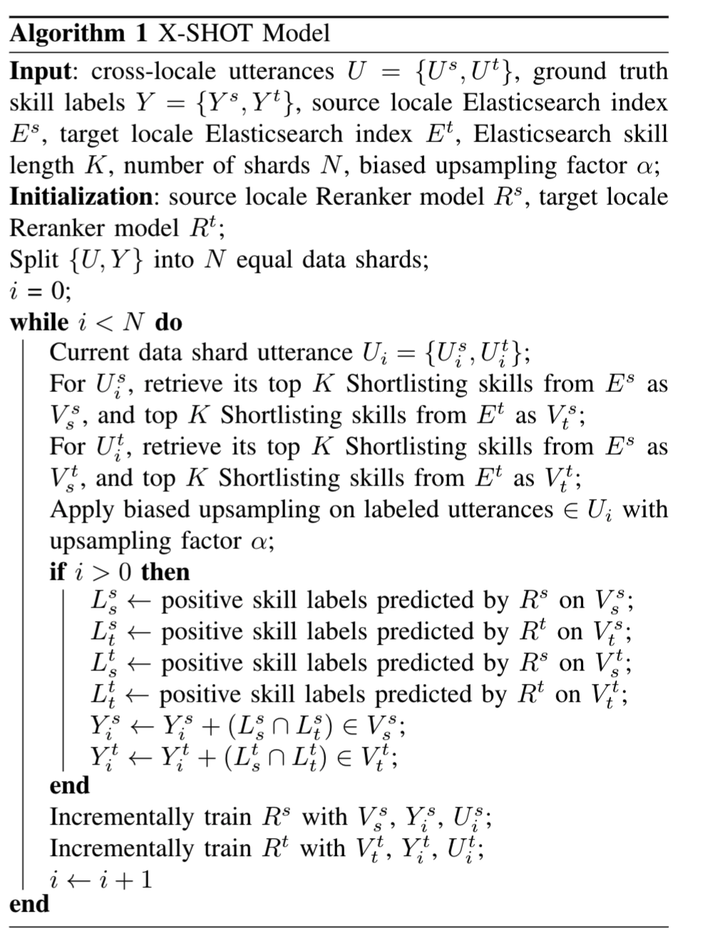
Framework Overview
Shortlisting: Elasticsearch to perform keyword-based matching
Reranking: train two locale Reranker models in a shard-based manner
Data Splitting
Shortlisting
Upsampling
Data Augmentation
Pseudo Labeling
Reranking
Incremental Training

Slide 6
Framework Diagram

Slide 7
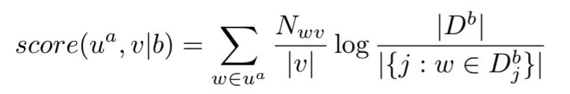
Shortlisting
Elasticsearch applies TF-IDF model to search the top K skills for an utterance in both locales.
Based on the rule based matching between utterance text and skill definition and category.

Slide 8
Framework Diagram

Slide 9
Reranking
Data Augumentation
Biased Upsampling: upsampling training instances with positive labels
Pseudo Labeling: co-training in a shard-based manner

Slide 10
Framework Diagram

Slide 11
Reranking
Reranker Model
Transformer based encoder
Fusion layer to capture utterance & skill interactive feature
Sequence decoder to consider Shortlisting sequential results
Sequential cross entropy loss for binary label sequence prediction.
Training Strategy
Incremental training among data shards
Pretrained Bert model initialization and parameter freezing
Early stopper to avoid overfitting

Slide 12
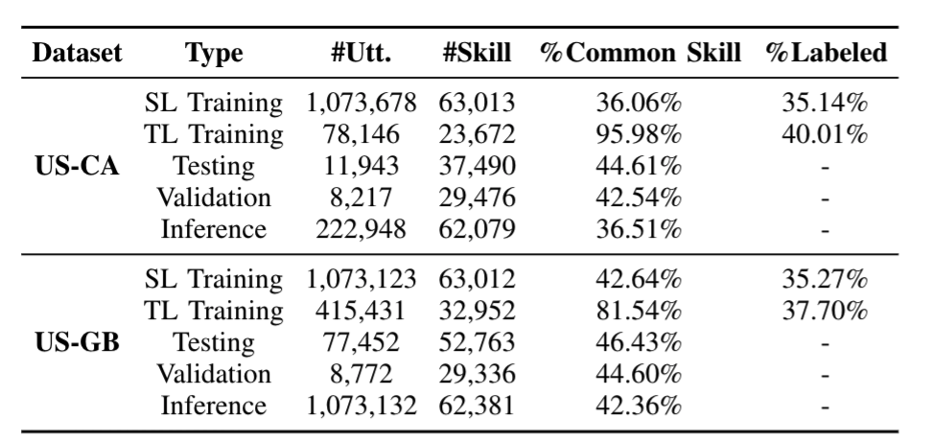
Experiments
Datasets: Two real-world cross-locale datasets from Alexa are constructed for model evaluation.
Dataset US-CA takes the United States for source locale (SL) and Canada for target locale (TL).
Dataset US-GB takes the United States for source locale and Great Britain for target locale.
Both datasets are sampled English utterances from Alexa devices during October 2020

Slide 13
Settings
Baselines:
Elasticsearch
Pointwise
Listwise
Upsampling
Positive-Unlabeled (PU) learning
Relabeling (FAISS + Cosine Similarity)
Evaluation Metrics:
Classification metrics: precision, recall, F1
Ranking metrics: precision@p, recall@p, F1@p, NDCG@p, MAP
Human metrics: precision, recall, F1

Slide 14
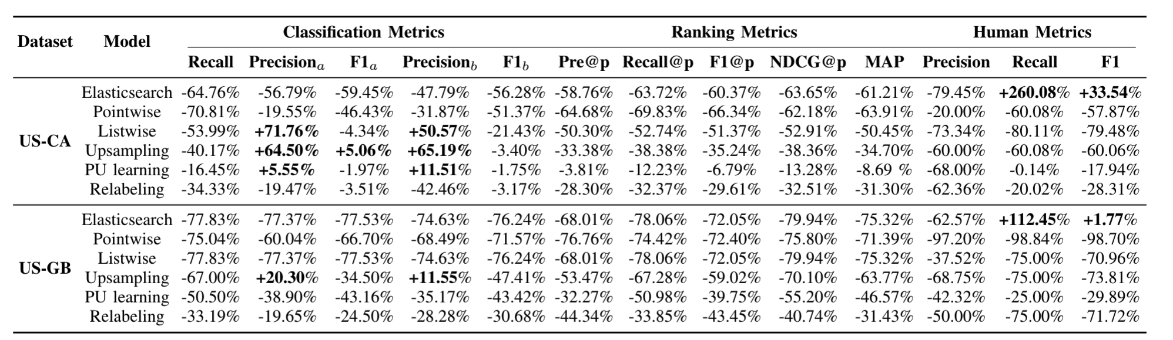
Model Comparison
Summarization of all baseline comparative performances. It reports all baseline normalized performance difference with the X-SHOT model. Bold positive values (+) mean related baselines outperform the X-SHOT model.

Slide 15
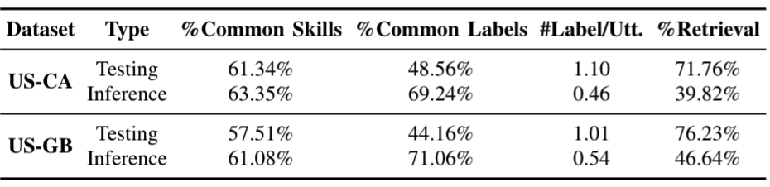
Model Prediction Statistics
We summarize the prediction results in both datasets US-CA and US-GB to explore the positive predicted skills. Meanwhile we also check the model prediction capability by reporting the ratio of utterances are with positive predicted skills.

Slide 16
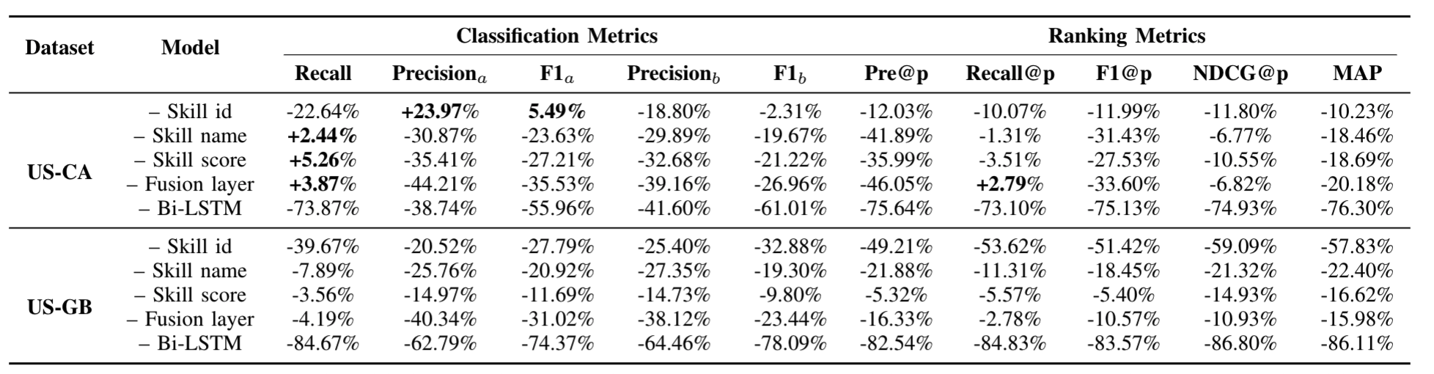
Ablation Study
Summarization for ablation studies. ``-'' refers to the removed model component and metric scores are the ablative model's normalized performance differences with the full model.

Slide 17
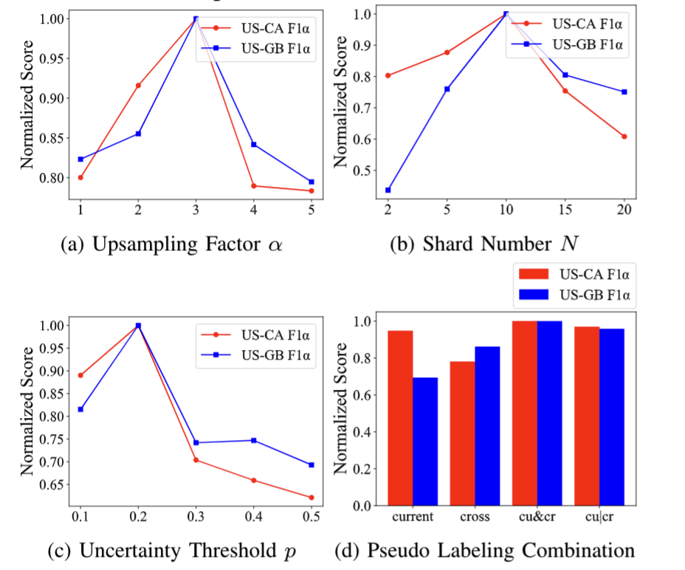
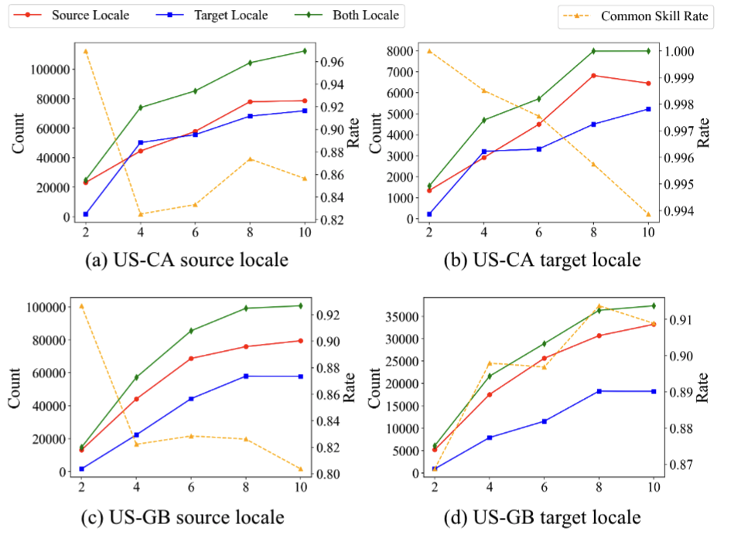
Parameter Tuning
Dynamic Label Change

Slide 18
Thanks!

