Slide 1

Behavior based Dynamic Summarization on Product Aspects via Reinforcement Neighbour Selection
Zheng Gao, Lujun Zhao, Heng Huang, Hongsong Li, Changlong Sun, Luo Si, Xiaozhong Liu

Slide 2
Outline
Introduction
Method
Experiment
Future Work

Slide 3
Introduction
Dynamic Summarization Importance
indicates products’ dynamic aspect-sentiment changes
depicts the changes into readable contexts for easier interpretation.
Challenges: lack of instant reviews for dynamic summarization
Solution: uses sufficient user behaviors (with amount 50 times more than reviews)

Slide 4
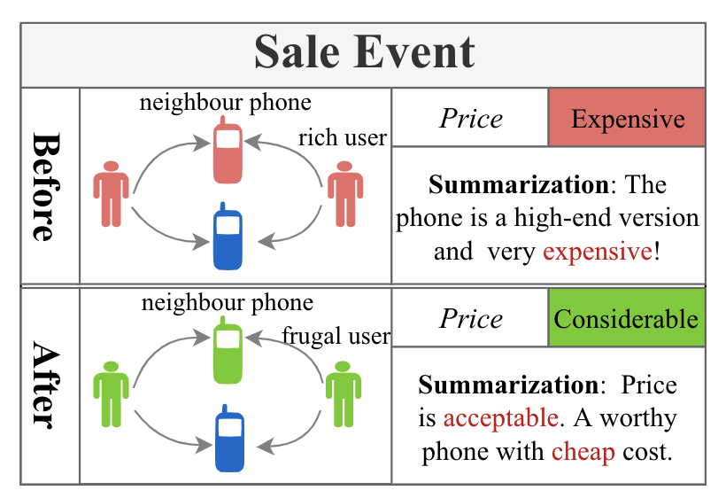
Introduction
Intuition of behavior based dynamic summarization

Slide 5
Method
Data Prerequisite
Behavior based Dynamic Summarization (BDS) model
Dynamic Product Behavior Representation
Multi-task Learning
Neighbor Product Selection Task (Task 1)
Summarization Generation Task (Task 2)
Notes:
Behavior basedDynamicSummarization (BDS) model t

Slide 6
Data Prerequisite
Product Sentiment Distribution (Pretraining in Task 1)
Product Descriptive Phrases (Input for Task 2)
Review Sentimental Phrases (Input for Task 2)
Seed Products (Neighbour product selection in Task 1)

Slide 7
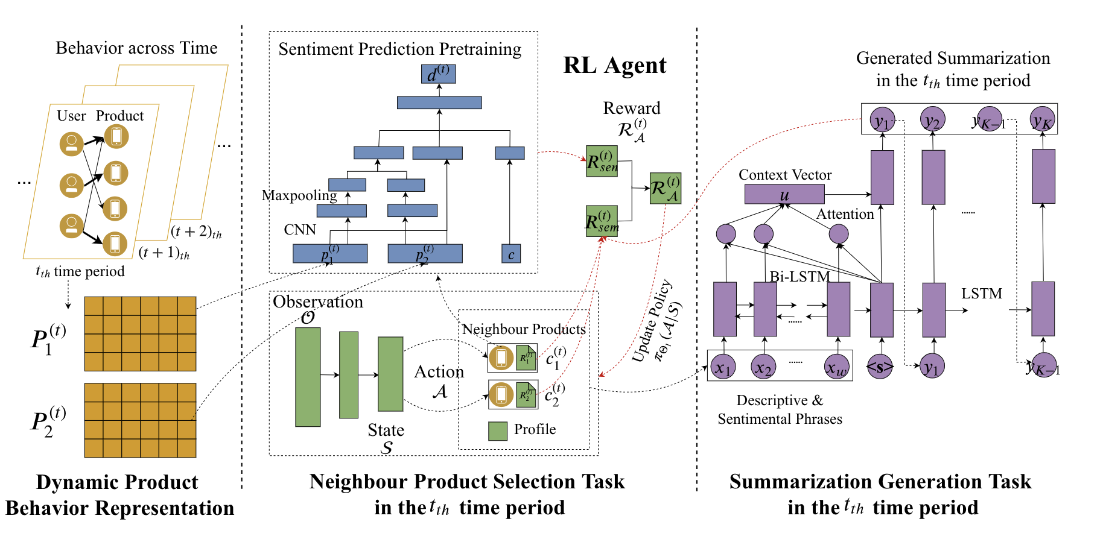
BDS Model

Slide 8
Experiment
Dataset
Automatic & Human Evaluation
Dynamic Performance
Input Component Evaluation
Case Study
Notes:
Input Component Evaluation

Slide 9
Dataset
User behavior & product review during 04/12/2018 – 07/10/2018.
First two week data helps to generate user consistent shopping preference, rest data are split into 5 consecutive time periods with four types of prepared information:
multi-type user behavior (Click, Add Cart, Purchase)
product category
product aspect sentiment distribution (Quality, Cost-performance Ratio, Fitness and Material)
ground truth summarization
In total, there are 125,598 products, 51,366 users and 108,749,788 multi-type behaviors
Notes:
‘Quality’,‘Cost-performance Ratio’, ‘Fitness’ and ‘Material’

Slide 10
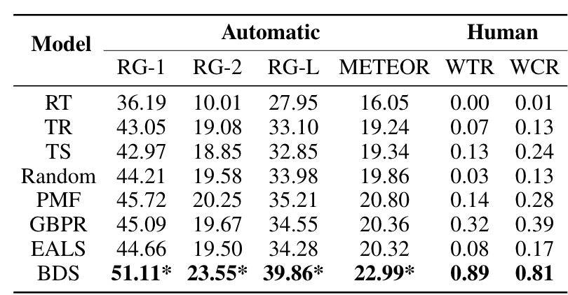
Automatic & Human Evaluation

Slide 11
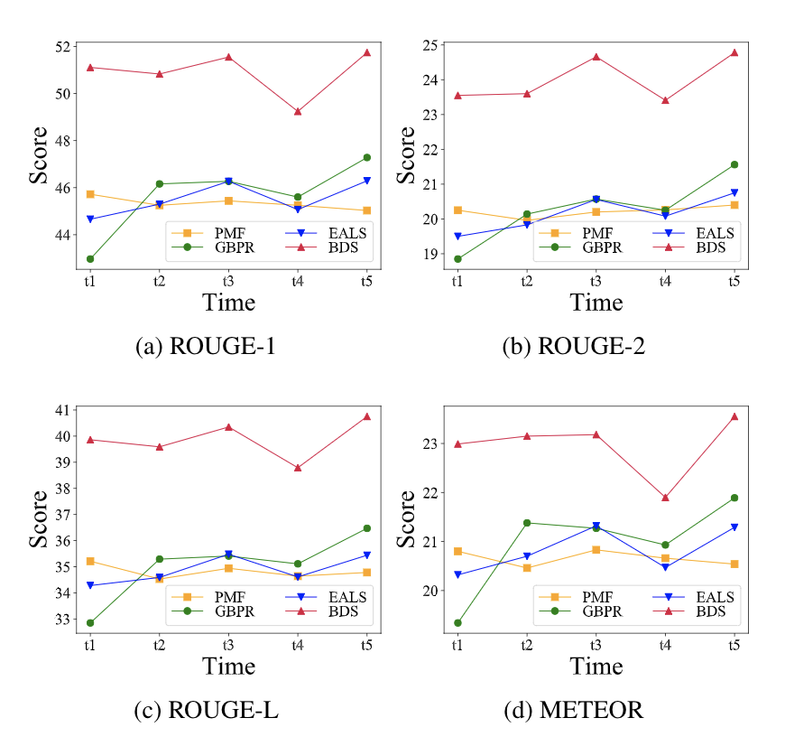
Dynamic Performance
Compared with three best baselines
Across all five time periods
Reported all four metrics in ROUGE and METEOR.

Slide 12
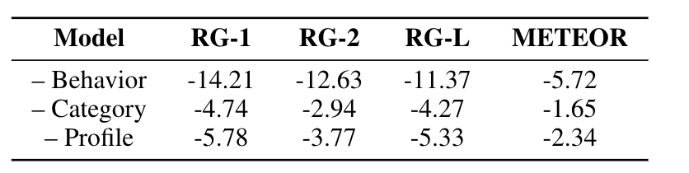
Input Component Evaluation
There are three types of model input:
user behavior (pretraining in Task 1)
product category(pretraining in Task 1)
profile - product descriptive phrases (input for Task 2)
Removing each input component to check the model performance drop

Slide 13
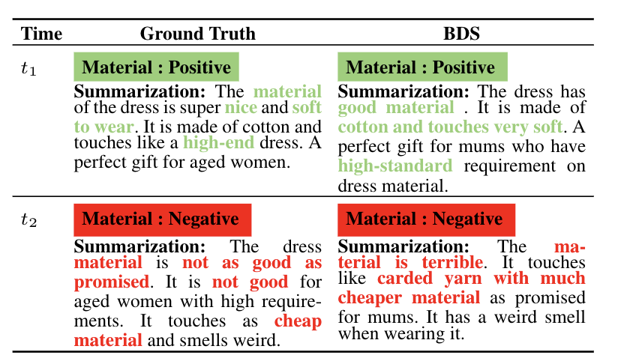
Case Study

Slide 14
Future Work
Integrate all separated segments into the main model to achieve joint training.
Put more efforts on exploring the influence of summarization generation task.
Be more sensitive and cautious about the generated summaries, which should be used as auxiliary information to sellers only, instead of making up “fake reviews” to mislead customers.
Notes:
ut more efforts onexploring the influence of summarization generation task

Slide 15
Thanks!!
Website: https://zhenggao.io!
Email: gao27@Indiana.edu!

