Slide 1
Improving Community Detection Performance in Heterogeneous Music Network by Learning Edge-type Usefulness Distribution
Zheng Gao, Chun Guo, Shutian Ma, Xiaozhong Liu
iConference 2022

Slide 2
Background
With music becoming an essential part of daily life, there is an urgent need to develop recommendation systems to assist people targeting better songs with fewer efforts.
The interactions between users and songs naturally construct a complex network, community detection approaches can be applied to reveal users' potential interests on songs by grouping relevant users & songs to the same community.
The type of interactions are heterogeneous, which challenges conventional community detection methods.

Slide 3
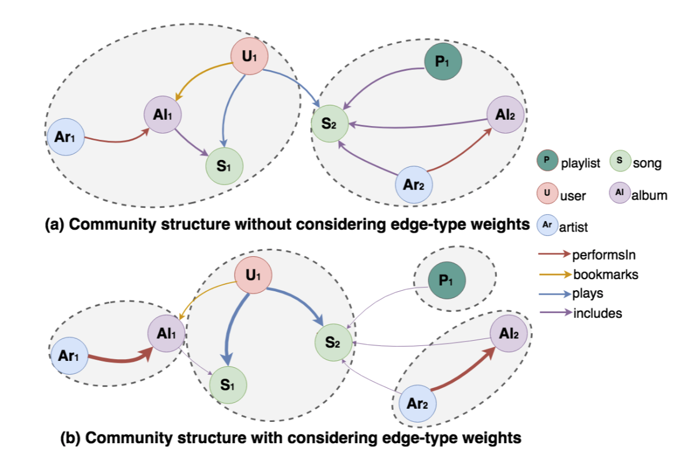
Edge-type Usefulness Distribution (ETUD)
We propose a genetic based method to learn the ETUD on heterogeneous networks in an evolutionary manner. Our model can highlight those edge-types more important for music recommendation by assigning higher weights on them. After that, all edges are updated by multiplying related ETUD values on their original weights, which converts a heterogeneous network to a homogeneous one.

Slide 4
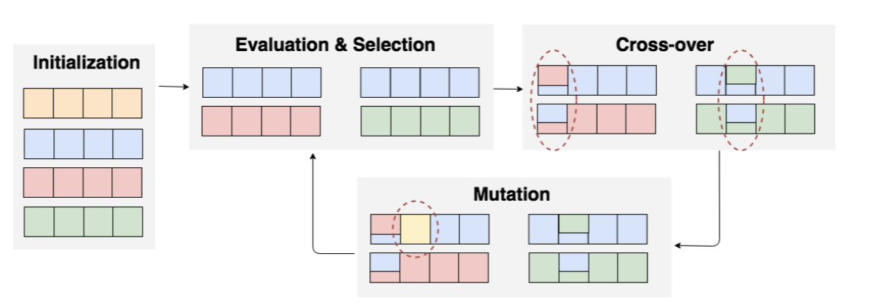
ETUD Pipeline - Initialization
We define a chromosome to represent a possible ETUD result. A chromosome is constructed by a set of genes ,where each gene refers to an edge-type respectively. The value stores in each gene represents the usefulness score of a particular edge-type. A chromosome is initialized by randomly assigning value ∈ [0, 1] to each of its gene in the beginning. In total, P chromosomes are randomly initialized for further evolution process.

Slide 5
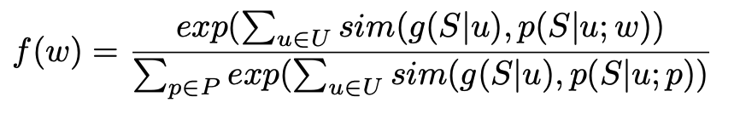
ETUD Pipeline – Evaluation
We assume that the best ETUD should be able to best reproduce users' listening preference. In other words, we should find an ETUD that maximizes the similarity between songs' ranking list generated under this ETUD and user real preference on songs.
Each chromosome’s fitness value can be calculated as:
Personalized PageRank algorithm is utilized to represent user listening preference p(S|u;w), NDCG@10 is chosen as similarity function. g(S|u) is the actual user listening preference. we calculate the similarity scores among all users and normalize it via a Softmax function on all chromosomes.

Slide 6
ETUD Pipeline – Selection
In genetic approach, chromosomes with higher fitness score should have higher chance to be preserved for the next-round evolution. Hence, we use bootstrap sampling strategy (random sampling with replicates) to randomly sample P chromosomes based on their fitness scores.

Slide 7
ETUD Pipeline – Crossover
The initialized & selected chromosomes can not fully cover the whole possible ETUD results. Hence, there is a need to search the whole ETUD result space and find out the best one.
In Cross-over step, all selected chromosomes are grouped into pairs first, and the Cross-over transformation will be applied within pairs. Given two chromosomes in the same pair, which are denoted as w1 and w2. In this step, w1 and w2 exchange values stored in partial of their genes to create two offspring chromosomes.

Slide 8
ETUD Pipeline – Mutation
Mutation step allows a chromosome to generate a new offspring chromosome within itself. For a chromosome, instead of exchanging values of genes with another chromosome, it exchanges its genes’ value with a random variable X randomly drew from uniform distribution X ∼ Uniform (0, 1).

Slide 9
ETUD Pipeline - Finalization
The whole evolution process will keep running for generations until the best chromosome no longer changes for N generations. And the chromosome with largest fitness value in the last generation will be the returned ETUD.

Slide 10
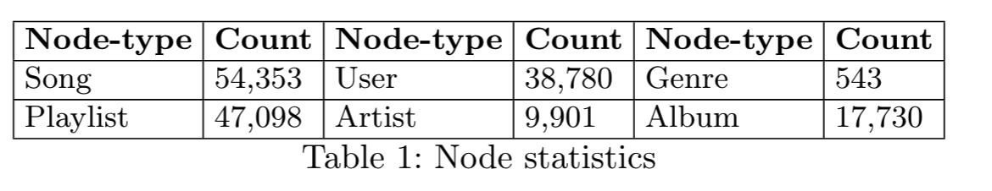
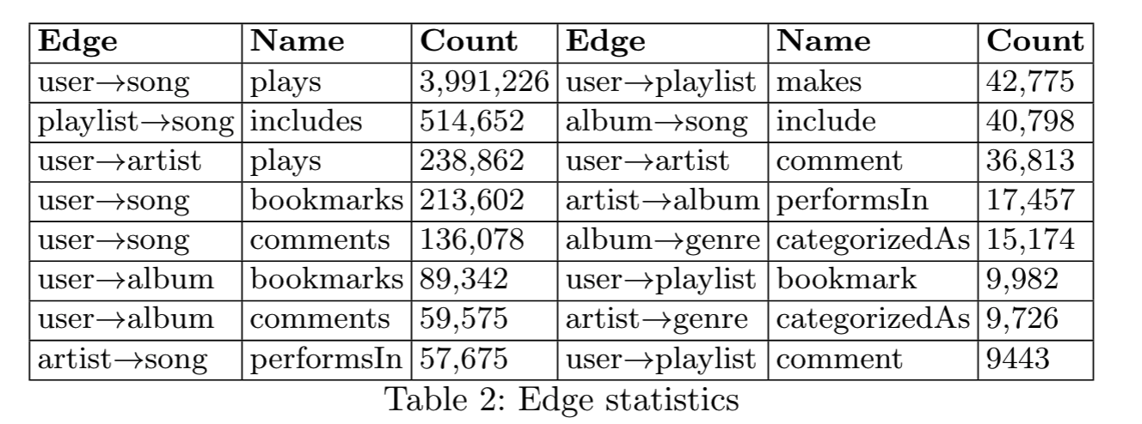
Dataset
The dataset used for music recommendation is from Xiami, one of the largest online music streaming services in China.
The listening history of 70 percent users are randomly sampled used to training our model (used for fitness score calculation). and the rest 30 percent users are used for our model testing.

Slide 11
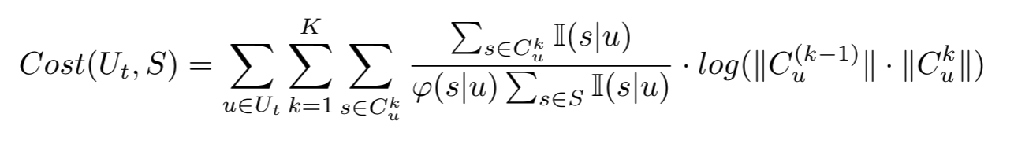
Task 1: Searching Cost with Between-community Jumping
The first task is to examine whether applying ETUD on heterogeneous networks can reduce the searching cost of retrieving all users' listened songs.
In our music network, each user u will belong to a community after a community detection method is leveraged. When user u looks for songs to listen, there is a searching cost for the user to retrieve all his/her favored songs. We simulate user searching behaviors to see how ETUD can help to reduce searching cost when added to existing community detection methods:
All communities are ranked by their contained number of listened songs in the descending order.
This searching cost function depicts how much effort users take to retrieve all their listened songs by jumping between communities. The user u starts to search from the most favored community to the least favored community in a descending sequence until all listened songs are retrieved.
The best community structure is that all listened songs are grouped into a single community.

Slide 12
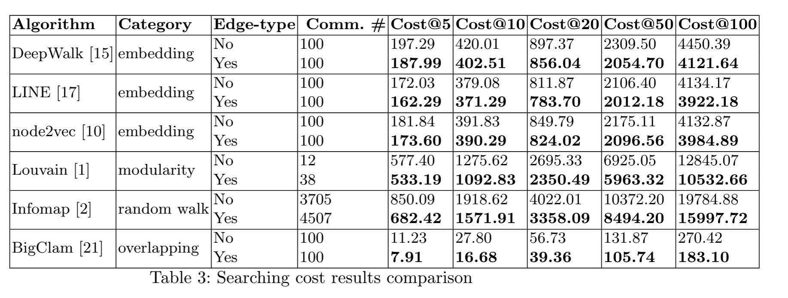
Task 1: Searching Cost with Between-community Jumping

Slide 13
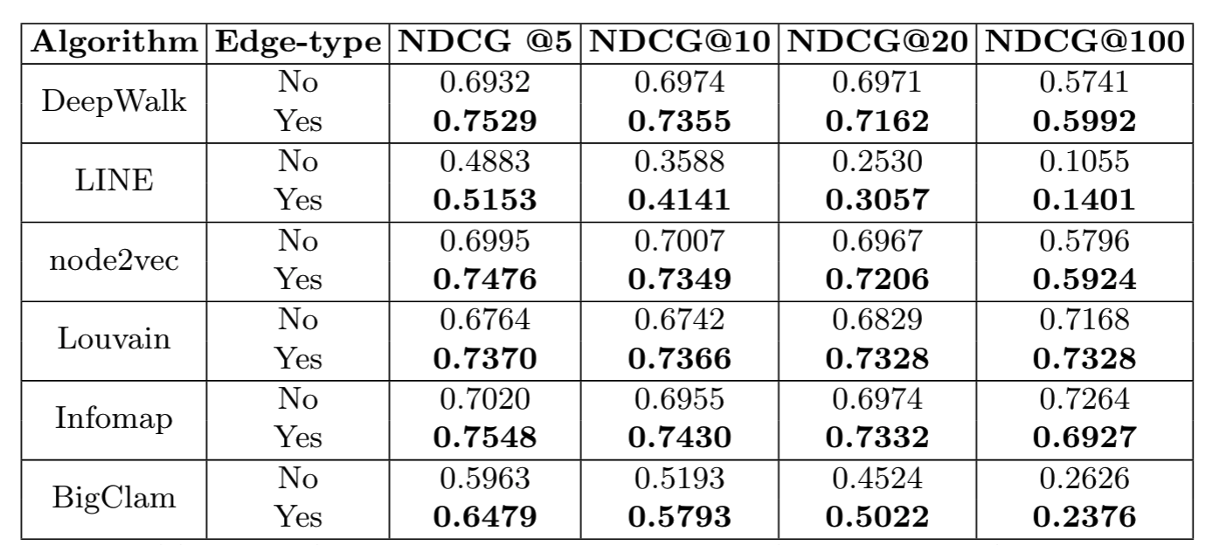
Task 2: Searching Accuracy within Community
We are also willing to see whether it also benefits music recommendation accuracy within communities. For each testing user, we select all songs in the same community as the user, and rank the songs based on their PageRank scores calculated during the training process.

Slide 14
Thanks!

