Slide 1
Contrastive Co-training for Diversified Recommendation
Authors : Xiyao Ma, Qian Hu, Zheng Gao, Mohamed AbdelHady
Presented at IJCNN 2022

Slide 2
Introduction
In this work, we propose Contrastive Co-Training (CCT) for diversified recommendation that improves diversity greatly and achieves comparable or even better accuracy.
To summarize, the contributions of this paper are three-folds:
We propose a contrastive co-training framework to improve diversity for recommendation. To the best of our knowledge, this is the first work to effectively integrate co-training and contrastive learning for the purpose of improving diversity.
We propose diversified contrastive learning to alleviate the popularity and category biases, further improving diversity.
Extensive experiments show that our proposed model greatly outperforms strong baselines in terms of diversity as well as preserve and even improve accuracy.

Slide 3
Problem Formulation
Given a set of users, items and their associated interactions, we build an associated user-item bipartite graph and aim to learn a function that predicts the probability that a user would adopt an item so as to recommend top-k relevant and diverse items for each user.

Slide 4
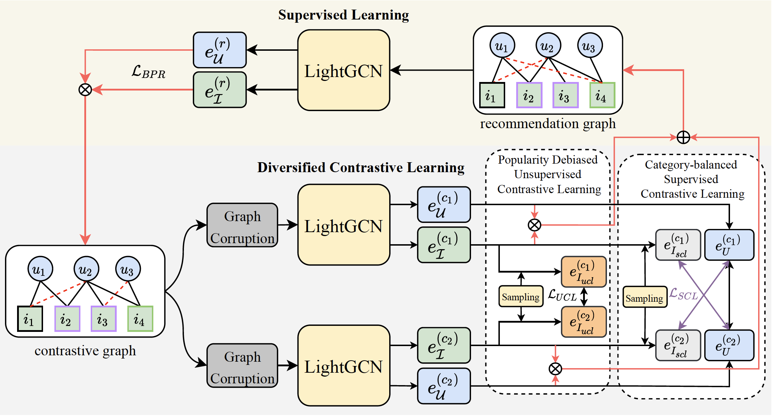
Method: Pipeline

Slide 5

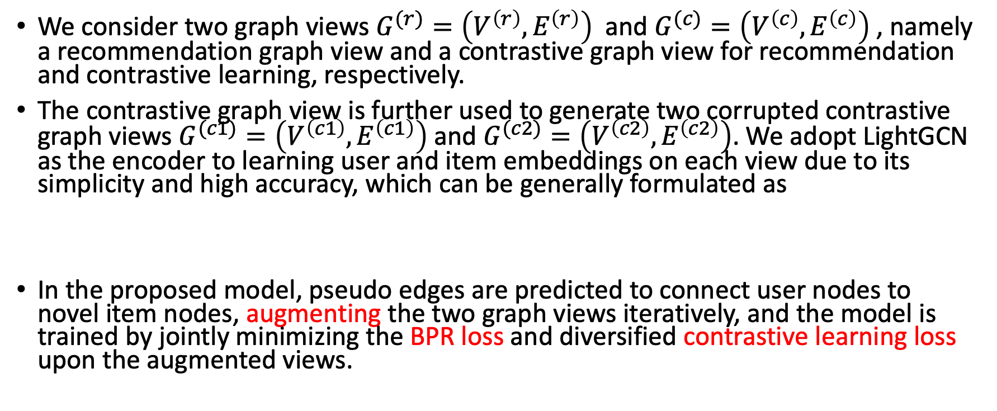
Method: Overview
We consider two graph views $G^{(r)}=\left(V^{\left(r\right)},E^{\left(r\right)}\right)$ and $G^{(c)}=\left(V^{\left(c\right)},E^{\left(c\right)}\right)$, namely a recommendation graph view and a contrastive graph view for recommendation and contrastive learning, respectively.
The contrastive graph view is further used to generate two corrupted contrastive graph views $G^{(c1)}=\left(V^{\left(c1\right)},E^{\left(c1\right)}\right)$and $G^{(c2)}=\left(V^{\left(c2\right)},E^{\left(c2\right)}\right)$. We adopt LightGCN as the encoder to learning user and item embeddings on each view due to its simplicity and high accuracy, which can be generally formulated as
In the proposed model, pseudo edges are predicted to connect user nodes to novel item nodes, augmenting the two graph views iteratively, and the model is trained by jointly minimizing the BPR loss and diversified contrastive learning loss upon the augmented views.

Slide 6
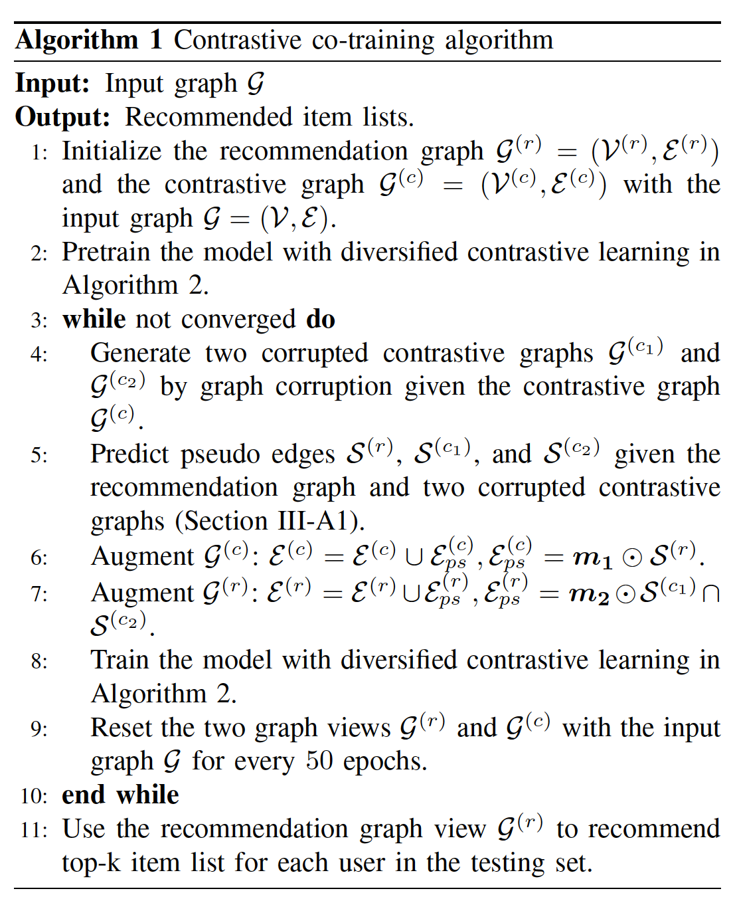
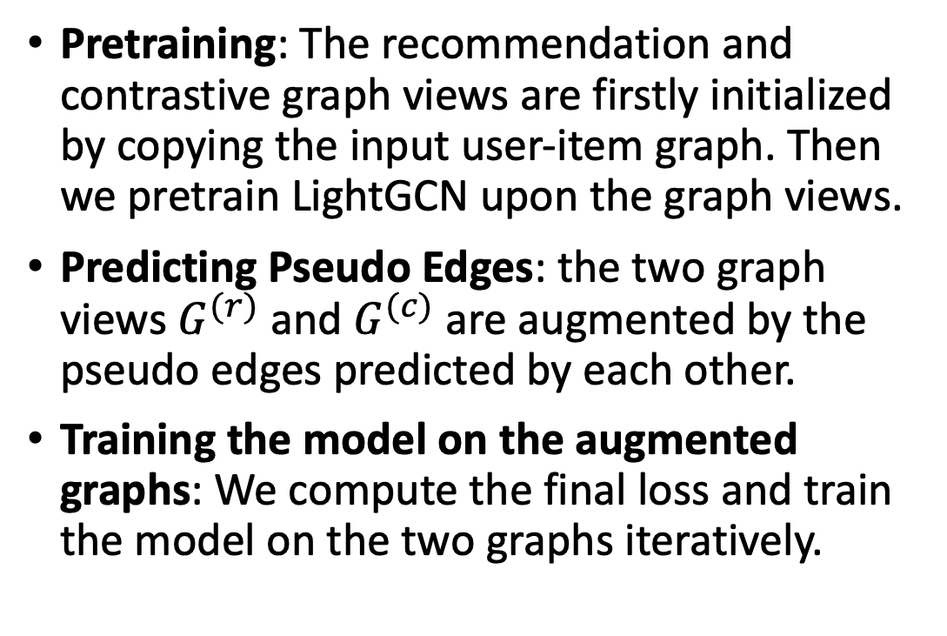
Method: Contrastive Co-training
Pretraining: The recommendation and contrastive graph views are firstly initialized by copying the input user-item graph. Then we pretrain LightGCN upon the graph views.
Predicting Pseudo Edges: the two graph views $G^{(r)}$ and $G^{(c)}$ are augmented by the pseudo edges predicted by each other.
Training the model on the augmented graphs: We compute the final loss and train the model on the two graphs iteratively.

Slide 7
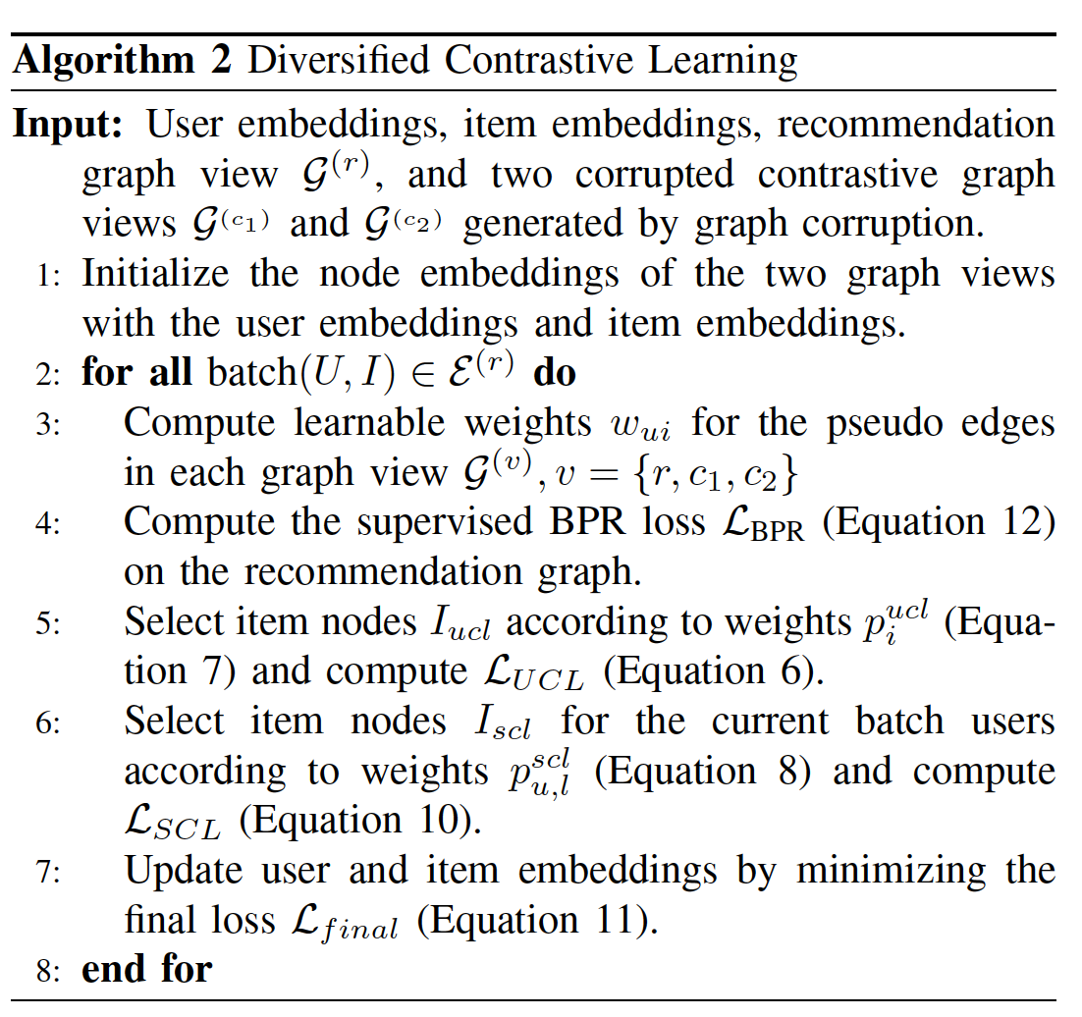
Method: Diversified Contrastive Learning
Graph Corruption: randomly discarding some observed user-item edges and node embedding dropout with a prior probability.
Popularity Debiased Unsupervised Contrastive Learning: sample more unpopular items and less popular items by assigning higher weights on the unpopular items and lower weights on the popular item during sampling.
Category-balanced Supervised Contrastive Learning: We emphasize the interactions of the items of unpopular categories and the corresponding users.

Slide 8
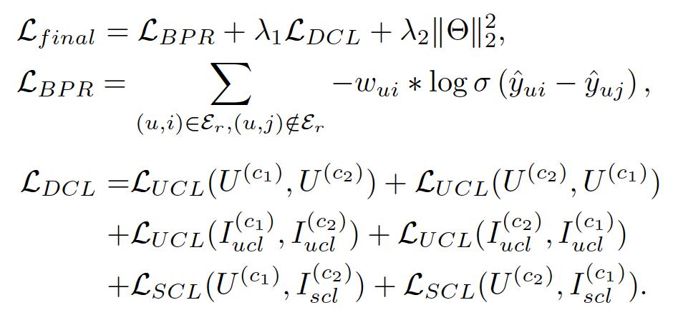
Method: Training Loss
We trained the model in the multi-task learning fashion with the final loss, as measured by the summation of supervised BPR ranking loss, diversified contrastive learning loss, and L2 regularization:

Slide 9
Experiment: Research Questions
RQ1: How does CCT perform top-k recommendation task in terms of accuracy and diversity metrics, compared with other state-of-the-art (SOTA) models?
RQ2: How do the components of CCT affect model performance with different settings?
RQ3: How does the proposed model impact eclectic users and long-tail items?

Slide 10
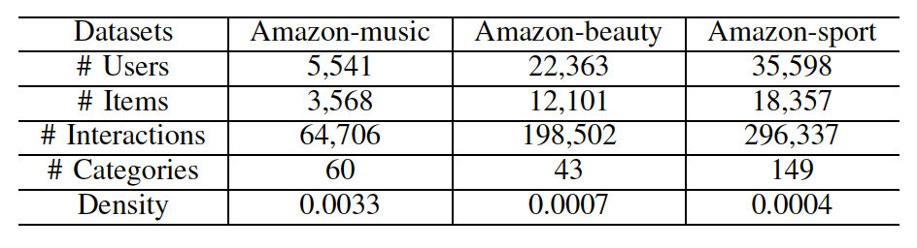
Experiment: Settings
Datasets:
We adopt three datasets, Amazon-music, Amazon-beauty, and Amazon-sport, from Amazon review dataset collections to evaluate model performances across the experiments.
Metrics:
Recall@k and NDCG@k are used as accuracy metrics; Intra-list Distance (ILD@k) and Category Coverage (CC@k) are used as diversity metrics.
Baselines:
MMR, DPP, NCF, LightGCN, SGL, PD-GAN, DGCN.

Slide 11
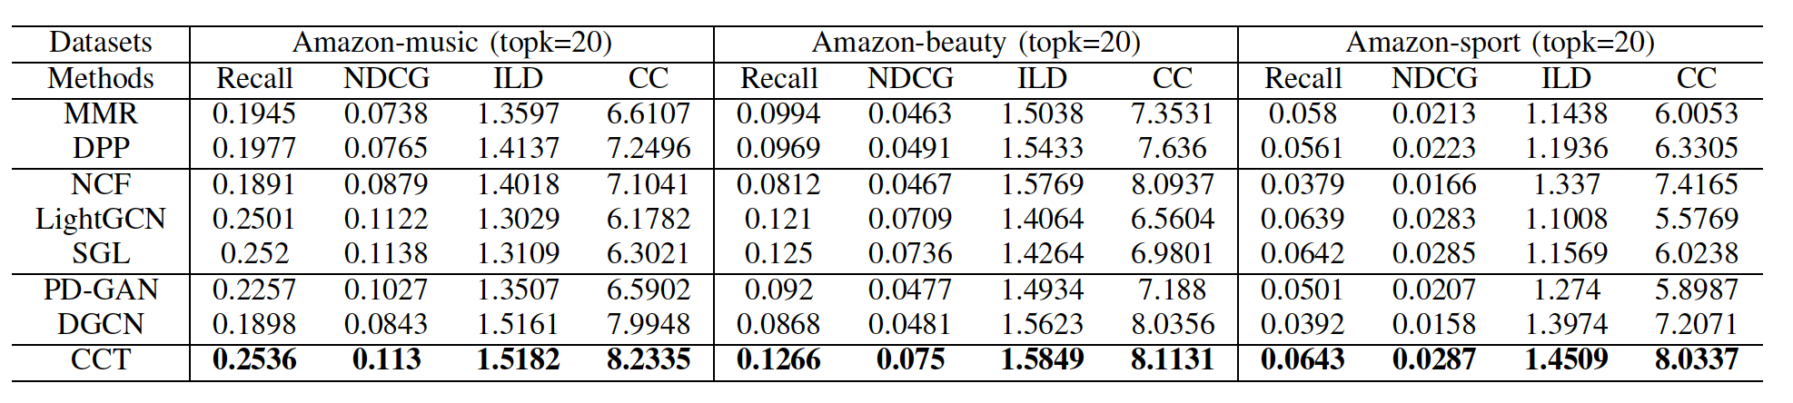
Experiment: Main Results (RQ1)
Model Performance Comparison in terms of accuracy and diversity.

Slide 12
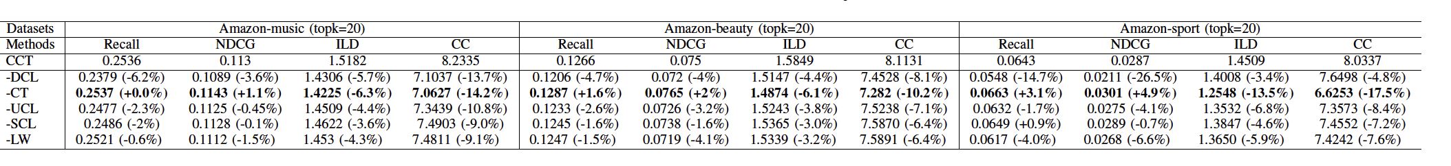
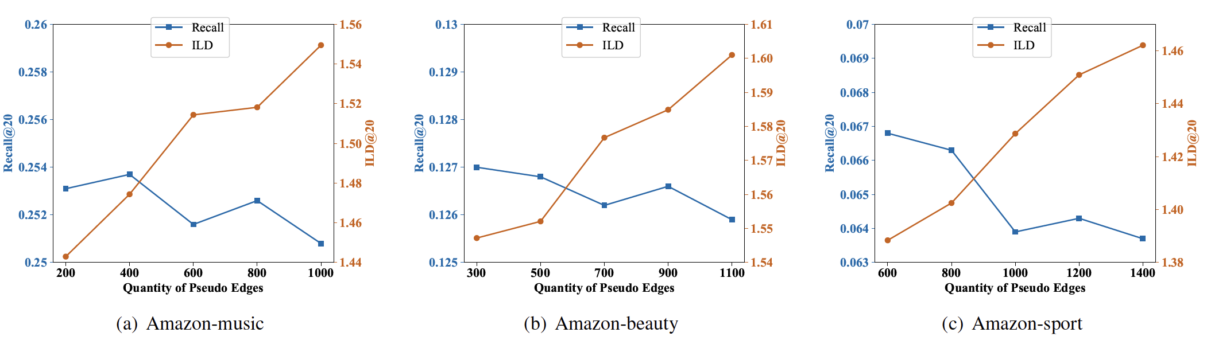
Experiment: Model Study (RQ2)
Ablation Study
Effect of the Quantity of Pseudo Edges

Slide 13
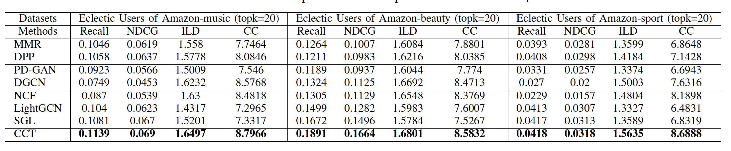
Experiment: Model Benefits (RQ3)
Model performance Comparison on Eclectic Users
We extract users that interacted with at least 20 items and at least different 6 categories from each dataset as the eclectic users.

Slide 14
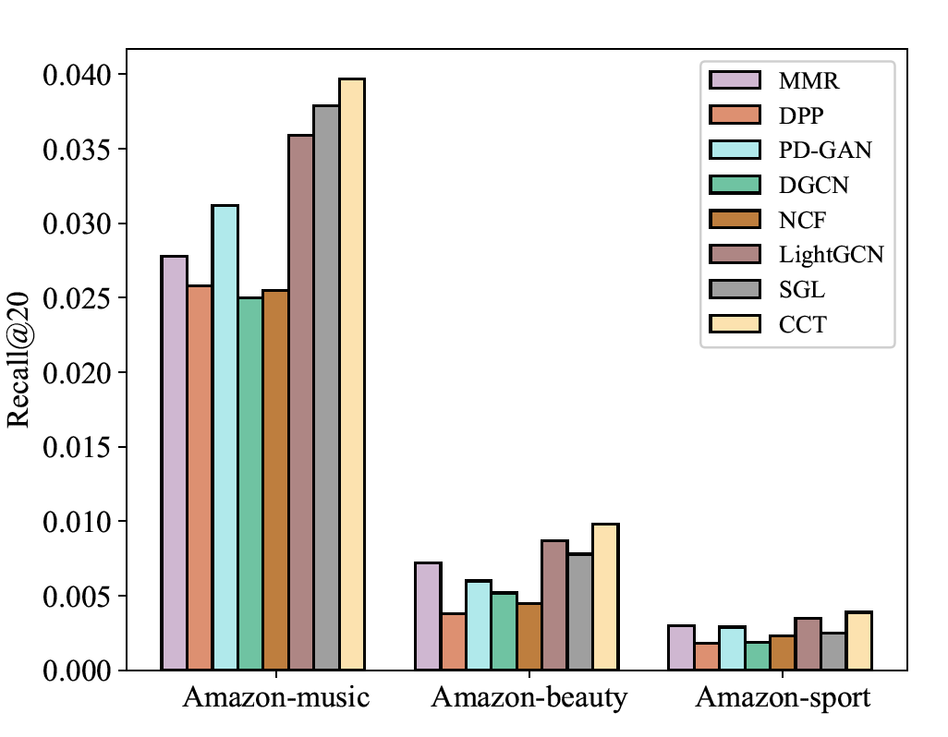
Experiment: Model Benefits (RQ3)
Performance comparison over long-tail items.

Slide 15
Conclusion
In this paper, we propose contrastive co-training for diversified recommendation that integrates co-training and contrastive learning which delivers the best diversity and accuracy tradeoff at the same time. On the one hand, co-training unearths the novel item that users might be interested in and predicts pseudo user-item edges to augment the graphs. On the other hand, diversified contrastive learning mitigate the damage when the pseudo labels are unreliable and further improve diversity by re-balancing item-level popularity and category level popularity.
In the future, we intend to further improve diversity by exploring methods to learn the uncertainty for the pseudo edges and utilize the edges that are of low confidence but might be true.

Slide 16
Thanks!
Q & A

