Slide 1
HCL: Hybrid Contrastive Learning for Graph-based Recommendation
Authors : Xiyao Ma, Zheng Gao, Qian Hu, Mohamed AbdelHady
Presented at IJCNN 2022

Slide 2
Introduction
we propose Hybrid Contrastive Learning (HCL) for graph-based recommendation that integrates unsupervised and supervised contrastive learning. To summarize, the contributions of this work are three-folds:
We identify the limitation of existing contrastive learning methods for recommendation and propose Hybrid Contrastive Learning.
We generalize a permutational approach that performs hybrid contrastive learning across multiple views which are generated to convey incomplete and noisy information with respect to node embeddings and topology.
Extensive experiments show the superiority of HCL regarding to model generalization and robustness over SOTA baselines on two public and one internal dataset.

Slide 3
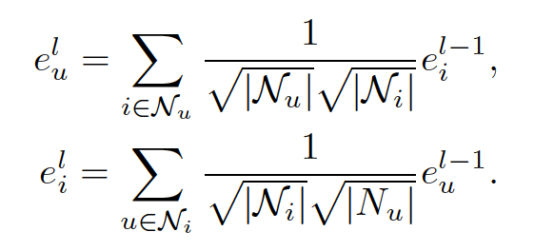

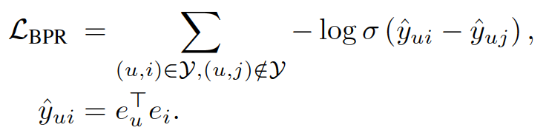
Preliminary
LightGCN is a strong graph collaborative filtering (GCF) baseline for recommendation that captures the high-order connectivity from the user-item bipartite graph, and the model is trained in a supervised learning paradigm. It is applied on the user-item bipartite graph to learn user and item representations by aggregating the representation of its direct neighbors N and with the defined graph convolution operations:
Bayesian Personalized Ranking (BPR) finally assigns higher probability to observed interactions than its unobserved interactions:

Slide 4
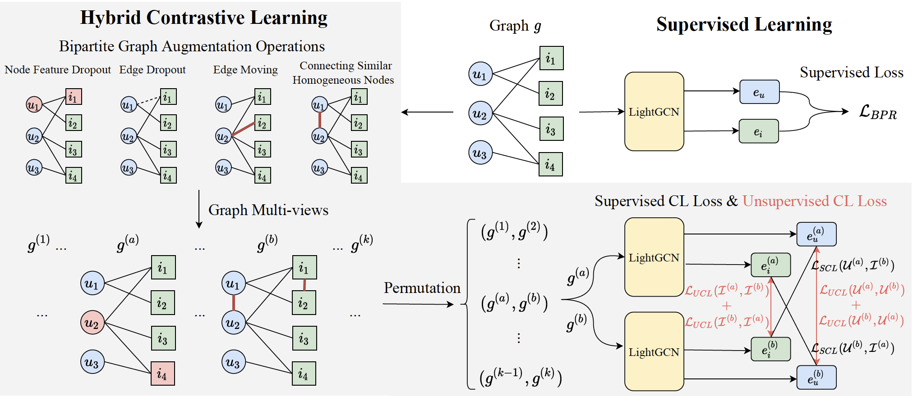
Method: HCL

Slide 5
Method: HCL
In general, the proposed HCL has three steps:
We propose novel bipartite graph augmentation strategies by taking node embeddings and topology into consideration to generate different incomplete and noisy views for the input user-item graph.
The proposed hybrid contrastive learning performs unsupervised and supervised contrastive learning on homogeneous nodes and observed user-item interactions, respectively.
We conduct the hybrid contrastive learning among multiple views permutationally.

Slide 6
Method: Bipartite Graph Augmentation
we propose four bipartite graph augmentation strategies to generate different graph views that contain incomplete and noisy information about node embedding and node topology to boost downstream contrastive learning, including node embedding dropout, edge dropout, edge moving and connecting similar homogeneous nodes.

Slide 7
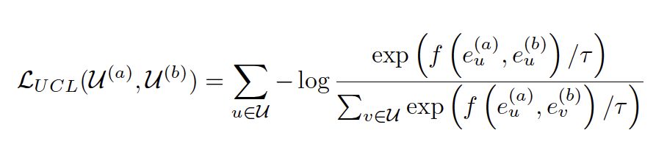
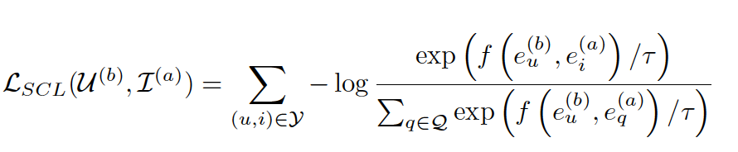
Method: Hybrid Contrastive Learning
Unsupervised Contrastive Learning: We pull together the different views of the same node and push apart those of different nodes.
Supervised Contrastive Learning: We propose to encourage the consistency of the embeddings of the users and the interacted items by computing supervised contrastive learning (SCL) loss given the observed user-item interactions. We maximize agreement between user representation and item representation generated from different views

Slide 8
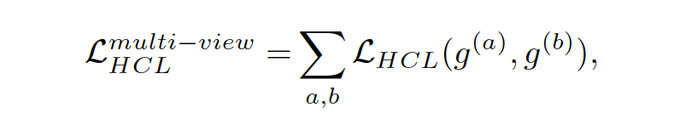
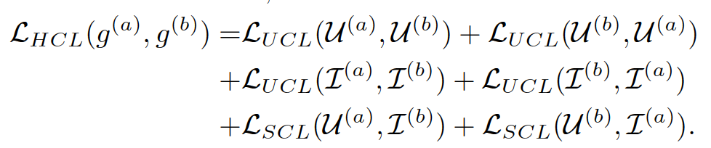

Method: Multi-view Permutation
The total multi-view HCL loss is the summation of the HCL loss terms computed on every pair of graph views permutationally, and each HCL loss term is the summation of unsupervised contrastive learning losses on user and item nodes and supervised contrastive learning losses.
We trained the model in the multi-task learning fashion with the final loss

Slide 9
Experiment: Settings
Datasets
We adopt two widely-used public datasets, Yelp2018 and Amazon-book, and one internal Alexa Recipe dataset to evaluate model performances across the experiments.
Baselines
We mainly adopt three categories of models as baselines for performance comparison: Non-GCF models (MF, NCF), GCF models (NGCF, LightGCN), and GCF model with contrastive learning (SGL).

Slide 10
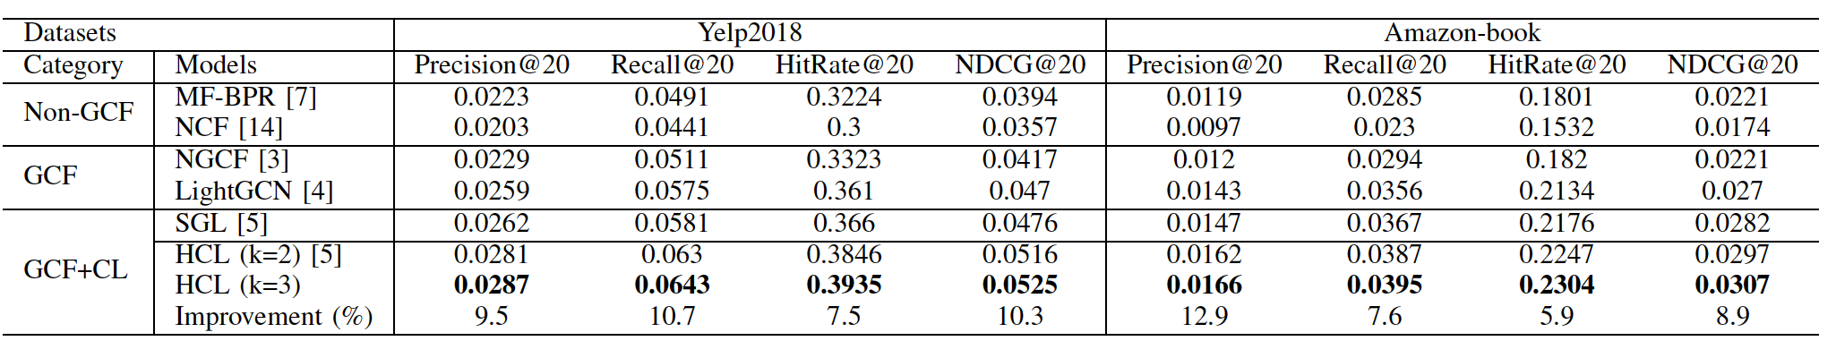
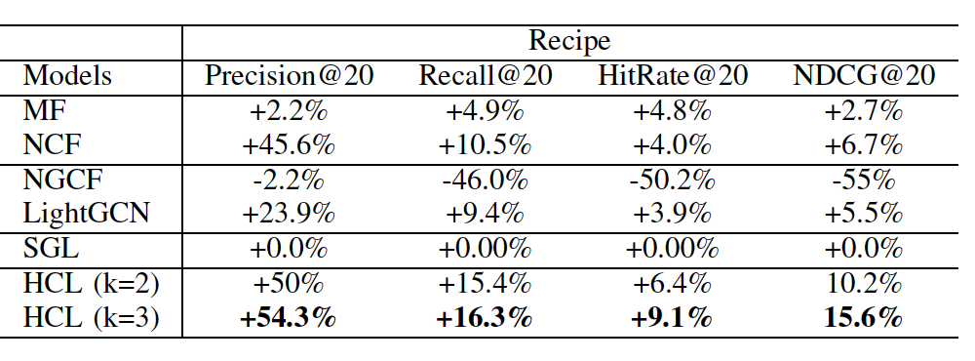
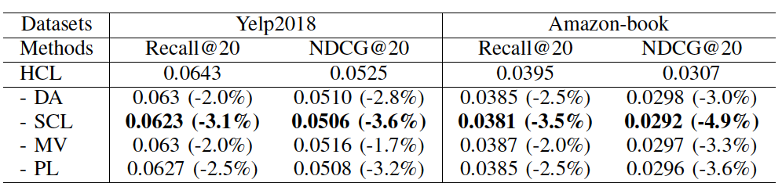
Experiment: Comparison Results
Model Performance Comparison on Public Datasets
Model Relative Performance Comparison on Recipe Dataset with SGL.
Ablation Study

Slide 11
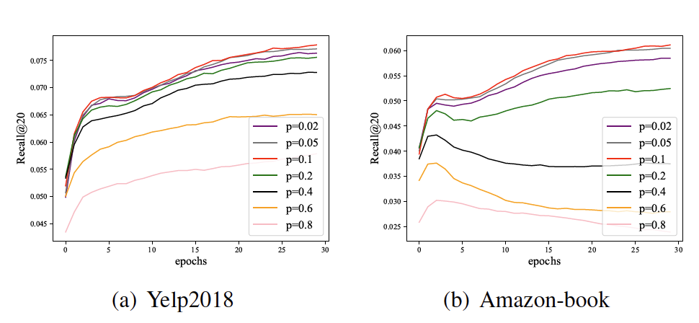
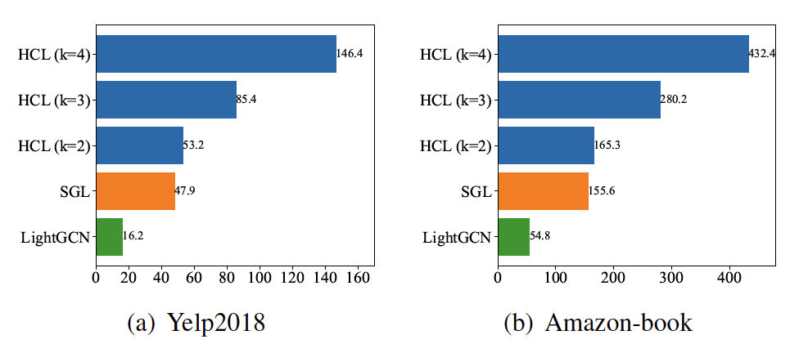
Experiment: Parameter Tuning
Effect of probability for bipartite graph augmentation
Time (seconds) of training models for one epoch.

Slide 12
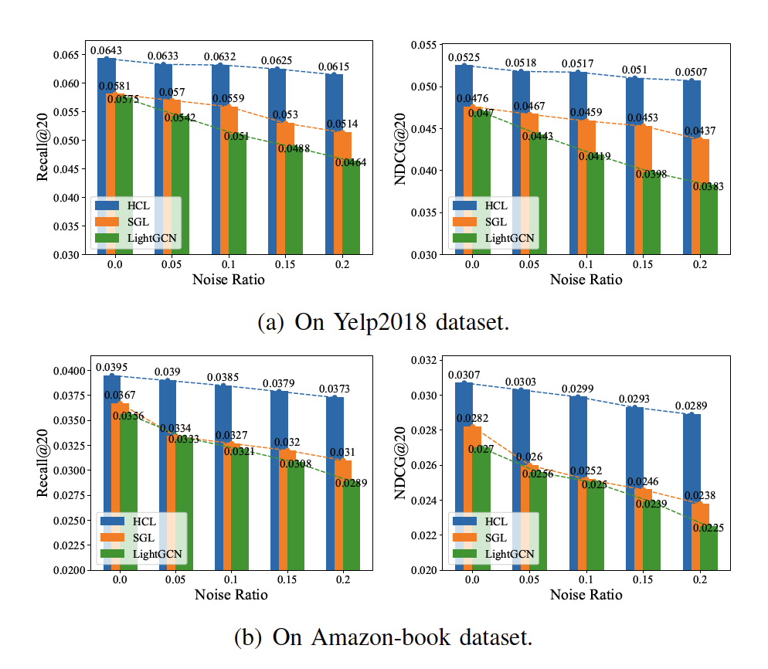
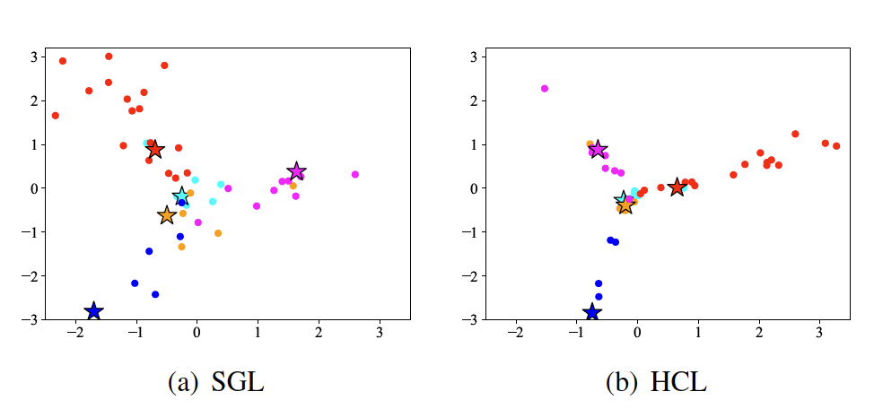
Experiment: Supplementary Studies
Model performance with noise ratios. The bar represents the results in terms of Recall@20 and NDCG@20, respectively
Visualization of users and items embeddings learnt by SGL and the proposed HCL.

Slide 13
Conclusion
In this paper, we proposed a novel framework, named HCL, with three contributions to well exploit contrastive learning for graph-based recommendation:
Bipartite graph augmentation operations from the perspectives of node embeddings and topology
Hybrid contrastive learning that combines unsupervised and supervised contrastive learning
Performing hybrid contrastive learning permutationally across multiple views.
In the future, we aims to improve the model further by exploring negative sampling methods and curriculum learning that gradually incorporates more difficult negative samples.

Slide 14
Thanks!
Q & A

