Slide 1
Paraphrase Label Alignment for Voice Application Retrieval in Spoken Language Understanding
Zheng Gao
Applied Scientist
Amazon Alexa AI

Slide 2
Background
Alexa Systems: respond to user requests by routing to related applications.
Utterance: the voice request issued by users.
1P/3P skills:
1P skill (also called as domain) includes all Alexa developed skills, such as Calendar, News, etc.
3P skill includes all non-Alexa developed skills, such as Uber, Lyft, etc.
More examples: https://www.amazon.com/alexa-skills/b?ie=UTF8&node=13727921011
Example:
Utterance: alexa, play today’s hits
Response: Pandora application will be invoked

Slide 3
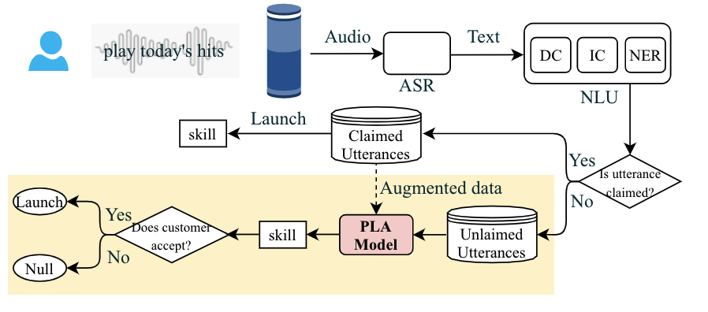
Research Question
Goal: To avoid unnecessary utterance failures in SLU systems such as model incapability or routing errors, we propose a skill retrieval system as a downstream service to suggest fallback skills to unclaimed utterances.
Input: unclaimed utterances
Output: suggested fallback skills
Keywords: data augmentation, pseudo label alignment

Slide 4
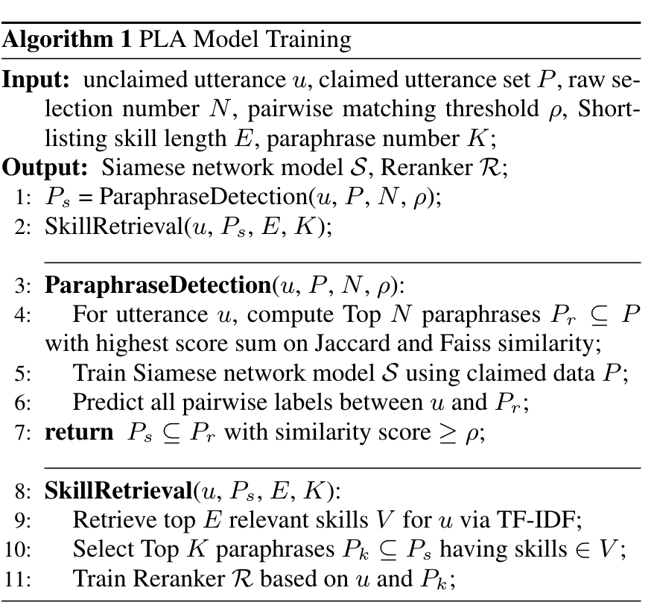
Method
Two Step Approach
Paraphrase detection: detect paraphrases from claimed utterances
Skill retrieval: retrieve skills via a customized loss function aligning paraphrase launched skills.
In the testing stage, we only apply the skill retrieval step on unclaimed utterances to predict relevancy labels of their Shortlisting skills and retrieve the skill with the highest prediction score. Claimed utterances and the paraphrase detection step are not involved.

Slide 5
Paraphrase Detection
Raw Selection
Word level similarity: Jaccard Similarity
Semantic similarity: Pretrained Bert embedding + FAISS model
Pairwise Matching
Siamese network: build on claimed utterances to detect utterance pairwise relationship
Given an utterance, select all claimed utterances with matching score (raw selection score + pairwise matching score) above threshold as the paraphrase candidate set.

Slide 6
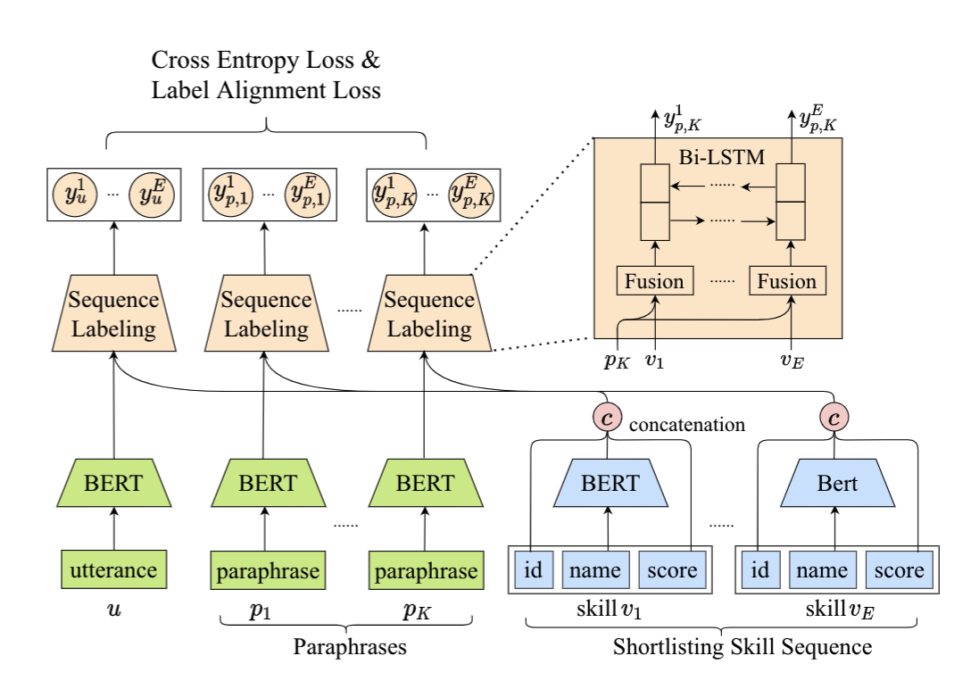
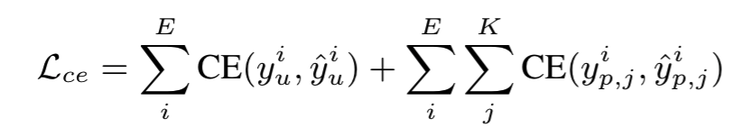
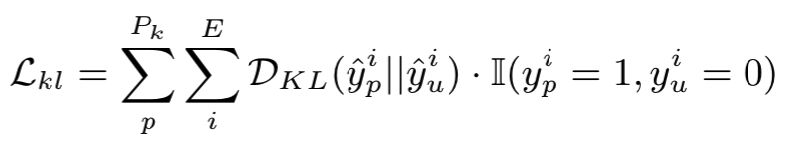
Skill Retrieval
Shortlisting
TF-IDF model in Elasticsearch
Reranking
Utterance and Skill Encoder
Sequence Labeling
Cross Entropy Loss + Label Alignment Loss
Loss Function
Cross entropy loss: predicted label sequence score with ground truth
Label alignment loss: minimize their prediction scores' KL divergence on the skills with positive labels in paraphrases but not in original utterance.

Slide 7
Datasets
Dataset en-US and en-CA are unclaimed English utterances from devices in the United States and Canada respectively. The third dataset is claimed English utterances from devices in both countries. In dataset en-US and en-CA
In the end, we collect 1 million unclaimed utterances in en-US, 80 thousand unclaimed utterances in en-CA, and 16 million claimed utterances in both countries.

Slide 8
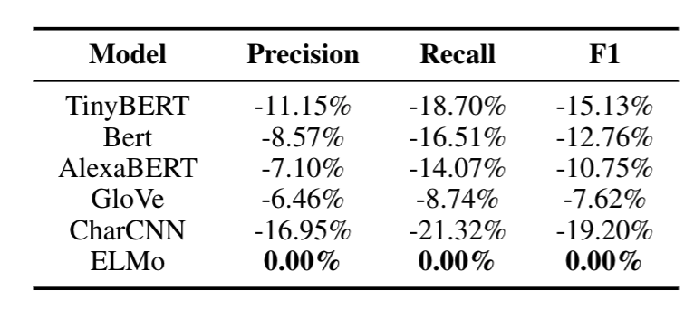
Paraphrase Detection Evaluation
Encoder Structure Exploration: TinyBERT, BERT, AlexaBERT, CharCNN, GloVe, ELMo in Siamese network structure.
Comparison Results: the relative change of each baseline score to the best model score.

Slide 9
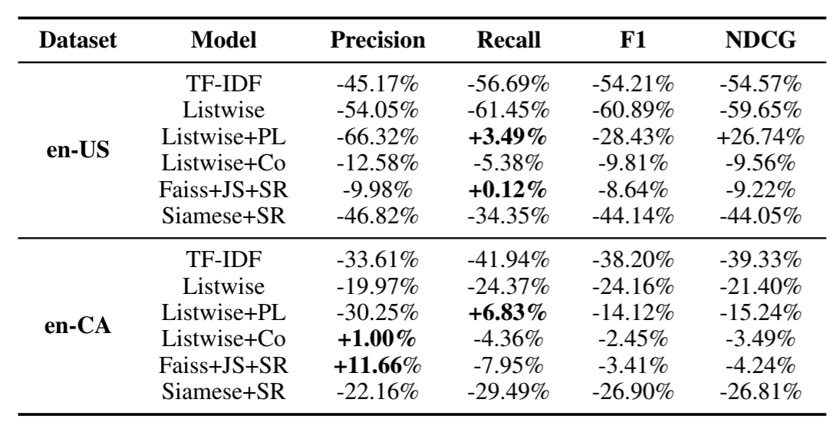
Skill Retrieval Evaluation
Model Variants:
TF-IDF
Listwise
Listwise + PL (paraphrase labels)
Listwise + Co (combined claimed and unclaimed training data)
Faiss + JS + SR (truncated model with Faiss model + Jaccard similarity + skill retrieval step)
Siamese + SR (truncated model with Siamese network and skill retrieval step )
Evaluation Metrics:
Precision, recall, F1 and NDCG

Slide 10
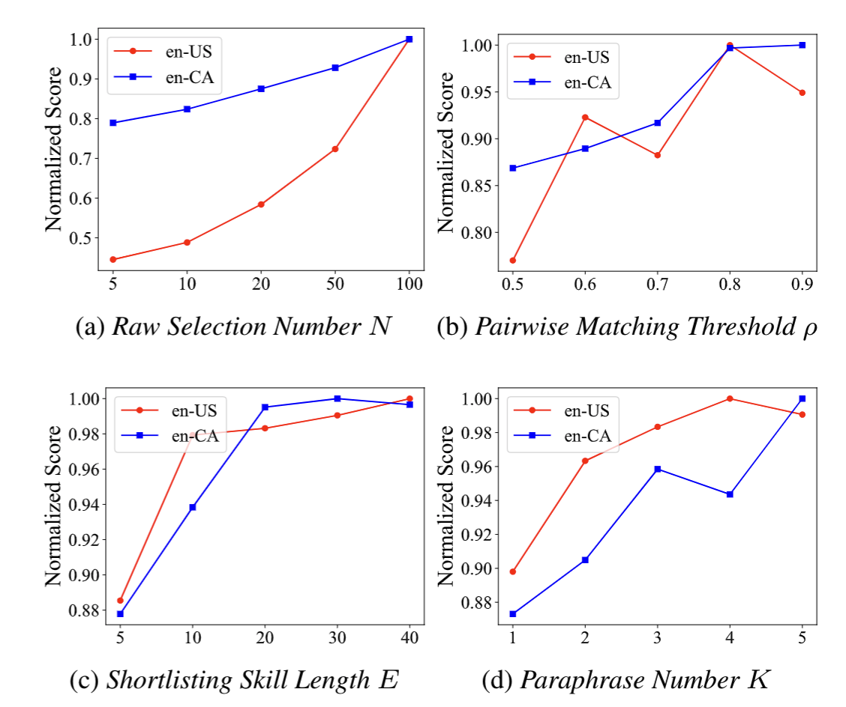
Parameter Tuning

Slide 11
Thanks!

