Slide 1

Detecting User Community in Sparse Domain via Cross-Graph Pairwise Learning
Zheng Gao, Hongsong Li, Zhuoren Jiang, Xiaozhong Liu

Slide 2
Outline
Introduction
Method
Experiment
Future Work

Slide 3
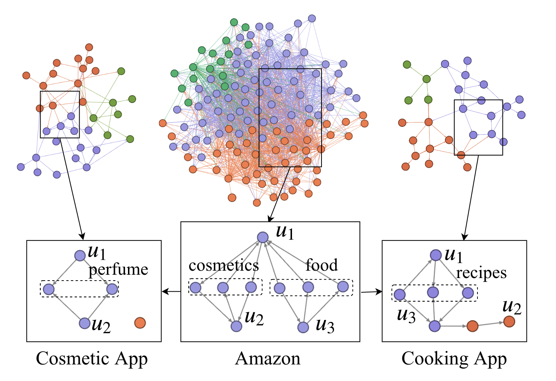
Introduction
Intuition of Cross-Graph Community Detection

Slide 4
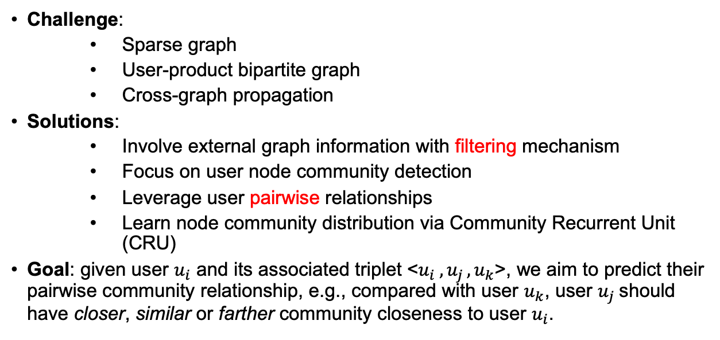
Introduction
Challenge:
Sparse graph
User-product bipartite graph
Cross-graph propagation
Solutions:
Involve external graph information with filtering mechanism
Focus on user node community detection
Leverage user pairwise relationships
Learn node community distribution via Community Recurrent Unit (CRU)
Goal: given user $u_{i}$ and its associated triplet <$u_{i} ,u_{j }, u_{k}$>, we aim to predict their pairwise community relationship, e.g., compared with user $u_{k}$, user $u_{j}$should have closer, similar or farther community closeness to user $u_{i}$.

Slide 5
Method
Task Overview
Raw Community Detection
User Propagative Representation
Community Recurrent Unit
Pairwise Community Detection
Training Strategy

Slide 6
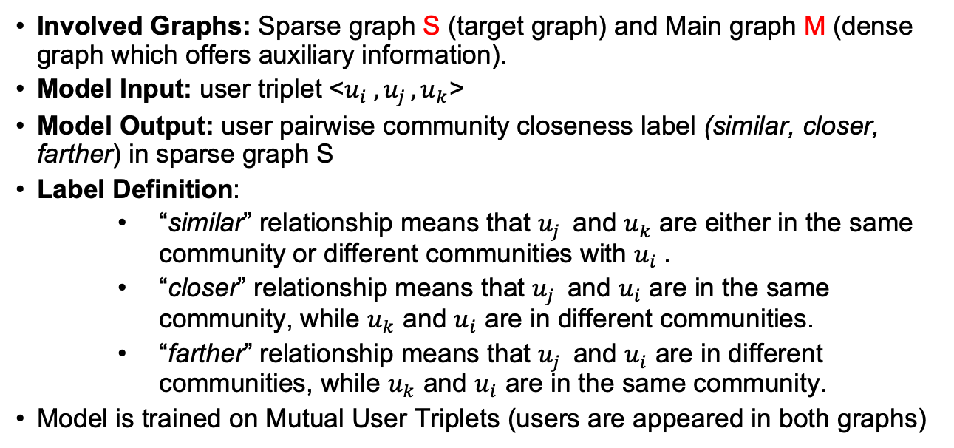
Task Overview
Involved Graphs: Sparse graph S (target graph) and Main graph M (dense graph which offers auxiliary information).
Model Input: user triplet <$u_{i} ,u_{j }, u_{k}$>
Model Output: user pairwise community closeness label (similar, closer, farther) in sparse graph S
Label Definition:
“similar” relationship means that $u_{j }$ and $u_{k}$ are either in the same community or different communities with $u_{i}$.
“closer” relationship means that $u_{j }$ and $u_{i}$ are in the same community, while $u_{k}$ and $u_{i}$ are in different communities.
“farther” relationship means that $u_{j }$ and $u_{i}$ are in different communities, while $u_{k}$ and $u_{i}$ are in the same community.
Model is trained on Mutual User Triplets (users are appeared in both graphs)

Slide 7
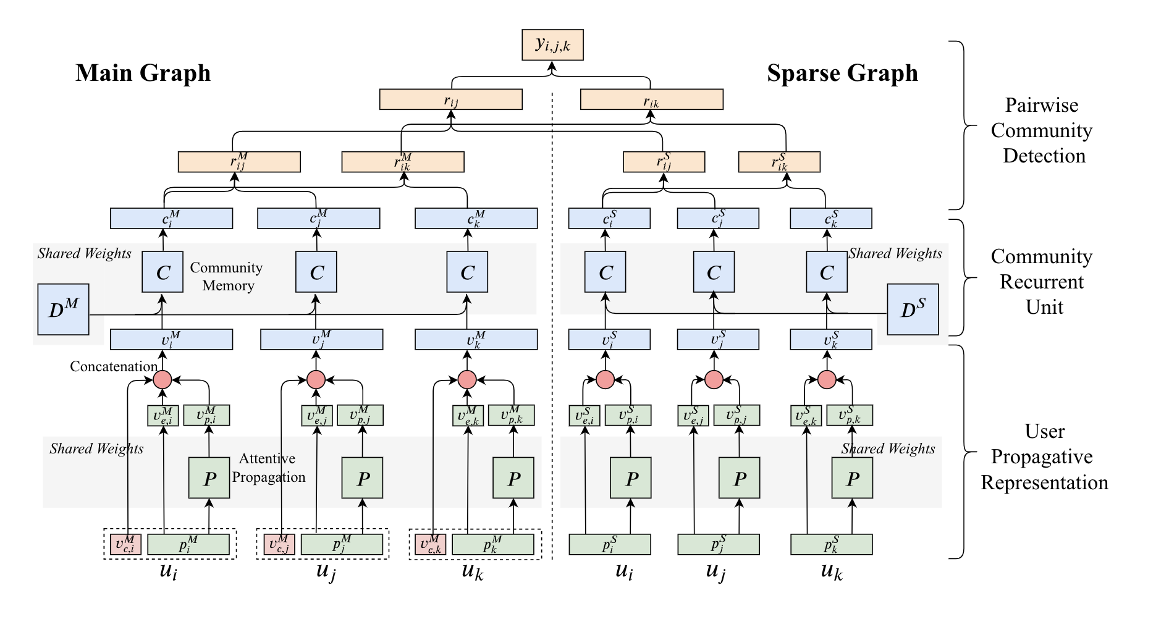
Model Architecture

Slide 8
Raw Community Detection
Use Infomap to generate raw communities in Main graph M.
Offer community level information for graph M due to dense connections.
Offer community level filter for propagated information from graph M

Slide 9
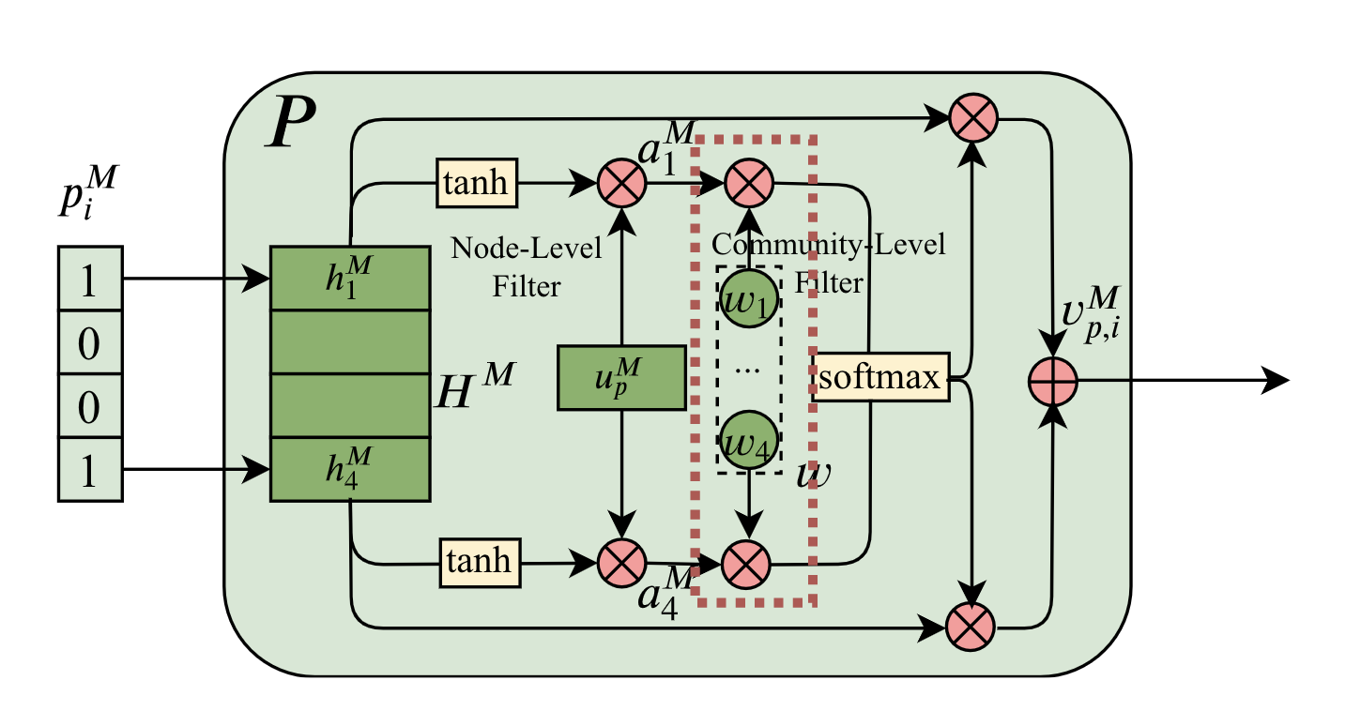
User Propagative Representation
Community-Level Filter: weight based
Node-Level Filter: attention based
User embedding is calculated as the weighted sum of its related product embeddings.

Slide 10
Model Architecture

Slide 11
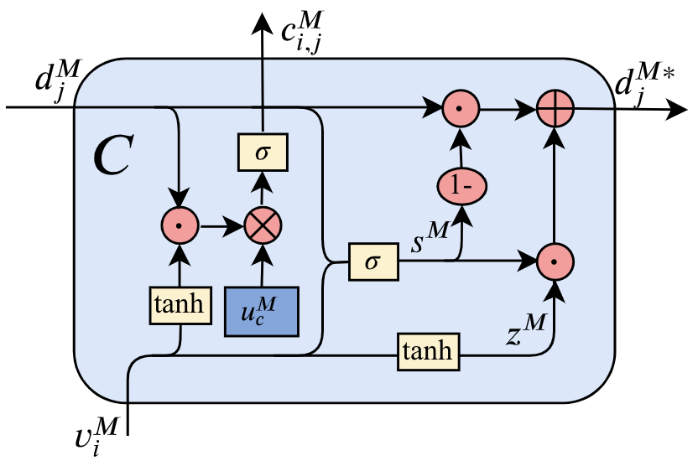
Community Recurrent Unit
Community Affiliation Gate: Learn user community distribution
Community Update Gate: Optimize community embedding
Community Constraint: Restrain community independency

Slide 12
Model Architecture

Slide 13
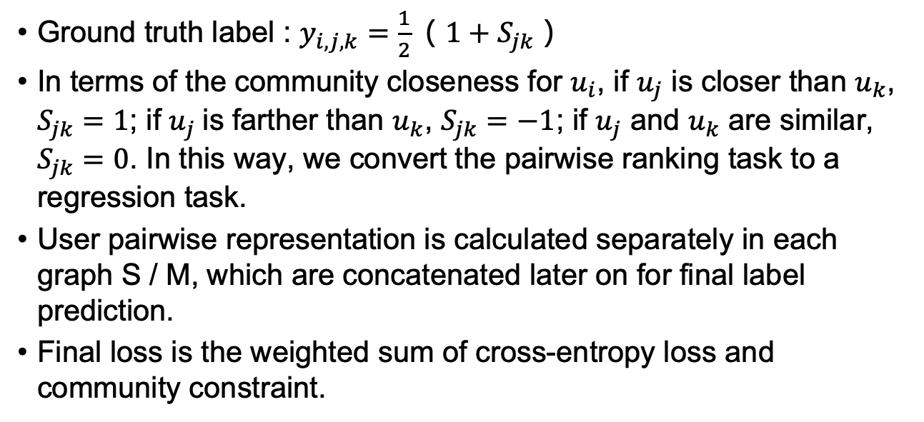
Pairwise Community Detection
Ground truth label : $y_{i,j,k}=\frac{1}{2}（1+S_{jk}）$
In terms of the community closeness for $u_{i}$, if $u_{j}$ is closer than $u_{k}$, $S_{jk}=1$; if $u_{j}$ is farther than $u_{k}$, $S_{jk}=−1$; if $u_{j}$ and $u_{k}$ are similar, $S_{jk}=0$. In this way, we convert the pairwise ranking task to a regression task.
User pairwise representation is calculated separately in each graph S / M, which are concatenated later on for final label prediction.
Final loss is the weighted sum of cross-entropy loss and community constraint.

Slide 14
Training Strategy
Shared weights for all users in separated graph.
Community memory is updated by taking the average of the three updated community representations in each user triplet.
Masked training strategy to randomly remove a small ratio of connected products from users in the main graph during each training batch.

Slide 15
Experiment
Dataset
Performance Comparison
Ablation Study
User-Type Analysis
Graph Sparsity Influence
Case Study

Slide 16
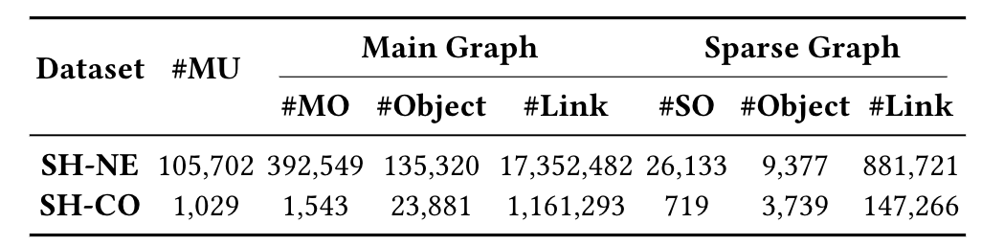
Dataset
Alibaba user logs from 09/20/2018 to 09/26/2018.
Ground truth label is calculated from seven-day behavior data. Training data is the first four-day behavior data.
Pseudo community label for training is generated from agreed community structure from all baseline models.
Two datasets: SHopping-NEws (SH-NE) and SHopping-COoking (SH-CO)
2,072,905 triplets in SH-NE dataset and 203,123 triplets in SH-CO dataset, from which 90% of the triplets are used for training and 10% for validation.

Slide 17
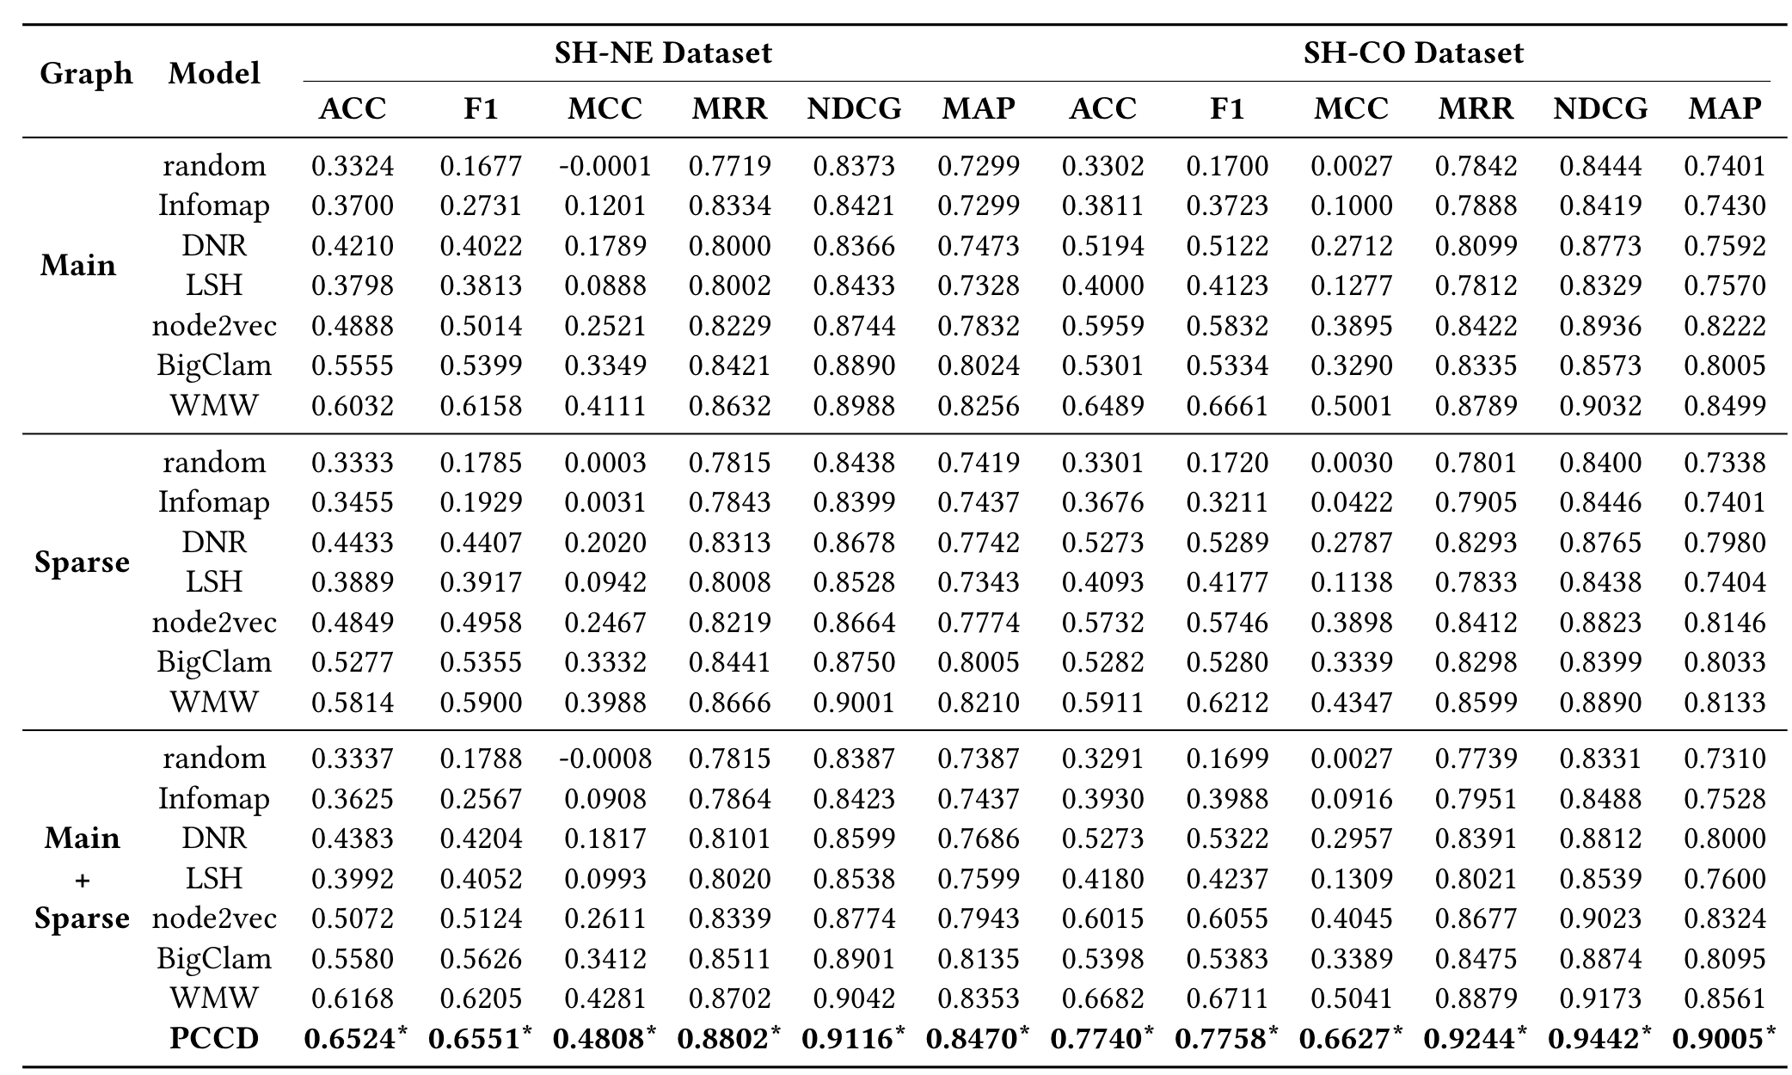
Performance Comparison

Slide 18
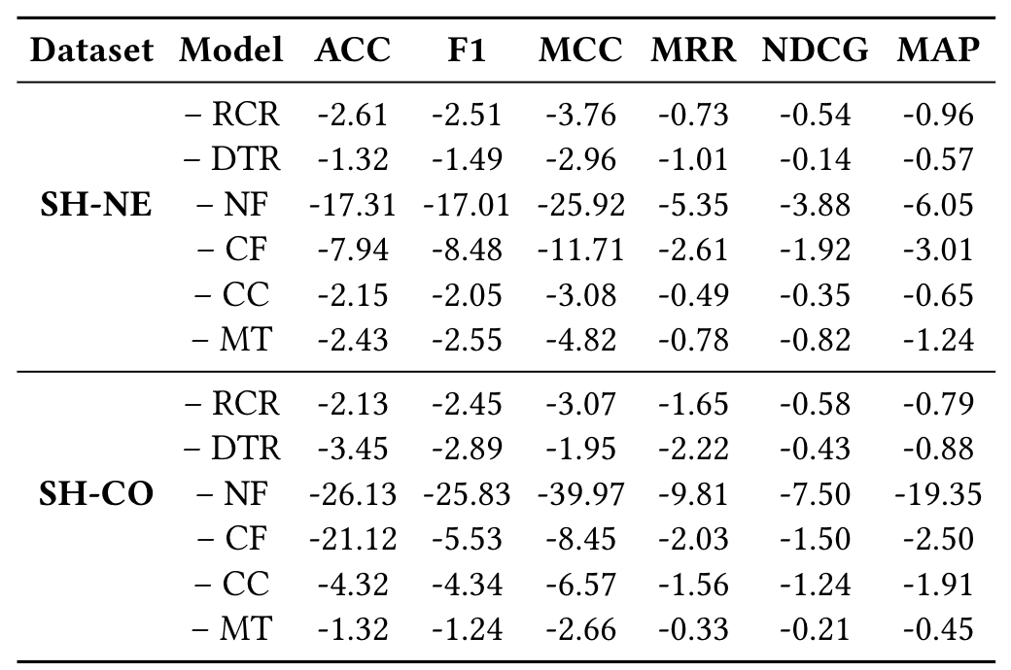
Ablation Study
Performance differences on all evaluation metrics between each ablated model and the original model. “-”refers to remove related component from our model. Results are scaled in percentage (%)
Six components: Raw Community Representation in the main graph (RCR), Direct Transformation Representation (DTR), Node-level filter (NF), Community-level filter (CF), Community Constraint (CC) and Masked Training (MT).

Slide 19
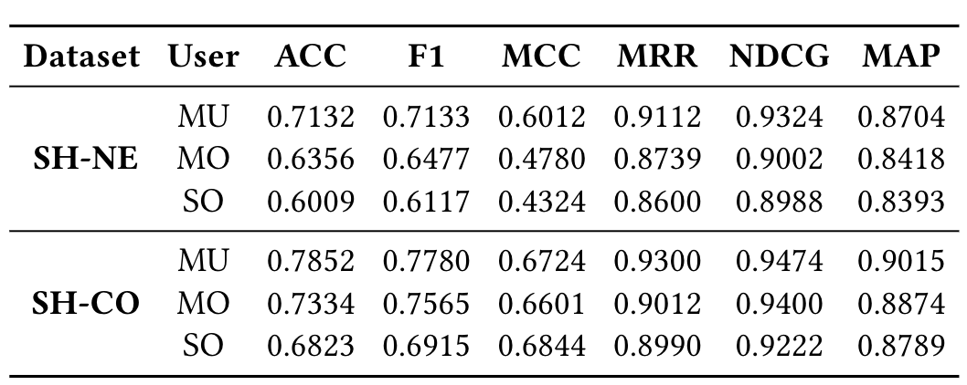
User-Type Analysis
MU: Mutual graph users, users appeared in both graphs.
MO: Main graph only, users only appeared in the main graph.
SO: Sparse graph only, users only appeared in the sparse graph.

Slide 20
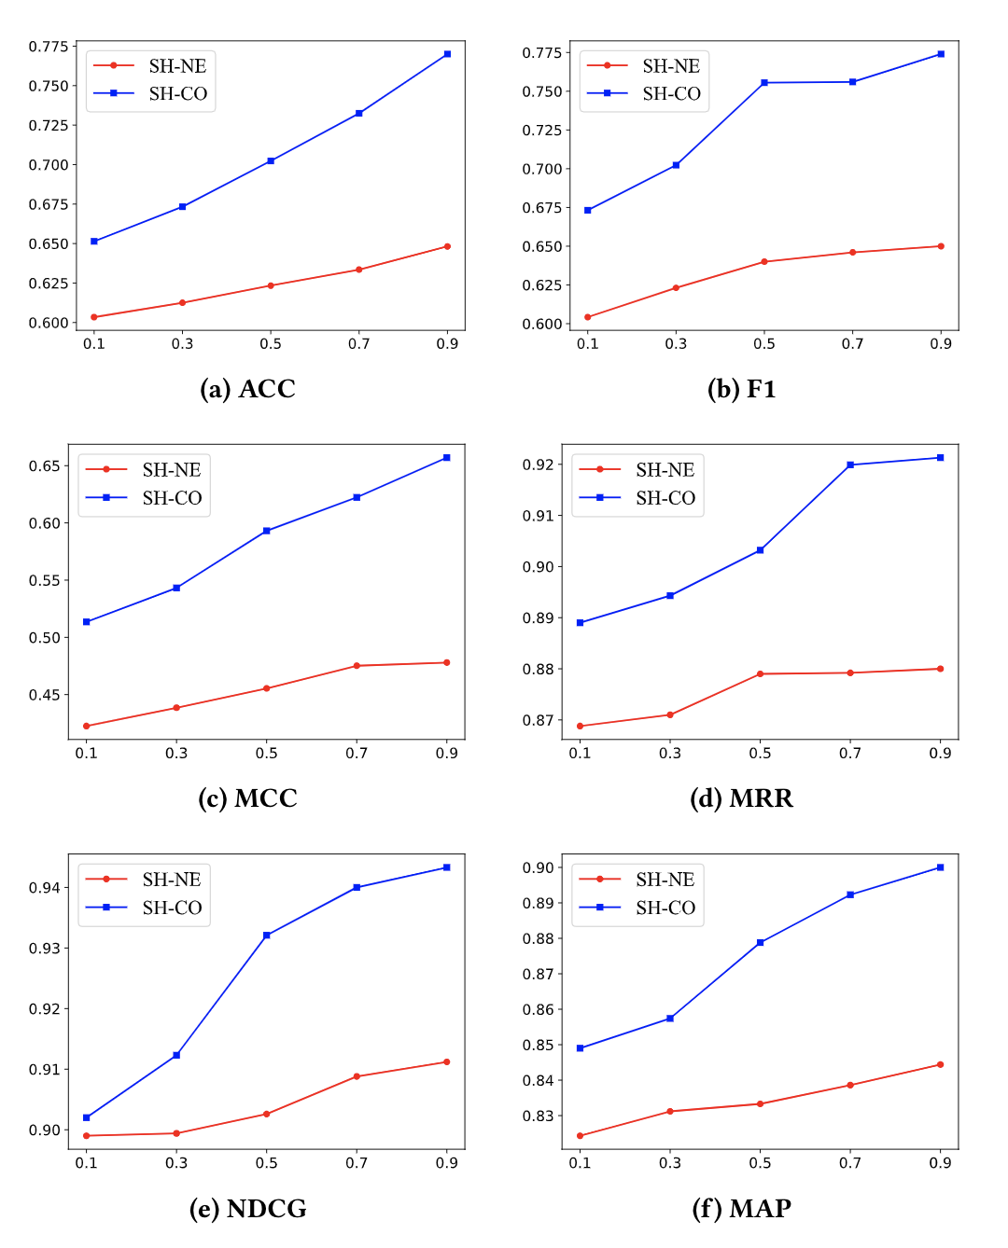
Graph Sparsity Influence
Sparse graphs are truncated and only keep partial connections, which aims to testify how well our model can handle cold-start problem.
Denser connections can lead to better evaluation results. While 50% is the breaking point in some metrics such as MRR and F1.

Slide 21
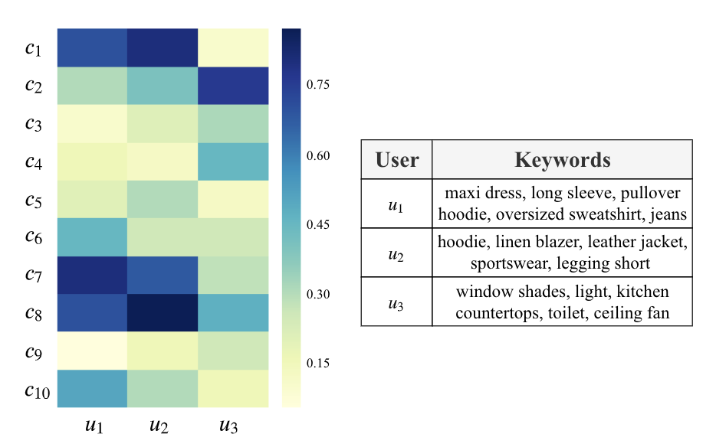
Case Study
The left part shows ten community affiliation scores of three selected users in the shopping graph. The right part shows the keywords of their purchased products.

Slide 22
Future Work
Omit pseudo community label generation or merge it into the whole pipeline.
Involve more user/product information into current model, i.e. user textual profile or session based behavior history.
Besides user nodes, enable product node community detection as well.
Run models in multiple graphs simultaneously instead of two graphs in current scenarios.

Slide 23
Thanks!!
Website: https://zhenggao.io!
Email: gao27@Indiana.edu!

