Slide 1
Web Dev 3: Deployment and Azure with ASP.NET Core
Code Labs

Slide 2
Welcome to Code Labs
Minimal slides
Lots of hands on coding
Don’t worry if you don’t finish
(code and docs are public)
Sessions are filmed
Get help from a proctor if you’re stuck!

Slide 3
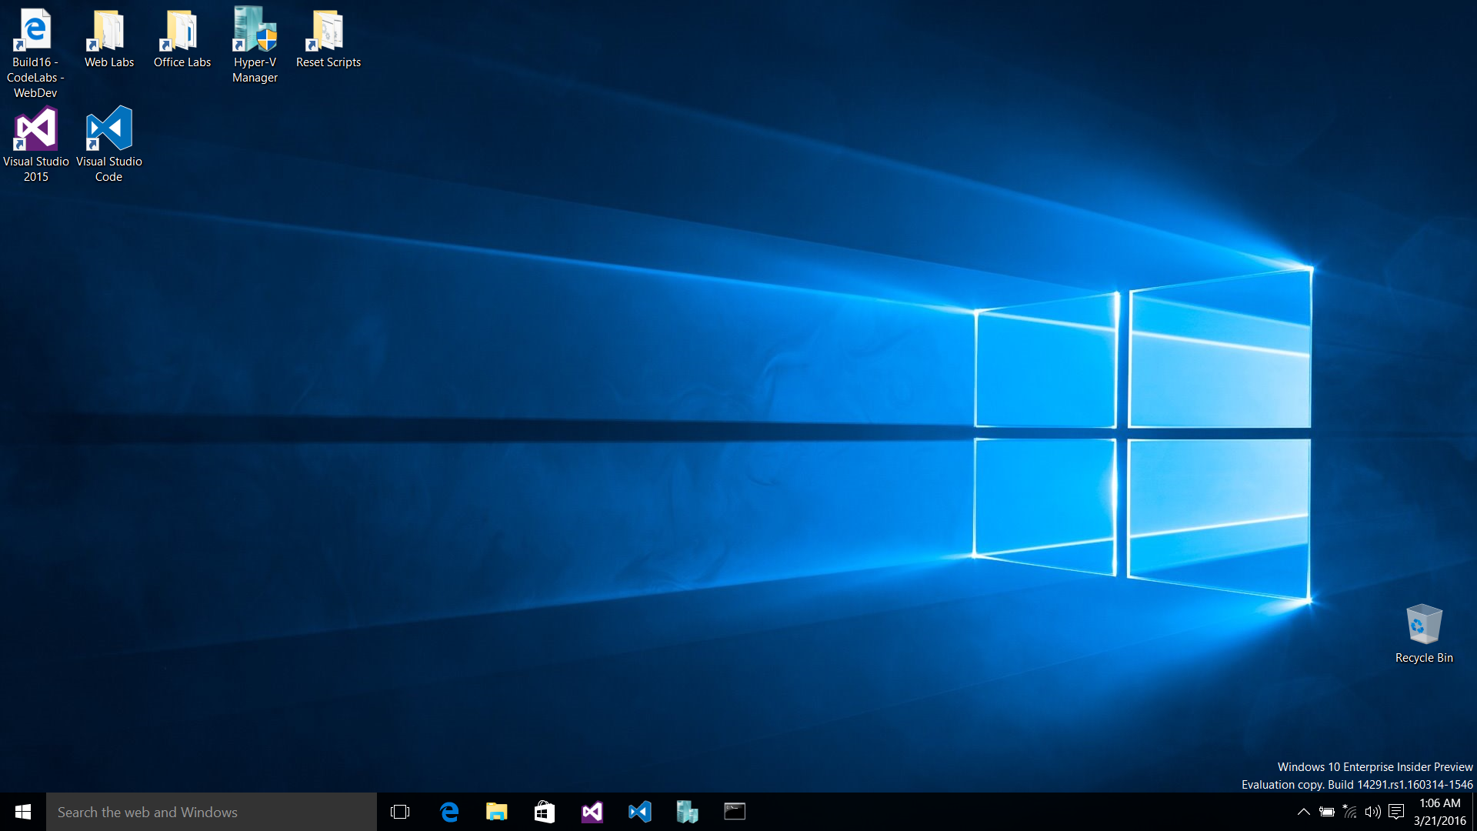

Slide 4
Code Labs: Web Dev track
Module 1 – Intro to ASP.NET Core
Module 2 – ASP.NET Core 1.0 Internals
Module 3 – Deployment and Azure w/ ASP.NET Core
Module 4 – Front End Web Development
Best if you do them in order, but not required

Slide 5
Module 3: Deployment and Azure
Build and Deploy from Visual Studio
Using Entity Framework Migrations
Deploying a Web Site to Staging
Performing Deployment Rollback in Production
Identity with Azure Active Directory

Slide 6
Azure Pass Signup
Your pass gives you $100 to use during Build
Important note: The usernames are missing the “@” portion in the usernames. When logging into Azure with the pass, add
“@build16.onmicrosoft.com”
to the end of the username

Slide 7
Exercise 1: Build & Deploy from Visual Studio
Notes:
Time: TBD

Slide 8
Exercise 2: Entity Framework Migrations
Task 1 - Enabling Migrations
Task 2 - Updating Database Schema Using Migrations
Notes:
Time: TBD

Slide 9
Exercise 3: Deploying a Web Site to Staging
Task 1 - Creating a Microsoft Azure Web App
Task 2 - Deploying to Staging Using Git
Task 3 - Promoting the Web App to Production
Notes:
Time: TBD

Slide 10
Exercise 4: Deployment Rollback
Task 1 - Updating the Application
Task 2 - Redeploying the application
Notes:
Time: TBD

Slide 11
Exercise 5: Azure Active Directory
Task 1 - Create an Azure Active Directory
Task 2 - Adding a new website to an organization
Task 3 - Walk through the Web Application code
Notes:
Time: TBD

Slide 12
Wrap-up
Notes:
Do this in the last 5 minutes of the event

Slide 13
Web Dev Code Lab Related Sessions Wednesday 03/30
11:30 – 12:30
14:00 – 15:00 | Microsoft Edge: What's Next for Microsoft's New Browser and Web Platform Moscone 2001
15:30 – 16:30 | What’s New in Typescript Marriott 9
17:00 – 18:00

Slide 14
Web Dev Code Lab Related Sessions Thursday 03/31
11:30 – 12:30
14:00 – 15:00
15:30 – 16:30 | Web Apps Across Windows Devices Moscone 2005
17:00 – 18:00 | ASP.NET Core 1.0 Marriott 9
18:30 – 19:30

Slide 15
Web Dev Code Lab Related Sessions Friday 04/01
09:00 – 10:00 | Entity Framework Core 1.0 Marriott 8
10:30 – 11:30 | Deploying ASP.NET Core Apps Moscone 2001
12:30 – 13:30 | ASP.NET Core: MVC Deep Dive Marriott 9 | Web Platform: An Inside Look at What’s New for Microsoft EdgeHTML, ChakraCore, F12 Tools, and Microsoft Edge Extensions Moscone 2001
14:00 – 15:00

Slide 16
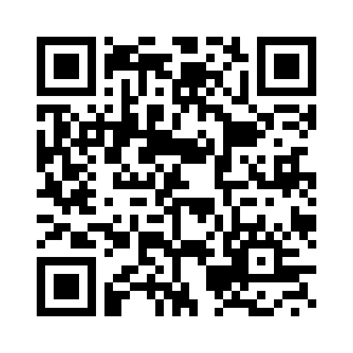
REVIEW THIS SESSION

