Slide 1
Publish, Deploy and Docker with ASP.NET Core
Jeffrey T. Fritz
Program Manager, Microsoft

Slide 2
Agenda
Minimal slides
Lots of hands on coding
Don’t worry if you don’t finish
(code and docs are public)
Ask for help if you’re stuck!

Slide 3
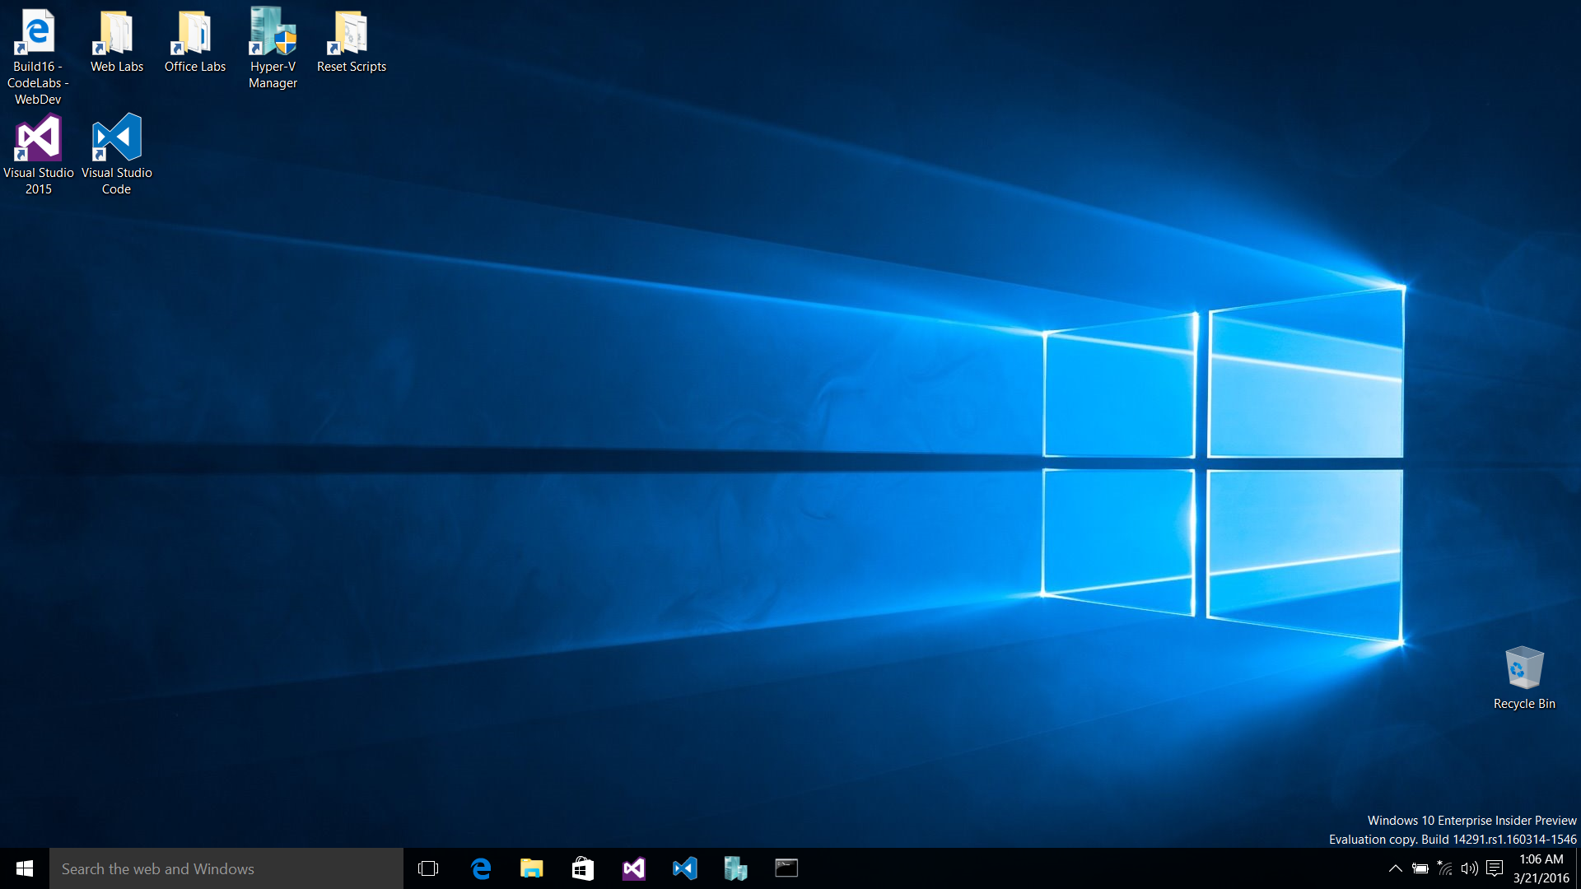

Slide 4
Publish, Deploy, and Docker
Build and Deploy from Visual Studio
Using Entity Framework Migrations
Docker Basics
Deploying to Docker
More complex Docker Deployments

Slide 5
Azure Pass Signup
Your pass gives you $100 to use during Build
Important note: The usernames are missing the “@” portion in the usernames. When logging into Azure with the pass, add
“@build16.onmicrosoft.com”
to the end of the username

Slide 6
Exercise 1: Build & Deploy from Visual Studio
Notes:
Time: TBD

Slide 7
Exercise 2: Entity Framework Migrations
Task 1 - Enabling Migrations
Task 2 - Updating Database Schema Using Migrations
Notes:
Time: TBD

Slide 8
Exercise 3: Deploying a Web Site to Staging
Task 1 - Creating a Microsoft Azure Web App
Task 2 - Deploying to Staging Using Git
Task 3 - Promoting the Web App to Production
Notes:
Time: TBD

Slide 9
Exercise 4: Deployment Rollback
Task 1 - Updating the Application
Task 2 - Redeploying the application
Notes:
Time: TBD

Slide 10
Exercise 5: Azure Active Directory
Task 1 - Create an Azure Active Directory
Task 2 - Adding a new website to an organization
Task 3 - Walk through the Web Application code
Notes:
Time: TBD

Slide 11
Wrap-up
Notes:
Do this in the last 5 minutes of the event

