Slide 1





{{title_maximum_6_words}}
1
2
3
PROBLEM
SOLUTION
ROI
{{problem_statement_maximum_100_characters}}
{{solution_statement _maximum_100_characters}}
{{roi _maximum_100_characters}}
Strategic Alignment
[ ] Develop People
[X] Generate Readiness
[ ] Project Power
[X] Develop Capabilities
CONTACT INFO:
{{name}}
{{phone}}
{{email}}
PROJECT SUMMARY
{{short_summary_maximum_200_characters}}
{{long_summary_maximum_600_characters}}
COMMANDER:
{{commander_name}}

Slide 2
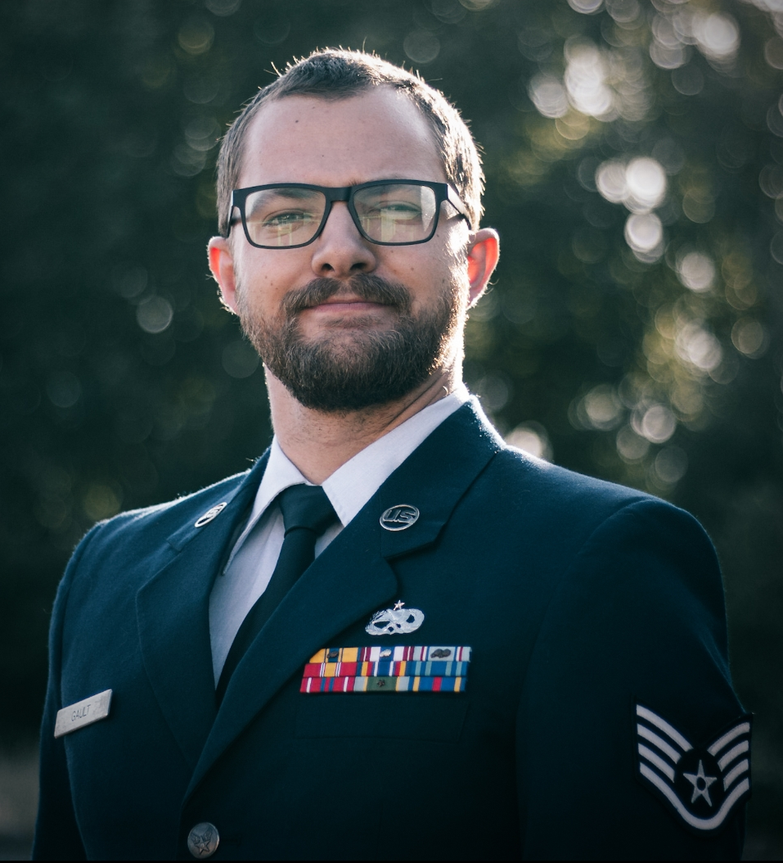
MARKET SUMMARY
“This tool allows students the freedom to make mistakes in a controlled but realistic environment without concern of damaging a $4.2M component” – TSgt David Taylor
{{market_summary_do_research_of_user_ market_maximum_700_characters}}
DAF MARKET
USERS / SQ’S / $’S
GOVT MARKET
USERS / SQ’S / $’S
INDUSTRY MARKET
USERS / SQ’S / $’S
PROJECT FUTURE
{{project_future_where_will_it_go_from_here}}
TRACTION / SUCCESS
Mission Improvement
$’s saved
Time saved
Joint Work
TIMELINE
PROJECT START
While certifying airmen on borescope procedures, I found that while they could identify where and how to enter the engine with the camera, when asked how they would measure damage I was met with blank stares. Over the weekend I created a prototype of the borescope trainer.
EVALUATING
Prototype 2 was shared with 16 MX units worldwide to implement as an in-house training tool.
DEC 24
JUL 25
SEP 24
APR 25
PROTOTYPE
Prototype 1 was used to certify 12 airmen at RAF Mildenhall, showing a real-world application and solution to problem identified
END RESULT
My future objectives include worldwide DoD and civilian parter adoption, optimizing design for rapid implementation, and broadening the range of aircraft mx training tools.
(Replace with picture)
SSgt Justin Gault
100 AMXS

