Slide 1
MyCroft Solutions
Web Application

Slide 2
Apis for Web Application
Api for log in operation(User and Admin)
Api for registration for compnay(Admin)
Api for CRUD Operations(Admin)
Api for Generate Report(Admin)
Api for send Queary to user(Admin)
Api for change password by given the admin (When User first time enter the application he should change the password given by the admin))
API for send data to Cloud repository(User)

Slide 3
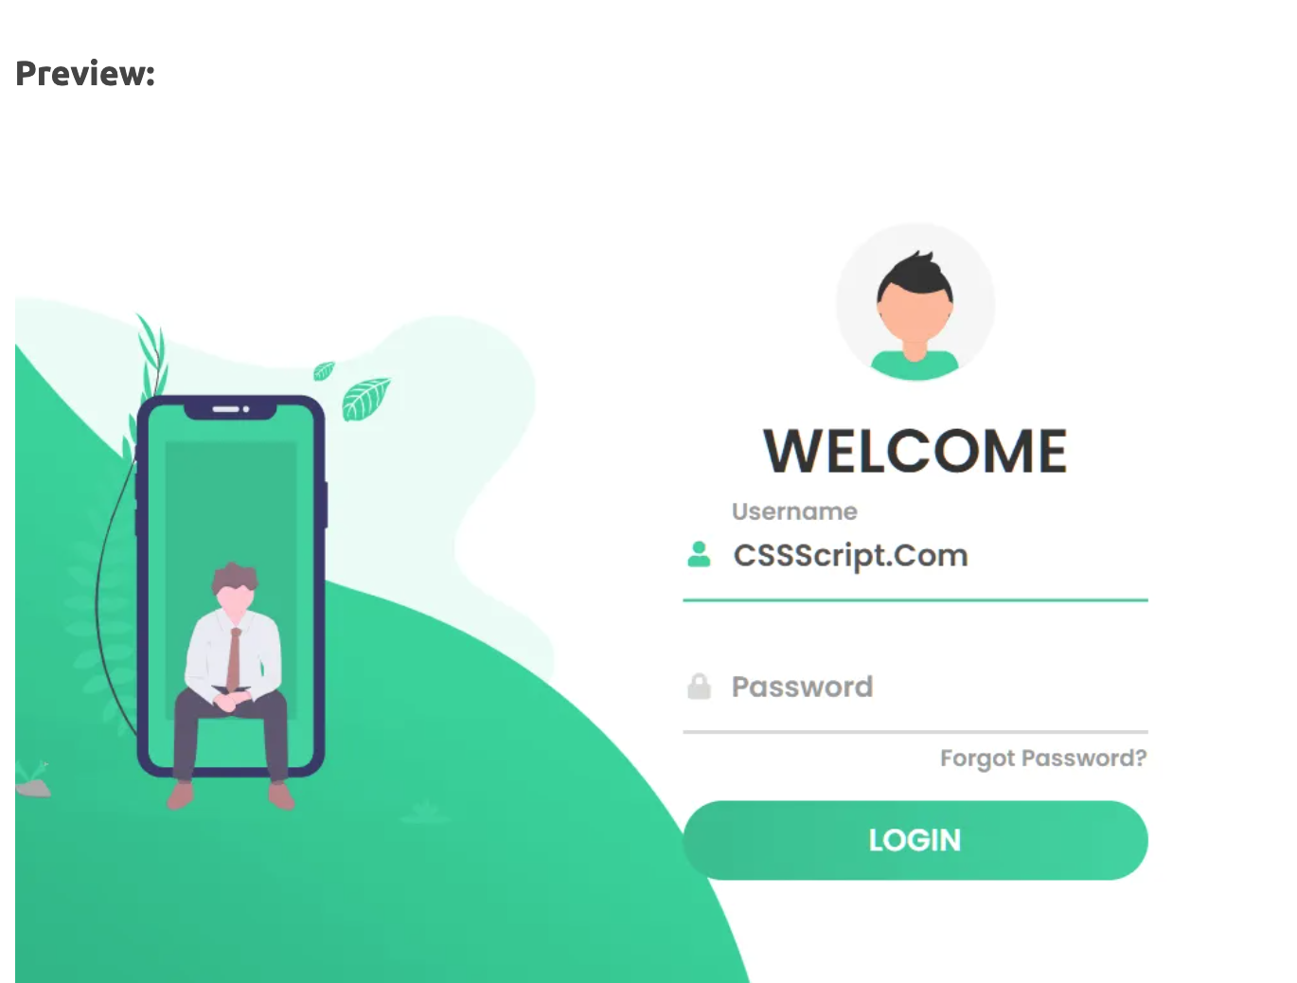
Login Page

Slide 4
Registration Page
Username
Password
Email
Gender
Contact Number
Organization name
Group id (auto)

Slide 5
Admin Page
Can do CRUD operation on the user and also send them their credential
Can Send query to the cloud repository to get data
Can can create report

Slide 6
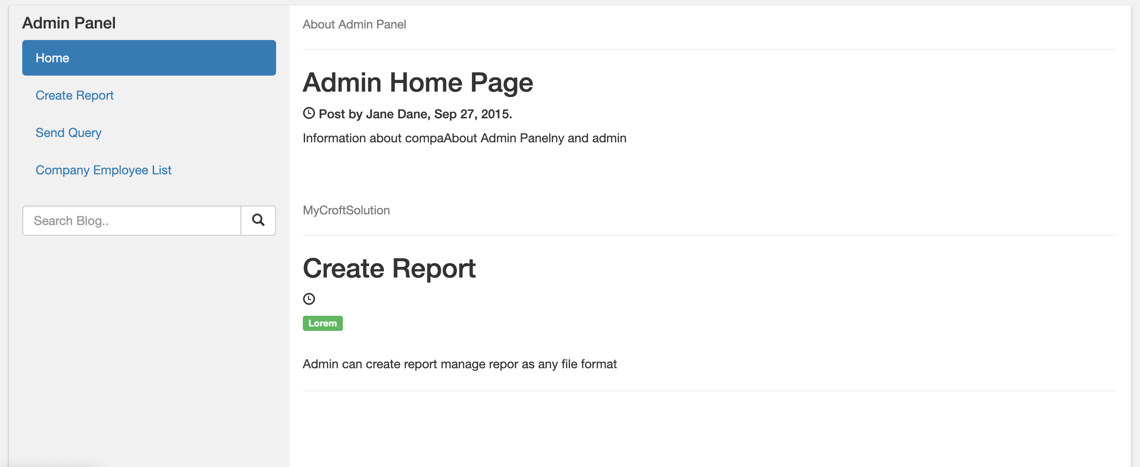
Admin Panel

Slide 7
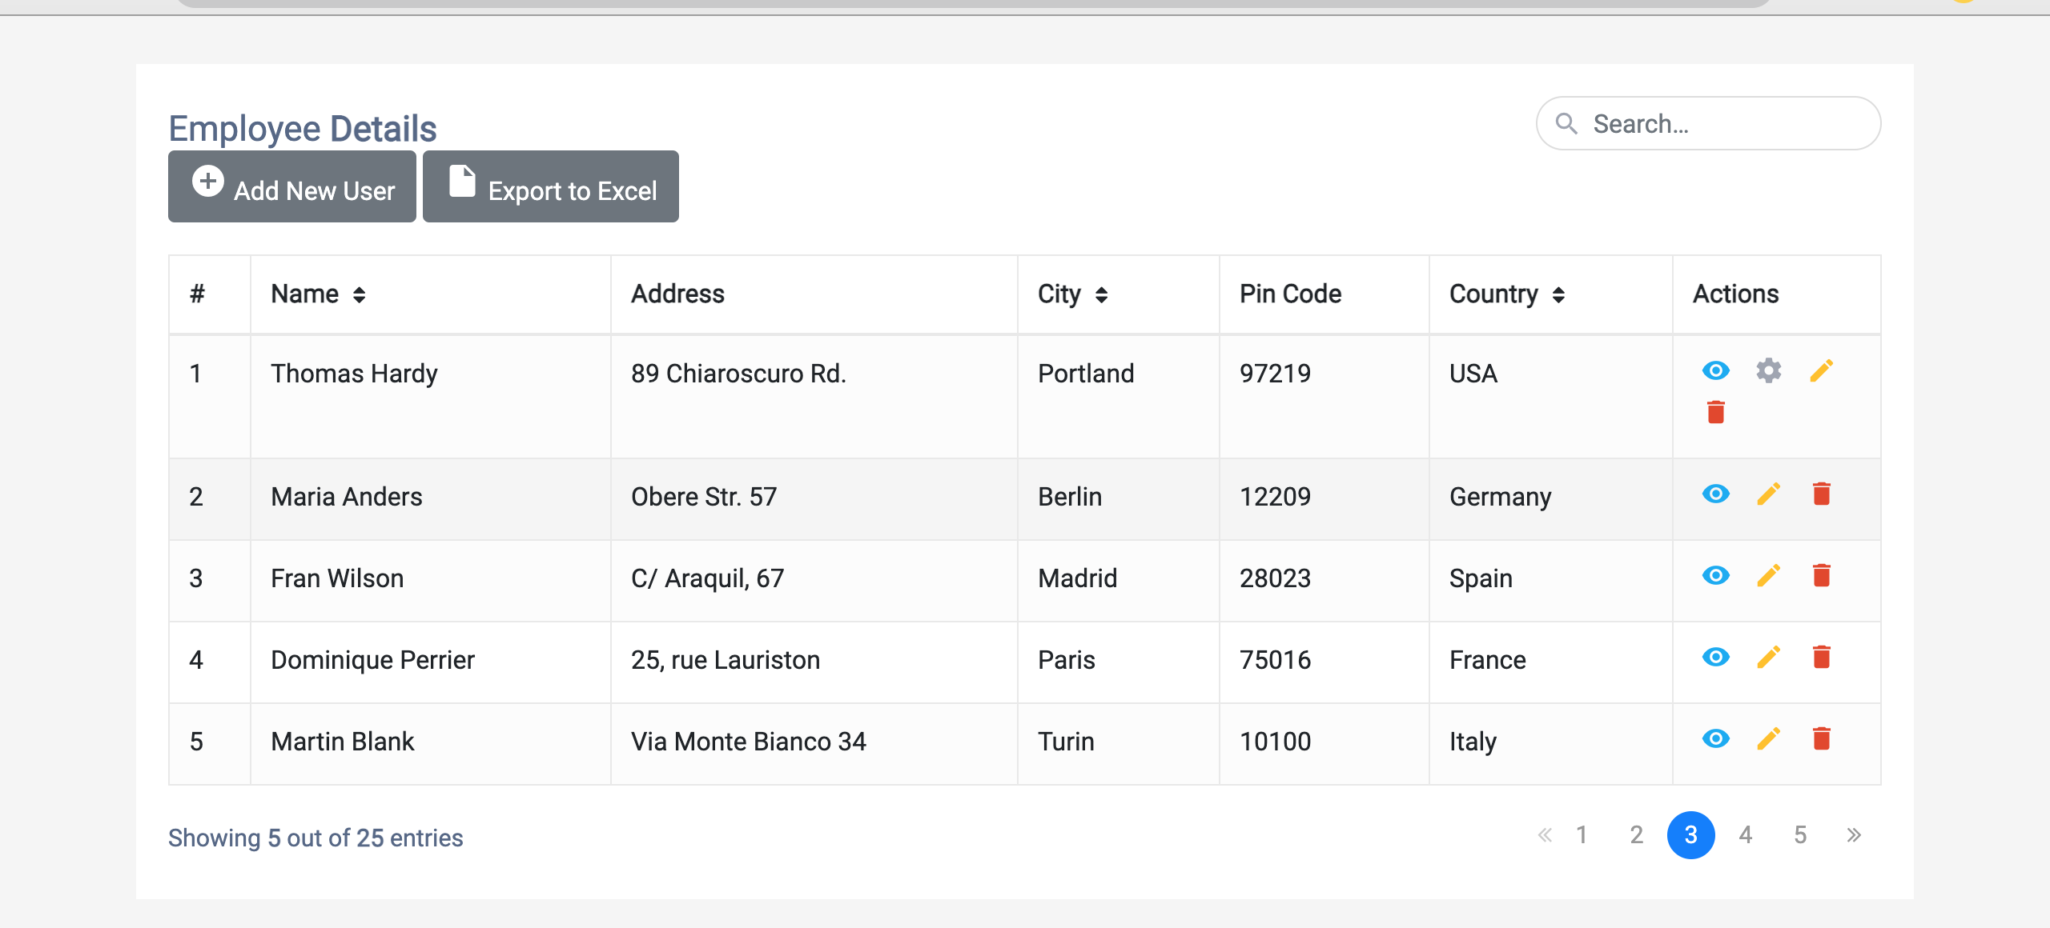
Company Employee list

Slide 8
User Page
When user login first time he should renew password given by admin
The user gets a link to download a file that contains the application and his credential

Slide 9
User Desktop Application
The application scan the user desktop and create a report
Functionality for deploying report of scan file to cloud repository(Manually)
Create a time schedule(Ex: every 6 hours or when the user connect internet) automatically deploy the report of scan file to the cloud repository

Slide 10
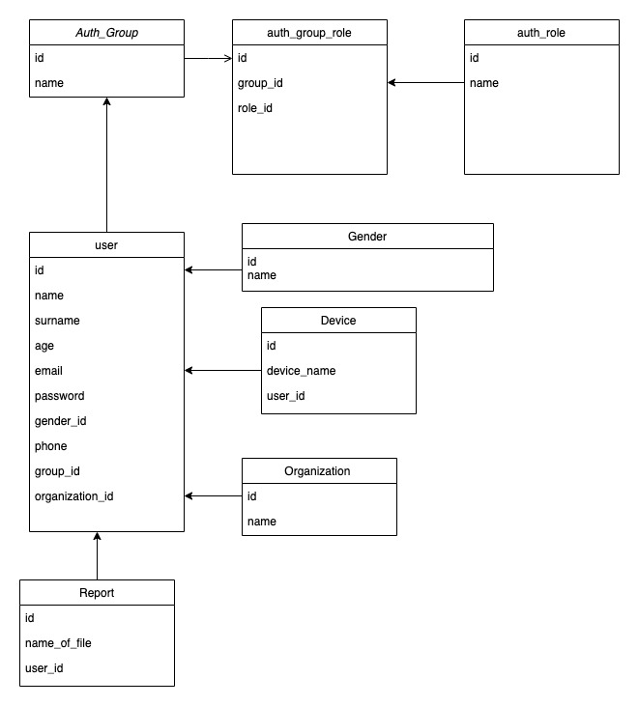
Database Shcema

