Slide 1
TenderTripwire
A tender changes.
The review changes with it.
An evidence-checking agent for small suppliers
Priyanshu Maheshwari
BHARAT AGENTIC 2026
01
Notes:
TenderTripwire checks a synthetic tender and supplier evidence, prepares a review packet after human approval, and withdraws stale conclusions when an amendment changes a requirement. All demonstration documents are fictional. No actual procurement submission or certification verification. Created fresh for this hackathon with GPT/Astra development assistance, Node.js and Qwen open-weight inference; see repository acknowledgements.

Slide 2
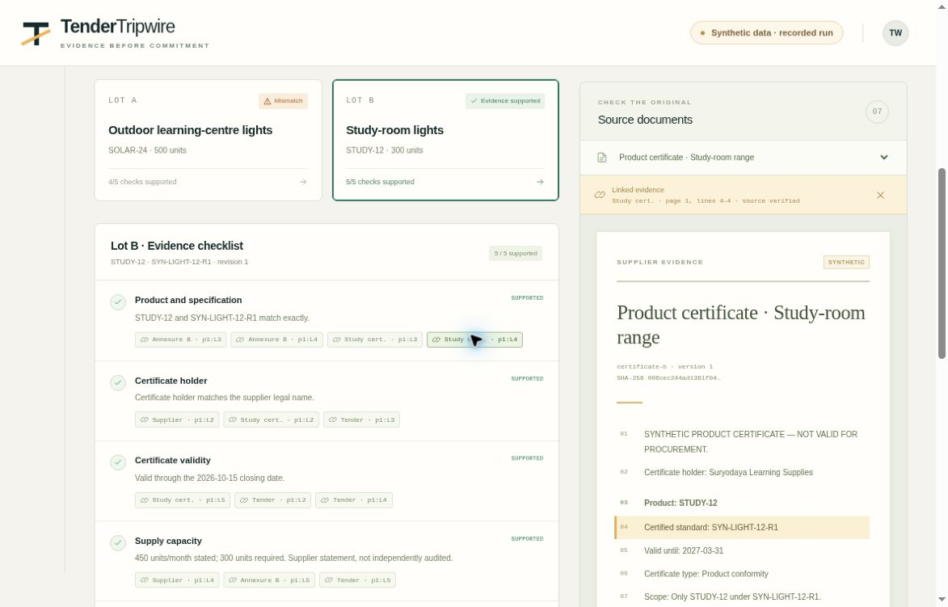
The certificate does not cover Lot A
Required: SOLAR-24
Evidence: SOLAR-18
The agent retrieves source lines, identifies the mismatch and checks the alternative lot.
Lot B has matching evidence in this scenario
02
Notes:
The source files are synthetic. Annexure A asks for SOLAR-24 under SYN-LIGHT-24-R2; the supplier certificate covers SOLAR-18 under SYN-LIGHT-18-R1. The baseline includes matching STUDY-12 evidence for Lot B. This capture presents a replay of a recorded genuine local model run; it is not fresh inference in the hosted viewer. Actual model-generated plan and tool events are preserved in the repository.

Slide 3
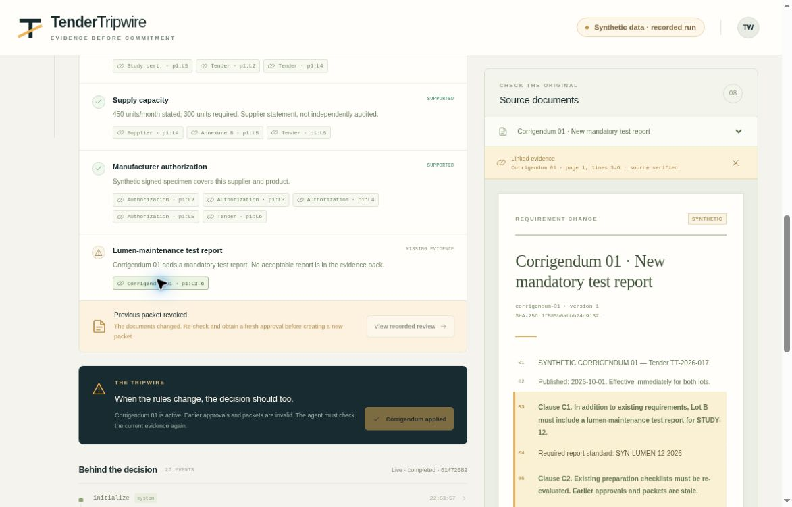
A new requirement revokes the old packet
New document
Lot B now needs a lumen-maintenance test report
The report is missing. Approval expires and the previous ZIP can no longer be downloaded.
03
Notes:
A human adds the synthetic corrigendum; this is not automatic discovery from a procurement portal. The system increments the evidence revision, revokes the prior approval and packet, and rechecks the changed requirement. A genuine follow-up model run reaches the missing-evidence outcome. No external tender is submitted and no declaration is invented.

Slide 4
A small model with verifiable safeguards
104
Genuine local inference
Qwen3-1.7B on CPU
No paid API account required
automated checks passed
Citation integrity, stale approvals, repeated requests, ZIP contents and document-injection defenses
Real model completed in 134 seconds inside a 2 CPU, 4 GiB container
Bounded model planning with deterministic validation and human approval
04
Notes:
Source: project automated test output and recorded model-run evidence, final version 2026-10-01 verified prototype. Automated count includes deterministic and explicitly mocked controller tests; it is not a live-model accuracy score. Recorded baseline and amendment runs passed. Final constrained Docker baseline acceptance passed in 134 seconds under enforced 2 CPU, 4 GiB RAM, no network and 280-second deadline. Separate authenticated publication and then anonymous pull both succeeded for the pinned digest. The public replay records the earlier verified run; later code adds explicit required-lot scope and one model repair attempt after a disclosed CI planning omission. Initial smaller-model attempts failed safely; the final implementation uses bounded planning and validated tools. This is a narrow synthetic prototype, not a benchmark for arbitrary real tenders. Qwen3-1.7B license Apache2; llama.cpp MIT. Runtime artifacts hash-verified. No private credentials used.

Slide 5
A focused pilot with small suppliers
First users
What a pilot would measure
Suppliers who prepare repeated bids with a small back-office team
Missed requirements
Time to assemble evidence
Incorrect ready decisions
Proposed business model
Next: broader document formats, real supplier feedback and independently labelled tender cases
Pay per reviewed packet or a monthly subscription
05
Notes:
This is a proposed pilot and revenue hypothesis, not traction, measured savings, market size or validated willingness to pay. Founder Priyanshu Maheshwari studied Business at NTU with Marketing specialization and Entrepreneurship minor; business operations experience informs product framing. Public procurement context: Government of India CPPP bidder instructions emphasize reading requirements and corrigenda, https://eprocure.gov.in/epublish/app?page=HelpForContractors&service=page . Current prototype uses structured synthetic documents and does not provide legal advice, guarantee eligibility, validate certificate authenticity or automate portal submission.

