Slide 1
INDIAN E-COMMERCE CUSTOMER RETENTION
July 28, 2022

Slide 2
Content:
Overview.
Understanding Problem Statement.
Project Objective.
Exploratory Data Analysis.
Data Visualization.
Processing Data Frame.
Model Building.
Model Choosing.
Conclusion.

Slide 3
Overview:
Customer satisfaction has emerged as one of the most important factors that guarantee the success of online store; it has been posited as a key stimulant of purchase, repurchase intentions and customer loyalty. A comprehensive review of the literature, theories and models have been carried out to propose the models for customer activation and customer retention. Five major factors that contributed to the success of an e-commerce store have been identified as service quality, system quality, information quality, trust and net benefit.
The research furthermore investigated the factors that influence the online customers repeat purchase intention. The combination of both utilitarian value and hedonistic values are needed to affect the repeat purchase intention (loyalty) positively. The data is collected from the Indian online shoppers. Results indicate the e-retail success factors, which are very much critical for customer satisfaction.

Slide 4
Understanding the problem
Item 1
Item 2
Item 3
The data is collected from the Indian online shoppers. Results indicate the e-retail success factors, which are very much critical for customer satisfaction.
There are two sheets (one is detailed) and second is encoded in the excel file.
A comprehensive review of the literature, theories and models have been carried out to propose the models for customer activation and customer retention.
Five major factors that contributed to the success of an e-commerce store have been identified as: service quality, system quality, information quality, trust and net benefit.

Slide 5
Project objective:
A). What is Customer Retention
Customer retention means the process of maintaining or keeping customers once you have acquired them. It’s all the activities that a company must do in order to keep their customers around. The goal is to build a long-lasting relationship between the brand and consumers. Once a customer becomes loyal to your brand, not only he will buy more from you than a normal customer but he’ll spread good words about your business, increase your reputation.
B). Why do we need Customer Retention?
Lower Marketing Costs
Repeat Purchases Means Repeat Profits.
Gain Valuable Feedback
Sell At Premium Price.
Word Of Mouth Advertising.

Slide 6
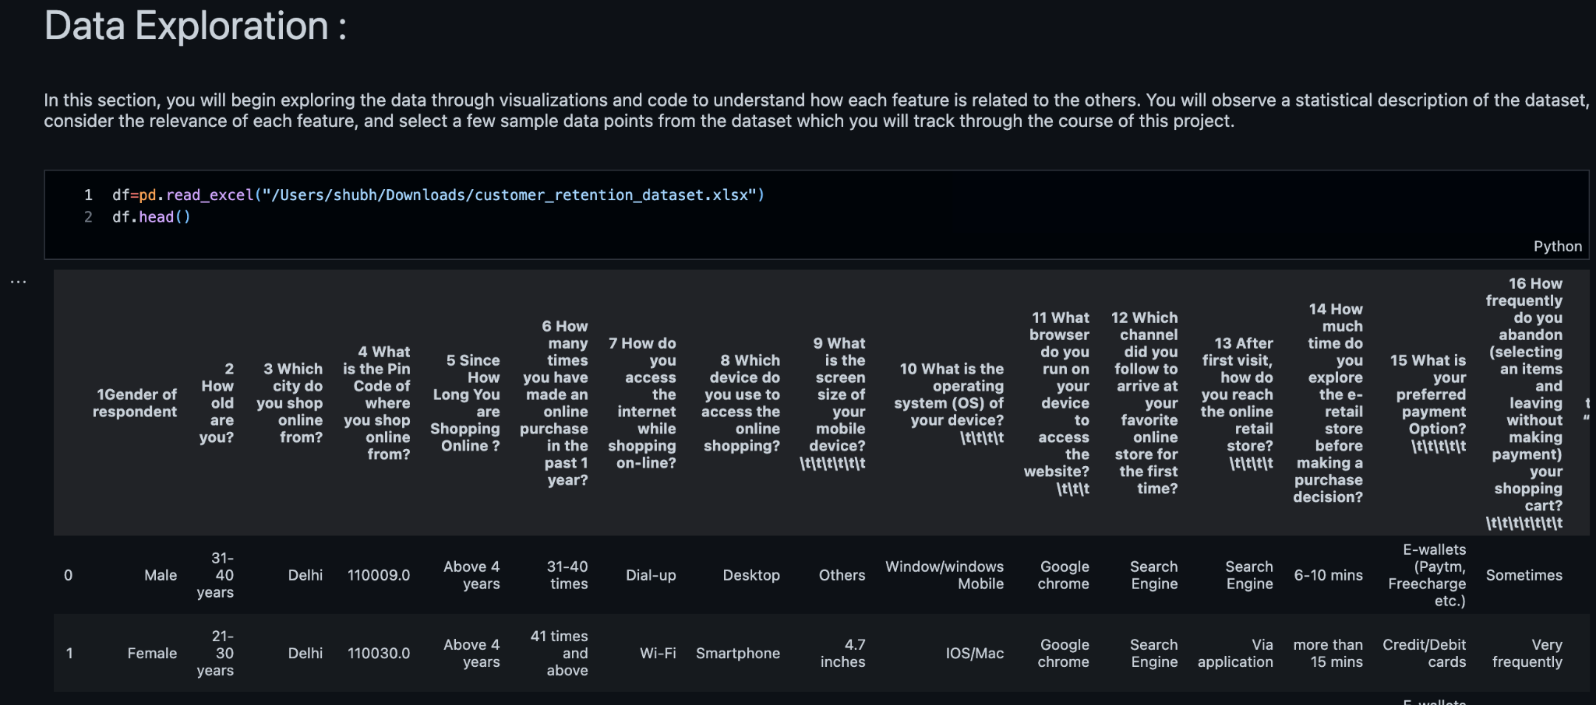
Exploratory Data Analysis
First Import The Imported Important Libraries Which Required For The Analyse The DataSet.
Then Imported The DataSet Which Is In The Excel. With The Help Of The Pandas Library.

Slide 7
After importing dataset did some analysis like checking the shape of dataset, checking for null value presence,checking unique value each feature contains and it’s value counts.
Then while looking into the value counts I found some duplicate entries in the features i.e. two words with same meaning.
With this help of the value count function observed the duplicate values in columns of the dataset.
Also sorted the columns for the univariate analysis and for personal info the some columns distributed.
Exploratory Data Analysis

Slide 8
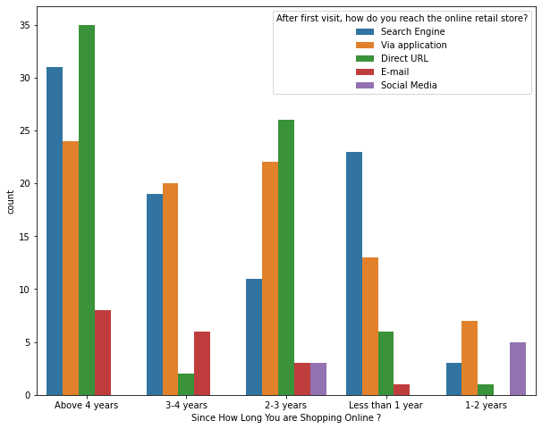
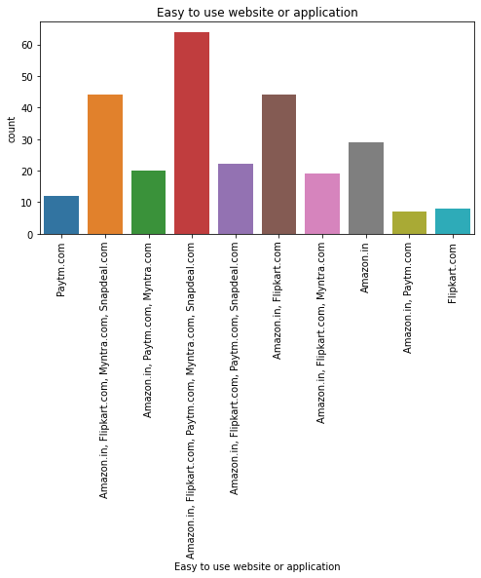
Data Visualization
Since all the features are categorical we can use only categorical, plotting to get better insight.
particularly I have used Count plot for Gender Of Response, Which city do you shop online from, How old are you? Area Of Pincode, Screen Size, Shopping Frequency, Internet Access, Operating System, etc. columns I had done the count plot.

Slide 9
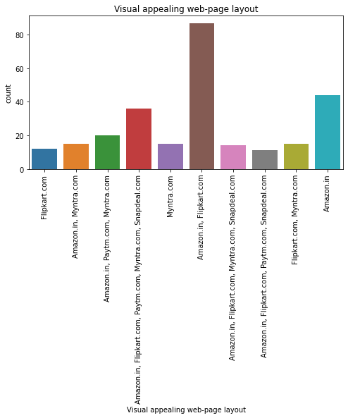
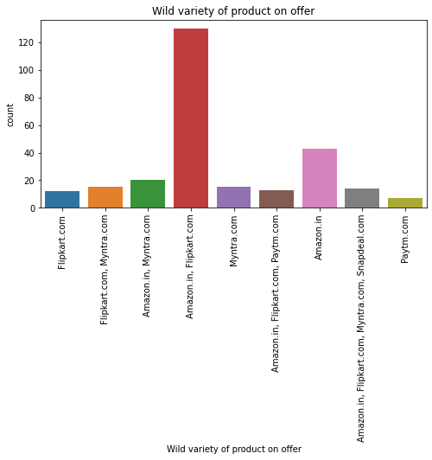
h
g

Slide 10
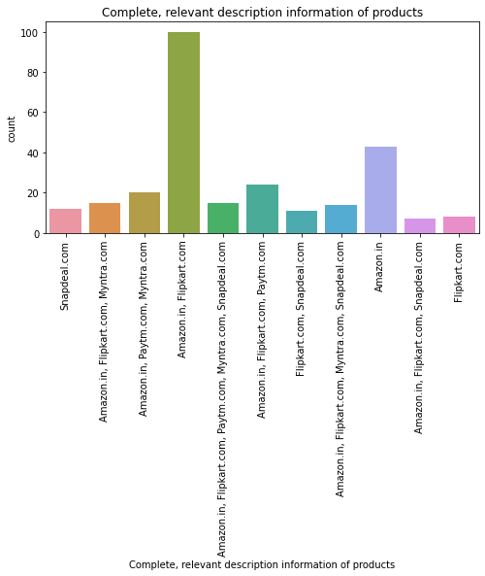
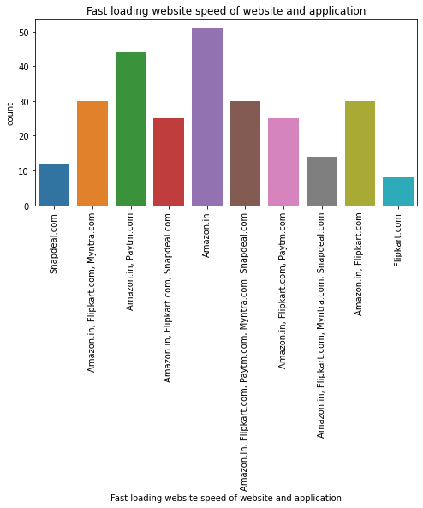
g

Slide 11
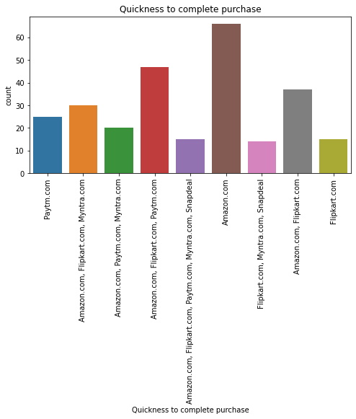
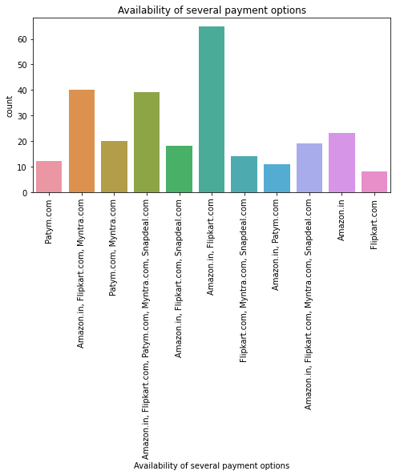
g

Slide 12
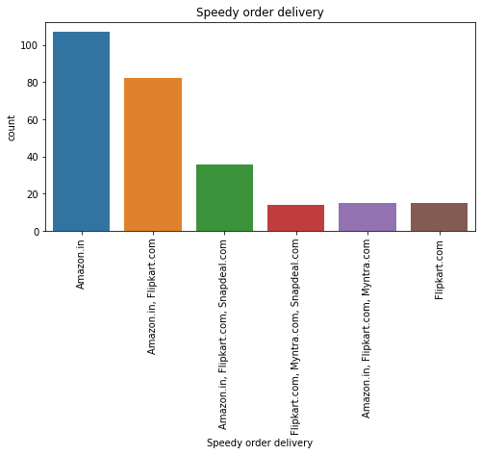
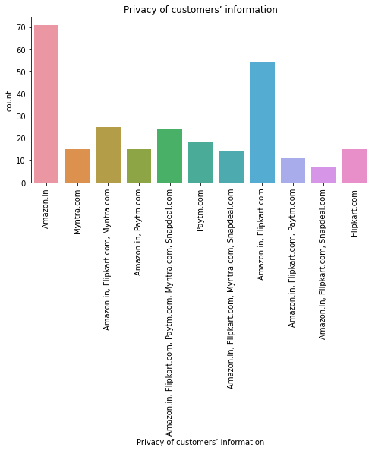
g

Slide 13
The Observation Are :-
1) There is double the number of women than men who have taken this survey.
2) Most of the people are in their 30's followed by 20's, teenagers and senior citizen are the least in number.
3) Most of the people belong from delhi, noida and bangalore, ambiguity can also be seen as noida has two categories (noida and greater noida) which need to be handled.
4) Most of the people shopping online have been shopping from a long time.
5) Majority of people shop online 10 times a year.
6) Almighty can also be seen for range 42 times and above which needs to be handled.

Slide 14
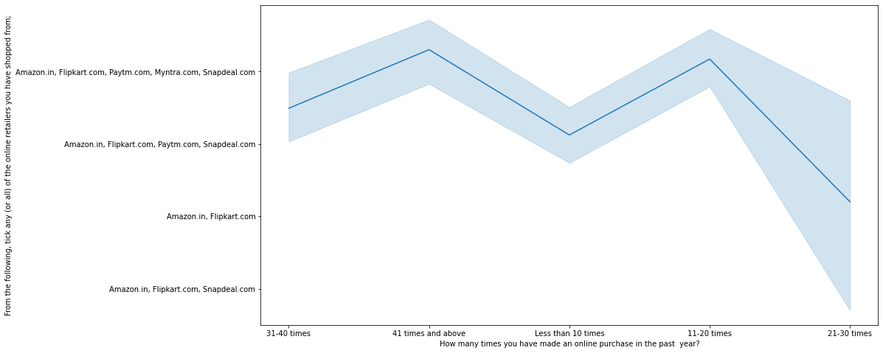
Also Done The analysis with various different factors And Plotted the line plot shown below .
Heavy shoppers who shop more than 41 times a year shop from all the online brands, some of the people who shop for 32-40 and less than 10 times a year seem to exclude myntra. People shop from Amazon and flipkart whatever be the case.

Slide 15
Visualization With Online Retailing :
g

Slide 16
Visualization With Online Retailing Observations :
Highest number of people have been shopping online for above 4 years except for the age group below 20 years and above 50 years.
People who are shopping online for 1-2 years does not include teenagers and older people.
Even though people who are shopping online for more than 3 years do not use the application rather use search engine and direct urls in large number which indicates that online brands should update all their platforms rather than just application.

Slide 17
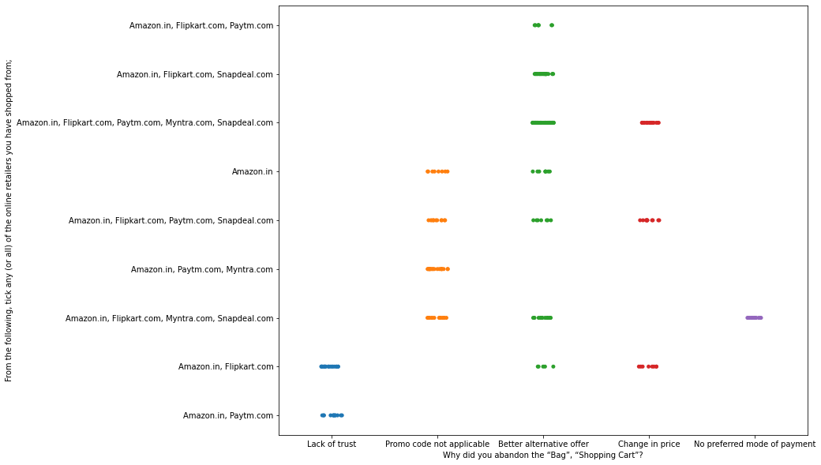
Made the Plots for the, Why did you abandon the Bag, Shopping Cart? Column For the Better Visualization.
g

Slide 18
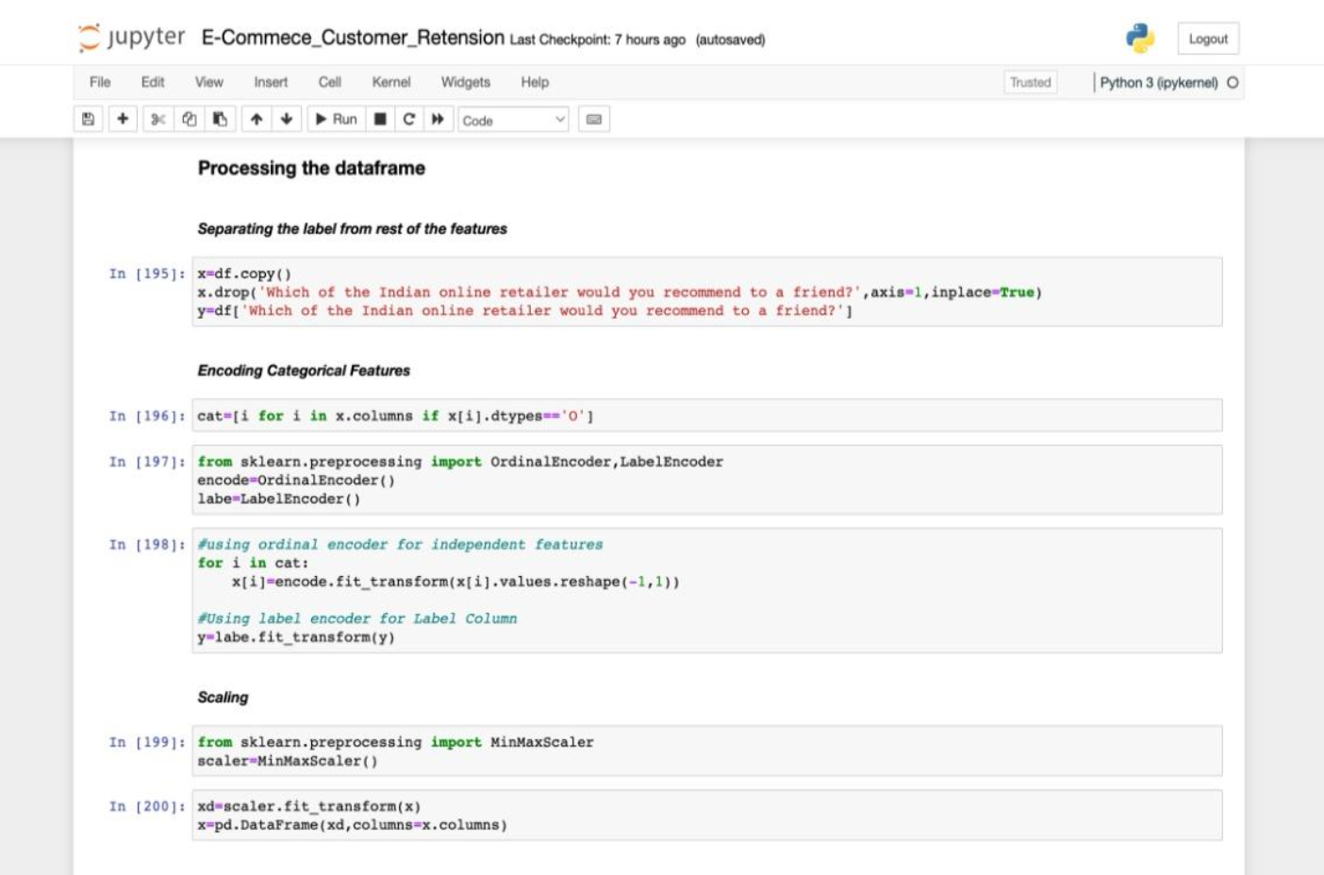
Processing the data frame :
In this I had separated the dataframe in new variables like Feature & Target variables.
Then Used the Encoding Techniques of Ordinal Encoder & Label Encoder.
2. Then The Data was Scale By using the MinMaxScalar Technique for better scaling of the data.

Slide 19
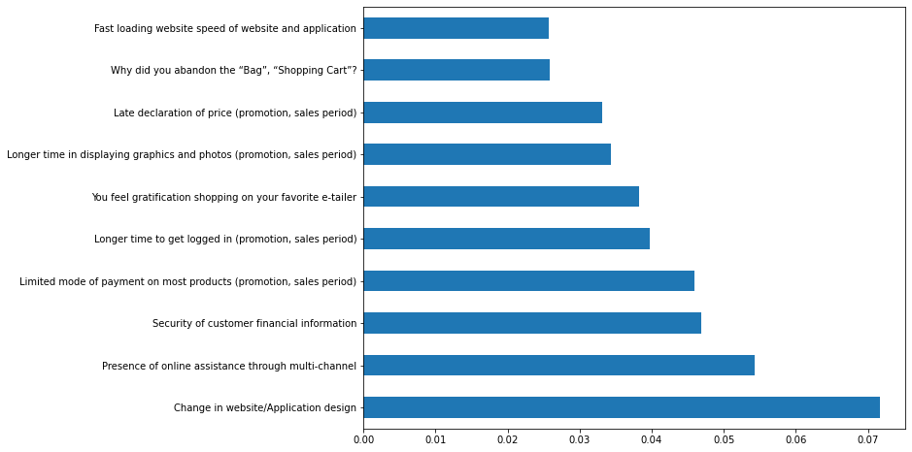
Model Building :

Slide 20
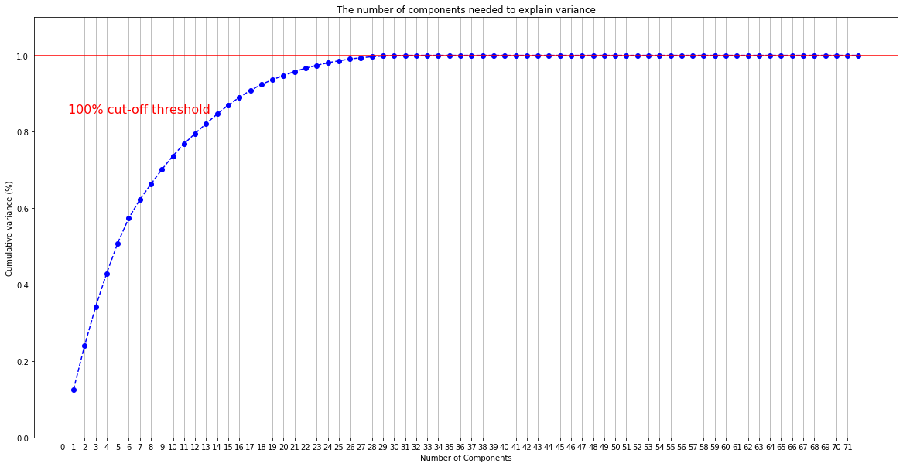
PCA :

Slide 21
Observations For PCA :
In this section you will use principal component analysis (PCA) to draw conclusions about the underlying structure of the wholesale customer data.
Since using PCA on a dataset calculates the dimensions which best maximize variance, we will find which compound combinations of features best describe customers.
We can clearly see that with 29 features all the information can be retained.

Slide 22
Model Choosing :
With the Random Forest method we get the precision value and recall value upto 100%.
With the Xgboost method we get the precision value and recall value upto 100%.
Both the models give accurate and equal results so we choose xgboost as or final model because of its quick speed.
3) Saving The Model With The Pickle.

Slide 23
Conclusion
The results of this study suggest following outputs which might be useful for E-commerce websites to extend their business :-
The cost of the product, there liability of the E-commerce company and there turn policies all play an equally important role in deciding the buying behaviour of online customers. The cost is an important factor as it was the basic criteria used by online retailers to attract customers. The reliability of the E-commerce company is also important, as it is even required in offline retail. It is important because customers are paying online, so they need to be sure of security of the online transaction. The return policies are important because in online retail customer does not get to feel the product. Thus, he wants to be sure that it will be possible to return the product if he does not like it in real. Whereas, the logistics factor, which included Cash on delivery option, One day delivery and the quality of packaging plays a secondary role in this process though these are Must-be-quality. This is so because these all does not interfere with the real product and people believe that this is the basic value that E-commerce websites provide.

Slide 24
G
All the websites were not equally preferred by online customers. Amazon was the most preferred followed by Flipkart. This can be explained easily by previous result that we got. These two companies are most trusted in the industry and hence, have a huge reliability. Also, the sellers listed on these websites are generally from Tier 1 cities as compared to Snapdeal and PayTM which have more sellers from tier 2 and 3 cities. Also, these websites have the most lenient return policies as compared to others and also the time required to process a return is low for these.
g

Slide 25
THANK YOU
SUBMITTED BY:
SHUBHAM J. CHOUGULE

