Slide 1

Discovering and creating exoplanet to learn about this unimaginable world of exoplanets
let's begin

Slide 2




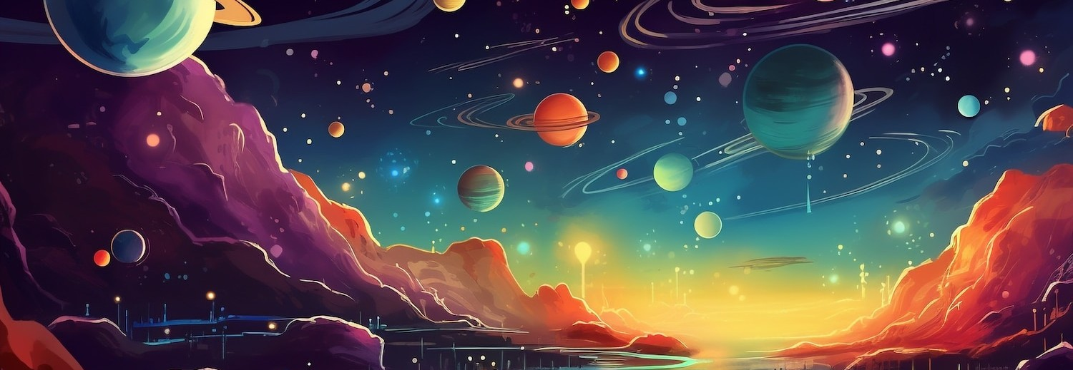
Welcome to the exciting world of exoplanets! In this guide, we will explore how to create and discover your own unique worlds beyond our solar system. Get ready to unleash your imagination and learn about the science behind these distant planets.

Slide 3
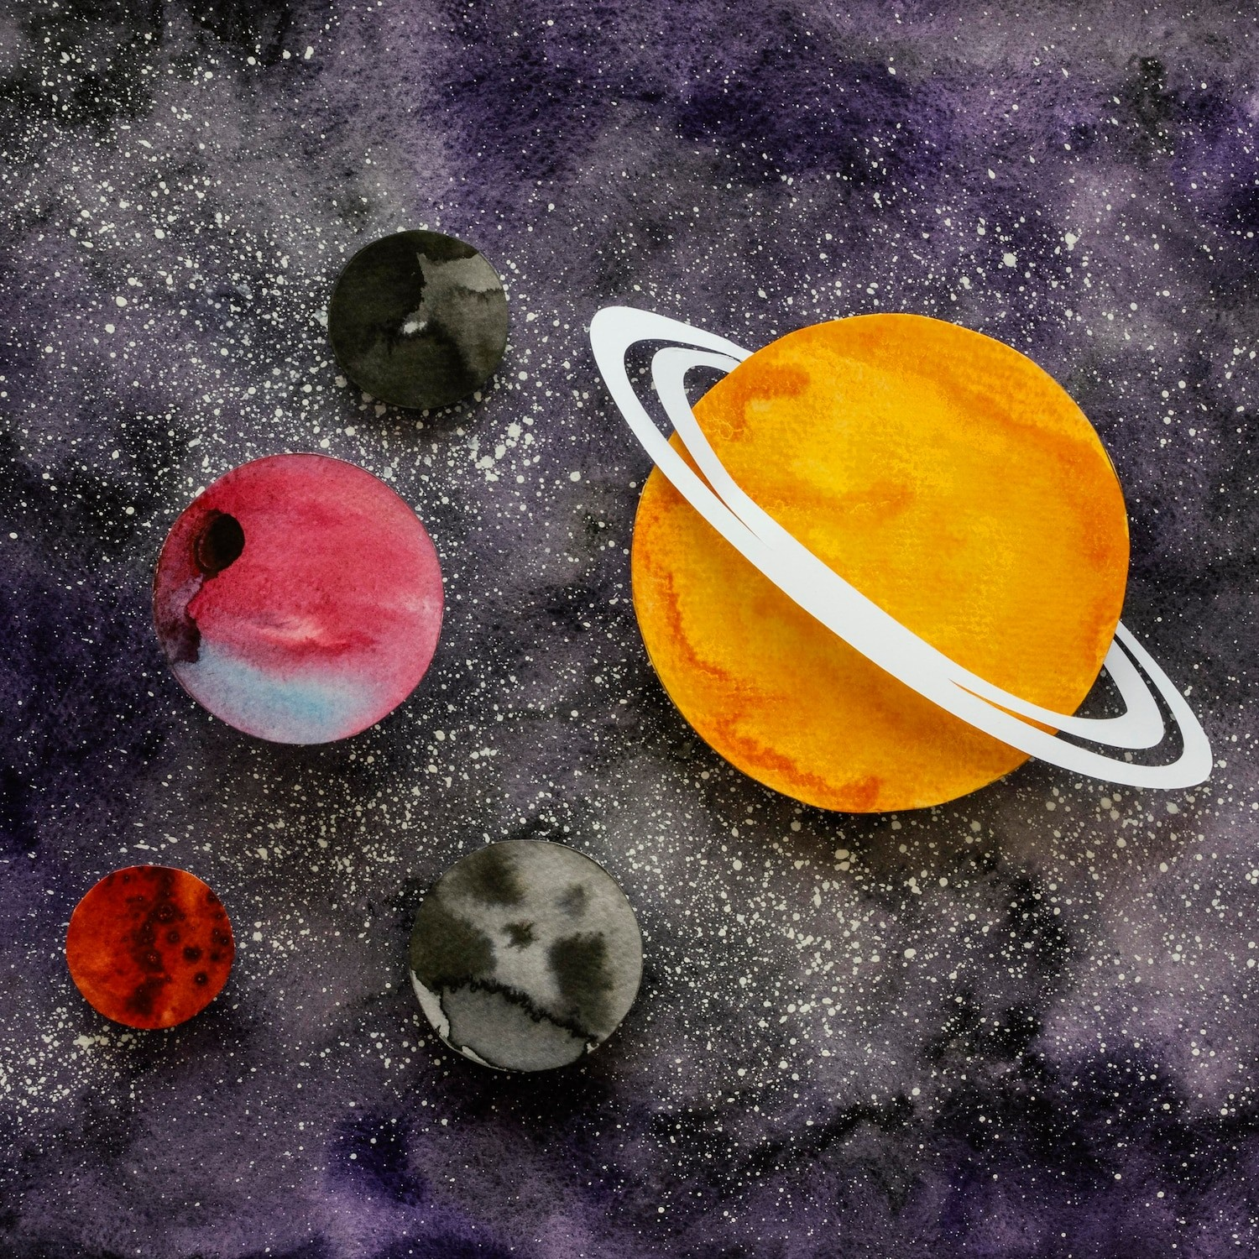




What are Exoplanets?
Exoplanets are planets that orbit stars outside our solar system. They come in many shapes and sizes, from gas giants to rocky worlds. Understanding their characteristics helps us imagine what life might be like on these distant planets.

Slide 4
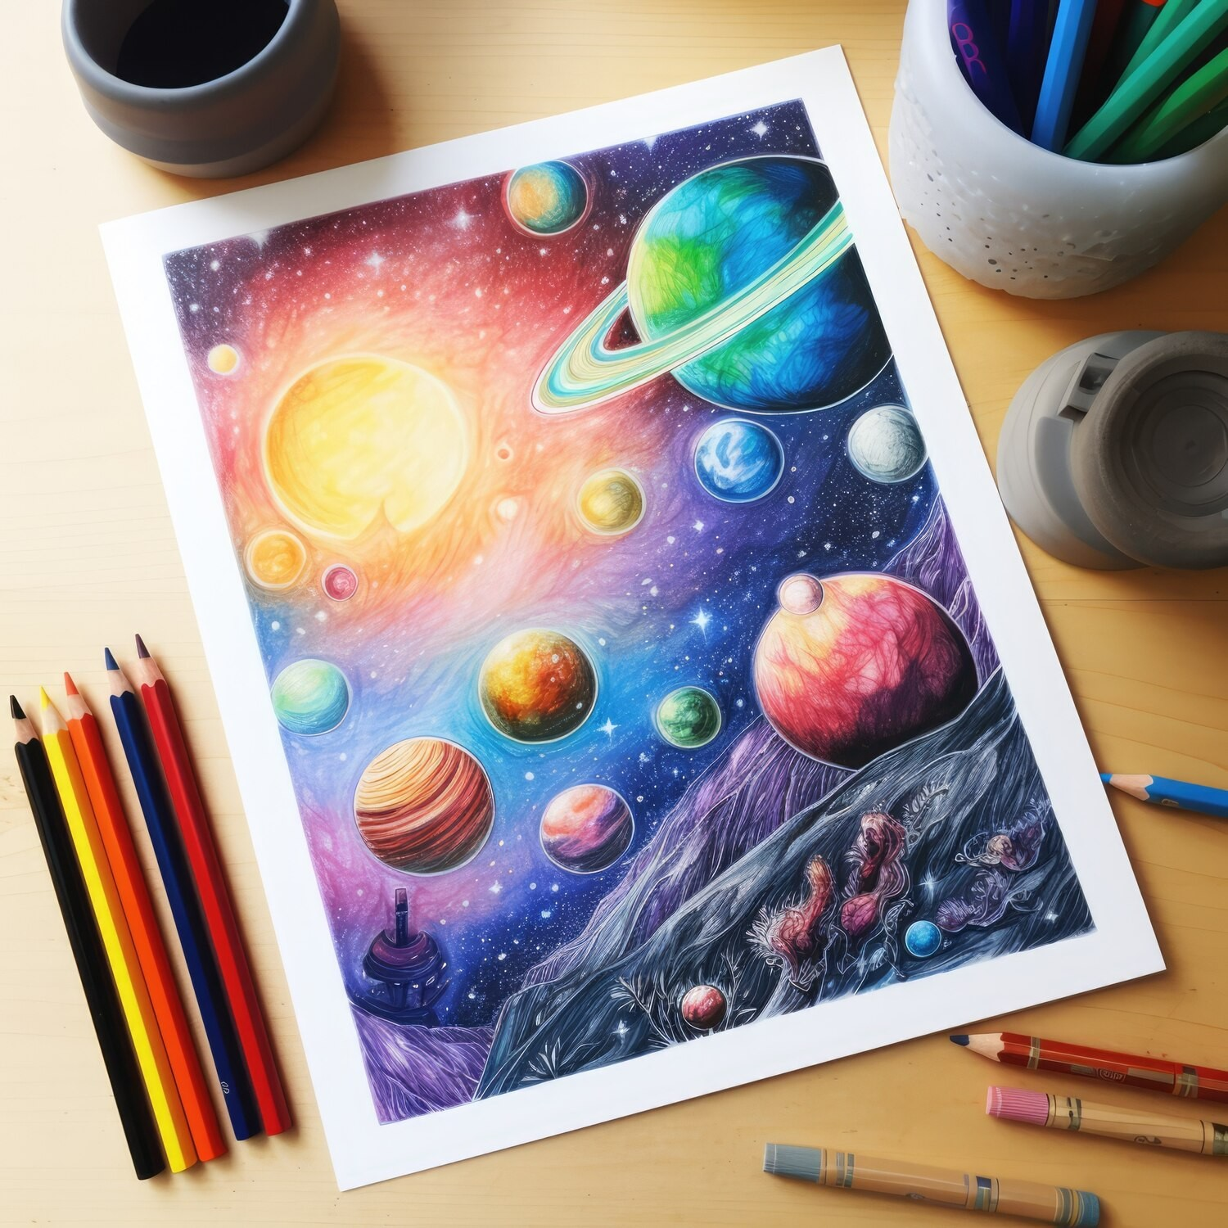



How to Create Your Exoplanet
Creating your own exoplanet is a fun exercise in imagination! Think about its size, atmosphere, and potential for life. Will it have oceans, mountains, or unique weather patterns? Use your creativity to design a world that is truly one-of-a-kind.
our web site will help you ﬁnd the closest resemblance of your exoplanet by matching your exoplanet's qualities with the real one

Slide 5




Finding Exoplanets
Scientists use tools like telescopes and satellites to discover exoplanets. They look for transits (when a planet passes in front of a star) and measure the light changes.
You can pretend to be a scientist and imagine how you would search for new worlds!

Slide 6



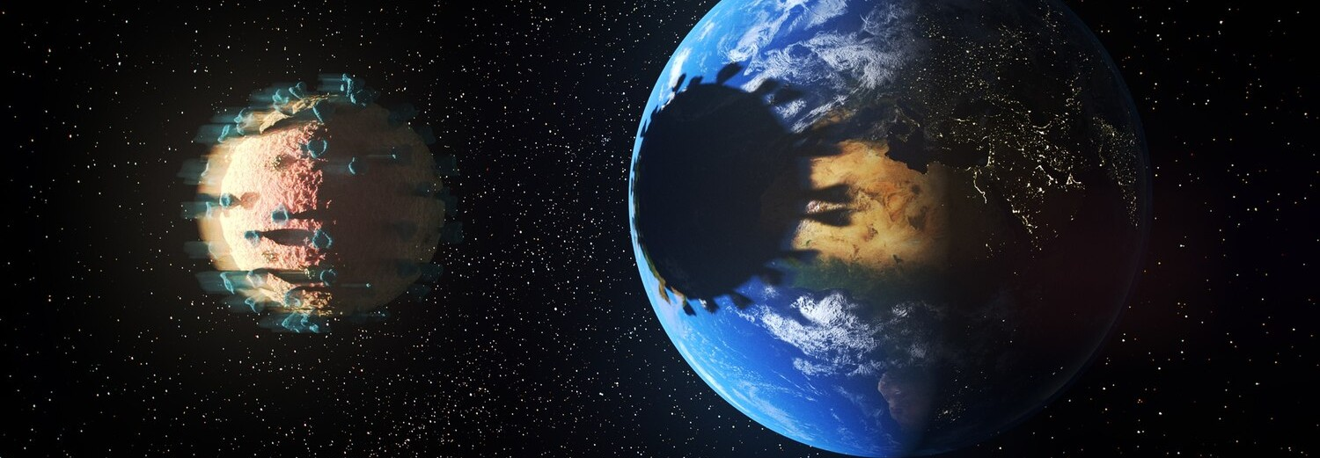
Studying exoplanets helps us understand the universe and our own planet better. It opens up possibilities for discovering alien life and understanding how planets form. Every new discovery brings us closer to answering big questions about our place in the cosmos.

Slide 7
LET’S UNDERSTAND THIS BY SEEING A DEMO

Slide 8
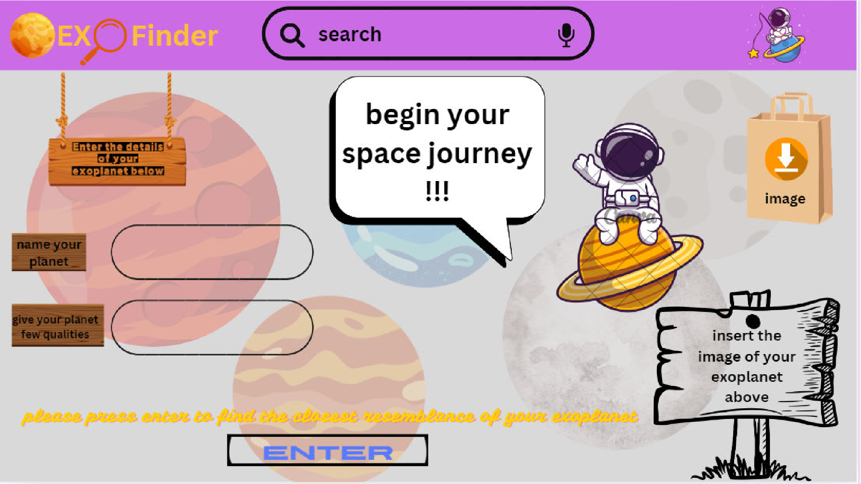

Slide 9




Conclusion: Your Journey Awaits
Now that you know about exoplanets and how to create your own, the adventure begins! Use your imagination and curiosity to explore the universe. Remember, every great discovery starts with a single idea.
What will you create?

Slide 10
Thanks You

