Slide 1


INTRUSION DETECTION USING ENSEMBLE MACHINE LEARNING
BATCH MEMBERS:
GUIDED BY:
Baala Kumaran S (950620104014)
Chidambaram S (950620104017)
Dhanush Bharathi M (950620104018)
Gnana Sutharstan J (950620104022)
Mr. S. Eswaramoorthy, AP/CSE

Slide 2
ABSTRACT
To design a generic detection mechanism to detect attacks such as DoS, Probe, R2L and U2R.
To reduce the training time by eliminating the unwanted features.
To built the ensemble model to give high accuracy score.
Adaptability to evolving threats and reduced false positive rates are key advantages.

Slide 3
LITERATURE SURVEY - 1
Thomas G . Dietterich (2000) introduced a Ensemble methods in machine learning.
Merits:
Improve predictive performance and generalization.
comprehensive overview and analysis of ensemble methods
Demerits:
Longer training times and increased resource utilization.

Slide 4
LITERATURE SURVEY - 2
S. Chebrolu, A. Abraham, and J. P. Thomas (2005) performed Feature deduction and ensemble design of intrusion detection systems.
Merits:
Propose data mining approaches for intrusion detection systems.
Demerits:
The proposed feature selection algorithm is computationally expensive.
Not a representative of real-world scenarios.

Slide 5
LITERATURE SURVEY - 3
C.-F. Tsai, Y.-F. Hsu, C.-Y. Lin, and W.-Y. Lin, (2009) performed a Intrusion detection by machine learning: A review.
Merits:
Provides a comprehensive overview of the literature on intrusion detection by machine learning.
Demerits:
Doesn’t provide any practical considerations.
The review focuses only on technical aspects.

Slide 6
LITERATURE SURVEY - 4
F. Amiri, M. M. R. Yousefi, C. Lucas, A. Shakery, and N. Yazdani (2011) performed Mutual information-based feature selection for intrusion detection Systems.
Merits:
Propose a novel approach for IDS which is based on the use of mutual information (MI).
Demerits:
Primarily focus on measuring the statistical dependence.
Missed out capturing complex interactions and dependencies between multiple features.

Slide 7
LITERATURE SURVEY - 5
I. Sharafaldin, A. H. Lashkari, and A. A. Ghorbani (2018) performed a Toward generating a new intrusion detection dataset and intrusion traffic characterization.
Merits:
Intrusion traffic characterization can help to identify new trends and patterns in attack traffic.
Focuses on the generation of a new dataset for intrusion detection.
Demerits:
Intrusion traffic characterization can be complex and challenging.

Slide 8
LITERATURE SURVEY - 6
Saikat Das, Sajal Saha, Annita Tahsin Priyoti, Etee Kawna Roy, Frederick T. Sheldon (2022) performed Network Intrusion Detection and Comparative Analysis Using Ensemble Machine Learning and Feature Selection
Merits:
Provides a detailed exploration of the application of ensemble machine learning.
Feature selection techniques for network intrusion detection.
Demerits:
They often rely on known patterns and signatures.
Ensemble complexity.

Slide 9
EXISTING MODEL
Vinayakumar etal.'s hybrid DNN framework for real-time cyberattack detection represents an existing model (from base paper).
This framework utilizes a combination of shallow and deep networks to monitor network traffic and host-level events, providing scalability and effectiveness in detecting cyberattacks in real-time.
It enables prompt identification of malicious activities by continuously monitoring network traffic and host-level events, leveraging extensive training data for accurate detection.
Evaluated using benchmark datasets, the framework demonstrates high accuracy and efficiency in detecting cyberattacks, making it a valuable asset for cybersecurity applications.

Slide 10
PROPOSED MODEL
The proposed model from the provided text is the Supervised Ensemble ML framework (SupEnML) integrated with Ensemble Feature Selection (EnFS).
This model combines multiple ML classifiers from various families and incorporates ensemble feature selection techniques to optimize feature sets for network intrusion detection.
This model aims to enhance accuracy and efficiency in detecting network anomalies, particularly Distributed Denial of Service (DDoS) attacks.

Slide 11
MODULES
Data Collection
Data Preprocessing
Labeling
Ensemble Feature Selection
a) Anova
b) Chi-squared
c) LASSO
d) Recursive Feature Elimination
5. Apply Machine Learning Algorithms (Models Used)
a) Random Forest
b) Logistic regression (LR)
c) Naïve Bayes (NB)
d) SVM
e) KNN
6. Apply Ensemble method (Majority Voting Classifier)

Slide 12
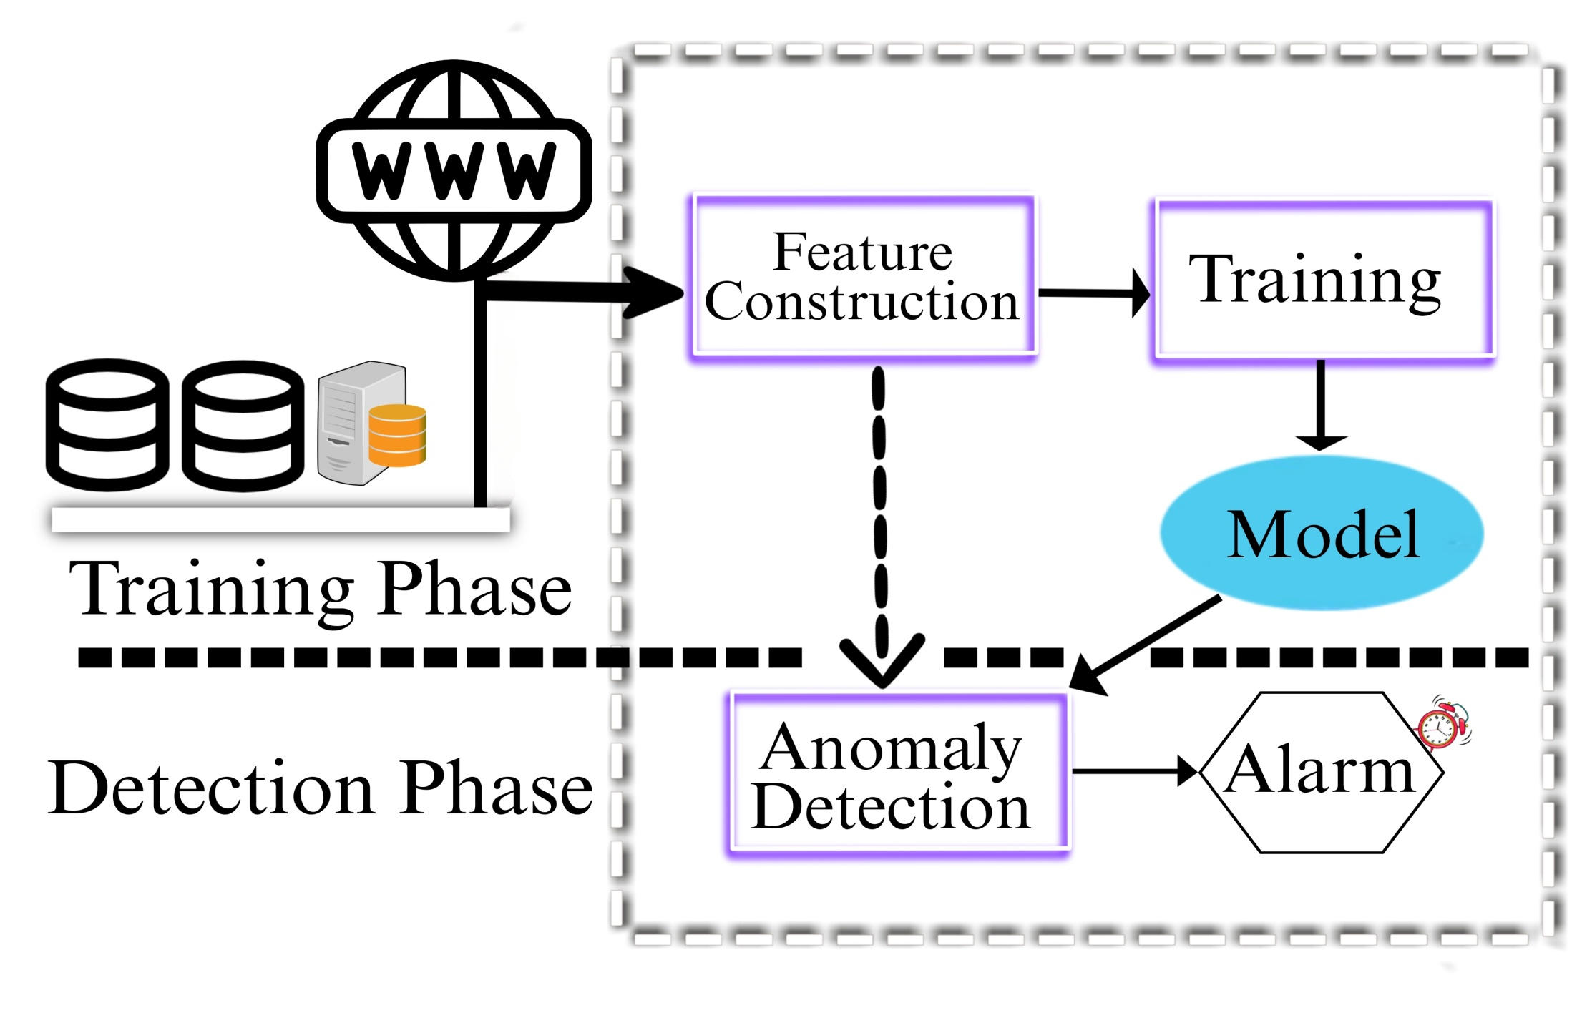
BLOCK DIAGRAM

Slide 13
FLOW DIAGRAM
DATA COLLECTION
PREPROCESSING
ENSEMBLE MODEL SELECTION
TRAINING
DEPLOYMENT
MODEL EVALUATION AND MODEL TESTING
TESTING
ENSEMBLE CONSTRUCTION
FEEDBACK LOOP

Slide 14
REFERENCE
Das, S., Saha, S., Priyoti, A. T., Roy, E. K., Sheldon, F. T., Haque, A., & Shiva, S. (2021). “Network intrusion detection and comparative analysis using ensemble machine learning and feature selection.” IEEE Transactions on Network and Service Management.
Dietterich, T. G. (2000, June). “Ensemble methods in machine learning.” In International workshop on multiple classifier systems (pp. 1-15). Berlin, Heidelberg: Springer Berlin Heidelberg.
Sharafaldin, I., Lashkari, A. H., & Ghorbani, A. A. (2018). “Toward generating a new intrusion detection dataset and intrusion traffic characterization.” ICISSp, 1, 108-116.
4.Tsai, C. F., Hsu, Y. F., Lin, C. Y., & Lin, W. Y. (2009). “Intrusion detection by machine learning: A review.” expert systems with applications, 36(10), 11994-12000.
5.Chebrolu, S., Abraham, A., & Thomas, J. P. (2005). “Feature deduction and ensemble design of intrusion detection systems.” Computers & security, 24(4), 295-307.

Slide 15
SYSTEM REQUIRMENTS
SOFTWARE REQUIREMENTS:
Platform : Windows 11,
Tool : Jupyter Notebook
HARDWARE REQUIREMENTS:
Processor : Ryzen 4000 series
RAM : 8GB
HDD : 10 GB

Slide 16
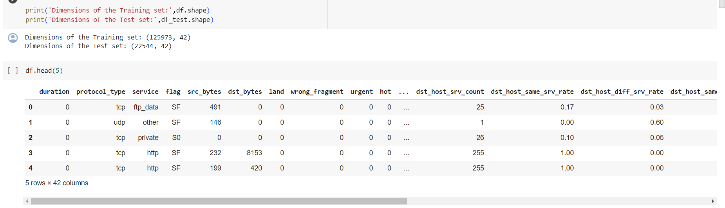
OUTPUTS
Loading Dataset

Slide 17
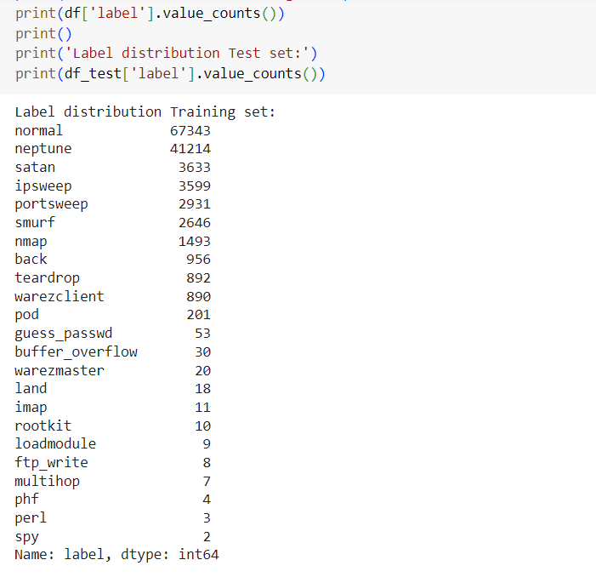
Label distribution of Training set

Slide 18
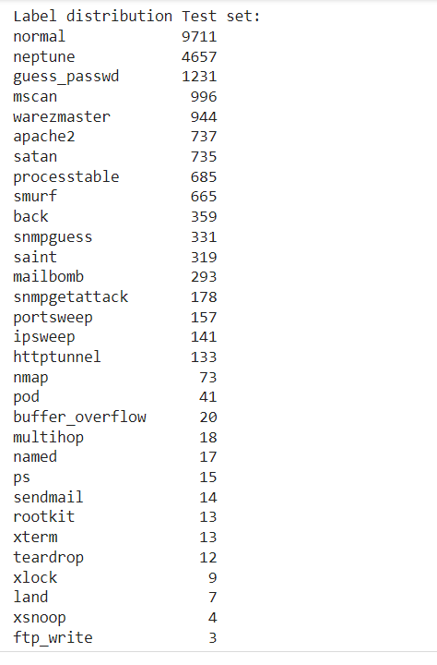
Label distribution of Test set

Slide 19
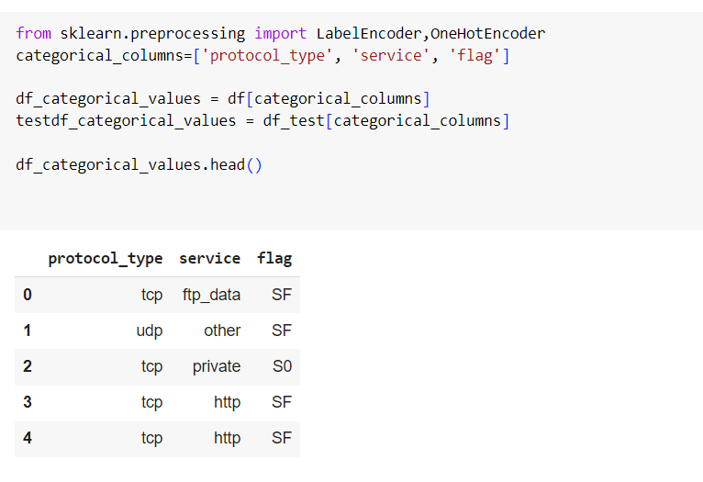
Categorizing Columns

Slide 20
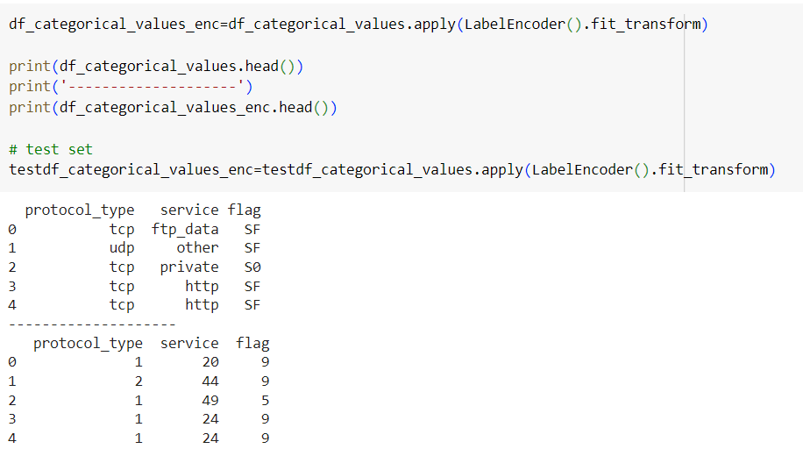
Label Encoding

Slide 21
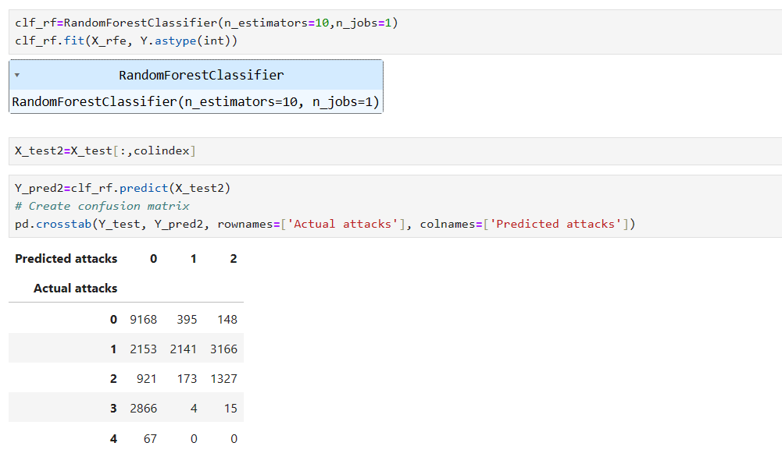
Model Selection – Random Forest

Slide 22
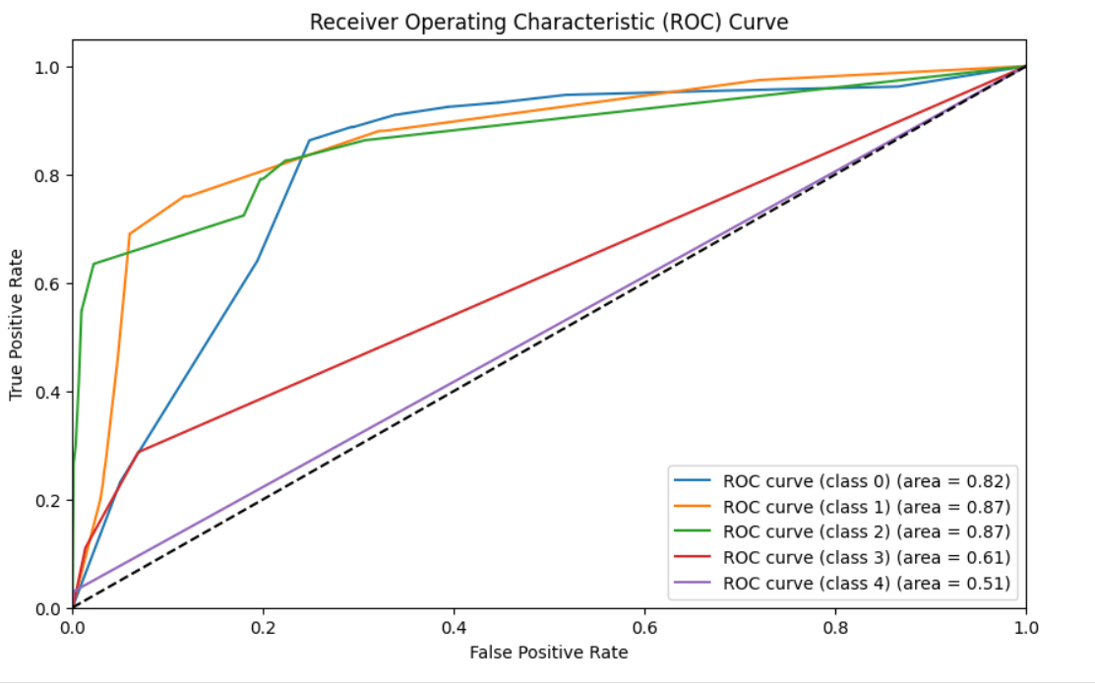

Slide 23
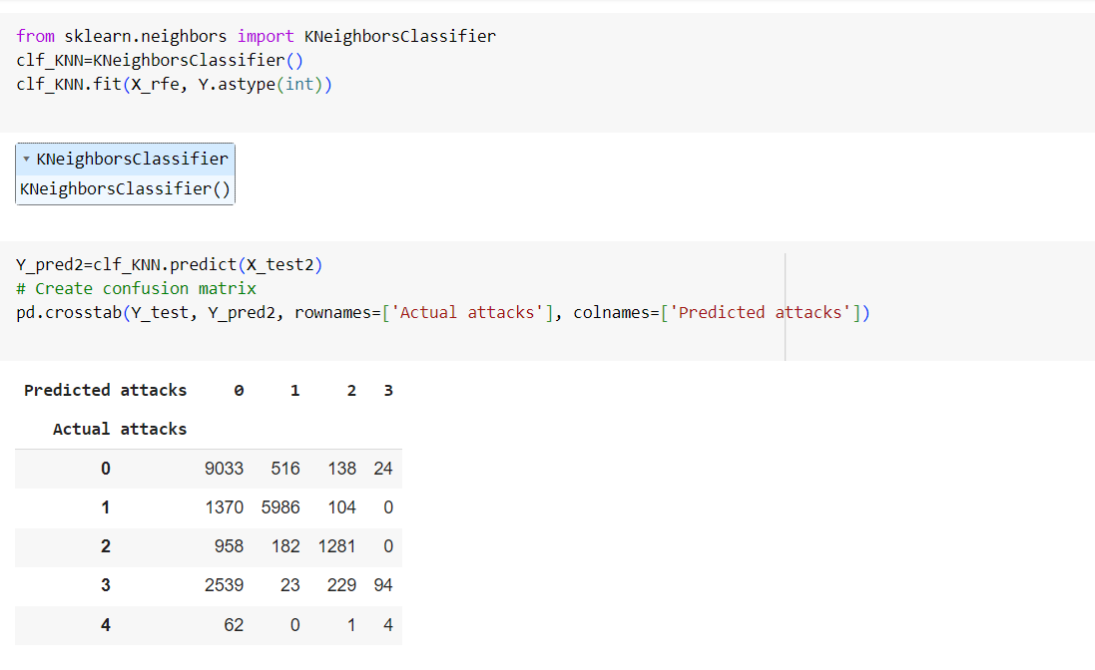
Model Selection – KNeibhourClassifier

Slide 24
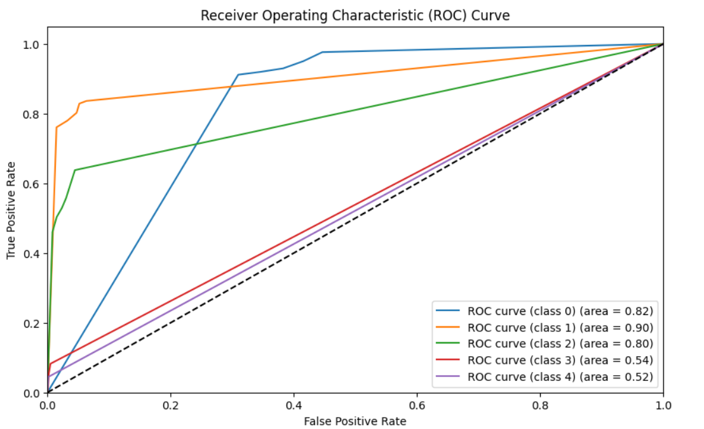

Slide 25
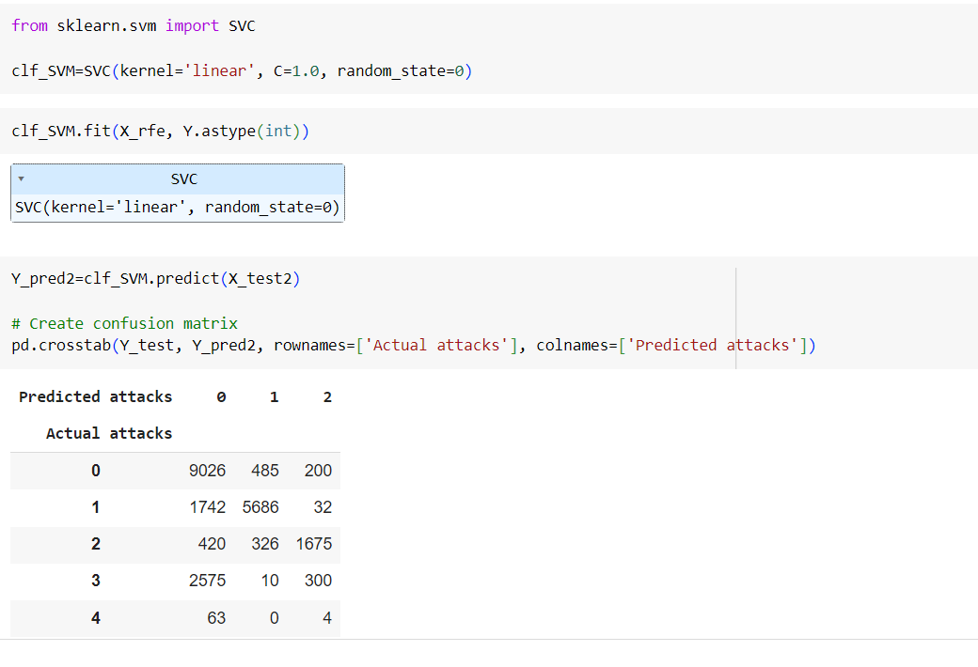
Model Selection – SVM

Slide 26
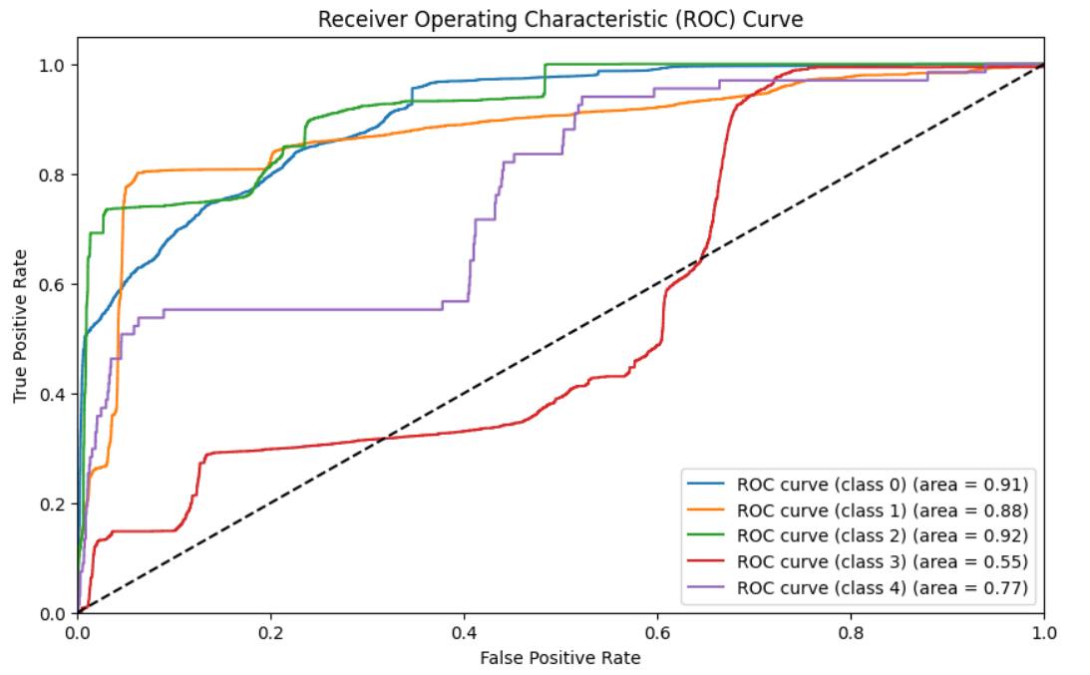

Slide 27
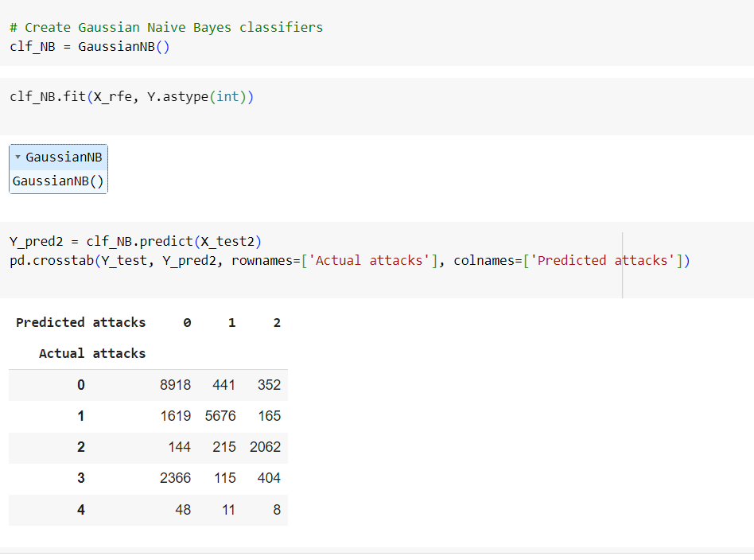
Model Selection – Gaussian Navie Bayes

Slide 28
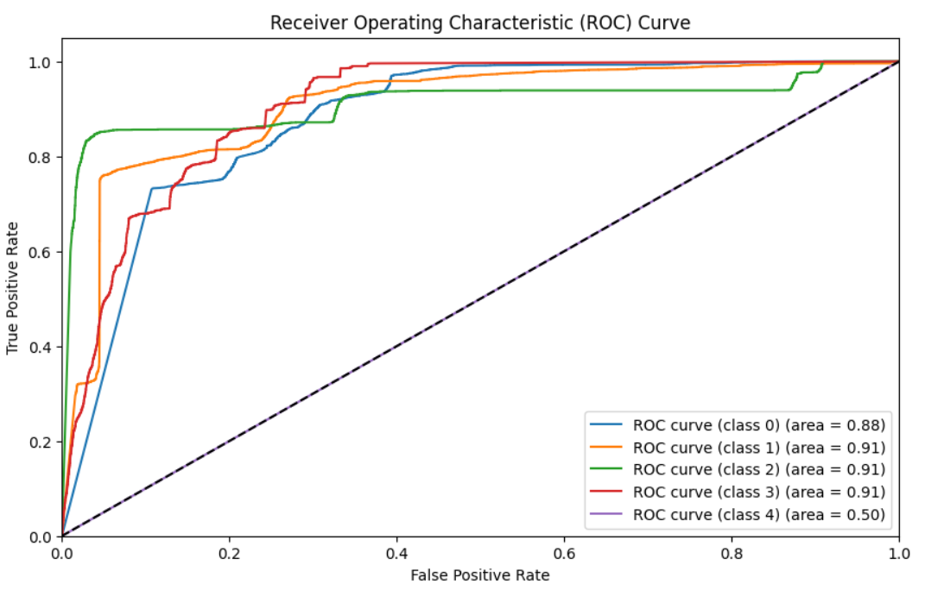

Slide 29
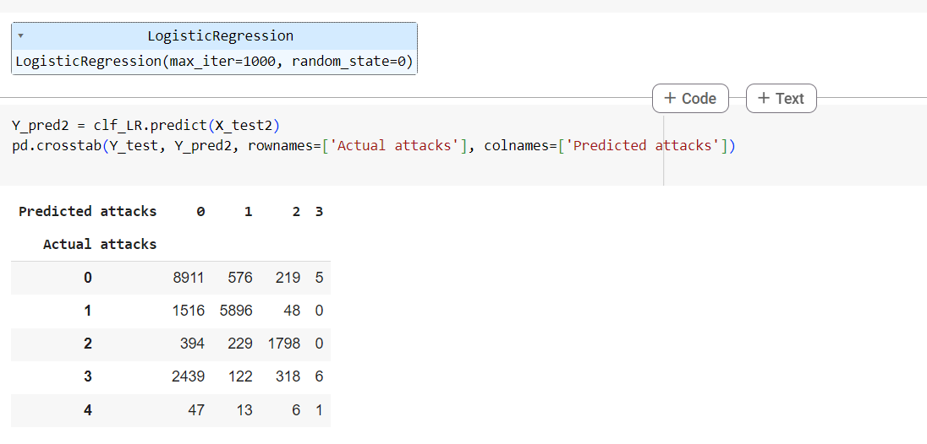
Model Selection – Logistic Regression

Slide 30
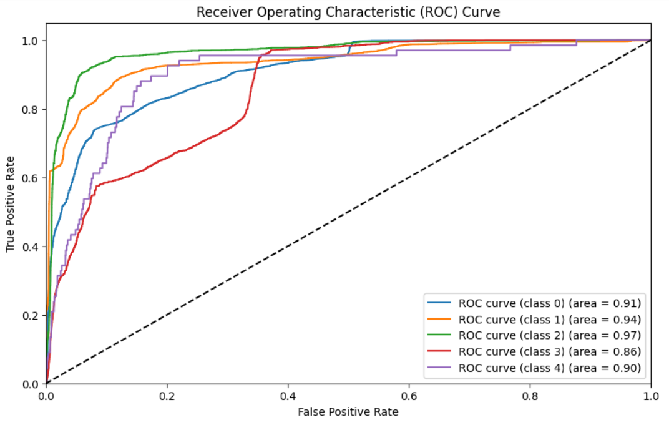

Slide 31
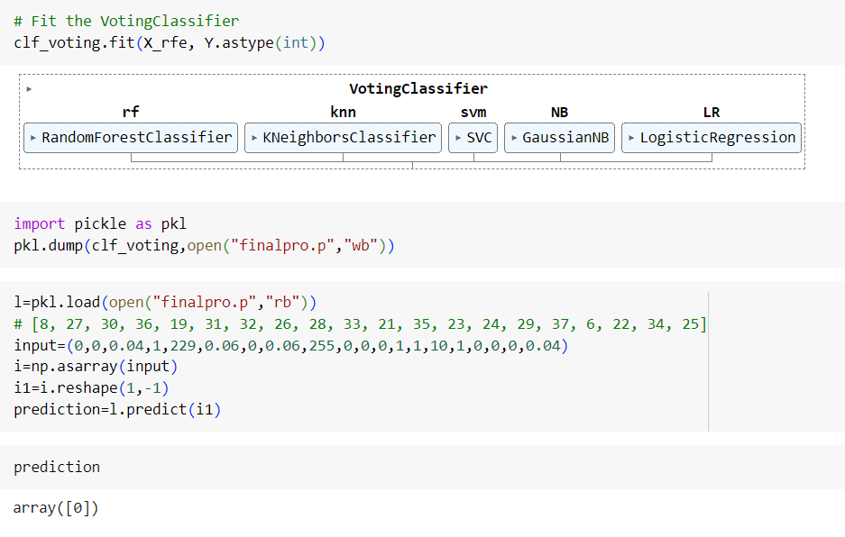
Model Ensembling Using Voting Classifier

Slide 32
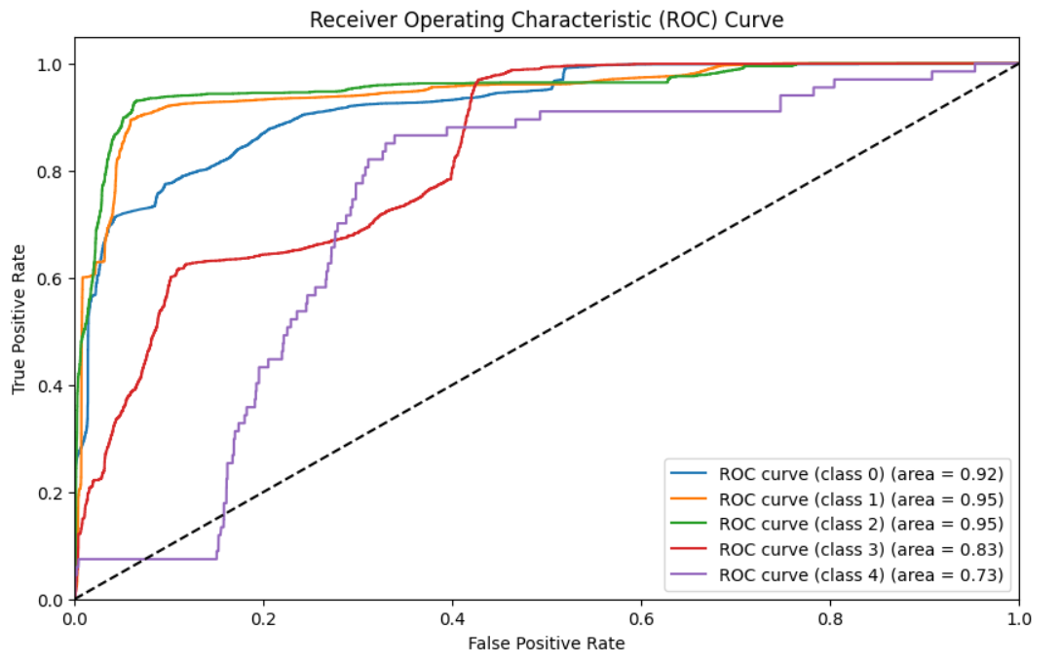

Slide 33
THANKYOU

