Slide 1
Time Series
Basics and processing
Advanced Programming for Neuroscience Students

Slide 2
What we will learn:
What is a time series?
Components of a time series
Processing time series
Analysis of time series
Example of time series data and how to process it

Slide 3
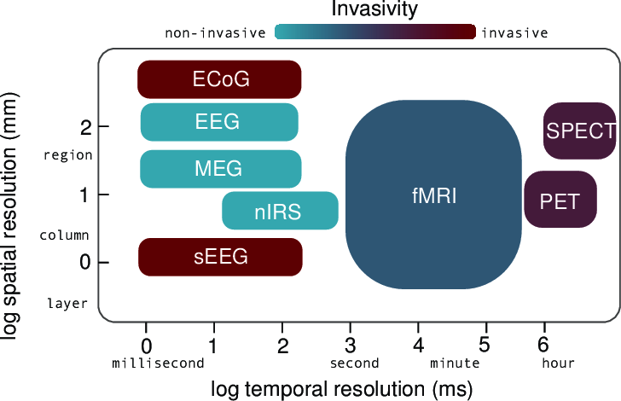
Spatial and temporal resolution
Fabian Pedregosa-Izquierdo

Slide 4
Our example time series - ECOG
We will explain the concept of time series through ECOG examples
What is ECOG?
I will show you on the next slide…

Slide 5
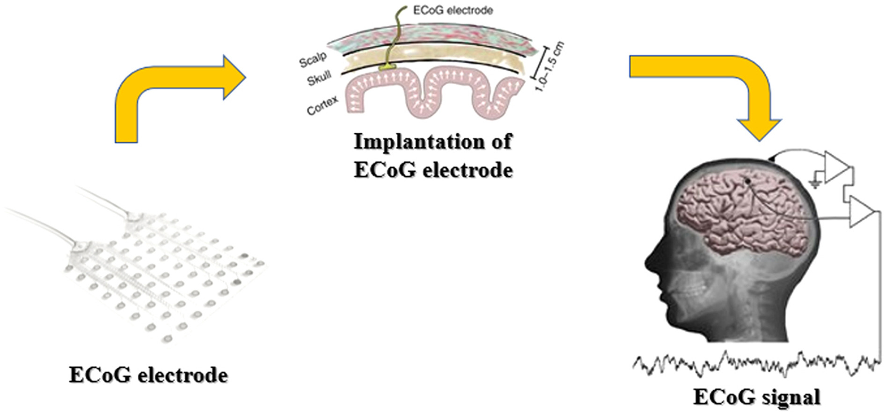
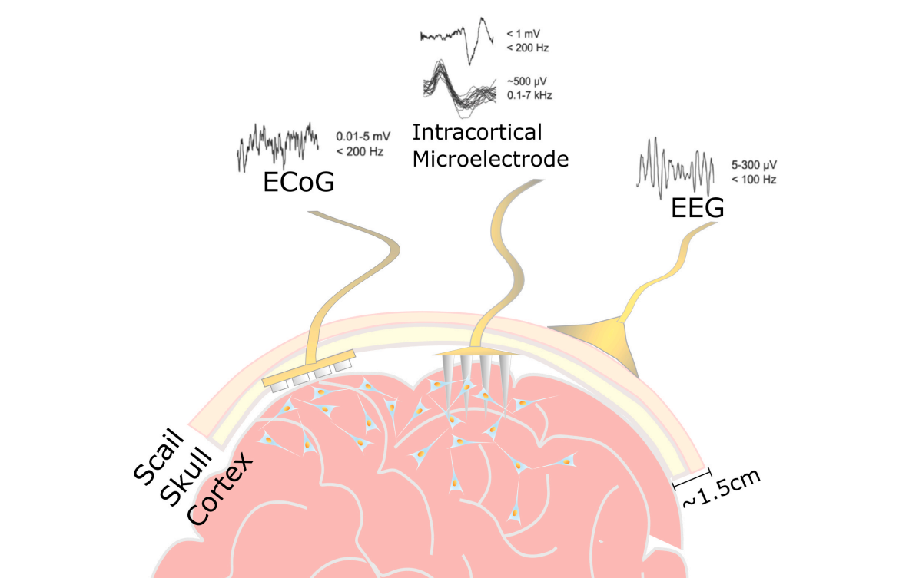
ECOG records neural signals over time
Alahi et al. (2021)

Slide 6
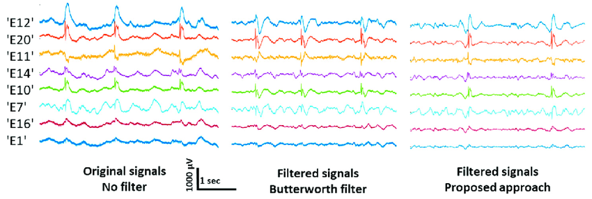
A raw time series signal

Slide 7
Components of a time series
Trend
Seasonality
Residuals (irregularities)
You spoke about trend and seasonality in the lecture.
We are going to focus on noise.

Slide 8
Example using real data
We are going to look at finger data and ECOG signals.
Experiment set up:
  Patients have electrodes on the surface of the brain for detection of epilepsy episodes
  Patients are asked to perform a task, and the brain signal response is recorded
  There are many trials for each event – each event consists of moving a finger after a stimulus appeared on the screen
https://www.nature.com/articles/s41562-019-0678-3
Notes:
The finger data is movement of finger in response to a stimulus – it tells you which finger to move. There are sensors on the fingers to record the movement.

Slide 9
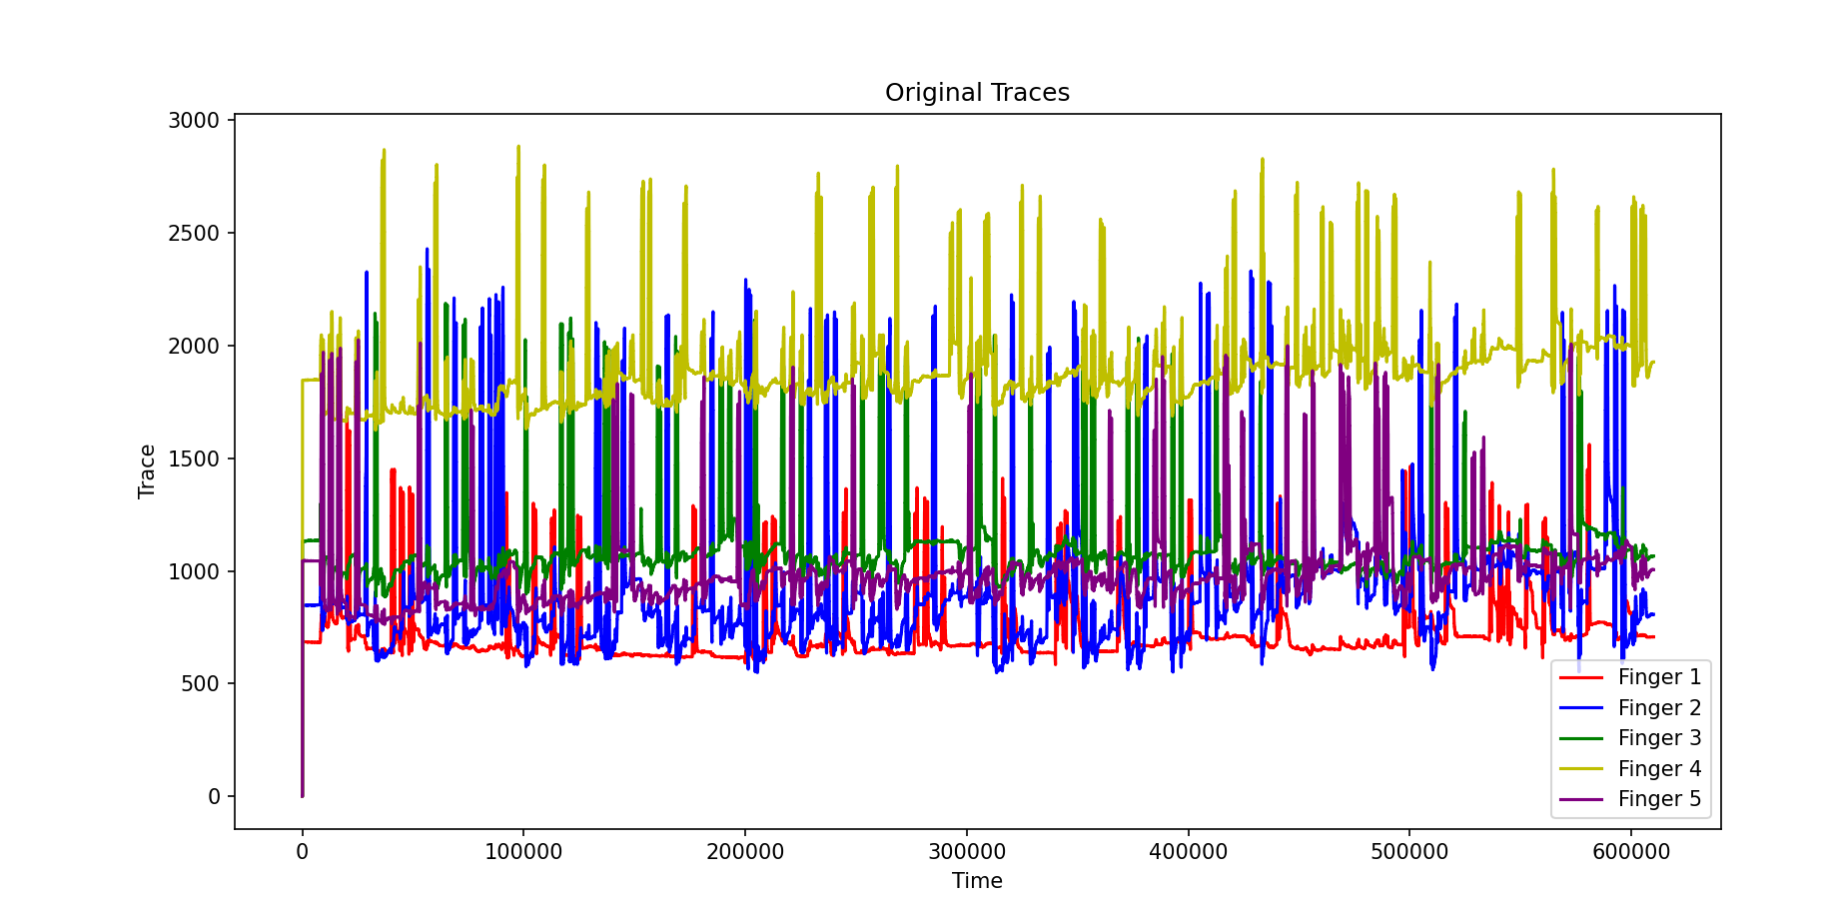
Finger data

Slide 10
Noise
What are some potential causes of noise to a signal?
  Movements
  Other organs functioning
  Technology noise
Why is it important to remove noise?

Slide 11
Noise removal and preprocessing
Filtering – we remove noise and smooth the signal using filters and windows (we also remove outliers)
We upsample or downsample in order to coordinate between different sampling rates
  What is sampling rate? How often we “check in” with the signal – how often we record it.
Normalization/Standardization – to compare across time series signals, we need to make sure they are on the same scale
And more…
We need to be careful when removing noise that we are not removing the actual signal!

Slide 12
Sampling rate in this data
Sampling rate of ECOG data – 1000 Hz (1 sample every millisecond)
Sampling rate of sensing finger movement – 25 Hz. In order to match the sampling rates – each finger movement is written 40 times – same one value on 40 rows - 40 * 25 = 1000
Why was this done?
So that the indices match up between the finger data and the brain data.

Slide 13
Let’s think about the data
How would you approach this data?
What questions can you ask about this data and what insights can the time series data provide?

Slide 14
Our task – find the start of every finger movement

Slide 15
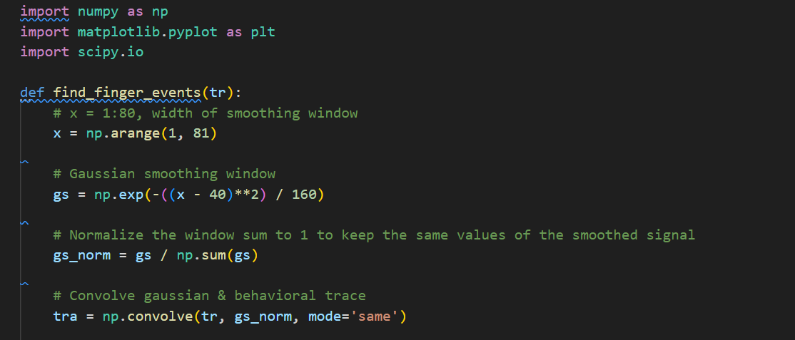
But first…
What are we doing here?
We apply a Gaussian function (a bell-shaped curve) to the data in a way that averages nearby values in a weighted manner, with more importance (weight) given to points closer to the target point.
This results in a smooth curve where noise is reduced, and the underlying trend becomes clearer

Slide 16
The data
You are given the following data:
  Finger flex data – with 5 columns and a bunch of rows. Each column belongs to a different finger that was moved during the study
  Figure out how you can find the start of when the finger moved.
  Hint: It is easy to find the maximum movement of a finger – how would that look in a signal?
  Ensure that the maximum is above the mean of the signal + the std of the signal
Try yourselves and then we will solve it together.

Slide 17
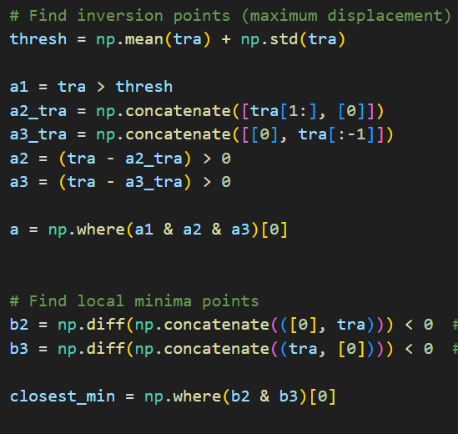
Start of event
What is happening in this portion of the code?
We find the maximum points – where the finger is at the height of movement
There are MANY ways to do this

Slide 18
Example
1 1 3 1 1 1 2 – original signal – the maximum is bigger than the two numbers next to it.
0 1 1 3 1 1 1 – everything shifted to the right
1 2 1 1 1 3 0 – everything shifted to the left
Difference between original signal and second:
1 0 2 -2 0 0 1
Difference between original signal and third:
0 1 2 0 0 -2 2

Slide 19

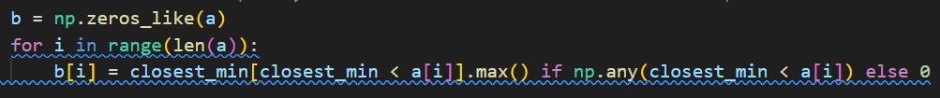
How do we find the start of the event?
We find the minimum closest to the maximum!

Slide 20
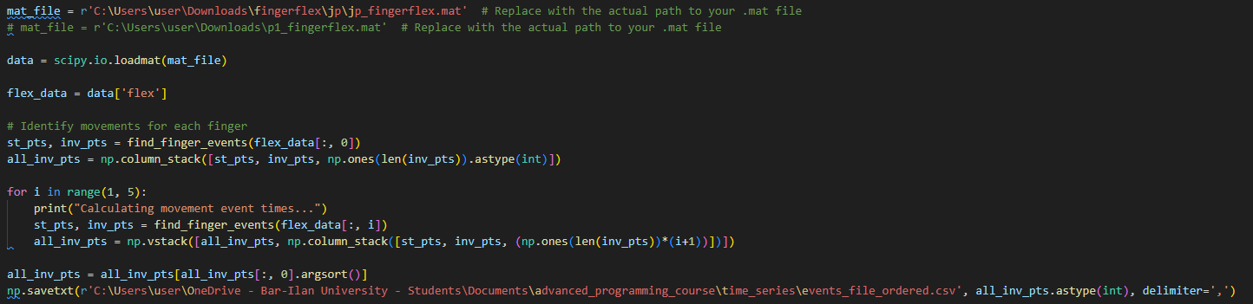
Aggregate events into one file

Slide 21
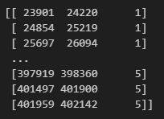
Show example of output
Inversion point – high
Number of event (finger)
Start of movement

Slide 22
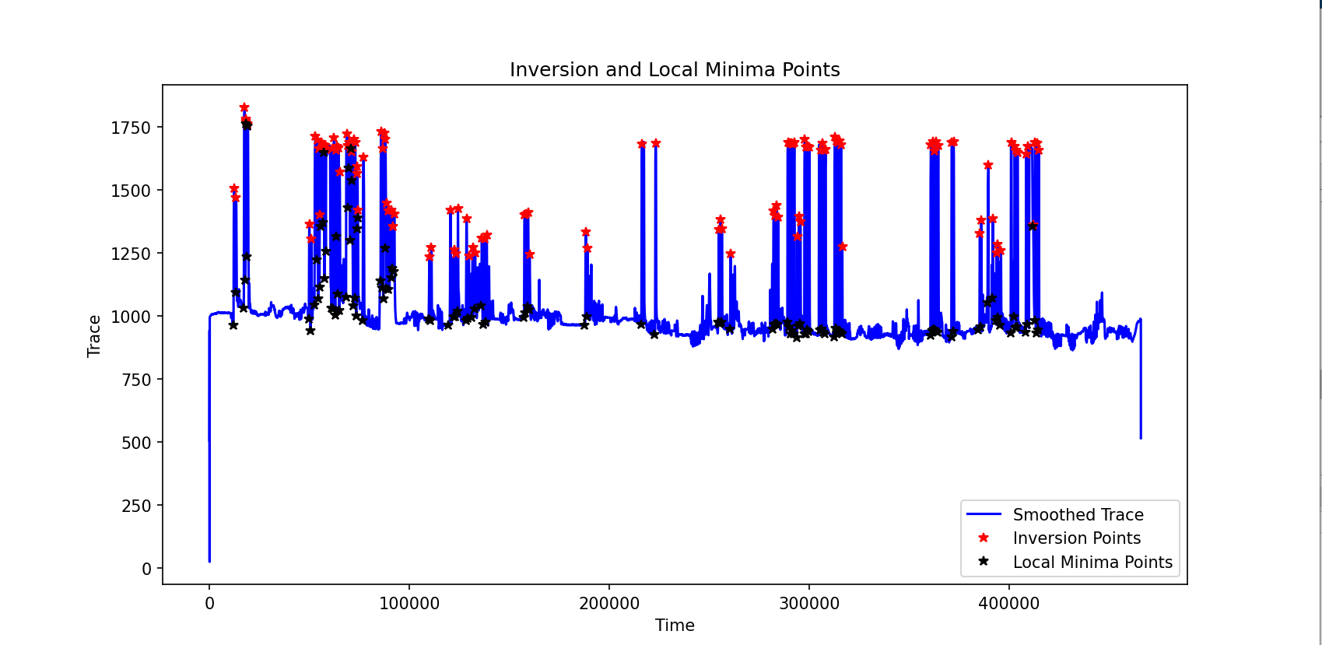
A single finger example

Slide 23
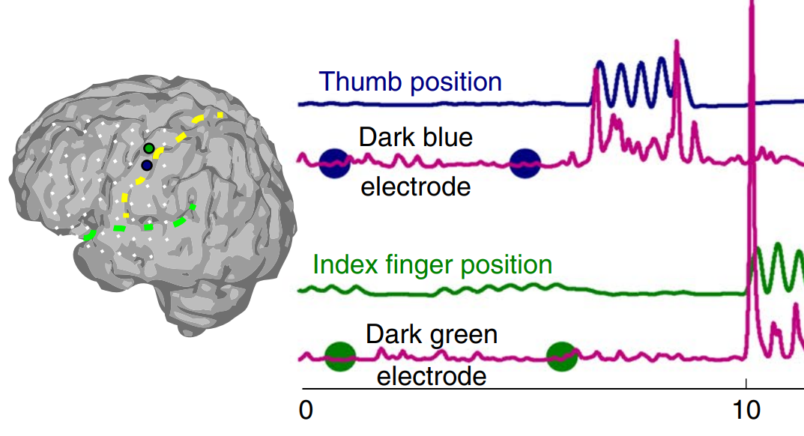
We have finger data and brain data…
What do we want to find out?
What can be an interesting question to ask about this data?
How does brain activity correlate to finger movement?
Go find it!

Slide 24
Introducing MiniProject2
We are going to combine the finger data with the brain data
How can we do this in a meaningful way?
What are the steps?
ERP!
An ERP is an Event Related Potential. A certain event that occurred that caused a brain response.
What is our event?
How can we find the brain response?
Why might it be useful to average across the timeseries for each event?

