Slide 1



Course Notes RAG & Adaptive Quiz Engine
IMPLEMENTATION & DEMO
EVERY ANSWER IS CHECKED
Verified citation
Claim found on the cited page
Auto-cited
A study assistant that answers only from your own lecture PDFs, cites the exact page, and quizzes you on the sections you know least.
Supported sentence linked to its page
Not found
BCSE306L Artificial Intelligence · Vellore Institute of Technology
No evidence above τ = 0.35, so no guess
Royce B Selvaraj (24BCB0078)
Srujan Buddharaju (24BDS0347)
Pranali Kamisetty ([Registration Number])
Notes:
Introduce the team and the one-line idea: answers come only from the student's own notes, every claim is cited to a page, and quizzes adapt to weak sections. The card on the right previews the three outcomes the grounding check can produce.

Slide 2




Generic chatbots don't know your lecture notes
THE PROBLEM
Answers you can't check
A general chatbot answers from its training data, not the course's notes, and gives no page to verify against.
Practice testing is one of only two learning techniques rated high utility across ages, materials and tasks.
Lecture PDFs break naive RAG
Character splitters cut equations in half, scramble table columns, and lose image-only formulas and handwritten scans.
Revision is passive
Dunlosky et al., Psychological Science in the Public Interest, 2013
Re-reading feels productive but gives no feedback on which sections a student actually knows.
Notes:
Three gaps: answers aren't grounded in the course material, lecture PDFs are hard to parse, and studying is passive. The research quote motivates the quiz half of the project: retrieval practice is one of the most effective study techniques.

Slide 3
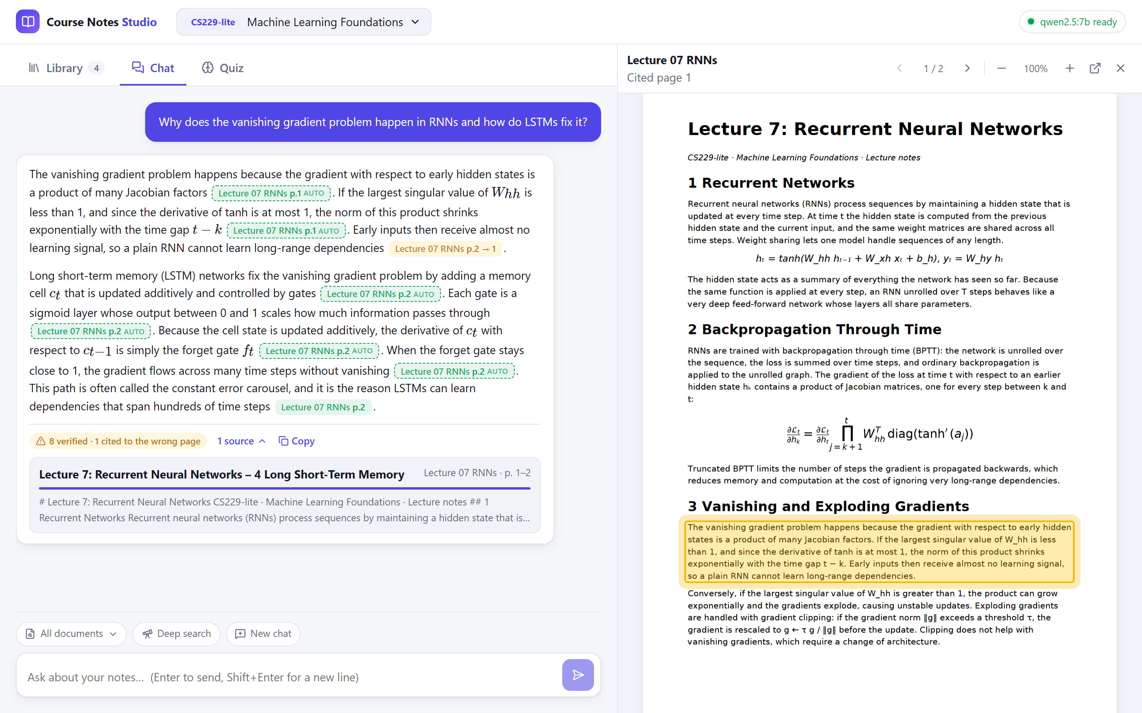



One workspace: library, chat and adaptive quiz
WHAT WE BUILT
Library
Upload lecture PDFs, Beamer slides or scans. Watch them parse, then preview the extracted Markdown with rendered math.
Grounded chat
Answers stream in with clickable page citations. A click opens the PDF with the supporting paragraph highlighted.
Adaptive quiz
Bloom-calibrated multiple-choice questions with a rationale for every option and a mastery score per section.
Runs fully offline on one laptop: RTX 4070 (8 GB), Qwen 2.5 7B through Ollama.
Notes:
Live demo starts here. Show the three tabs. The screenshot is a real answer from Qwen 2.5 7B: green chips are verified citations, dashed 'auto' chips were added by the grounding check, and the viewer on the right highlights the paragraph the citation points to.

Slide 4
Five stages from a lecture PDF to a checked answer
HOW IT WORKS
1
2
3
4
5
Parse
Chunk
Retrieve
Rerank
Verify
Layout model finds headings, tables and formulas; OCR reads scans; formulas become LaTeX.
Sections become parents (≈800–1200 tokens); 200–300-token children with 50-token overlap are indexed.
Dense and keyword search run in parallel and are fused by rank, then mapped back to parent sections.
A cross-encoder scores each section against the question; nothing above τ = 0.35 means “Not found”.
Qwen writes a cited answer; every citation is then checked against the retrieved pages.
Docling · RapidOCR
Hierarchical chunker
BGE-M3 · bm25s · RRF
bge-reranker-v2-m3
Qwen 2.5 7B · Ollama
Python · FastAPI · Qdrant · SQLite · React + Vite · server-sent events for streaming
Notes:
Walk through the five stages. The first two run once per upload as a background job; the last three run for every question in about a quarter of a second plus generation time.

Slide 5
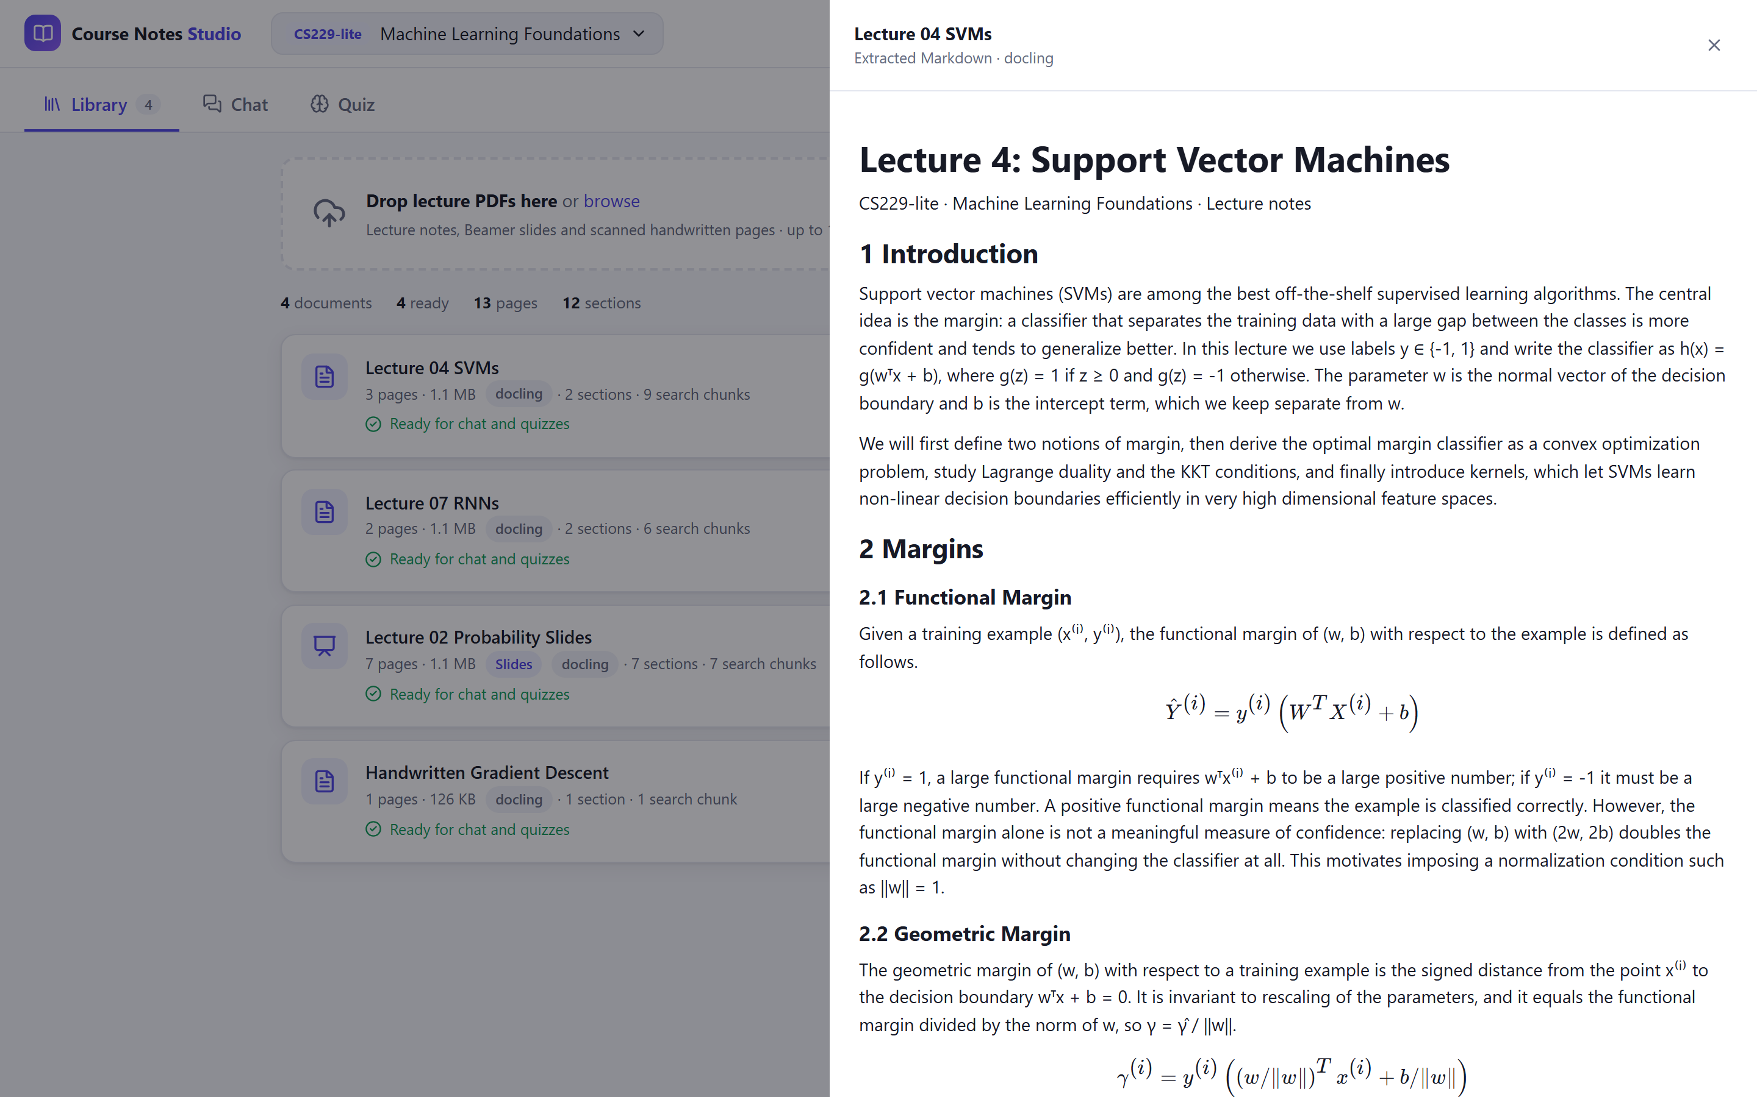



Parsing keeps equations, tables and scans intact
INGESTION
Image-only equation → LaTeX
Bayes' rule recovered as LaTeX from a slide where the formula is only a picture
Table → Markdown rows
Kernel table keeps its 4 rows × 3 columns; rows are also rewritten as sentences for search
Handwriting → text
Scanned notes are OCR'd: “If alpha is too large, gradient descent can overshoot…”
Structure → parent/child chunks
Headings and slides set the parents; a formula or table is never split
13
41 s
23
pages
on the GPU
search chunks
Notes:
Docling's layout model plus formula recognition is what makes lecture notes usable. The preview on the right is the parsed Markdown for the SVM lecture with equations rendered by KaTeX. The four sample PDFs (13 pages, including a scanned handwritten page) ingest in about 41 seconds on the laptop GPU.

Slide 6
Hybrid search finds both meaning and exact symbols
RETRIEVAL
Dense · BGE-M3
top 25 by meaning
Reciprocal Rank Fusion
Cross-encoder rerank
keep top 5 with score > 0.35
RRF(d) = Σₘ 1 / (60 + rankₘ(d))
top 15 children → their parent sections, so the model sees whole derivations
Keyword · BM25
top 25; “α” = “\alpha”, “Lemma 3.2”
Nothing passes?
reply “Not found in course notes”
Why both?
Embeddings understand paraphrases (“why do early inputs stop learning?”) but blur exact tokens; BM25 with a math-aware tokenizer catches theorem numbers, variable names and Greek letters. Fusing ranks, not scores, needs no tuning between the two.
Notes:
The retrieval funnel. Two rankings of child chunks are fused with RRF, promoted to parent sections, then a cross-encoder decides relevance. The 0.35 threshold is what turns 'probably irrelevant' into an explicit Not Found instead of a hallucinated answer.

Slide 7
Every citation is checked against the retrieved pages
GROUNDED CHAT
1
Source
the cited file and page must be in the retrieved context
2
Page
if the claim's words are on another page, the chip shows p.2 → 1
3
Highlight
the viewer opens on the single paragraph that matches the claim
4
Completion
uncited but supported sentences get an auto citation; the rest are flagged as unsupported
Sentences with a verified citation (Qwen 2.5 7B): 29% → 100%
Notes:
Demo: ask the vanishing-gradient question and click a chip. Explain the four checks. The small model tended to cite once per paragraph; repeating the rule in the user turn plus server-side completion took verified coverage from 29% to 100% of sentences.

Slide 8

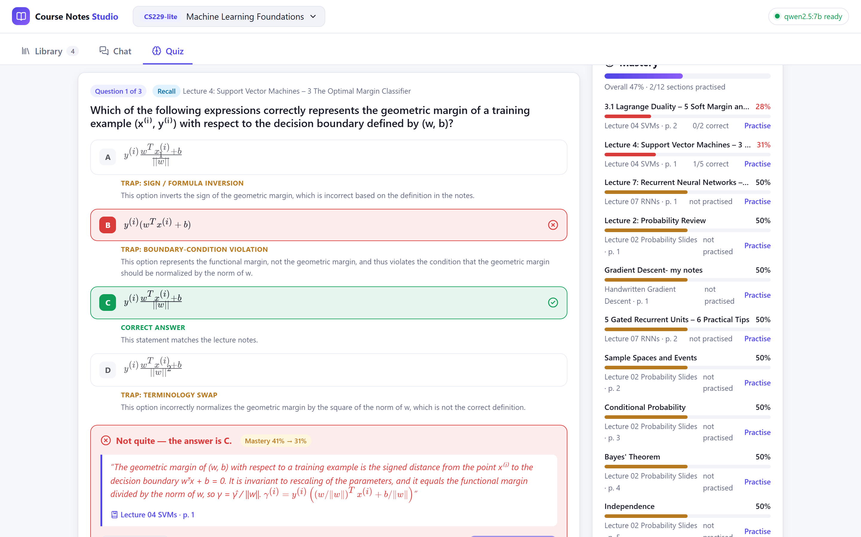



Every question is repaired and validated first
ADAPTIVE QUIZ
Pick sections
70% weighted toward weak sections, 30% by relevance
Number the evidence
notes shown as [S1], [S2]… so Qwen cites sentence ids, not a retyped quote
Generate to a schema
4 options; each distractor labelled sign inversion, boundary violation or terminology swap
Repair and validate
fix label slips; reject if not exactly one correct, bad LaTeX, or unsupported evidence
Questions passing validation: 33% with free-text quotes → 67% with evidence ids → 100% (9 of 9) with repair
Notes:
Generate a 3-question quiz on KKT conditions. After answering, every option shows its rationale and trap type, the source quote links to the page, and the mastery change is shown. Only the first attempt counts toward mastery.

Slide 9
Weak sections come back far more often
ADAPTIVE PRACTICE
After each first attempt
M ← clip(M + α(S − M), 0, 1)
S = 1 if correct, 0 if not · α = 0.25 · M starts at 0.5
Choosing the next quiz's sections
P(section c) ∝ (1.05 − M꜀)²
for 70% of slots; the other 30% keep coverage
A section at 10% mastery is picked about 40× more often than one at 90%.
Notes:
The student model is one number per parent section. A correct first try pulls it toward 1, a wrong one toward 0. Sampling with a squared weight strongly favours weak sections without ever starving the others.

Slide 10
Right lecture section found for 10 of 10 questions
RESULTS
Measure | Final
Hit@1 / Hit@5 | 100% / 100%
Mean reciprocal rank | 1.00
Cited page inside section | 100%
Warm query latency | 268 ms
The one miss in the first run was “variance of a Bernoulli variable”, answered by a table. Rewriting table rows as sentences for embedding and reranking fixed it (score 0.38 > τ), and lifted the kernel-table question from 0.61 to 0.86.
10 hand-written questions over 4 lecture PDFs (13 pages): paraphrases, theorem numbers, a table lookup and a handwritten scan.
Notes:
Benchmark of ten tricky questions. Offline stand-ins use hashing embeddings and lexical reranking, so they test the pipeline, not the models. With BGE-M3 and the cross-encoder, the first run missed only the table question; linearizing tables fixed it.

Slide 11

What made a 7B model reliable enough
RESULTS
Sentences with a verified citation
29%
100%
AUTOMATED TESTS, ALL PASSING
rule repeated in the user turn + server-side completion
289
backend unit + API end-to-end
Quiz questions passing validation
100%
56
frontend unit (Vitest)
33%
numbered evidence sentences + repair of label slips
9
browser end-to-end (desktop + mobile)
Benchmark questions found (Hit@1)
90%
100%
5
live tests on the real models
table rows rewritten as sentences for search
Positive and negative cases for every component: invalid, empty, encrypted and duplicate PDFs, off-topic questions, malformed model output.
Notes:
The three fixes that mattered most, measured on the real stack. On the right, the test suites: unit and end-to-end tests run offline in about a minute; the live suite exercises Docling, BGE-M3, the reranker and Qwen together.

Slide 12
Modules 1–4: agents, search, local search, logic
RELATION TO THE SYLLABUS
Module | Syllabus topics | Where it appears in this project | Link
M1 Introduction & Intelligent Agents | Agent structure, environments, applications of AI | The app is a learning agent: it perceives notes (parser, OCR) and questions, acts by answering and quizzing, and keeps a student model. The environment is partially observable (knowledge is hidden) and sequential. | Strong
M2 Search | State-space search, best-first, uniform cost, A* | Retrieval is search over a space of passages: Qdrant's HNSW index runs greedy best-first search on vector distance; BM25 and RRF rank and prune candidates to the top 15 / top 5. | Strong
M3 Local & Adversarial Search | Hill climbing, simulated annealing, minimax | Quiz generation is generate-and-test: score a draft against constraints, repair it, or restart with a higher temperature. Distractors are chosen as the most tempting wrong answers. | Partial
M4 Logic & Reasoning | Propositional and first-order logic, forward chaining | Citation and quiz validation are rule-based inference: facts (file, page, section range) fire rules that conclude valid / moved / unsupported; “exactly one correct option” is a propositional constraint. | Strong
Notes:
How the project maps to BCSE306L. Modules 1, 2 and 4 are used directly; local search is used in spirit by the generate-repair-retry loop.

Slide 13
Modules 5–8: uncertainty, planning, language
RELATION TO THE SYLLABUS
Module | Syllabus topics | Where it appears in this project | Link
M5 Uncertain Knowledge | Quantifying uncertainty, Bayes rule, Bayesian networks | BM25 comes from the probabilistic relevance model; the reranker outputs P(relevant | question, passage) and τ = 0.35 is a decision threshold; mastery is a belief about the student, updated by evidence (a simplified knowledge-tracing model). | Strong
M6 Planning | Classical, hierarchical planning, acting under uncertainty | A quiz is planned top-down: goal (n questions on weak spots) → slots → section → Bloom level → generate → validate. Ingestion is a tracked plan (queued → parsing → chunking → indexing → ready) with a fallback parser. | Partial
M7 Communicating, Perceiving, Acting | Probabilistic language processing, information retrieval, information extraction, perception, object recognition | The core of the project: hybrid retrieval and reranking (IR), layout parsing, tables and formula-to-LaTeX (IE), LLM generation and tokenization (language), layout detection and OCR on page images (perception). | Strong
M8 Contemporary Issues | Current topics in AI | Hallucination and grounded generation, verifiable citations, local and private inference on a laptop GPU, academic integrity. | Strong
Notes:
Module 7 is the heart of the project: information retrieval, information extraction and probabilistic language processing. Module 5 appears in the probabilistic ranking, the relevance threshold and the student model.

Slide 14
Course outcomes met by the project
RELATION TO THE SYLLABUS
CO1
Evaluate AI methods and their foundations
CO2
Apply AI to inference, perception, representation and learning
10-question retrieval benchmark (Hit@k, MRR); offline stand-ins vs. real models; before/after ablations of each fix.
Perception (layout, OCR), knowledge representation (parent/child chunks, vectors), inference (verification rules), learning (mastery model).
CO3
Reason with uncertainty and knowledge representation
CO4
Show how search drives problem solving
Probabilistic ranking, a relevance threshold that answers “Not found” instead of guessing, mastery as an updated belief.
Best-first vector search, BM25 ranking, rank fusion and top-k pruning decide what the model is allowed to say.
Notes:
The four BCSE306L course outcomes, each with the concrete part of the project that demonstrates it.

Slide 15

Problems we hit, and how we fixed them
WHAT WE LEARNED
Quotes were paraphrased
One citation per paragraph
Qwen rewrote the “exact quote”, so 2 of 3 questions failed. Showing the notes as numbered sentences and asking for ids makes quotes verbatim by construction.
Only 29% of sentences carried a citation. Repeating the rule in the user turn and completing citations on the server reached 100%.
Tables were invisible to search
Every heading was level 1
Pipes and dashes don't look like a question. Rewriting rows as “Distribution: Bernoulli; Variance: p(1 − p).” fixed the benchmark miss.
Docling flattens heading levels, so sections never merged into 800-token parents. Merging now stops only at “Lecture N” / “Chapter N”.
Notes:
Four problems that only showed up with the real models, each with a measured fix.

Slide 16



What it can't do yet, and where it goes next
LIMITATIONS & NEXT STEPS
Bigger evaluation
Stronger verification
Better student model
A larger, independently written question set per course, and quiz-quality ratings from students and faculty.
Use an entailment (NLI) model next to the lexical check, so paraphrased claims are verified too.
Replace the moving-average mastery with Bayesian knowledge tracing and spaced-repetition scheduling.
KNOWN LIMITATIONS
Evaluation scale: 10 benchmark questions over 4 synthetic lecture PDFs; results need confirming on real course material.
A 7B model still varies run to run: answers may cite few sentences (completion fills the gap), and two distractors can look nearly identical once rendered.
Formula OCR can misread symbols (γ̂ read as Ŷ), and the lexical page check cannot verify paraphrased claims.
Notes:
Be candid: the benchmark is small and synthetic, and a 7B model is not deterministic. The next steps target exactly those gaps.

Slide 17
Questions and feedback welcome
THANK YOU
Royce B Selvaraj (24BCB0078) · Srujan Buddharaju (24BDS0347) · Pranali Kamisetty ([Registration Number])
github.com/RoyceRRNS/AI_Project
Notes:
Thank the panel and invite questions. The repository has the code, tests, benchmark results, this deck and the report.

