Slide 1
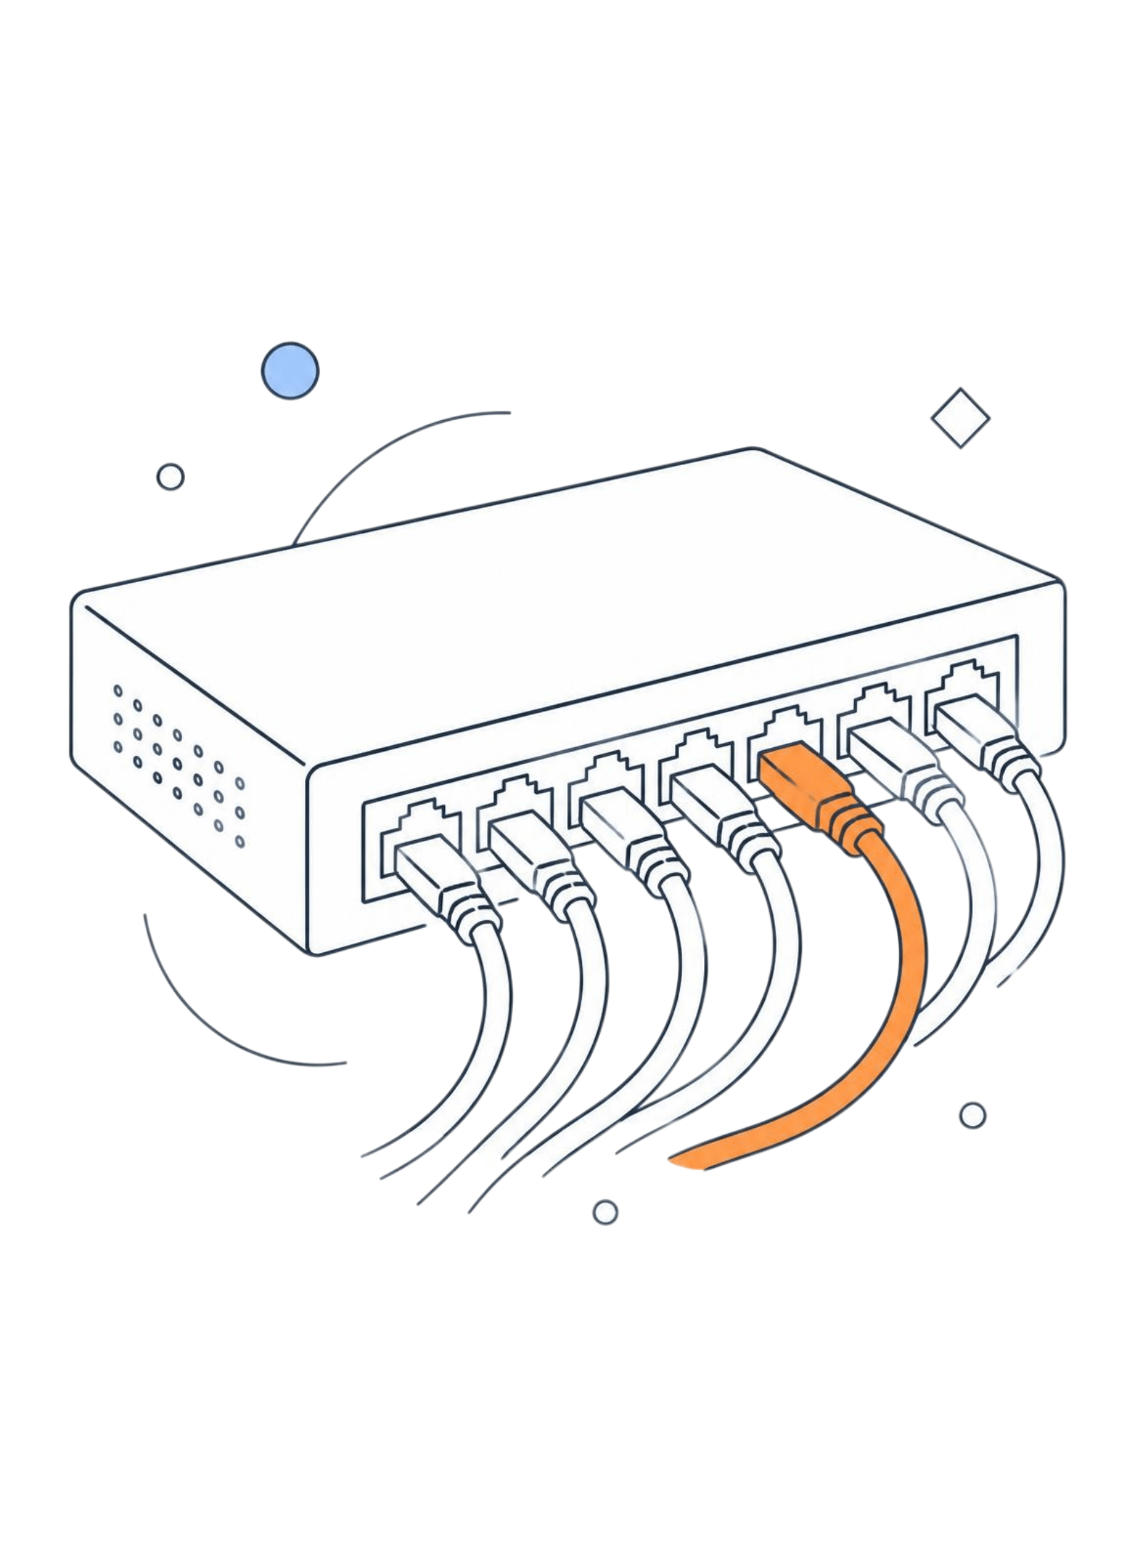



Hearing Network Traffic Anomalies
A tutorial on detection by sonification
Based on Axon, Happa, Goldsmith & Creese, University of Oxford
CHARITH | VINAY | ROYCE
Notes:
[Speaker 1, ~0:30] Greet audience, introduce the team and the paper: “Hearing Attacks in Network Data: an Effectiveness Study” by Axon, Happa, Goldsmith and Creese (University of Oxford). Roadmap: Speaker 1 covers why we would listen to traffic and how the sonification system works; Speaker 2 covers the four attacks, the experiment and the results; Speaker 3 covers hearing unknown attacks without training and the takeaways.

Slide 2


Speaker 1
Why listen to network traffic?
Sonification turns data into non-speech sound, so analysts can hear deviations from the normal sound of the network.
Limits of today’s tools
Why sound helps
Automated alerts can be inaccurate
Analysts must verify and catch misses
Displays are mostly visual or text
Heard peripherally, while multitasking
Humans spot patterns in sound well
Works in medicine and astronomy
Signature-based
Sonification (this talk)
Matches known attack patterns
Cannot detect new anomalies
Listeners hear deviations from normal
Can flag attacks with no known signature
2
Notes:
[Speaker 1, ~1:30] Security Operations Centres rely on IDSs, firewalls and statistical or machine-learning anomaly detection, but these can be inaccurate, so human analysts still verify alerts and look for missed threats, mostly through text and visual displays. Sonification (non-speech audio) is an additional channel: it can be heard peripherally while multitasking, humans are good at pattern recognition in sound, and it has worked for anomaly detection in medicine and astronomy. Signature-based detection only finds known attacks; the idea here is that a listener hears deviations from the normal sound, so even attacks with no signature may stand out.

Slide 3




Speaker 1
How the sonification works
01
02
03
Sample packets
Map fields to sound
Flag the unusual
Each sampled packet header plays one note; tempo follows the packet rate
Size sets note length, direction sets pan, field type sets pitch
IPs and ports outside the hotlist play as dissonant notes
Sound dimensions
Instruments and hotlists
Packet rate: tempo
Packet size: note duration
Incoming: left pan; outgoing: right pan
Pitch: source IP low, dest IP mid, port high
HTTP: strings; TCP: clarinet; FTP: piano
Hotlist: most commonly seen IPs and ports
Common values: consonant notes
Unusual values: dissonant notes
3
Notes:
[Speaker 1, ~2:00] The system uses parameter-mapping sonification: each sampled packet header becomes one note event. Packet rate sets tempo and packet size sets note duration (max 1 s). Direction sets pan: incoming traffic left, outgoing right. Pitch range shows the field type: source IPs low, destination IPs medium, destination ports high. Protocol sets the instrument: HTTP strings, TCP clarinet, FTP piano. A hotlist of the most common IPs and ports is built from the first part of the data: hotlisted values play consonant notes, unusual values play dissonant notes, and unusual packets are sampled with higher probability.

Slide 4



Speaker 2
Experiment: hearing four attacks
4,500
DDoS: SYN flood heard as dissonant low-pitch clarinet notes from unusual sources
Port scan: Unusual destination ports heard as dissonant high-pitch notes
Exfiltration: FTP piano notes panned right, sent to an unusual destination IP
packets per second of synthetic background traffic, handled by packet sampling
Study design
The fourth attack: silence
30 CS and cybersecurity researchers
Attack order randomised per listener
Tested before and after training
Connectivity loss fades the sound out
Slowest to detect: 6.4 s on average
Some listeners thought the test had ended
4
Notes:
[Speaker 2, ~1:30] The study used synthetic packet-header data: 25 desktop hosts talking to 40 remote hosts, background traffic of about 4,500 packets per second (scaled up from real traces, handled by sampling). Four attacks were injected. DDoS (TCP SYN flood) is heard as extra dissonant low-pitch clarinet notes. Port scan is heard as dissonant high-pitch activity from unusual destination ports. Data exfiltration over FTP is heard as piano notes panned right to an unusual destination IP. Loss of connectivity fades the sound towards silence. Participants were 30 computer science and cybersecurity researchers; attack order was pseudorandomised for each of them.

Slide 5



Speaker 2
Results: detection and identification
Accuracy
Speed
Identification
Accurate detection
Quick detection
Naming the attack
F-score above 0.9 after training
Recall of 1.0: no attack missed
Precision about 0.85
Pre-training F-score about 0.75
DDoS: 2.4 s on average
Port scan: 2.7 s
Data exfiltration: 3.0 s
Connectivity loss: 6.4 s
114 of 120 correctly identified
Port scan confused with DDoS six times
24 of 30 noticed a combined attack
5
Notes:
[Speaker 2, ~1:30] After training, participants detected every attack (recall 1.0) with an F-score above 0.9 and precision around 0.85, meeting the target. Mean detection time was under 3 seconds for DDoS, port scan and exfiltration (2.4, 2.7 and 3.0 s); connectivity loss took 6.4 s because the sound thinned gradually and some listeners took silence to mean the test had ended. Of the attacks detected, 114 of 120 were identified correctly; the only errors were six port scans mistaken for DDoS, probably because both include low-pitch dissonance and the pitch ranges were hard to tell apart. 24 of 30 recognised a combined attack. Hand over to Speaker 3.

Slide 6


Speaker 3
Hearing the unknown without training
Intuitive detection
How participants listened
Only 30 s of normal traffic was played
Step 1: Listen to 30 s of normal traffic
Attacks heard as deviations from the baseline
Pre-training recall of 0.96
Suggests promise for unknown attacks
Step 2: Click when anything sounds abnormal
Step 3: Describe the sound change and name the attack type
Musical experience had no significant effect
6
Notes:
[Speaker 3, ~1:30] Key point: before any training, participants were played only 30 seconds of normal traffic and asked to click on anything abnormal. They still clicked around the start of each attack (recall 0.96, though with more false alarms, F-score about 0.75), so attacks were audible as deviations from the baseline. That suggests promise for attacks with no known signature, including zero-days, though the paper stresses this needs further testing. Walk the three steps of the procedure on the right. Musical experience had no significant effect on detection speed or identification, and accuracy improved with training.

Slide 7


Speaker 3
Findings and takeaways
Measure | Result | Meaning
Detection | F-score above 0.9; no attacks missed | Attacks heard accurately
Speed | Under 3 s for three of four attacks | Fast enough for monitoring
Identification | 114 of 120 detected attacks named | Sound carries the attack type
Takeaways
Attacks can be heard as deviations from a normal baseline
Listeners need no musical training; practice improves accuracy
Next: better pitch mapping, listener fatigue, real SOC trials
7
Notes:
[Speaker 3, ~1:30] Summarise: detection was accurate and fast, and the attack type could mostly be identified by ear. Takeaways: attacks can be heard as deviations from normal; no musical training is needed, and practice improves accuracy. Caveats from the paper: synthetic data, only four attacks, pitch range was hard to interpret, and fatigue and use alongside real SOC tools are untested. Next steps: other sound mappings, real-world data and SOC trials. Sonification is positioned as a complement to existing detection tools. Invite questions.

