Slide 1
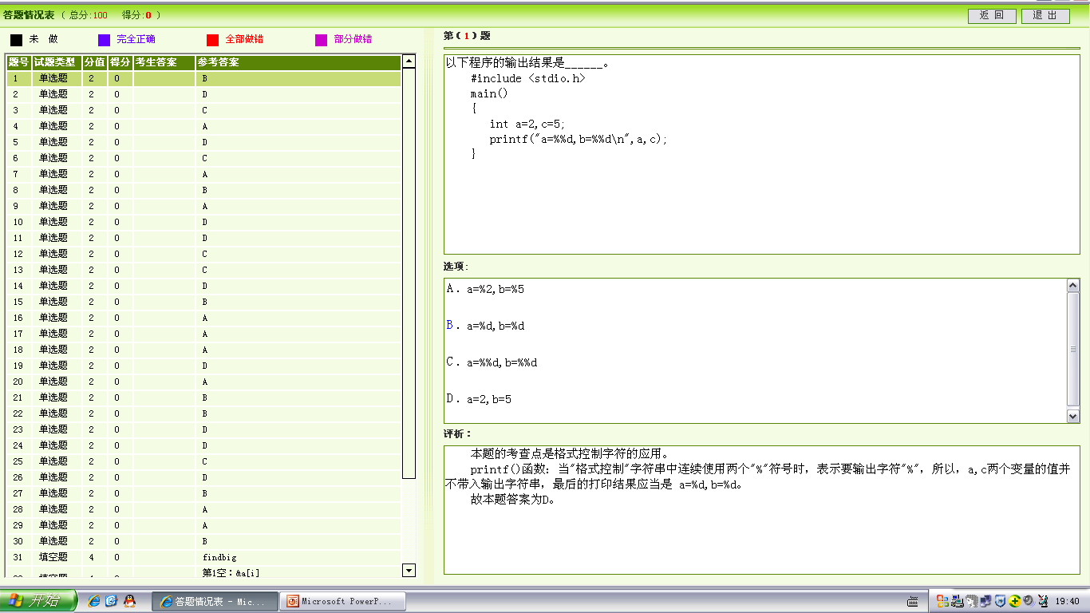

Slide 2
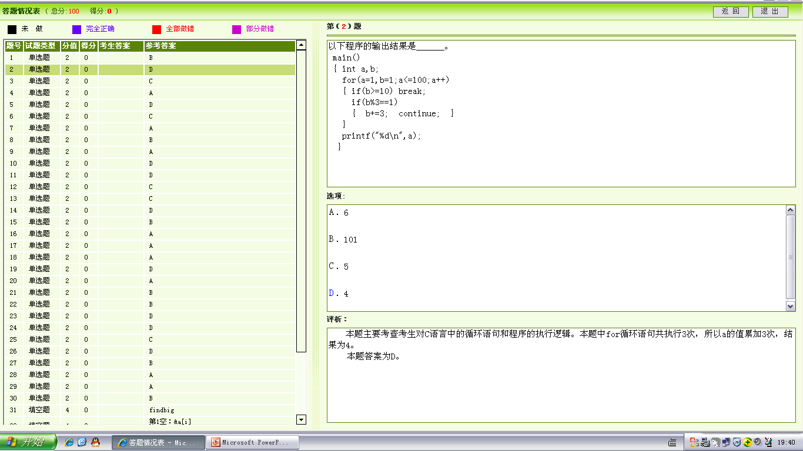

Slide 3
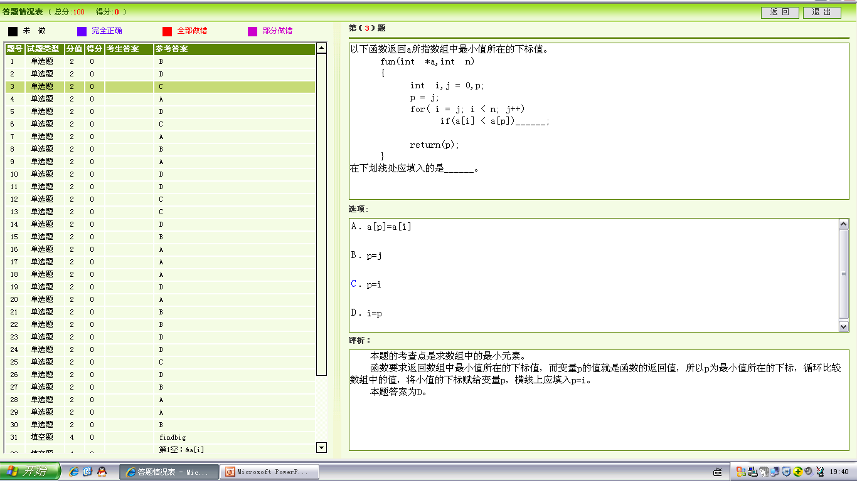

Slide 4
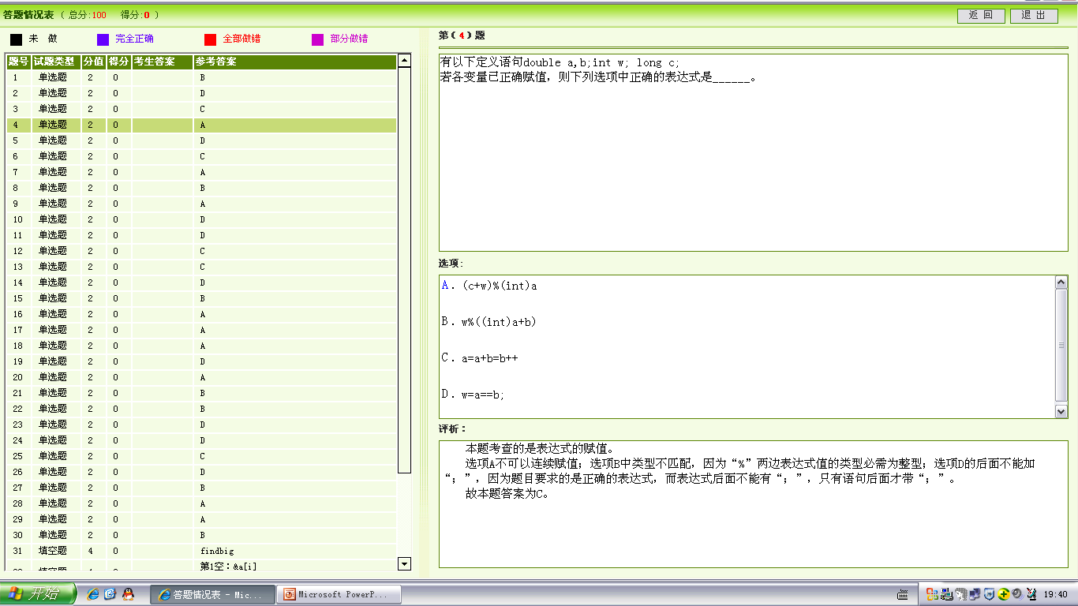

Slide 5
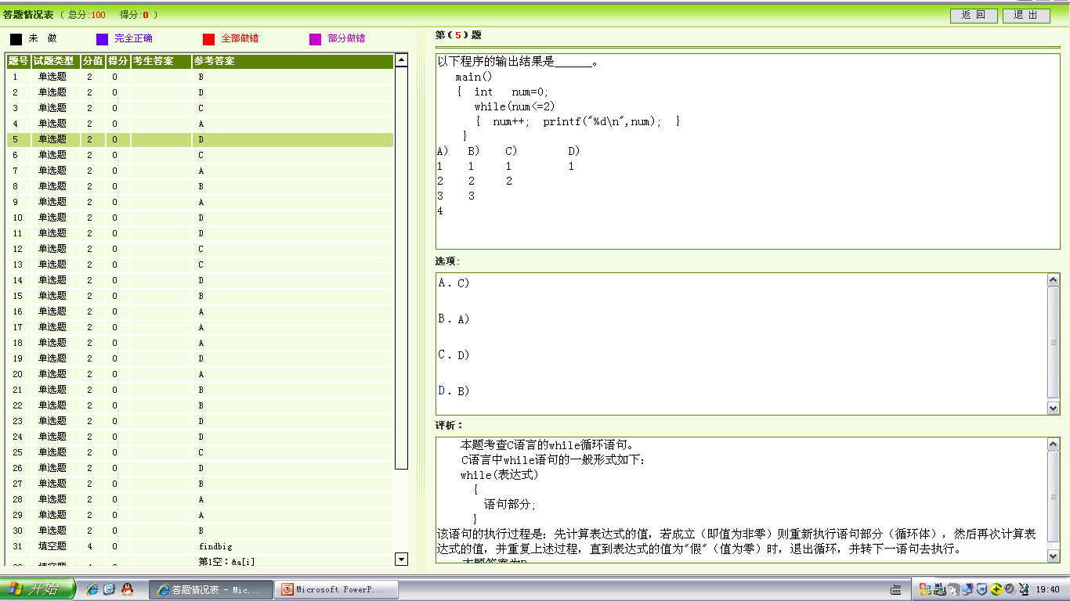

Slide 6
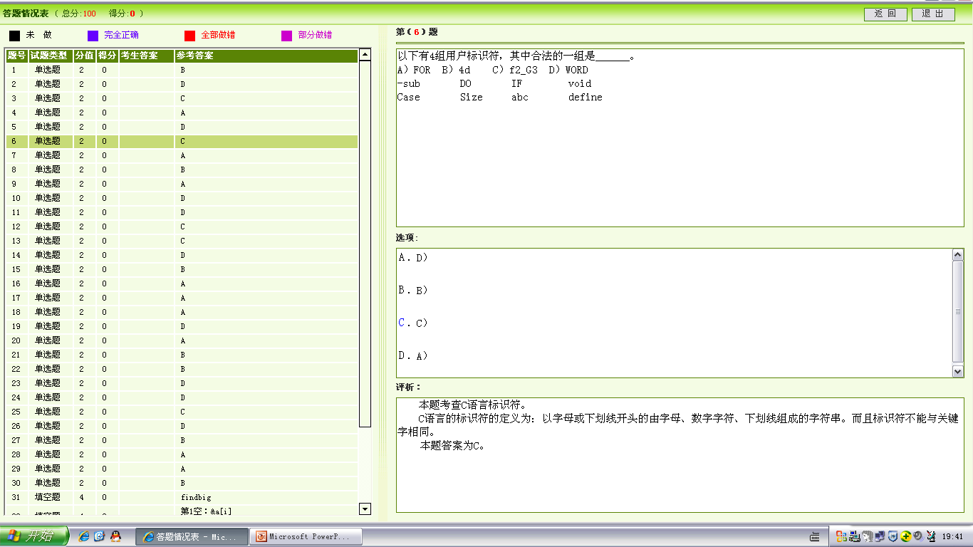

Slide 7
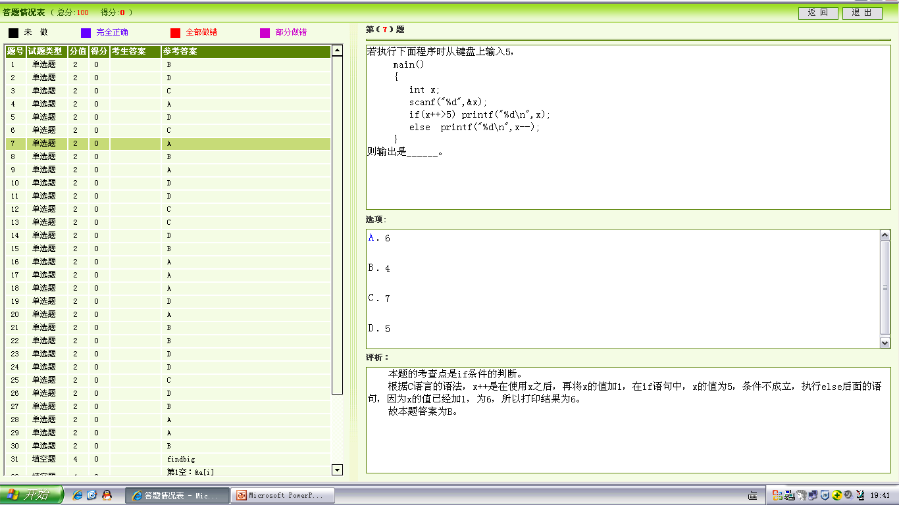
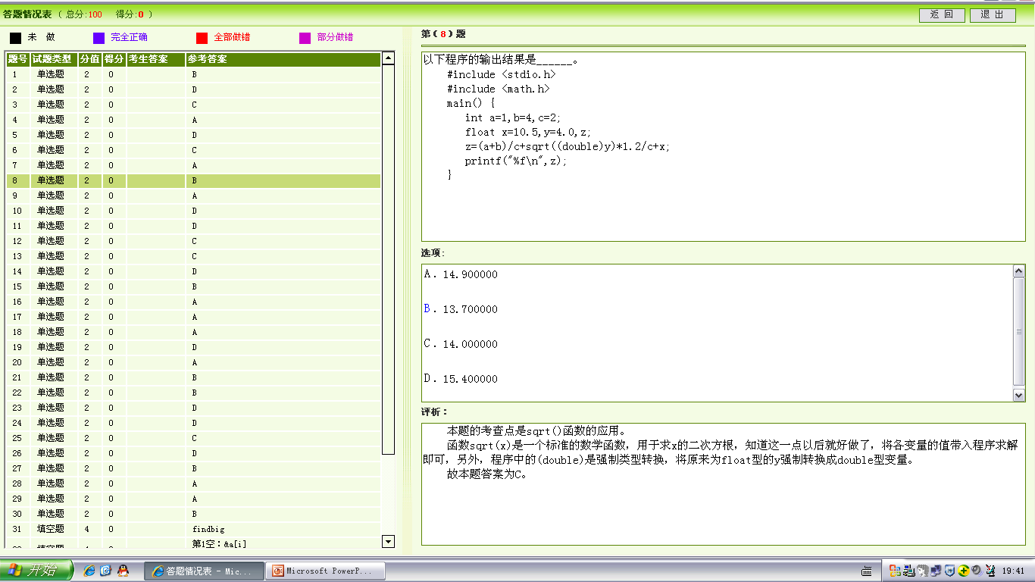

Slide 9
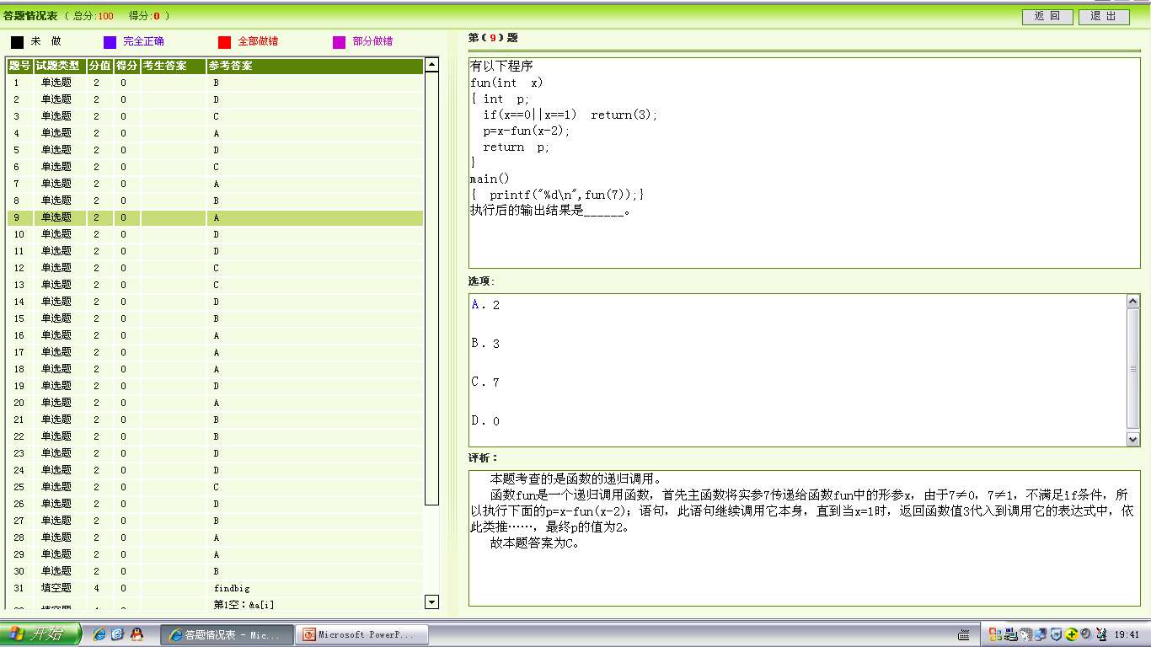

Slide 10
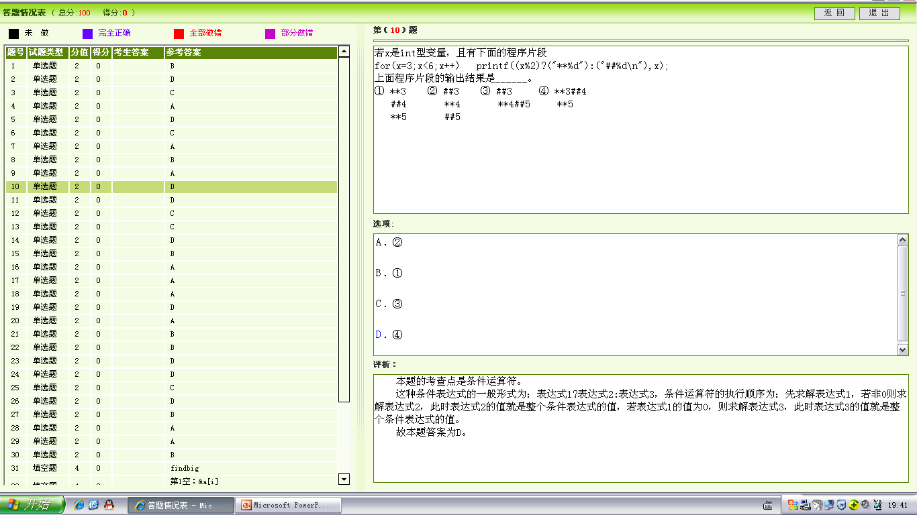

Slide 11
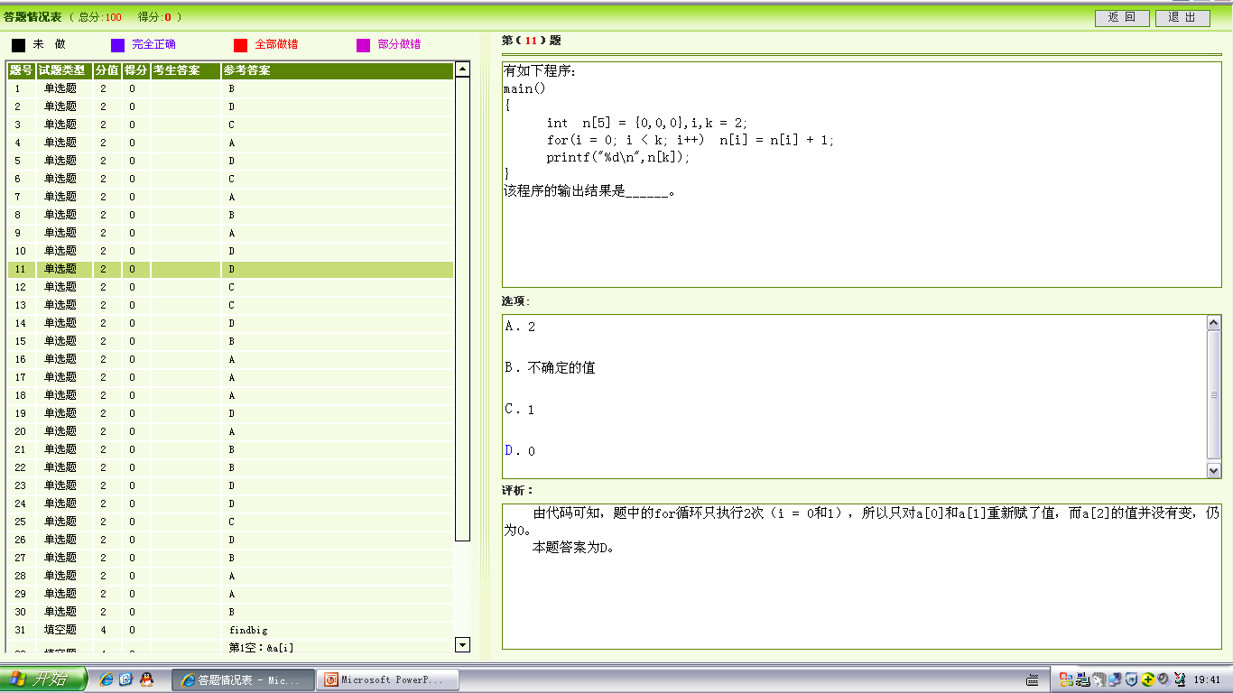

Slide 12
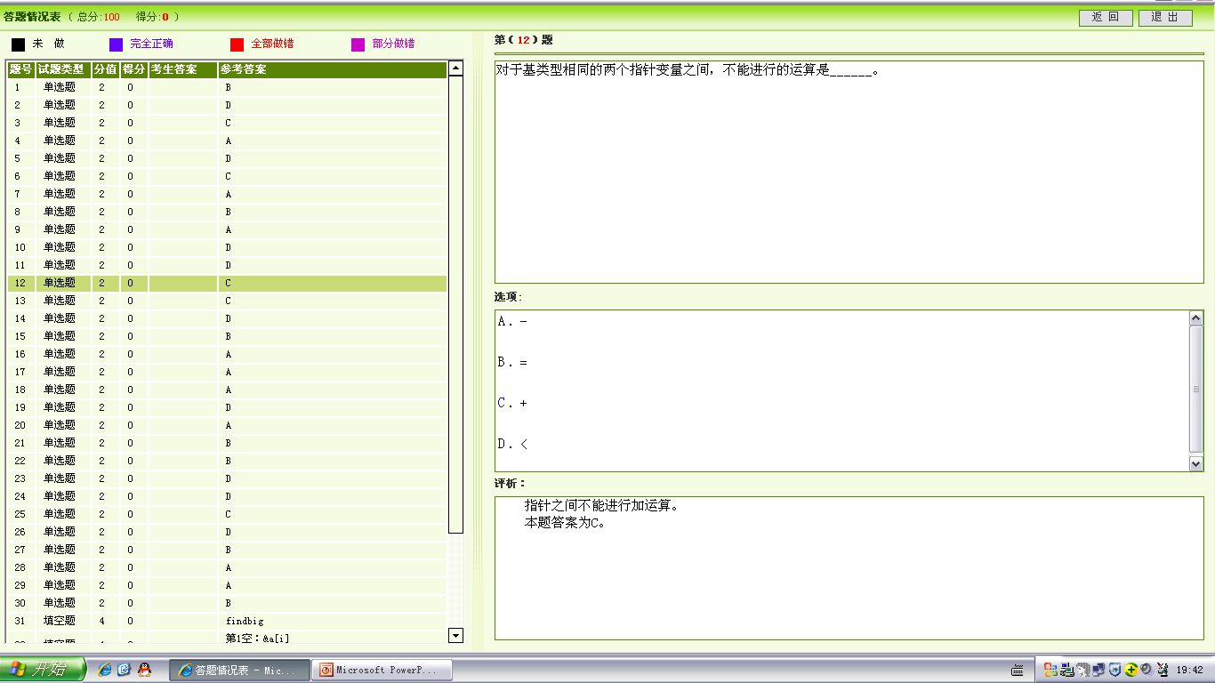

Slide 13
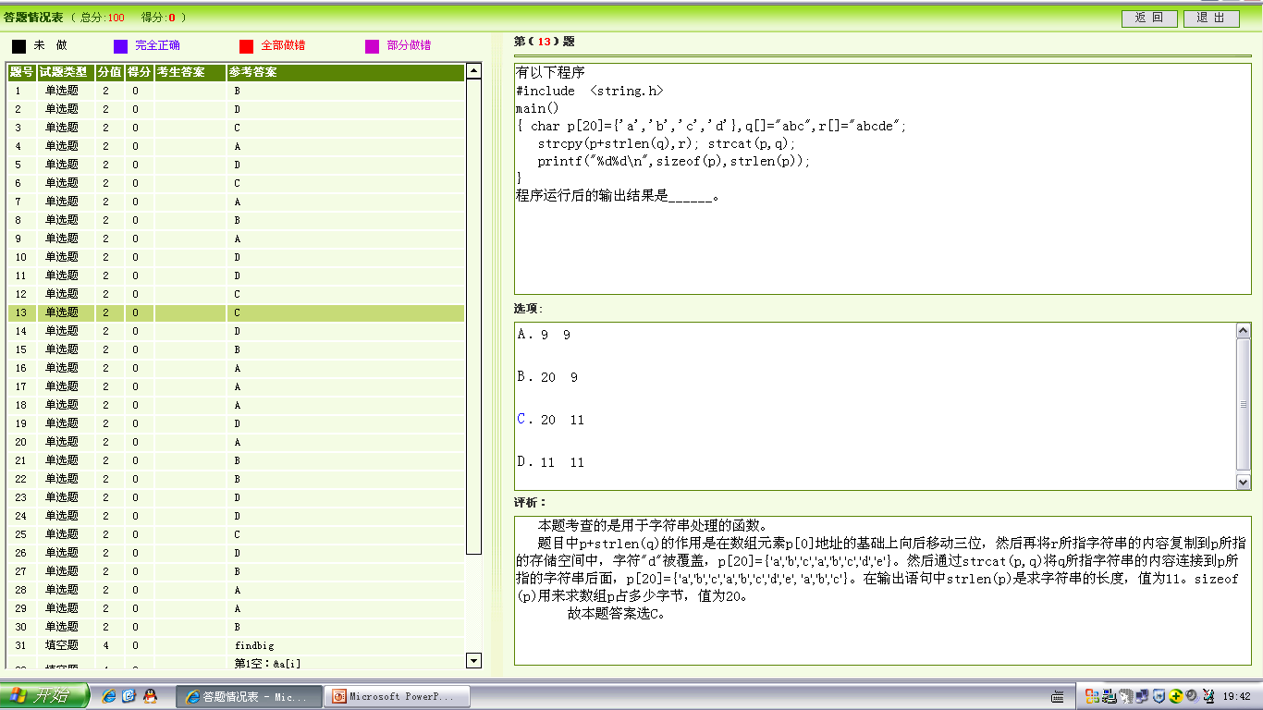

Slide 14
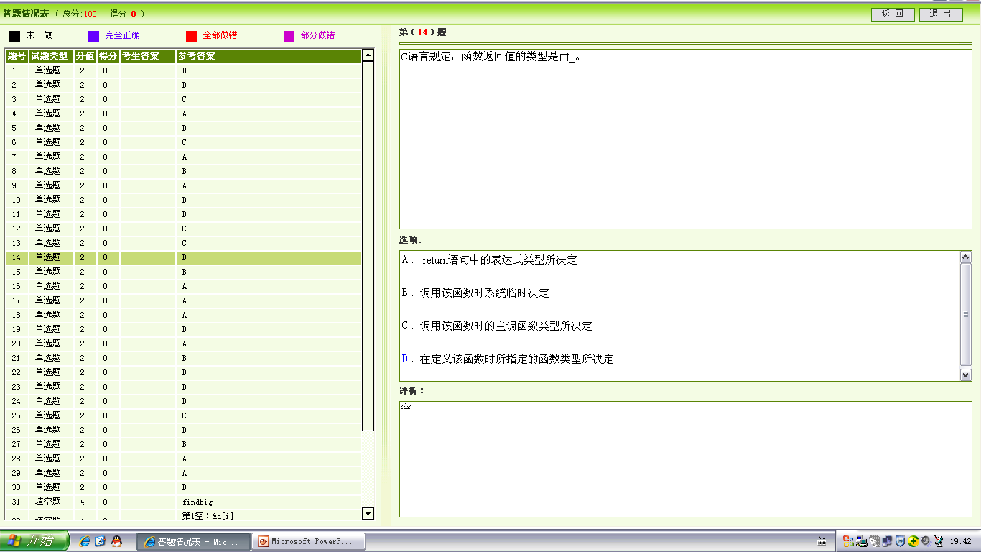
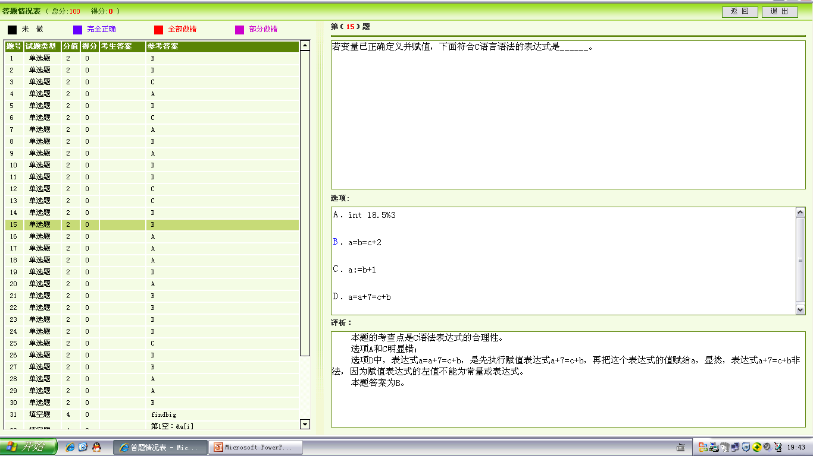


Slide 16
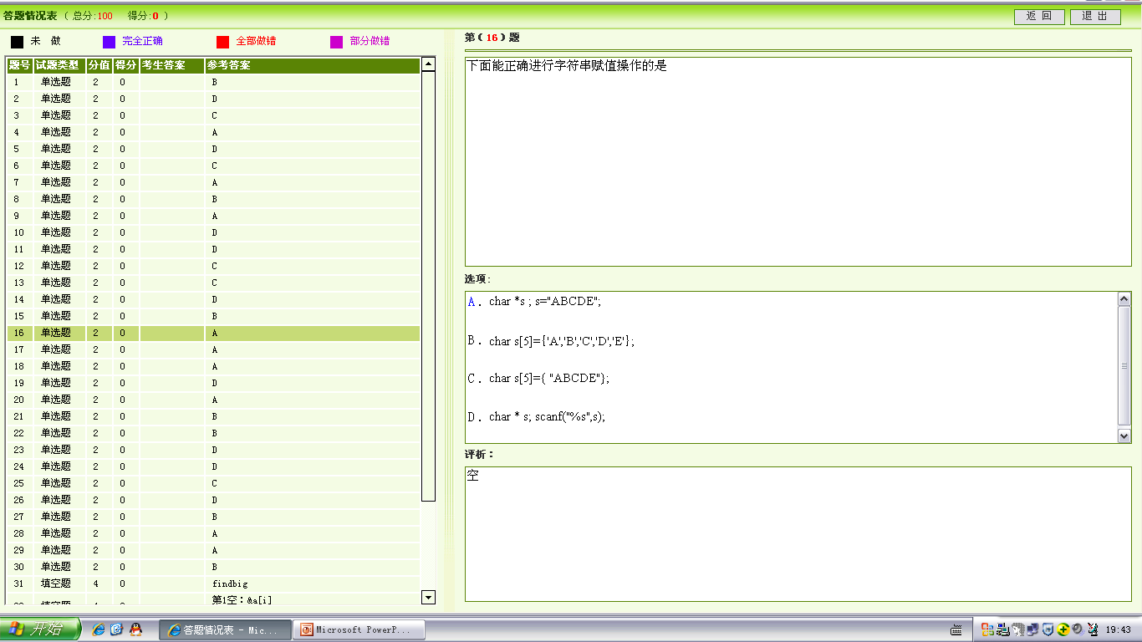

Slide 17
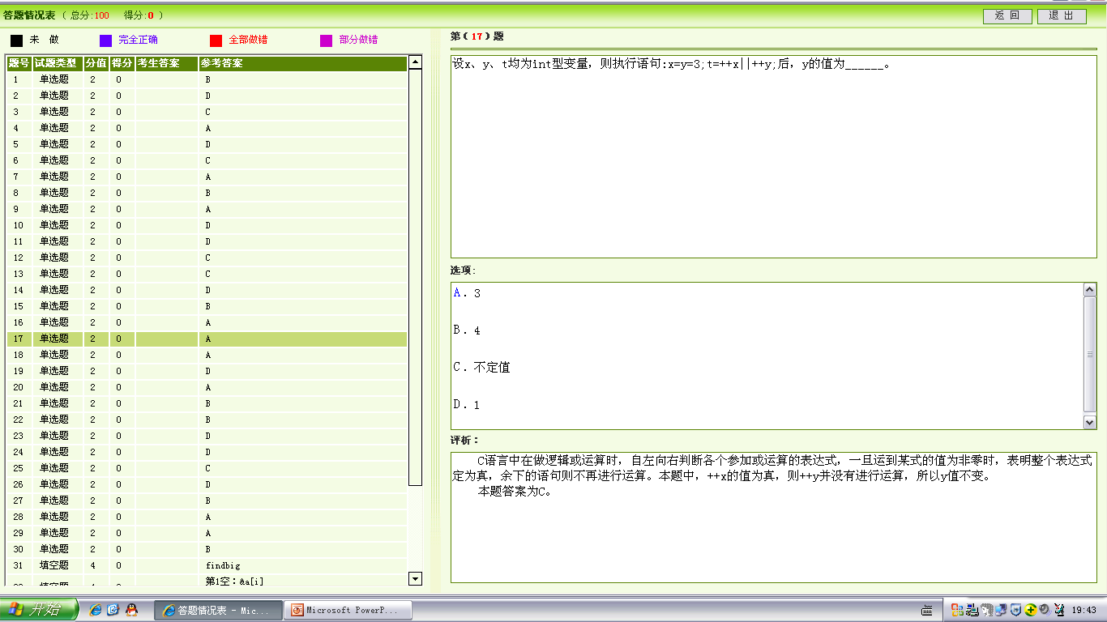

Slide 18
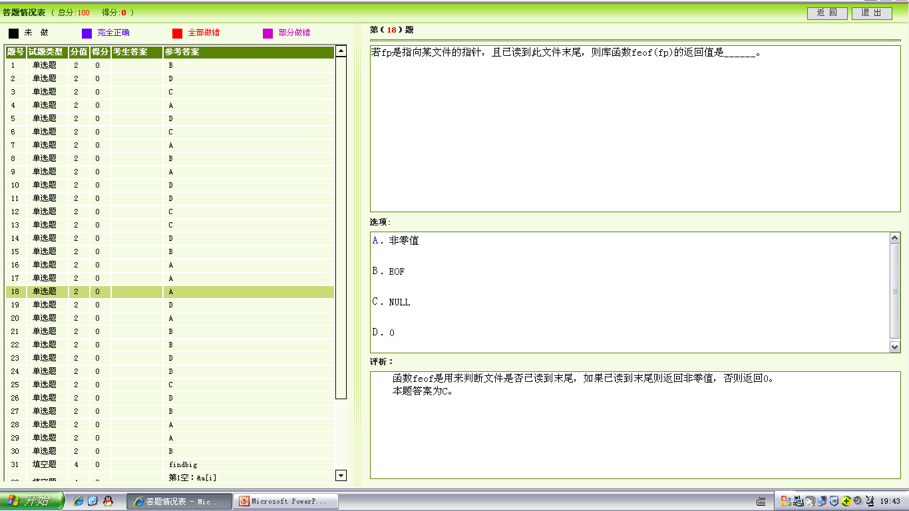

Slide 19
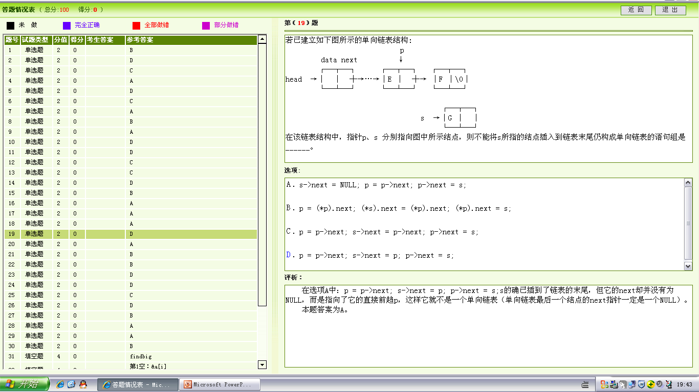

Slide 20
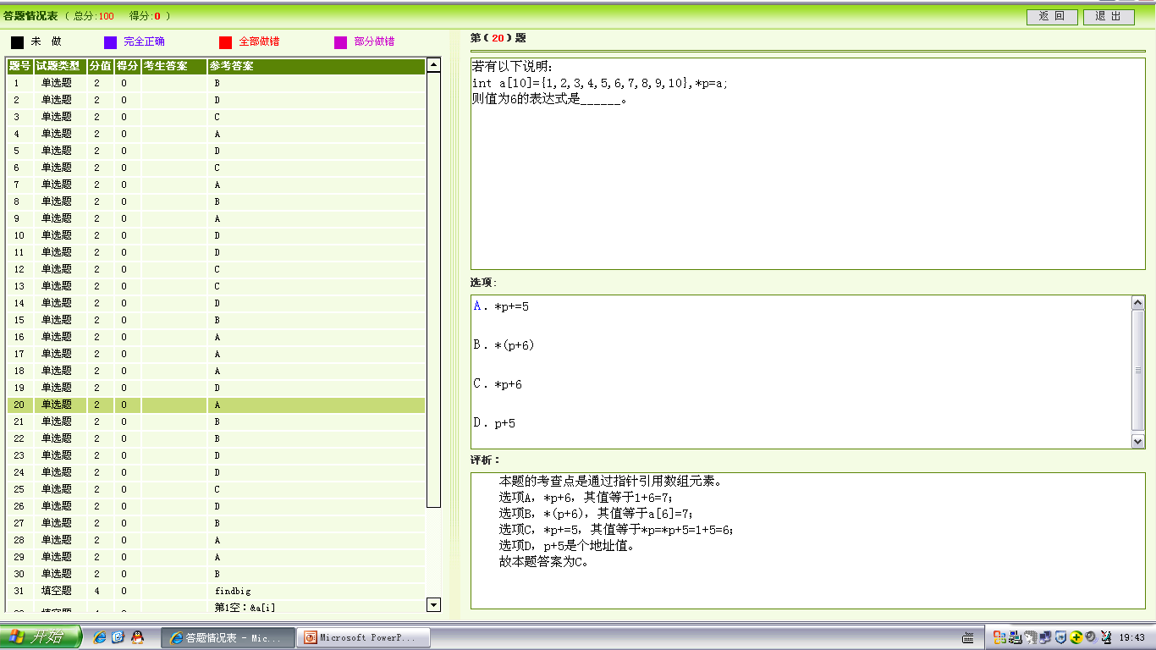

Slide 21
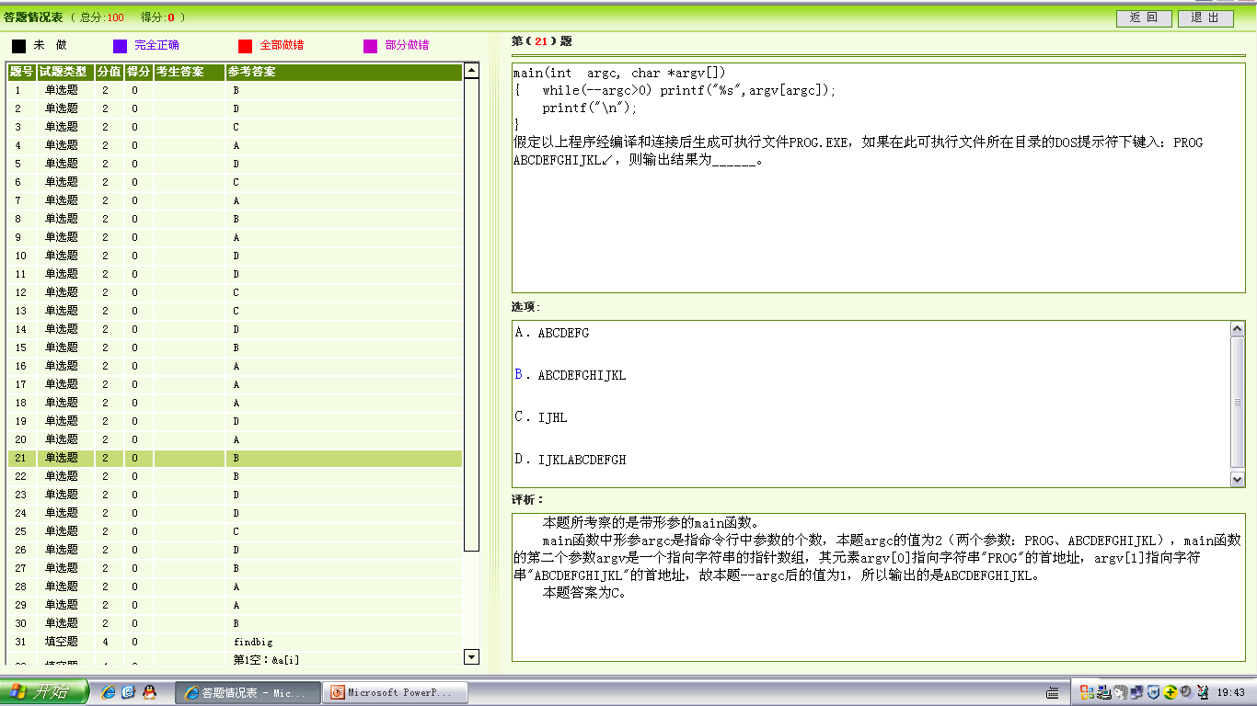

Slide 22
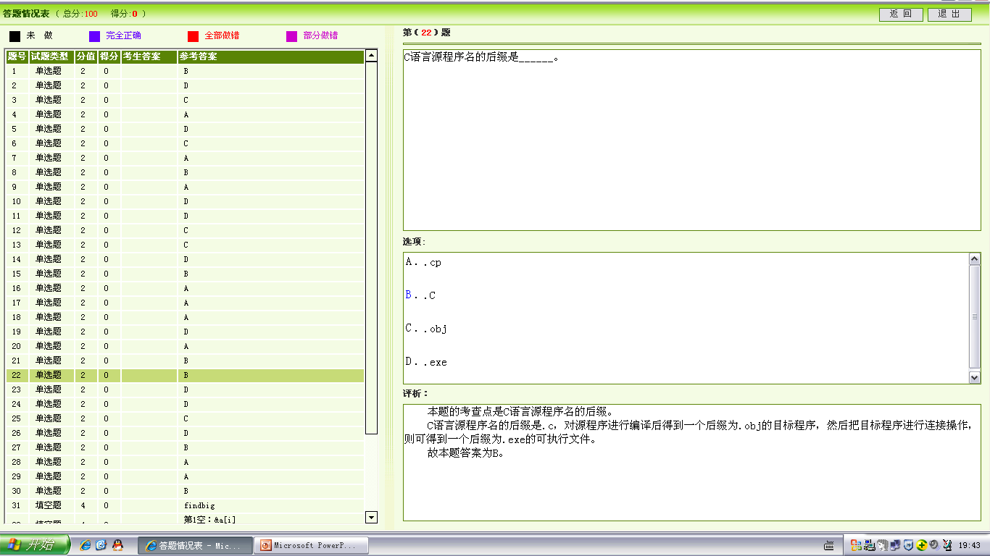

Slide 23
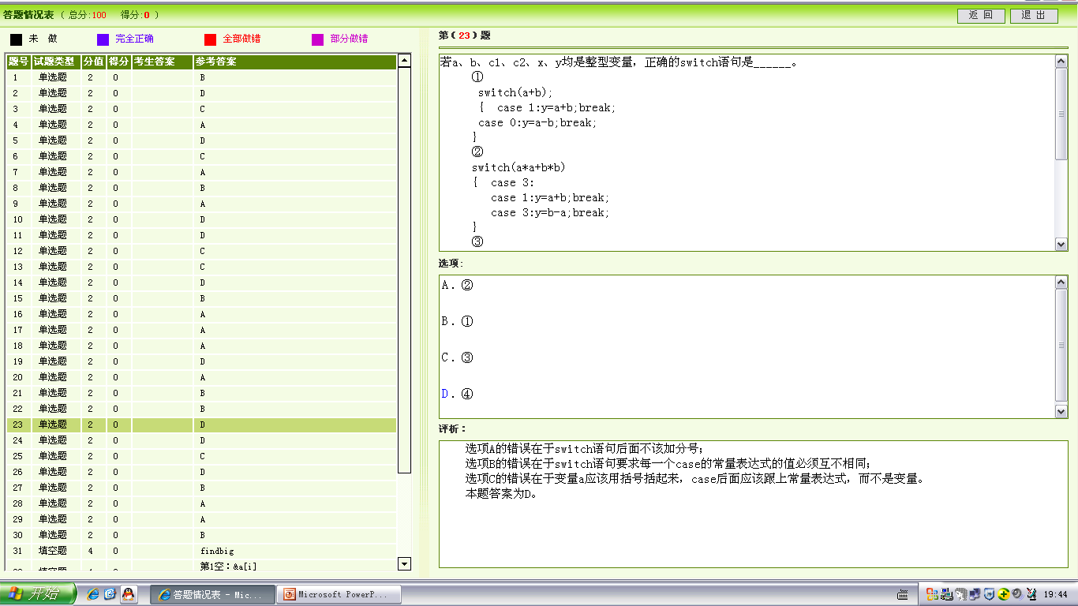

Slide 24
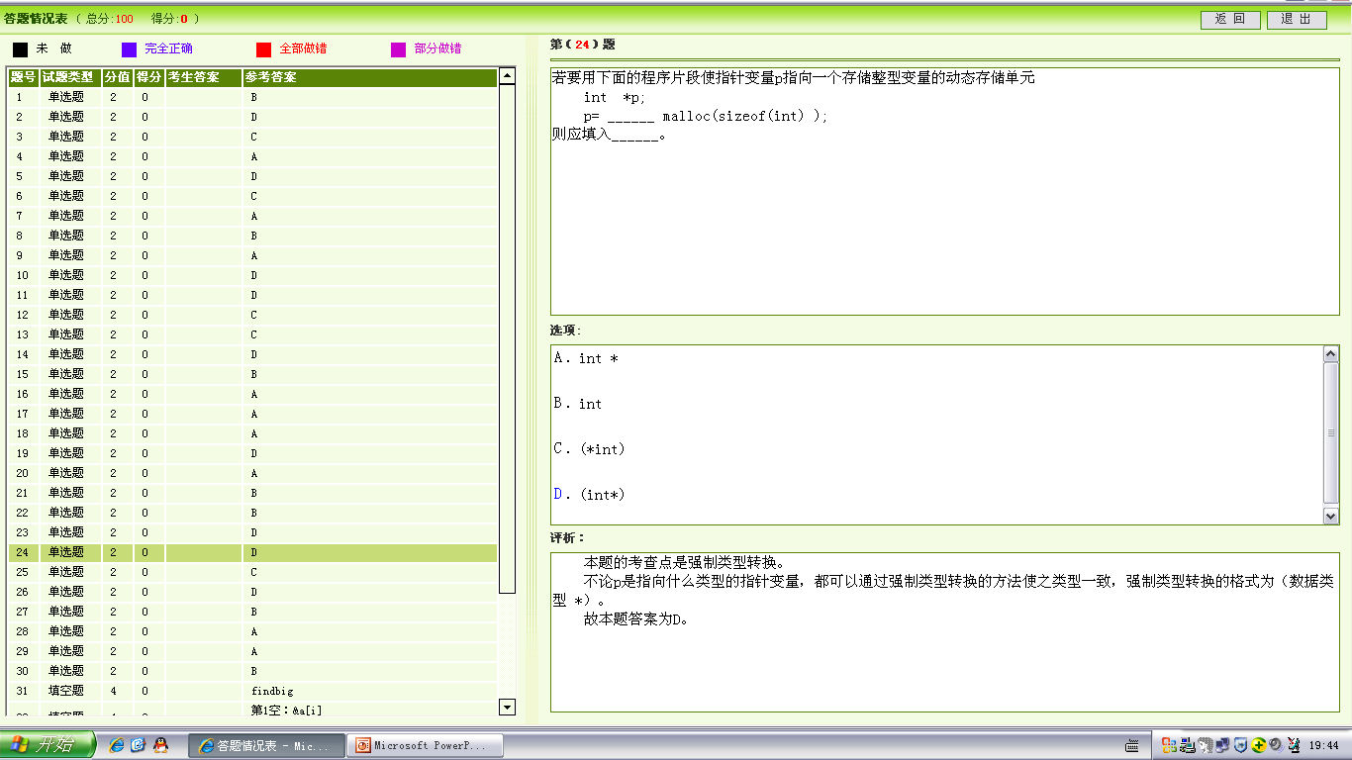

Slide 25
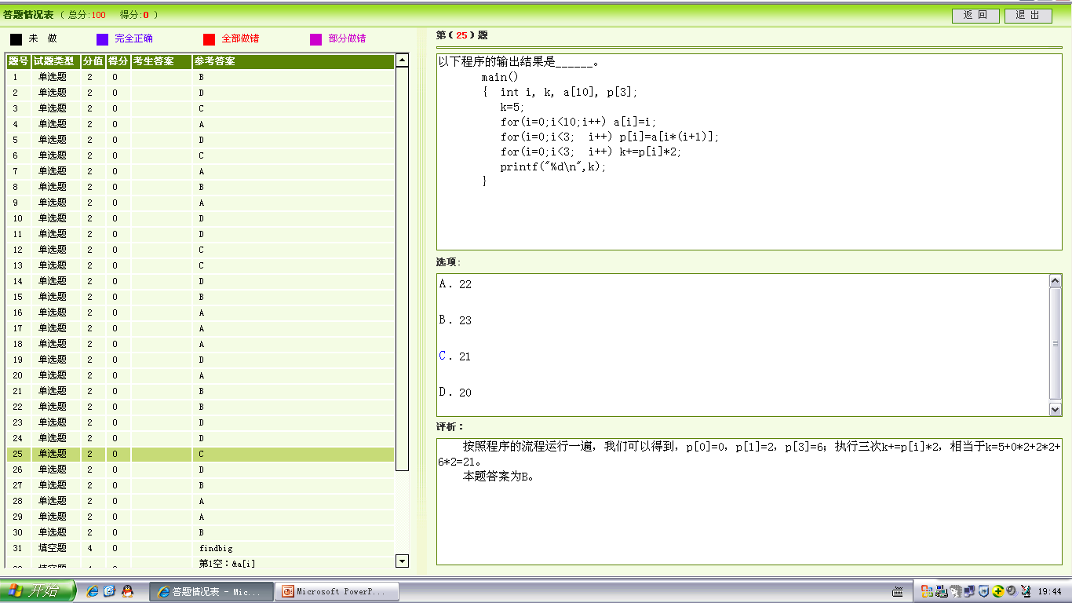

Slide 26
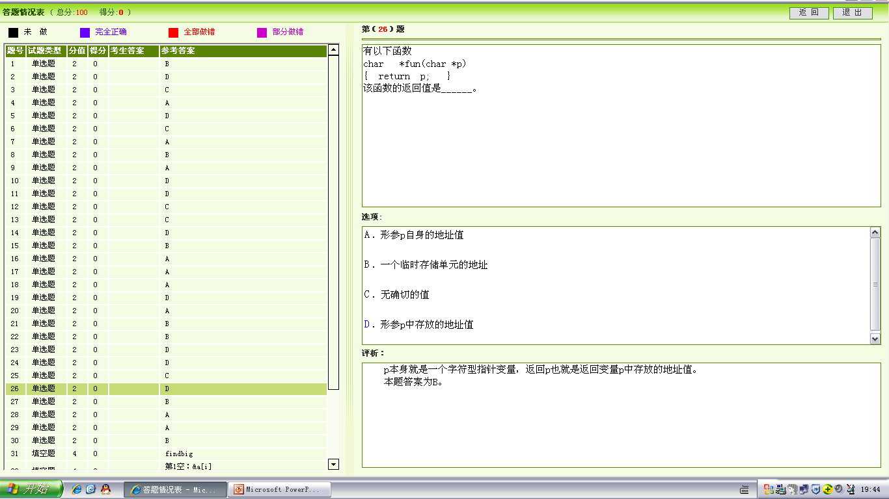

Slide 27
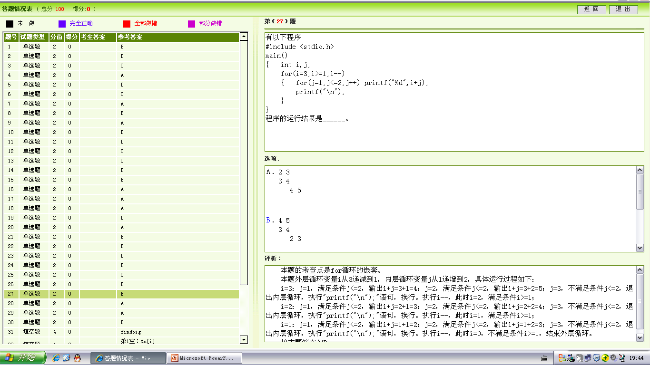

Slide 28
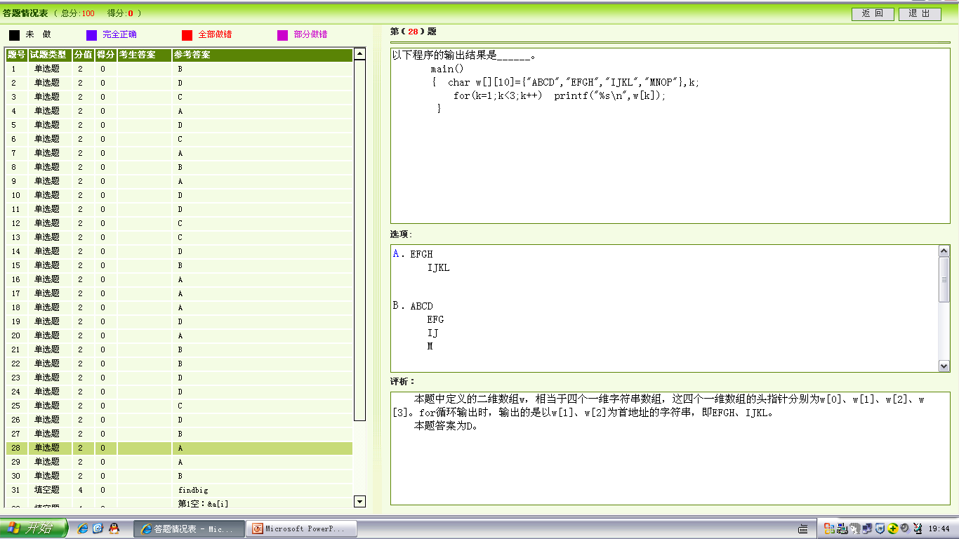

Slide 29
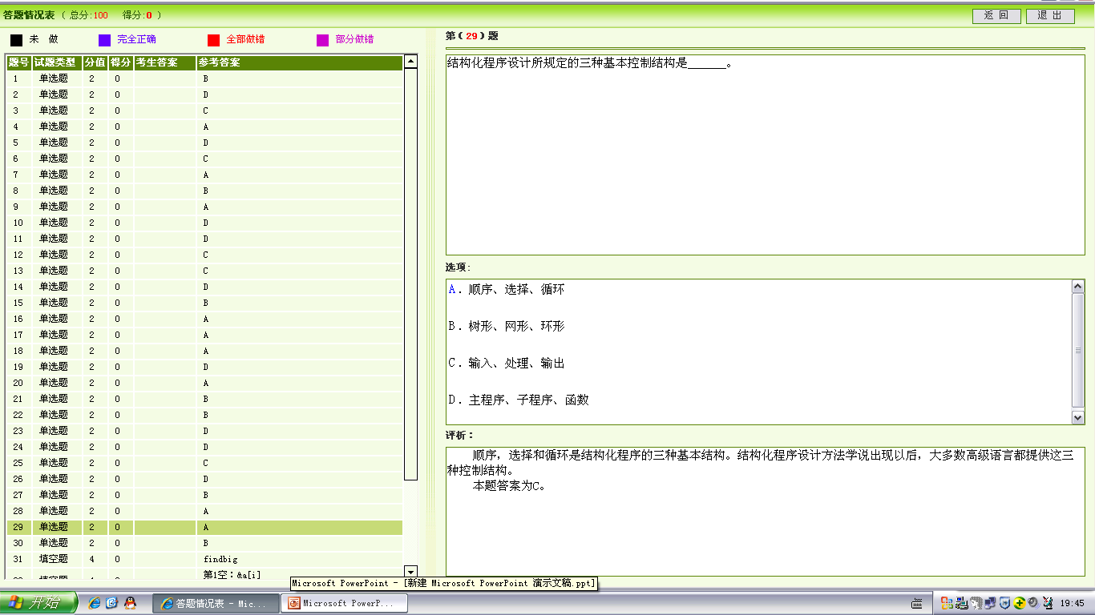

Slide 30
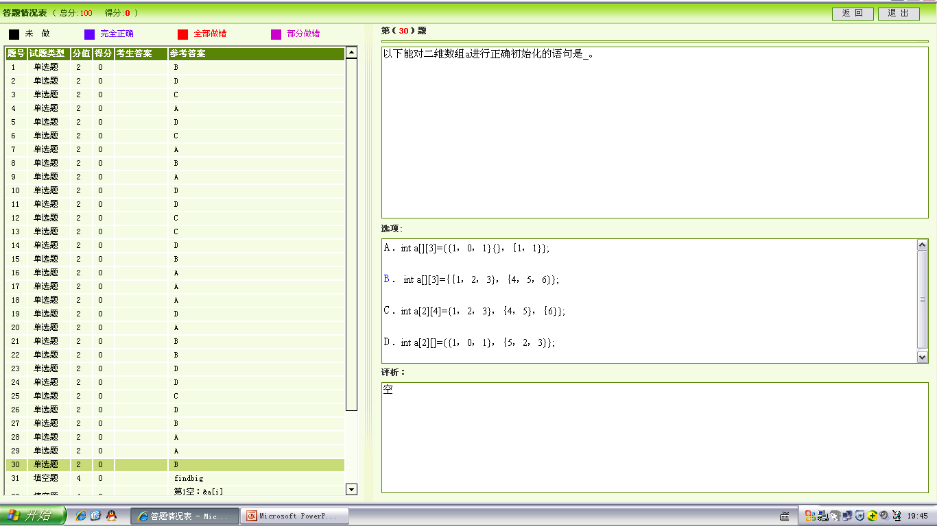

Slide 31
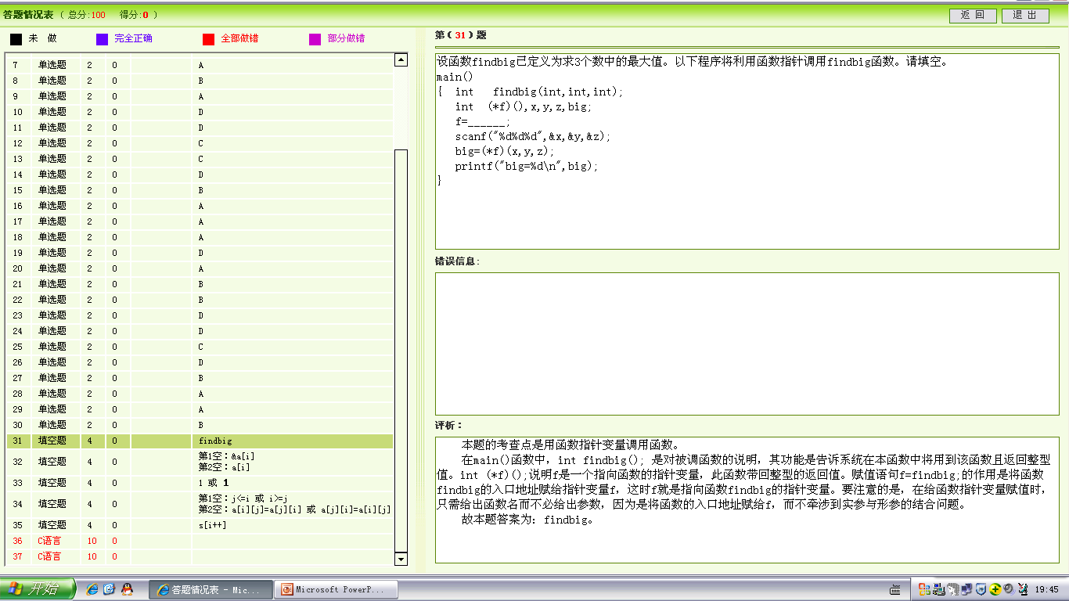

Slide 32
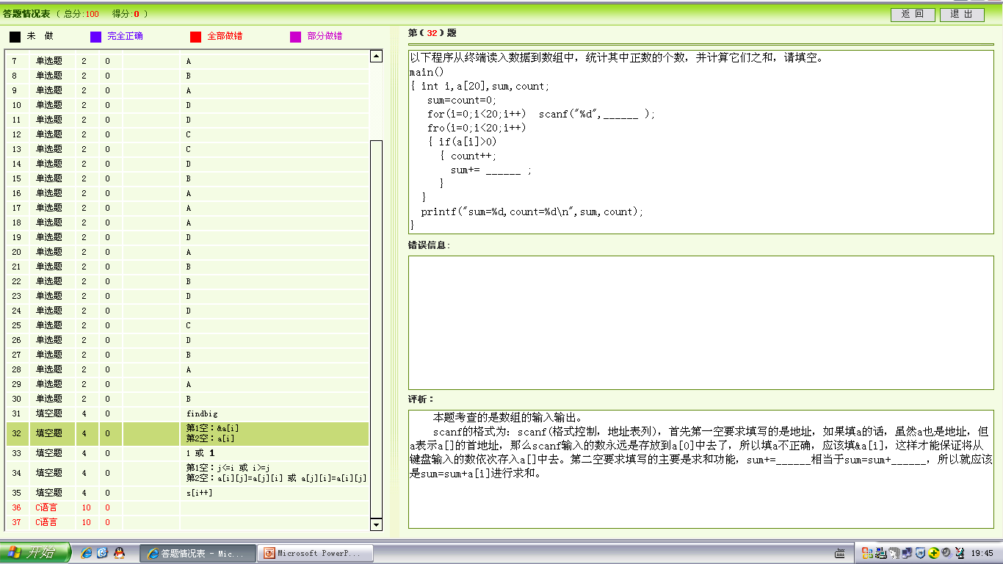

Slide 33
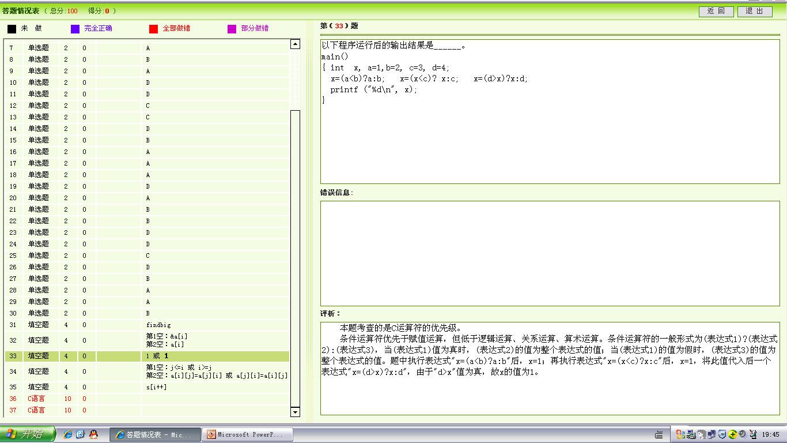

Slide 34
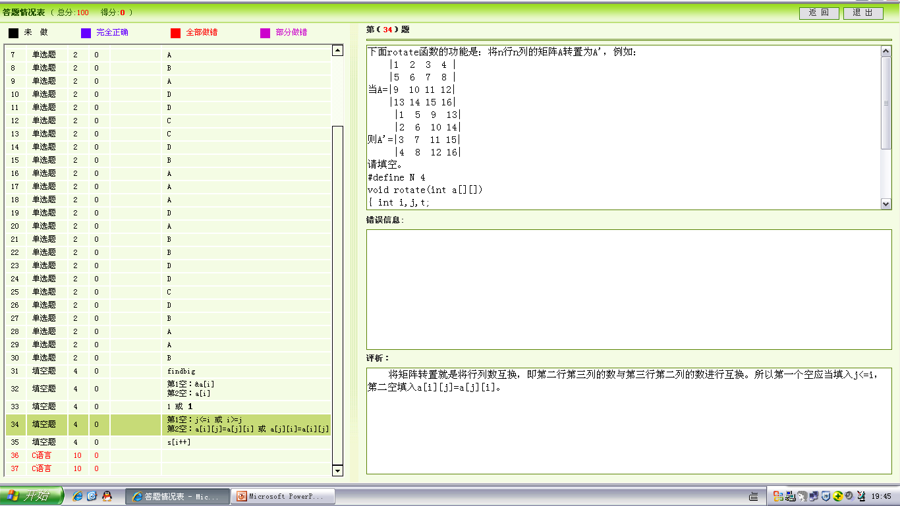

Slide 35
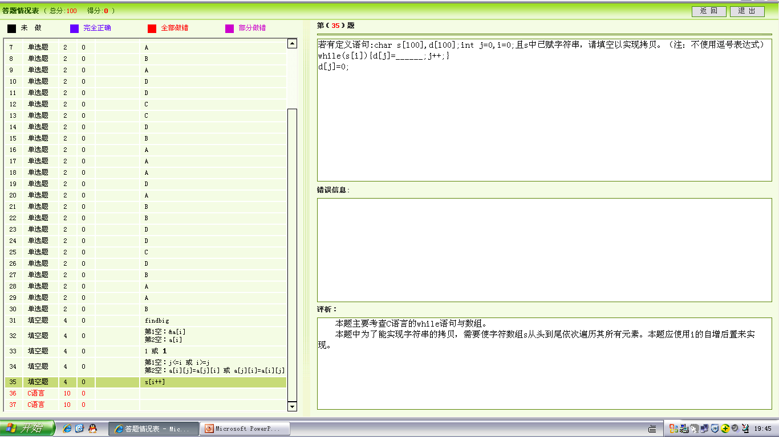

Slide 36
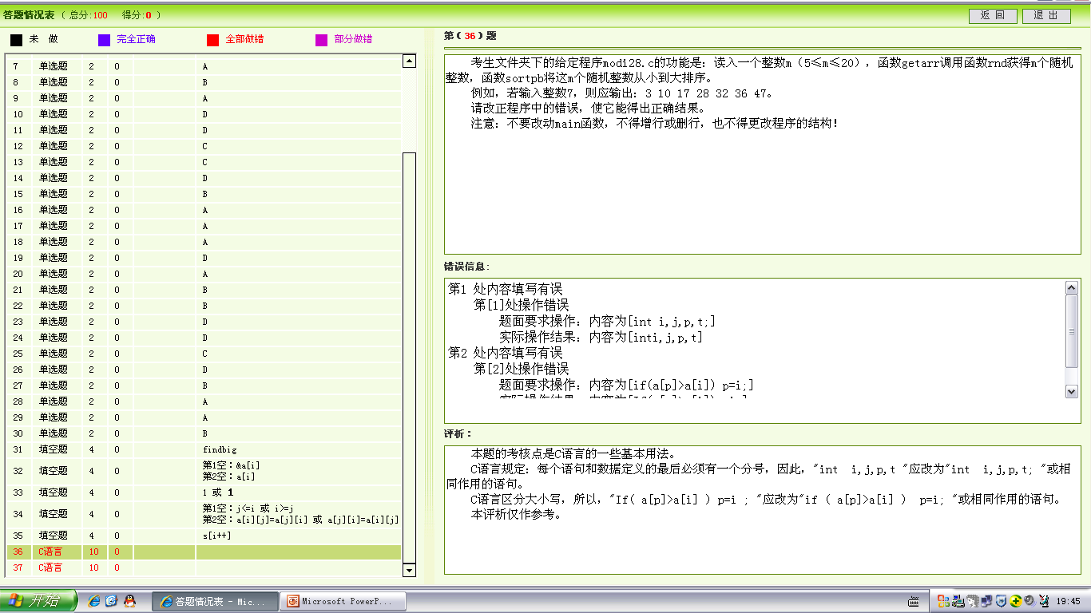

Slide 37
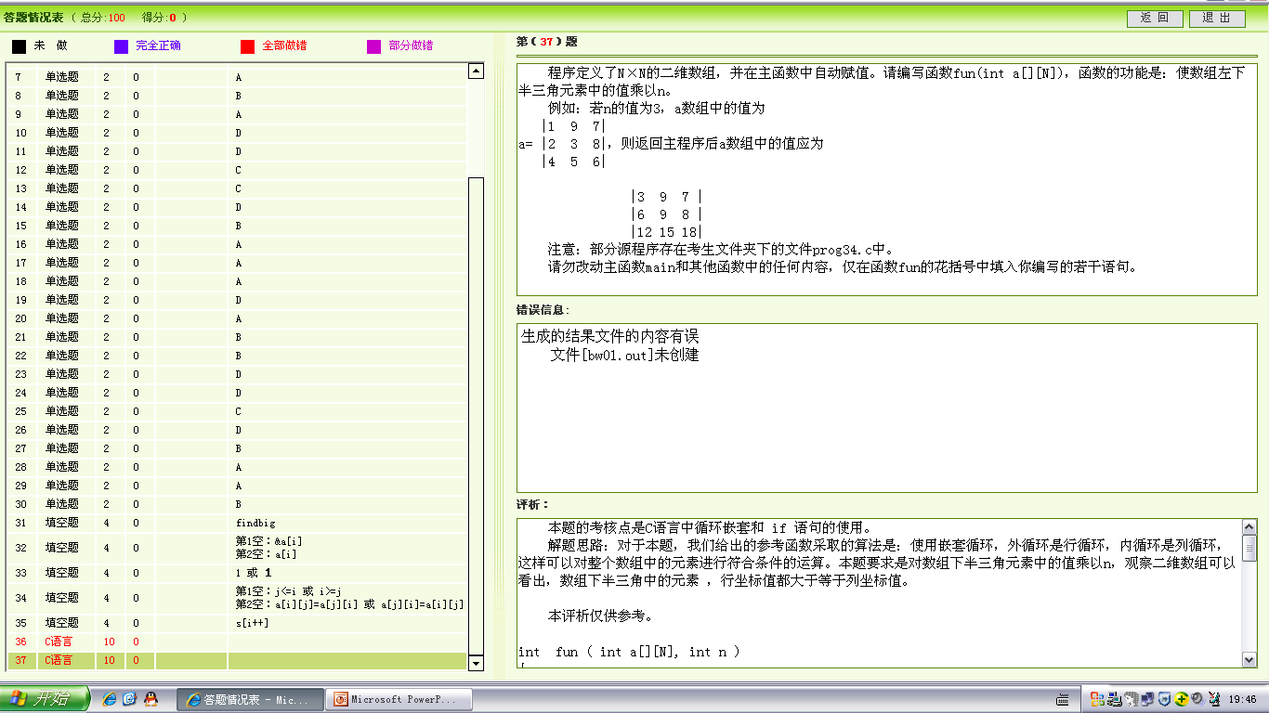

Slide 38
int fun ( int a[][N], int n )
{
int i,j;
/*先行后列对数组左下半三角元素中的值乘以n*/
for (i=0;i<N;i++)
for (j=0;j<=i;j++)
a[i][j] *=n;
}
main ( )
{ int a[N][N], n, i, j;
clrscr();
printf("***** The array *****\n");
for ( i =0; i<N; i++ )
{ for ( j =0; j<N; j++ )
{ a[i][j] = rand()%10; printf( "%4d", a[i][j] ); }/*随机产生比10小的整数存放在a数组中*/
printf("\n");
}
do n = rand()%10 ; while ( n >=3 );/*随机产生大于等于3且小于10的整数作为左下半三角元素的乘数n的值*/
printf("n = %4d\n",n);
fun ( a, n );
printf ("***** THE RESULT *****\n");
for ( i =0; i<N; i++ )
{ for ( j =0; j<N; j++ ) printf( "%4d", a[i][j] );
printf("\n");
}
NONO( );
}

