Slide 1
Data and Computer Communications
Internet Applications
Domain Name Server
& the World Wide Web
MIS420
Carlo Mobarak
Sagesse University
2018

Slide 2
DNS
The Internet Directory Service
the Domain Name Service (DNS) provides mapping between host name & IP address
defined in RFCs 1034 / 1035
key elements
  domain name space
  DNS database
  name servers
  name resolvers
Notes:
The Domain Name System (DNS) is a directory lookup service that provides a mapping between the name of a host on the Internet and its numerical address. DNS is essential to the functioning of the Internet. It is defined in RFCs 1034 and 1035. Four elements comprise the DNS:
• Domain name space: DNS uses a tree-structured name space to identify resources on the Internet.
• DNS database: Conceptually, each node and leaf in the name space tree structure names a set of information (e.g., IP address, type of resource) that is contained in a resource record (RR). The collection of all RRs is organized into a distributed database.
• Name servers: These are server programs that hold information about a portion of the domain name tree structure and the associated RRs.
• Resolvers: These are programs that extract information from name servers in response to client requests. A typical client request is for an IP address corresponding to a given domain name.

Slide 3
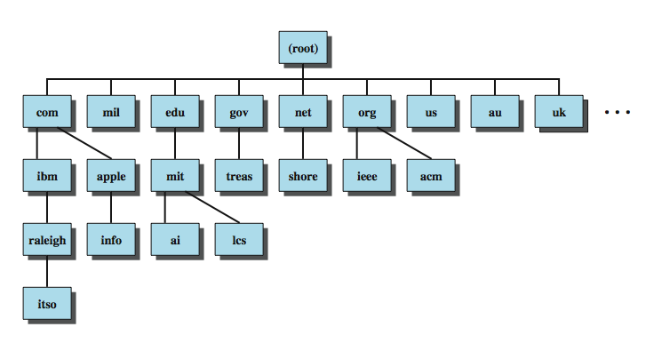
Domain Names
Notes:
The 32-bit IP address provides a way of uniquely identifying devices attached to the Internet. This address is interpreted as having two components: a network number, which identifies a network on the Internet, and a host address, which identifies a unique host on that network. A domain refers to a group of hosts that are under the administrative control of a single entity, such as a company or government agency. Domains are organized hierarchically, so that a given domain may consist of a number of subordinate domains. Names are assigned to domains and reflect this hierarchical organization. Stallings DCC8e Figure 23.1 shows a portion of the domain naming tree. At the very top level are a small number of domains that encompass the entire Internet. Each subordinate level is named by prefixing a subordinate name to the name at the next highest level. As you move down the naming tree, you eventually get to leaf nodes that identify specific hosts on the Internet. These hosts are assigned Internet addresses. An Internet-wide organization is responsible for assigning domain names so that every domain name is unique. The actual assignment of addresses is delegated down the hierarchy. For example, the main host at MIT, with a domain name of mit.edu, has four IP addresses: 18.7.21.77, 18.7.21.69, 18.7.21.70, and 18.7.21.110. The subordinate domain lcs.mit.edu has the IP address 18.26.0.36

Slide 4
DNS Database
hierarchical database
containing resource records (RRs)
features
  variable-depth hierarchy for names
  distributed database
  distribution controlled by database
provides name-to-address directory service for network applications
Notes:
DNS is based on a hierarchical database containing resource records (RRs) that include the name, IP address, and other information about hosts. The key features of the database are:
• Variable-depth hierarchy for names: DNS allows essentially unlimited levels and uses the period (.) as the level delimiter in printed names, as described earlier.
• Distributed database: The database resides in DNS servers scattered throughout the Internet and private intranets.
• Distribution controlled by the database: The DNS database is divided into thousands of separately managed zones, which are managed by separate administrators. The database software controls distribution and update of records.
Using this database, DNS servers provide a name-to-address directory service for network applications that need to locate specific servers. For example, every time an e-mail message is sent or a Web page is accessed, there must be a DNS name lookup to determine the IP address of the e-mail server or Web server.

Slide 5
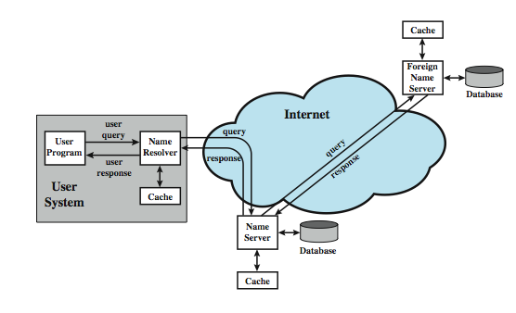
DNS Operation
Notes:
DNS operation typically includes the following steps, as shown in Stallings DCC8e Figure 23.3:
1. A user program requests an IP address for a domain name.
2. A resolver module in the local host or local ISP formulates a query for a local name server in the same domain as the resolver.
3. The local name server checks to see if the name is in its local database or cache, and, if so, returns the IP address to the requestor. Otherwise, the name server queries other available name servers, starting down from the root of the DNS tree or as high up the tree as possible.
4. When a response is received at the local name server, it stores the name/address mapping in its local cache and may maintain this entry for the amount of time specified in the time to live field of the retrieved RR.
5. The user program is given the IP address or an error message.
Typically, single queries are carried over UDP. Queries for a group of names are carried over TCP. The distributed DNS database that supports the DNS functionality must be updated frequently because of the rapid and continued growth of the Internet. Accordingly, dynamic updating functions for DNS have been defined. In essence, DNS name servers automatically send out updates to other relevant name servers as conditions warrant.

Slide 6
DNS Server Hierarchy
DNS database is distributed hierarchically
  may extend as deep as needed
any organization owning a domain can run name servers
each server manages authoritative name data for a zone
13 root name servers at top of hierarchy share responsibility for top level zones
Notes:
The DNS database is distributed hierarchically, residing in DNS name servers scattered throughout the Internet. Name servers can be operated by any organization that owns a domain; that is, any organization that has responsibility for a subtree of the hierarchical domain name space. Each name server is configured with a subset of the domain name space, known as a zone, which is a collection of one or more (or all) subdomains within a domain, along with the associated RRs. This set of data is called authoritative, because this name server is responsible for maintaining an accurate set or RRs for this portion of the domain name hierarchy. The hierarchical structure can extend to any depth. Thus, a portion of the name space assigned to an authoritative name server can be delegated to a subordinate name server in a way that corresponds to the structure of the domain name tree. For example, a name server corresponds to the domain ibm.com. A portion of that domain is defined by the name watson.ibm.com, which corresponds to the node watson.ibm.com and all of the branches and leaf nodes underneath the node watson.ibm.com.
At the top of the server hierarchy are 13 root name servers that share responsibility for the top level zones (Table 23.3). This replication is to prevent the root server from becoming a bottleneck. Even so, each individual root server is quite busy. For example, the Internet Software Consortium reports that its server (F) answers almost 300 million DNS requests daily (www.isc.org/services/public/F-root-server.html).

Slide 7
Name Resolution
query begins with name resolver on host
knows name/address of local DNS server
given a name request, the resolver can:
  return name from cache if already known
  send DNS query to local server which may return answer, or query other servers
recursive technique - server queries other servers for resolver
iterative technique - resolver queries servers in turn as needed
Notes:
As Stallings DCC8e Figure 23.3 (previous slide) shows, each query begins at a name resolver located in the user host system (e.g., gethostbyname in UNIX). Each resolver is configured to know the name and address of a local DNS name server. If the resolver does not have the requested name in its cache, it sends a DNS query to the local DNS server, which either returns an address immediately, or does so after querying one or more other servers. Again, resolvers use UDP for single queries and TCP for group queries. There are two methods by which queries are forwarded and results returned. Suppose a name server (A) forwards a DNS request to another name server (B). If B has the name/address in its local cache or local database, it can return the IP address to A. If not, then B can do either of the following:
1. Query another name server for the desired result and then send the result back to A. This is known as a recursive technique.
2. Return to A the address of the next server (C) to whom the request should be sent. A then sends out a new DNS request to C. This is known as the iterative technique.
In exchanges between name servers, either the iterative or recursive technique may be used. For requests sent by a name resolver, the recursive technique is used.

Slide 8
Hypertext Transfer Protocol
HTTP
base protocol for World Wide Web
for any hypertext client/server application
is a protocol for efficiently transmitting information to make hypertext jumps
  can transfer plain text, hypertext, audio, images, and Internet accessible information
versions 0.9, 1.0, & now 1.1 (RFC2616)
Notes:
The Hypertext Transfer Protocol (HTTP) is the foundation protocol of the World Wide Web (WWW) and can be used in any client/server application involving hypertext. The name is somewhat misleading in that HTTP is not a protocol for transferring hypertext; rather it is a protocol for transmitting information with the efficiency necessary for making hypertext jumps. The data transferred by the protocol can be plaintext, hypertext, audio, images, or any Internet-accessible information.
We begin with an overview of HTTP concepts and operation and then look at some of the details, basing our discussion on the most recent version to be put on the Internet standards track, HTTP 1.1 (RFC 2616).

Slide 9
HTTP Overview
transaction oriented client/server protocol
between Web browser (client) and Web server
uses TCP connections
stateless
  each transaction treated independently
  each new TCP connection for each transaction
  terminate connection when transaction complete
flexible format handling
  client may specify supported formats
Notes:
HTTP is a transaction-oriented client/server protocol. The most typical use of HTTP is between a Web browser and a Web server. To provide reliability, HTTP makes use of TCP. Nevertheless, HTTP is a "stateless" protocol: Each transaction is treated independently. Accordingly, a typical implementation will create a new TCP connection between client and server for each transaction and then terminate the connection as soon as the transaction completes, although the specification does not dictate this one-to-one relationship between transaction and connection lifetimes.
The stateless nature of HTTP is well suited to its typical application. A normal session of a user with a Web browser involves retrieving a sequence of Web pages and documents. The sequence is, ideally, performed rapidly, and the locations of the various pages and documents may be a number of widely distributed servers.
Another important feature of HTTP is that it is flexible in the formats that it can handle. When a client issues a request to a server, it may include a prioritized list of formats that it can handle, and the server replies with the appropriate format. For example, a lynx browser cannot handle images, so a Web server need not transmit any images on Web pages. This arrangement prevents the transmission of unnecessary information and provides the basis for extending the set of formats with new standardized and proprietary specifications.

Slide 10
Key Terms
cache
client
connection
entity
gateway
message
origin server
proxy
resource
server
tunnel
user agent
Notes:
A number of important terms defined in the HTTP specification are summarized in Stallings DCC8e Table 23.4.
Cache - A program's local store of response messages and the subsystem that controls its message storage, retrieval, and deletion.
Client - program that establishes connections for sending requests.
Connection - A transport layer virtual circuit between two programs
Entity - A particular representation or rendition of a data resource, it consists of entity headers and an entity body.
Gateway - A server that acts as an intermediary for some other server. Message - The basic unit of HTTP communication, consisting of a structured sequence of octets transmitted via the connection.
Origin Server - server on which a given resource resides or is to be created.
Proxy - intermediary program that acts as both a server and a client for the purpose of making requests on behalf of other clients.
Resource - A network data object or service which can be identified by a URI.
Server - application program that accepts connections in order to service requests by sending back responses
Tunnel - intermediary program that is a blind relay between two connections
User Agent - client that initiates a request eg. browsers, editors, spiders, etc

Slide 11
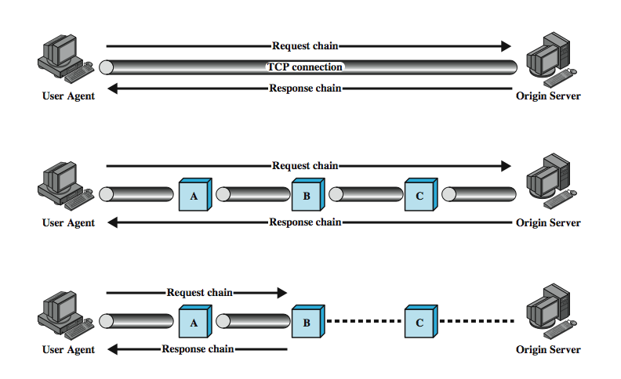
Examples of HTTP Operation
Notes:
Stallings DCC8e Figure 23.6 illustrates three examples of HTTP operation. The simplest case is one in which a user agent establishes a direct connection with an origin server. The user agent is the client (eg. web browser) that initiates the request. The origin server is the web server on which a resource of interest resides. The client opens a TCP connection that is end-to-end between the client and the server. The client then issues an HTTP request. The request consists of a specific command (method), an address ( Uniform Resource Locator (URL)), and a MIME-like message containing request parameters, information about the client, and perhaps some additional content information. When the server receives the request, it attempts to perform the requested action and then returns an HTTP response. The response includes status information, a success/error code, and a MIME-like message containing information about the server, information about the response itself, and possible body content. The TCP connection is then closed.
The middle part of Figure 23.6 shows a case in which there are one or more intermediate systems with TCP connections between logically adjacent systems. Each intermediate system acts as a relay, so that a request initiated by the client is relayed through the intermediate systems to the server, and the response from the server is relayed back to the client.

Slide 12
HTTP Operation - Caches
often have a web cache
stores previous requests/ responses
may return stored response to subsequent requests
may be a client, server or intermediary system
not all requests can be cached
Notes:
The lowest portion of Stallings DCC8e Figure 23.6 (previous slide) shows an example of a cache. A cache is a facility that may store previous requests and responses for handling new requests. If a new request arrives that is the same as a stored request, then the cache can supply the stored response rather than accessing the resource indicated in the URL. The cache can operate on a client or server or on an intermediate system other than a tunnel. In the figure, intermediary B has cached a request/response transaction, so that a corresponding new request from the client need not travel the entire chain to the origin server, but is handled by B. Not all transactions can be cached, and a client or server can dictate that a certain transaction may be cached only for a given time limit.

Slide 13
Summary
domain name service (DNS)
  names, database, name resolution, messages
HyperText Transfer Protocol (HTTP )
  overview
  request and response messages
Notes:
Chapter23 summary.

