Slide 1

Competitive Advantage with E-business

Slide 2
Study Questions
How do companies use e-commerce?
What technology is needed for e-commerce?
Why is Web important to business?
How can organizations benefit from social networking?
How do organizations exchange data?
8-<number>
Notes:
Chapter 8: E-Commerce and Web 2.0

Slide 3
Customer Relationship Management (CRM)
Track interaction with customers
Customer may install portion of vendor’s CRM on their system to facilitate purchasing
  Adds sufficient value to overcome risks of unknown software
Vendor creates competitive advantage
  Creates high switching costs
8-<number>

Slide 4
Benefits of Inter-Organizational Systems
Organizations can focus on their core competencies
  Can outsource most activities
  Avoid time and expense of building infrastructure
    Reduces capital requirement
    Requires fewer employees
      Lowers payroll and associated costs
  Shortens time to market
8-<number>

Slide 5
How do companies use e-commerce (introduction)?
Electronic commerce (e-commerce) is the buying and selling of goods and services over public and private computer networks. It requires all of the following:
  Buyers and sellers
  Products and suppliers
  A place to “meet”
  Marketing to attract the buyer
  Accept and process the order
All of these elements are present in both
e-commerce and traditional commerce
8-<number>
Notes:
Chapter 8: E-Commerce and Web 2.0

Slide 6
How do companies use e-commerce (What’s different?)
For the Seller
  Open 24/7
  Shoppers from anywhere
  Virtual inventory is cheaper and extensive
  Lower transaction costs
  Target your customers
  Build an order over time
For the Buyer
  Open 24/7
  Never leave home
  Easy to view and explore product line
  Comparison shop
  Web site knows you
  Build an order over time
8-<number>
Notes:
Chapter 8: E-Commerce and Web 2.0

Slide 7
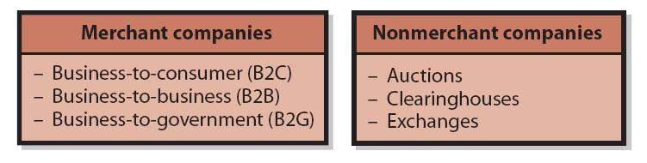
How do companies use e-commerce?
Merchant companies are those companies that take title to the goods they sell; i.e., they buy goods and resell them.
Non-merchant companies are those that arrange for the sale of goods without ever owning them or taking title.
8-<number>
Notes:
Chapter 8: E-Commerce and Web 2.0

Slide 8
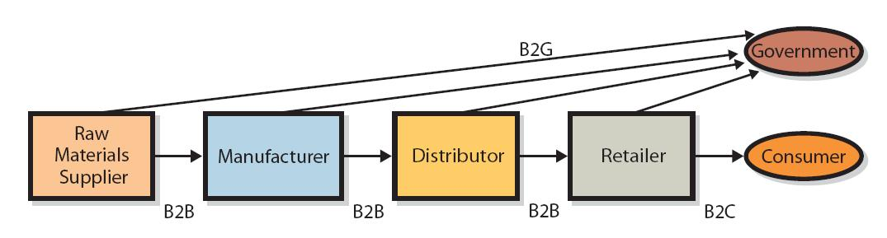
How do companies use e-commerce
(merchant companies)?
B2C transactions occur between a supplier and retail customer. The supplier generally uses a Web storefront.
B2B transactions occur between companies.
B2G transactions occur between companies and governmental organizations.
Example of Use of B2B, B2G, and B2C
8-<number>
Notes:
Chapter 8: E-Commerce and Web 2.0

Slide 9
How do companies use e-commerce
(non-merchant companies)?
There are two types of non-merchant e-commerce companies:
  Auctions match buyers and sellers using the e-commerce version of standard auction where the auction company receives a commission on each product that’s sold. eBay.com is the best-known example.
  A clearinghouse provides goods at a stated price, arranges for delivery but never takes title to the goods. The company receives a commission on each product that’s sold. Amazon.com is the best-known example.
8-<number>
Notes:
Chapter 8: E-Commerce and Web 2.0

Slide 10
How do companies use e-commerce (improved efficiency)?
E-commerce leads to disintermediation, which is the elimination of middle layers in the supply chain
  The consumer can buy from a retailer or use e-commerce to go directly to the manufacturer.
  E-commerce improves the flow of price information; i.e., you can go to any number of Web sites that offer product price comparisons.
  The additional information enables the consumer to pay the lowest price and serves ultimately to remove inefficient vendors.
From the seller’s side, e-commerce produces information about price elasticity (the change in demand that accompanies a change in price)
  Using an auction, a company can learn not just what the top price for an item is, but also learn the second, third, and other prices from the losing bids.
  Managing prices by direct interaction with customers yields better information than managing prices by watching competitors’ pricing.
8-<number>
Notes:
Chapter 8: E-Commerce and Web 2.0

Slide 11
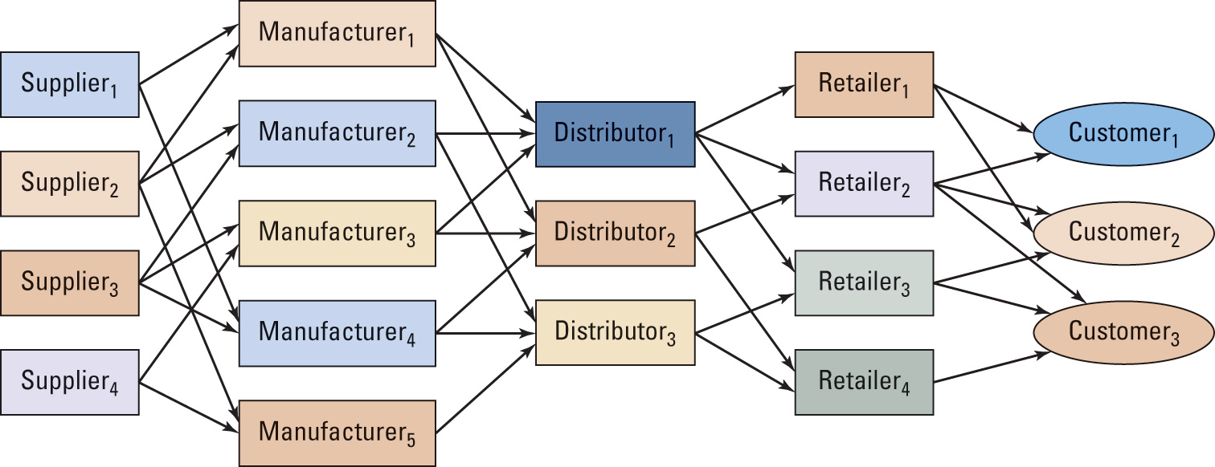
8-<number>
Notes:
Chapter 8: E-Commerce and Web 2.0

Slide 12
Each of the organizations in the supply chain is an independent company with its own goals and objectives; each has a competitive strategy that may differ from other organizations in the chain.
Supply chain profitability is the difference between the sum of the revenue generated by the supply chain and the sum of the costs that all organizations in the supply chain incur to obtain that revenue.
  In general, the maximum profit to the supply chain will not occur if each organization in the supply chain maximizes its own profits in isolation.
  In other words, the profitability of the supply chain generally increases if one or more of the organizations operates at less than its own maximum profitability.
8-<number>
Notes:
Chapter 8: E-Commerce and Web 2.0

Slide 13
Why is Web important to business?
The first e-commerce applications merely duplicated the experience of shopping in a store front. Amazon.com was the first to recognize the true potential of the Web when it added “Customers who bought this book . . . “
World Wide Web refers to a loose cloud of capabilities, technologies, business models, and philosophies that sets e-commerce apart from traditional software.
Google, Amazon, and eBay are major winners and distinguished from traditional processing giants such as Microsoft, Oracle, and SAP
Web relies on software as a service as opposed to software as a product; revenue is derived from advertising rather than sale of software
8-<number>
Notes:
Chapter 8: E-Commerce and Web 2.0

Slide 14
Why is Web important to business?
Other characteristics of software as a service
  The bulk of processing occurs on servers rather than on the user’s own computers. Thus it takes advantage of “thin-client” computing (less powerful PCs)
  Value increases with use; e.g., Amazon increases in value as more readers write reviews
  It’s perpetually labeled as beta software because its features and functions are constantly changing.
  It relies on viral marketing. That is, users spread the word about its virtues rather than the company that provides it.
  Web also provides
    Social networking services to connect people with similar interests.
8-<number>
Notes:
Chapter 8: E-Commerce and Web 2.0

Slide 15
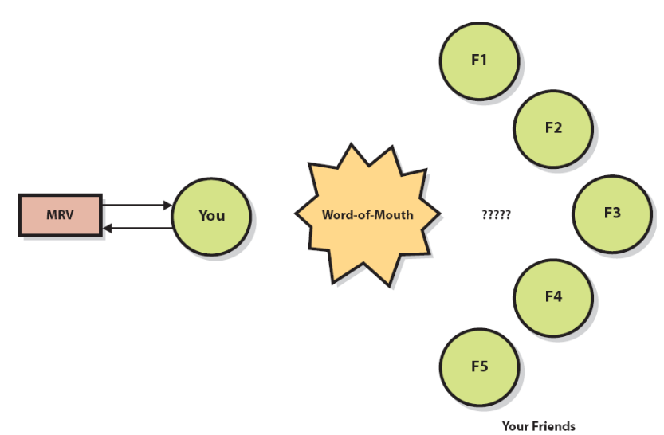
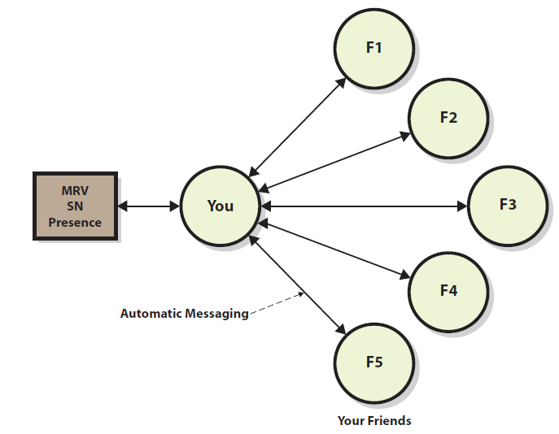
How do organizations benefit from Social Networking?
Social Networking (SN) is the interaction of people connected by friendship, interests, business association, and/or other common traits
Social Networking supports N:M communication and social collaboration. SN groups are of three types:
  Public – anyone can find the group by searching and join
  Invitation – anyone can find the group but must be invited to join
  Private –group cannot be found by searching and members must be invited
Traditional Marketing at MRV
Social Network Marketing
8-<number>
Notes:
Chapter 8: E-Commerce and Web 2.0

Slide 16
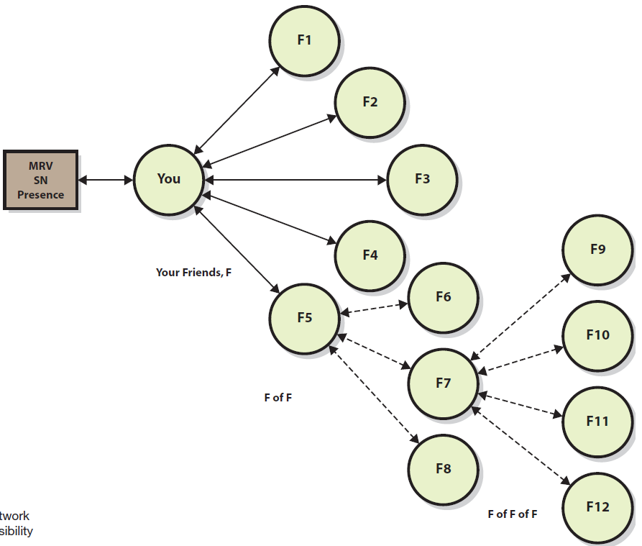
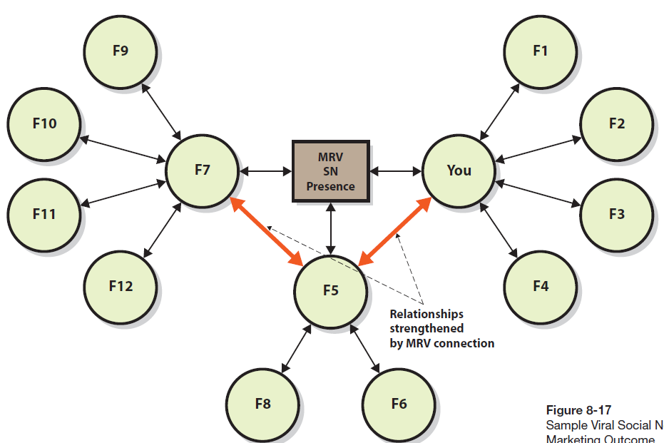
How do organizations benefit from Social Networking?
Your friends have friends which in turn leads to viral marketing
Viral marketing is even more powerful if the message induces your friends and their friends to form a direct relationship with the organization; e.g., “look at these photos” and the photos are on the organization’s Web site
8-<number>
Notes:
Chapter 8: E-Commerce and Web 2.0

Slide 17
How do organizations exchange data?
Companies must communicate with other companies in order to purchase supplies, sell products, or generally do business. Some of the alternative for exchanging data and messages are listed below
    Telephone
    Paper (fax, postal mail).
    E-mail
    FTP
    Blogs
    Social Networking
8-<number>
Notes:
Chapter 8: E-Commerce and Web 2.0

Slide 18
Summary
E-Commerce is the buying and selling of goods and services over public and private computer networks. It offers tremendous opportunities but organizations should also address four economic factors when considering e-commerce activity: channel conflict, price conflict, logistics expense, and customer service expense.
Web refers to a loose cloud of capabilities, technologies, business models, and philosophies that sets e-commerce apart from traditional software.
A supply chain is a network of organizations and facilities that transforms raw materials into finished goods for customers. Most supply chains have suppliers, manufactures, distributors, and retailers.
In general, the maximum profits to the supply chain will not occur if each independent organization within it maximizes its own profit in isolation.
Three fundamental supply chain information systems are: supplier relationship management (SRM), inventory, and CRM.
Organizations can exchange documents and data between programs using various alternatives.
Social Networking (SN) is the interaction of people connected by friendship, interests, business association, or other common traits
8-<number>
Notes:
Chapter 8: E-Commerce and Web 2.0

