Slide 1
Paddy Disease Classification using Convolutional Neural Networks

Slide 2
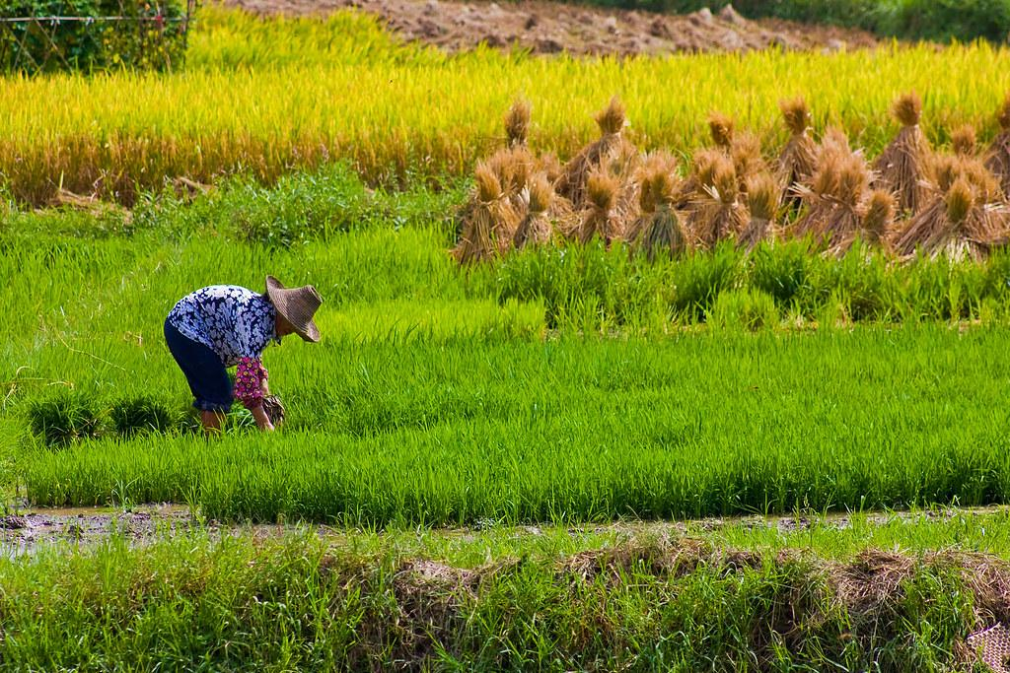
Importance of Rice as a Staple Food Crop:
Provides sustenance for over half of the world's population
Grown in over 100 countries, with 90% of the total global production from Asia
Can be a good source of nutrients, including magnesium, phosphorus, manganese, selenium, iron, folic acid, thiamin, and niacin
Can be processed into white or brown rice, with regional and cultural preferences determining market availability and final consumption

Slide 3
Impact of Diseases on Rice Production:
Diseases can significantly reduce rice yield and quality
Common rice diseases include bacterial leaf blight, brown spot, sheath blight, and leaf smut
Diseases can be spread through seeds, soil, water, and air, making them difficult to control
Climate change and environmental factors can exacerbate the spread and severity of rice diseases
Accurate and early disease detection is crucial for effective disease management and prevention

Slide 4
Motivation
Accurate and early disease detection is essential for effective disease management and prevention
Early detection can help farmers take appropriate measures to prevent or control the spread of diseases
Appropriate measures can lead to higher yields and reduced losses
Farmers can benefit from a user-friendly and accessible tool for rice disease detection
behind the project !

Slide 5
Objectives
Develop a CNN-based models for classifying paddy diseases
Evaluate the performance of the model in terms of accuracy
Provide a user-friendly and accessible tool for rice disease detection for farmers and agricultural experts

Slide 6
Background

Slide 7
types of paddy diseases and their symptoms
Blast (Pyricularia grisea or P. oryzae)
Leaf Blast:
Irregular brown or black spots on leaves
Spots may have a "bull's eye" appearance
Neck Blast:
Black or brown lesions on the neck of the rice plant
Can cause the plant to break and lodge
Nodal Blast:
Black or brown lesions on the nodes of the rice plant
Can cause the plant to break and lodge
Bacterial Leaf Blight (Xanthomonas oryzae pv. oryzae)
Healthy leaf:
Green and healthy appearance
Infected leaf:
Long, water-soaked lesions that turn yellow or brown
Lesions may have a wavy or jagged appearance
Rice tungro disease (Rice tungro virus or RTSV, RTBV)
Healthy leaf:
Green and healthy appearance
Infected leaf:
Yellowing or discoloration of leaves
Stunted growth and reduced tillering

Slide 8
types of paddy diseases and their symptoms
Brown Spot (Helminthosporium oryzae)
Small, dark brown or black spots on leaves
Spots may have a yellow halo
Sheath Blight (Rhizoctonia solani)
Infected sheath:
Gray or tan lesions on the leaf sheath
Lesions may have a "frog-eye" appearance
Infected leaves:
Yellowing or browning of leaves
Reduced tillering and plant height
Sheath Rot (Sarocladium oryzae)
Dark brown or black spots on panicle
Glumes and grains may be affected
False Smut (Ustilaginoidea virens)
White or greenish-white masses on panicles
Masses turn brown or black as they mature
Grain discoloration (fungal complex)
Discoloration of grains
May affect grain quality and yield
Leaf streak (Xanthomonas oryzae pv. oryzicola)
Long, narrow lesions on leaves
Lesions may be yellow, brown, or orange

Slide 9
THE DATASET

Slide 10
The dataset contains images of 10 classes of rice diseases, including leaf blast, false smut, neck blast, sheath blight, bacterial stripe disease, and brown spot.
The dataset is split into training, validation
The images are resized to 224x224 pixels and normalized using mean and standard deviation values.
The labels of the dataset are one-hot encoded to represent the ten classes of rice diseases.

Slide 11
Model Architecture 1

Slide 12
Input -> Conv2D(64, 3, activation='relu') -> MaxPooling2D() ->
Conv2D(32, 3, activation='relu') -> MaxPooling2D() ->
Dropout(0.25) -> Flatten() -> Dense(64, activation='relu') ->
Dense(num_classes, activation='softmax')

Slide 13
Model Architecture 2

Slide 14
Input -> Rescaling(1./255) ->
Conv2D(64, 3, activation='relu') -> MaxPooling2D() ->
Conv2D(32, 3, activation='relu') -> MaxPooling2D() ->
Conv2D(32, 3, activation='relu') -> MaxPooling2D() ->
Conv2D(32, 3, activation='relu') -> MaxPooling2D() ->
Dropout(0.25) -> Flatten() ->
Dense(128, activation='relu') ->
Dense(64, activation='relu') ->
Dense(num_classes, activation='softmax')

Slide 15
Evaluation metrics:
Accuracy
Loss function: Categorical Cross-Entropy
Training procedure:
Split the dataset into training, validation, and testing sets.
Preprocess the dataset, normalization, and resizing.
Define the CNN architecture, including the number of layers, filters, and activation functions.
Compile the model with the optimization algorithm, loss function, and evaluation metrics.
Evaluate the model on the validation and testing sets.

Slide 16
experimental results
The CNN model achieved an accuracy of 61% on the testing set for model 1
The CNN model achieved an accuracy of 80% on the testing set for model 2

Slide 17
Conclusion

Slide 18
Developed a customized CNN architecture for paddy disease classification
Achieved an accuracy of 80% on the testing set
Provided a user-friendly and accessible User Interface for rice disease detection for farmers and agricultural experts
Contributed to sustainable agriculture by minimizing yield losses and promoting efficient resource utilization
Highlighted the potential of AI-driven technology in fortifying agricultural resilience and ensuring global food security.

Slide 19
Future Work

Slide 20
Improving the model architecture
Collecting more data to increase the diversity and representativeness of the dataset, including images from different geographical locations, growth stages, and environmental conditions
Applying the model to other crops, such as wheat, corn, or soybean, to demonstrate its generalizability and versatility
Collaborating with agricultural experts and organizations to validate the model's performance and promote its adoption in practical settings
Exploring the use of unsupervised or semi-supervised learning techniques to reduce the reliance on labeled data and improve the model's robustness and adaptability.

Slide 21
THANK YOU

