Slide 1

SOP EVALUATION USING ML TECHNIQUES
Project Team:
Anju Krishna,
Dushyant Singh,
Jiya Maria Eapen,
Athish Jobin,
Roy Joseph

Slide 2
PROBLEM STATEMENT
In the realm of higher education, the evaluation of Statements of Purpose (SOPs) is pivotal for university admissions. Traditionally reliant on human evaluators.
Human assessment, while bringing expertise, is time-consuming, prone to biases, lacks scalability, and may result in inconsistent evaluations across applicants.
The need for a more efficient, objective, and scalable approach is necessary to automate SOP evaluation, ensuring fairness, consistency, and informed decision-making in university admissions.

Slide 3
OBJECTIVE
The goal of the project is to categorize Statements of Purpose (SOPs) as approved or rejected using natural language processing techniques.
Utilizing Natural Language Processing (NLP) techniques, this classification problem entails analyzing and classifying SOPs according to predetermined standards, including content, structure, and relevance to admission requirements.
The objective is to create a machine learning model that can evaluate SOPs automatically and predict with high accuracy whether admissions committees will accept or reject a particular SOP.

Slide 4
IN SCOPE
NLP preprocessing steps that helps in Classification
Data Augmentation
Training machine learning models such as Random Forest Classifier or other classifiers to classify SOPs as approved or rejected is in scope.
Along with hyper parameter tuning and dimensionality reduction
OUT OF SCOPE
Factors external to the text data, such as applicant information or admission policies, are not considered within scope for this classification problem.
While deep learning methods can be powerful for NLP tasks, they are out of scope.
Defining specific business rules or criteria for SOP approval or rejection is typically outside the scope

Slide 5
DATA SET
DATA SET DESCRIPTION The dataset comprises a collection of Statements of Purpose (SOPs) submitted by university applicants, along with their corresponding admission decisions.
Each SOP is represented as a text document, and the admission decision indicates whether the applicant was accepted or rejected.
The data set consist of 818 statement of purposes(SOPs), where the column Label denotes whether the SOP is approved or not with values 1 and 0

Slide 6
DATA PREPARATION
DATA CLEANING
DATA AUGMENTATION
NLP
PRE-PROCESSING

Slide 7
DATA CLEANING
Handled Data Duplication
Dropped unwanted Rows
Handled Null Values
Replacing Target Columns

Slide 8
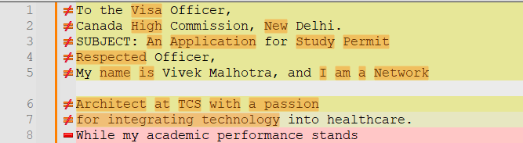
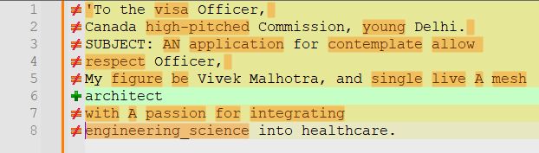
DATA AUGMENTATION
The data was biased where the approved SOPs are 630 and the rejected ones are 173
So we needed a balanced dataset for the model.
Used Synonym replacement method for creating more SOPs
After the AUGMENTATION the Dataset is made up to 631 [Approved] and 519 [Rejected]

Slide 9
NLP PREPROCESSING
Punctuations removal
Convert to Lower Case
Tokenization
Stop words Removal
Lemmatization with POS tagging

Slide 10

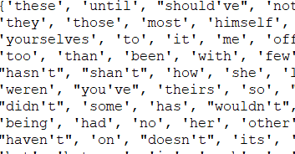
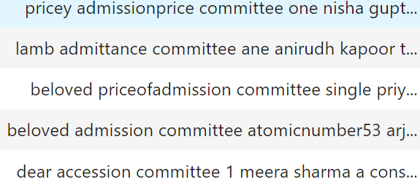
Punctuation Removal: Punctuation are removed from text data as they don't usually carry significant meaning for many NLP tasks.
Stop Words Removal: Stop words are common words like "the," "is," and "and" that occur frequently but don't contribute much to the meaning of a sentence. Removing stop words can reduce noise and increase efficiency
Convert to Lower Case: Converting all text to lowercase helps standardize the text data and ensures that words with different cases are treated the same way during analysis,

Slide 11
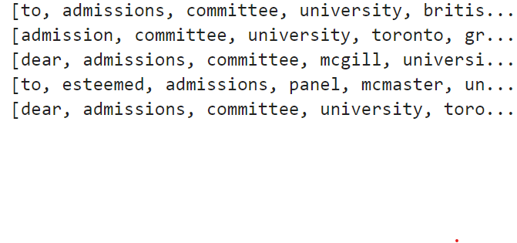
Tokenization: Tokenization involves splitting text into individual words or tokens. This step is essential for further analysis as it breaks down the text into manageable units for processing.
Lemmatization with POS Tagging
Lemmatization reduces words to their base or root form (lemma), which helps in standardizing the vocabulary.
Part-of-Speech (POS) tagging is used in conjunction with lemmatization to identify the grammatical category of each word (noun, verb, adjective, etc.), ensuring accurate lemmatization based on context.
Reduces data complexity, enhancing model efficiency.

Slide 12
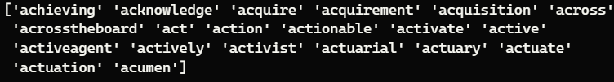

VECTORIZATION
COUNT VECTORIZER
It converts text into a vector on the basis of the frequency (count) of each word that occurs in the entire text.
Feature columns
TF-IDF VECTORIZER
It measures the orginality of a word by comparing the number of times a word appears in a doc with the number of docs the words appear in.
Feature columns

Slide 13
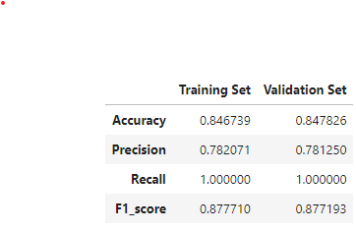
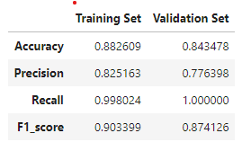
MODEL TRAINING AND EVALUATION
DATA
TF-IDF VECTORIZER
COUNT VECTORIZER
Random Forest Classifier
Random Forest Classifier

Slide 14
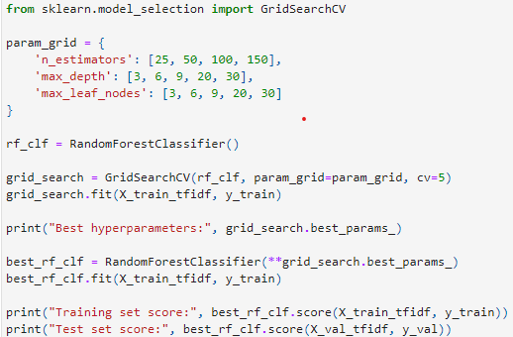
HYPERPARAMETER TUNING
Best hyperparameters:
{'max_depth': 20, 'max_leaf_nodes': 30,
'n_estimators': 100}
Training set score: 0.987
Test set score: 0.965

Slide 15
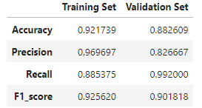
DATA
COUNT VECTORIZER
LATENT DIRICHLET ALLOCATION
RANDOM FOREST CLASSIFIER
DIMENSIONALITY REDUCTION

Slide 16
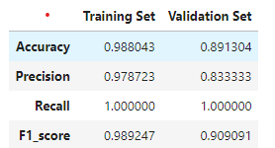
DATA
TF-IDF VECTORIZER
RANDOM FOREST CLASSIFIER
TRUNCATED SVD
DIMENSIONALITY REDUCTION

Slide 17
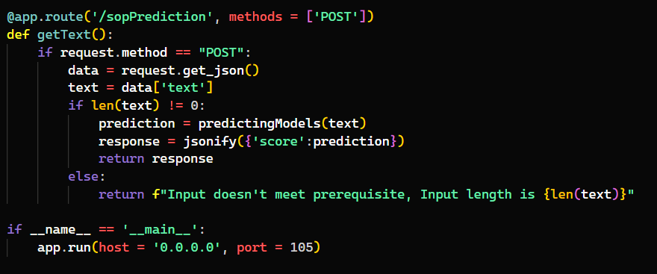
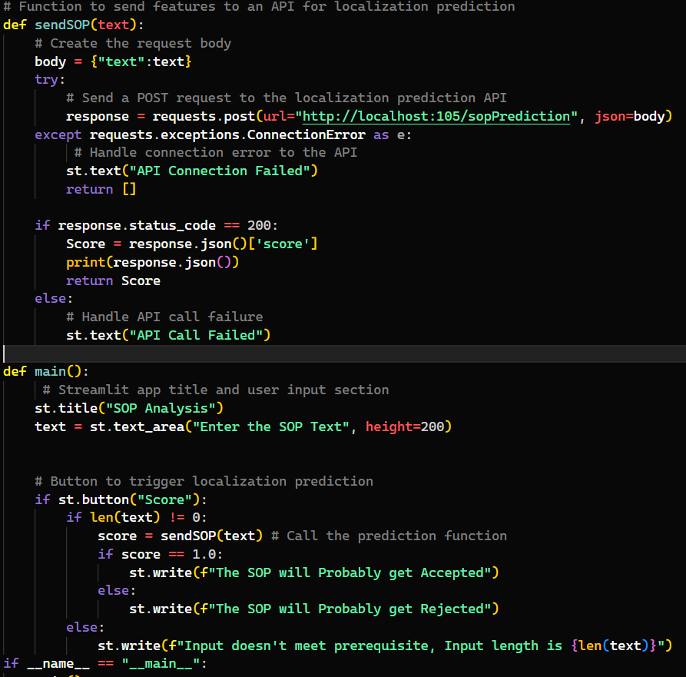
USER INTERFACE
Streamlit:
Streamlit is a Python library designed for rapid development of interactive and data-driven web applications.
It simplifies the creation of user interfaces, making it particularly suitable for data science and machine learning projects.
Flask: Flask is a lightweight and versatile web framework for Python used primarily for building APIs and backend services.
It provides tools and functionalities for handling HTTP requests, routing, and structuring APIs, making it a popular choice for developing scalable and robust backend systems.

Slide 18
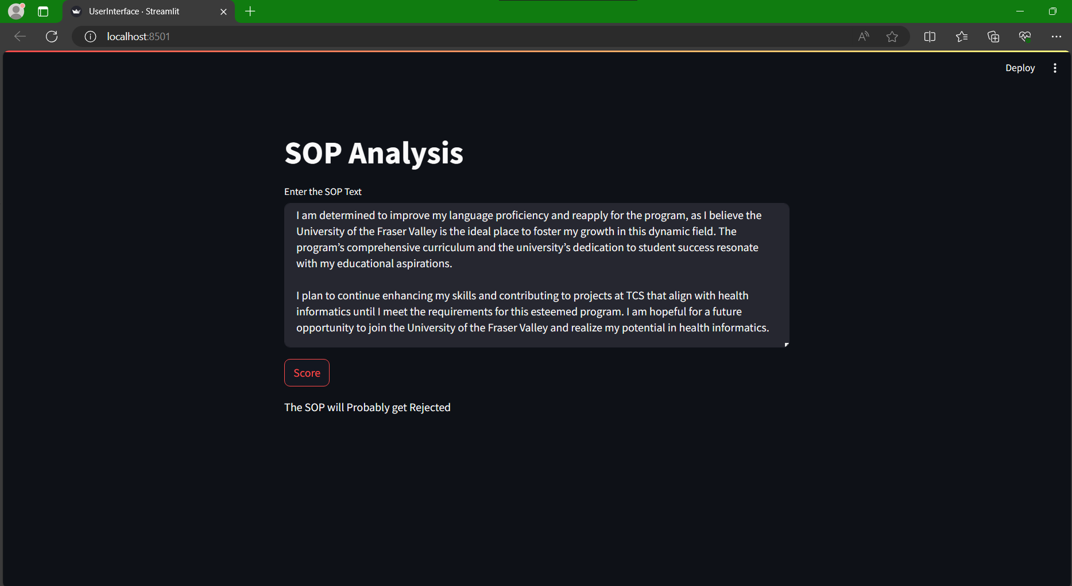
USER INTERFACE

Slide 19

Thank You!

