Slide 1
Migration Journey Dataset: Key Findings
Objective: summarize respondent profile and journey risks for stakeholders.
Sample size: 460 records, 89 variables.
Tooling: Python (pandas, matplotlib, seaborn, python-pptx).
Source file: IMS_Test_Data 1.xlsx (Sheet1).

Slide 2
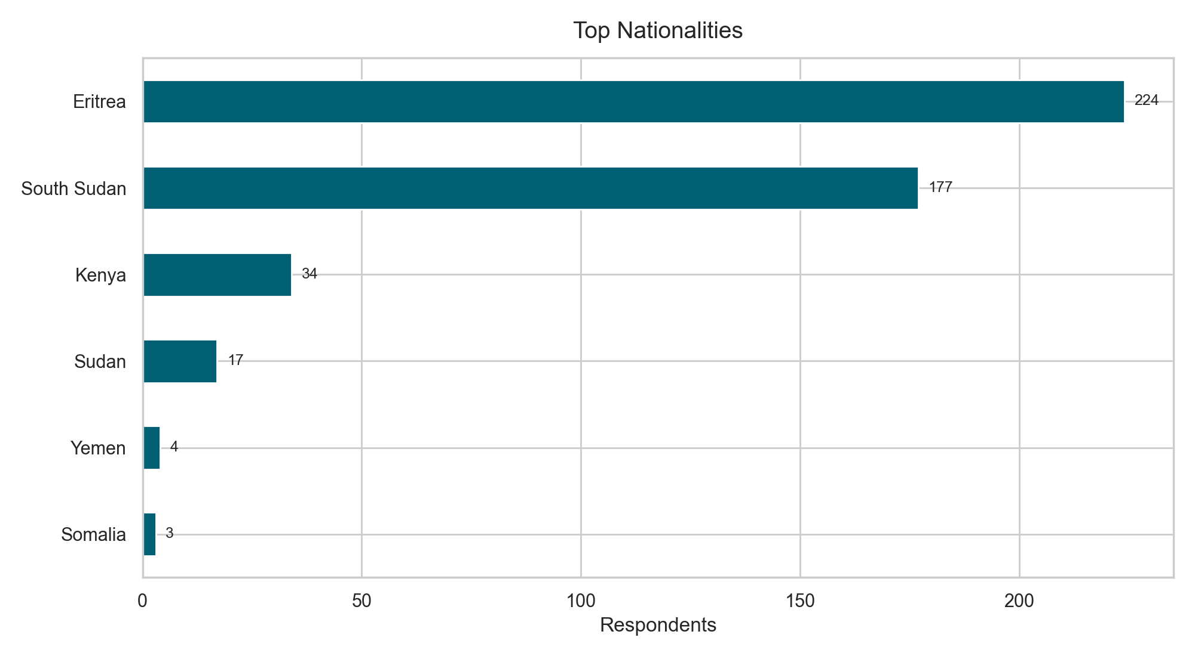
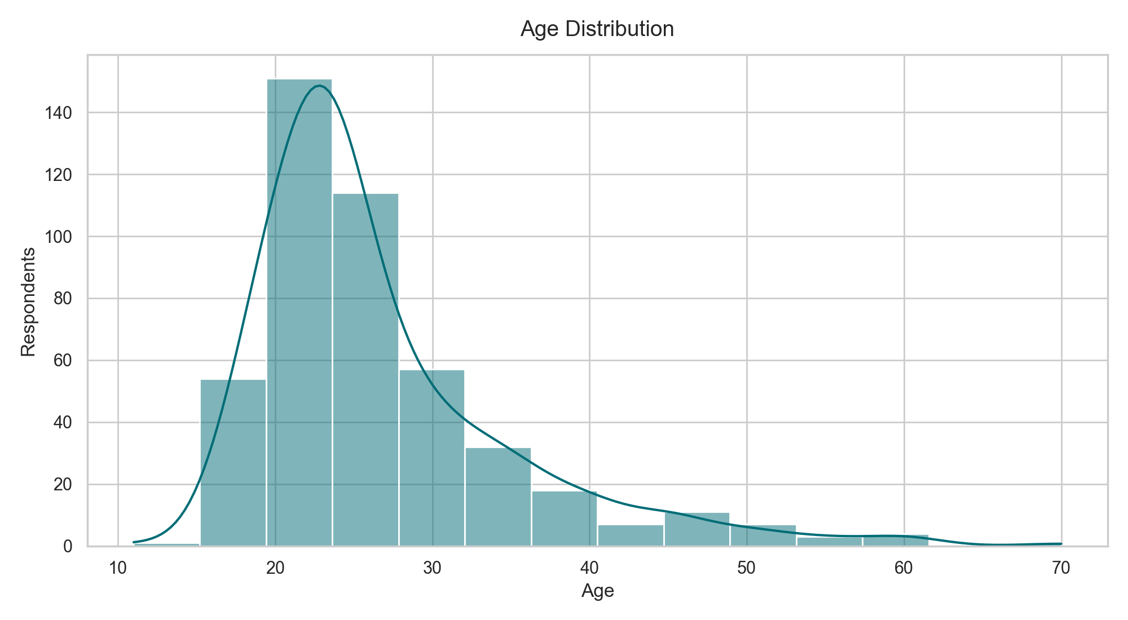
1) Respondent Demographics
Median age: 24.0 years (IQR 22-30).
Sex split: Female 55.0%, Male 45.0%.
Education mostly primary or secondary; low tertiary completion.

Slide 3
2) Migration & Legal Context
Current location concentration: Midlandia (459), Eastlandia (1).
Top legal statuses: Refugee (261), Asylum seeker (112), Irregular/no legal documents to stay in this country (66).
Top education levels: Primary school (201), Secondary or high school (142), Did not complete any schooling (82).
Income before departure: No 318, Yes 142.

Slide 4
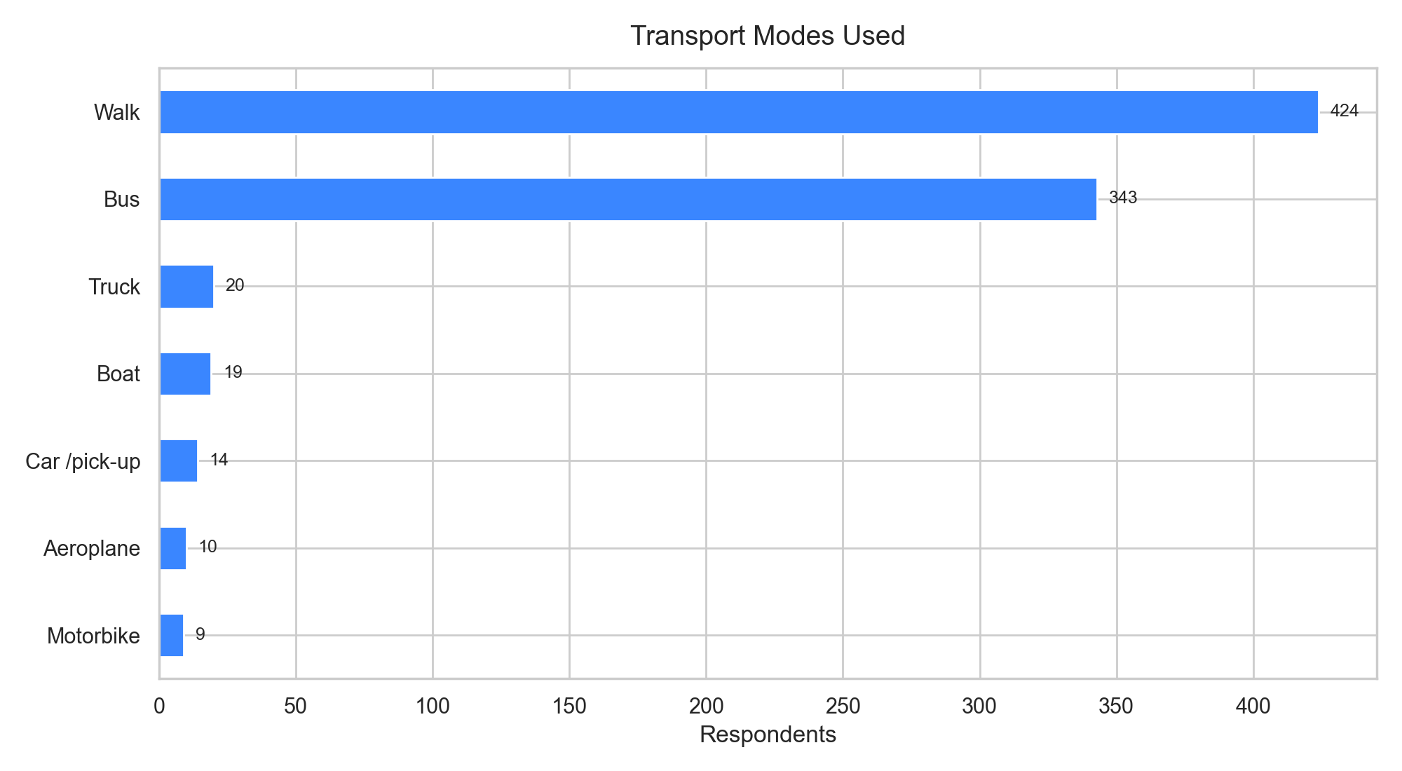
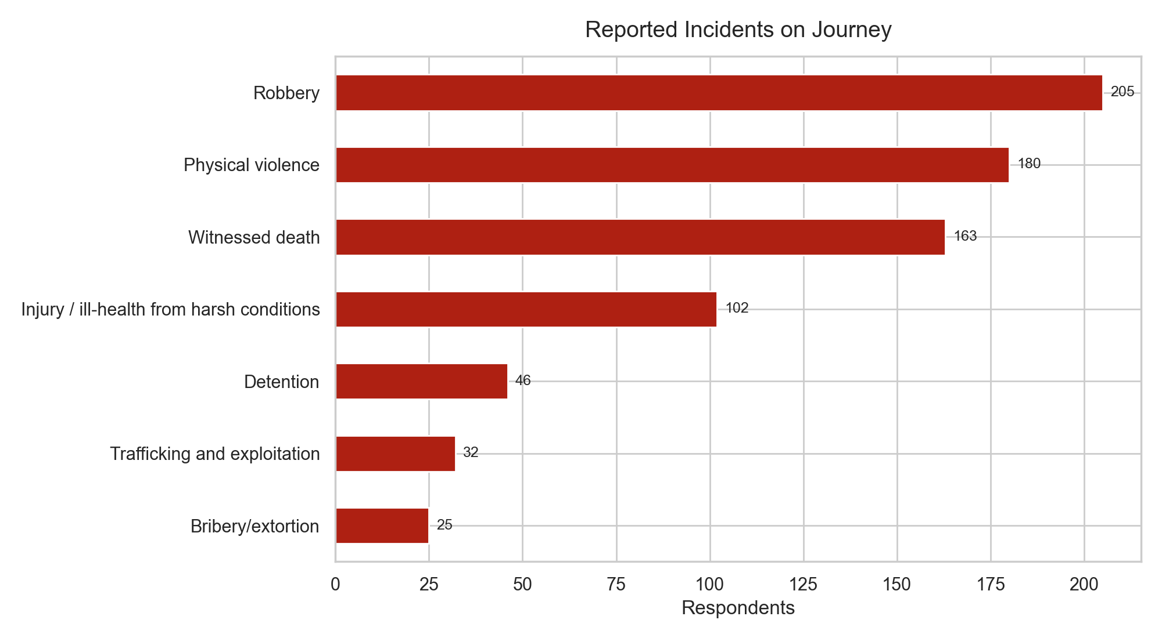
3) Journey Methods and Exposure to Harm
Walking and bus travel dominate mobility patterns.
Robbery and physical violence are the most frequently reported incidents.
Multiple respondents also report witnessed death and health impacts.

Slide 5
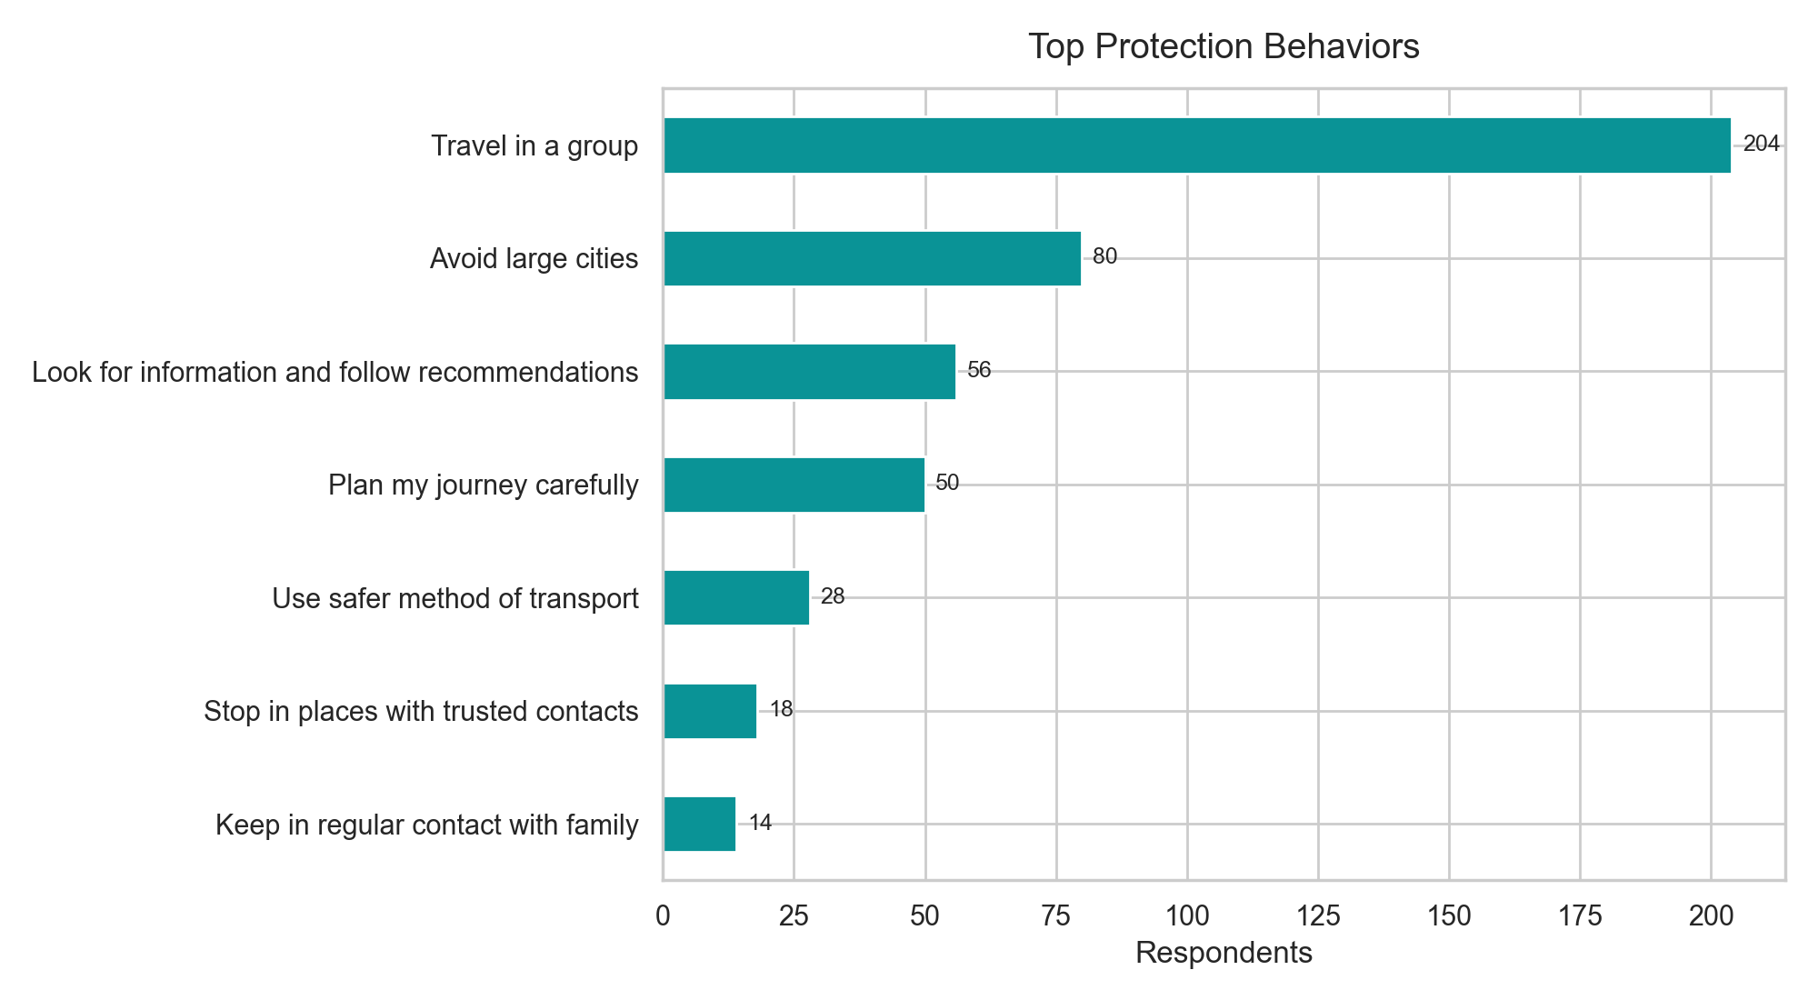
4) Protection Behaviors and Priority Actions
Most common strategy is traveling in groups.
A large subgroup reports taking no protective action.
Priority: scale trusted-information channels and route safety guidance.
Priority: targeted support where robbery and violence rates are highest.
Priority: strengthen case management for high-risk groups.

