Slide 1

STOCK OPTIMATE
DATA MANAGEMENT AND DATABASE DESIGN
GROUP-4
TEAM MEMBERS
AMRESH SINGH
GEETA TIRUMALASETTY
NILANJAN ROY
SUYESHA LAMNE

Slide 2


Purpose and Design
Project’s Significance
The project encompasses a complete inventory management system, monitoring stock levels, product details, and warehouse information, while also managing sales, purchase orders, and shipping logistics.
It provides financial insights through profit and loss analysis and maintains a database of relationships with employees, customers, and suppliers, essential for business operations and strategic decision-making.
Design Aspects
Designed Entity-Relationship (ER) diagram to model the database schema and Data Visualization to Integrate Power BI for advanced analysis and to generate dashboards to track inventory trends and sales.
Developed SQL Triggers to automate database actions like updating inventory after transactions and enhance data integrity and enforce business rules. Stored Procedures to Encapsulate SQL queries for routine tasks and Improve performance and security for inventory management. User-Defined Functions to Offer reusable logic for complex data tasks and Increase system flexibility and maintainability. SQL Views to present tailored data subsets to users and simplify data access by abstracting database complexity.
Frontend Development is created with the use HTML and CSS for a responsive, visually appealing interface and backend development is done by employing Node.js for server-side logic and use React for dynamic and interactive UIs.

Slide 3
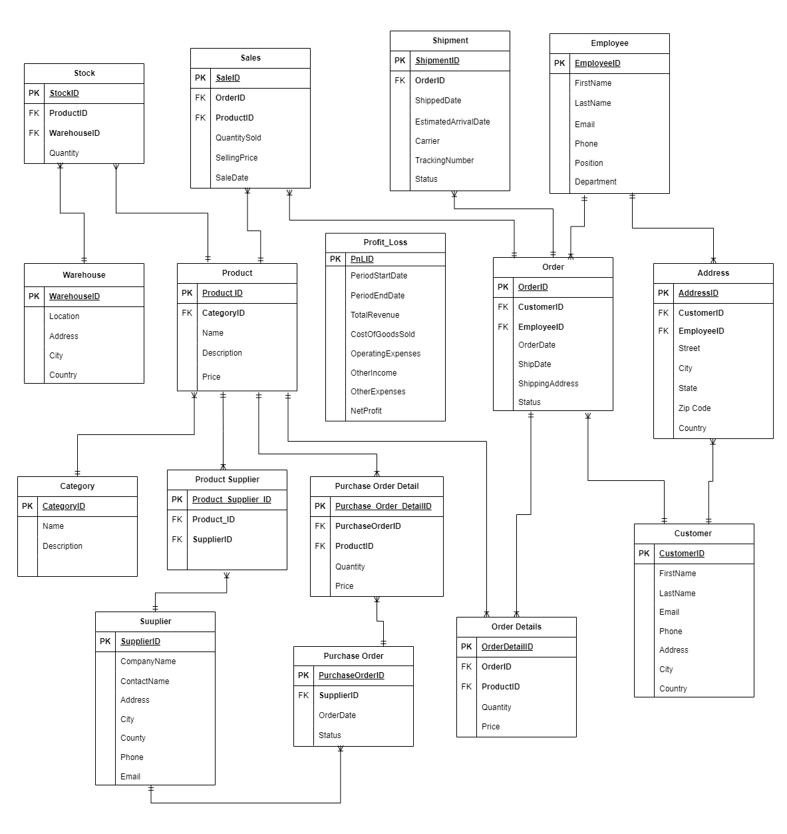
ENTITY
RELATIONSHIP
DIAGRAM

Slide 4
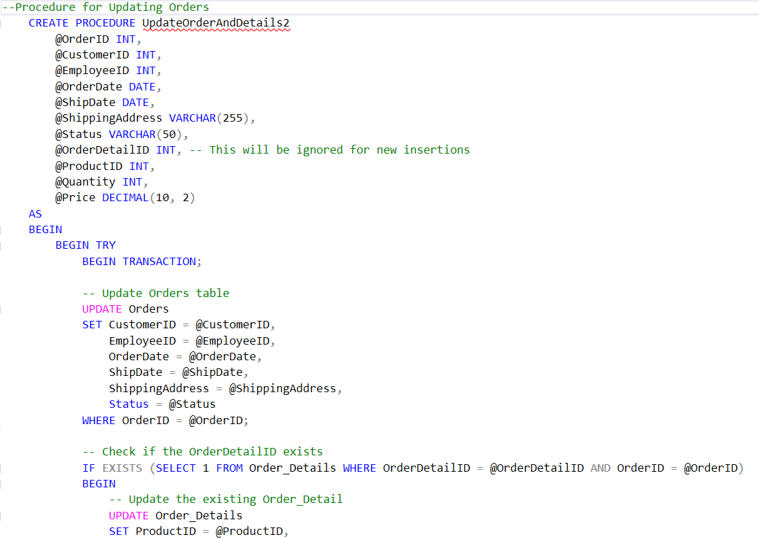
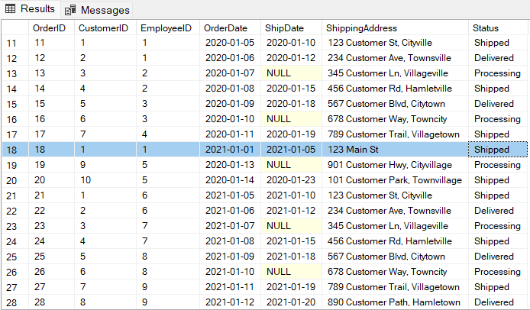
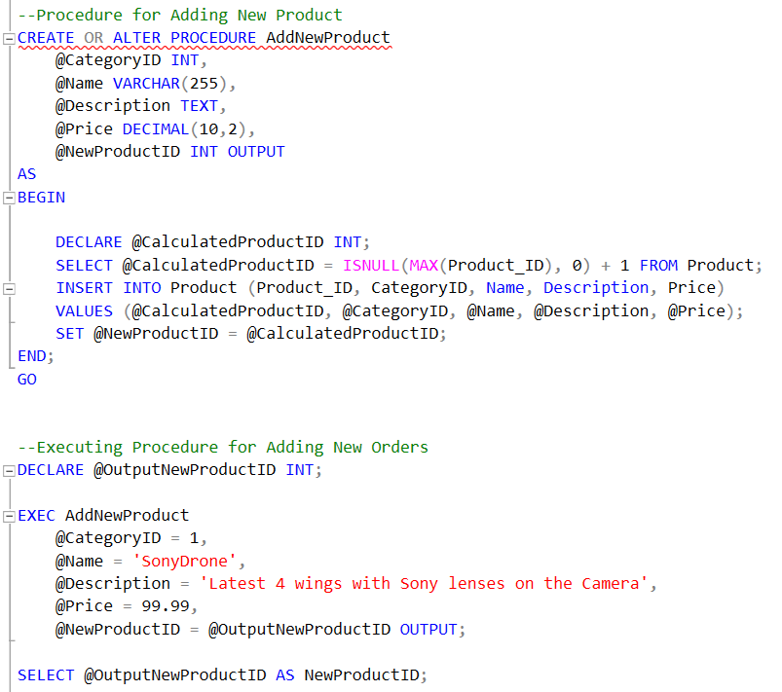
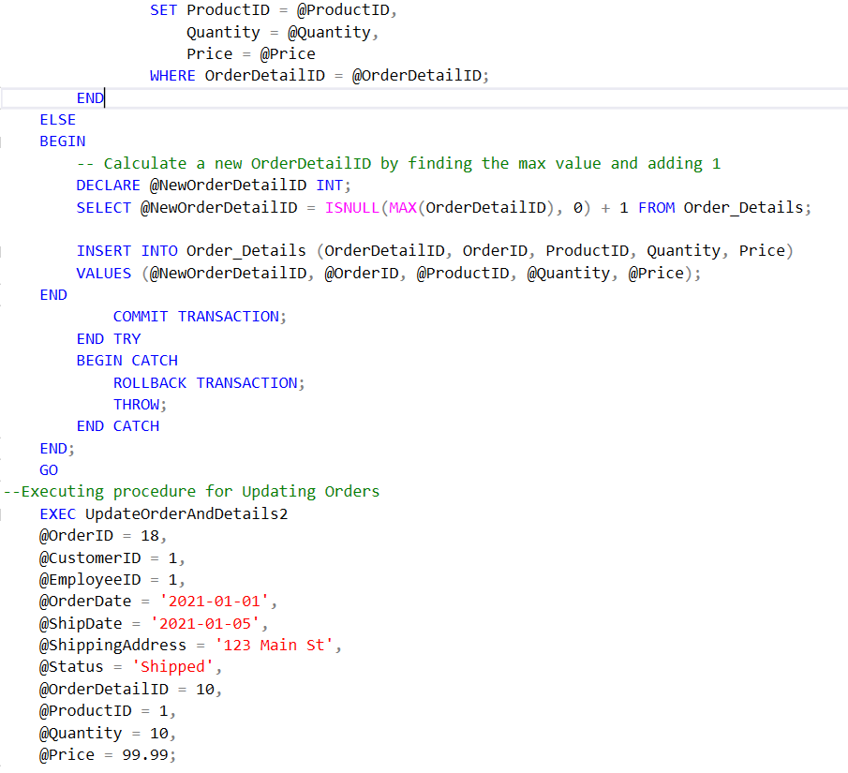
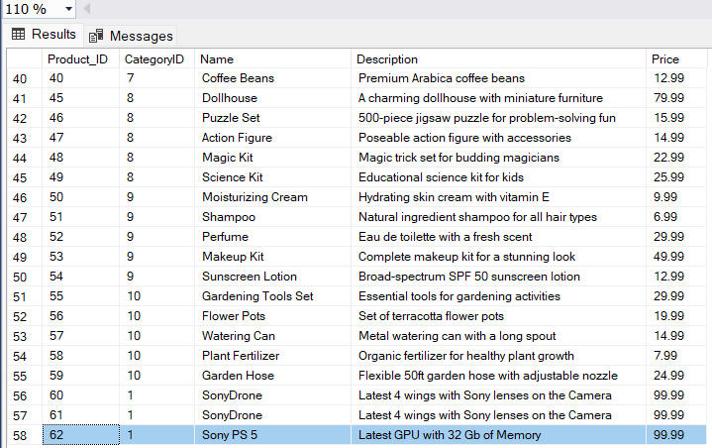
STORED PROCEDURES

Slide 5
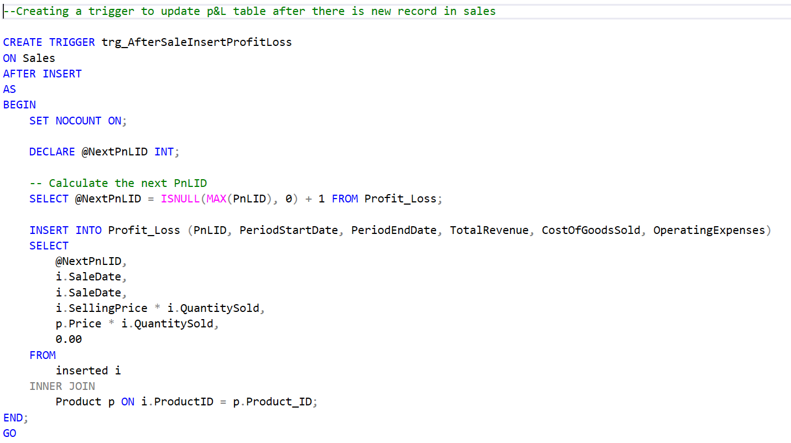
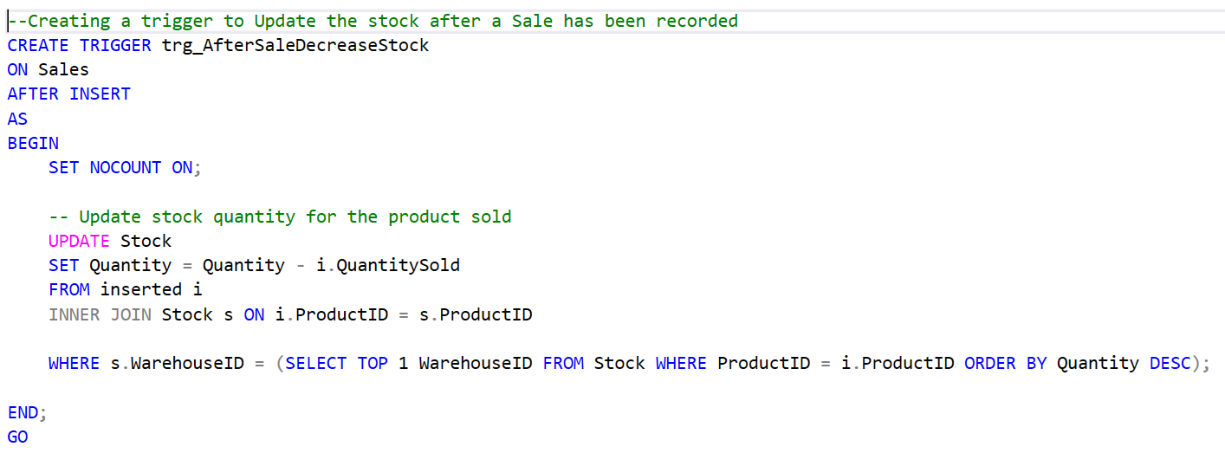
TRIGGERS

Slide 6
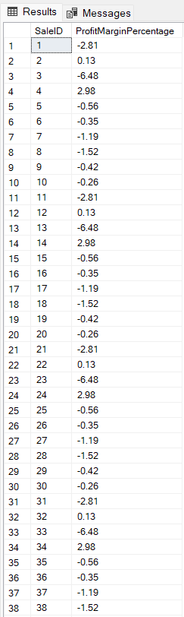
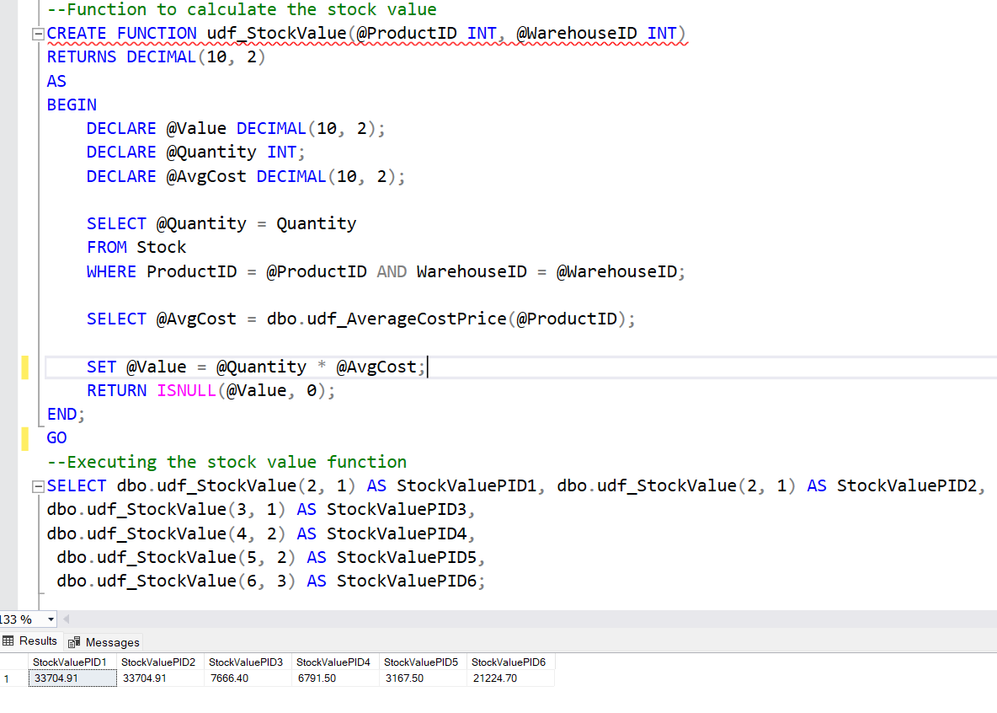
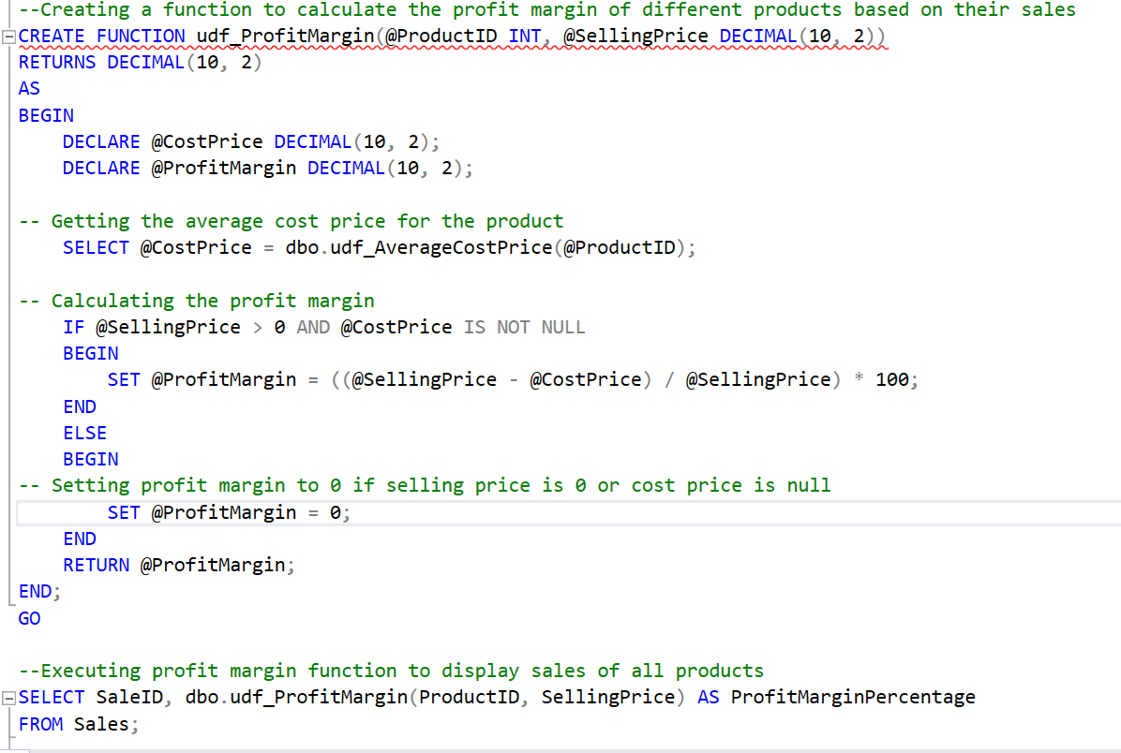
USER DEFINED
FUNCTION

Slide 7
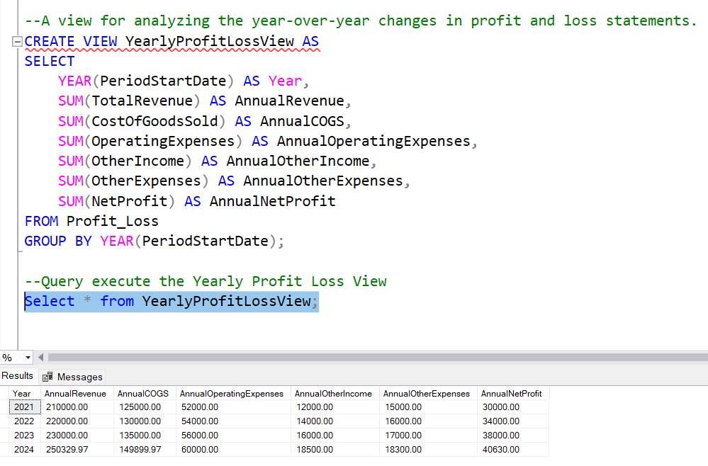
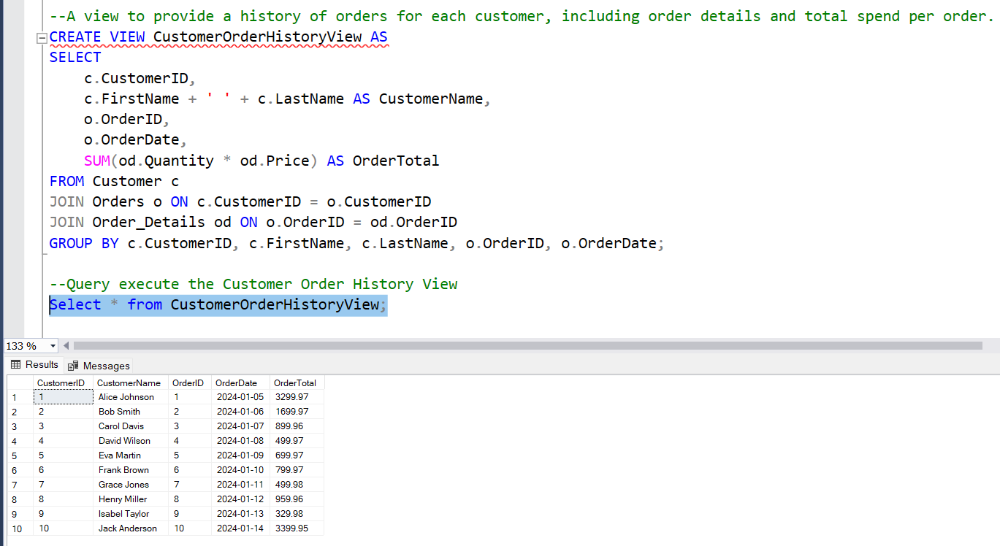
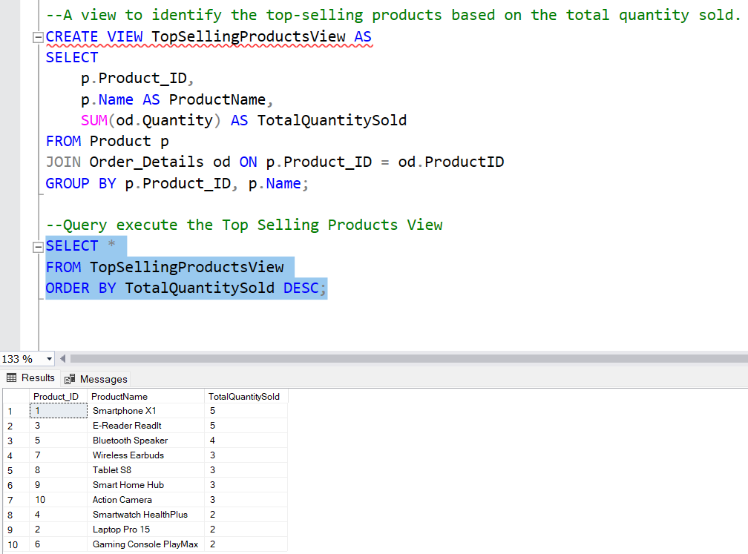
VIEWS

Slide 8
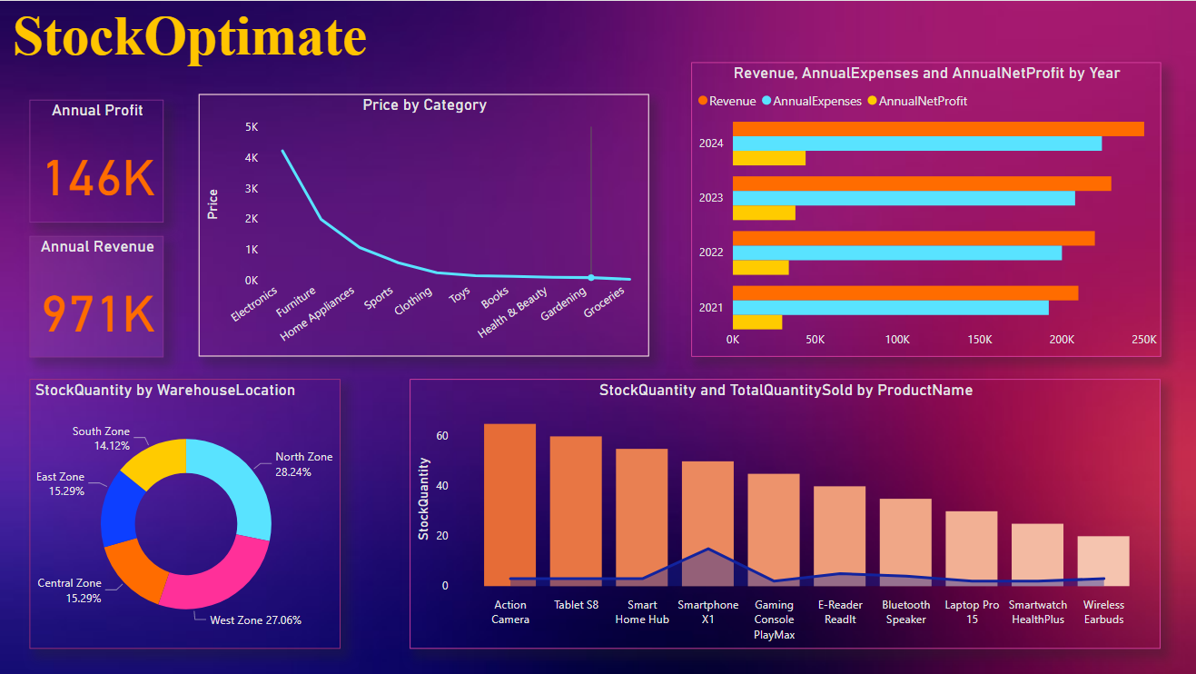
POWER BI

Slide 9
THANK YOU
FOR YOUR ATTENTION

