Slide 1

MANGALORE INSTITUTE OF TECHNOLOGY &ENGINEERING
(A Unit of Rajalaxmi Education TrustO, Mangalore)
Autonomous Institute affiEated to V.T.U., Belagavi, Approved by AICTE, New Delhi. Accredited by NAAC with A+ Grade, An ISO 9001: 2015 Certified Institution
DEPARTMENT OF ARTIFICIAL INTELLIGENCE AND MACHINE LEARNING
Project Phase II
(Subject Code:23AISE409)
" Probabilistic Cascading Failure and Agent Assisted Root Cause Analysis for Microservice Systems "
Project Associates:
K Bharath Parmar (4MT24AI402)
Royson salis (4MT23AI046)
Anish C (4MT23AI008)
Dhanush K(4MT23AI401)
Under the Guidance of:
DR. MANJUNATH PRASAD
Head of Department
Dept of AIML

Slide 2
CONTENTS
Abstract
Introduction
Problem Statement and Objectives
Literature Survey and Research Gap
Proposed System and Work Done
Requirements, Architecture
The Product: Live Screens
How the Algorithms Work (in plain words)
Testing, Evaluation and Results
Conclusion and Future Work
References
Notes:
Agenda.

Slide 3
ABSTRACT
When one microservice fails, the services that depend on it fail too, and finding the real cause is slow.
We built Microservice Mapper: it watches a running system from outside, learns what is normal for each service, and draws the live map.
When something breaks it names the most likely root cause and warns which healthy services are in danger next.
We tested it on two systems with 34 deliberately injected faults: it caught 97%, and pointed at the right service first in 58% of those.
Notes:
What it is, what it does, how we tested it.

Slide 4
INTRODUCTION
Many small services
An online shop is not one program. It is a frontend, a cart, payments, orders, a database... that call each other.
One failure, many alarms
When the database stops, orders fails, then the frontend fails. The engineer sees three red services and must guess which one started it.
What we built
A tool that finds the starting point and warns who is next, without touching the services.
Notes:
Why this problem is hard for operators.

Slide 5
PROBLEM STATEMENT
frontend
fails last
orders
fails second
database
fails first: the real cause
What is needed
A lightweight, explainable tool that learns normal, names the likely root cause, and estimates who is at risk.
calls go this way, failures travel back the other way
Monitoring shows every red service equally.
A fixed alert limit is wrong: normal is different for every service.
Nobody tells you which service will fail next.
Notes:
A failure travels along the call chain.

Slide 6
OBJECTIVES
1 Observe
Discover the services and who calls whom from outside, and draw a live map.
2 Explain
Learn each service's normal, detect problems, and rank the root cause.
3 Predict
Estimate which healthy services fail next, and measure it honestly.
Notes:
Three objectives.

Slide 7
LITERATURE SURVEY
Paper | Method | Limitation | What we add
MicroRCA [1] | Service graph, ranking by anomaly | Ranks causes only | Cascade forecast
CloudRanger [2] | Causal links between metrics | Needs long history | Short warm-up
Microscope [3] | Causality graph from connections | No spread estimate | Risk probabilities
Sage [4] | Causal model, machine learning | Needs model training | Works with no training
Ikram et al. [5] | Causal discovery on metrics | Needs lots of data | Cause versus victim from call graph
Notes:
Related root-cause work. Our difference: observe from outside, plus a forecast of the spread.

Slide 8
RESEARCH GAP
Separate steps
Detecting and finding the cause are usually different tools.
Fixed limits
Every service has its own normal, one limit fits none.
Heavy setup
Many need agents or labelled history first.
No forecast
Rarely tells you who will fail next.
Notes:
Why existing tools do not already solve this.

Slide 9
PROPOSED SYSTEM
01
Watch from outside: SSH, Docker, sockets. Nothing installed.
02
Live map: every link has a confidence.
03
Learn normal for each service from its own history.
04
Rank the root cause and forecast the spread.
05
Prove it with deliberately injected faults.
Notes:
Five parts, each one answers a gap on the previous slide.

Slide 10
WORK DONE IN NUMBERS
39,000
lines of TypeScript
(server, collector, dashboard)
10,000
lines of Python
(ML pipeline, simplified logic)
296
automated tests, all passing
50
documentation chapters
2
benchmark systems on AWS EC2
34
faults injected over 217 minutes
Notes:
Evidence of the work: size, testing and documentation.

Slide 11
REQUIREMENTS
Functional
Non-functional
Find services and links over SSH
Detect abnormal services
Rank the root cause
Predict services at risk
No code change in the services
Runs on a normal CPU
Every score has a reason
Keys stay on your machine
Software
Hardware
Node.js, TypeScript, React
Docker on the target host
Python 3 (optional ML)
SSH access
Any laptop or server
Linux host with Docker
Tested on AWS EC2
No GPU needed

Slide 12
SYSTEM ARCHITECTURE
Target host
Our backend
Dashboard
no agent installed
Node.js, CPU only
React, 2D and 3D
Containers
the running services
Collect and map
build the live graph
Live map
Docker API
stats, logs, events
Learn normal
baseline per service
live
Incidents
cause and ranking
SSH
Socket tables
who talks to whom
Find the cause
rank root cause
Cascade risk
who is next
Config file
declared dependencies
Predict the spread
who is next
Notes:
Left: the target host, nothing installed. Middle: our backend. Right: what the operator sees.

Slide 13
HOW IT WORKS
1 Watch
Read CPU, memory, requests, errors and who talks to whom.
2 Learn normal
Keep each service's own recent history as its baseline.
3 Find the cause
When several services look bad, follow the calls back to the source.
4 Predict
Pass the danger along the calls to see who is next.
Everything runs on an ordinary CPU. No training is needed before it starts working.
Notes:
Four steps, repeated every 5 seconds.

Slide 14
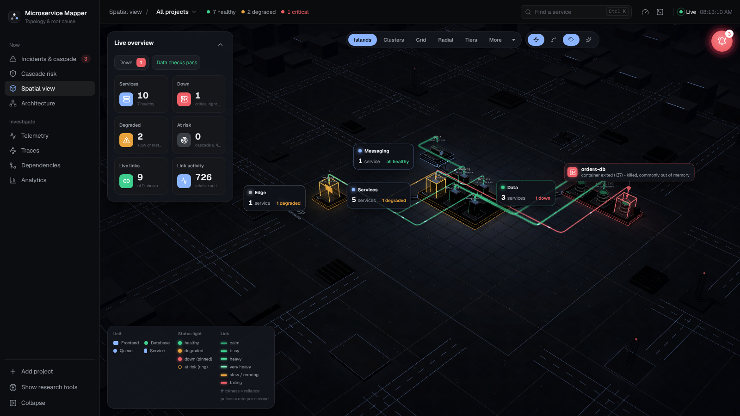
THE PRODUCT: LIVE MAP
Every service is a block; colour shows health.
Lines are calls; red lines are failing links.
Here the database (orders-db) has stopped, shown in red.
Dashboard on the built-in simulated shop: database crash scenario
Notes:
Spatial view of the dashboard.

Slide 15
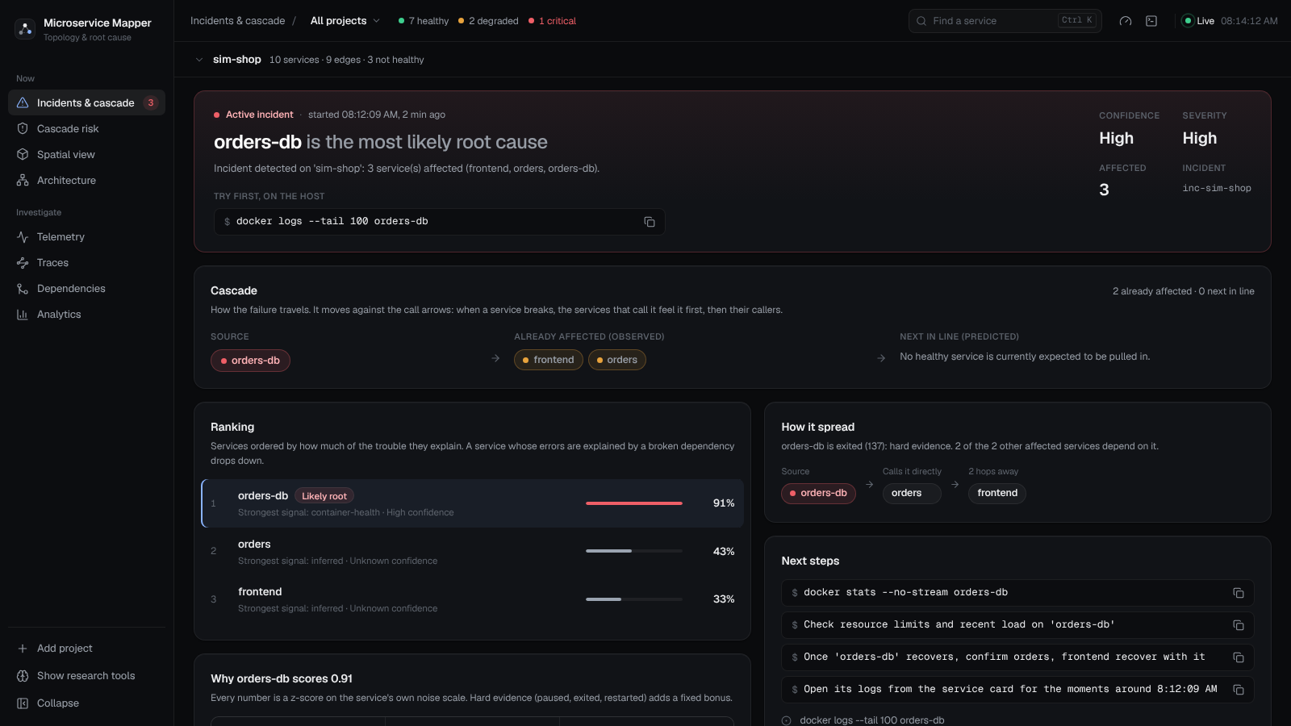
THE PRODUCT: FINDING THE CAUSE
It names orders-db as the root cause, with High confidence.
The ranking shows why: orders and frontend are victims.
It even suggests the first command to run.
Same scenario: the incident page
Notes:
Incidents page.

Slide 16
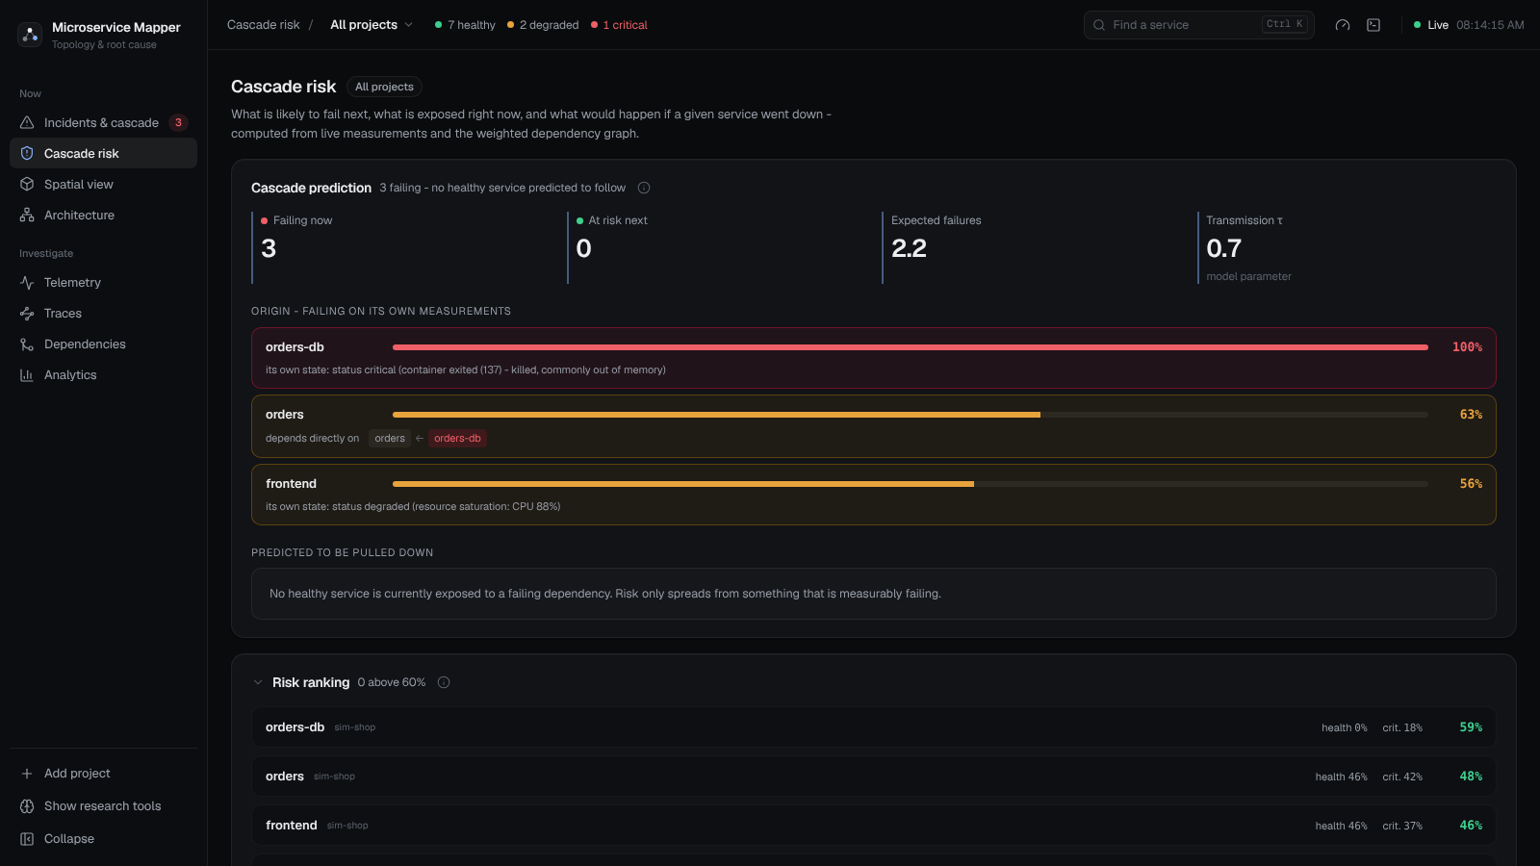
THE PRODUCT: WHO IS NEXT
Shows how the failure travels and how likely each service is to be hit.
Risk only spreads from something that is really failing.
Probability shown for every service.
Same scenario: the cascade page
Notes:
Cascade risk page.

Slide 17
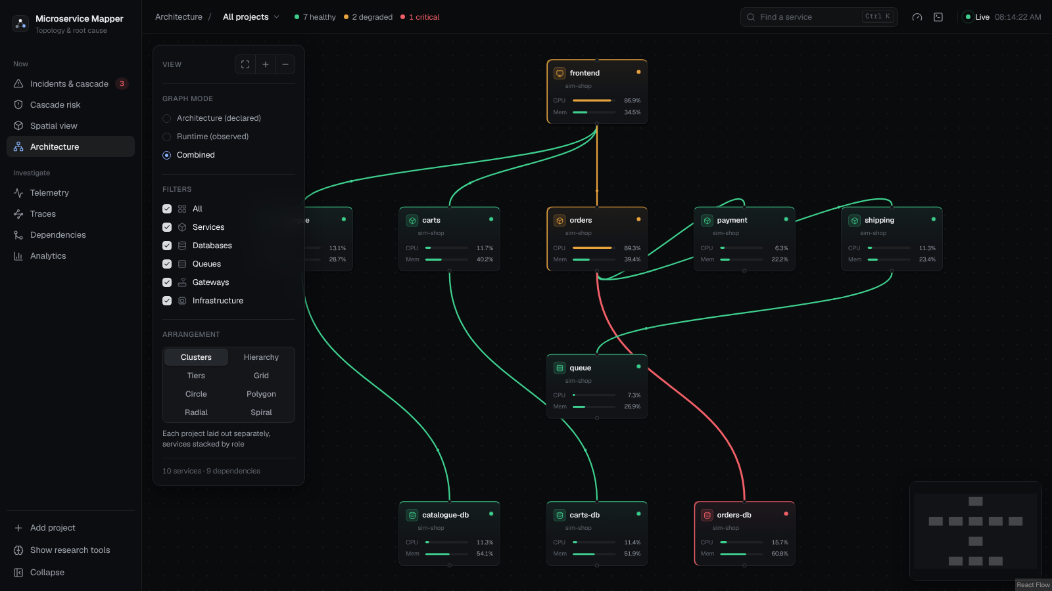
THE PRODUCT: DEPENDENCY MAP
Discovered automatically, nothing declared by hand.
Each link is declared, observed, or both.
Live CPU and memory on every block.
Dependency graph of the simulated shop
Notes:
Architecture page.

Slide 18
STEP 1: DETECT A PROBLEM
Normal: this service sits around 10% CPU.
Now: 25% then 30%, two readings in a row.
Verdict: far outside its usual wobble, so raise an alarm.
Safe: a missing reading is never treated as zero.
Notes:
Compare a service with itself. Two readings in a row, so one odd number does not trigger an alarm.

Slide 19
STEP 2: FIND THE ROOT CAUSE
web
errors and slow answers
web looks bad, but payments, which it calls, explains it. So web is a victim.
payments looks bad and nothing it calls explains it. So payments is the root cause.
A stopped container always wins, it is a fact, not a guess.
calls
payments
traffic collapsed, very slow
bank gateway
normal
Notes:
Failures travel against the calls, so a service explained by a broken service it calls is a victim.

Slide 20
STEP 3: PREDICT THE SPREAD
web
chance of failing 46%
Start: stopped = 100%, slow or failing = 50%, healthy = 0%.
Pass on: 70% of a failure reaches the caller, scaled by how much it depends on it.
Result: a ranked list of services at risk, and a "what if this one fails" view.
Honest: this is a model with a stated assumption, not a measured number.
strong link
orders
chance of failing 82%
very strong link
database
stopped: 100%
Notes:
Each service passes on most of the danger it sees from the services it calls.

Slide 21
DID MACHINE LEARNING HELP?
The idea
Give a model the same signals and let it learn the weights from labelled faults.
The test
Train on the past, test on the future. Also train on one system and test on the other.
The result
It found only 50% of the faults. The rules found 97%.
The decision
Keep the simple, explainable rules. Retest when there is much more data.
Notes:
We tried a learned model against our hand-built rules and tested it fairly.

Slide 22
HOW WE TESTED
8
Stopped container faults
10
Crash faults
2
Crash loop faults
6
Memory pressure faults
6
CPU brownout faults
2
Paused faults
Two systems: ShopFlow (13 services) and LedgerLine (12 services) on AWS EC2.
217 minutes recorded; 34 faults in six kinds.
Scores come from comparing the mapper's output with the answer key.
Notes:
A fault injector breaks services on purpose and keeps a private answer key. The mapper never sees it.

Slide 23
RESULT
Method | Faults detected | Right service first | False alarms / hour
Live mapper (rules) | 97% | 58% | 5.9
Rules, fixed threshold | 97% | 55% | 8.9
Rules, tuned threshold | 82% | 46% | 4.4
Learned model | 50% | 53% | 3.0
Right service first is measured among the faults that were detected. Only 34 faults, so small differences are noise.
Notes:
Same held-out test data for every method.

Slide 24
PERFORMANCE COMPARISON
Notes:
Higher is better for detection and naming; lower is better for false alarms.

Slide 25
KEY FINDINGS
97%
of faults detected
58%
named the right service first
5.9 / h
false alarms per hour
Decision: the learned model found only 50% of faults, so the rules stay.
Limit: 34 faults is a small sample.
Cascade: the probabilities are a model, not measured.
Notes:
Three numbers and one decision.

Slide 26
CONCLUSION AND FUTURE WORK
Conclusion: an agentless tool that learns normal per service, ranks the root cause and forecasts the spread.
Evidence: 97% of 34 faults detected; right service first in 58% of those.
Future work: more labelled faults, calibrate the cascade, support Kubernetes.

Slide 27
REFERENCE
[1] L. Wu, J. Tordsson, E. Elmroth, O. Kao. MicroRCA: Root Cause Localization of Performance Issues in Microservices. IEEE/IFIP NOMS, 2020.
[2] P. Wang, J. Xu, M. Ma, et al. CloudRanger: Root Cause Identification for Cloud Native Systems. IEEE/ACM CCGrid, 2018.
[3] J. Lin, P. Chen, Z. Zheng. Microscope: Pinpoint Performance Issues with Causal Graphs in Micro-service Environments. ICSOC, 2018.
[4] Y. Gan, M. Liang, S. Dev, D. Lo, C. Delimitrou. Sage: Practical and Scalable ML-Driven Performance Debugging in Microservices. ASPLOS, 2021.
[5] A. Ikram, S. Chakraborty, S. Mitra, S. Saini, S. Bagchi, M. Kocaoglu. Root Cause Analysis of Failures in Microservices through Causal Discovery. NeurIPS, 2022.

