Slide 1

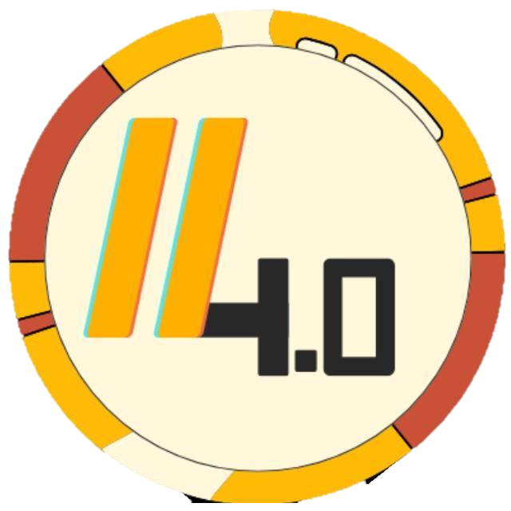
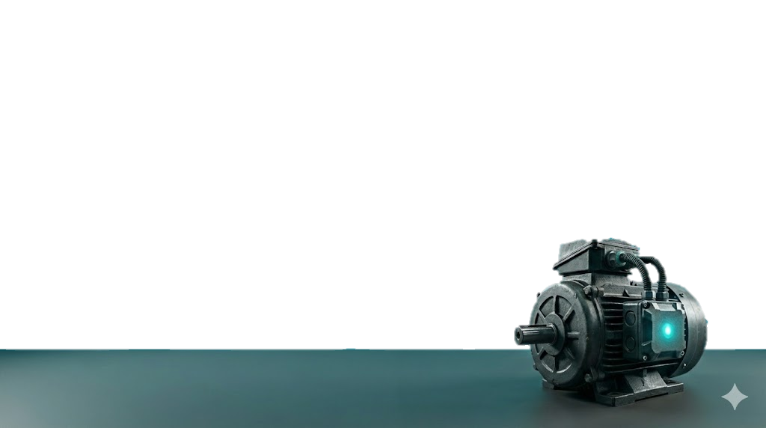
SpinSafe
Autonomous Edge-AI Guardian for Industrial Motors
Team: Electrophoenix
Track: Slash (Open)

Slide 2

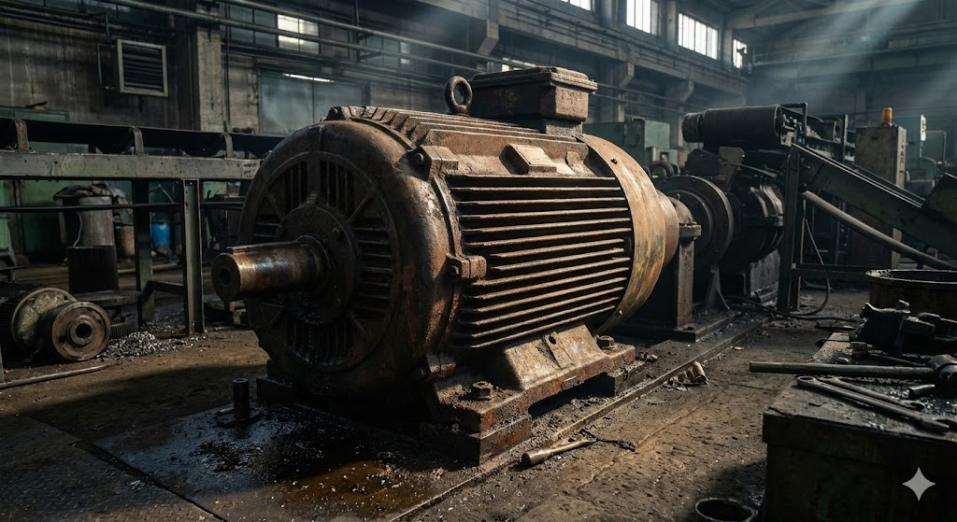
The Cost of Sloth Intelligence
Smart is useless if it's slow.
Why We are Solving This
The "Fast but Dumb" Baseline: Traditional hardwired PLCs react to danger in milliseconds, but only using rigid, single-variable thresholds. They cannot detect the complex, multi-sensor anomalies (e.g., vibration + temperature spikes) that indicate a motor is about to fail.
The "Sloth Intelligence" Trap: Industry 4.0 relies on sending heavy sensor data to the Cloud for AI analysis. But network latency (500ms+) makes this "smart" system useless for autonomous, emergency shutdowns. By the time the cloud detects a stall, the motor is already burning.
The Financial Bleed: Unplanned industrial downtime costs manufacturers an average of $22,000 per minute. Waiting on cloud latency directly burns capital.
The Safety Hazard: Catastrophic motor stalls create immediate physical risks (fires, shrapnel) for on-site personnel if not killed instantly.
The Legacy Gap: Millions of legacy motors power the industrial world. Upgrading an entire factory to native "smart motors" is financially impossible. The industry desperately needs a cheap, retrofittable "brain."
Millisecond Reaction (Hardware)
Complex AI Compute (Cloud)
SpinSafe

Slide 3



The SpinSafe Approach : Edge Native AI
Sense
Think
Protect
A retrofittable, robust sensor node mounts directly to the motor chassis. It continuously samples high-frequency vibration, current, and temperature data right from the metal.
This is the core innovation. Instead of streaming raw data to a slow cloud, an onboard microcontroller (like the ESP32) runs a lightweight machine-learning model locally. It spots complex anomaly patterns in real-time.
The millisecond a stall or critical failure is predicted, the node autonomously triggers a local hardware interrupt to instantly cut motor power—completely independent of Wi-Fi.
Zero Cloud Dependency for Critical Safety Decisions.

Slide 4
System Architecture
Motor (The Asset)
Sensor Array (Vibration, Speed & Temperature)
ESP32 Node (TinyML Inferencing)
Relay Cutoff (Millisecond Action)
Hardware :
MPU6050 Gyro-Accelerometer
High-Power MOSFET Trigger Relay
D1286464 I2C OLED Display
Ds18B20 Thermal Probe
Infrared Speed Sensor
DC-DC Buck Converter
Motor Supply
Motor (BLDC, Brushed DC or AC)
Resistors, Capacitor & Diodes
Cloud Database Server
Cloud Based Display Interface
Software :
C++ (Arduino IDE)
Edge Impulse (TinyML)
Python (Jupyter Notebook)

Slide 5







The SpinSafe Advantage :
Retrofit, Don't Replace
Zero-Latency Safety
Predictive Sensor Fusion
Preventive Maintenance
We do not require factories to buy native "smart motors." SpinSafe mounts non-invasively to existing motor legacy chassis, bringing high-end predictive intelligence to standard, low-cost industrial motors.
While competitors wait hundreds of milliseconds for AWS or Azure to process telemetry, our TinyML model infers anomalies locally. We guarantee millisecond relay cutoffs, rendering the system completely immune to factory Wi-Fi dead zones.
Traditional PLCs only trip if one metric (like heat) crosses a hard, dumb line. Our AI fuses MPU6050 vibration signatures with thermal data to predict stalls before the physical limits are breached.
Competitors miss minute fault signatures. SpinSafe catches them. While the edge handles instant safety, we route telemetry to cloud RNN models to analyze historical vibration trends, predicting mechanical wear weeks before a stall.
The intelligence of the Cloud, with the reaction time of a hardware fuse.

Slide 6
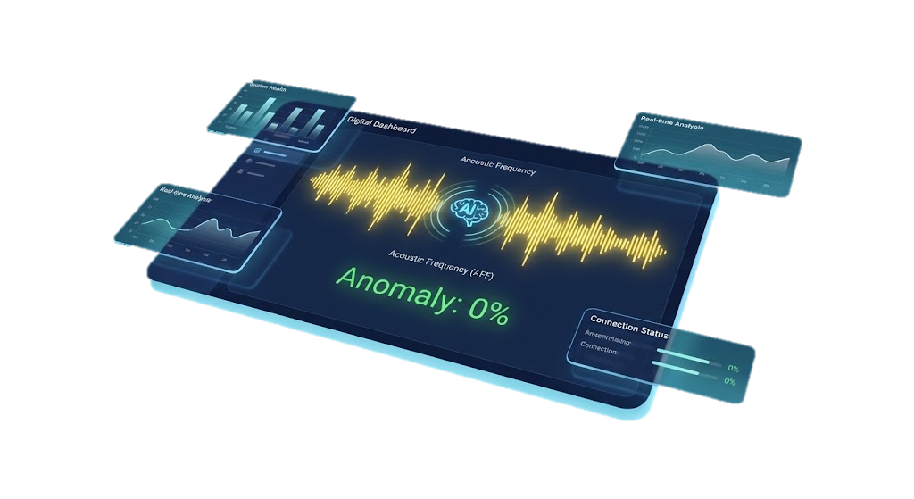
SpinSafe : The Bottom Line
The ROI Breakdown
What's Next?
Node Cost : ~$15 per unit (ESP32, MPU6050, Thermal Probe, Relay).
Value Protected: Eradicates the $22,000/minute industry average cost of unplanned downtime.
The ROI: Instantaneous. Preventing a single 5-minute stall saves $110,000 on a $15 hardware investment.
Deployment: 100% retrofittable = zero friction to scale.
Custom PCB Fabrication: Miniaturizing the ESP32 and relay into a single, ruggedized industrial enclosure.
Acoustic ML Models: Expanding the TinyML dataset to include audio anomaly detection (listening for bearing whines).
Pilot Testing: Deploying V2 nodes on real-world industrial HVAC and CNC spindle motors.
Industrial safety that pays for itself the millisecond it deploys.

Slide 7
Conclusion: The Catalyst for Industry 4.0
Sometimes, the smallest retrofit creates the largest revolution.
Redefining Maintenance : The End of "Run-to-Failure
Beyond the Motor
Activating Legacy Iron
We are fundamentally changing maintenance from a reactive emergency to a predictable science. By catching minute faults at the edge, machines now speak for themselves before they break.
The physics of mechanical failure are universal. If our TinyML architecture can secure a high-RPM RS 775, it can be instantly adapted for industrial water pumps, HVAC compressors, and CNC spindles too.
The future isn't about throwing away functional machines to buy "smart" ones. True Industry 4.0 is about deploying edge intelligence to the millions of "dumb" machines already powering the world.
Securing the future, one millisecond at a time.
THANK YOU
Team 𝕰𝖑𝖊𝖈𝖙𝖗𝖔𝖕𝖍𝖔𝖊𝖓𝖎𝖝
Tuhin Roy Shifa Tasnim Partha Das

