Slide 1
Local Search Algorithms Iterative Improvement Search
Notes:
Copyright © Shay Bushinsky

Slide 2
Iterative Improvement Search
Another approach to Search:
Start with some guess about the goal
Continue to improve it until real goal is reached
OR: Start with a sub optimal solution and strive to reach an optimal one

Slide 3
Typical Problems
Intended for NP-Complete problems:
Large combinatorial solution space
No apparent algorithm
Easy to verify the solution correctness
Discrete optimization problems:
Graph coloring
TSP
Scheduling
Resource optimization
Effective in spaces with a lot of local optima

Slide 4
Candidate Problems for Local Search
Problems that may not have an obvious “goal test” or “path cost”
In some problems the “path to the goal” is not important - optimization problems – the goal is important

Slide 5
Real Local search problems
N-Queens
VLSI circuit planning
Job Shop Scheduling
Optimizing Communications
Portfolio Management

Slide 6
Local search benefits
Little memory consumption – current best state or few states only
Cope better with large problem spaces where systematic search does not lead anywhere
suitable for online as well as offline search

Slide 7
Configuration states
state space = set of “complete” configurations;
find optimal configuration, e.g., TSP
find configuration satisfying constraints, e.g., timetable, i.e. CSP

Slide 8
The hill climbing family
Classical hill climbing
Steepest ascent
Stochastic hill climbing

Slide 9
Hill Climbing Algorithm
Add a heuristic to “generate and test:”
1 Evaluate the initial state - if it is goal state quit, otherwise current state is initial state.
2 repeat :
3 select a new operator for this state and generate a new state.
4 evaluate the new state
A) if it is closer to a goal state than current state, make it the current state
B) if it is no better – ignore it
5 until the current state is a goal state or no new operators available

Slide 10
Steepest Ascent Hill Climbing
This algorithm differs from the basic Hill climbing algorithm by choosing the best successor rather than the first successor that is better.
This indicates that it has elements of the breadth first algorithm.

Slide 11
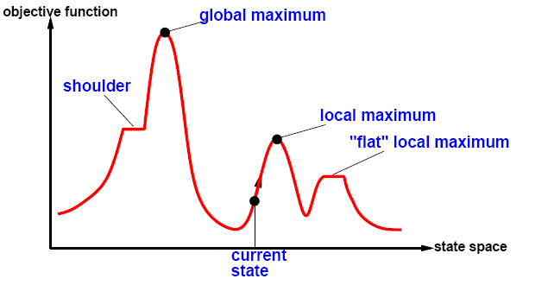
Iterative improvement methods
Employing a global search heuristic function on the search space

Slide 12
Definition of Local Minima
A sub-optimal (or in-feasible) state in the search space which cannot be improved
Let c be a configuration
Let N(c) be a neighborhood of c
Let f be an objective function or a constraint minimization function (we strive for f(x)->0), C is local minima iff for every nἐN(c) f(n)>=f(c)

Slide 13
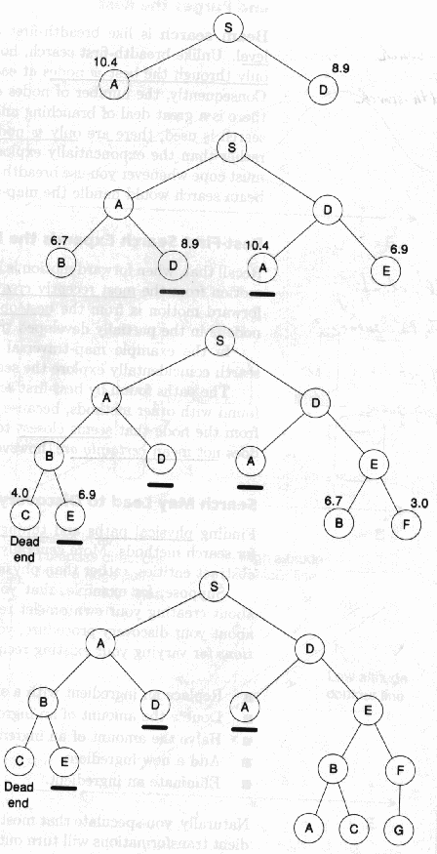
Hill Climbing Beam Search
Keep track of K states rather than just one
Their heuristic value reflects how close is the node to target
• Start with K randomly generated states
• Stop if any goal state
• Multiple Successors generated for each of the k states
• Choose top K successor states in next cycle
• Example with k=2 - strives to find goal G where numbers denote distance to goal

Slide 14
Overcoming Greed
Beam search is rather fast o(b*d) economic in space o(k) but not complete nor optimal
Susceptible to local optima
Solution: add non determinism to encourage diversity

Slide 15
Stochastic Beam Search
Like beam search, but probabilistically choose the k nodes at the next generation.
The probability that a neighbor is chosen is proportional to its heuristic value.
Like asexual reproduction: each node gives its mutations and the fittest ones survive.

Slide 16
GENETIC ALGORITHMS

Slide 17
Discrete Optimization problems
A set of parameters – genomes or chromosomes
A function combining them to a single value – the fitness function
A set of constraints on the parameters – incorporated in the fitness function
Goal: find the parameters that maximize / minimize the fitness function subject to the constraints

Slide 18
Extending Beam Search
Like stochastic beam search, but pairs of nodes are combined to create the offspring:
For each generation:
Randomly choose pairs of nodes where the fittest individuals are more likely to be chosen.
For each pair, perform a cross-over: form two offspring each taking different parts of their parents:
Mutate some values
Report best node found.

Slide 19
Genetic Algorithms
The Key Questions:
–What is the fitness function?
–How is an individual represented?
–Which individuals survive?
–How are individuals selected?
–How do individuals reproduce?

Slide 20
Representations
Fixed length string
Bit string (over a binary alphabet)
mapping of the SAT problem
Graph coloring – 2 bits represent a color
Over a small alphabet
A string over {C,G,A,T}
Variable length string
Rules
Vector of real numbers
Optimize f(x) – find a solution x=0.B1B2B3…Bn e.g. maximize f(x)=sin(2Pix^3)sin(25x) 0<x<1
Permutations
N queens
TSM cities
Lists
Trees
Lisp programs
Notes:
Biological terminology is often used for this representation.
A locus is a string position, and an allele is the symbol in that string position.

Slide 21
LIFE
Depends on 20 proteins – amino acids
Each human cell needs protein which is encoded in its DNA and produced by its Ribosome
Each cell nucleolus consists of 23 chromosomes that form the genome of the individual: genotype
Each chromosome encodes four amino acids {A, C, G, T}

Slide 22
Typical representation
Find the maximum of the parabolic function: 31p-p^2 0<p<31
Genome: p’s range can be represented by 5 bits: 0-31
The function gets its maximum at 15 and 16 coded 10000 and 01111

Slide 23
Random initial population
Genome | P | fitness
10110 | 22 | 198
00011 | 3 | 84
00010 | 2 | 58
11001 | 25 | 150
The average population fitness is 128.5 which is pretty close to the goal but will be improved in future generations

Slide 24
Lists representation
Lists data structure for genes:
Mutations: add/delete a node in the list
Recombination: exchange a node sequence:
Single point/uniform crossover

Slide 25
GA parameters
Reproduction:
Single offspring
Two children
Persistency:
None
Elitist survival
Population ranking:
Fitness ranking – skewed by super heroes
Ordinal ranking – a more even distribution
Selection method:
Roulette (proportional)
Tournament - select randomly k individuals from the population and compare their fitness. The one with the best fitness is allowed to mate

Slide 26
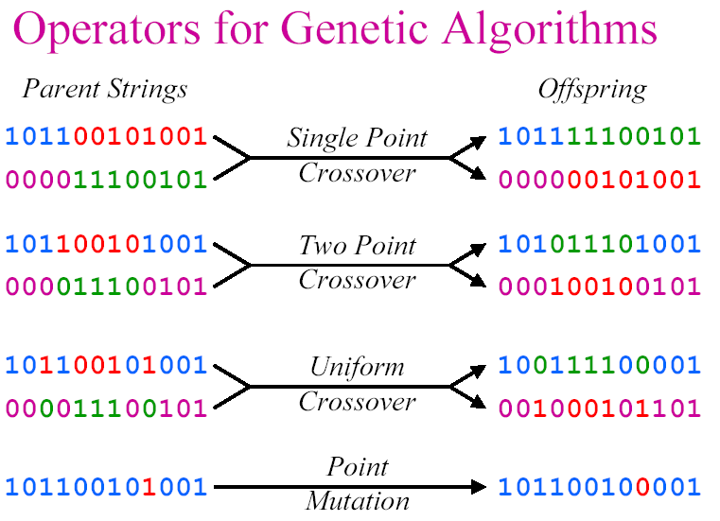
Reproduction Operators

Slide 27
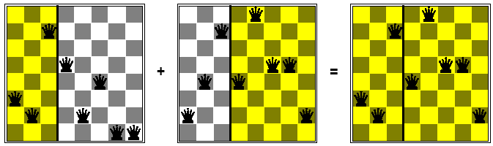
Single point cross over

Slide 28
The Genetic Algorithm Input
The fitness function
A threshold defining an acceptable level of fitness for terminating the algorithm
The size of the population
Generation parameters
the fraction of the population that reproduces
the mutation rate

Slide 29
Population size (p)
The population size value indicates the number of chromosomes in the first generation.
This number is constant through out the run of the program.
A small population size value will run faster in real time, but will take more generations to properly evolve.

Slide 30
Crossover rate (r)
Crossover rate can be defined as the percentage specifying the fraction of
selected pairs that undergo crossover.
In most applications, this rate is very high, over 2/3rds. Or less than 1/3rd move on to the next generation…
A 100% crossover rate, means that crossover always takes place.

Slide 31
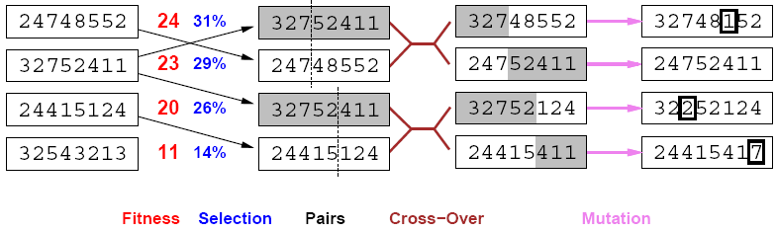
stochastic local beam search + generate successors from pairs of states

Slide 32
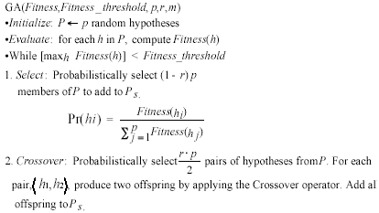
The Genetic Algorithm

Slide 33
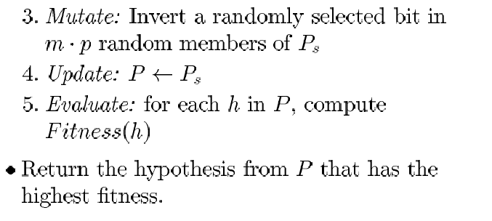
The Genetic Algorithm

Slide 34
Termination Criteria
A solution is found that satisfies minimum criteria
Fixed number of generations reached
Allocated budget (computation time/money) reached
The highest ranking solution's fitness is has reached a plateau
Manual inspection
Combinations of the above

Slide 35
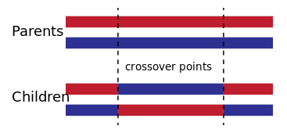
Two Point Crossover
Two children produced

Slide 36
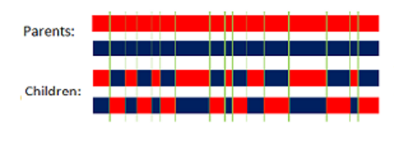
Uniform Crossover

Slide 37
SELECTION METHODS

Slide 38
Parent selection
Expected number of copies of an individual i:
E( n_{i} ) = μ • f(i) / <f>
(μ = pop.size, f(i) = fitness of i, ⟨f⟩ avg. fitness in pop.)

Slide 39
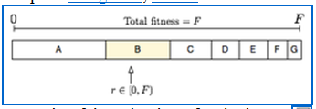
Roulette wheel algorithm
Also known as FPS – Fitness Proportional Selection
Given a probability distribution, spin a 1-armed wheel n times to make n selections
No guarantees on actual value of n_{i}

Slide 40
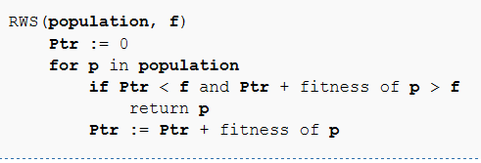
RWS
Inefficient code for illustration:

Slide 41
RWS problems
One highly fit member (“super hero”) can rapidly take over if rest of population is much less fit:
Premature Convergence
At end of runs, when the fitness of genes become similar, lose selection pressure
Highly susceptible to function transposition

Slide 42
SUS - Stochastic Universal Sampling

Slide 43
Baker’s SUS algorithm
A FPS method
One spin instead of N (1 sample)
Reduces bias by giving weaker members a chance to be chosen

Slide 44
SUS Motivation
If we have an individual that occupies 4.5% of the wheel and we select 100 individuals, we would expect on average for that individual to be selected between four and five times.
Stochastic Universal Sampling guarantees this. The individual will be selected either four times or five times, not three times, not zero times and not 100 times…

Slide 45
SUS Explained
Works by making a single spin of the roulette wheel.
This provides a starting position and the first selected individual. The selection process then proceeds by advancing all the way around the wheel in equal sized steps, where the step size is determined by the number of individuals to be selected

Slide 46
SUS Explained
So if we are selecting 30 individuals we will advance by 1/30 x 360 degrees for each selection. Note that this does not mean that every candidate on the wheel will be selected. Some weak individuals will have very thin slices of the wheel and these might be stepped over completely depending on the random starting position.

Slide 47
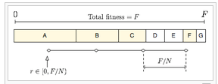
Baker’s SUS algorithm
SUS starts from a small random number, and chooses the next candidates from the rest of population remaining, not allowing the fittest members to saturate the candidate space (N = number of offsprings to keep)

Slide 48
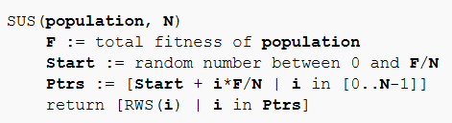
Baker’s SUS algorithm
n evenly spaced arms on wheel and spin once
Guarantees floor(E( n_{i} ) ) ≤ n_{i} ≤ ceil(E( n_{i} ) )
Stochastic universal sampling
Notes:
Less stochasticness

Slide 49
Tournament selection

Slide 50
Tournament selection
Informal Procedure:
Pick k members at random then select the best of these
Repeat to select more individuals

Slide 51
Tournament selection
Probability of selecting member i depends on:
Rank of i
Size of sample k
A higher k increases selection pressure
Whether contestants are picked with replacement
Picking without replacement increases selection pressure
Whether fittest contestant always wins (deterministic) or this happens with probability p
For k = 2, time for fittest individual to take over population is the same as linear ranking with s = 2 • p

Slide 52
Tournament selection cons
Relies on global population statistics
Could be a bottleneck especially in parallel implementation
Relies on the presence of an external fitness function which might not exist: e.g. evolving game players

Slide 53
Survivor Selection Methods

Slide 54
AGING: Seniors fit for reproduction
As in nature, adult individuals are considered more fit for genetic operations, compared to young and old ones.
The model aims to emulate the natural genetic system in a more natural way.

Slide 55
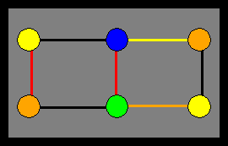
Constraint-satisfaction search

Slide 56
CSP Tradeoff
Feasibility versus objective function improvement
One approach: Start with a non feasible configuration and strive to reach a feasible one
Second approach: always remain in the feasible world
Third approach: hybrid - relaxation

Slide 57
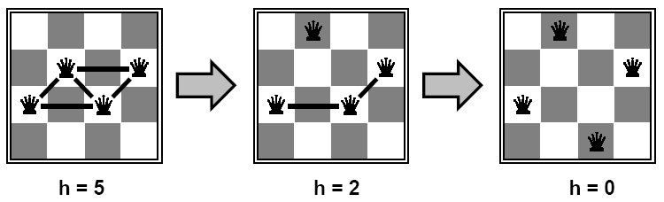
Minimal conflicts heuristic
Move the piece with the largest number of conflicts to the square in the same column where the number of conflicts is smallest.
Solves the 1,000,000 queen problem in less than 50 steps on average.
It assumes that the initial configuration is 'reasonably good'
Notes:
Belong to the iterative repair family
This heuristic is applicable to CSP problems which will be discussed in a later chapter.
Note that this heuristic can get the search stuck in local optima – as it is extremely dependent on the starting position
(worst case start position: all queens are aligned)

Slide 58
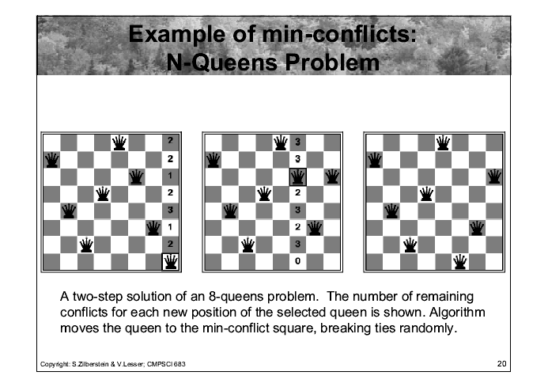

Slide 59
Algorithm in pseudo code
algorithm MIN-CONFLICTS
input: csp, a constraint satisfaction problem
max_steps,the number of steps allowed before giving up
current_state, an initial assignment of values for the variables in the csp
output: a solution set of values for the variable or failure
for i=1 to max_steps do
if current_state is a solution of csp then return current_state
var <-- a randomly chosen variable from the set of conflicted variables CONFLICTED[csp]
value <-- the value v for var that minimizes CONFLICTS(var,v,current,csp)
set var = value in current_state
return failure

