Slide 1

Multi-Object Tracking
Hasan Atakan Bedel
Corporate Private
Notes:
<number>

Slide 2
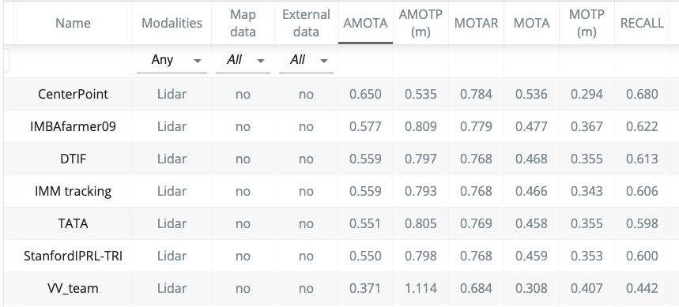
KALMAN VS DEEP LEARNING
Corporate Private
Notes:
<number>

Slide 3


METRICS

Slide 4
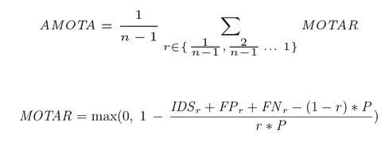
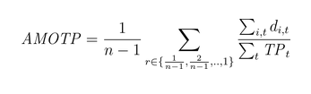
NUSCENES METRICS
AMOTA and AMOTP
These are integrals over the MOTA/MOTP curves using n-point interpolation
r = recall = 0.9
P refers to the number of ground-truth positives for the current class

Slide 5
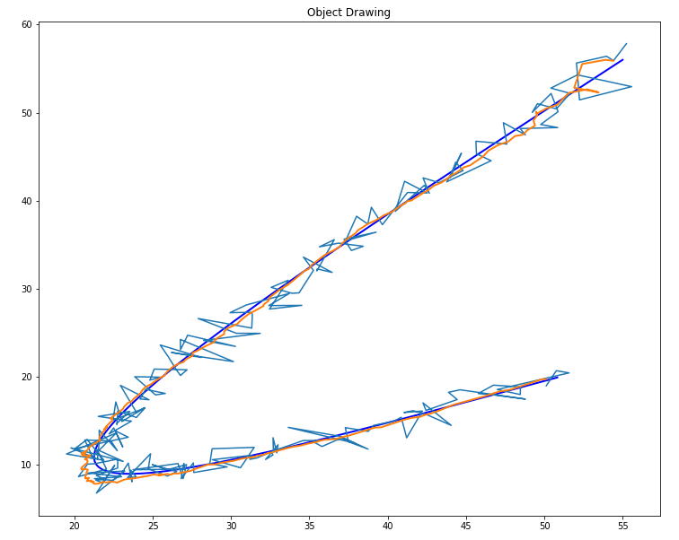
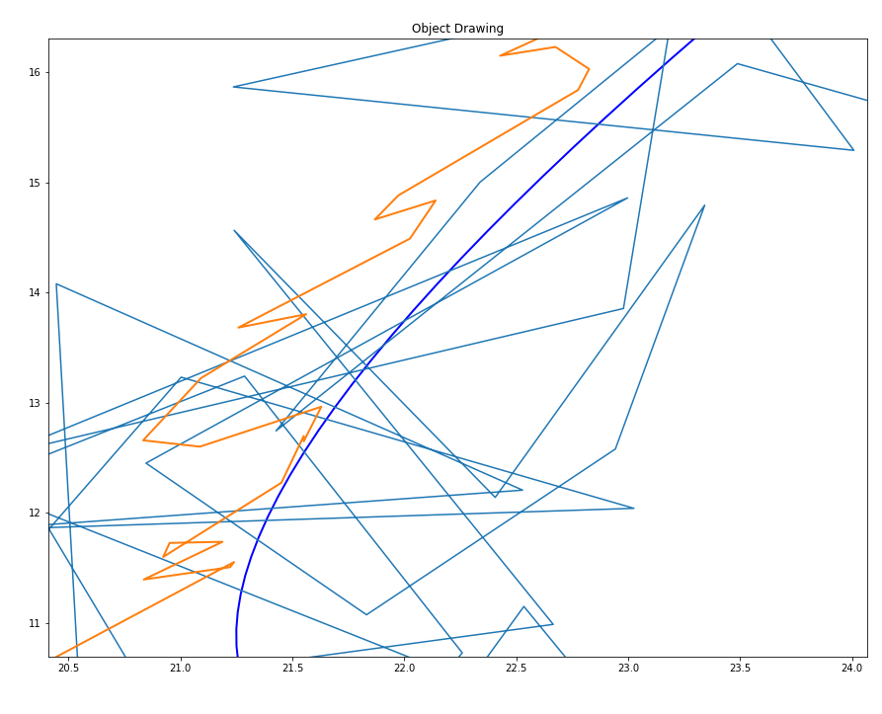

Slide 6
VIDEO-1 HERE

Slide 7
IMM – UKF - JPDAF
Joint Probability Data Association Filter
Interacting Multiple Model
Unscented Kalman Filter

Slide 8
IMM
Share states between models to bound them
Mixing
Model Probabilities Update
Fusing Models for output
Which model did better?
Just For Output

Slide 9
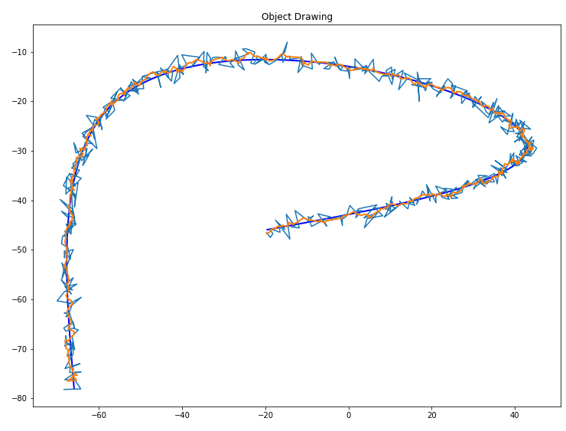
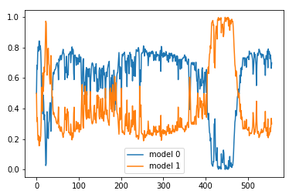
IMM single tracking demo

Slide 10
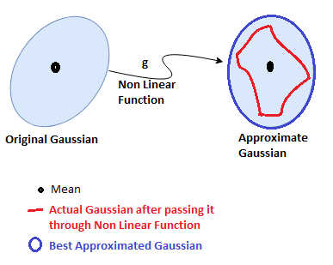
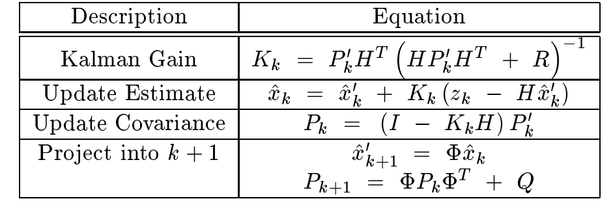
UKF
S, innovation matrix

Slide 11
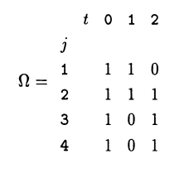
JPDAF
Generate Association Probabilities
O(m_k ^ (Nr+1))
Validation Matrix
Event Space
[[0 0 0 0]
[0 0 0 2]
[0 0 2 0]
[0 1 0 0]
[0 1 0 2]
[0 1 2 0]
[0 2 0 0]
[1 0 0 0]
[1 0 0 2]
[1 0 2 0]
[1 2 0 0]]
Calculate Event Probabilities
PDAF

Slide 12
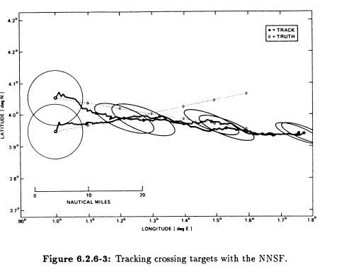
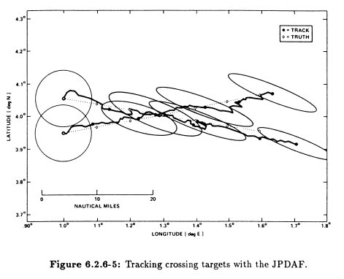
WHY JPDAF?

Slide 13
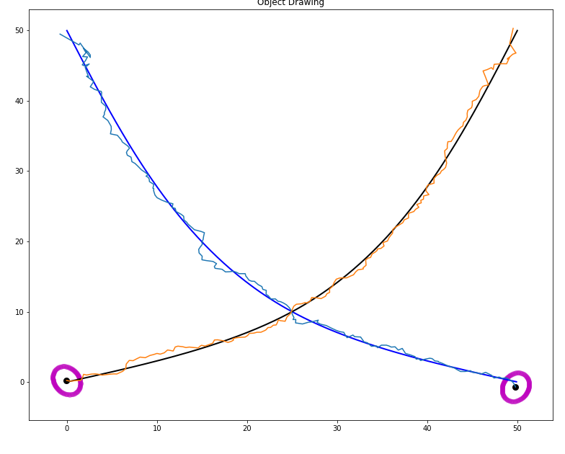
DOES IT WORK?, YES

Slide 14
VIDEO-2 Crossing Tracks

Slide 15
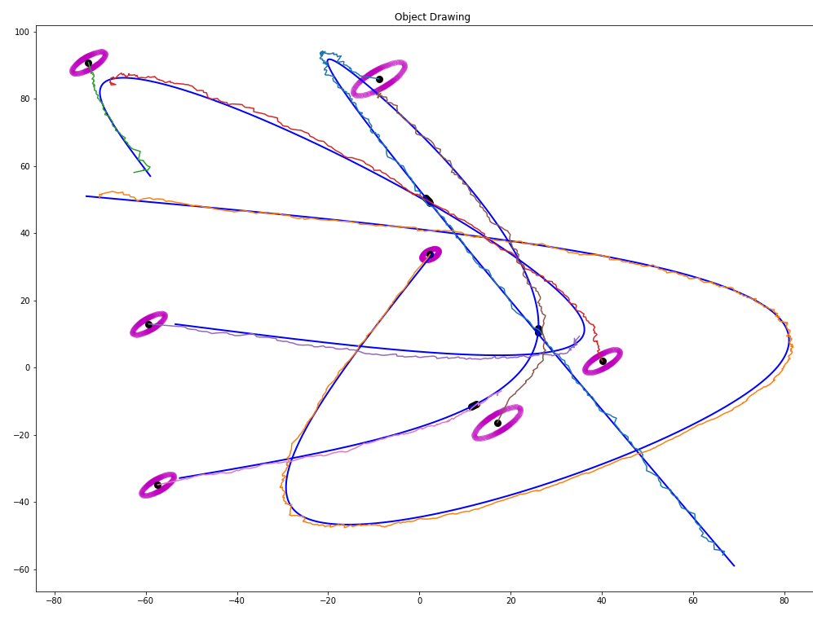
Multi-tracking CV model

Slide 16
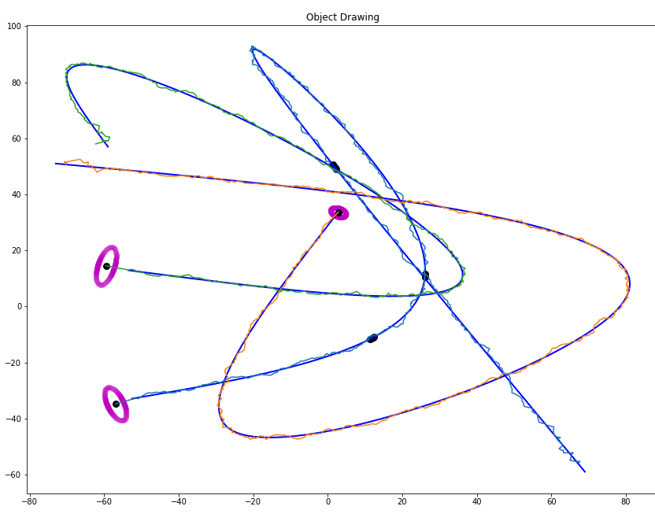
Multi-tracking CVTR model

Slide 17
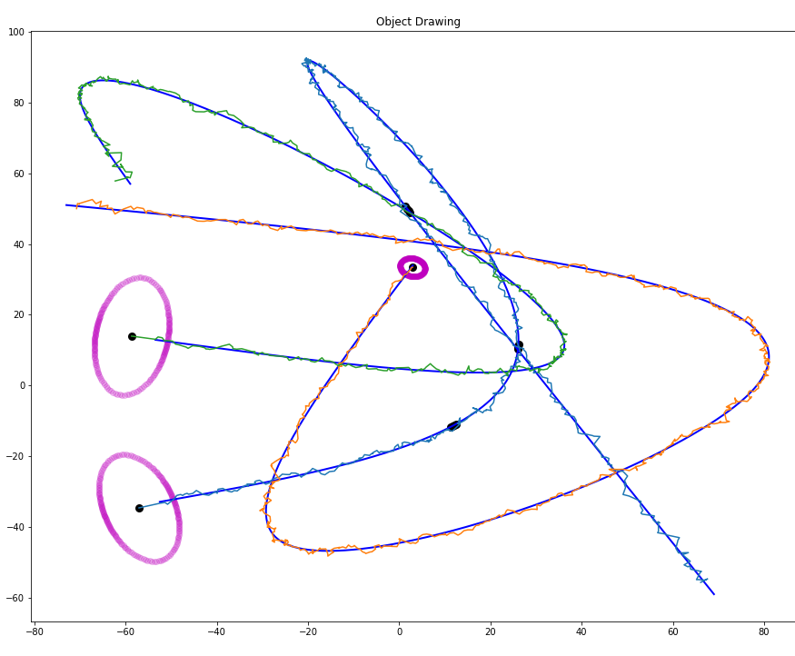
Multi-tracking IMM

Slide 18
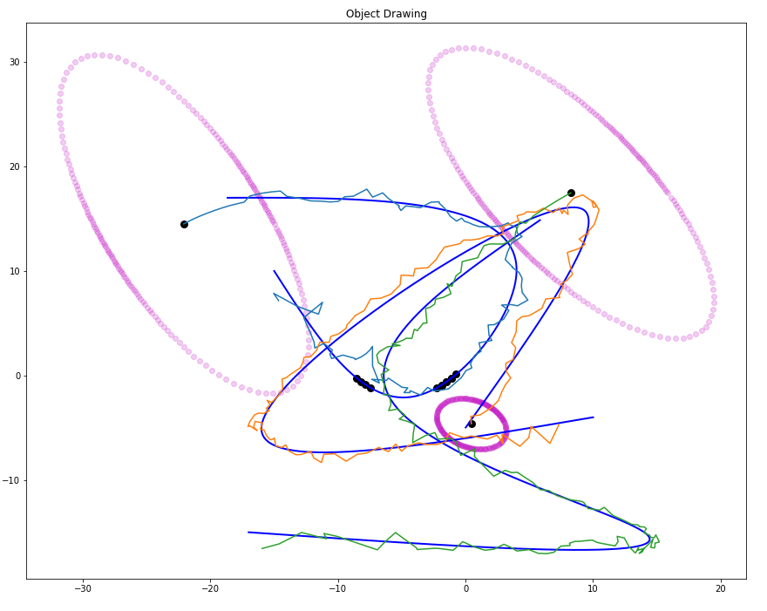
CLOSER LOOK
CAN IT PREDICT?

Slide 19
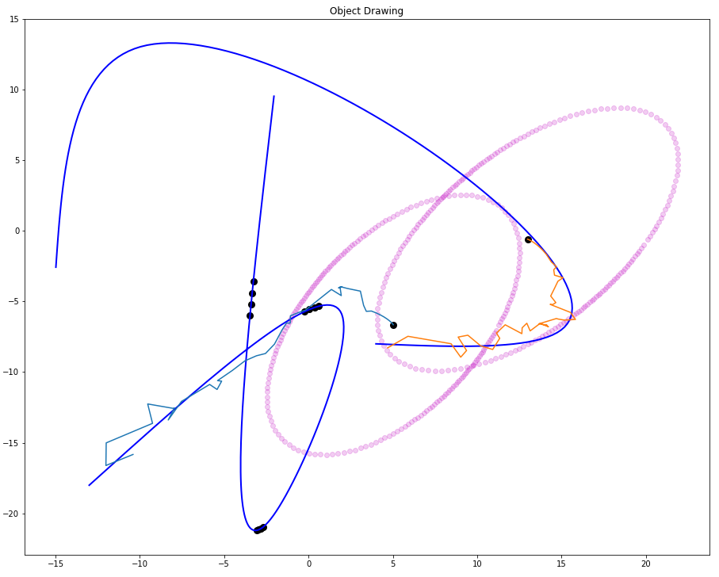
CVTR
(Constant Velocity Turn Rate) PREDICTION

Slide 20
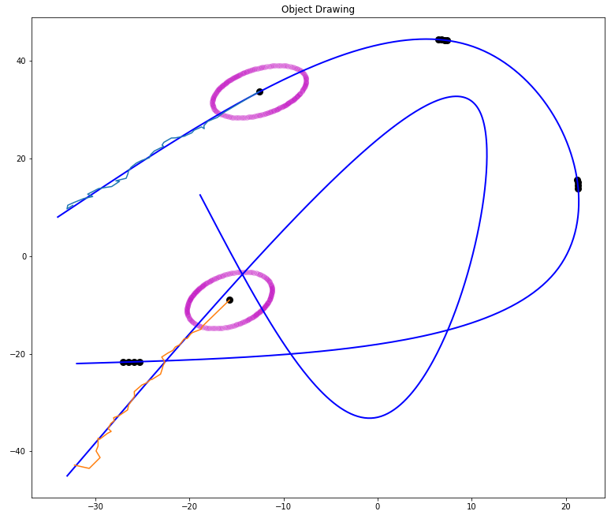
CV
(Constant Velocity) PREDICTION

Slide 21
TIME PERFORMANCE
SINGLE MODEL
MULTIPLE MODEL
LINEAR
NONLINEAR
209 FPS
441 FPS
99
FPS
3 objects
152 FPS
222 FPS
59
FPS
4 objects
5 objects
75
FPS
104 FPS
42 FPS
7 objects
22
FPS
19
FPS
15
FPS
(18)
FPS
(3)
FPS

Slide 22
TIME SPENT ON DIFFERENT PARTS, WITH 8 OBJECTS, 6 FPS
PredictTime : 0.013 s → 8.63 %
NewTrackCheckTime : 0.00113 s -> 0.74 %
AverageValidationMatrixTime : 0.000175 s -> 0.11 %
EventGenerationTime : 0.00732 s -> 4.83 %
CalculationAssociationProbsTime : 0.112 s -> 74.50 %
UpdateTime : 0.0169 s -> 11.16 %

Slide 23

OPTIMIZATION OF THE PROCESS NOISE
WHAT IS PROCESS NOISE?

Slide 24
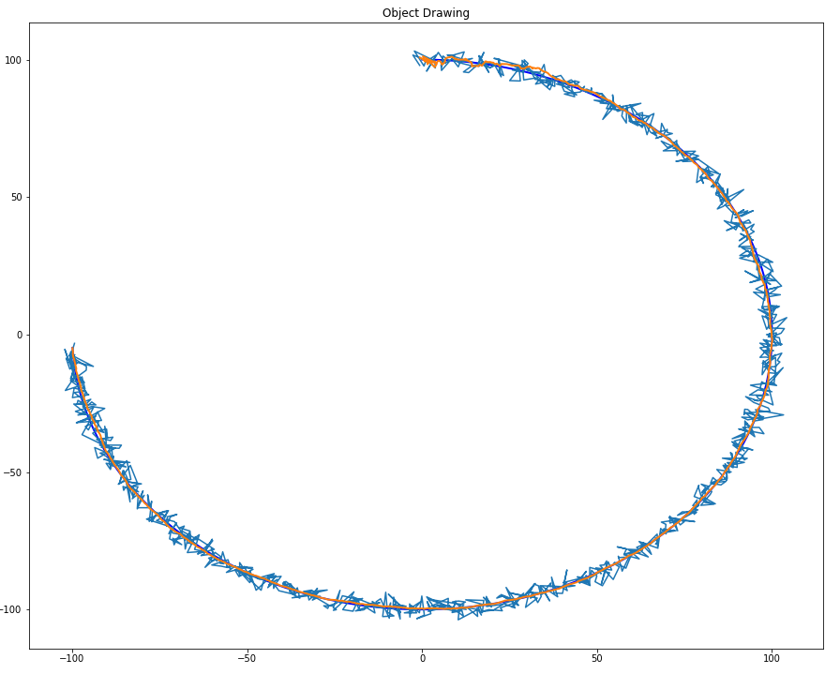
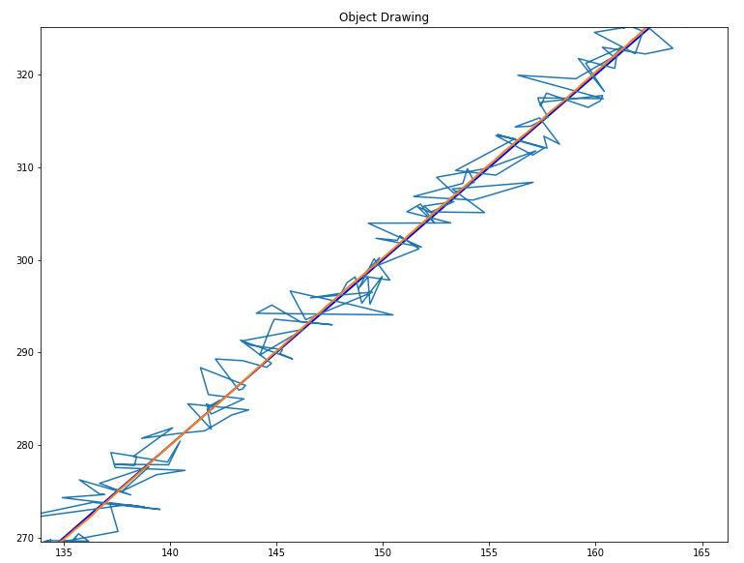
What happens if process noise is set to 0?

