Slide 1

Multiple Object Tracking
Hasan Atakan Bedel
Corporate Private

Slide 2
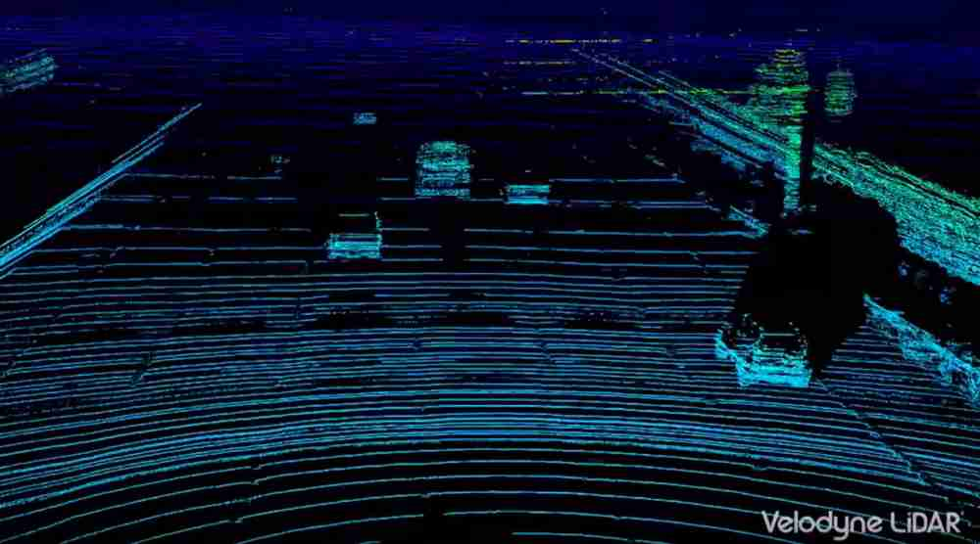
Problem definition
Deep Learning
Output
~10Fps
10 Fps?
Process Point Cloud
(Object Detection)
CenterX
CenterY
CenterZ
Width
Height
Length
Vx
Vy
CenterX
CenterY
CenterZ
Width
Height
Length
Vx
Vy
N Measurements
Multiple Object Tracking
(Filtering)
Measurement z_i(k)
i € (1..N)
Tracks Z_i(k)
i € (1..M)
Corporate Private

Slide 3
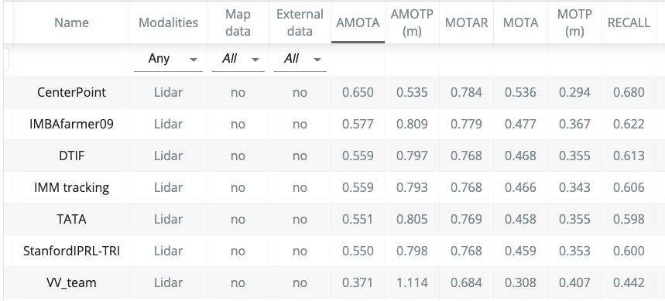
Nuscenes Dataset
Tracking Challenge

Slide 4
Has both paper and code
StanfordIPRL-TRI Team
CenterPoint Team
Description:
Our method uses the Kalman Filter to perform the 3D multi-object tracking for the NuScenes dataset.
We use the training set to estimate the Kalman Filter’s covariance matrices for the initial state, the process model noise, and the observation model noise.
In the data association part, we use Mahalanobis distance as the distance function. And we apply the greedy algorithm to find the best matching pairs of the predictions and the detections.
Description:
We use a keypoint detector to find centers of objects and simply regress to other attributes, including 3D size, 3D orientation, and velocity.
In our center-based framework, 3D object tracking simplifies to greedy closest-point matching. The resulting detection and tracking algorithm is simple, efficient, and effective.

Slide 5
How to filter?
Kalman Filter?
Deep Learning?
How to label?
Main Source:
(Masters Thesis) - 3D-LIDAR Multi Object Tracking for Autonomous Driving

Slide 6
Problem Decomposition
Measurements
Object Center Point Tracking
Bounding Box Tracking
(Data Association)
Motion Models
Constant Velocity
Constant Turn Rate
Random Motion
Existing Tracks
(Update Tracks)
(Predict Next State)

Slide 7
Problem Decomposition
Measurements
Object Center Point Tracking
Bounding Box Tracking
(Data Association)
Motion Models
Constant Velocity
Constant Turn Rate
Random Motion
Existing Tracks
(Update Tracks)
(Control Bounding Box)
Track History

Slide 8
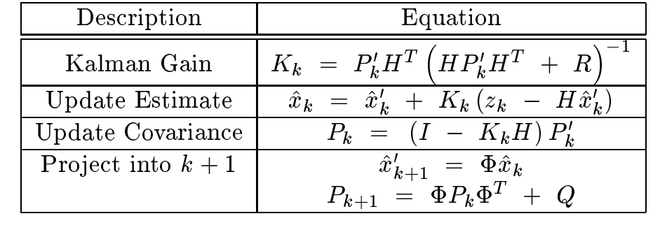



Update Tracks
Associated Data
Measurement Covariance
Unscented Kalman Filter
Yes
Model linear?
No
Kalman Filter
Process Noise

Slide 9
Motion Models
Random Motion Model(RM)
Constant Turn-Rate Velocity(CTRV)
Constant Velocity(CV)
Constant Velocity
Zero returning rate
Constant Velocity
Contant Turn-Rate
Zero Velocity
Zero Turn-Rate
Heading to the same bearing on all time steps
Rectilinear motion with a uniform acceleration and a
coordinated turn
For Static Objects

Slide 10
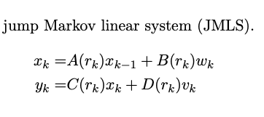
Motion Models
Interacting Multiple Model(IMM) FILTER
Markov chain with transition probability matrix
Π = [πij , P(rk = j|rk−1 = i)].
[0.9, 0.05, 0.05;
0.05, 0.05, 0.9;
0.05, 0.05, 0.9]
µi(k) , P(rk = i | y0:k)
rk ∈ {1, 2, . . . , Nr} is the mode state
[0.33, 0.33, 0.33]

Slide 11
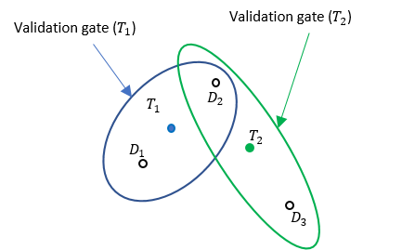
Data association
Global Nearest Neighbor (GNN) Algorithm
Use Euclidian or Mahalanobis distance
Joint Probabilistic Data Association(JPDA) Filter

Slide 12
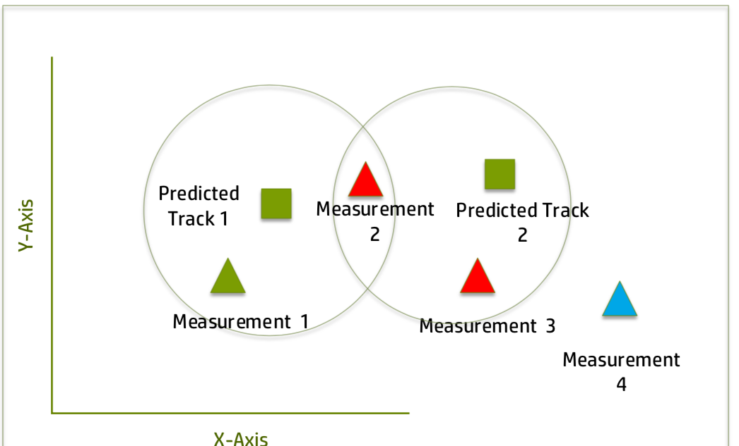
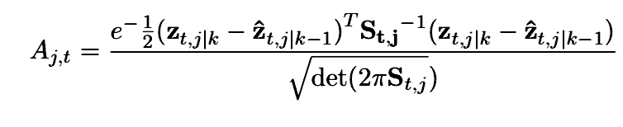
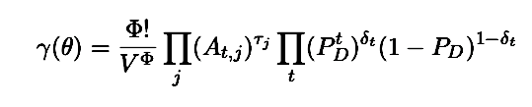
Joint Probabilistic Data Association(JPDA) Filter
The Gaussion likelihood of associating measurement j with t (track) -> event : Θjt

Slide 13
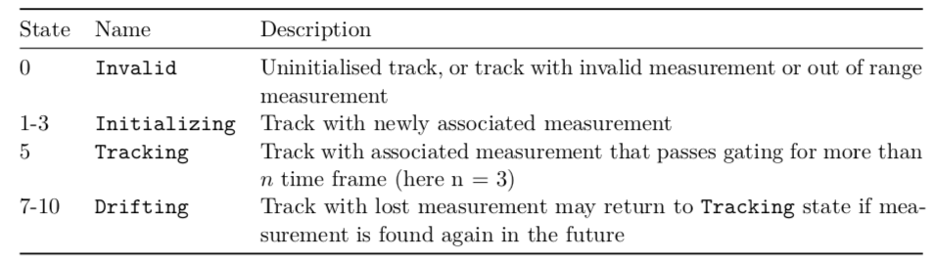
Track Management

Slide 14


Track Pruning
Differentiator
Track History
Threshold
PASS
Calculate Variance
Duplicate(CHOOSE)

Slide 15
Bounding Box Tracker
The bounding box has to be mapped exclusively to a track
Bounding box dimensions are not among the filtered states
Association only occurs when track has met the threshold of maturity level

Slide 16
Bounding Box Update Rules
Bounding box are generally should not shrink
Bounding box should never rotate too fast
Bounding box should not have sudden movement in the opposite direction against previous time steps travel heading

Slide 17
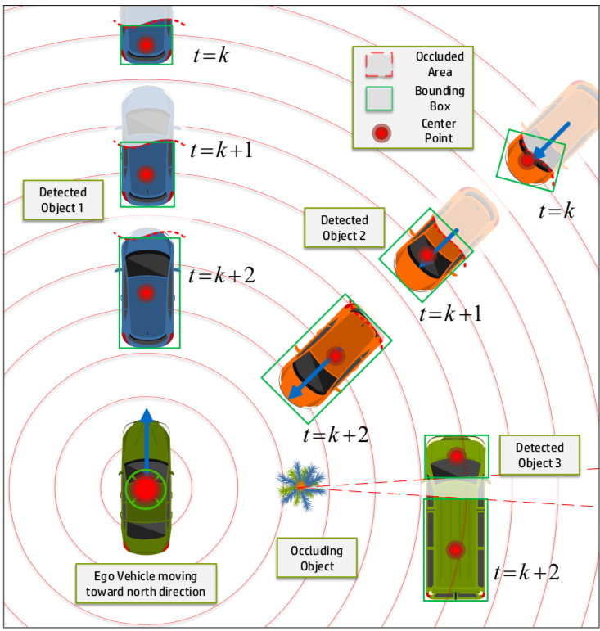
Bounding Box Dimension And Heading
Bounding Box Parameters:
Width
Length
Height
Yaw Heading

