Slide 1

Multi-Object Tracking
Hasan Atakan Bedel
Corporate Private
Notes:
<number>

Slide 2
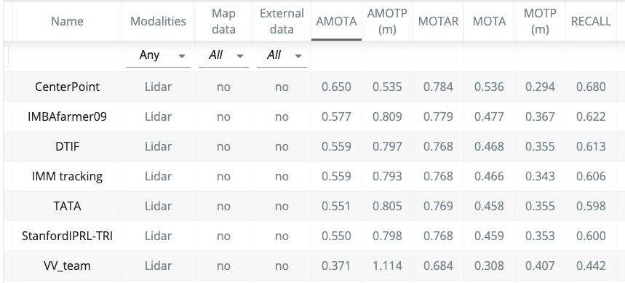
KALMAN VS DEEP LEARNING
Corporate Private
Notes:
<number>

Slide 3


METRICS

Slide 4
MOTA (multi object tracking accuracy) [3]: This measure combines three error sources: false positives, missed targets and identity switches.
MOTP (multi object tracking precision) [3]: The misalignment between the annotated and the predicted bounding boxes.
FAF: The average number of false alarms per frame.
MT (ratio of mostly tracked trajectories): The ratio of ground-truth trajectories that are covered by a track hypothesis for at least 80% of their respective life span.
ML (ratio of mostly lost trajectories): The ratio of ground-truth trajectories that are covered by a track hypothesis for at most 20% of their respective life span.
FP (number of false positives): The total number of false positives.
FN (number of false negatives): The total number of false negatives (missed targets).
IDS (number of identity switches): The total number of identity switches.
Frag (number of track fragmentations): The total number of times a trajectory is fragmented (i.e. interrupted during tracking).

Slide 5
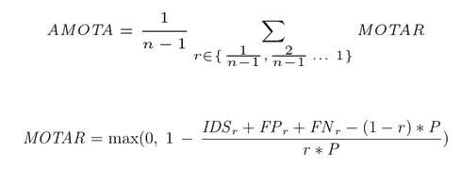
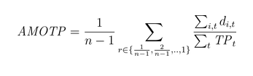
NUSCENES METRICS
AMOTA and AMOTP
These are integrals over the MOTA/MOTP curves using n-point interpolation
r = recall = 0.9
P refers to the number of ground-truth positives for the current class

Slide 6
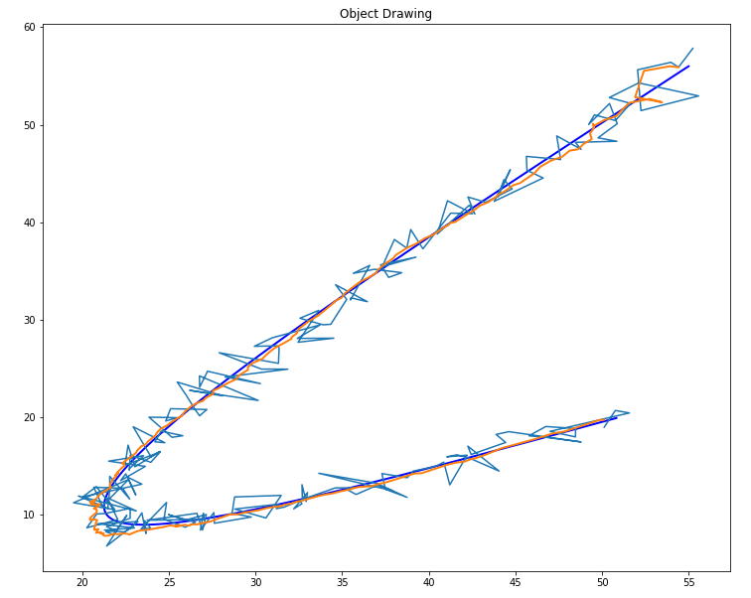
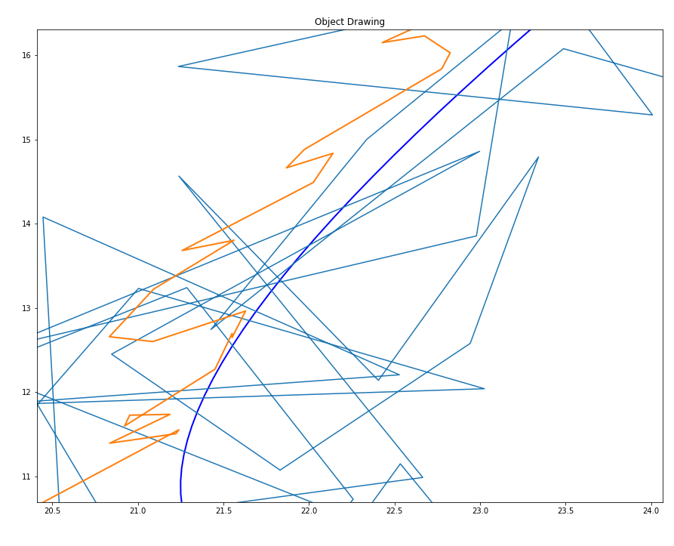

Slide 7
VIDEO-1 HERE

Slide 8
IMM – UKF - JPDAF
Joint Probability Data Association Filter
Interacting Multiple Model
Unscented Kalman Filter

Slide 9
IMM
Share states between models to bound them
Mixing
Model Probabilities Update
Fusing Models for output
Which model did better?
Just For Output

Slide 10
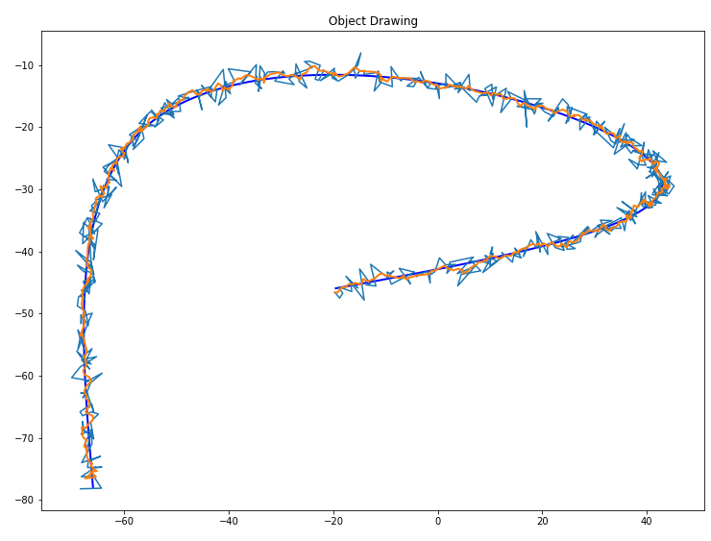
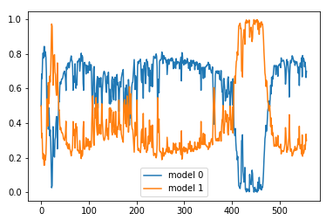
IMM single tracking

Slide 11
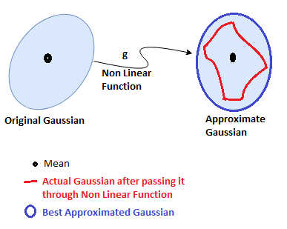
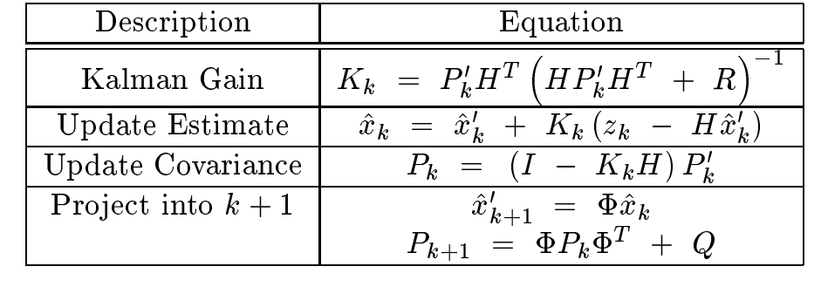
UKF
S, innovation matrix

Slide 12
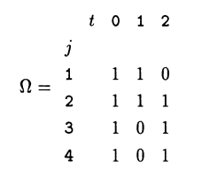
JPDAF
Generate Association Probabilities
O(m_k ^ (Nr+1))
Validation Matrix
Event Space
[[0 0 0 0]
[0 0 0 2]
[0 0 2 0]
[0 1 0 0]
[0 1 0 2]
[0 1 2 0]
[0 2 0 0]
[1 0 0 0]
[1 0 0 2]
[1 0 2 0]
[1 2 0 0]]
Calculate Event Probabilities
PDAF

Slide 13
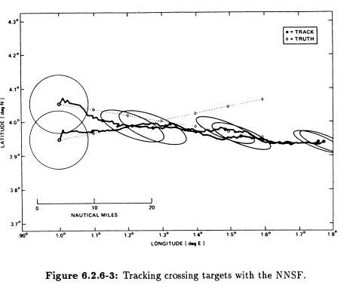
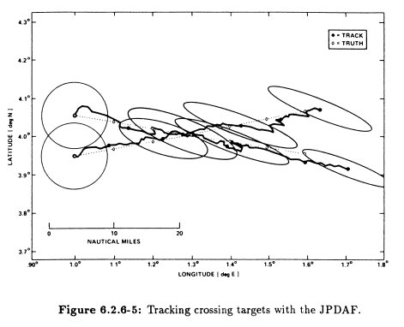
WHY JPDAF?

Slide 14
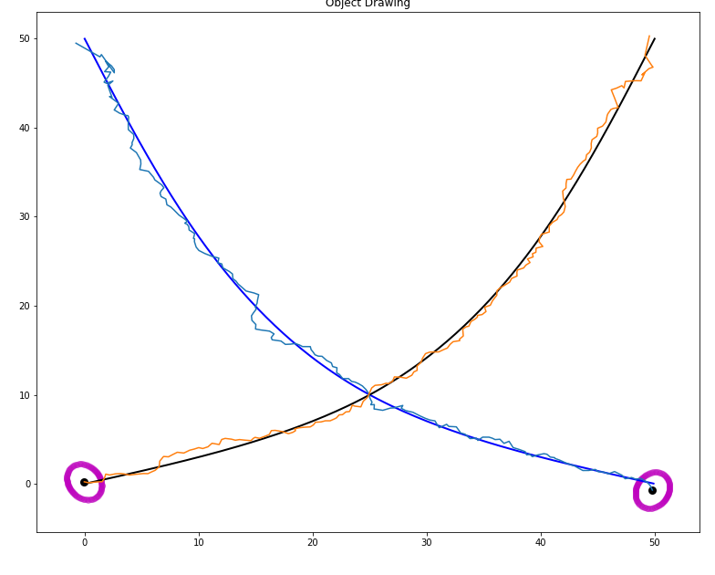
DOES IT WORK?, YES

Slide 15
VIDEO-2 Crossing Tracks

Slide 16
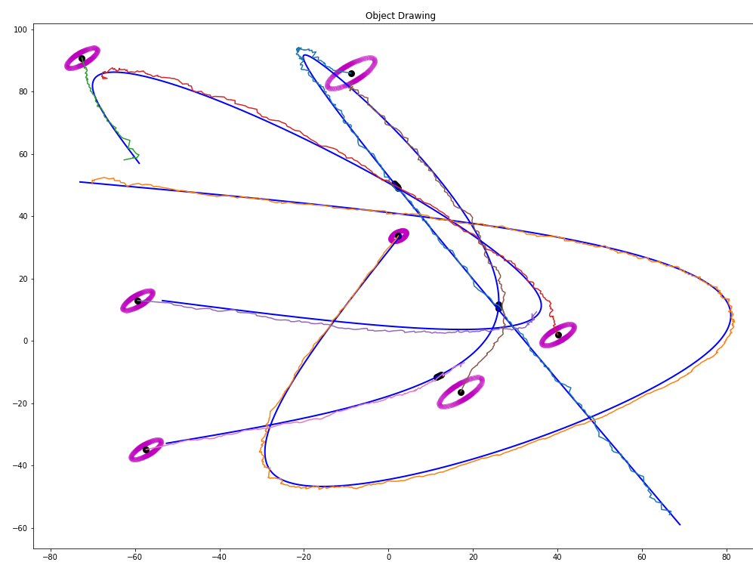
Multi-tracking CV model

Slide 17
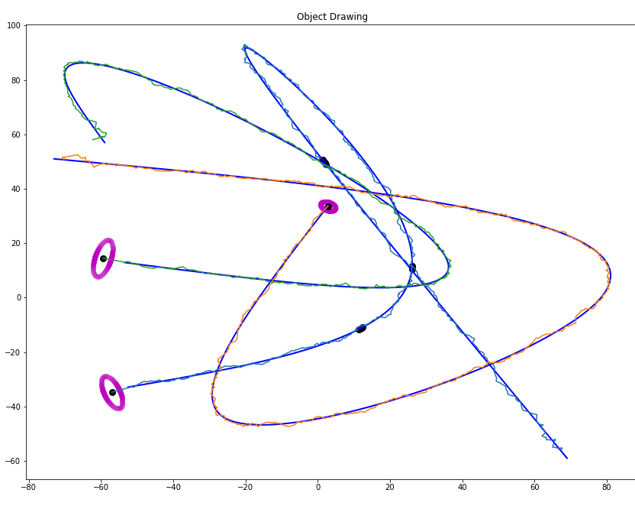
Multi-tracking CVTR model

Slide 18
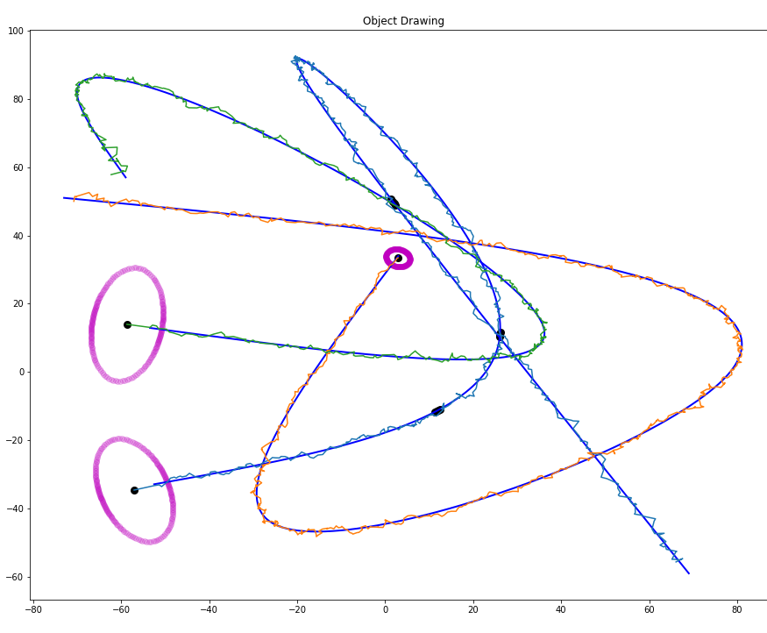
Multi-tracking IMM

Slide 19
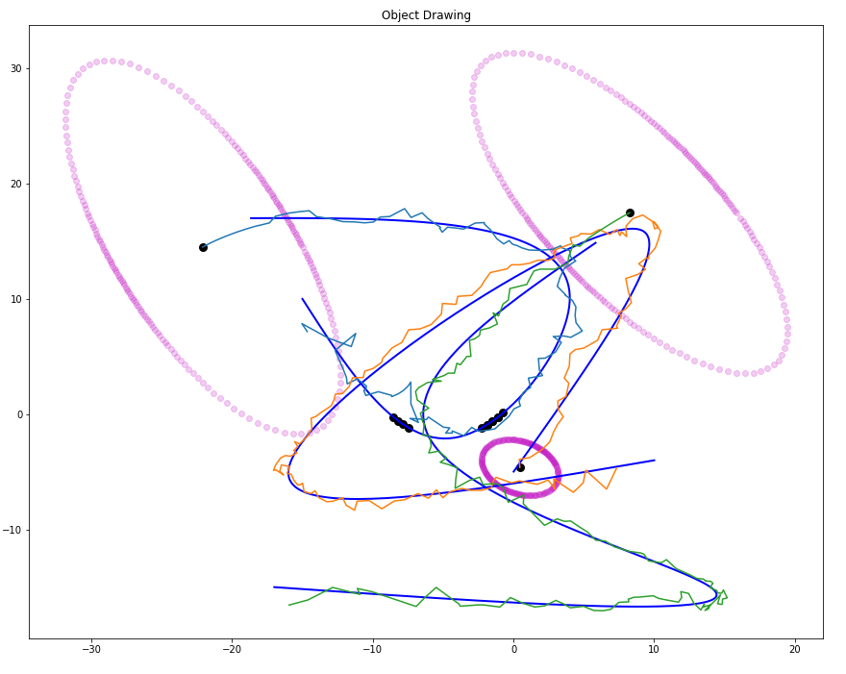
CLOSER LOOK
CAN IT PREDICT?

Slide 20
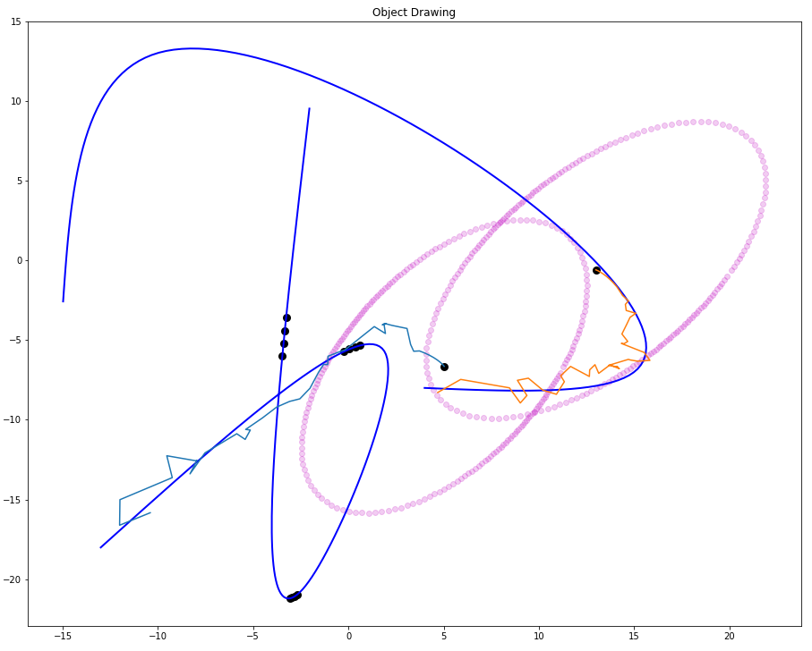
CVTR
(Constant Velocity Turn Rate) PREDICTION

Slide 21
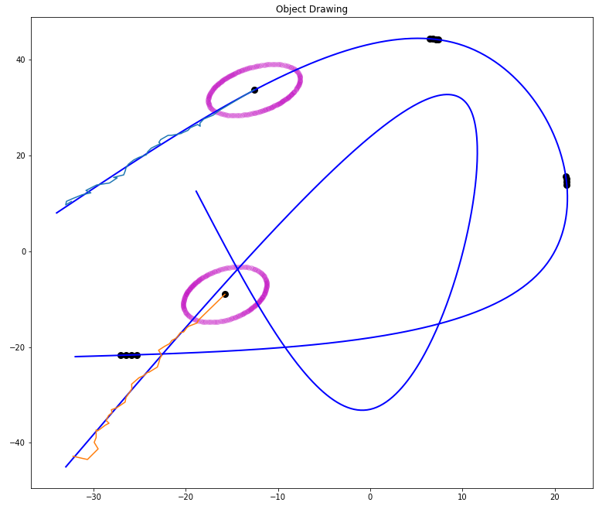
CV
(Constant Velocity) PREDICTION

Slide 22
TIME PERFORMANCE
SINGLE MODEL
MULTIPLE MODEL
LINEAR
NONLINEAR
209 FPS
441 FPS
99
FPS
3 objects
152 FPS
222 FPS
59
FPS
4 objects
5 objects
75
FPS
104 FPS
42 FPS
7 objects
22
FPS
19
FPS
15
FPS
(18)
FPS
(3)
FPS

Slide 23
TIME SPENT ON DIFFERENT PARTS, WITH 8 OBJECTS, 6 FPS
PredictTime : 0.013 s → 8.63 %
NewTrackCheckTime : 0.00113 s -> 0.74 %
AverageValidationMatrixTime : 0.000175 s -> 0.11 %
EventGenerationTime : 0.00732 s -> 4.83 %
CalculationAssociationProbsTime : 0.112 s -> 74.50 %
UpdateTime : 0.0169 s -> 11.16 %

Slide 24

OPTIMIZATION OF THE PROCESS NOISE
WHAT IS PROCESS NOISE?

Slide 25
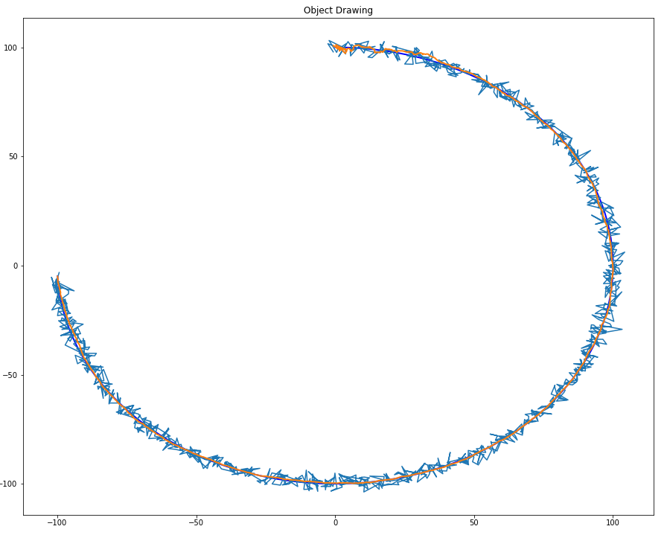
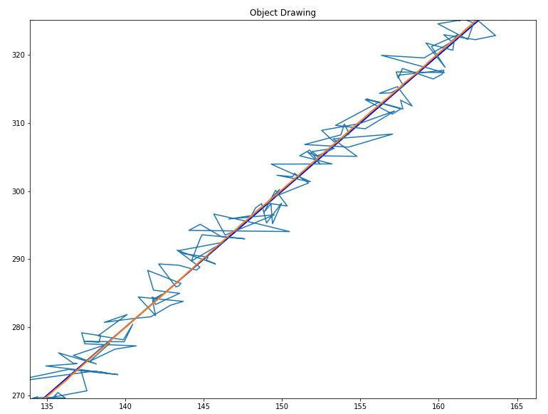
What happens if process noise is set to 0?

Slide 26
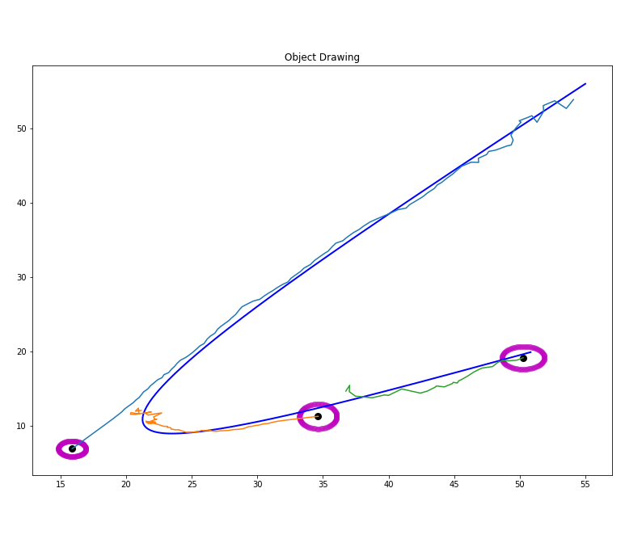
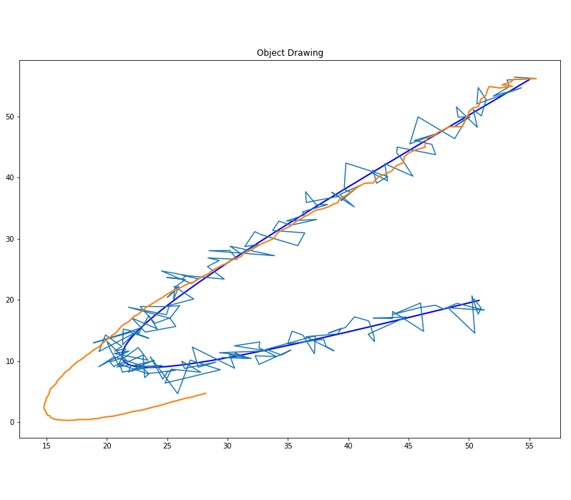
Why do we need it then?
CV Model with PDAF
CV Model with NSSF Tracking

Slide 27
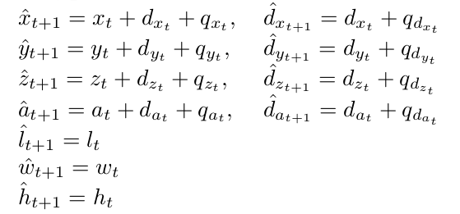
Optimization
Process Model

Slide 28
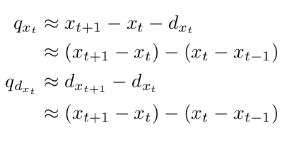
[0.12984269860386852,0,0,0,0],
[0,0.1327995178603939,0,0,0],
[0,0,0.6076644273338012,0,0],
[0,0,0,2.932375672412064,0],
[0,0,0,0,1.2714107424978]

Slide 29
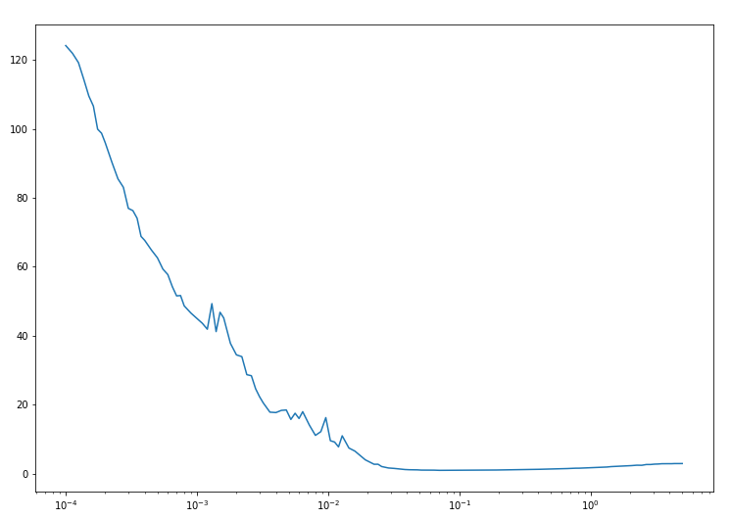
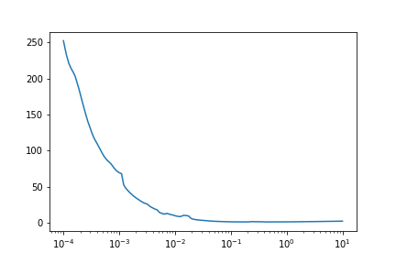
CV Model Loss Space
Best scale = 0.1664
CVTR Model Loss Space
Best scale = 0.0704

