Slide 1

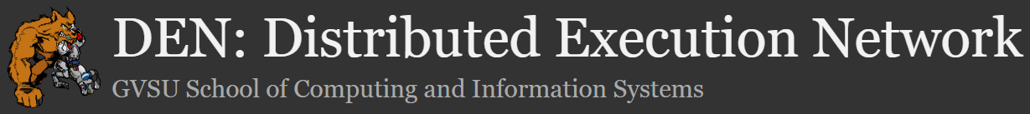
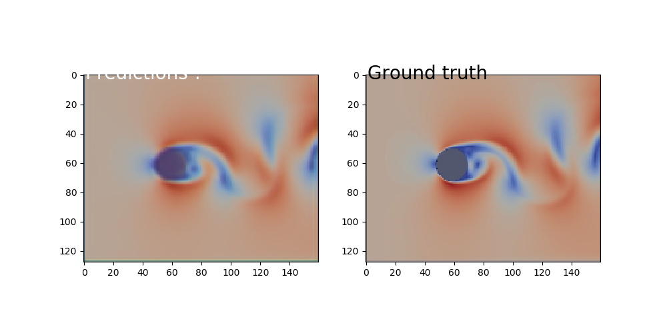
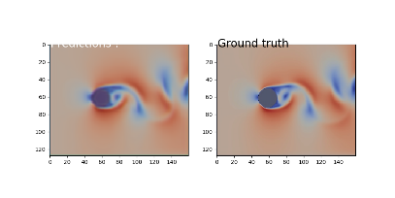
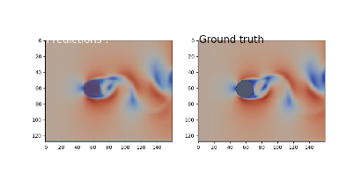
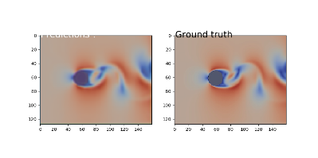
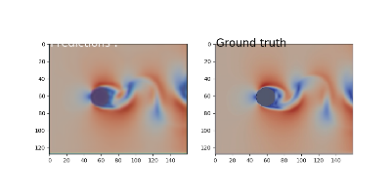
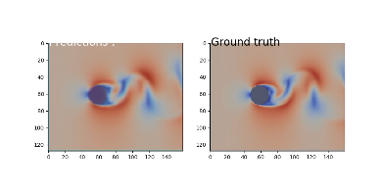
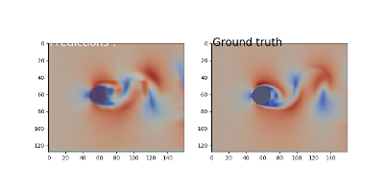
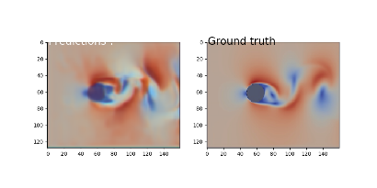
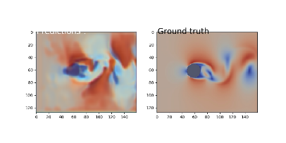
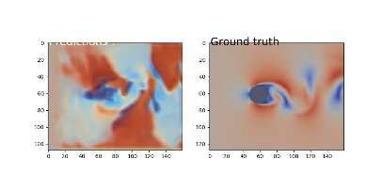
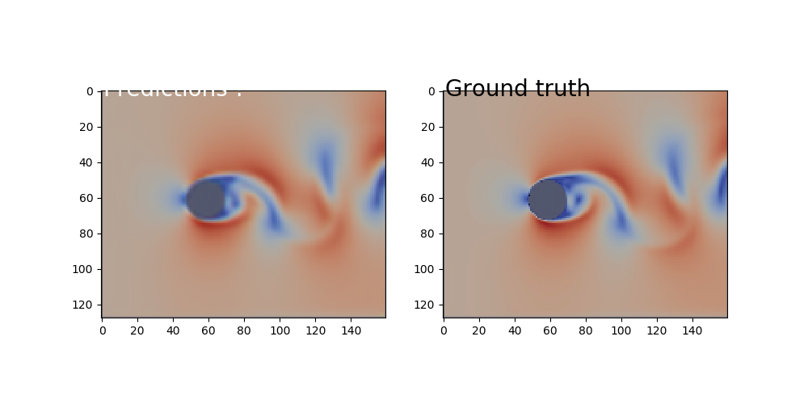
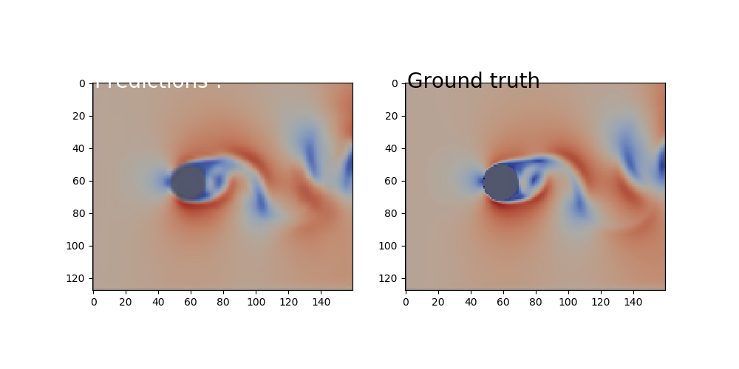
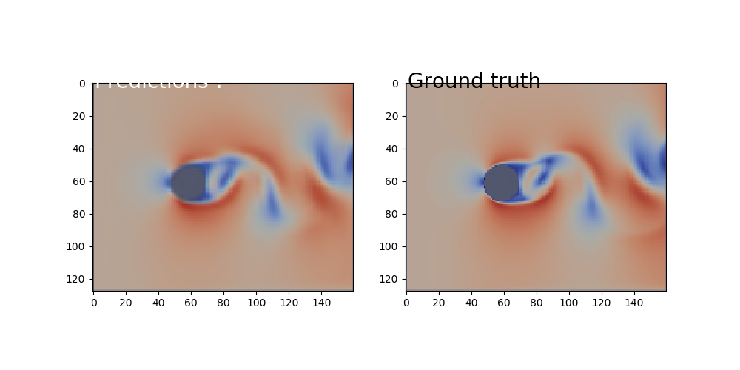
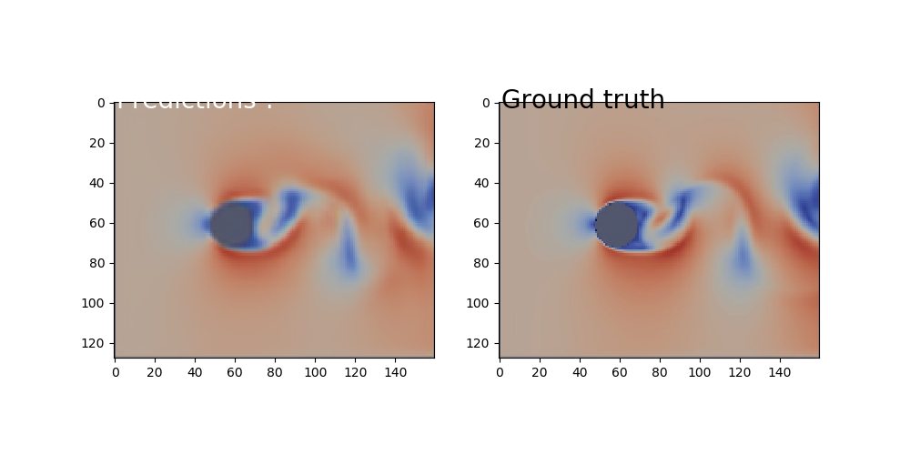
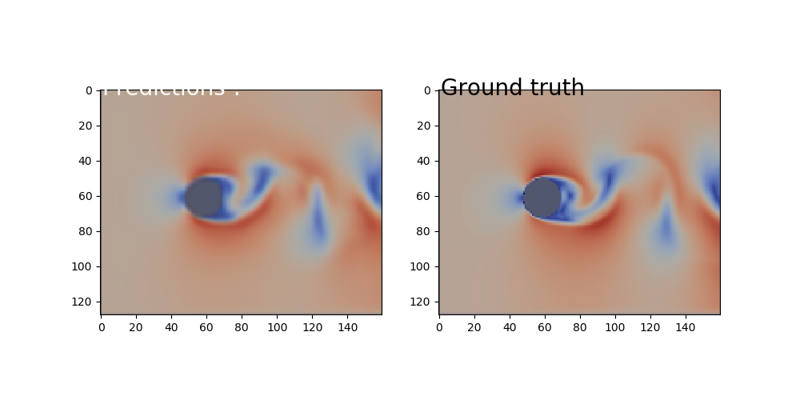
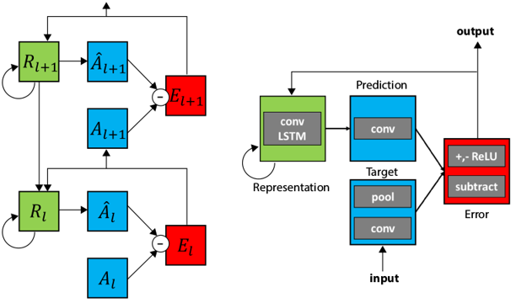
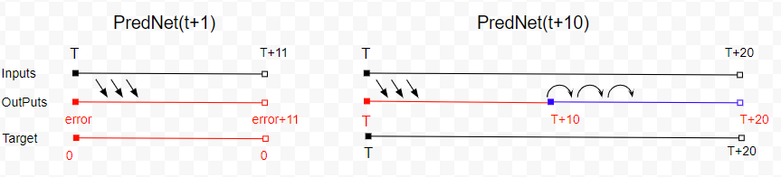
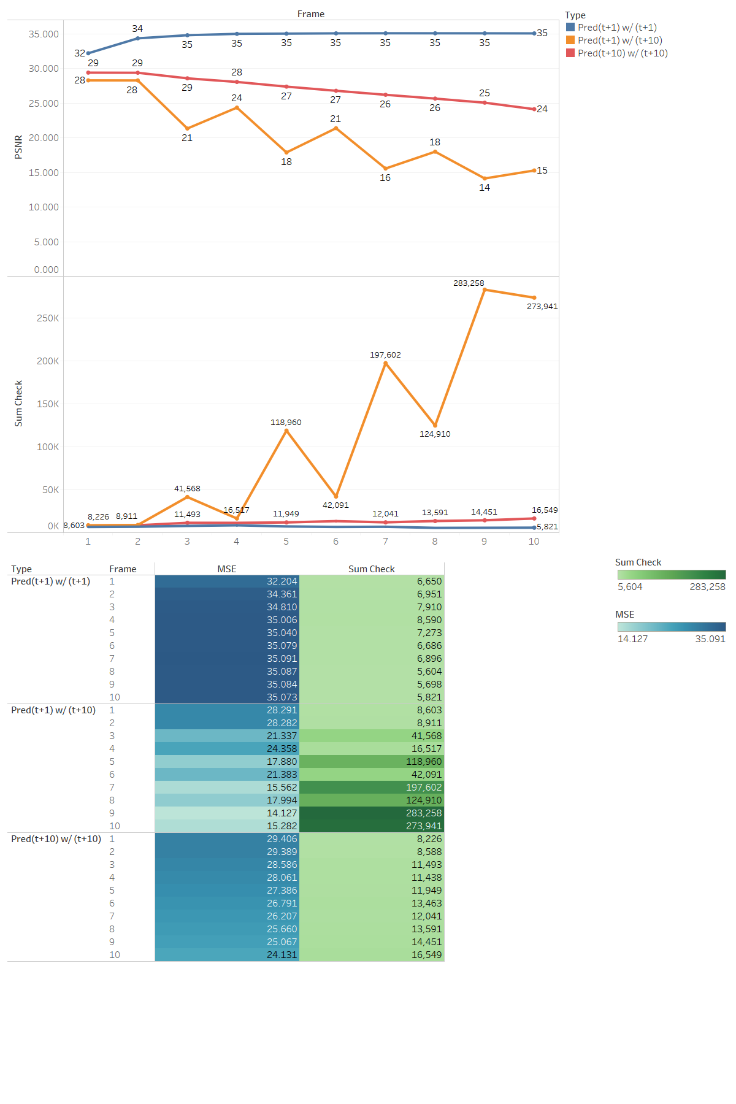
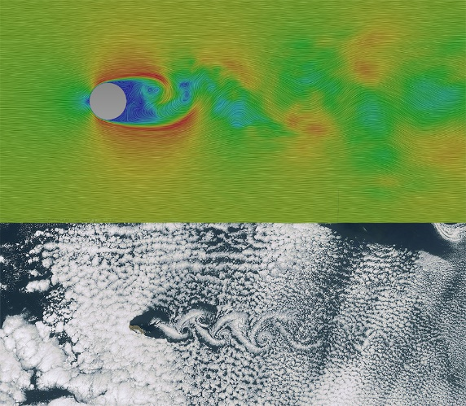
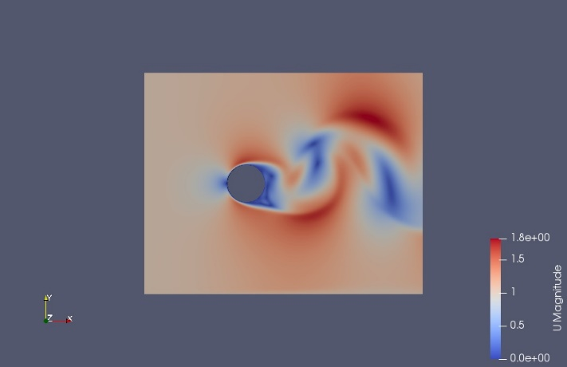
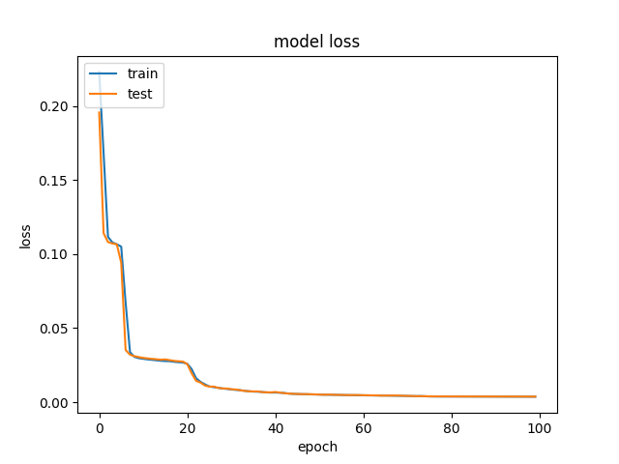
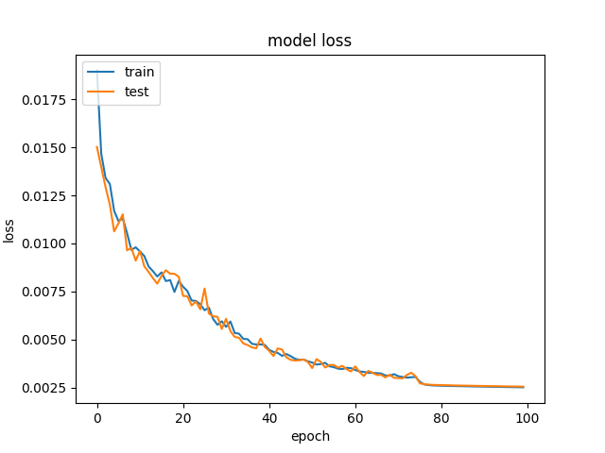
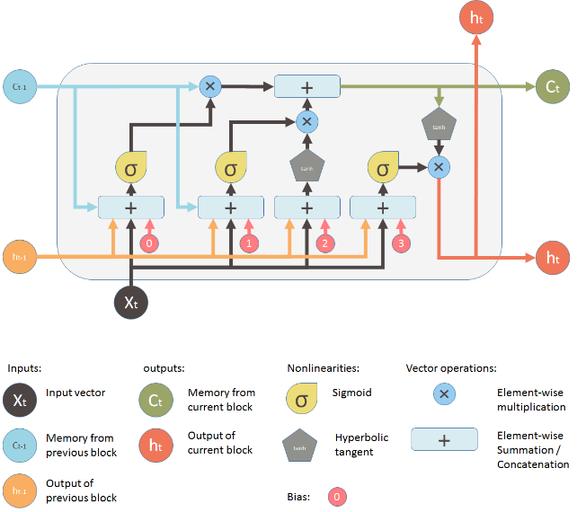
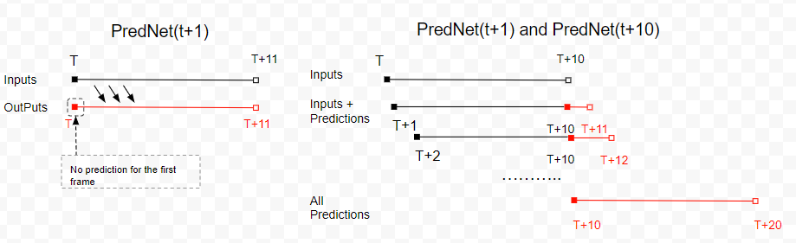

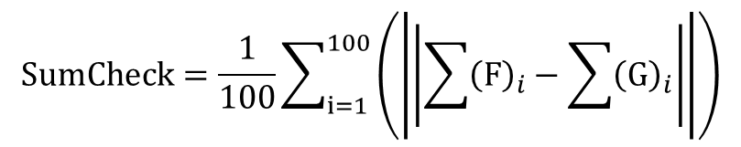
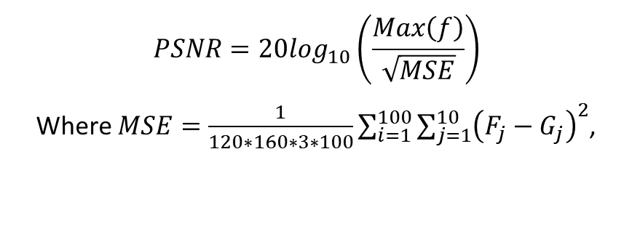
Application of Deep Learning to Computational Fluid Dynamics Author: Jie Tao Advisor: Dr. Greg Wolffe
Abstract
Implementation
Results
The modeling of complex physical and biological phenomena has long been the domain of computational fluid dynamics. Given the recent success of deep learning models in a variety of application areas, this project attempted to determine if a deep neural network could be used to predict fluid motion.
The neural net architecture employed in this research was the ConvLSTM. It used convolutional neurons to discover spatial features, and Long Short-Term Memory neurons to learn time-based patterns. It contained almost 7 million parameters, which took about 100 minutes to train (Titan V GPU w/5120 cores). Two models were developed: PredNet(t+1) (predict next frame), and PredNet(t+10) (predict next 10 frames). Three prediction strategies were based on these models.
Results indicate the model can generate predictions visually indistinguishable from ground truth (defined by the Pisofoam incompressible flow solver). Standard video prediction metrics (Peak Signal to Noise Ratio) showed that the PredNet(t+10) model was able to extrapolate rolling predictions for 10 seconds with reasonable accuracy in a controlled environment. Training with a variety of samples (velocity, mesh, features) would be needed to determine if the models have the ability to generalize over a wide range of conditions.
PredNet is a deep neural network customized for video prediction and unsupervised learning (Lotter, Kreiman, Cox).
It is used here to train two models:
PredNet(t+1): predicts next frame
PredNet(t+10): predicts next 10 frames
Results exported from the three prediction strategies and compared with ground truth, visually and quantitatively.
Figure 9: PredNet(t+1) with t+1 prediction. Left: prediction, right: ground truth. Warmer color represents higher velocity. Shown are the 2nd, 4th, 6th, 8th, and 10th predicted frame.
Parameter | Configure | Desc
Input | PredNet(t+1): (11, 3, 128, 160) PredNet(t+10): (20, 3, 128, 160) | 11 frames grouped into a sample, each frame with size 160*128 pixels and 3 channels (RGB).
Stack size | (3, 48, 96, 192) | There are 4 layers that input RGB images; with 48, 96 and 192 channels in the 2nd, 3rd and 4th layers respectively.
A filter size | (3, 3, 3) | The targets for layers 2 and 3 are computed by a 3*3 convolution filter.
Â filter size | (3, 3, 3, 3) | The targets for layers 1, 2 and 3 are computed by a 3*3 convolution filter.
Output | {1} for t+1 training {3,128,160} for prediction and t+n training | For t+1 training the model outputs error, goal is reducing error to 0. For t+n or prediction stage, the model output is prediction image.
Loss function | MAE | Mean absolute error
Optimizer | adam
Validate ratio | 5% | 5% of total samples used as validation
Total Params | 6,915,948
Table at right shows model configuration.
Figure 10: PredNet(t+1) with t+10 prediction . Left: prediction, right: ground truth.
Shown are the 12th, 14th, 16th, 18th, and 20th predicted frame. Note dissolution in predicted image.
Background and Approach
Figure 11: PredNet(t+10) with t+10 prediction . Left: prediction, right: ground truth.
Shown are the 12th, 14th, 16th, 18th, and 20th predicted frame
To compare results and characterize error, 100 random samples were used to calculate Peak Signal to Noise Ratio (RGB: 0-255), and cumulative velocity (Sum of pixels).
Computational Fluid Dynamics (CFD) is the state-of-the-art solution for modeling complex physical and biological systems. Deep Learning is a new approach that has demonstrated stunning capabilities in select applications. We wondered:
Can a deep learning model learn to make predictions about fluid motion?
How do the results compare to traditional CFD solvers?
Our test case used the Pisofoam incompressible flow solver:
Momentum equation: $\frac{∂}{∂t}\left(u\right)+∇⋅\left(u⊗u\right)=−∇p$
Pressure equation: $∇⋅\left[{\left(\frac{1}{A}\right)}_{f}∇p\right]=∇⋅{\left(\frac{H}{A}\right)}_{f}$
$$PSNR=20log_{10}\left(\frac{Max\left(f\right)}{\sqrt{MSE}}\right)$$
Where $MSE=\frac{1}{120∗160∗3∗100}\sum_{i=1}^{100}{{\sum_{j=1}^{10}{\left(F_{j}−G_{j}\right)}}^{2}}$,
$$SumCheck=\frac{1}{100}\sum_{i=1}^{100}{\left(\left|\left|\sum{{\left(F\right)}_{i}}−\sum{{\left(G\right)}_{i}}\right|\right|\right)}$$
Figure 6: Trained models. Left: t+1 module denoted as PredNet(t+1). Input is [t, t+11), output is sum of error from PredNet which approaches 0 after training. Right: new model denoted as PredNet(t+10), which uses trained weights from PredNet(t+1). Input is [t, t+20), output is prediction [t, t+20]. After t=10, input consists solely of previous predictions. Frames [t+10, t+20) are an extrapolation.
Figure 5: Structure of PredNet. Left: information flow within two layers. Right: Module operation in each layer.
High-performance Computing (HPC) allows complex models to be trained in a reasonable amount of time. The table below shows the hardware/software infrastructure for training.
Figure 12: Quantitative comparison of three prediction strategies based on 100 random samples.
Figure 12 shows that the PredNet(t+1) model provides good performance for t+1 prediction, but rapidly degrades in t+10 prediction. The PredNet(t+10) model performs better in t+10 prediction. The extrapolation training helps PredNet(t+10) maintain rolling predictions farther into the future.
Item | Specs
HPC Name: | Ghost
Processor | AMD Ryzen ThreadRipper 16-core liquid-cooled CPU
Memory | 64GB DDR4 3200MHz Corsair RAM
Hard Drive | 1 TB Samsung SSD; 2 TB Seagate HDD
GPU | NVIDIA Titan V w/5120 cores (640 TensorCores), 12 GB GDDR5
OS | Ubuntu 18.04 LTS
Software | Keras (TensorFlow_GPU), Python 3.6.7
Figure 1: Examples of Karman vortex streets; numerical result (top) and real-life example of clouds (bottom).
Figure 2: One simulation frame. Water enters from left with velocity = 1m/s. Warmer colors represent higher velocities.
Conclusion
CFD simulations are time-based, which suggests the use of Long Short-Term Memory (LSTM) neural layers. However, there is also a spatial component to the input. Our network architecture utilized a Convolutional LSTM, which supports performing convolution on multi-dimensional data.
Mini-batch size is 10, 100 samples per epoch. Learning rate set at 0.001 for epoch < 75, then reduced to 0.0001. After 100 epochs, loss values of both training models are lower than 0.002. Training on Titan V took 23 mins and 101 mins for the two models, respectively.
The results of this investigation support the hypothesis that a deep learning model can effectively predict/simulate fluid motion. In a restricted environment, fluid flow reaches a static or dynamically stable status, expressing a pattern that a deep learning model can learn. However, it should be noted that the model did not learn fluid dynamics, it learned what fluid motion looks like.
Currently the model is restricted to a controlled scenario that stimulates 10 seconds. We plan to create additional samples by varying velocity, mesh, and features to determine if the deep learning model can learn to generalize.
Figure 7: Left: PredNet(t+1) loss plot, Right: PredNet(t+10) loss plot
Prediction strategies: utilized the two trained models.
PredNet(t+1) does t+1 prediction
PredNet(t+1) does rolling prediction
PredNet(t+10) does rolling prediction
References
n.d. About OpenFOAM. https://www.openfoam.com.
Gregory Wolffe, John Oleszkiewicz, David Cherba, Dewei Qi. 2002. "Parallelizing Solid Particles in Lattice-Boltzmann Fluid Dynamics." Proceedings of PDPTA.
Olah, Christopher. 2015. Understanding LSTM Networks. Retrieved August 27. http://colah.github.io/posts/2015-08-Understanding-LSTMs/.
Shuo Sun, Gaoxiao Liu. 2018. Air Quality Forcasting Using Convlutional LSTM.
n.d. Standard solvers. https://www.openfoam.com/documentation/user-guide/standard-solvers.php.
n.d. What is CFD | Computational Fluid Dynamics. https://www.simscale.com/docs/content/simwiki/cfd/whatiscfd.html.
William Lotter, Gabriel Kreiman, David Cox. 2016. "Deep Predictive Coding Networks for Video Prediction and Unsupervised Learning." arxiv.org.
Xingjian Shi, Zhourong Chen, Hao Wang, Dit-Yan Yeung, Wai-kin Wong, Wang-chun Woo. 2015. "Convolutional LSTM Network: A Machine Learning Approach for Precipitation Nowcasting." arxiv.org
Figure 8: Prediction strategies. Left: PredNet(t+1) with t+1 prediction. Right: PredNet(t+1) and PredNet(t+10) with t+10 rolling prediction.
Figure 3: Structure of the LSTM. From left to right: forget gate, input gate, input modulation gate, and output gate.
Figure 4: To capture spatial features, ConvLSTM replaces matrix multiplication with convolution at each gate.

