Slide 1
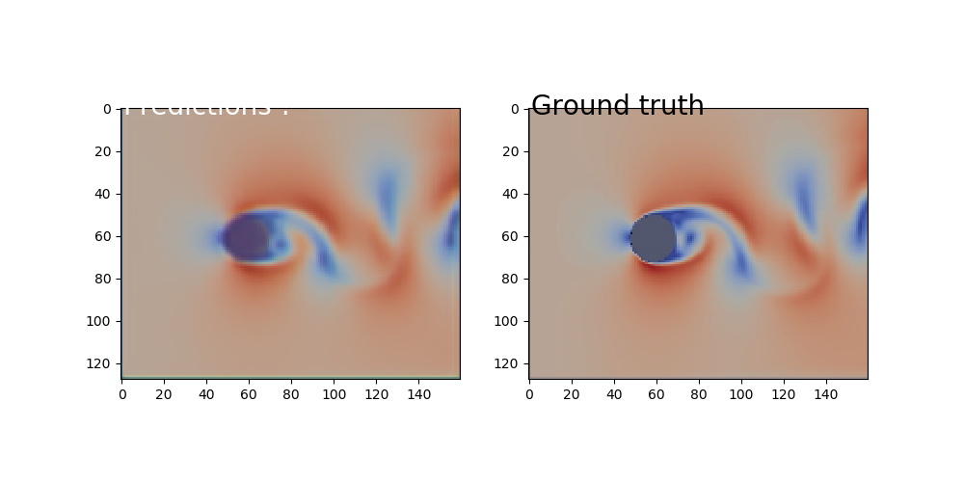
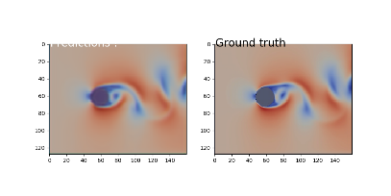
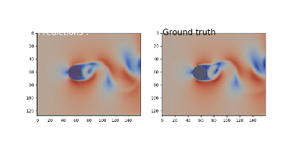
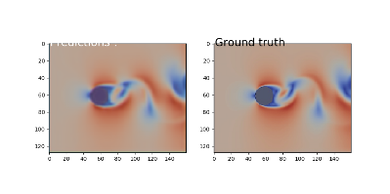
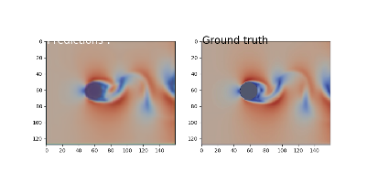
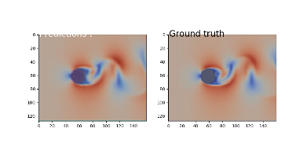
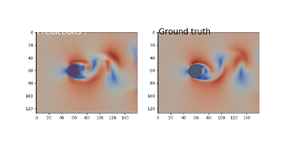
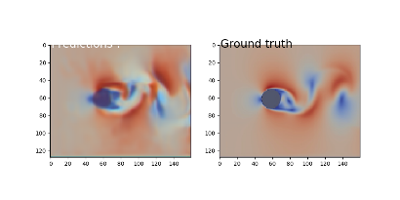
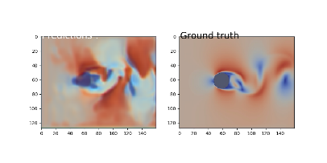
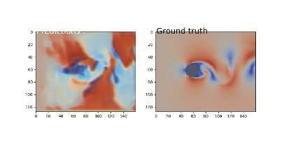
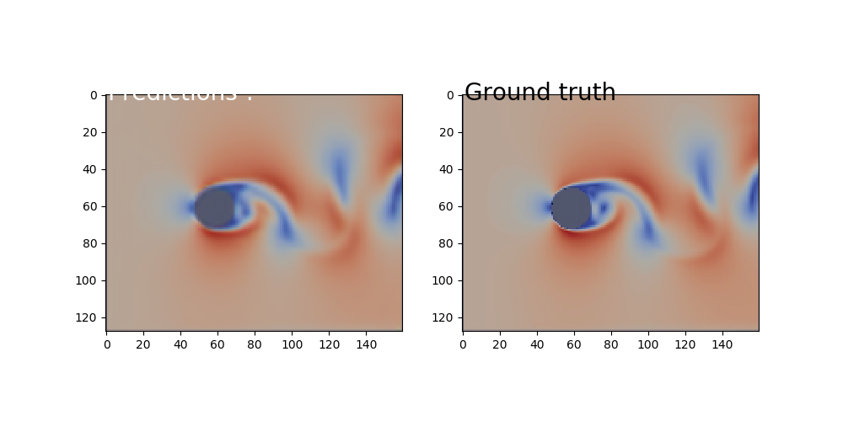
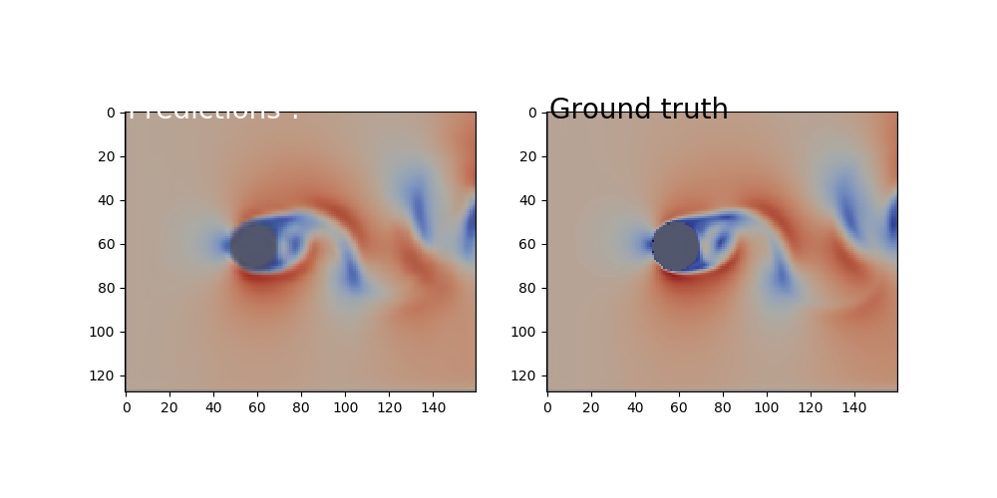
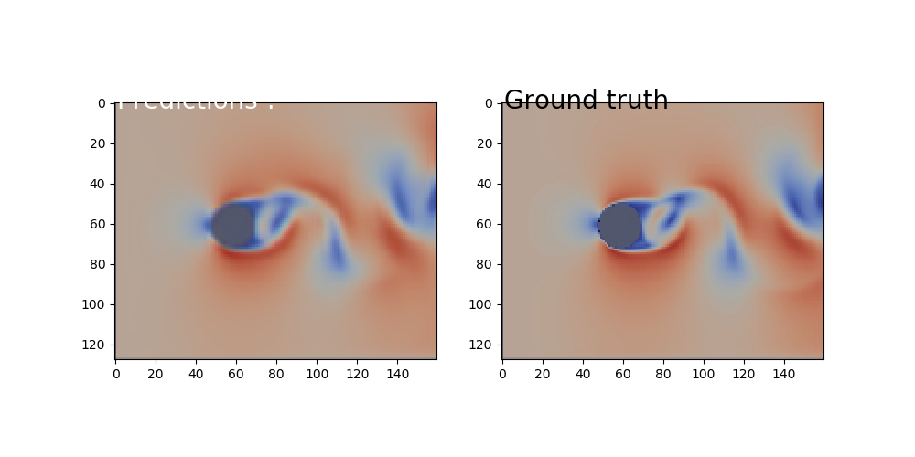
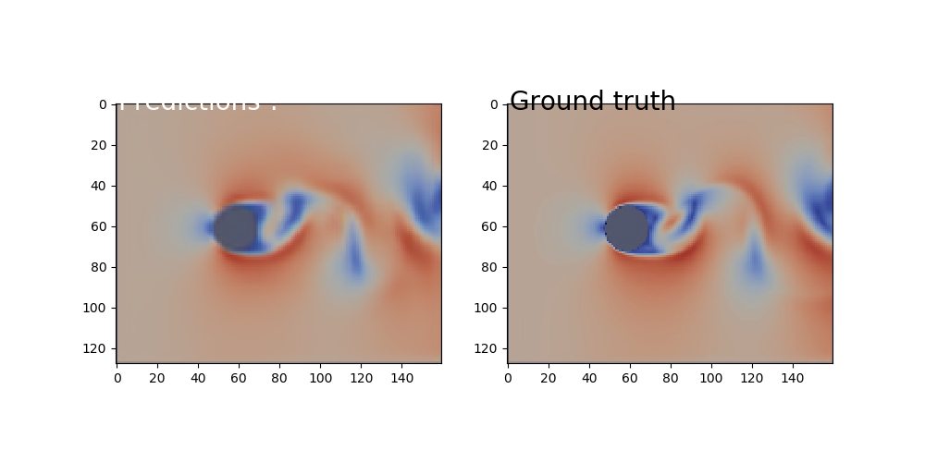
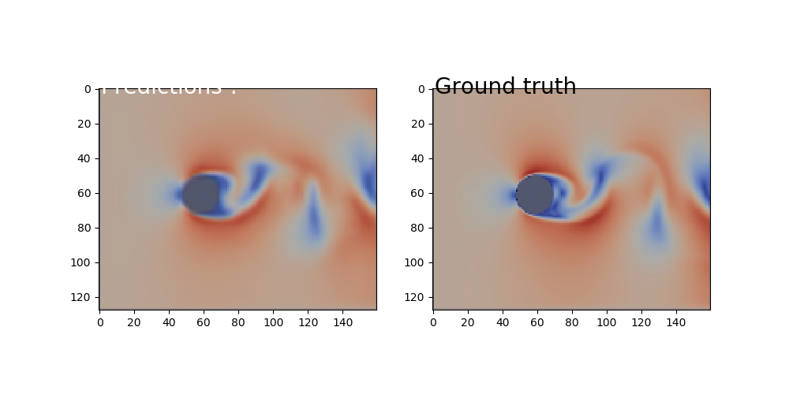
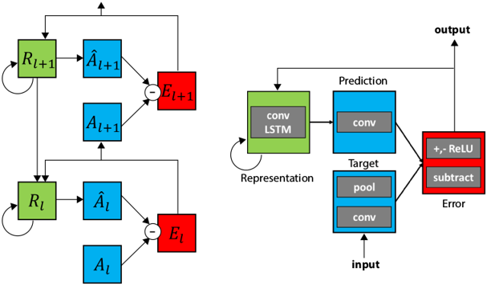
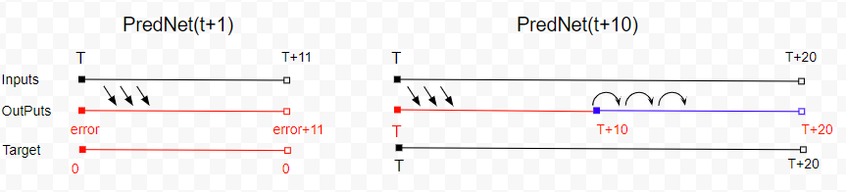
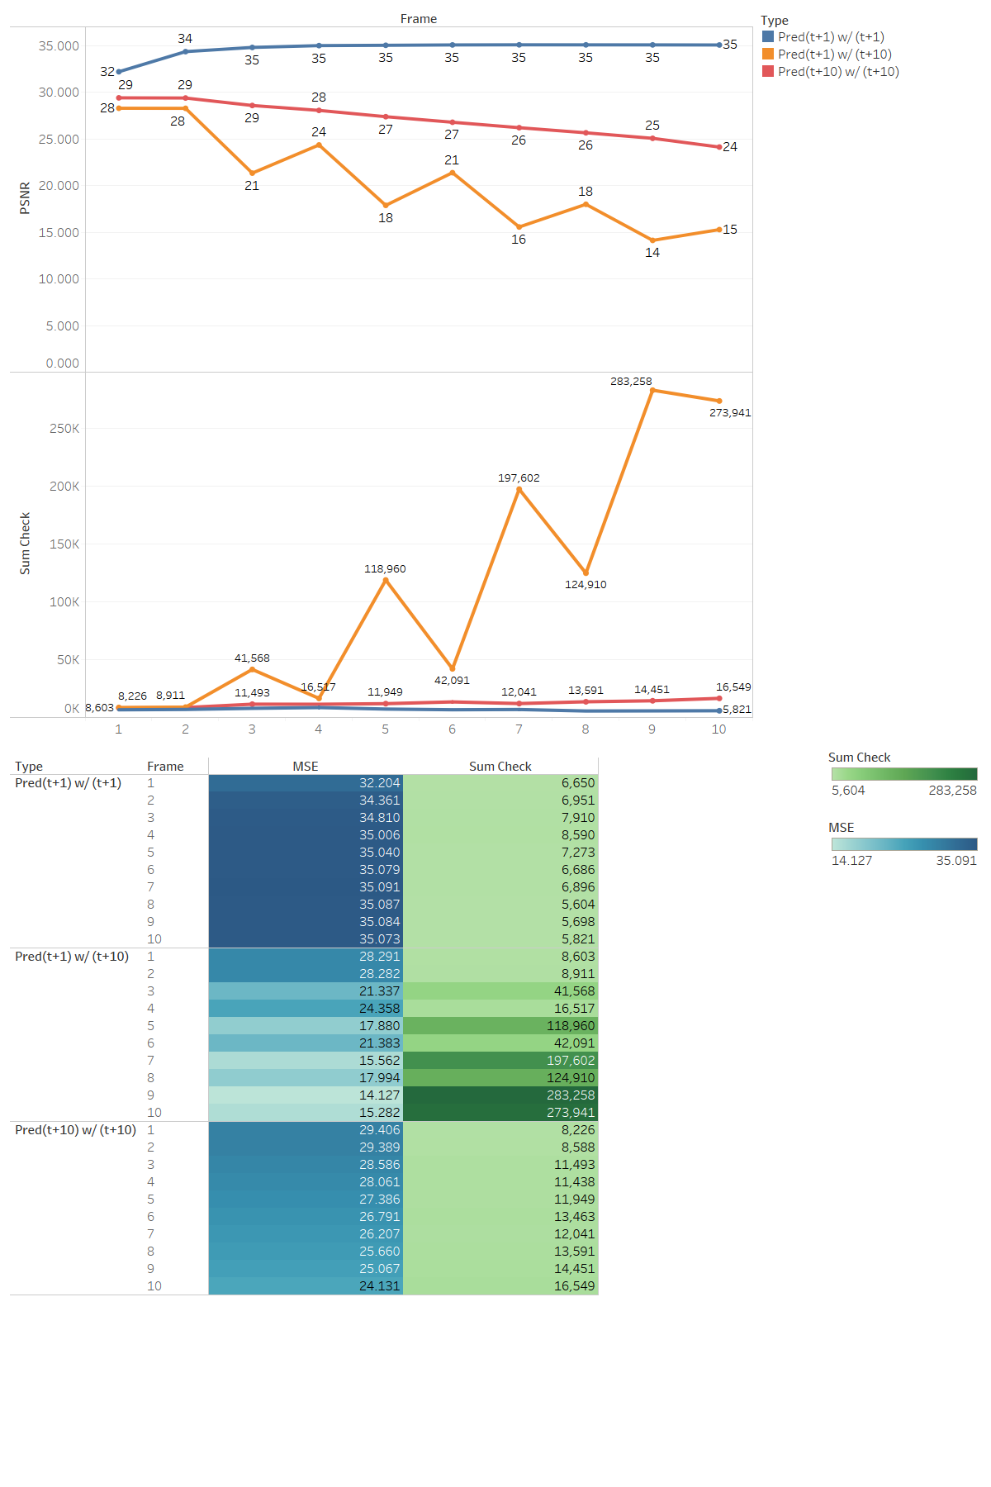
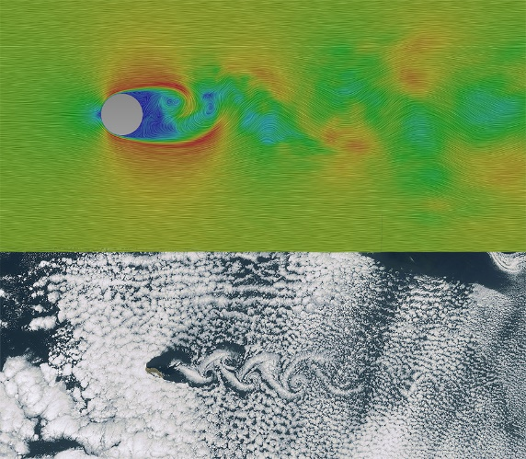
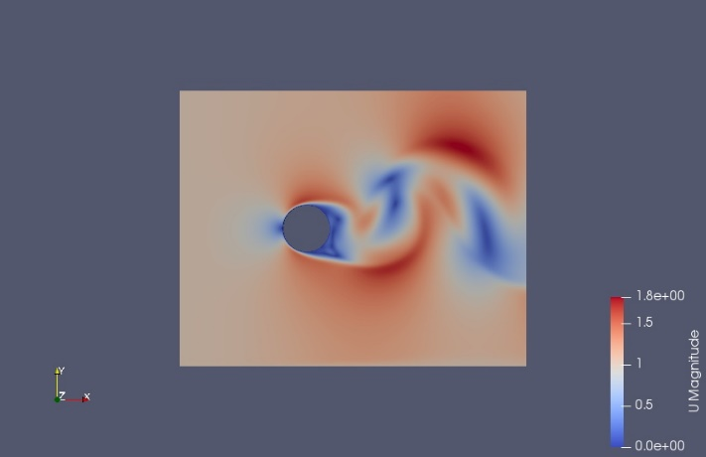
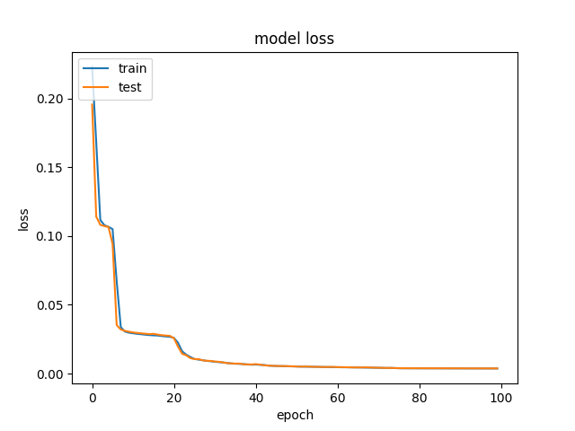
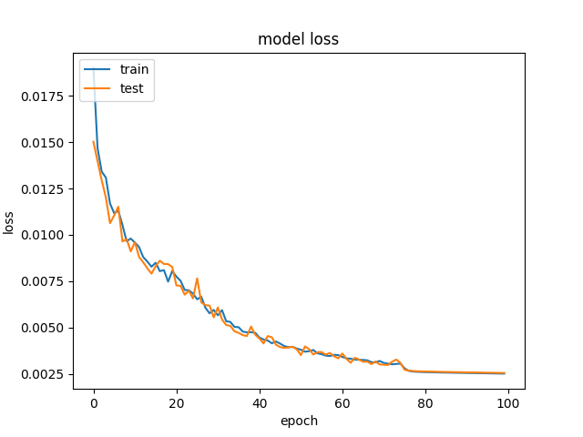
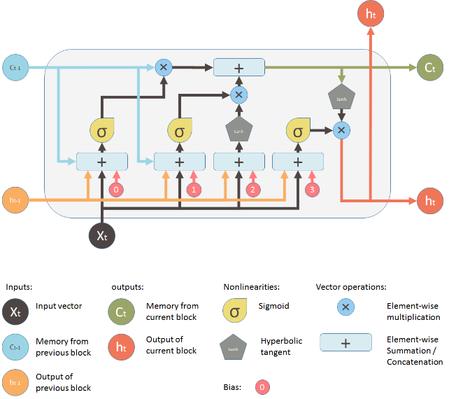
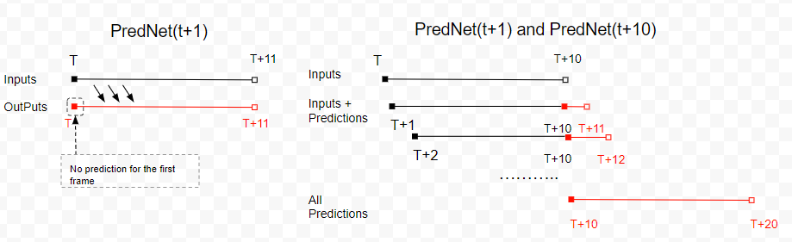

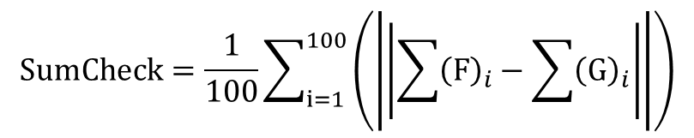
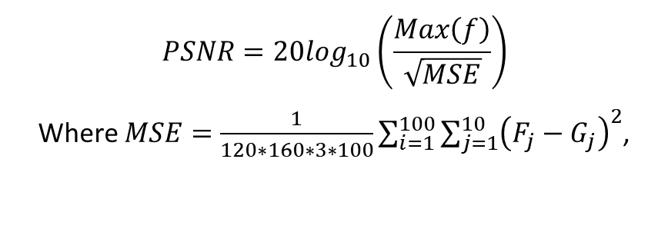
Application of Deep Learning to Computational Fluid Dynamics Author: Jie Tao Supervisor: Dr. Greg Wolffe
Abstract
Implementation
Result
PredNet is a predictive neural network for video prediction and unsupervised learning. It is introduced by William Lotter, Gabriel Kreiman, David Cox in their paper Deep Predictive Coding Networks for Video Prediction and Unsupervised Learning. The authors successfully use it to do the next frame prediction in car driving. Essentially, it is encoder-decoder structure with recursive ConvLSTM. We can refer to $R_{l}$ and ${\hat{A}}_{l}$ as a decoder, $A_{l}$ as an encoder. At timestep = 0, the decoder(generator) cannot predict well since no information inputs. As timestep > 0, the decoder can predict ${\hat{A}}^{t}$ by the previous inputs $A^{t−1}$ and its error $E^{t−1}$ while $R$ is response for handling spatial and temporal information. We used this PredNet to train two models: PredNet(t+1) and Pred(t+10).
We exported the results from three prediction manners and compared them with ground truth visually and quantitatively.
Figure 9: Prediction(t+1) with t+1 prediction. Left: prediction, right: ground truth. The order is 2nd, 4th, 6th, 8th, 10th predicted frame
Figure 10: Prediction(t+1) with t+10 prediction . Left: prediction, right: ground truth. The order is 12nd, 14th, 16th, 18th, 20th predicted frame
Background and Approach
Figure 11: Prediction(t+10) with t+10 prediction . Left: prediction, right: ground truth. The order is 12nd, 14th, 16th, 18th, 20th predicted frame
To validation the result and reduce the deviation, we randomly pick up 100 samples, then calculate the average of PSNR (RGB: 0-255, 3 channels) and difference of sum of all pixels:
Since the complexity of physical or biological system, CFD significantly depends on the computational power and the equation. Although CFD is very mature in the industry, we are thinking: can we use deep learning model to make prediction in CFD? What’s the result of deep learning simulation compared with CFD? With these two hypothesizes, we created a simple case and adapted it to the deep learning model.
$$PSNR=20log_{10}\left(\frac{Max\left(f\right)}{\sqrt{MSE}}\right)$$
Where $MSE=\frac{1}{120∗160∗3∗100}\sum_{i=1}^{100}{{\sum_{j=1}^{10}{\left(F_{j}−G_{j}\right)}}^{2}}$,
$$SumCheck=\frac{1}{100}\sum_{i=1}^{100}{\left(\left|\left|\sum{{\left(F\right)}_{i}}−\sum{{\left(G\right)}_{i}}\right|\right|\right)}$$
Figure 6: left: we trained t+1 module denoted as PredNet(t+1), our input is [t, t+11), output is sum of error from PredNet which closes to 0 in the training. Right: we construct a new PredNet denoted as PredNet(t+10), which uses same weights as PredNet(t+1) (Copy from trained PredNet(t+1)). The input is [t, t+20), and output is predication [t, t+20]. The difference is we let the previous prediction as input after t=10, which means [t+10, t+20) is extrapolation
Figure 5: the structure of PreNet. Left: information flow within two layers. Right: Module operation in each layer.
With help of high-performance computing (HPC), we can try more complex models and train it much faster than before. Table blew shows the hardware and software we use in the training stage
Figure 12: quantitatively comparison results within three manners based on 100 samples
Through Figure 12, we can easily find out that PredNet(t+1) gives a good performance in t+1 prediction, but rapidly degradation in t+10 prediction. While PredNet(t+10) is relatively better in t+10 prediction. The extrapolation training helps PredNet(t+10) to keep the robust in the rolling prediction.
Figure 1: Examples of Karman vortex streets; numerical result (top) and real-life example of clouds^12 (bottom)
Figure 2: One frame from our samples. Water comes from the left side with velocity = 1m/s and flows out to the right side horizontally. The warmer color presents the faster velocity; the colder color presents the slower velocity.
Item | Specs
HPC Name: | Ghost
Processor | AMD Ryzen ThreadRipper 16-core liquid-cooled CPU
Memory | 64GB DDR4 3200MHz Corsair RAM
Hard Drive | 1 TB Samsung SSD; 2 TB Seagate HDD
GPU | NVIDIA Titan V w/51`20 cores (640 TensorCores), 12 GB GDDR5
OS | Ubuntu 18.04 LTS
Software | Keras (TensorFlow GPU), Python 3.6.7
Since CFD simulation is based on time series, we can use Long short-term memory (LSTM). In our case, however, the inputs are not only including time series information, but also spatial information. So we utilized Convolutional LSTM. Compared with LSTM, ConvLSTM allows multidimensional data coming with convolutional operations in each gate.
Our batch size sets as 10, 100 samples for each epoch, and learning rate sets as 0.001 when epoch < 75, otherwise 0.0001. After 100 epoch, loss values of both training methods are lower than 0.002. With Titian V, it just took 23 mins and 101 mins to train them respectively.
Conclusion
The result of this project supports that deep learning can be applied in the sample case of CFD field. If we control the environment of fluid flow, it can reach a static or dynamic stable status. Then we can use deep learning model to learn the pattern of this stable statues. However, in this project we only applied deep learning model to one strictly controlled scenario and it can only stimulate 10 seconds. In the future, we are planning to create more variety samples in the different velocity, mesh and features of fluid. So that we can figure out if this deep learning model has ability to be used in general situation.
Figure 7: left: PredNet(t+1) loss plot, right: Prednet(t+10) loss plot
We created three prediction manners in term of the two trained models. The first manner uses PredNet(t+1) to do t+1 prediction. The second manner also use PredNet(t+1) but facilitated the rolling prediction. The third manner is as same as the second one but changed the model to PredNet(t+10).
Reference
n.d. About OpenFOAM. https://www.openfoam.com.
Gregory Wolffe, John Oleszkiewicz,David Cherba, Dewei Qi. 2002. "Parallelizing Solid Particles in Lattice-Boltzmann Fluid Dynamics." Proceedings of PDPTA ’02.
Olah, Christopher. 2015. Understanding LSTM Networks. August 27. http://colah.github.io/posts/2015-08-Understanding-LSTMs/.
Shuo Sun, Gaoxiao Liu. 2018. Air Quality Forcasting Using Convlutional LSTM. stanford.
n.d. Standard solvers. https://www.openfoam.com/documentation/user-guide/standard-solvers.php.
n.d. What is CFD | Computational Fluid Dynamics. https://www.simscale.com/docs/content/simwiki/cfd/whatiscfd.html.
William Lotter, Gabriel Kreiman, David Cox. 2016. "Deep Predictive Coding Networks for Video Prediction and Unsupervised Learning." arxiv.org.
Xingjian Shi, Zhourong Chen, Hao Wang, Dit-Yan Yeung, Wai-kin Wong, Wang-chun Woo. 2015. "Convolutional LSTM Network: A Machine Learning Approach for Precipitation Nowcasting." arxiv.org
Figure 8: three prediction manners. Left: PredNet(t+1) with t+1 prediction. Right: Prednet(t+1) and PredNet(t+10) with t+10 rolling prediction.
Figure 3: the structure of LSTM. From left to right, we can see forget gate, input gate, input modulation gate and output gate.
Figure 4: ConvLSTM replaces matrix multiplication with convolution operation at each gate, which leads it can capture spatial features.

