Slide 1




18.085 · Computational Science and Engineering I · Fall 2026
Eigendecomposition and
symmetric matrices
Lecture 7 · A = VΛV⁻¹ · the spectral theorem A = VΛVᵀ · the matrix exponential
Wednesday 30 September 2026
Where it shows up today
Analytical mechanics
Waves
Quantum mechanics
Quantum chemistry
Notes:
PACING (45 min for this deck, after ~30 min of L06):
1-8 eigendecomposition ............ ~11 min
9-15 symmetric matrices ............ ~12 min
16-20 powers, e^{At}, modes ......... ~9 min
21-28 applications .................. ~11 min
29 questions ..................... ~2 min
If running late, skip 15 (spectral sum), 23 (CO2) and 27 (benzene): that saves about 4 minutes.
V2: slides 29-39 are an optional pool of extra examples (optics, EM, circuits, water waves, nonlinear optics), ~1.5 min each.
Questions follow at 40; appendices A-E after that.
Every click on a slide reveals the next line (Appear, no motion).

Slide 2



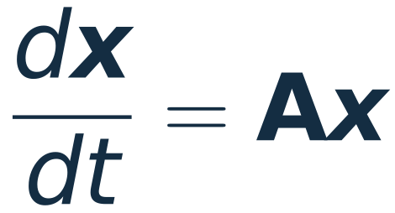
Today: four steps, one hypothesis
1
2
3
4
Eigendecomposition
Symmetric matrices
Powers and the exponential
Modes in time
Stack the eigenvectors into V and the eigenvalues into Λ.
Real eigenvalues, orthogonal eigenvectors: the spectral theorem.
Raise the eigenvalues, leave the eigenvectors alone.
Solve mode by mode, then four physical systems.
The hypothesis under all four: A has n linearly independent eigenvectors.
18.085 · Lecture 7 · Overview
02
Notes:
~1 min. These are the four objectives from the L07 notes.
The single hypothesis (n independent eigenvectors) is flagged now because slide 8 shows what happens without it,
and slides 9-14 show that symmetric matrices satisfy it (proved here for distinct eigenvalues; the repeated case is part of
the spectral theorem, stated but not proved).

Slide 3
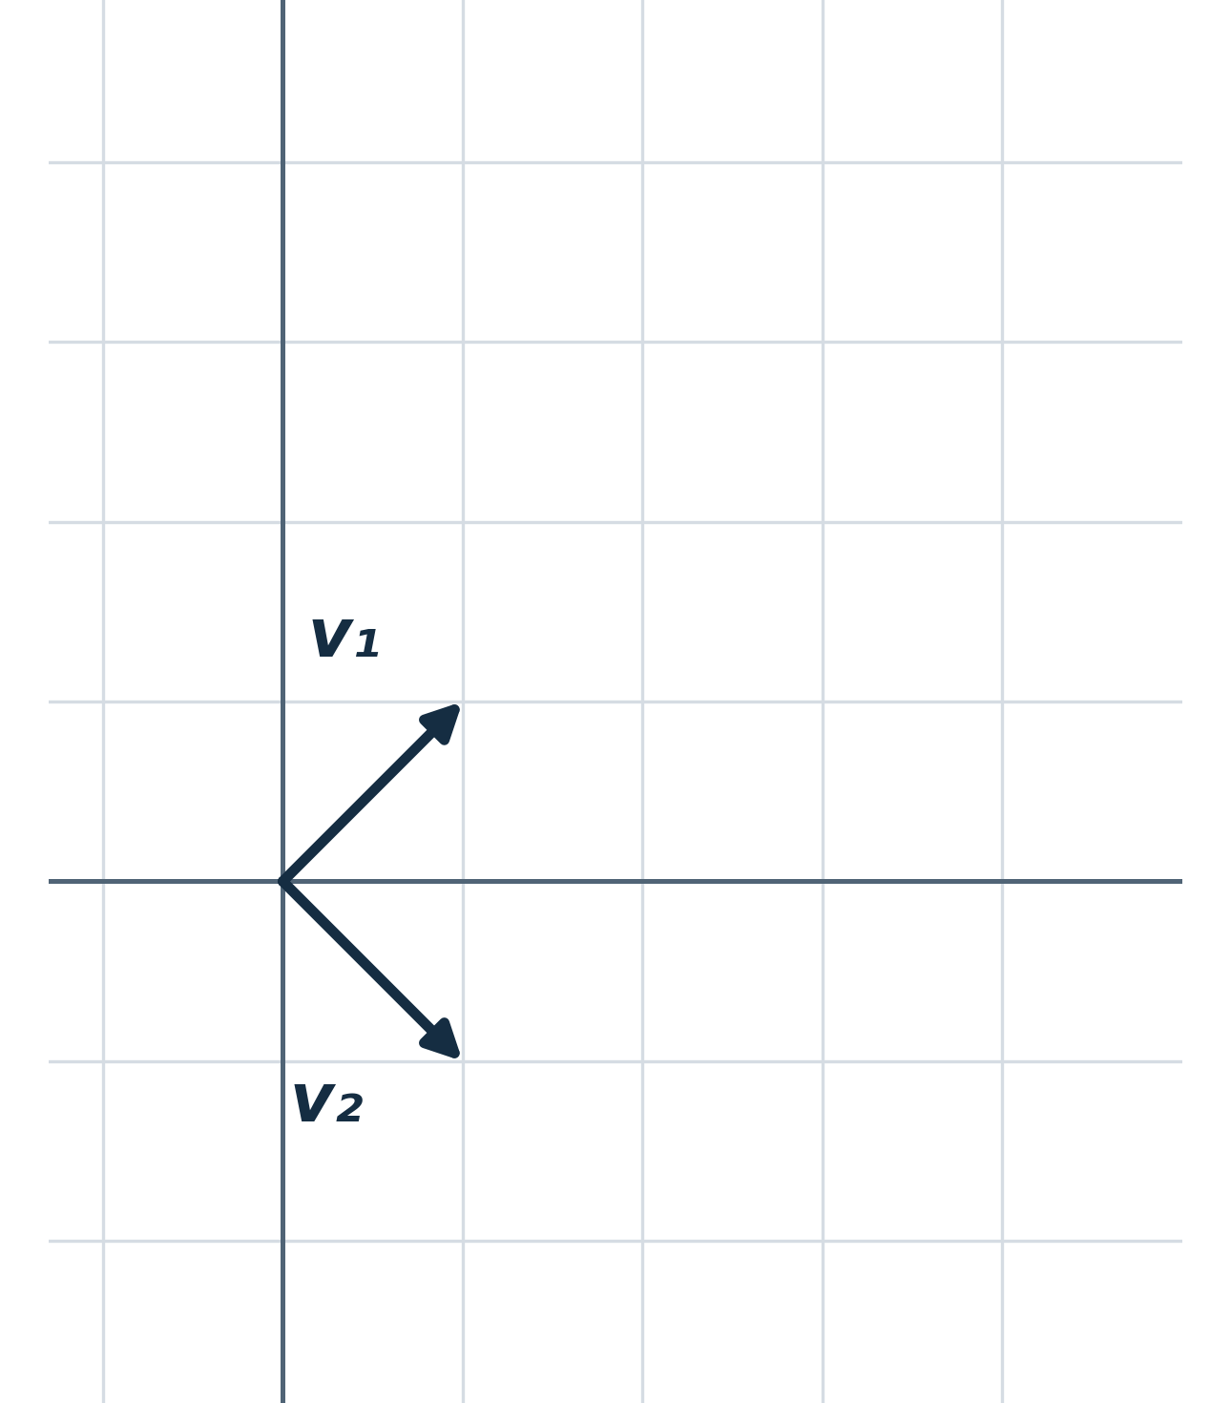
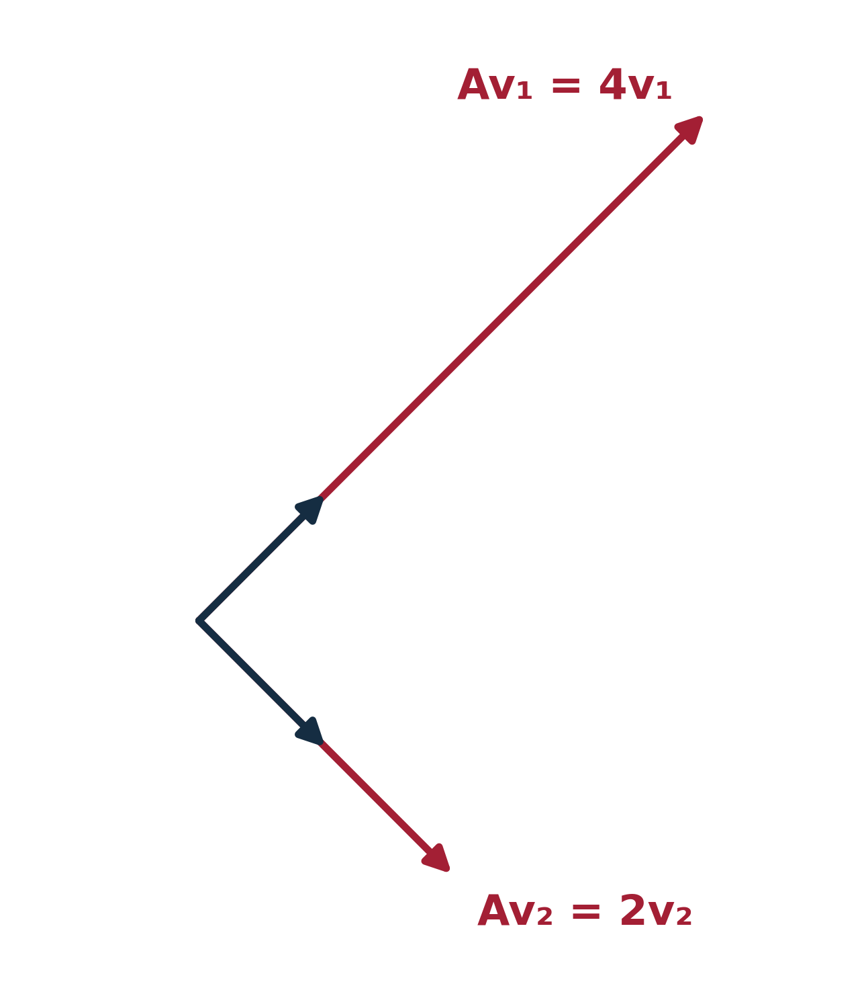

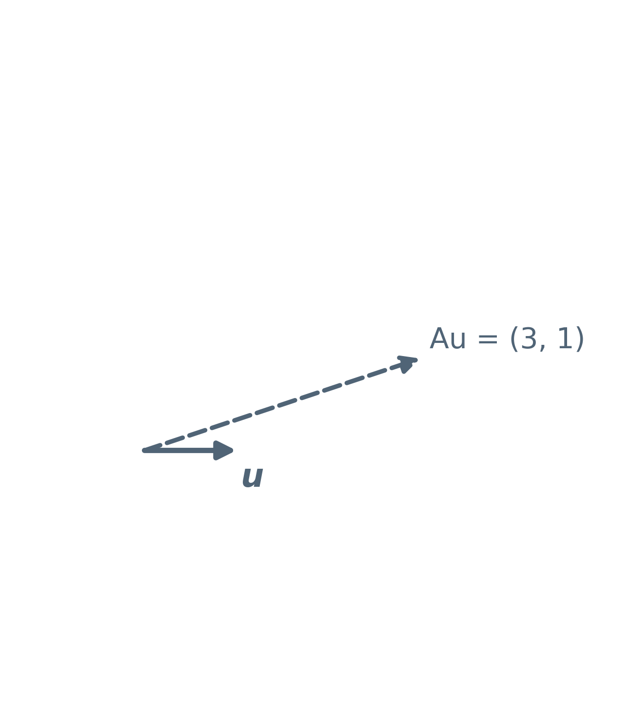
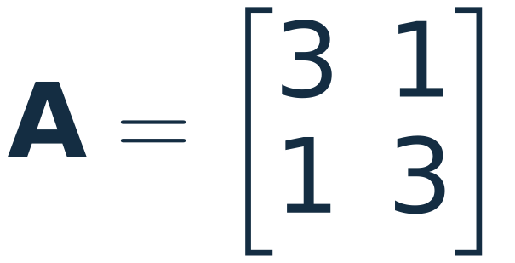
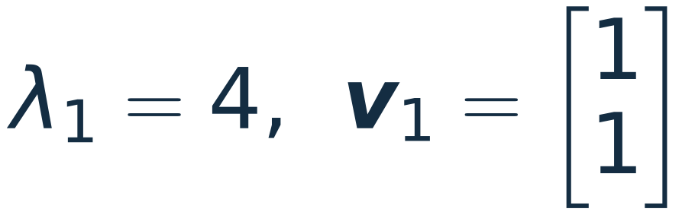
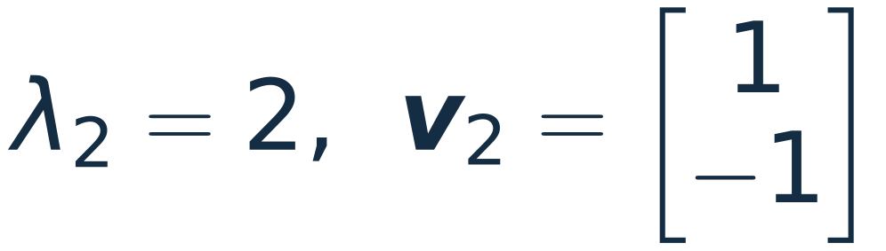
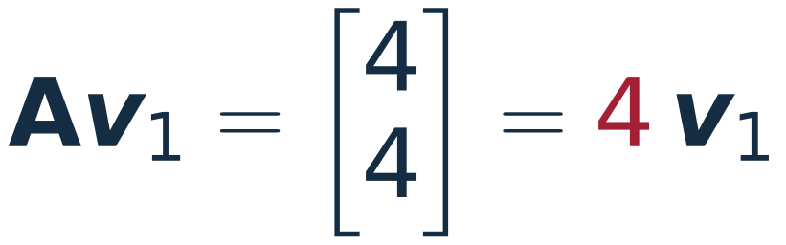
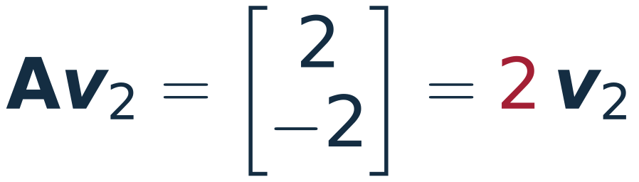
Where Lecture 6 left us
An eigenvector keeps its direction; A only stretches it by λ.
The example from Lecture 6:
A generic vector is also turned: u = (1, 0) goes to Au = (3, 1).
In the eigenbasis, A is diagonal.
Today: turn that sentence into a matrix identity.
18.085 · Lecture 7 · Eigendecomposition
03
Notes:
~1.5 min. Students saw this matrix in L06 twenty minutes ago; keep it quick.
Click 1: the two eigenvectors are only stretched, by 4 and by 2.
Click 2: a generic vector turns, which is why A looks complicated in the standard basis.
Click 3: the sentence from the end of L06. Today it becomes A V = V Λ.

Slide 4
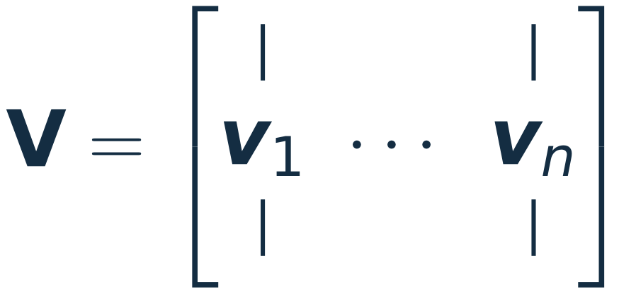

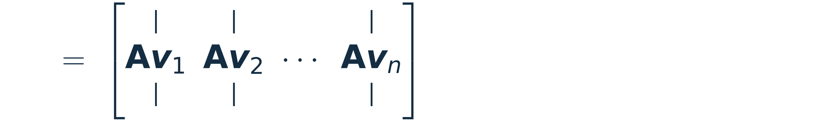
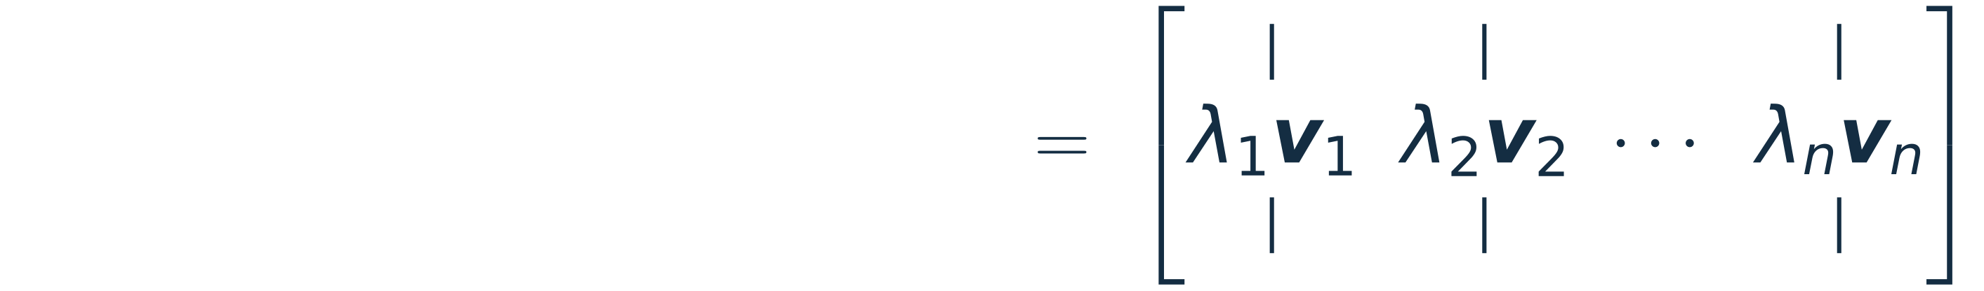
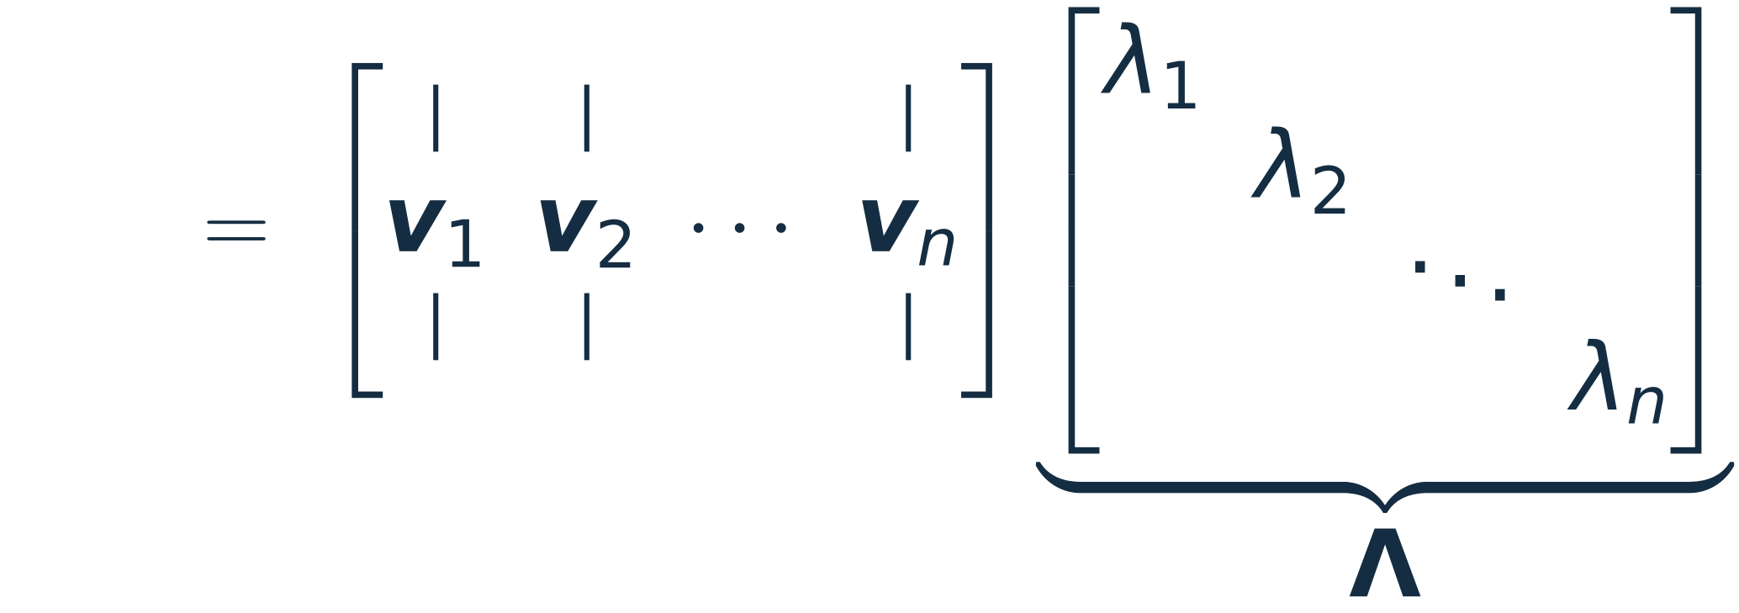

Put the eigenvectors in the columns of V
The n independent eigenvectors of A, side by side:
column j of AV = A × column j of V (Lecture 1)
use Avⱼ = λⱼvⱼ in every column
Scaling column j by λⱼ is exactly what right-multiplication by a diagonal matrix does.
Λ is the diagonal eigenvalue matrix.
18.085 · Lecture 7 · Eigendecomposition
04
Notes:
~2.5 min. Read the product by columns, as in Lecture 1.
Click 1: AV column by column. Click 2: each column is lambda_j v_j.
Click 3: "same columns as V, each scaled by its own number" = V times a diagonal matrix on the RIGHT.
Ask: what would Lambda V (diagonal on the left) do instead? (Scale the rows. Not what we have.)
Click 4: AV = V Lambda. No hypothesis used yet beyond A v_j = lambda_j v_j.

Slide 5
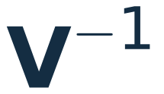






A = VΛV⁻¹, read right to left
n independent columns make V invertible. Multiply on the right by V⁻¹:
rewrite x in
the eigenbasis
scale coordinate i
by λᵢ
go back to the
original basis
KEY IDEA
Nothing in the middle step mixes coordinates. All the complication of A sits in the change of basis, done once at the start and undone once at the end.
18.085 · Lecture 7 · Eigendecomposition
05
Notes:
~2 min. Read A = V Lambda V^{-1} as a recipe, not a formula (the three-arrow picture in the notes).
Clicks 1-3 build the arrows. Click 4: the key idea.
Link back: this is "in the eigenbasis A is diagonal" written as an identity.

Slide 6
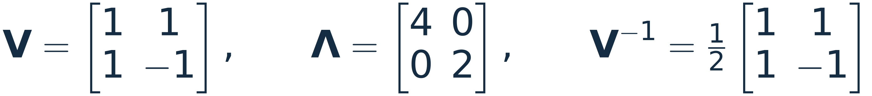
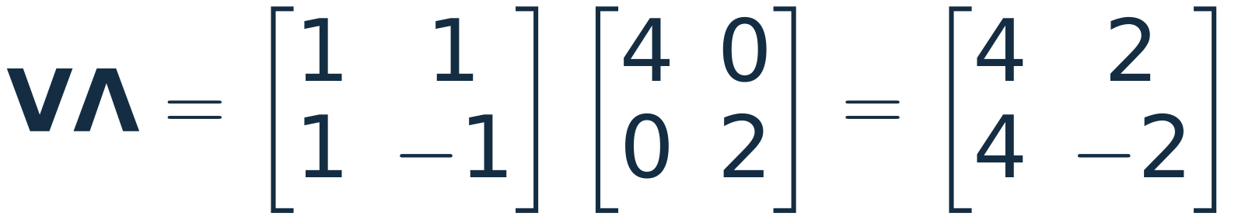
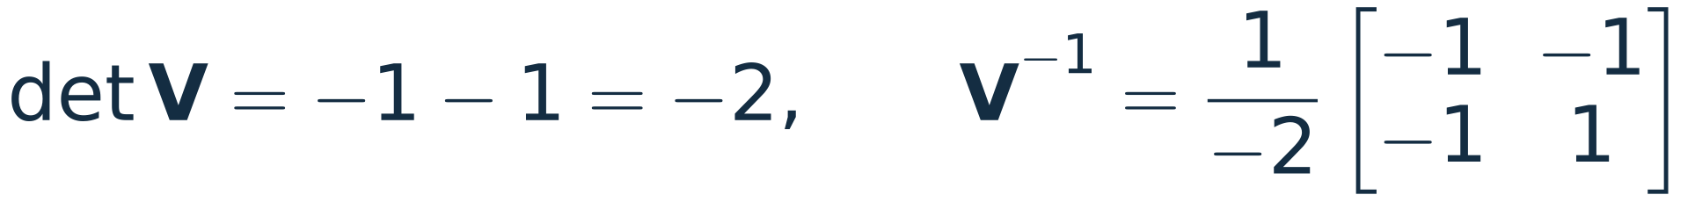
Worked example: the matrix from Lecture 6
Λ on the right scales column 1 by 4 and column 2 by 2.
WHERE V⁻¹ CAME FROM
2 × 2 rule: swap the diagonal, negate the off-diagonal, divide by det.
18.085 · Lecture 7 · Eigendecomposition
06
Notes:
~1.5 min. From the notes: V, Lambda, V^{-1}, and the product returns A.
Click 1: V Lambda first (scaled columns). Clicks 2-4: the product. Click 5 (optional): where V^{-1} came from.
Next slide: the same recipe applied to one concrete vector.

Slide 7
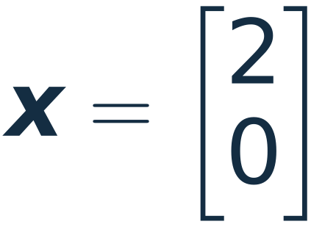
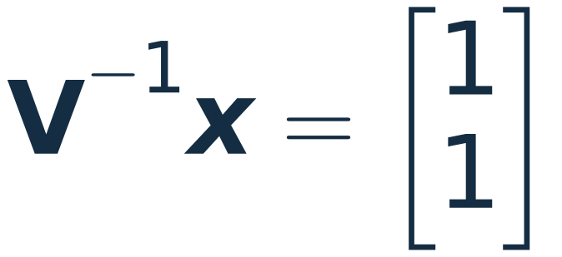
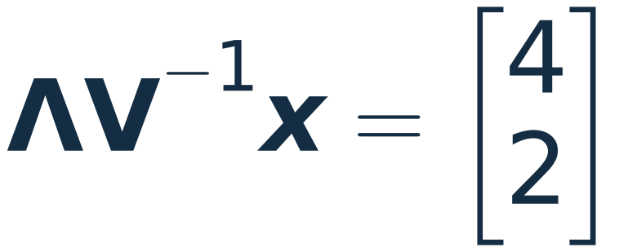
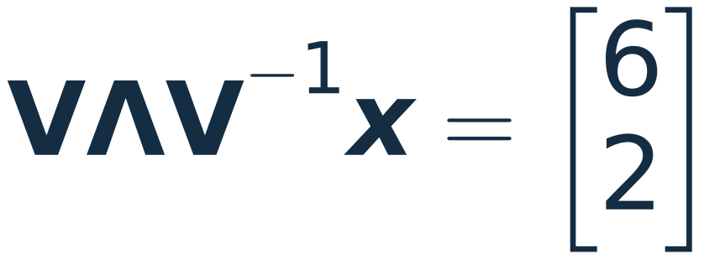


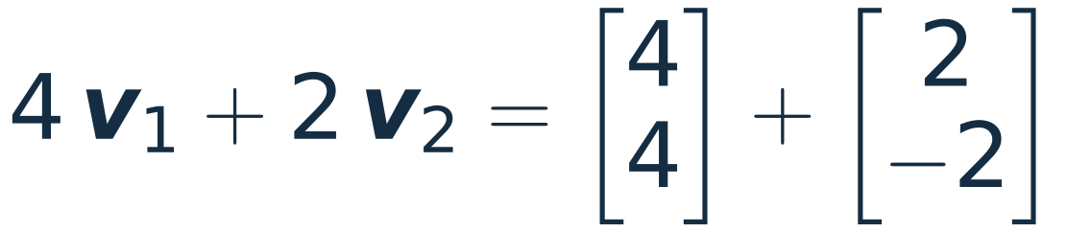
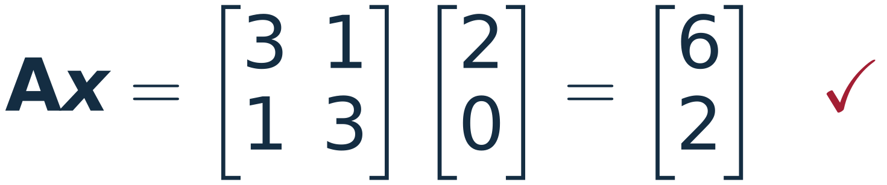
The recipe with numbers: A x for x = (2, 0)
coordinates of x
in the eigenbasis
each coordinate times
its own eigenvalue
back to the
standard basis
Multiplying directly gives the same answer.
Coordinates in the eigenbasis never mix: coordinate i is multiplied by λᵢ and by nothing else.
18.085 · Lecture 7 · Eigendecomposition
07
Notes:
~1.5 min. A trivial numerical run of the three arrows.
Click 1: x = (2,0) = 1*v1 + 1*v2, so V^{-1}x = (1,1). (Students can check: (1,1)+(1,-1) = (2,0).)
Click 2: scale by 4 and 2. Click 3: 4 v1 + 2 v2 = (6,2). Click 4: direct multiplication agrees.
Question to ask: what is A^3 x? Answer: 64 v1 + 8 v2 = (72, 56). (Slide 17 makes this general.)

Slide 8
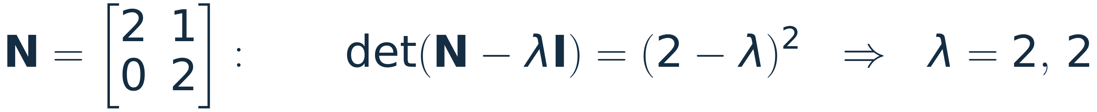

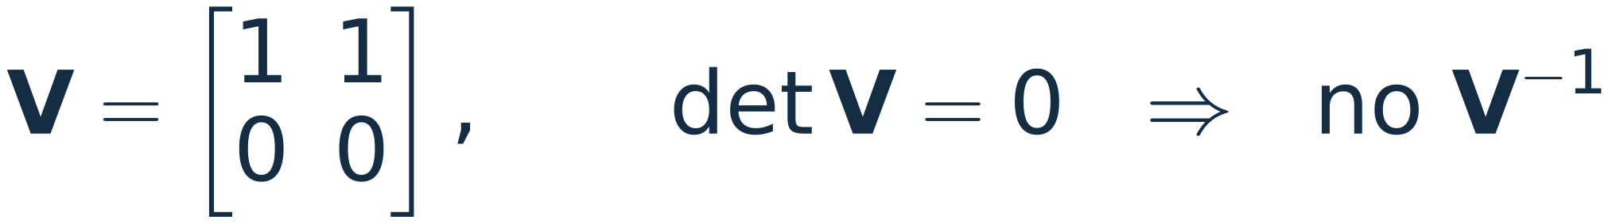
Not every matrix has one
WATCH OUT
The derivation needed V⁻¹, which needs n linearly independent eigenvectors. A defective matrix (Lecture 6) does not have them, so there is nothing to invert. Every formula in the rest of this lecture inherits that hypothesis.
Real symmetric matrices are never defective: that is part of the spectral theorem, next.
18.085 · Lecture 7 · Eigendecomposition
08
Notes:
~1 min. N is the defective example (same N as PS0 Problem 12(c)).
Click 1: only one eigenvector direction. Click 2: the best attempt at V is singular.
Click 3: the hypothesis. Transition: symmetric matrices always have a full set.

Slide 9


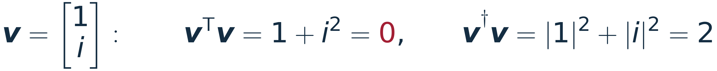
Symmetric matrices
real, n × n
WHY WE CARE
Essentially every matrix this course builds from a physical equilibrium is symmetric: K, T, B, C, AᵀA, AᵀCA, stiffness and mass matrices. Complex cousins: Hermitian matrices, A† = A, such as quantum Hamiltonians.
1
All eigenvalues are real.
2
There are n eigenvectors, and they can be chosen orthogonal to each other.
conjugate transpose: conjugate, then transpose. We allow complex v because we do not yet know that λ is real.
vᵀv can vanish for v ≠ 0. v†v cannot: it is a sum of |vᵢ|².
Both proofs are three lines, and both show exactly where symmetry is used.
18.085 · Lecture 7 · Symmetric matrices
09
Notes:
~1.5 min. State (1) and (2).
Click 1: why symmetric is the case we care about (K, T, B, C from Lectures 2-3; A^T C A from the framework).
Clicks 2-3: the dagger notation. The example v = (1, i) shows why the plain transpose is the wrong length for complex vectors.

Slide 10
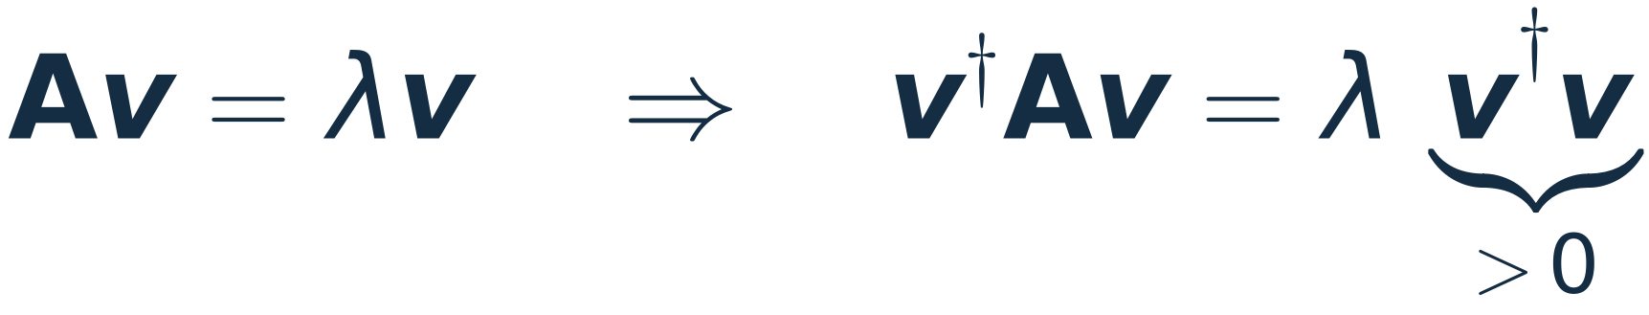
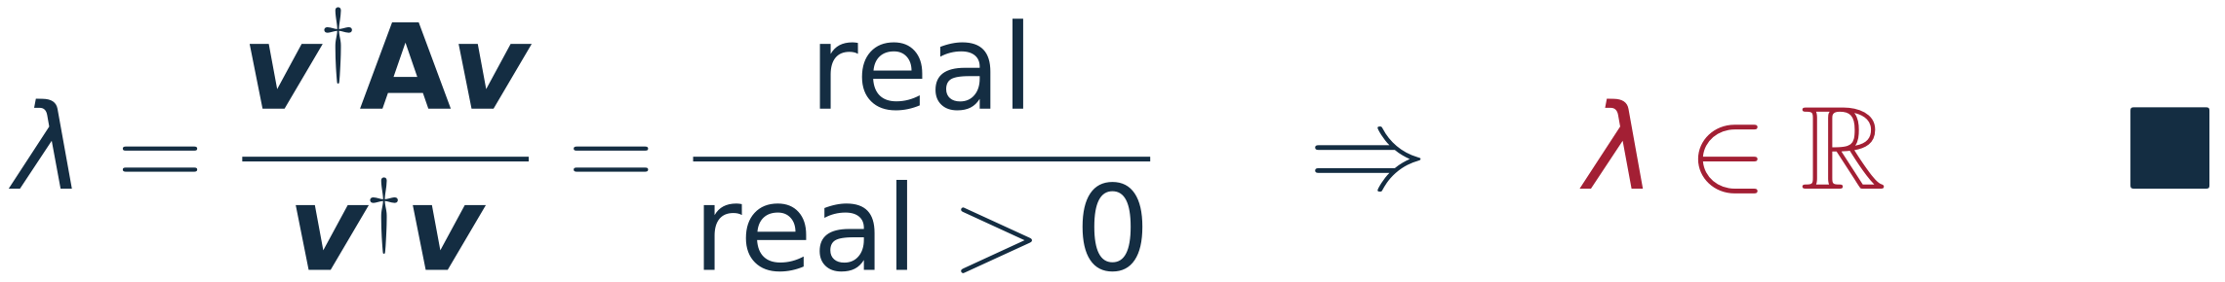
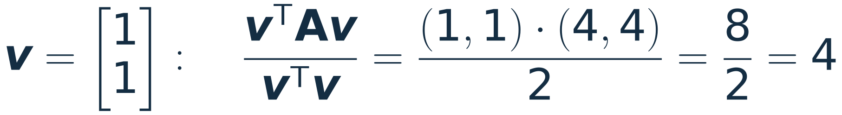
Proof (1): the eigenvalues are real
Inner product of both sides with v. v†v = Σ|vᵢ|² is real and positive because v ≠ 0.
v†Av is a 1 × 1 number: conjugate = conjugate transpose. Symmetry used here: A real and A = Aᵀ give A† = A.
A number equal to its own conjugate is real, so v†Av is real.
NUMBER CHECK
The ratio v†Av / v†v is the Rayleigh quotient.
18.085 · Lecture 7 · Symmetric matrices
10
Notes:
~2.5 min. From the notes, line by line.
Click 1: the key step. Emphasise the red A^dagger = A: this is the only place symmetry enters.
Click 2: a number equal to its conjugate is real. Click 3: real / real.
Click 4: number check with Lecture 6's matrix: v = (1,1) gives 8/2 = 4.

Slide 11
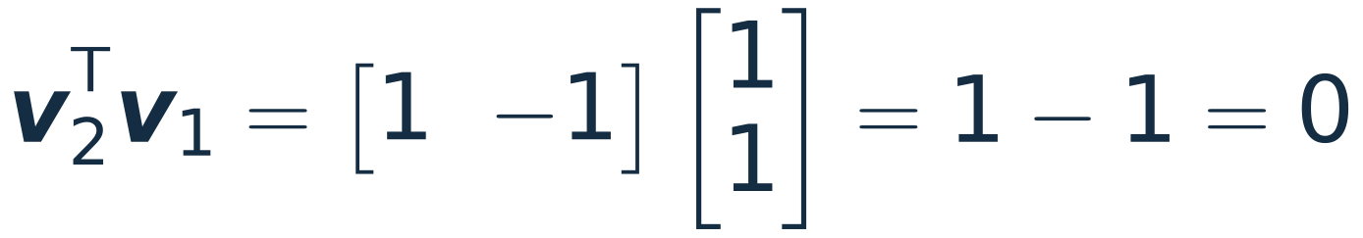
Proof (2): distinct eigenvalues, orthogonal eigenvectors
Two eigenpairs (λ₁, v₁) and (λ₂, v₂) of a real symmetric A, with λ₁ ≠ λ₂.
inner product with v₂
the same number computed the other way: move A across, use A† = A, and λ₂ real by (1)
NUMBER CHECK
v₁ = (1, 1) and v₂ = (1, −1) for Lecture 6's matrix
Both proofs use A† = A once. Without it, both collapse.
18.085 · Lecture 7 · Symmetric matrices
11
Notes:
~2 min. Same move as proof (1): compute v2^dagger A v1 two ways.
Click 1: the second way, with the symmetry step in red and part (1) used for lambda_2* = lambda_2.
Click 2: subtract; lambda_1 != lambda_2 forces v2^dagger v1 = 0.
Click 3: number check.

Slide 12
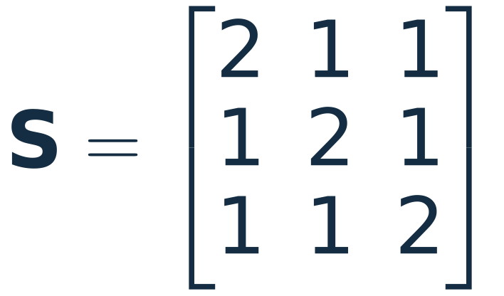
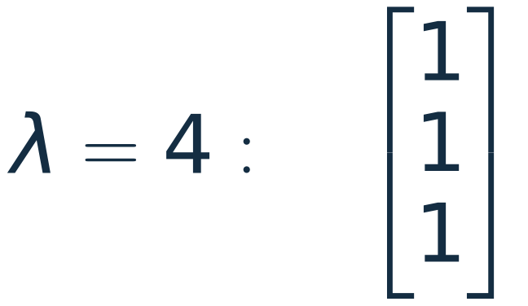
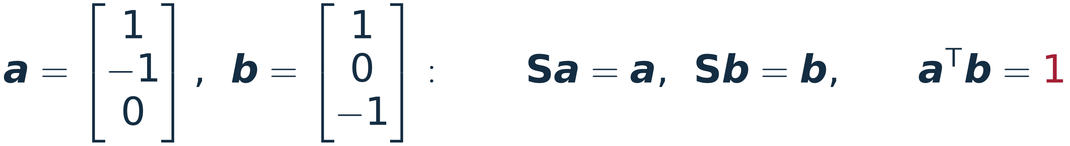
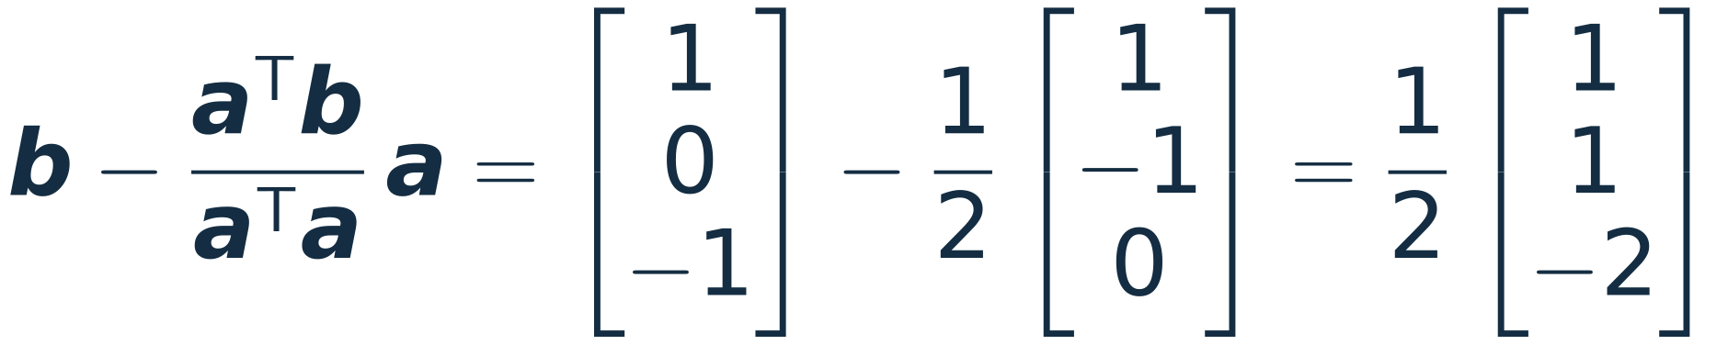
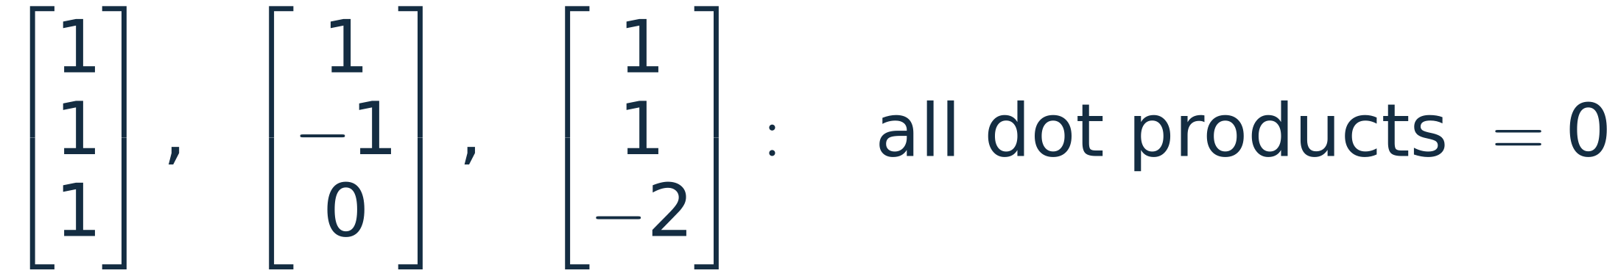
When an eigenvalue repeats
Proof (2) divided by λ₁ − λ₂, so it says nothing here. Two honest eigenvectors can fail to be orthogonal:
Any combination of a and b is again an eigenvector for λ = 1, so choose inside the plane:
For a symmetric matrix, a repeated eigenvalue comes with a whole plane of eigenvectors; we choose an orthogonal basis inside it.
18.085 · Lecture 7 · Symmetric matrices
12
Notes:
~2 min. The aside from the notes, with a concrete 3x3.
S has lambda = 4 once (all-ones direction) and lambda = 1 twice (the plane x+y+z = 0).
Click 1: a and b are both eigenvectors, dot product 1.
Click 2: project out the a-component (one step of Gram-Schmidt). Click 3: an orthogonal set.
Careful: a repeated eigenvalue gives a plane of eigenvectors only because S is symmetric (compare N on slide 8,
repeated eigenvalue, one line). That a symmetric matrix is never defective is part of the spectral theorem;
it is stated, not proved, in L07.
Benzene (slide 27) has exactly this situation.

Slide 13
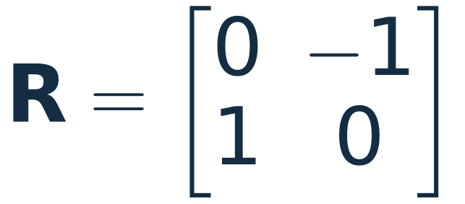
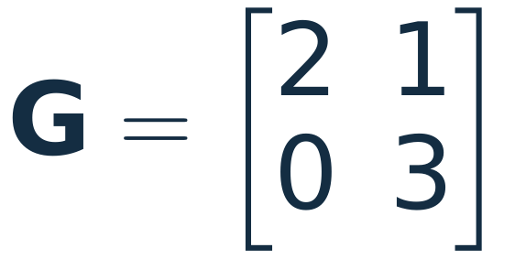
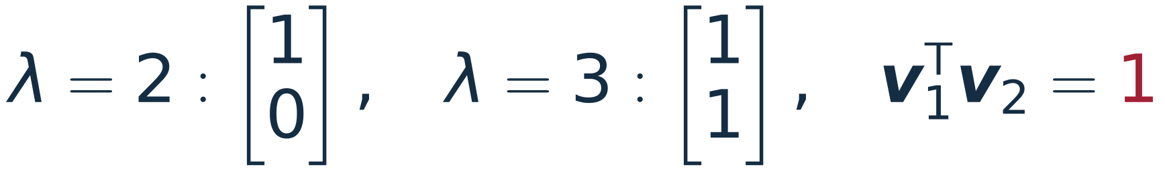
Symmetry is the hypothesis, not a bonus
A ROTATION
NOT SYMMETRIC
Every real vector is turned by 90°, so none keeps its direction: complex eigenvalues, no real eigenvector.
Real eigenvalues, but the eigenvectors meet at 45°, not 90°. Even with unit columns VᵀV ≠ I: no scaling makes V⁻¹ = Vᵀ.
Do not carry the conclusions of this section over to a non-symmetric matrix.
18.085 · Lecture 7 · Symmetric matrices
13
Notes:
~1 min. Two counterexamples, one for each property.
Click 1: rotation, eigenvalues +/- i. Click 2: upper-triangular G, real eigenvalues but eigenvectors at 45 degrees.
Click 3: the warning from the notes.

Slide 14
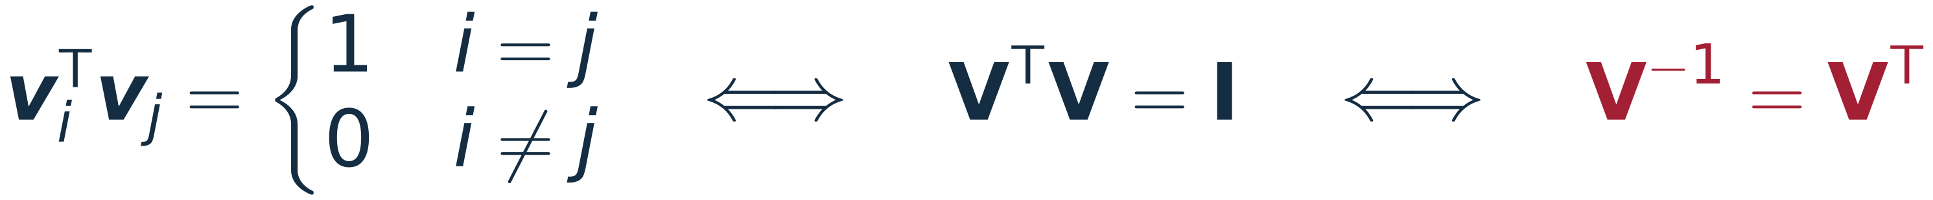
The spectral theorem
Put (1) and (2) together. λ is real, so the eigenvectors can be taken real; scale each to length 1 (Lecture 6). The columns of V are orthonormal:
KEY IDEA · SPECTRAL THEOREM
Real eigenvalues, perpendicular eigenvectors, and the change of basis undone by a transpose: no elimination needed.
so A = VΛVᵀ with Λ = diag(4, 2)
The single most useful factorisation in the course.
18.085 · Lecture 7 · Symmetric matrices
14
Notes:
~1.5 min. The inverse in the eigendecomposition is now free: just a transpose.
Click 1: the boxed statement from the notes. Click 2: Lecture 6's example with normalised eigenvectors.
Honest scope: proofs (1) and (2) cover distinct eigenvalues. That a symmetric matrix always has a full orthonormal set,
repeated eigenvalues included, is part of the theorem as stated; the usual proof goes through Schur's theorem.

Slide 15
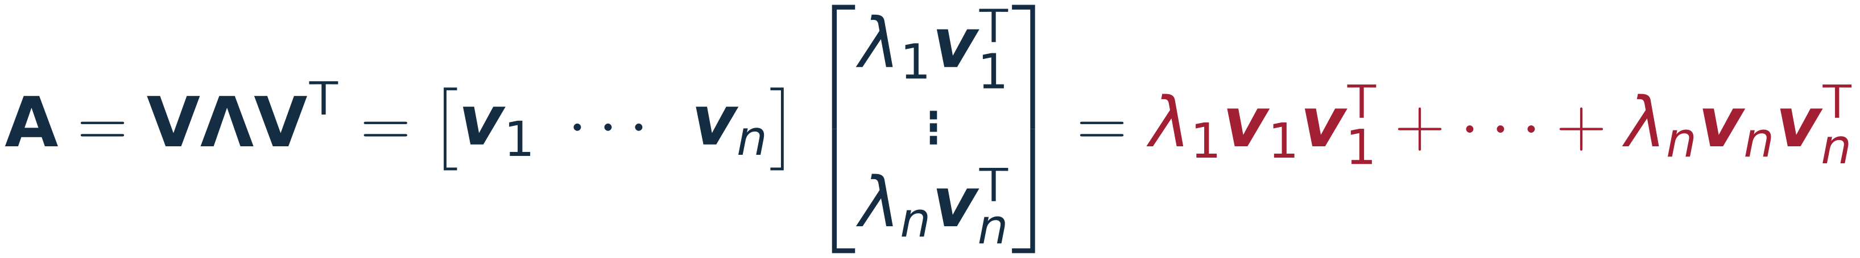
The same theorem as a sum
Multiply VΛVᵀ as columns times rows (Lecture 1):
QUANTUM NOTATION
H = Σ Eₖ |ψₖ⟩⟨ψₖ|
the same statement, written with bras and kets
Each vᵢvᵢᵀ projects onto one eigendirection: A is a sum of eigenvalue × projection.
18.085 · Lecture 7 · Symmetric matrices
15
Notes:
~1.5 min. OPTIONAL if short on time (not in the L07 notes, but it is the spectral theorem read by columns x rows).
Click 1-2: check with Lecture 6's matrix: 4 * (projection onto (1,1)) + 2 * (projection onto (1,-1)).
Click 3: the projections are idempotent, mutually orthogonal and sum to I.
Click 4: the physicists' form, which students will see in quantum mechanics.

Slide 16
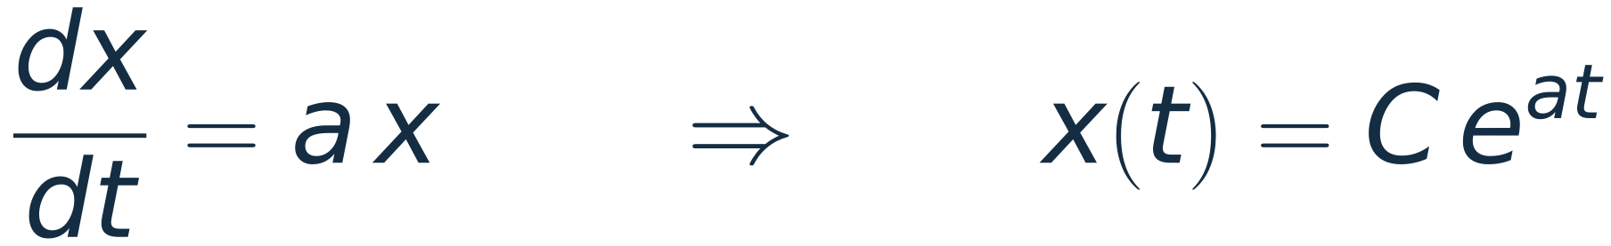
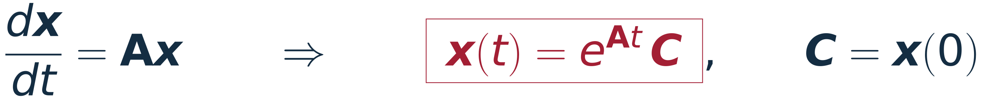
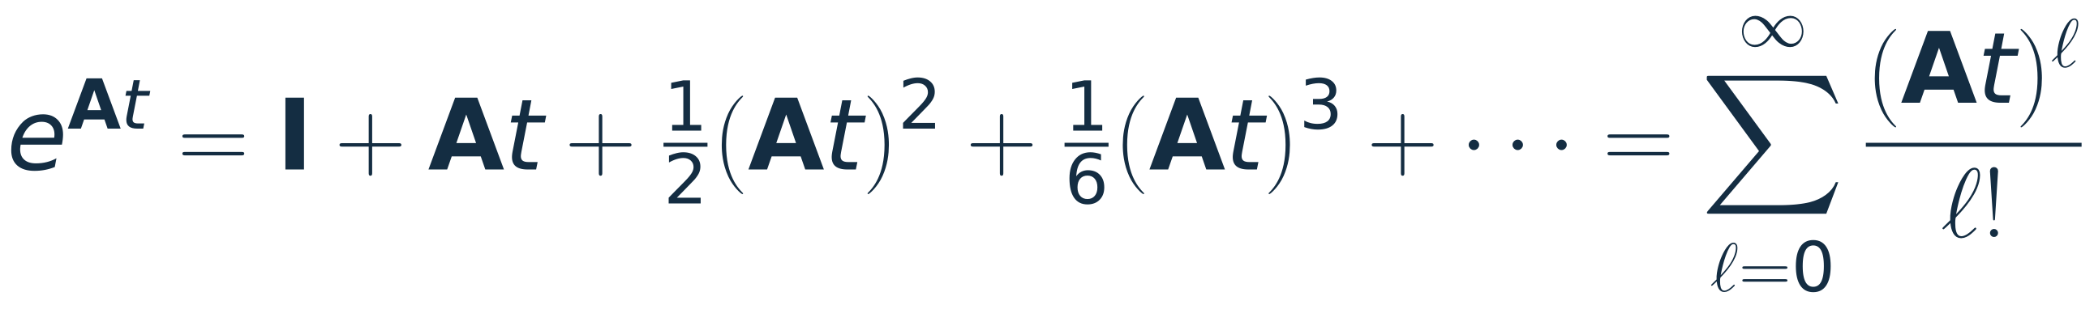
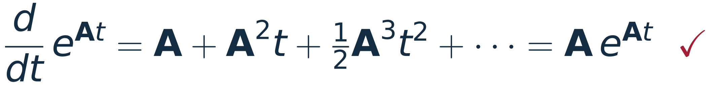
Where the matrix exponential comes from
one equation: growth or decay at rate a
n coupled equations; C is now a vector
defined by the Taylor series of eˣ
term by term: it does solve the ODE
Well defined, but it asks for every power of A. The eigendecomposition makes all of them cheap.
18.085 · Lecture 7 · Matrix exponential
16
Notes:
~1.5 min. Scalar ODE, then the system. Click 3 (the derivative check) is not in the notes;
it is one line and shows that x = e^{At} C really solves dx/dt = A x, with C = x(0).

Slide 17
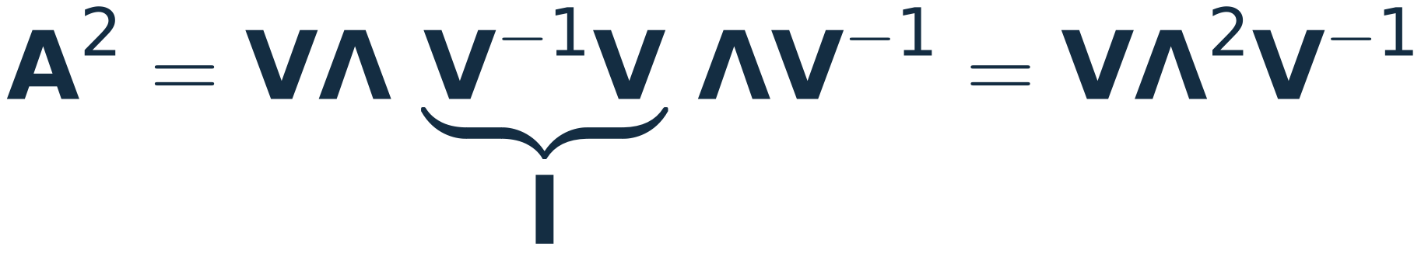
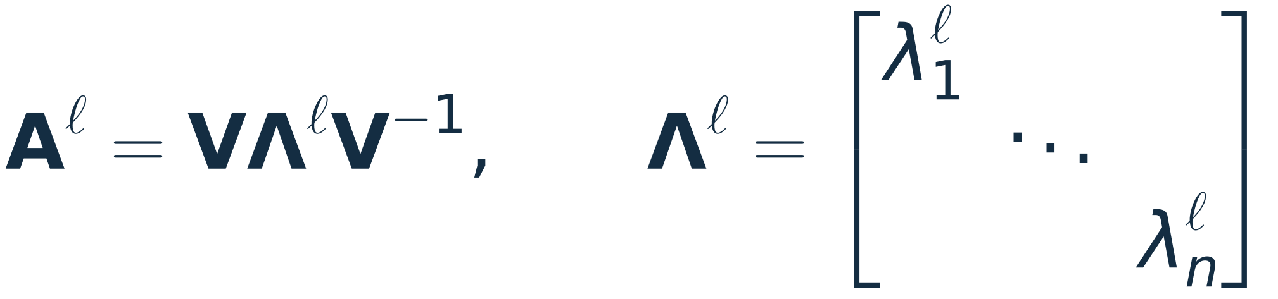
Powers are free in the eigenbasis
the interior V⁻¹V cancels
the factors telescope, and a power of a diagonal matrix is the diagonal of powers
4¹⁰ = 1 048 576 and 2¹⁰ = 1 024: two scalar powers instead of nine 2 × 2 products.
To raise a matrix to a power, raise its eigenvalues to that power and leave the eigenvectors alone.
18.085 · Lecture 7 · Matrix exponential
17
Notes:
~1.5 min. The notes' derivation, then A^10 for Lecture 6's matrix.
Check value: A^10 = [[524800, 523776], [523776, 524800]] (code in the appendix prints it).
Question: which entry dominates as l grows, and why? (4^l: the lambda = 4 mode, direction (1,1).)

Slide 18
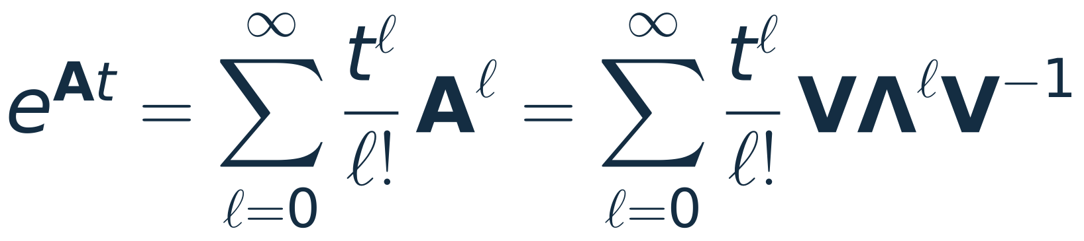
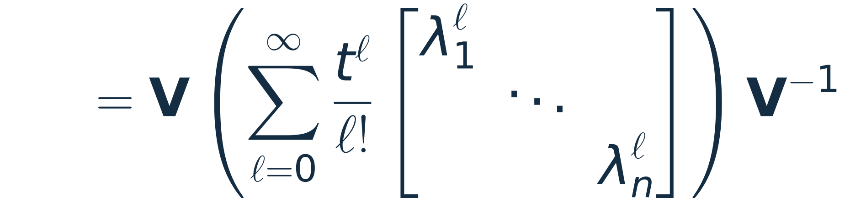
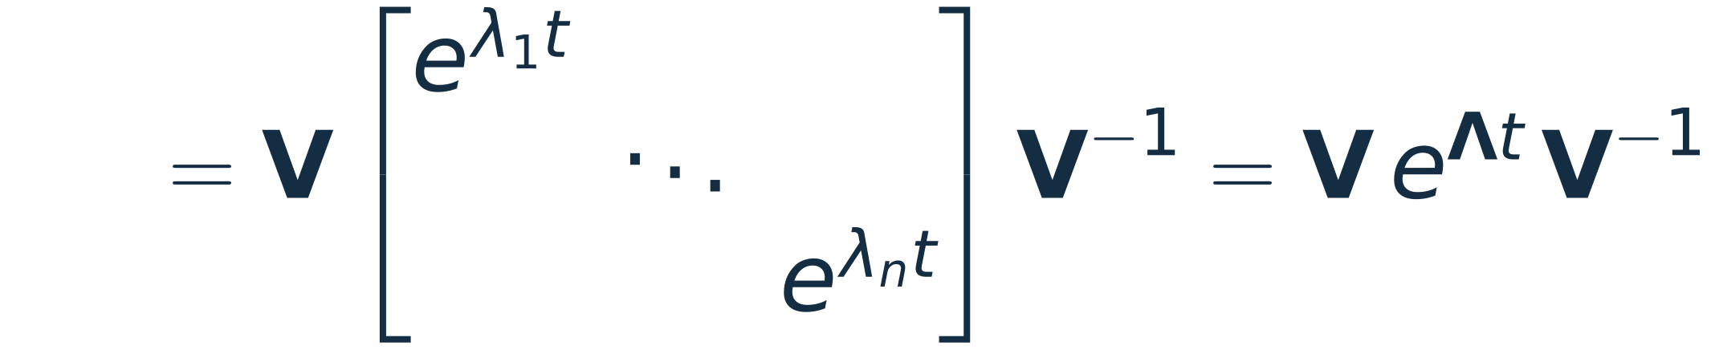
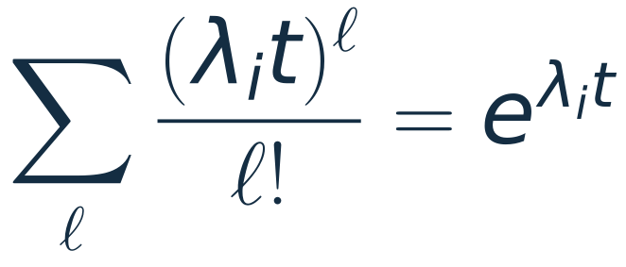

Assembling the exponential
V and V⁻¹ do not depend on ℓ: pull them out of the sum
each diagonal entry is a scalar series:
SYMMETRIC A
Lecture 6's matrix:
18.085 · Lecture 7 · Matrix exponential
18
Notes:
~2 min. Three lines from the notes, then the boxed symmetric form.
Click 4: e^{At} for Lecture 6's matrix. At t = 0 it is I; its columns grow like e^{4t} along (1,1).

Slide 19





Worked example: two blocks cooling
The difference dies three times faster than the average: the blocks equalise first, then cool together.
18.085 · Lecture 7 · Matrix exponential
19
Notes:
~2 min. Scaled units: each link conducts 1, each block holds heat 1. The matrix is -K2 (fixed-fixed, Lecture 2).
Click 1: eigenpairs. Click 2: T(0) = (1,0) = 1/2 (1,1) + 1/2 (1,-1), so c = (1/2, 1/2) and each mode decays at its own rate.
Click 3: the chart (T2 rises, then falls). Click 4: T2 peaks at t = ln(3)/2 = 0.55 with T2 = 1/(3 sqrt 3) = 0.19.
Values for checking: T(0.5) = (0.4148, 0.1917), T(1) = (0.2088, 0.1590), T(2) = (0.0689, 0.0664).
This is a preview of Lecture 9 (heat equation = dx/dt = -K x with large n).

Slide 20













Modes: the three arrows, now running in time
modal amplitudes
each mode on its own
recombine
What each eigenvalue does to its mode
decays: stable (heat flow, damping)
grows: unstable
oscillates, |e^(iωt)| = 1. Not from a real symmetric A: from A = −iH/ħ (slide 25)
Lecture 8: if K is positive definite, every eigenvalue of −K is negative, so dx/dt = −Kx is stable.
Lecture 9: the heat equation. Lecture 14: oscillations.
18.085 · Lecture 7 · Matrix exponential
20
Notes:
~1.5 min. The aside from the notes: if A is a physical operator, its eigenvectors are the modes;
decompose, let each mode evolve with its own e^{lambda_i t}, recombine.
Clicks 1-3: real negative, real positive, imaginary. A real symmetric A only gives the first two (its eigenvalues are real);
the imaginary case comes from A = -iH/hbar (quantum), and second-order systems (pendula, strings) oscillate as cos(omega t) with omega^2 an eigenvalue of K.
lambda = 0 is neutral: e.g. the translation mode of CO2 (slide 23), from the singular free-free B.
Click 4: where this is going (L8, L9, L14).

Slide 21
One factorisation, four fields
Analytical mechanics
Waves
Stiffness matrix K (mass-weighted)
Second-difference matrix Kₙ
eigenvalues = ω², eigenvectors give the normal modes
eigenvalues ∝ ω², eigenvectors = standing waves
Quantum mechanics
Quantum chemistry
Hamiltonian H (Hermitian)
Hückel matrix αI + β·(bond matrix)
eigenvalues = energies, e^(−iHt/ħ) moves the state
eigenvalues = orbital energies, eigenvectors = orbitals
Every symmetric [a b; b a] has eigenvectors (1, ±1)/√2: today's example returns in the pendula and in ammonia.
18.085 · Lecture 7 · Applications
21
Notes:
~45 s. Four fields, one move: build a symmetric matrix, diagonalise it, act on each eigenvalue.
Point at the caption: the 2x2 [a b; b a] structure is why Lecture 6's eigenvectors keep coming back.

Slide 22



Analytical mechanics: coupled pendula
two pendula (each alone: k = mg / length), a weak spring κ between them
k = 1, κ = 0.1, m = 1: ω₁ = 1, ω₂ = 1.095. Almost all the energy has moved to pendulum 2 at t = π/(ω₂ − ω₁) ≈ 33.
x(t) = V cos(Ωt) Vᵀ x(0), Ω = diag(ωᵢ): a function of a symmetric matrix acts on each eigenvalue, like e^(At).
18.085 · Lecture 7 · Applications
22
Notes:
~1.75 min. Analytical mechanics: T = 1/2 xdot^T M xdot and V = 1/2 x^T K x are both quadratic forms with symmetric matrices.
Click 1: normal coordinates q = V^T x split the Lagrangian into independent oscillators, omega_i = sqrt(lambda_i / m).
The K here is [a b; b a], so the modes are today's (1,1) and (1,-1): in phase and out of phase.
Click 2: start pendulum 1 displaced, both at rest (xdot(0) = 0). Click 3: beats; energy sloshes across every ~33 time units.
"Almost all": at t = 33 pendulum 1 keeps about 0.2% of the energy; the transfer is exact only when omega1 and omega2 are commensurate.
If asked: second-order systems use cos(sqrt(Lambda) t) instead of e^{Lambda t}; same three arrows.

Slide 23



Mechanics at molecular scale: vibrations of CO₂
Three masses, two bonds of stiffness k. K is the free–free matrix B (Lecture 2), so it is singular.
mass-weighting restores symmetry, so the spectral theorem applies
mode | observed
translation | —
symmetric stretch | ≈ 1340 cm⁻¹ (Raman pair 1285/1388)
antisymmetric stretch | 2349 cm⁻¹ = 4.26 µm, infrared
bend (needs 2D) | 667 cm⁻¹ = 15 µm, infrared
The antisymmetric stretch at 4.26 µm is the band most NDIR CO₂ sensors measure.
18.085 · Lecture 7 · Applications
23
Notes:
~1.5 min. OPTIONAL if short on time.
M^{-1}K is not symmetric, but M^{-1/2} K M^{-1/2} is: same eigenvalues omega^2, and the modes are M^{-1/2} times its eigenvectors.
Eigenvalues: 0 (translation: B is singular), k/m_O (C at rest), k(1/m_O + 2/m_C) (C moves against both O).
Click 3: the spring model predicts the frequency ratio 1.91; measured 2349/1340 = 1.75. The 9% miss is the
interaction between the two bonds, which a nearest-neighbour spring model leaves out.
The symmetric stretch does not change the dipole, so it is IR-silent (seen in Raman; the Raman band is split into
1285/1388 cm^-1 by a Fermi resonance with the bend overtone, unperturbed value about 1337-1340).
Click 4: NDIR sensors (building ventilation, breath analysers) sit on the 4.26 um band. The 15 um bend is CO2's main greenhouse band.
Force constant from 1337 cm^-1: k = m_O omega^2 = 1.7 kN/m.

Slide 24



Waves: standing waves are eigenvectors of K
n beads (mass m, spacing h) on a string under tension τ, both ends fixed: the fixed–fixed matrix again.
Low modes approach 1 : 2 : 3 as n grows (1 : 1.99 : 2.94 at n = 12). High modes bend over, as phonons do.
18.085 · Lecture 7 · Applications
24
Notes:
~1.5 min. Same K_n as PS0 Problem 15 (eigenvalues of K).
Click 1: eigenvectors are sampled sines, eigenvalues 4 sin^2(k pi / 2(n+1)).
Click 2: the first three modes for n = 12. Click 3: frequencies against the harmonic series.
Click 4: for k << n, sin(x) ~ x gives omega_k proportional to k (a continuous string, a guitar).
Near k = n the curve flattens toward 2 sqrt(tau/mh): a lattice has a highest frequency (phonons in a crystal).
At n = 12 the third partial is about 35 cents flat; a continuous string (n -> infinity) is exactly harmonic.
A travelling wave is a combination of these standing modes, each with its own time factor: the three arrows again.

Slide 25



Quantum mechanics: ammonia as a two-level system
tunnelling amplitude Δ > 0
ν ≈ 23.87 GHz: the molecule flips every ≈ 21 ps. The first atomic clock (NBS, 1948–49) and the first maser (Gordon, Zeiger and Townes, 1954) both ran on ammonia's inversion lines.
The exponent −iEt/ħ is imaginary: no mode grows or decays, each only rotates. e^(−iHt/ħ) is unitary.
18.085 · Lecture 7 · Applications
25
Notes:
~1.75 min. Basis: N above the H3 plane, N below. Tunnelling couples them with strength Delta > 0 (Delta, not A, to avoid the lecture's matrix A).
H is [a b; b a] again, so the stationary states are today's (1, +-1)/sqrt 2: symmetric (lower, because Delta > 0) and antisymmetric (upper).
Click 1: the Schroedinger equation is dpsi/dt = M psi with M = -iH/hbar; same V, eigenvalues -iE/hbar.
Click 2: starting in "N up", P(down) = sin^2(Delta t / hbar). Splitting 2 Delta = h nu.
Click 3: chart for nu = 23.87 GHz (the (3,3) inversion line): full transfer at 1/(2 nu) = 21 ps.
Click 4: history. Splitting h nu = 99 micro-eV = 0.80 cm^-1.
For the optics-minded: two evanescently coupled waveguides obey the same equation in z; a 50:50 coupler is the quarter-period point.

Slide 26





Quantum chemistry: Hückel orbitals of butadiene
π electrons hop between bonded carbons (β < 0 per bond, α on each site). The bond matrix is 2I − K₄, so its eigenvectors are K₄'s: sampled sines.
(N even) shrinks as the chain grows
Longer chains absorb longer wavelengths: β-carotene absorbs blue, so carrots look orange. A single fixed β overshoots the shift; real chains alternate bond lengths.
18.085 · Lecture 7 · Applications
26
Notes:
~1.5 min. Hueckel: H = alpha I + beta (adjacency). The adjacency of a 4-carbon chain is tridiagonal like K_4.
The bond (adjacency) matrix is 2I - K_4, so it shares K_4's eigenvectors, and its eigenvalues are 2 - lambda_k(K_4) = 2 cos(k pi/5).
Click 1: eigenvalues 2 cos(k pi/5) = +-1.618, +-0.618 (the golden ratio). beta < 0, so alpha + 1.618 beta is lowest.
Click 2: 4 pi electrons fill the two lowest orbitals. The orbital coefficients are sampled sines, exactly the string modes of slide 24.
Click 3: measured lambda_max (ethylene 165, butadiene 217, hexatriene 258, octatetraene 289, beta-carotene ~450 nm;
sources differ by a few nm with solvent). Hueckel gap = 4|beta| sin(pi/(2(N+1))).
Click 4: honest caveat. Fitting beta to each molecule gives |beta| from 3.8 eV (N=2) to 10 eV (N=22): one beta
cannot fit all. Real polyenes alternate single and double bonds, which keeps the gap open (Peierls).

Slide 27



Quantum chemistry: benzene's repeated eigenvalue
A ring: the eigenvectors are discrete Fourier modes (roots of unity, PS0 Part VIII), orthonormal under † since they are complex.
THE REPEATED CASE
α ± β each appear twice (k and 6 − k give the same cosine). Complex running waves or real cos/sin standing waves: both are orthonormal bases of the same plane.
152 kJ/mol
So delocalisation lowers the π energy by 2|β| (the change 2β is negative).
Measured: three cyclohexene double bonds would release 3 × 120 = 360 kJ/mol on hydrogenation; benzene releases 208.
extra stability of benzene = 2|β|, so |β| ≈ 76 kJ/mol
18.085 · Lecture 7 · Applications
27
Notes:
~1.25 min. OPTIONAL if short on time.
The ring's bond matrix is circulant, so the Fourier matrix diagonalises it (link to PS0 roots of unity).
Energies alpha + 2 beta cos(2 pi k/6): alpha+2beta, alpha+beta (x2), alpha-beta (x2), alpha-2beta.
The Frost circle picture: the levels are the heights of a hexagon inscribed in a circle of radius 2|beta|, vertex down.
Click 1: the degenerate pairs are the repeated-eigenvalue case of slide 12.
Click 2: 6 electrons: 2(alpha+2beta) + 4(alpha+beta) = 6 alpha + 8 beta versus 6 alpha + 6 beta for three ethylenes.
Click 3: heats of hydrogenation: cyclohexene -120 kJ/mol, benzene -208 kJ/mol, difference 152 kJ/mol.
Caveat if asked: this thermochemical beta (about 0.8 eV) differs from the spectroscopic one; Hueckel is a one-parameter model.

Slide 28
The same three arrows every time
System | Symmetric matrix | Eigenvalue | Eigenvector | Then
Two blocks cooling | −K₂ | −(decay rate) | average, difference | decays as e^(λt)
Coupled pendula, CO₂ | M^(−½) K M^(−½) | ω² | normal mode (via M^(−½)) | oscillates, cos ωt
Beaded string | Kₙ | ∝ ω² | standing wave (sine) | oscillates, cos ωt
Ammonia | H | energy E | stationary state | phase e^(−iEt/ħ)
Butadiene, benzene | αI + β·(bond matrix) | orbital energy | molecular orbital | fill with electrons
Into the eigenbasis, act on each eigenvalue separately, back out.
18.085 · Lecture 7 · Applications
28
Notes:
~45 s. Summary table. The last column is the only thing that changes between fields.

Slide 29




More examples: optics, EM, circuits, waves
Optics
Electromagnetism
Ray (ABCD) matrices; the paraxial Schrödinger equation
Waveguide cutoffs and ring antenna arrays
powers of a 2 × 2 matrix; GRIN modes and e^(−iHz)
K and B in two dimensions; circulant coupling
Circuits
Waves and nonlinear optics
An RC line, coupled LC resonators
Seiches, the inverted oscillator, parametric gain
time constants from T; mode splitting
AᵀCA with depth; σₓ with and without i
Each one is today's move: diagonalise, act on each eigenvalue, recombine.
18.085 · Lecture 7 · More examples
29
Notes:
V2 addition: an optional pool of examples. Pick what fits the time; each slide stands alone.
Pacing if used: about 1.5 min per slide. None of these slides is needed for the rest of the deck.

Slide 30



Optics: ray matrices, powers and stability
A periodic lens waveguide: gap d, then a thin lens f, repeated.
M is not symmetric: its eigenvalues can be complex (here on the unit circle), like the rotation on slide 13.
ray after N cells: raise the eigenvalues to the power N
|λ| = 1.56 > 1: the ray grows by about 1.56 per lens
Bounded for 0 < d < 4f (f > 0). Two-mirror laser cavity, same trace test: 0 < g₁g₂ < 1 with gᵢ = 1 − L/Rᵢ.
18.085 · Lecture 7 · More examples
30
Notes:
~1.5 min. ABCD matrices are 2x2 with det = n_in/n_out, so det = 1 when the ray starts and ends in the same index. NOT symmetric.
The characteristic polynomial is lambda^2 - (A+D) lambda + 1: the eigenvalues multiply to 1.
|A+D| <= 2: a pair e^{+-i theta} on the unit circle, rays stay bounded. |A+D| > 2: real pair lambda and 1/lambda, one of them
larger than 1 in size, rays blow up. Here A + D = 2 - d/f.
Click 3: f = d = 100 mm gives theta = 60 degrees, so M^3 = -I (image inverted after 3 lenses) and M^6 = I.
d = 420 mm: (A+D)/2 = -1.1, eigenvalues -0.64 and -1.56 (product 1).
Click 4: for a two-mirror cavity the same test reads 0 < g1 g2 < 1 with g_i = 1 - L/R_i (the endpoints are marginal, as d = 4f is).
A diverging lens (f < 0) is never stable in this arrangement.
Link: this is the "powers are free" slide (17) applied to a non-symmetric matrix; V exists because the eigenvalues are distinct
(it fails exactly at the edge |A+D| = 2, where M can be defective).

Slide 31


Optics: the paraxial Schrödinger equation
graded-index (GRIN) medium; x across the beam, z along it, k = n₀k₀
λ₀ = 1.064 µm, n₀ = 1.5, 2π/g = 18.85 mm; ground-mode waist 26 µm; input shifted by 60 µm. On an 800-point grid, the eigenvalues of H over g are 0.500, 1.500, 2.500, 3.499.
Quarter-pitch GRIN rod lenses collimate the light leaving optical fibres.
The beam's centroid follows the ray exactly, because H is quadratic (Ehrenfest's theorem).
18.085 · Lecture 7 · More examples
31
Notes:
~1.5 min. From Helmholtz with E = psi e^{ikz} and slow variation in z: 2ik psi_z + psi_xx + 2k^2 (Dn/n0) psi = 0.
With Dn/n0 = -g^2 x^2/2 this is a Schroedinger equation with z as time and a harmonic potential.
Click 1: second differences give K again; H is symmetric, so psi(z) = V e^{-i Lambda z} V^T psi(0): the matrix exponential of the lecture.
Click 2: the eigenvalues of H are equally spaced, g(m + 1/2); mode m travels as e^{i(k - beta_m) z}, so beta_m is the offset below k.
All modes rephase every 2 pi / g (the pitch).
Click 3: an off-axis Gaussian (a coherent state) keeps its shape and its centroid follows the ray matrix, a rotation in (x, x'/g).
Centroid vs ray agree to 0.4 um over two pitches on the 800-point grid (error falls like h^2).
Numbers: k = 2 pi n0 / lambda0 = 8.86e6 1/m, g = 1/(3 mm), waist w0 = sqrt(2/(k g)) = 26 um.

Slide 32

EM: waveguide modes are eigenvectors of K and B
A hollow metal pipe, cross-section a × b. TM modes: E_z = 0 on the walls, so the grid matrix is K (fixed). TE modes: ∂H_z/∂n = 0, so it is B (free).
Kronecker sum: two-dimensional eigenvectors are products of one-dimensional ones (sines for K, cosines for B).
WR-90 mode | exact (GHz) | grid 45 × 20
TE10 | 6.557 | 6.556
TE20 | 13.114 | 13.104
TE01 | 14.754 | 14.738
TE11 = TM11 | 16.145 | 16.131
TE30 | 19.671 | 19.635
H_z across the 22.86 × 10.16 mm guide. B is singular: its constant eigenvector would be a 'TE00' mode, which carries no wave.
WR-90 carries X band (8.2–12.4 GHz): above the TE10 cutoff, below TE20, so exactly one mode propagates.
18.085 · Lecture 7 · More examples
32
Notes:
~1.5 min. Transverse Helmholtz problem: -Laplacian u = k_c^2 u on the cross-section; f_c = c k_c / (2 pi).
TM (E_z Dirichlet) -> K on interior nodes; TE (H_z Neumann) -> B on cell centres. In 2D the matrix is the Kronecker sum
B_x (x) I + I (x) B_y; its eigenvalues are sums lambda_i + mu_j, which is why the exact cutoffs are c/2 sqrt((m/a)^2 + (n/b)^2).
The table is the grid calculation (45 x 20 cells, h = 0.51 mm) against the exact values; errors are 0.02-0.2%.
Mode order: TE10 6.557, TE20 13.114, TE01 14.754, TE11 = TM11 16.145, TE30 19.671 GHz (TE30 comes before TE21 at 19.74).
The zero eigenvalue of B (constant H_z) is the TE00 "mode", which does not exist as a waveguide mode.
Click 3: X-band single-mode operation, the reason WR-90 has these dimensions.

Slide 33



EM: a ring of antennas and its Fourier modes
whatever the coupling values: the same algebra as benzene (slide 27)
Arrows: the phase of each element. Driving the ring in mode m (|m| < N/2) makes the far-field phase wind as e^(imφ): a beam carrying orbital angular momentum. Circular arrays driven this way are a common way to launch radio OAM beams.
m and −m share an eigenvalue: another repeated eigenvalue, and another free choice of basis (running or standing waves).
18.085 · Lecture 7 · More examples
33
Notes:
~1.25 min. OPTIONAL.
Rotational symmetry (coupling depends only on the separation around the ring) makes Z circulant, and every circulant matrix is
diagonalised by the Fourier matrix, whatever its entries (checked numerically with random couplings).
Reciprocity makes Z symmetric, which is what pairs m with -m (same eigenvalue).
Real antennas: Z is complex symmetric, not Hermitian; the Fourier eigenvectors still hold because they come from the circulant structure.
Click 2: a 4-element ring with self term 5 and nearest-neighbour coupling 1: eigenvalues 5 + 2 cos(2 pi m/4) = 7, 5, 5, 3.
Click 3: phase modes are the OAM modes of a uniform circular array (radio OAM system studies, e.g. Mohammadi et al., IEEE TAP 2010).

Slide 34




Circuits: an RC line discharging
n = 10: τ₁ = 44.8 RC (the formula gives 44.7), τ₂ = 5.05 RC. After a few τ₂ only the slowest mode, a quarter sine, is left.
Delay grows with the square of the wire length, which is why long on-chip wires are broken up by repeaters.
18.085 · Lecture 7 · More examples
34
Notes:
~1.5 min. Node j: C dv_j/dt = (v_{j-1} - 2 v_j + v_{j+1})/R, with v_0 = 0 (grounded driver) and an open far end:
T with its free end last. Strang's T has T_11 = 1; numbering the nodes from the open end gives exactly that matrix (same eigenvalues).
Click 1: time constants RC / lambda_k. The 2-section case gives the golden-ratio pair 0.382 and 2.618.
Click 2: start from all nodes at 1 V; the profile relaxes into the slowest mode and then decays.
Numbers: far-end voltage 0.415 at t = 50 RC and 0.136 at t = 100 RC; tau_1/tau_2 = 8.9.
Click 3: tau_1 = 1/(4 sin^2(pi/(2(2n+1)))) RC ~ (2n+1)^2/pi^2 RC (44.7 at n = 10, exact 44.77) -> 0.41 R_tot C_tot for large n.
Click 4: a distributed RC wire's delay scales as length^2; repeaters cut a long wire into short pieces with linear total delay.

Slide 35


Circuits: coupled LC resonators, wireless power
inductance matrix, symmetric (M₁₂ = M₂₁); q = charges on the capacitors
MIT, 2007 (Kurs et al., Science): two self-resonant coils at about 10 MHz lit a 60 W bulb more than 2 m away, with about 40% efficiency. The two modes are resolved once the coupling beats the loss (κQ > 1).
The same [a b; b a] as the pendula and ammonia: modes (1, ±1), and energy that sloshes at the beat frequency.
18.085 · Lecture 7 · More examples
35
Notes:
~1.5 min. Kirchhoff: L q1'' + M q2'' + q1/C = 0 and the same with 1 <-> 2. Mass matrix [[L, M], [M, L]], stiffness I/C.
Click 1: eigenvectors of [[L, M], [M, L]] are (1, +-1) with eigenvalues L +- M, so omega^2 = 1/(C(L +- M)).
Click 2: f0 = 10 MHz and kappa = 0.05 give 9.759 and 10.260 MHz; the energy moves from tank 1 to tank 2 in 1/(2 Delta f) = 1.0 us,
exactly as the pendula did (slide 22). Chart: the two branches separate roughly as 1 -+ kappa/2.
Click 3: the 2007 MIT demonstration (Soljacic group), coils at 9.9 MHz. Real tanks are lossy: the splitting kappa f0 is visible only when it exceeds
the linewidth f0/Q, i.e. kappa Q > 1 ("strong coupling"). Kurs et al. write the coupling as a rate; at 2 m their M/L was far below 0.05.

Slide 36

Water waves: seiches are eigenvectors of AᵀCA
linear shallow-water waves in a long lake of depth h(x)
the course's AᵀCA: depth plays the role of the spring constants
Lake Erie: 388 km long, mean depth 19 m. Flat bottom: T₁ = 15.8 h. Parabolic bottom with the same mean depth: 14.3 h. Observed: 14.2 h, then 9.2, 6.0 and 4.1 h.
At constant width, a real depth profile only changes C: the matrix stays symmetric, the method the same.
18.085 · Lecture 7 · More examples
36
Notes:
~1.5 min. Continuity eta_t + (h u)_x = 0 and momentum u_t = -g eta_x give eta_tt = g (h eta_x)_x, with zero flux at the ends.
Click 1: on a grid, eta at cell centres, flux at faces: A = difference matrix (free-free), C = depth at the faces.
g A^T C A is symmetric positive semidefinite; its zero eigenvalue is the mean water level (no motion).
Click 2: flat bottom -> A^T A = B -> cosine modes and Merian's formula. Parabolic bottom h0 (1 - (2x/L)^2) -> Legendre polynomials
(Lamb); the 400-cell grid reproduces the Legendre periods to 0.5% and the mode shapes to 4 digits.
Click 3: Lake Erie modes 14.2, 9.2, 6.0, 4.1 h ("A study of Lake Erie seiche and low frequency water level fluctuations in the presence of
surface ice", Ocean Engineering, 2017; other sources differ by about 0.1 h). The parabolic basin uses h0 = 1.5 x 19 m, which keeps the mean depth;
it improves the first three periods over the flat model. It is an idealisation, not a fit.
A varying width b(x) adds a diagonal matrix on the left (a generalised symmetric problem, like the CO2 mass-weighting).
Seiches matter for flooding: strong winds along Erie's axis pile water at one end (Buffalo or Toledo), and it then sloshes at these periods.

Slide 37

Water waves: the inverted oscillator
Stretch by eᵗ along x = p, squeeze by e⁻ᵗ along x = −p. det = 1, so phase-space area is kept. The eigenvectors are today's (1, ±1)/√2 once more.
Observed with surface gravity water waves: Rozenman, Efremov, Schleich, Shemer and Arie, “Observation of phase space dynamics of inverted harmonic oscillator”, arXiv:2607.18297.
The ordinary oscillator rotates phase space (λ = ±i); the inverted one stretches and squeezes it (λ = ±1).
18.085 · Lecture 7 · More examples
37
Notes:
~1.5 min. Hamilton's equations x' = dH/dp, p' = -dH/dx.
Ordinary oscillator: the matrix [[0,1],[-1,0]] is -R (R from slide 13), eigenvalues +-i, circles stay circles.
Click 1: flip the sign of the potential and the matrix becomes symmetric, [[0,1],[1,0]], eigenvalues +-1.
Click 2: e^{At} = V diag(e^t, e^-t) V^T = [[cosh t, sinh t], [sinh t, cosh t]], with V = (1, +-1)/sqrt 2, today's V.
A phase-space cloud is stretched along the unstable direction and squeezed along the stable one; det e^{At} = 1 (Liouville).
Same matrix as parametric amplification on the next slide.

Slide 38


Nonlinear optics: one matrix, gain or oscillation
Parametric amplification idler empty at z = 0
Frequency conversion A₂ = 0 at z = 0
Undepleted pump, phase matched, amplitudes in photon-flux units. Photons are made in pairs: cosh² − sinh² = 1. κz = 1: gain 2.4 (3.8 dB), and 8.7 dB of quadrature squeezing in the degenerate case. Record: 15 dB (Vahlbruch et al., PRL 2016). Advanced LIGO has used squeezed light since 2019 (up to 3 dB above 50 Hz in O3).
Same σₓ: κ gives eigenvalues ±κ (gain and squeezing); iκ gives ±iκ (conversion and back, as in ammonia).
18.085 · Lecture 7 · More examples
38
Notes:
~1.5 min. Undepleted pump, perfect phase matching, pump phase chosen so that the coupling kappa is real.
Both panels: chi(2) medium, strong undepleted pump, perfect phase matching; the idler (or the converted wave) starts empty.
Click 1: d/dz (A_s, A_i*) = kappa sigma_x (A_s, A_i*): real symmetric, eigenvalues +-kappa. With A_i(0) = 0:
A_s = A_s(0) cosh(kappa z), A_i* = A_s(0) sinh(kappa z). Gain cosh^2: 2.38 at kappa z = 1, 14.2 at 2, 101 at 3.
Degenerate case: the quadratures scale as e^{+-kappa z}: squeezing 20 log10 e = 8.7 dB per unit kappa z; 15 dB is kappa z = 1.73.
Click 2: sum-frequency generation: d/dz (A1, A2) = i kappa sigma_x (A1, A2): eigenvalues +-i kappa, |A2|^2 = sin^2(kappa z):
complete conversion at kappa z = pi/2, then back. Same maths as ammonia and the directional coupler.
Photon-flux normalisation is what makes the two couplings equal (Manley-Rowe); with raw field amplitudes they differ by omega_s n_i / (omega_i n_s).
Click 3: LIGO: up to 3 dB above 50 Hz in O3 (Tse et al., PRL 2019). In O4, frequency-dependent squeezing reached several dB more (PRX 2023).

Slide 39
More examples at a glance
System | Matrix | Eigenvalues | Eigenvectors | Result
Lens waveguide | ABCD, det 1 (not symmetric) | e^(±iθ) | — | bounded iff |A + D| < 2
GRIN medium | K/(2kh²) + diag | g(m + ½) | Hermite–Gauss modes | self-imaging every 2π/g
Metal waveguide | K or B, in 2D | k_c² | TE and TM modes | one-mode band
Ring antenna array | circulant Z | mode impedances | phase (OAM) modes | beams with e^(imφ)
RC line | T / RC | 1/τ | quarter-sine modes | delay ∝ length²
Coupled LC | [L M; M L] | L ± M | in and out of phase | splitting ≈ κf₀
Lake seiche | g AᵀCA | ω² | seiche modes | periods of hours
Inverted oscillator, OPA | σₓ | ±1 | (1, ±1)/√2 | stretch and squeeze
Frequency conversion | iσₓ | ±i | (1, ±1)/√2 | conversion and back
Into the eigenbasis, act on each eigenvalue separately, back out.
18.085 · Lecture 7 · More examples
39
Notes:
~30 s. Summary of the optional examples. The lens-waveguide matrix is the only non-normal one (no orthonormal eigenvectors), on purpose.
The ordinary oscillator's matrix is antisymmetric and i sigma_x is complex symmetric: both are normal, so still unitarily diagonalisable.

Slide 40
Questions for the room
1
A has eigenvalues 1 and ½ with independent eigenvectors. What does Aᵏ approach as k → ∞?
4
If A = VΛVᵀ, what is A⁻¹, and when does it exist?
2
Can a real symmetric matrix have the eigenvalue 2 + i?
5
In the two-block example, which mode is left after a long time?
3
v = (1, 2) is an eigenvector of a symmetric 2 × 2 matrix. Name a second eigenvector without computing anything.
6
Make the pendulum spring ten times weaker (κ = 0.01). Does the energy transfer take longer or shorter?
18.085 · Lecture 7 · Questions
40
Notes:
Answers:
1. A^k = V diag(1, (1/2)^k) V^{-1} -> V diag(1, 0) V^{-1}: the projection onto v1 along v2.
2. No: eigenvalues of real symmetric matrices are real (proof 1).
3. (2, -1): eigenvectors of a symmetric 2x2 with distinct eigenvalues are orthogonal. (If the eigenvalue is repeated, every vector works.)
4. A^{-1} = V Lambda^{-1} V^T, which exists exactly when no lambda_i is 0.
5. The average mode (1,1): it decays like e^{-t}, the difference like e^{-3t}.
6. Longer: omega2 = sqrt(1.02) = 1.00995, so pi/(omega2 - omega1) = 316 instead of 33.

Slide 41
Appendix A · A = VΛVᵀ, powers and the exponential
import numpy as np # arrays and linear algebra
from scipy.linalg import expm # reference matrix exponential
A = np.array([[3.0, 1.0], [1.0, 3.0]]) # Lecture 6's symmetric matrix
lam, V = np.linalg.eigh(A) # symmetric solver: real lam, orthonormal V
print("eigenvalues:", lam) # ascending order: [2. 4.]
print("V^T V = I:", np.allclose(V.T @ V, np.eye(2))) # orthonormal columns
print("A = V L V^T:", np.allclose(V @ np.diag(lam) @ V.T, A)) # spectral theorem
A10 = V @ np.diag(lam**10) @ V.T # a power: raise only the eigenvalues
print("A^10 =", np.round(A10).astype(int).tolist()) # [[524800, 523776], [523776, 524800]]
t = 0.3 # any time will do
E = V @ np.diag(np.exp(lam * t)) @ V.T # e^{At} = V e^{Lambda t} V^T
print("e^{At} matches expm:", np.allclose(E, expm(A * t))) # agrees with SciPy
OUTPUT
eigenvalues: [2. 4.]
V^T V = I: True
A = V L V^T: True
A^10 = [[524800, 523776], [523776, 524800]]
e^{At} matches expm: True
18.085 · Lecture 7 · Python appendix
41
Notes:
L07_eigendecomposition.py: numpy and scipy (expm, for the check). Runs as is; the output shown is what it prints.

Slide 42
Appendix B · two blocks cooling and coupled pendula
import numpy as np # arrays and linear algebra
K = np.array([[2.0, -1.0], [-1.0, 2.0]]) # fixed-fixed K2 from Lecture 2
lam, V = np.linalg.eigh(-K) # eigenpairs of dT/dt = -K T
print("eigenvalues:", lam) # [-3. -1.] = minus the decay rates
T0 = np.array([1.0, 0.0]) # block 1 hot, block 2 cold
c = V.T @ T0 # modal amplitudes c = V^T T(0)
for t in [0.5, 1.0, 2.0]: # a few sample times
T = V @ (c * np.exp(lam * t)) # each mode decays on its own
print(f"T({t}) =", np.round(T, 4)) # recombine the modes
k, kap = 1.0, 0.1 # pendulum and spring stiffness (m = 1)
Kp = np.array([[k + kap, -kap], [-kap, k + kap]]) # coupled-pendula stiffness matrix
lam, V = np.linalg.eigh(Kp) # eigenvalues are omega^2
w = np.sqrt(lam) # normal-mode frequencies
print("omega:", np.round(w, 4)) # [1. 1.0954]
print("transfer time:", round(np.pi / (w[1] - w[0]), 1)) # almost all energy in pendulum 2
OUTPUT
eigenvalues: [-3. -1.]
T(0.5) = [0.4148 0.1917]
T(1.0) = [0.2088 0.159 ]
T(2.0) = [0.0689 0.0664]
omega: [1. 1.0954]
transfer time: 32.9
18.085 · Lecture 7 · Python appendix
42
Notes:
L07_modes.py: numpy only. Runs as is; the output shown is what it prints.

Slide 43
Appendix C · ammonia and Hückel
import numpy as np # arrays and linear algebra
H = np.array([[0.0, -1.0], [-1.0, 0.0]]) # ammonia, units E0 = 0, Delta = 1
E, V = np.linalg.eigh(H) # energies -1 and +1
psi0 = np.array([1.0, 0.0]) # start with the N atom up
for s in [0.0, np.pi / 4, np.pi / 2]: # s = Delta t / hbar
psi = V @ (np.exp(-1j * E * s) * (V.T @ psi0)) # V e^{-i Lambda s} V^T psi0
print(f"s = {s:.3f} P_down = {abs(psi[1])**2:.3f}") # equals sin^2 s
adj4 = np.diag(np.ones(3), 1) + np.diag(np.ones(3), -1) # butadiene bond matrix
print("butadiene x:", np.round(np.linalg.eigvalsh(adj4), 3)) # E = alpha + x beta
adj6 = np.roll(np.eye(6), 1, axis=1) # one step round the ring
adj6 = adj6 + adj6.T # benzene bond matrix
print("benzene x:", np.round(np.linalg.eigvalsh(adj6), 3)) # note the repeated values
OUTPUT
s = 0.000 P_down = 0.000
s = 0.785 P_down = 0.500
s = 1.571 P_down = 1.000
butadiene x: [-1.618 -0.618 0.618 1.618]
benzene x: [-2. -1. -1. 1. 1. 2.]
18.085 · Lecture 7 · Python appendix
43
Notes:
L07_quantum.py: numpy only. Runs as is; the output shown is what it prints.

Slide 44
Appendix D · lenses, GRIN modes, waveguide cutoffs
import numpy as np # arrays and linear algebra
f, d = 100.0, 100.0 # lens focal length and spacing (mm)
M = np.array([[1, d], [-1 / f, 1 - d / f]]) # one cell: gap d, then lens f
print("eigenvalues:", np.round(np.linalg.eigvals(M), 4)) # e^{+-i pi/3}
print("M^6 = I:", np.allclose(np.linalg.matrix_power(M, 6), np.eye(2)))
k, g = 2 * np.pi * 1.5 / 1.064e-6, 1 / 3e-3 # wavenumber in glass, GRIN constant
x = np.linspace(-200e-6, 200e-6, 800); h = x[1] - x[0] # transverse grid
K = 2 * np.eye(800) - np.eye(800, k=1) - np.eye(800, k=-1) # second differences
H = K / (2 * k * h**2) + np.diag(k * g**2 * x**2 / 2) # paraxial Hamiltonian, symmetric
print("beta_m / g:", np.round(np.linalg.eigvalsh(H)[:4] / g, 3)) # m + 1/2
a, b, n1, n2 = 22.86e-3, 10.16e-3, 45, 20 # WR-90 cross-section and grid
B = lambda n: np.diag([1] + [2] * (n - 2) + [1]) - np.eye(n, k=1) - np.eye(n, k=-1)
L = np.kron(B(n1) / (a / n1)**2, np.eye(n2)) + np.kron(np.eye(n1), B(n2) / (b / n2)**2)
fc = 299792458.0 * np.sqrt(np.linalg.eigvalsh(L)[1:5]) / (2 * np.pi) # skip the zero mode
print("TE cutoffs (GHz):", np.round(fc / 1e9, 3)) # TE10, TE20, TE01, TE11
OUTPUT
eigenvalues: [0.5+0.866j 0.5-0.866j]
M^6 = I: True
beta_m / g: [0.5 1.5 2.5 3.499]
TE cutoffs (GHz): [ 6.556 13.104 14.738 16.131]
18.085 · Lecture 7 · Python appendix
44
Notes:
L07_optics_em.py: numpy only. Runs as is; the output shown is what it prints.

Slide 45
Appendix E · RC line, coupled LC, seiches, σₓ
import numpy as np # arrays and linear algebra
n = 10 # RC line: n sections, far end open
T = 2 * np.eye(n) - np.eye(n, k=1) - np.eye(n, k=-1); T[-1, -1] = 1 # T, free end last
print("tau_1, tau_2 (units RC):", np.round(1 / np.linalg.eigvalsh(T)[:2], 2))
Lm = np.array([[1.0, 0.05], [0.05, 1.0]]) # inductance matrix, kappa = M/L
w2 = np.linalg.eigvalsh(np.linalg.inv(Lm)) # omega^2 in units of 1/(LC)
print("f/f0:", np.round(np.sqrt(w2), 4)) # 0.9759 and 1.0260
g, L, h0, N = 9.81, 388e3, 28.5, 400 # parabolic Lake Erie, mean depth 19 m
xe = np.linspace(-L / 2, L / 2, N + 1); dx = xe[1] - xe[0] # cell edges
A = (np.eye(N - 1, N, k=1) - np.eye(N - 1, N)) / dx # differences at interior faces
C = np.diag(h0 * (1 - (2 * xe[1:-1] / L)**2)) # depth at the faces
w = np.sqrt(np.linalg.eigvalsh(g * A.T @ C @ A)[1:5]) # skip the zero (mean level) mode
print("seiche periods (h):", np.round(2 * np.pi / w / 3600, 2))
sx = np.array([[0.0, 1.0], [1.0, 0.0]]) # inverted oscillator / parametric gain
lam, V = np.linalg.eigh(sx) # eigenvalues -1, +1
print("e^{sx}:", np.round(V @ np.diag(np.exp(lam)) @ V.T, 4).tolist()) # cosh 1, sinh 1
OUTPUT
tau_1, tau_2 (units RC): [44.77 5.05]
f/f0: [0.9759 1.026 ]
seiche periods (h): [14.32 8.27 5.85 4.53]
e^{sx}: [[1.5431, 1.1752], [1.1752, 1.5431]]
18.085 · Lecture 7 · Python appendix
45
Notes:
L07_circuits_waves.py: numpy only. Runs as is; the output shown is what it prints.

