Slide 1



Positive definite matrices
and the Hessian
Lecture 8 · the energy xᵀMx · the second derivative test · Newton's method
Monday 5 October 2026
Where it shows up today
Physics
Engineering
Chemistry
Notes:
Lecture 8, Monday 5 October. These slides go with Sections 1 to 3 of the notes and stop at the Hessian: the symmetric part and the two tests are not here.
Time: the full deck is about 50 minutes (slides 2 to 8: 17, slides 9 to 12: 11, slides 13 to 21: 17, slides 22 and 23: 4). The core, slides 2 to 12, is about 28 minutes. The core plus slides 13, 14, 17, 20 and 22 is about 36. Each application slide stands alone, so any of them can be skipped.
The computed numbers come from L08_hessian.py and L08_applications.py (appendix). Measured values are named in the notes of their slides.

Slide 2
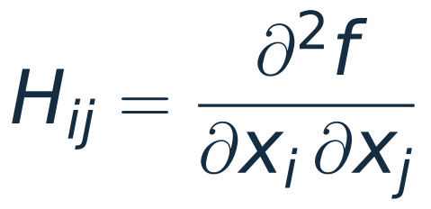
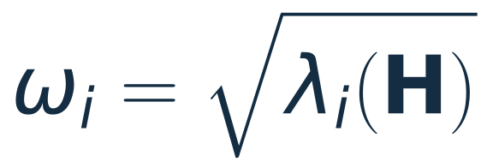


Today: one definition, one matrix, many uses
1
2
3
4
Positive definite
The Hessian
On the computer
Where it is used
A symmetric matrix whose energy is positive for every non-zero x.
The symmetric matrix of all second derivatives of a function f.
Finite differences, eigvalsh, and Newton's method.
Stability, focusing, buckling, error bars, molecular vibrations.
The question behind every slide: is this critical point a minimum?
These slides follow Sections 1 to 3 of the notes and stop at the Hessian.
Notes:
~1 min. The map of the hour. Card 1 is the definition from Section 1 of the notes. Card 2 is the Hessian, Section 3. Card 3 is what a computer does with it. Card 4 is why anyone cares.
The question written under the cards is the thread: every example today asks it.

Slide 3
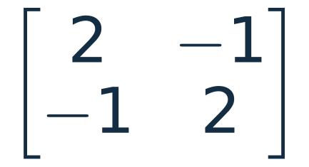
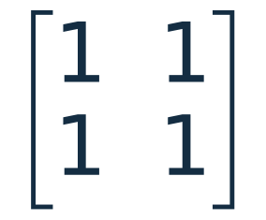
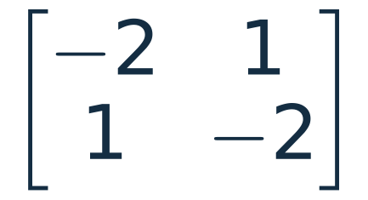
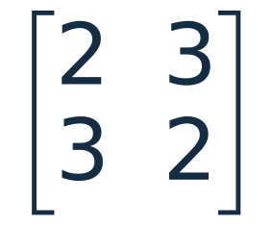

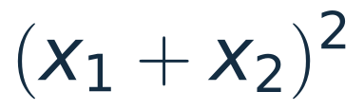
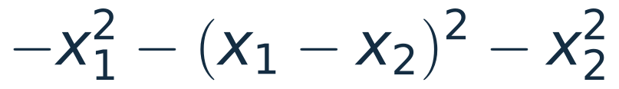
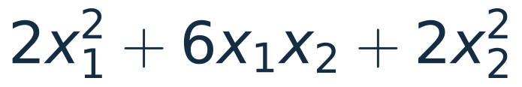
Which of these matrices is positive definite?
A symmetric matrix M is positive definite when
(a)
(b)
(c)
(d)
xᵀMx =
xᵀMx =
xᵀMx =
xᵀMx =
positive unless x = 0
zero at x = (1, −1)
negative unless x = 0
10 at (1, 1), −2 at (1, −1)
positive
definite
positive
semi-definite
negative
definite
indefinite
KEY IDEA
Positive definite: the energy xᵀMx is zero at x = 0 and positive everywhere else. A bowl.
Notes:
~3 min. Ask before clicking: let the room vote on each matrix. These are the four matrices of Example 1.3 in the notes.
Click 1: (a) is a sum of three squares that vanish together only at x = 0.
Click 2: (b) is a perfect square, zero on the whole line x2 = -x1.
Click 3: (c) is minus (a).
Click 4: (d) takes both signs: 10 at (1, 1) and -2 at (1, -1).
Click 5: the key idea.
Point out that finitely many test vectors can show a matrix is NOT positive definite, but cannot show that it is.

Slide 4
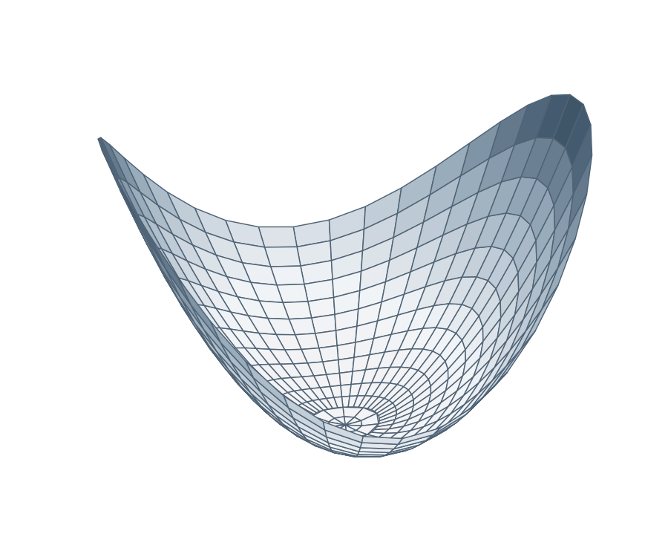
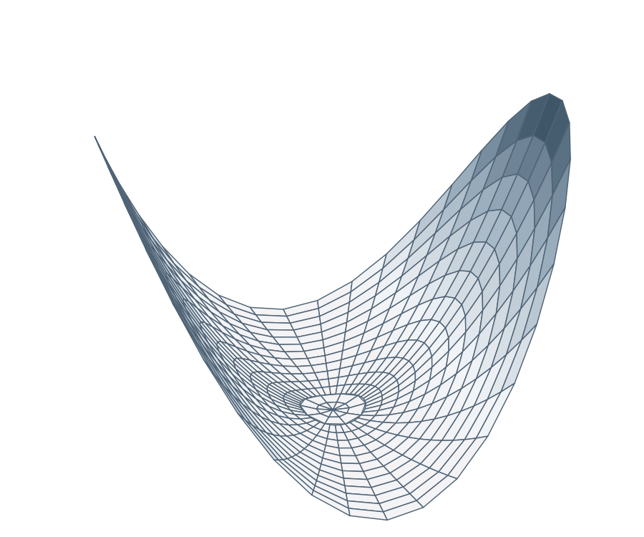
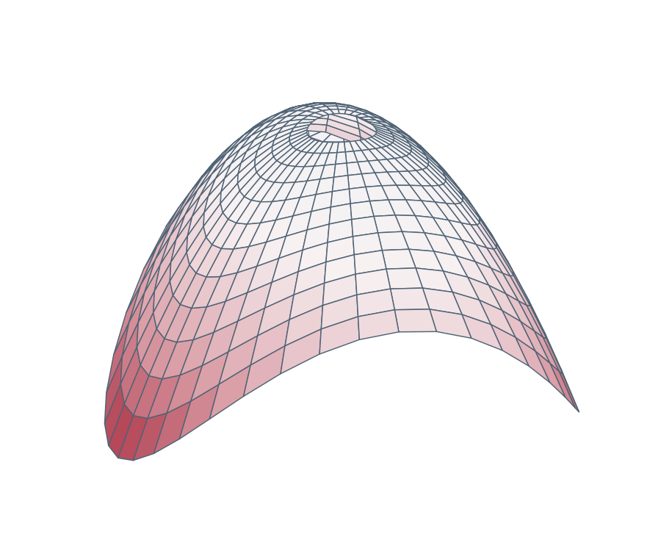
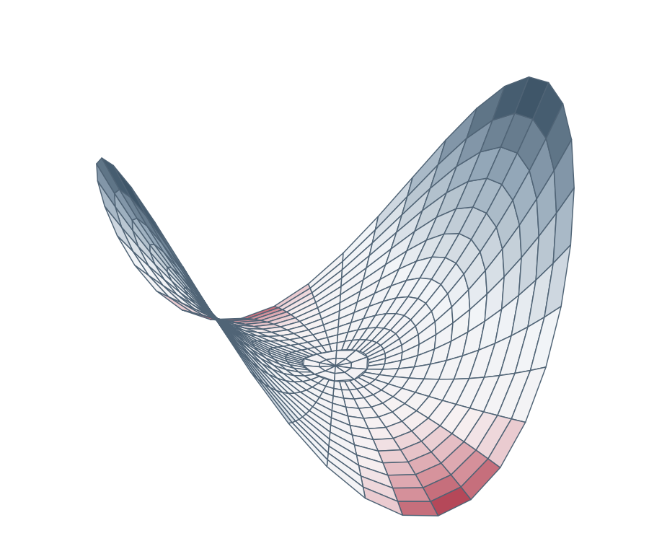
Four shapes of the energy xᵀMx
bowl
trough
dome
saddle
positive definite
positive semi-definite
negative definite
indefinite
Near a critical point, a smooth function looks like a constant plus a quadratic shape of this kind. The matrix that says which one is the Hessian.
Colour shows the sign of xᵀMx: navy is positive, red is negative.
Notes:
~2 min. The same four matrices, now as surfaces z = xᵀMx over the unit disc. Colour is the sign: navy positive, red negative.
Clicks 1 to 4 show the surfaces one at a time. The trough is the interesting one: a whole line of non-zero vectors with zero energy. That line is the gap between > 0 and >= 0.
Click 5: the bridge to the Hessian. Near a critical point a smooth function is a constant plus a shape like these. Two cases are not drawn: the trough upside down (negative semi-definite) and the flat case M = 0.

Slide 5
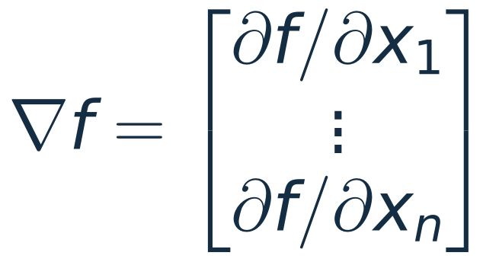
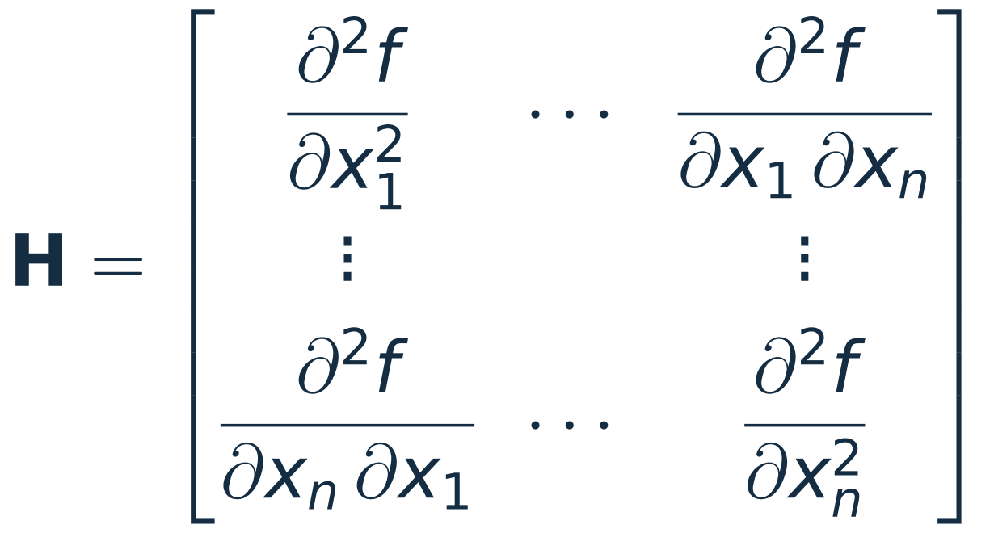
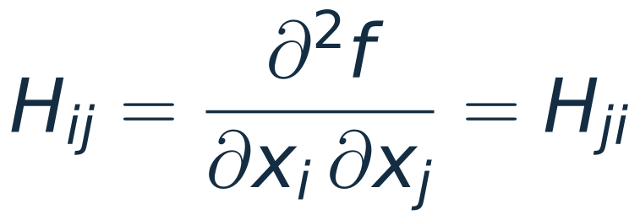
The gradient and the Hessian
For a smooth function f(x₁, …, xₙ):
one variable
first derivatives:
a vector
n variables
second derivatives:
an n × n matrix
At a critical point the linear term vanishes:
mixed derivatives are equal,
so H is symmetric
KEY IDEA
If H(x₀) is positive definite, the critical point x₀ is a local minimum. A question about f becomes a question about a matrix.
For n = 1 the Hessian is the single number f″(x₀), and positive definite means f″(x₀) > 0.
Notes:
~3 min. Section 3 of the notes. Both derivatives of the one-variable test have to be generalised: f' becomes a vector, f'' becomes a matrix.
Click 1: symmetry. For a smooth f the order of differentiation does not matter, so H is symmetric and everything from Lecture 7 applies: real eigenvalues, orthogonal eigenvectors.
Click 2: Taylor to second order, first in one variable and then in n.
Click 3: at a critical point the linear term is gone, and the sign of the change in f is the sign of dᵀHd.
Click 4: the key idea. This is why the definition of the first half of the lecture is the right one.

Slide 6
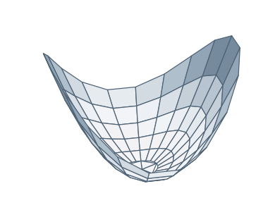
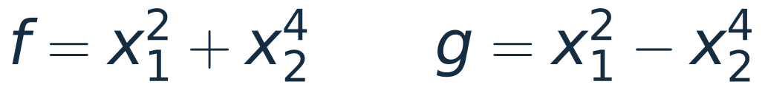
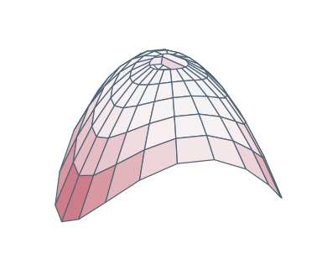

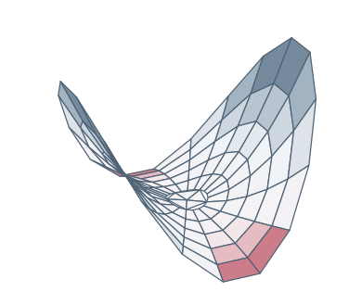
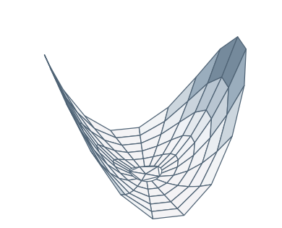
The second derivative test
At a critical point x₀, where the gradient is zero, look at the Hessian H(x₀):
positive definite
local minimum
WATCH OUT
all eigenvalues positive
negative definite
local maximum
all eigenvalues negative
f has a minimum at the origin. g does not: g(0, x₂) = −x₂⁴ is negative.
The test is sufficient, not necessary.
One variable: f″(x₀) = 0 decides nothing either. x⁴ has a minimum at 0, x³ does not.
indefinite
saddle
eigenvalues of both signs
semi-definite
no verdict
a zero eigenvalue, the others of one sign
Why eigenvalues: with y = Qᵀd (Q: orthonormal eigenvectors of H), dᵀHd = λ₁y₁² + … + λₙyₙ². Section 5 of the notes.
Notes:
~2 min. Theorem 3.1 of the notes is row 1. Rows 2 and 3 follow by the same argument.
Clicks 1 to 4: one row each. Click 5: the warning.
Row 4 is where the test stops: with a zero eigenvalue the quadratic term is flat in some direction and higher-order terms decide. The pair in the box has the same Hessian at the origin and opposite behaviour.
Sufficient, not necessary.
The rows describe definiteness by the signs of the eigenvalues. The notes prove that in Section 5; the caption gives the one-line reason.

Slide 7
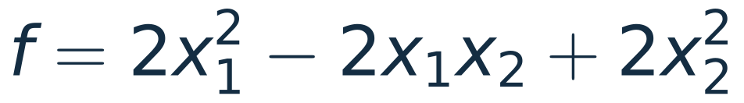
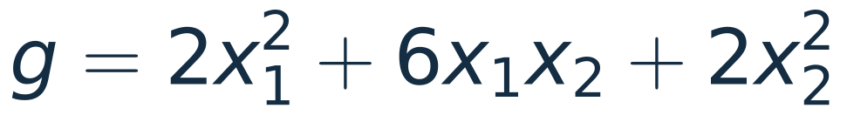
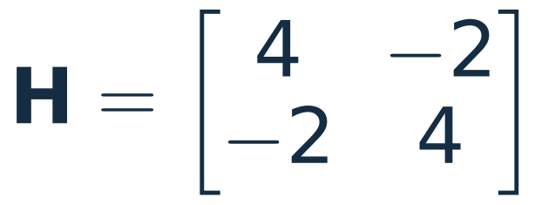
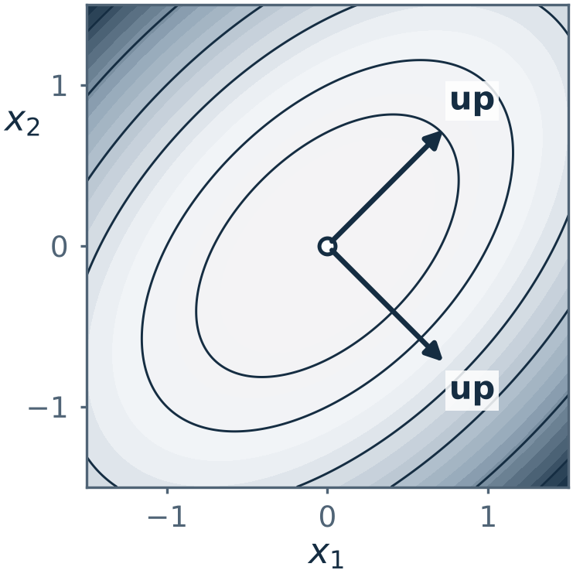
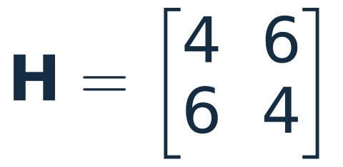
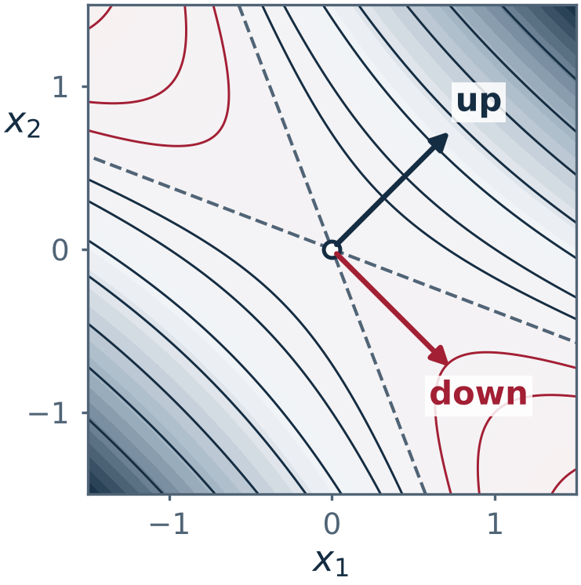
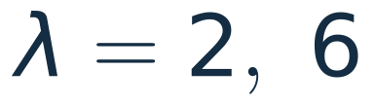
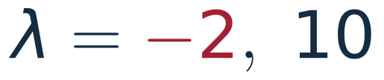
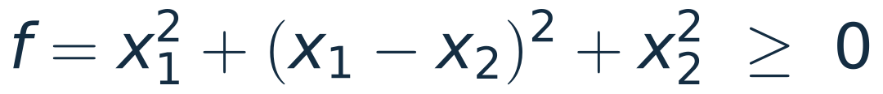
Example: a minimum and a saddle
Given two functions. Find the kind of critical point each one has at the origin.
positive definite
a minimum at the origin
indefinite
a saddle at the origin
KEY IDEA
A quadratic form xᵀMx has Hessian 2M at every point: the test is the definiteness of M.
Notes:
~3 min. Example 3.2 of the notes. Both functions are quadratic forms xᵀMx, so the gradient is 2Mx and the Hessian is 2M at every point. The only critical point is the origin.
Click 1: the two Hessians. They are twice the matrices (a) and (d) of slide 3.
Click 2: eigenvalues and verdicts. f is a sum of squares; g rises along (1, 1) and falls along (1, -1).
Click 3: contour plots. Closed ellipses for the bowl, hyperbolas for the saddle, with the two zero-level lines dashed.
Click 4: the key idea.

Slide 8
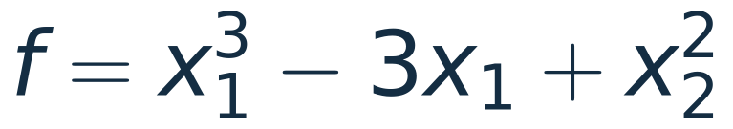
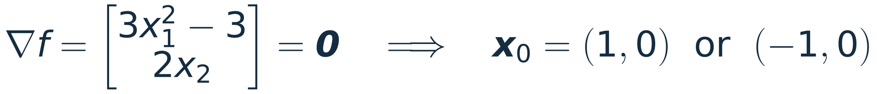
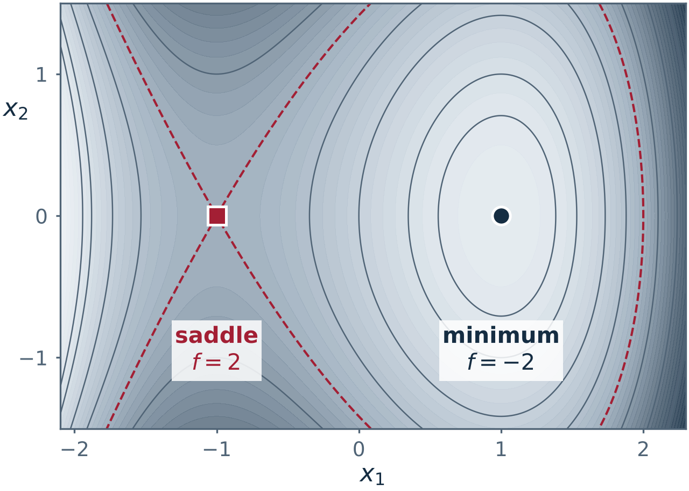

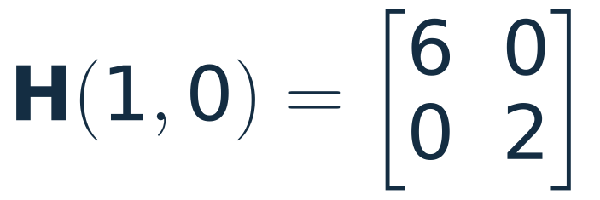
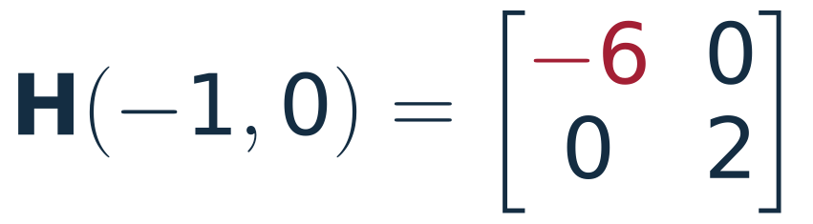
Example: the Hessian depends on the point
Given
Find its critical points, and classify each one.
it changes from point to point
positive definite
local minimum, f = −2
indefinite
saddle, f = 2
The red dashed curve is the level f = 2 through the saddle. Along x₁ the saddle is a maximum, along x₂ a minimum.
Notes:
~3 min. Example 3.4 of the notes. The function is not quadratic, so the Hessian changes from point to point and the test is applied at each critical point separately.
Click 1: the gradient and its two zeros.
Click 2: the Hessian as a function of x.
Click 3: at (1, 0), positive definite, a minimum with f = -2.
Click 4: at (-1, 0), indefinite, a saddle with f = 2. Along x1, f(-1 + h, 0) = 2 - 3h² + h³ is below 2; along x2 it is above.
Click 5: the picture.
This function comes back on slides 10 to 12.

Slide 9
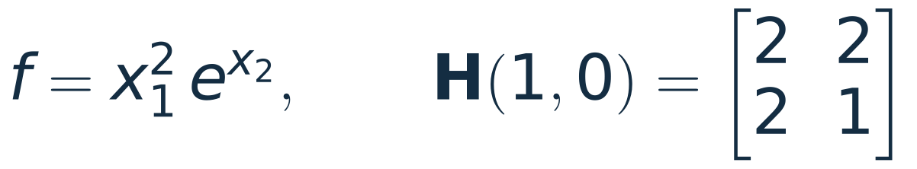
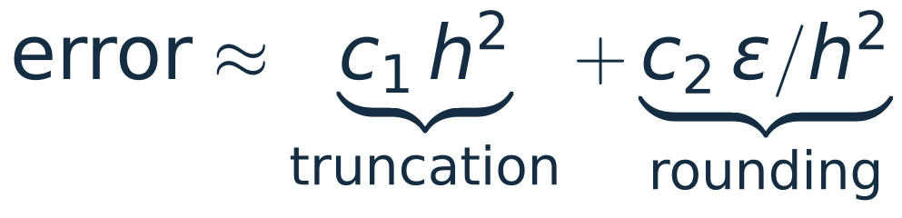
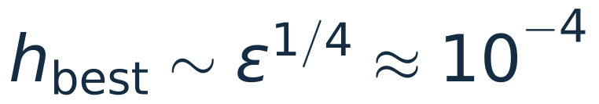
The Hessian by finite differences
When there are no formulas for the second derivatives, estimate them from values of f:
central differences, step h along
the unit vectors eᵢ and eⱼ
Test:
Large h: the formula is inaccurate. Small h: the subtraction loses digits (machine ε ≈ 2.2 × 10⁻¹⁶).
COST
2n(n + 1) evaluations of f as coded: 12 for n = 2, 180 for n = 9, 180 600 for n = 300.
With h = 1e-4 the largest error in any entry is 5 × 10⁻⁹.
Notes:
~3 min. When f is a simulation or an energy from a program, there are no formulas for the second derivatives. Estimate them from values of f.
The test function has the exact Hessian [[2, 2], [2, 1]] at (1, 0), so the error can be measured.
Click 1: the chart. The error falls like h² down to h = 1e-4 and then rises again.
Click 2: why. Truncation error falls with h, rounding error grows as 1/h². The two balance near the fourth root of machine epsilon.
Click 3: the cost. The code makes 4 evaluations for each entry on or above the diagonal: 2n(n+1) in all. That grows with the square of the number of variables.
Code: hessian_fd in L08_hessian.py.

Slide 10
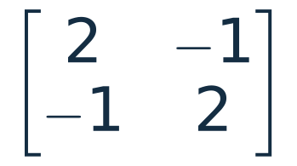
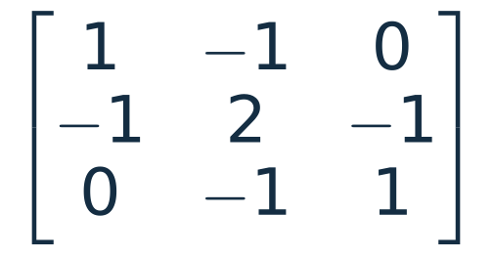
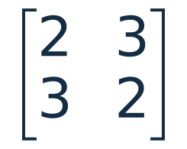
Definiteness on the computer: eigvalsh
A symmetric matrix has real eigenvalues (Lecture 7). Compute them and read the signs.
matrix
eigvalsh returns
verdict
1, 3
positive
definite
lam = np.linalg.eigvalsh(H)
tol = 1e-6 * abs(lam).max()
lam.min() > tol positive definite
lam.max() < -tol negative definite
both signs indefinite
otherwise semi-definite
3.9e-17, 1, 3
semi-definite
−1, 5
indefinite
H of slide 8 at (1, 0),
by finite differences
2.00, 6.00
minimum
WATCH OUT
A zero eigenvalue is often not computed as exactly 0: about 10⁻¹⁶ in size when the entries are exact, much more for a finite-difference Hessian (7 × 10⁻⁶ on slide 21). Use a tolerance.
H of slide 8 at (−1, 0),
by finite differences
−6.00, 2.00
saddle
eigvalsh is the eigenvalue routine for symmetric matrices: real eigenvalues, in ascending order.
Notes:
~2 min. The eigenvalue route, which is what the notes use: a symmetric matrix has real eigenvalues, so compute them and read the signs.
eigvalsh is the routine for symmetric matrices. It returns real numbers in ascending order, so the first entry is the smallest.
Click 1: matrices (a) and (d) of slide 3, and between them the free-free second difference matrix, which is semi-definite: its exact eigenvalues are 0, 1, 3.
Click 2: the finite-difference Hessians of slide 8's function at its two critical points.
Click 3: the warning. The computed zero is 3.9e-17 on this machine and could as well be negative. Never test an eigenvalue against exact zero. For a finite-difference Hessian the error in H sets the size of a computed zero: 7e-6 for the three atoms of slide 21.
eigvalsh assumes symmetry and reads only one triangle of the matrix. The tolerance in classify is relative: 1e-6 times the largest eigenvalue in size.
Code: classify in L08_hessian.py.

Slide 11

Newton's method: let the Hessian choose the step
Replace f near xₖ by its quadratic model, and step to the lowest point of the model:
one linear solve per step, with the Hessian as the matrix
Example. f = x₁³ − 3x₁ + x₂², from (2, 1) to the local minimum (1, 0)
step k | x₁ | distance to minimum
0 | 2 | 1.4
1 | 1.25 | 2.5e-1
2 | 1.025 | 2.5e-2
3 | 1.0003049 | 3.0e-4
4 | 1.00000005 | 4.6e-8
5 | 1.00000000 | 1.1e-15
KEY IDEA
Newton: the number of correct digits about doubles at each step, and the error is below 10⁻⁸ after 5 steps. Gradient descent with step 0.1 needs 83.
Notes:
~3 min. The Hessian is not only a test, it is also a tool for finding the minimum.
Replace f near the current point by its quadratic model. If H is positive definite the model is a bowl, and its lowest point solves H s = -grad f. One linear system per step.
Click 1: the iteration.
Click 2: the numbers for slide 8's function from (2, 1). x2 is 0 after one step, because f is exactly quadratic in x2.
Click 3: the error on a log scale, against gradient descent with a fixed step 0.1.
Click 4: the count. Newton is below 1e-7 after 4 steps and at rounding level after 5. Gradient descent with step 0.1 first gets below 1e-8 at step 83.
(1, 0) is a local minimum only: f goes to minus infinity as x1 does.
The price: Newton needs the Hessian and a linear solve at every step.
Code: newton and descent in L08_hessian.py.

Slide 12
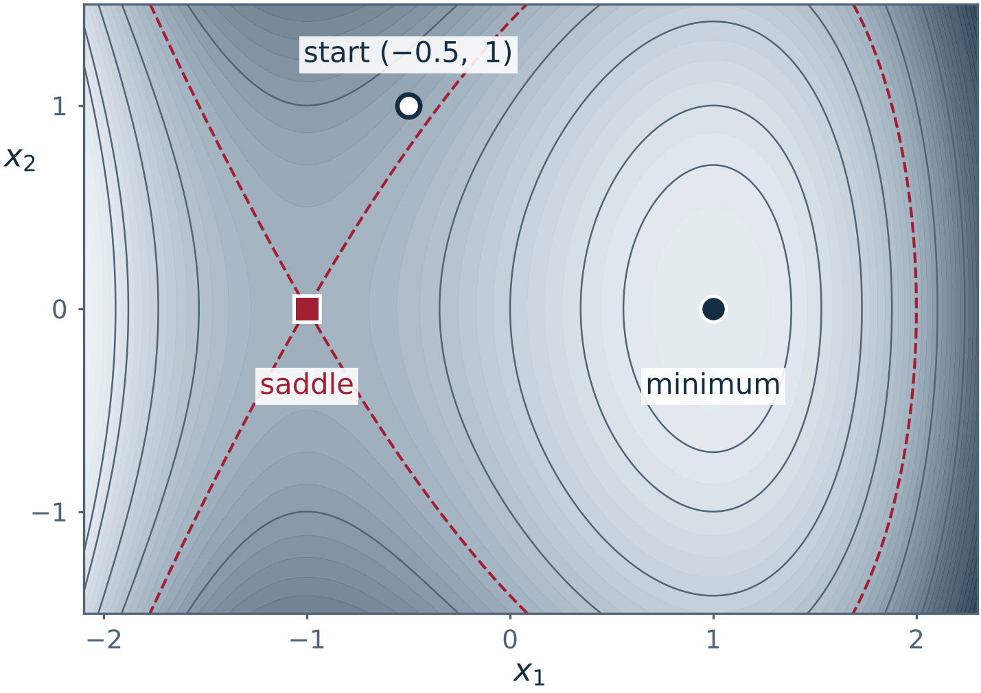
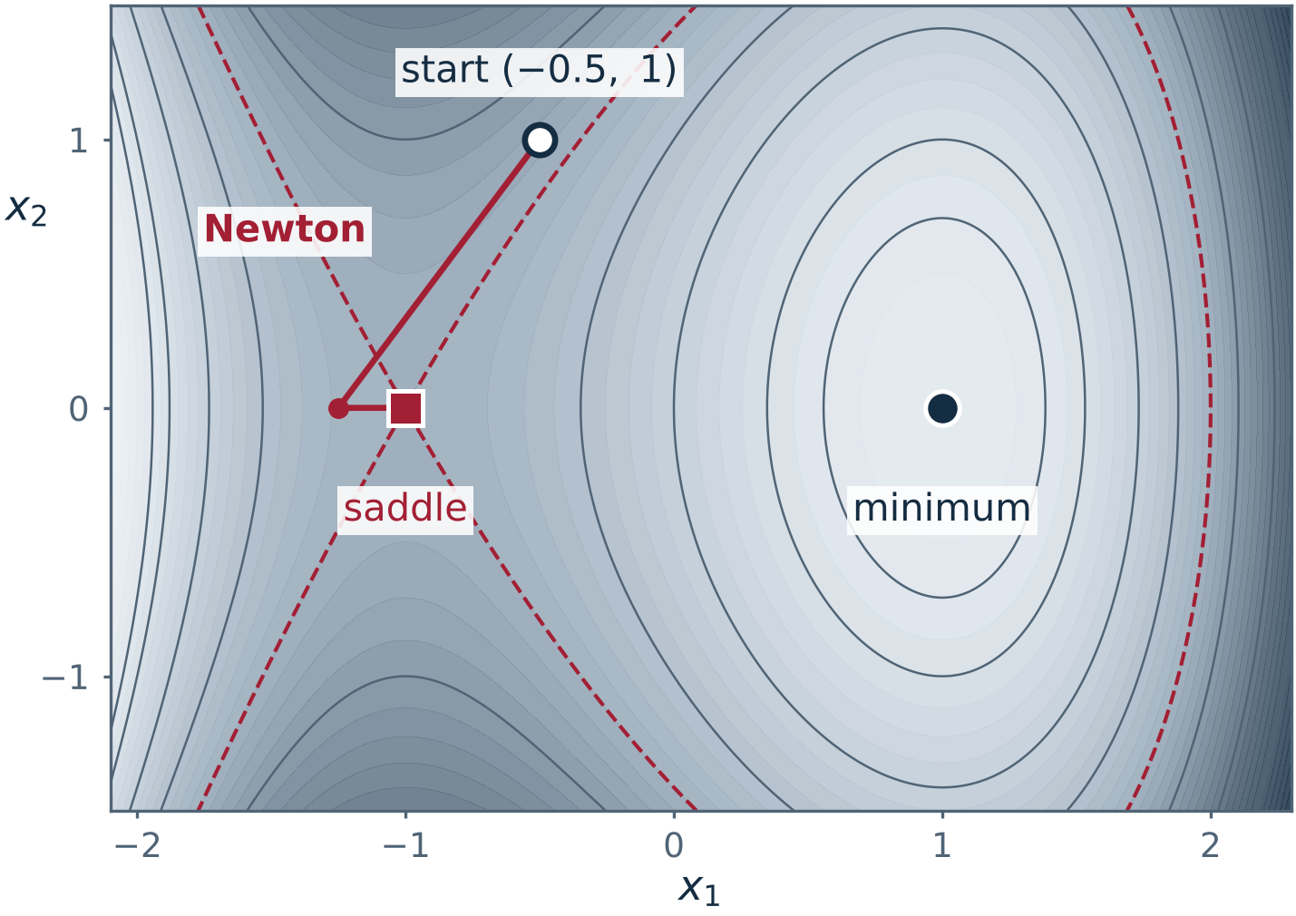
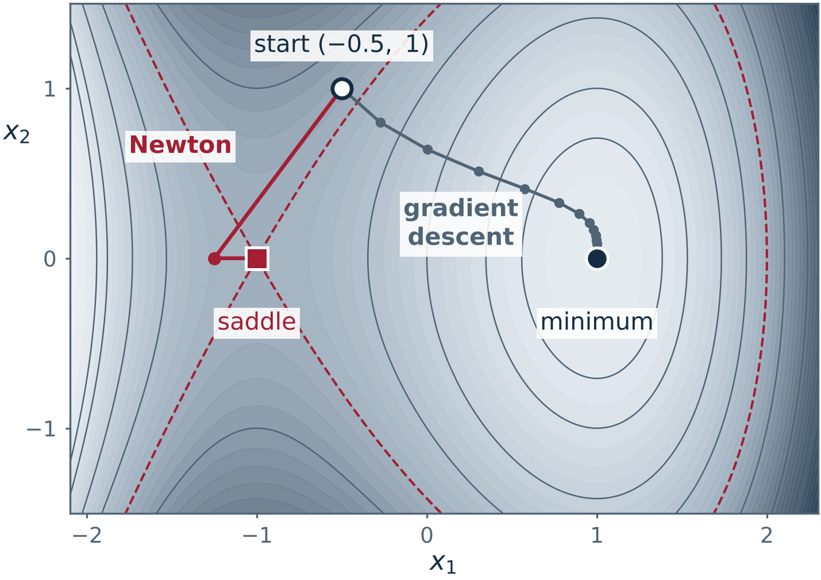
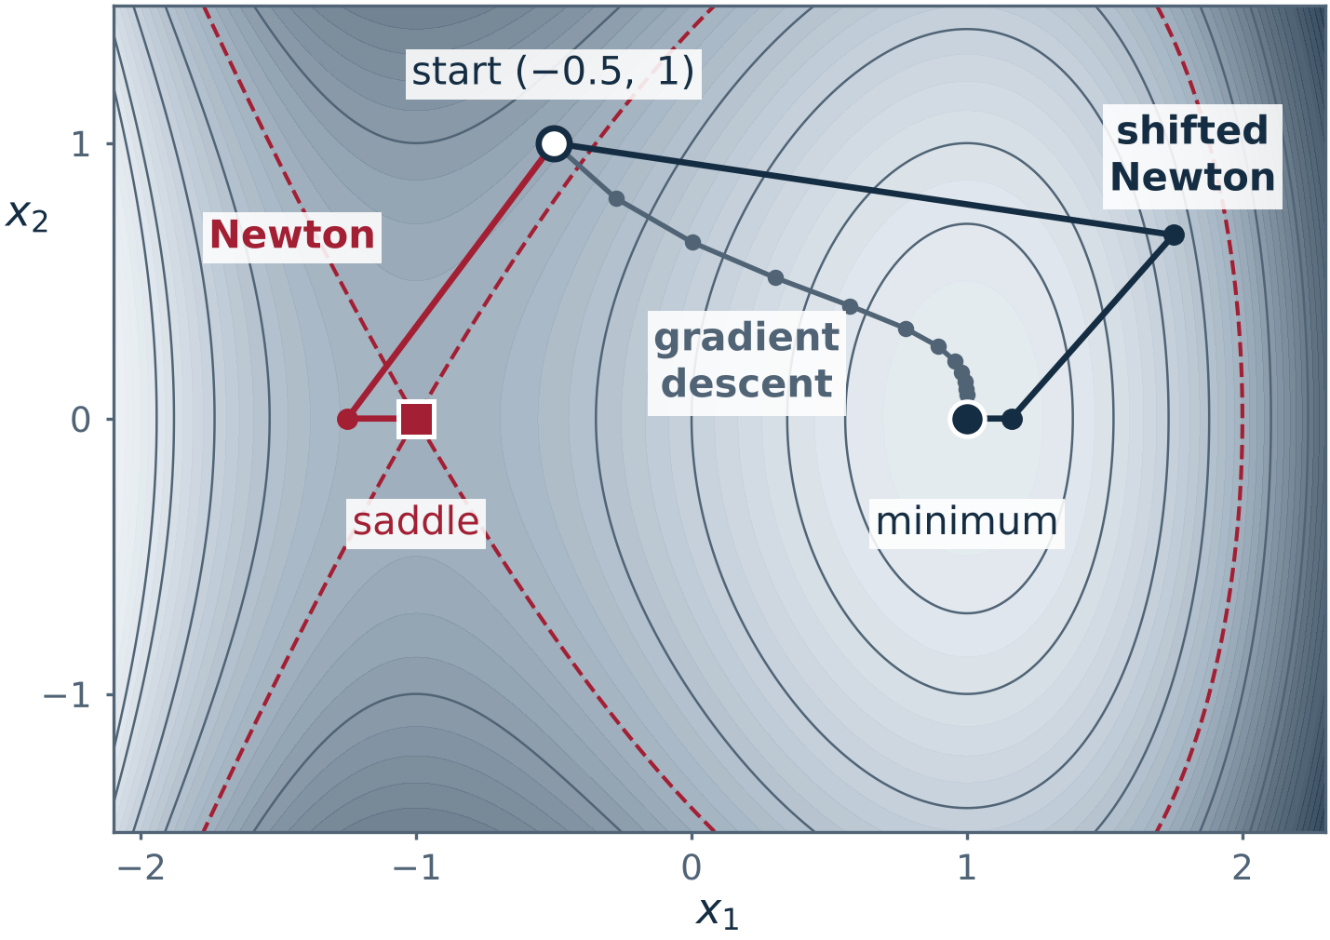
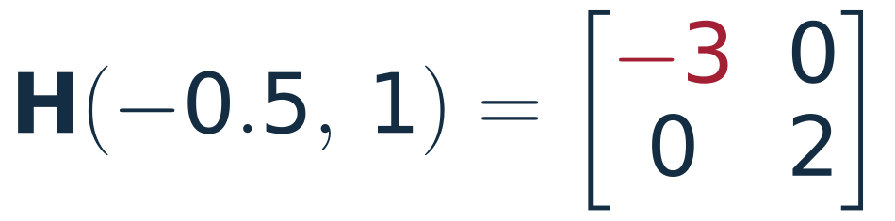
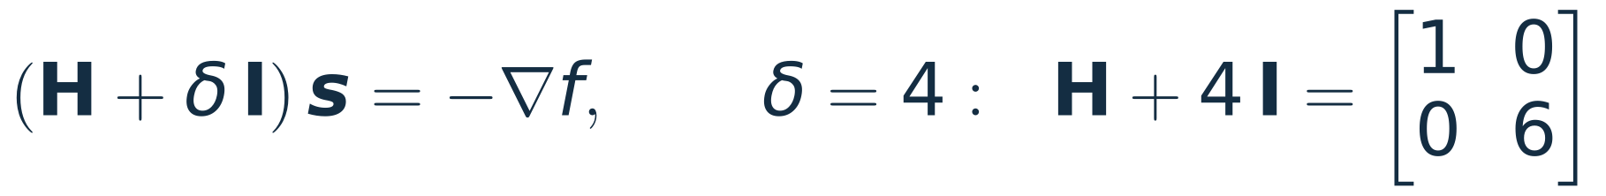
Newton needs a positive definite Hessian
The same f, started from (−0.5, 1):
indefinite
The quadratic model is now a saddle. Newton steps to the model's critical point and converges to the saddle (−1, 0) of f.
Gradient descent only goes downhill. It reaches the local minimum (1, 0), slowly.
Repair. Shift H until it is positive definite:
Only the first step needs a shift. Newton then reaches the local minimum: error below 10⁻⁸ after 5 steps.
Practical optimisers do a version of this: they modify H, or limit the step, whenever H is not positive definite.
Notes:
~3 min. The same function, a different start. At (-0.5, 1) the Hessian is diag(-3, 2): indefinite.
Click 1: the quadratic model is then a saddle, and solving H s = -grad f finds the model's saddle point. Newton goes left and converges, fast, to the saddle of f.
Click 2: gradient descent uses no Hessian. It goes downhill and arrives at the minimum, slowly.
Click 3: the repair. Add a multiple of the identity so that every eigenvalue is positive. Here the smallest eigenvalue is -3 and the shift is 4, which lifts it to 1. After that first step H is positive definite along the path and the shift is zero. The method reaches the local minimum, with error below 1e-8 after 5 steps.
This is why optimisation codes care about definiteness. Adding delta*I adds delta to every eigenvalue and leaves the eigenvectors alone.
Code: newton_shifted in L08_hessian.py.

Slide 13
Where the Hessian is used
The same three steps each time: an energy or a misfit, a critical point, the eigenvalues of H.
Physics
Engineering
Chemistry
Small oscillations
the frequencies are the square roots of the eigenvalues
Buckling
the load at which H stops being positive definite
Bond stiffness
a second derivative, measured by spectroscopy
Trapping a charge
no electrostatic field can do it
Fitting data
the bowl of the misfit, and the error bars
Reactions
minimum or transition state
Astigmatism
a lens as a 2 × 2 Hessian
Vibrations
a 9 × 9 Hessian for three atoms
The computed numbers on the next eight slides come from L08_applications.py.
Notes:
~1 min. Eight examples in three fields. Each of the next slides stands alone and takes 1.5 to 2 minutes. If time is short, keep 14 (oscillators, which is Example 3.5 of the notes), 17 (buckling) and 20 (transition states).
The pattern to point out on every one: a scalar function, a point where its gradient is zero, and the signs of the Hessian eigenvalues there.

Slide 14
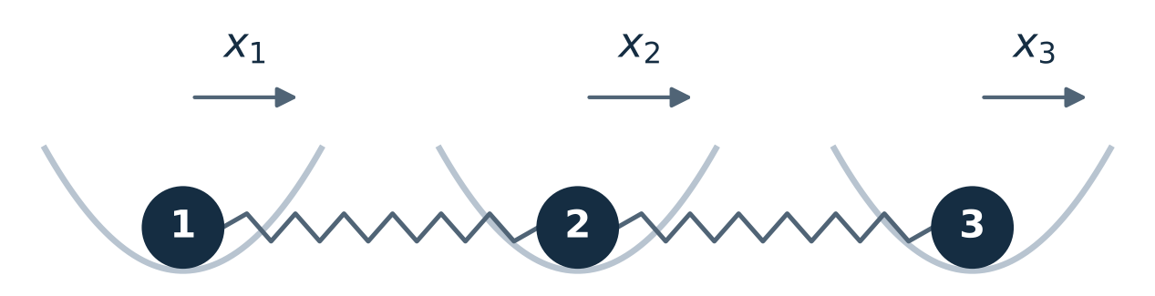
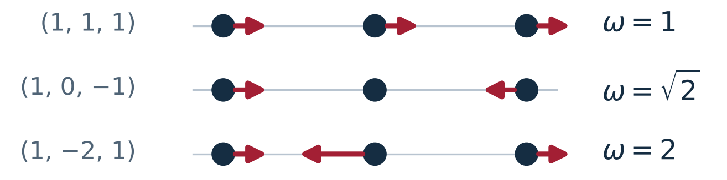
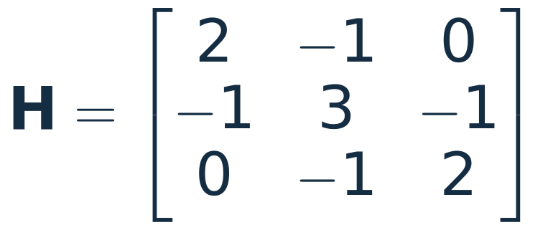



Physics: small oscillations
Given three unit masses, each tied to its rest position and to its neighbours by unit springs.
Find whether x = 0 is stable, and the frequencies of vibration.
eigenvectors of H: the shapes of the three modes
all positive: H is positive definite,
the equilibrium is stable
KEY IDEA
A negative eigenvalue would make ω imaginary: the motion grows instead of oscillating. Stable means positive definite.
quantum mechanics: every mode keeps the energy ½ħω in its lowest state
Example 3.5 of the notes. The eigenvectors are orthogonal because H is symmetric (Lecture 7).
Notes:
~2 min. Example 3.5 of the notes. V is a sum of five squares, so it is positive definite by inspection; the Hessian says the same.
Click 1: the Hessian and its eigenvalues 1, 2, 4. All positive, so the origin is a minimum of V: a stable equilibrium.
Click 2: with unit masses the equations of motion are x'' = -Hx, so each eigenvector oscillates at the frequency sqrt(lambda). The shapes: all together (the joining springs do nothing), ends opposed, middle against the ends.
Click 3: quantum mechanics. Each mode is an independent oscillator with lowest energy hbar*omega/2, so the lowest total energy is 2.21 hbar and not zero.
Click 4: what a negative eigenvalue would do.

Slide 15




Physics: no electrostatic trap for a charge
Given a charge in an electrostatic field. Find a point where it can rest stably.
In empty space φ obeys Laplace's equation, so its Hessian H has trace zero:
the (x, z) section of φ:
up along x, down along z
If one eigenvalue is positive, another is negative: a saddle, not a bowl. Earnshaw's theorem.
The way out. Make the saddle oscillate:
motion along one axis, in scaled time;
q ∝ field strength / frequency²
Bounded for q < 0.908: the Paul trap. Nobel Prize in Physics 1989 (Paul and Dehmelt, shared with Ramsey).
A fixed saddle pushes the charge out along one axis. A saddle that flips sign fast enough holds it, on average.
Notes:
~2 min. A stable resting point for a charge needs a minimum of its potential energy, so a positive definite Hessian. Laplace's equation says the trace of the Hessian of the potential is zero.
Click 1: the trace is the sum of the eigenvalues. If one is positive another is negative, so the point is a saddle. (If all three are zero the test is silent, but a solution of Laplace's equation has no local minimum in any case.) This is Earnshaw's theorem. It is about electrostatic fields alone: a Penning trap adds a static magnetic field.
Click 2: the standard example, with eigenvalues 2, 2, -4: confining in x and y, expelling along z.
Click 3: the way out is to make the field oscillate, so that the saddle flips sign. The equation is for one axis in scaled time; q grows with the field strength and falls with the square of its frequency. Chart: a static saddle expels the charge at once (red; u = 7.35 already at tau = 3), the oscillating one with q = 0.4 holds it (navy; |u| stays near 1.5 at most).
Click 4: the stability limit 0.908 is computed in the script from the one-period map. Paul and Dehmelt shared half of the 1989 Nobel Prize for the ion trap technique; Ramsey received the other half.
Trapped ions are now clocks and quantum computers. Optional slide.

Slide 16




Physics: astigmatism is a 2 × 2 Hessian
A thin lens adds an optical path that is quadratic in the position x on the lens:
cross-section of the beam behind the lens
F is the Hessian of −W: the matrix
of lens powers, in dioptres (D)
Given
Find where a parallel beam is focused.
KEY IDEA
Positive definite F: converging in every meridian. Indefinite F: converging in one meridian, diverging in the other (mixed astigmatism).
both positive: F is positive definite, and the lens converges in every direction
line foci at z = 1/4 m and 1/2 m,
round spot at z = 1/3 m
On a prescription this lens reads sphere +2.00, cylinder +2.00, axis 135°: the eigenvalues and eigenvectors of F in another notation.
A ray that crosses the lens at x leaves with slope −Fx. After a distance z it is at (I − zF)x.
Notes:
~2 min. A thin lens multiplies the field by exp(ikW) with W quadratic in the position on the lens. For a perfect lens of focal length f, W = -|x|²/(2f). In general the quadratic form has a symmetric matrix F: the matrix of powers, in dioptres (1/m).
Click 1: the example. F is the matrix from Lectures 6 and 7.
Click 2: eigenvalues 4 and 2 dioptres, along (1, 1) and (1, -1): the principal meridians of the lens, at right angles because F is symmetric.
Click 3: a ray entering parallel at x leaves with slope -Fx. At distance z the beam is the image of the aperture under I - zF. That matrix is singular at z = 1/4 and z = 1/2: two line foci, each along the other meridian. At z = 1/3 it is -(1/3) times a reflection: a round spot.
Click 4: definiteness. Click 5: the optometrist writes the same matrix as sphere, cylinder and axis. In minus-cylinder form, which is the more usual one, the same lens is +4.00 / -2.00 x 45.
Optional slide.

Slide 17





Engineering: the buckling of a column
Given two rigid links of length L, a rotational spring k at each joint, a vertical load P. Find the load at which the straight column stops being stable.
springs, minus the work of the load
Hessian at the straight position
critical load 0.382 k/L
PL/k = 0.2
PL/k = 0.6
Below the critical load: one bowl. The eigenvalues of H/k are 0.18 and 2.42.
Above it: −0.22 and 2.02. The straight column is a saddle, and two buckled minima appear (red: energy below the straight state).
Buckling is H losing positive definiteness.
Notes:
~2 min. The smallest model of a column: two rigid links, a rotational spring at the base and at the joint, a dead load on top. theta1 and theta2 are the angles of the links from the vertical.
The energy is spring energy minus the work of the load, which is P times the distance the top comes down.
Click 1: the Hessian at the straight position. The first matrix is the fixed-free second difference matrix; the load subtracts PL times the identity.
Click 2: the smallest eigenvalue of the first matrix is (3 - sqrt 5)/2 = 0.382, so H is positive definite exactly while PL/k < 0.382. That is the critical load.
Click 3: the energy below and above the critical load. Below: one bowl. Above: the straight column is a saddle and two buckled minima appear on either side. At PL/k = 0.6 they are far out, at 65 and 99 degrees, because this load is 57% above critical.
Real columns: the same calculation with a stiffness matrix K and a geometric stiffness matrix, and the critical load is a generalised eigenvalue.

Slide 18





Engineering: fitting data, and how sure the fit is
Given five measurements y at t = 0, …, 4. Find the best line c₀ + c₁t, and its uncertainty.
the misfit; row i of A
is (1, tᵢ)
both positive: the misfit is a bowl with one lowest point
data, then the best line
contours of the misfit S
Red arrows: the eigenvectors of H. The bowl is about 22 times more curved along the short one than along the long one.
s² estimates the noise from the residuals. A shallow direction of the bowl is a poorly determined combination of c₀ and c₁.
RESULT
Least squares returns later in the course. The point today: the Hessian of the misfit carries the error bars.
Notes:
~2 min. A preview of least squares, which comes back later in the course. The misfit is a function of the two parameters, and it is a quadratic form plus lower-order terms.
Click 1: its Hessian is 2AᵀA, the same at every point. Both eigenvalues are positive, so the misfit is a bowl with one lowest point, at c = (1.04, 1.99).
Click 2: the inverse of the Hessian gives the uncertainty. The bowl is about 22 times more curved along one eigenvector than along the other (67.02 / 2.98); the shallow direction is the combination of intercept and slope that the data determine least well.
Click 3: the error bars, and the fitted line on the left plot. s² = 0.107/3 is the residual sum of squares over (5 points - 2 parameters). numpy.polyfit(t, y, 1, cov=True) returns the same numbers.
Optional slide.

Slide 19

Chemistry: bond stiffness is a second derivative
Given the vibration wavenumber of a two-atom molecule. Find the stiffness of its bond.
μ: reduced mass, c: speed of light, ν̃: harmonic wavenumber
Near its minimum the energy of a bond is a parabola. The curvature k is the 1 × 1 Hessian of V.
Here the single bonds are near 500 N/m and the triple bonds near 2000 N/m.
k = V″(rₑ) > 0 is the one-variable second derivative test: the bond length rₑ is a minimum of V.
Notes:
~2 min. The simplest Hessian in chemistry is 1 × 1. The energy of a diatomic molecule as a function of bond length has a minimum at r_e, and near it the curve is a parabola with curvature k.
The molecule vibrates at omega = sqrt(k/mu). Spectroscopy gives the wavenumber, so k follows from it. The values used are the harmonic wavenumbers, which are the observed lines corrected for anharmonicity.
Click 1: four molecules. H2 and HCl are single bonds; CO and N2 are triple bonds.
Click 2: the pattern. Stiffness tracks bond order.
Wavenumbers used (harmonic values): H2 4401, HCl 2991, CO 2170, N2 2359 per cm. HCl by hand: mu = 0.9796 u, k = mu (2 pi c nu)² = 516 N/m.
For scale: a car suspension spring is of order 20 000 N/m. A single bond is a few percent of that.

Slide 20





Chemistry: stable molecule or transition state?
Given an energy surface with two valleys and a pass. Find what each critical point is.
positive definite
a minimum: a stable molecule
one negative eigenvalue
a saddle: a transition state
KEY IDEA
Chemists count the negative eigenvalues of the Hessian at each stationary geometry.
None: a stable structure.
Exactly one: a transition state.
Ammonia: the pyramid is a minimum, with a mirror-image twin. The flat molecule between them is the transition state, 24.2 kJ/mol higher.
Lecture 7 met the same double well: the ammonia molecule tunnelling between its two minima.
Notes:
~2 min. A reaction is a path on an energy surface from one minimum to another, over the lowest pass between them. The pass is a critical point too. What kind?
The three critical points are (1, 0), (-1, 0) and (0, 0); the picture shows them unlabelled until click 2.
Click 1: at (1, 0) and (-1, 0) the Hessian is diag(8, 2), positive definite.
Click 2: at the origin it is diag(-4, 2). One negative eigenvalue: a maximum along the reaction direction, a minimum across it. The labels appear on the picture.
Click 3: this count is how quantum chemistry programs label every stationary geometry they find.
Click 4: ammonia. The nitrogen sits above or below the plane of the three hydrogens: two mirror-image minima. The planar molecule is the transition state, 24.2 kJ/mol higher. Lecture 7 used this double well for the tunnelling splitting at 23.87 GHz.
The eigenvector of the negative eigenvalue points along the reaction path.

Slide 21


Chemistry: three atoms, a 9 × 9 Hessian
Given three atoms at rest in an equilateral triangle, with the energy below for each pair.
rᵢⱼ: distance between atoms i and j.
ε, σ: depth and size of the pair energy.
Find the eigenvalues of its 9 × 9 Hessian.
Six zeros. Three translations and three rotations cost no energy, so H is only positive semi-definite. On the three vibrations it is positive definite.
Three positive. The vibrations. The largest is the breathing mode.
Water also has three atoms and three vibrations, observed at 1595, 3657 and 3756 cm⁻¹.
Finding the geometry is Newton's method with an approximate Hessian (quasi-Newton).
The Hessian comes from hessian_fd: 180 evaluations of the energy.
Notes:
~2 min. Three atoms, nine coordinates. The energy is the sum of three Lennard-Jones pair energies; the minimum is an equilateral triangle with side 2^(1/6) sigma and energy -3 epsilon.
Click 1: the eigenvalues of the 9 × 9 finite-difference Hessian. Six are zero, three are positive.
Click 2: the six zeros are the motions that change no distance: three translations, three rotations. H is positive semi-definite, and the triangle is a minimum once those are set aside. On the computer the six zeros come out as large as 7e-6, and classify, with its relative tolerance, returns semi-definite. The three positive ones are the vibrations: a degenerate pair at 85.72 and the breathing mode at 171.44, in units of epsilon/sigma². These are 1.5 k and 3 k with k = 57.15 the stiffness of one pair.
Click 3: the same count for water, with the observed wavenumbers. And finding the geometry in the first place is Newton's method from slide 11, usually with an approximate Hessian that is updated from gradients (quasi-Newton).
Units: epsilon and sigma are the depth and the length scale of the pair energy. Optional slide.

Slide 22
The same question in every field
Field | Function | H positive definite means | Its eigenvalues give
Mechanics | potential energy V(x) | stable equilibrium | squared frequencies ω²
Electrostatics | potential φ in empty space | never: the trace is zero | which directions expel
Optics | minus the optical path, −W | focusing in every meridian | principal powers
Structures | energy of the loaded column | no buckling | margin to buckling
Data fitting | misfit S(c) | a single best fit | error bars, through H⁻¹
Chemistry | energy of a molecule | stable structure, rigid motions aside | stiffness and vibrations
KEY IDEA
Find the critical point. Form the Hessian. Read the signs of its eigenvalues.
Notes:
~1 min. One table for the whole second half. Read one or two rows, not all six.
The last column is the reason to compute the eigenvalues and not only their signs: they are frequencies, powers, margins, uncertainties.
Next: the notes go on to the symmetric part of a matrix and to the pivot and eigenvalue tests.

Slide 23


Questions for the room
1
At a critical point the Hessian is the matrix below. Minimum, maximum or saddle?
2
What kind of point is the origin for the function below?
Saddle: one positive and one negative eigenvalue.
Saddle: H has eigenvalues −1 and 5, and f(1, −1) = −1.
3
A potential in empty space has Hessian eigenvalues 3 and 1 in two directions. What is the third?
4
A molecule has four atoms, not all on one line. How large is its Hessian, and how many eigenvalues are zero?
−4: the trace is zero. No trap.
12 × 12, with 6 zeros. The other 6 are vibrations.
Notes:
~3 min, or as an exit ticket. Each click shows one answer.
1. Saddle. The matrix is diagonal, so the eigenvalues are 2 and -1.
2. Saddle. H = [[2, 3], [3, 2]] has eigenvalues -1 and 5. Check: f(1, -1) = 1 - 3 + 1 = -1 < 0, f(1, 1) = 5 > 0.
3. -4. The trace of the Hessian of a potential in empty space is zero, so 3 + 1 + x = 0.
4. 12 × 12, with 6 zero eigenvalues. The other 3N - 6 = 6 are vibrations.

Slide 24
Appendix A: L08_hessian.py, the Hessian test
"""18.085 Lecture 8: the Hessian on the computer (slides 9 to 12)."""
import numpy as np
def hessian_fd(f, x, h=1e-4):
"""Hessian of f at x by central differences (error ~ h^2)."""
x = np.asarray(x, float); n = x.size
H = np.zeros((n, n)); I = np.eye(n)
for i in range(n):
for j in range(i, n):
ei, ej = h * I[i], h * I[j] # steps along x_i and x_j
H[i, j] = (f(x + ei + ej) - f(x + ei - ej)
- f(x - ei + ej) + f(x - ei - ej)) / (4 * h * h)
H[j, i] = H[i, j] # the Hessian is symmetric
return H
def classify(H, rtol=1e-6):
"""Read the kind of critical point off the eigenvalues of H."""
lam = np.linalg.eigvalsh(H) # real, ascending; H must be symmetric
tol = rtol * np.abs(lam).max() # a computed zero is zero only up to the error in H
if lam.min() > tol: return "local minimum (positive definite)"
if lam.max() < -tol: return "local maximum (negative definite)"
if lam.min() < -tol and lam.max() > tol: return "saddle (indefinite)"
return "no verdict (semi-definite)"
Notes:
Slides 9 and 10. hessian_fd makes 4 evaluations of f for each entry on or above the diagonal. classify reads the eigenvalues from eigvalsh, with a tolerance.

Slide 25
Appendix B: L08_hessian.py, Newton's method
f = lambda x: x[0]**3 - 3*x[0] + x[1]**2 # Example 3.4 of the notes
grad = lambda x: np.array([3*x[0]**2 - 3, 2*x[1]])
hess = lambda x: np.array([[6*x[0], 0.0], [0.0, 2.0]])
def newton(x, steps=5):
"""Newton's method: solve H s = -grad, then step."""
path = [np.array(x, float)]
for _ in range(steps):
s = np.linalg.solve(hess(path[-1]), -grad(path[-1]))
path.append(path[-1] + s)
return np.array(path)
def newton_shifted(x, steps=8, floor=1.0):
"""Newton with H replaced by H + shift*I whenever H is not safely positive definite."""
path = [np.array(x, float)]
for _ in range(steps):
H = hess(path[-1])
shift = max(0.0, floor - np.linalg.eigvalsh(H)[0]) # lift the smallest eigenvalue to 'floor'
s = np.linalg.solve(H + shift * np.eye(len(H)), -grad(path[-1]))
path.append(path[-1] + s)
return np.array(path)
def descent(x, steps=200, alpha=0.1):
"""Gradient descent with a fixed step: no Hessian."""
path = [np.array(x, float)]
for _ in range(steps):
path.append(path[-1] - alpha * grad(path[-1]))
return np.array(path)
Notes:
Slides 11 and 12. newton solves H s = -grad f at every step. newton_shifted first lifts the smallest eigenvalue of H to at least 1. descent uses the gradient only.

Slide 26
Appendix C: what the two scripts print
finite-difference Hessian, largest error in any entry
h = 1e-1: 3.3e-03
h = 1e-2: 3.3e-05
h = 1e-3: 3.3e-07
h = 1e-4: 5.0e-09
h = 1e-5: 1.3e-06
h = 1e-6: 7.2e-05
h = 1e-7: 9.5e-03
h = 1e-8: 3.3e-01
[1.0, 0.0] local minimum (positive definite)
[-1.0, 0.0] saddle (indefinite)
Newton from (2, 1): distance to the local minimum (1, 0)
k = 0: x = (2.0000000000, 1.0) error 1.4e+00
k = 1: x = (1.2500000000, 0.0) error 2.5e-01
k = 2: x = (1.0250000000, 0.0) error 2.5e-02
k = 3: x = (1.0003048780, 0.0) error 3.0e-04
k = 4: x = (1.0000000465, 0.0) error 4.6e-08
k = 5: x = (1.0000000000, 0.0) error 1.1e-15
first k with error < 1e-8: Newton 5 gradient descent, step 0.1:
83
from (-0.5, 1): Newton ends at [-1. 0.] descent ends at [1. 0.]
shifted Newton ends at [1. 0.] first k with error < 1e-8: 5
eigvalsh of the free-free matrix: [3.92505363e-17 1.00000000e+00
3.00000000e+00] -> no verdict (semi-definite)
oscillators: H = [[2, -1, 0], [-1, 3, -1], [0, -1, 2]] eigenvalues
[1. 2. 4.]
frequencies [1. 1.4142 2. ] zero-point energy 2.2071 hbar
lens: powers [2. 4.] D, line foci [0.5 0.25] m, circle 0.3333 m
+2.00 / +2.00 x 135 gives F: True +4.00 / -2.00 x 45 gives F:
True
Paul trap: bounded for q below 0.908 ; q = 0.4: largest |u| = 1.54 ;
static saddle at tau = 3: 7.35
column: critical load 0.382 k/L
PL/k = 0.2: eigenvalues [0.18 2.42] local minimum (positive
definite)
PL/k = 0.6: eigenvalues [-0.22 2.02] saddle (indefinite)
buckled state at PL/k = 0.6 (degrees): [65.1 99.1] local minimum
(positive definite)
fit: intercept 1.04 +- 0.15, slope 1.99 +- 0.06
eigenvalues of the Hessian 2 A^T A: [ 2.98 67.02] ratio 22
H2 4401.21 cm^-1 -> k = 575 N/m
HCl 2990.95 cm^-1 -> k = 516 N/m
CO 2169.81 cm^-1 -> k = 1902 N/m
N2 2358.57 cm^-1 -> k = 2295 N/m
surface at [1, 0] : eigenvalues [2. 8.] local minimum (positive
definite)
surface at [-1, 0] : eigenvalues [2. 8.] local minimum (positive
definite)
surface at [0, 0] : eigenvalues [-4. 2.] saddle (indefinite)
three atoms: Hessian eigenvalues [ 0. 0. 0. 0. 0.
0. 85.72 85.72 171.44] no verdict (semi-definite)
largest computed 'zero': 6.8e-06 pair stiffness 57.15 1.5 k and
3 k: 85.72 171.44
Notes:
Output of python3 L08_hessian.py (left) and python3 L08_applications.py (right, long lines wrapped). The computed numbers of slides 11 to 21 appear here, and so does the error table of slide 9.

Slide 27
Appendix D: L08_applications.py, modes and lens
"""18.085 Lecture 8: where the Hessian is used (slides 14 to 21)."""
import numpy as np
from L08_hessian import hessian_fd, classify
# --- physics: three coupled oscillators (Example 3.5 of the notes) -------------------
V = lambda x: 0.5 * (x[0]**2 + x[1]**2 + x[2]**2 + (x[0] - x[1])**2 + (x[1] - x[2])**2)
H = hessian_fd(V, np.zeros(3)) # [[2,-1,0],[-1,3,-1],[0,-1,2]]
lam, Q = np.linalg.eigh(H) # eigenvalues 1, 2, 4
omega = np.sqrt(lam) # frequencies 1, sqrt(2), 2
E0 = 0.5 * omega.sum() # zero-point energy in units of hbar
# --- optics: an astigmatic lens, power matrix in dioptres -----------------------------
F = np.array([[3.0, 1.0], [1.0, 3.0]])
powers, axes = np.linalg.eigh(F) # 2 D along (1,-1), 4 D along (1,1)
focal_lines = 1.0 / powers # 0.50 m and 0.25 m
z_circle = 2.0 / powers.sum() # circle of least confusion, 1/3 m
def prescription(S, C, axis_deg):
"""Power matrix of a lens written as sphere S, cylinder C, axis in degrees."""
a = np.deg2rad(axis_deg); n = np.array([-np.sin(a), np.cos(a)]) # unit vector across the axis
return S * np.eye(2) + C * np.outer(n, n)
Notes:
Slides 14 and 16. The oscillator Hessian is computed by finite differences from V, not typed in. The eigenvalues of F are the principal powers of the lens; prescription builds the power matrix from sphere, cylinder and axis.

Slide 28
Appendix E: L08_applications.py, the Paul trap
# --- physics: a charge in an oscillating saddle (Paul trap) --------------------------
def rk4(rhs, y, t0, t1, n):
"""Classical Runge-Kutta from t0 to t1 in n steps; returns every y on the way."""
out = [np.array(y, float)]; dt = (t1 - t0) / n; t = t0
for _ in range(n):
y = out[-1]
k1 = rhs(t, y); k2 = rhs(t + dt/2, y + dt/2*k1)
k3 = rhs(t + dt/2, y + dt/2*k2); k4 = rhs(t + dt, y + dt*k3)
out.append(y + dt/6 * (k1 + 2*k2 + 2*k3 + k4)); t += dt
return np.array(out)
def trap_path(q, static=False, T=60.0, n=6000):
"""u(tau) for u'' = 2 q cos(2 tau) u from u = 1, u' = 0. static=True freezes the saddle (cos -> 1)."""
rhs = lambda t, y: np.array([y[1], 2 * q * (1.0 if static else np.cos(2 * t)) * y[0]])
return rk4(rhs, [1.0, 0.0], 0.0, T, n)[:, 0]
def mathieu_trace(q, n=1000):
"""Trace of the one-period map of the trap equation. |trace| < 2 means bounded motion."""
rhs = lambda t, y: np.array([y[1], 2 * q * np.cos(2 * t) * y[0]])
return sum(rk4(rhs, np.eye(2)[c], 0.0, np.pi, n)[-1, c] for c in range(2))
def q_limit():
lo, hi = 0.5, 1.2 # bisection on |trace| = 2
for _ in range(40):
mid = 0.5 * (lo + hi)
lo, hi = (mid, hi) if abs(mathieu_trace(mid)) < 2 else (lo, mid)
return 0.5 * (lo + hi)
Notes:
Slide 15. rk4 is the classical Runge-Kutta method. trap_path gives the curves of the chart. mathieu_trace integrates one period for both unit initial conditions; |trace| < 2 means bounded motion, and q_limit finds where that stops.

Slide 29
Appendix F: L08_applications.py, engineering
# --- engineering: a two-link column under load P (k = L = 1) -------------------------
T2 = np.array([[2.0, -1.0], [-1.0, 1.0]]) # fixed-free second difference matrix
P_cr = np.linalg.eigvalsh(T2).min() # Hessian k*T2 - P*L*I loses definiteness here
Pi = lambda th, p: 0.5*th[0]**2 + 0.5*(th[1]-th[0])**2 - p*(2 - np.cos(th[0]) - np.cos(th[1]))
def buckled(p, th=(0.8, 1.3)):
"""A buckled equilibrium for p = PL/k above the critical load, by Newton's method."""
th = np.array(th); g = lambda t: np.array([t[0] + (t[0]-t[1]) - p*np.sin(t[0]), (t[1]-t[0]) - p*np.sin(t[1])])
for _ in range(30):
th = th - np.linalg.solve(hessian_fd(lambda t: Pi(t, p), th), g(th))
return th
# --- engineering: fitting a line, error bars from the Hessian ------------------------
t = np.arange(5.0); y = np.array([1.1, 2.9, 5.2, 6.8, 9.1])
A = np.column_stack([np.ones(5), t]) # misfit S = |y - A c|^2, Hessian 2 A^T A
c = np.linalg.solve(A.T @ A, A.T @ y) # best intercept and slope
s2 = np.sum((y - A @ c)**2) / (5 - 2) # noise variance from the residuals
cov = s2 * np.linalg.inv(A.T @ A) # covariance = 2 s2 * (Hessian)^-1
Notes:
Slides 17 and 18. The column Hessian is T2 - (PL/k) I. buckled finds a buckled equilibrium by Newton's method with the finite-difference Hessian. The fit uses the normal equations.

Slide 30
Appendix G: L08_applications.py, chemistry
# --- chemistry: bond stiffness k = V''(r_e) from the vibration wavenumber ------------
u, c_cm = 1.66053907e-27, 2.99792458e10 # atomic mass unit (kg), speed of light (cm/s)
bonds = {"H2": (4401.21, 1.00783, 1.00783), "HCl": (2990.95, 1.00783, 34.96885),
"CO": (2169.81, 12.0, 15.99491), "N2": (2358.57, 14.00307, 14.00307)}
def stiffness(nu, m1, m2):
mu = m1 * m2 / (m1 + m2) * u # reduced mass
return mu * (2 * np.pi * c_cm * nu)**2 # k = mu * omega^2, in N/m
# --- chemistry: a model energy surface with two wells --------------------------------
surface = lambda x: (x[0]**2 - 1)**2 + x[1]**2
# --- chemistry: three atoms, nine coordinates (Lennard-Jones, eps = sigma = m = 1) ---
def lj(X):
P = X.reshape(3, 3); e = 0.0
for i in range(3):
for j in range(i + 1, 3):
r = np.linalg.norm(P[i] - P[j]); e += 4 * (r**-12 - r**-6)
return e
r0 = 2**(1/6) # bond length at the minimum
k_pair = 36 * 2**(2/3) # stiffness of one pair there, 57.15
tri = np.array([[0, 0, 0], [r0, 0, 0], [r0/2, r0*np.sqrt(3)/2, 0]]).ravel()
Notes:
Slides 19 to 21. stiffness converts a wavenumber in 1/cm to a force constant in N/m. surface is the double well. lj is the energy of three Lennard-Jones atoms and tri is the equilateral triangle.

