Slide 1




The heat equation
in practice
Lecture 9 · continuity · Fourier's law · one and two dimensions · coolers
Wednesday 7 October 2026
Where it shows up today
Processors
Coolers
Kitchens
Lasers and cables
Notes:
Companion deck to the Lecture 9 notes (L09_v2). It adds numbers, devices and nine short simulations to Sections 1 to 6. About 50 minutes in full, and about 43 without slides 5, 14, 19, 24 and 25, which are marked in their notes.
Videos: each one starts on the next click and loops until you leave the slide. Clicking on the picture pauses and resumes it. The still shown before the first click is a frame of the video.

Slide 2
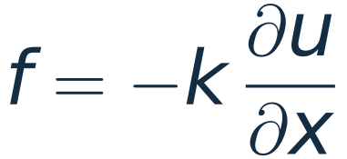
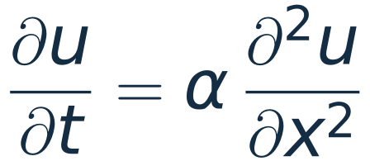
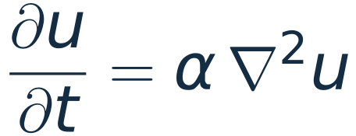

Today: two laws, one equation, many machines
1
2
3
4
Two laws
One equation
Two dimensions
Machines
Continuity counts the heat. Fourier's law says how fast it flows.
One number, the diffusivity. Time grows as length squared.
Four neighbours instead of two, and one sparse factorisation.
Processor and graphics coolers. Then an egg, a laser and a cable.
The question behind every slide: where does the heat go, and how long does it take?
These slides add numbers, devices and simulations to Sections 1 to 6 of the notes.
Notes:
One minute. The four parts of the deck. Parts 1 and 2 follow the notes; parts 3 and 4 go beyond them but use nothing new: the same two laws, written cell by cell on a grid.

Slide 3
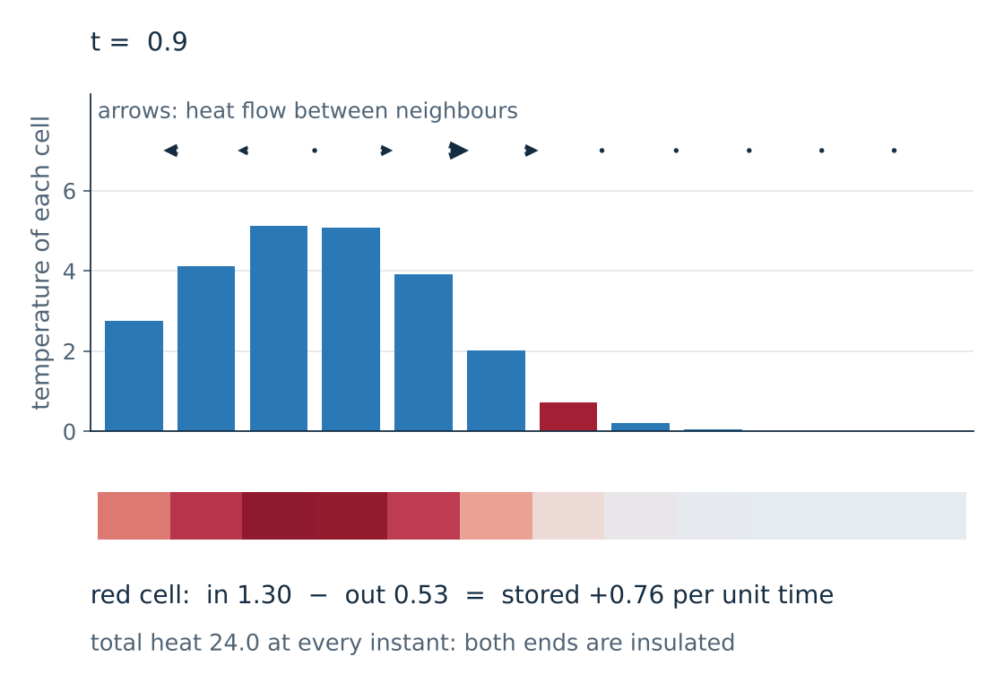
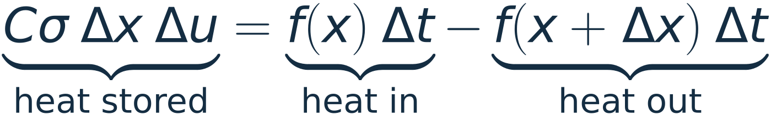
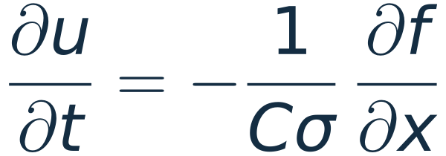
Continuity: heat is counted
For a short piece of the rod, during a short time Δt:
Divide by Δx Δt and let both go to zero:
equation (1)
of the notes
KEY IDEA
Nothing here is a model of heat. It is bookkeeping: heat that flows into a piece and does not flow out is stored there.
Video: twelve cells of a rod with insulated ends. The red cell stores the difference of its two arrows.
Notes:
Two minutes. Section 2 of the notes in one line: stored = in minus out. Click 1 and 2 build the equation. Click 3 starts the video: the arrows are the fluxes between neighbouring cells, and the line under the rod reads the two arrows of the red cell and their difference. The total stays at 24.0 because nothing crosses the ends. The cell temperatures are the solution of du/dt = -Bu, computed from the eigenvectors of B as in Lecture 7.

Slide 4
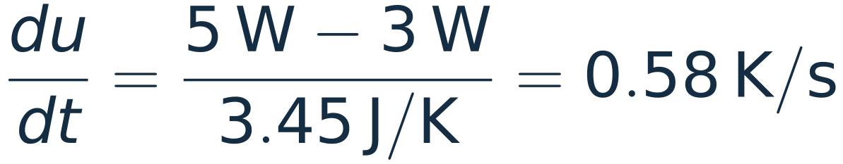
Continuity in numbers: one centimetre of copper
Given a piece of copper rod 1 cm long, with a cross-section of 1 cm². Heat enters the left face at 5 W and leaves the right face at 3 W.
5 W in
copper
1 cm × 1 cm²
3 W out
Find how fast its temperature rises.
2 W stays
Heat capacity of the piece:
AND IF IN EQUALS OUT?
If 5 W enters and 5 W leaves, the temperature does not change although heat is flowing. That is a steady state: the flux is the same at every point.
Divide the 2 W that stays by this capacity:
about 35 K per minute
C is the heat capacity per mass and σ the mass per length, as in Section 1 of the notes.
Notes:
Two minutes. Ask the room for the answer before click 1. The only step that needs care is the heat capacity of the piece: C times sigma times the length, 3.45 J/K. Two watts stored then gives 0.58 K/s, about 35 K per minute. Click 3: equal flux in and out means no change. Steady does not mean no flow.

Slide 5
The same bookkeeping in other fields
What is conserved | Density | Flux | What sets the flux
Heat | energy per length, Cσu | watts, f | Fourier: f = −k ∂u/∂x
Dye in water | concentration | molecules per second | Fick: flux = −D × gradient
Electric charge | charge density | current density | Ohm: current follows the field
Cars on a road | cars per kilometre | cars per hour | drivers: speed falls as density rises
Probability | |ψ|² | probability current | the gradient of the phase of ψ
KEY IDEA
In every row: rate of change of the density = −∂(flux)/∂x. The conservation law is always the same. The physics of each field is in the last column.
Fick's law has the form of Fourier's law, so dye in still water obeys the heat equation.
Notes:
One minute; can be skipped. The point of the aside in Section 3 of the notes: a conservation law plus a constitutive law. The first four rows give, in order, the heat equation, the diffusion equation, charge relaxation, and traffic waves (a nonlinear law, which is why traffic forms jams). The last row is the continuity equation of quantum mechanics, where the current is |ψ|² times the gradient of the phase, times ħ/m.

Slide 6
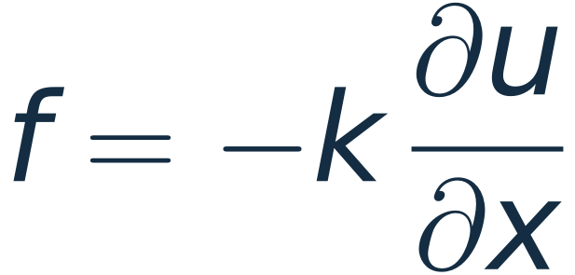
Fourier's law: downhill, at a rate set by k
Per unit area of cross-section: f in W/m², ∂u/∂x in K/m, k in W/(m K). In the notes f is the whole flow in watts, so their k is this k times the area A.
The minus sign. Heat goes from hot to cold.
The size of k. A property of the material. It covers five orders of magnitude.
KEY IDEA
A cooler follows from this chart: metal to carry the heat, and as little air or paste in its path as possible.
Rounded handbook values near room temperature. Thermal pastes range from about 1 to 10 W/(m K).
Notes:
Two minutes. Equation (2) of the notes, written per unit area so that k is the handbook conductivity. The chart shows what a designer has to work with: copper and aluminium are within a factor of two of each other, silicon is a good conductor, and air is fifteen thousand times worse than copper. The two red bars, air and paste, are the poor conductors that end up in the path between a chip and its cooler.

Slide 7
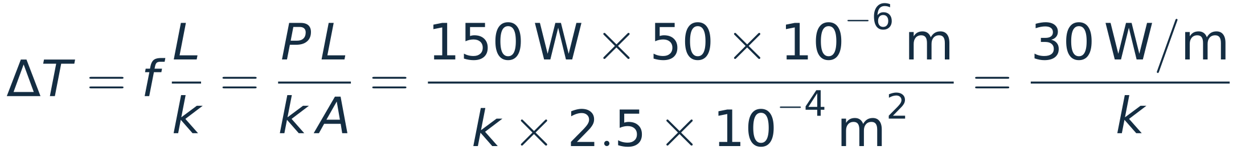
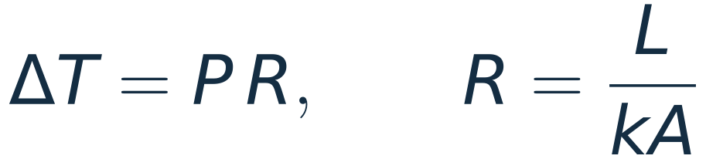
Fourier's law in numbers: why paste matters
Given 150 W crossing a gap 50 µm thick and 2.5 cm² in area, between a chip and its cooler. Find the temperature difference across the gap for three fillings.
air
thermal paste
indium solder
Thermal resistance, in K/W:
1150 K
6 K
0.4 K
k = 0.026 W/(m K)
k = 5 W/(m K)
k = 82 W/(m K)
Ohm's law, with temperature as voltage and heat flow as current.
KEY IDEA
The largest L/k in the path sets most of the temperature drop. Paste is there to displace air, and the layer is kept as thin as possible.
A real contact touches at many points, so the air figure is never reached. Many desktop processors have the die soldered to the lid with indium.
Notes:
Two minutes. Ask which filling they expect to matter. Click 1: the formula reduces to 30 over k. Click 2: 1150 K for air, 6 K for paste, 0.4 K for solder. The air figure is not physical, since real surfaces touch at asperities, but it shows why the gap must be filled. Click 3 names the thermal resistance L/(kA), which the cooler slides use.

Slide 8
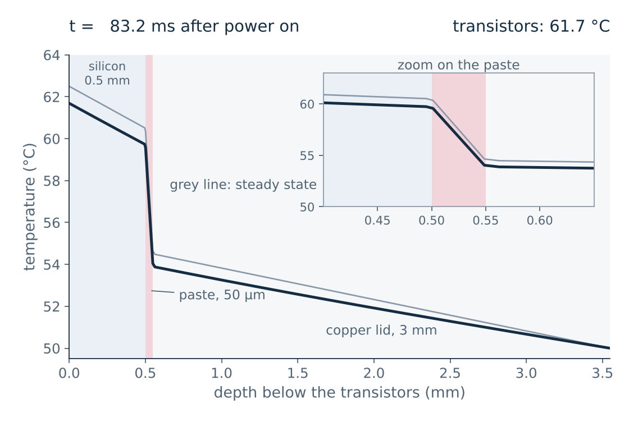
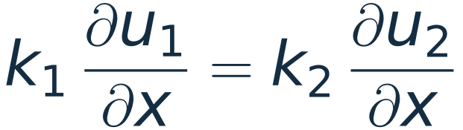
Through the stack: the thin layer drops the most
Given 60 W/cm² leaving the transistors, and three layers on the way to the cooler. Find the temperature drop across each layer.
Layer | L, mm | k | f L / k
silicon die | 0.5 | 150 | 2.0 K
paste | 0.05 | 5 | 6.0 K
copper lid | 3 | 400 | 4.5 K
At an interface the flux is the same on both sides:
so the slope jumps by the ratio of the conductivities: 30 times steeper in the paste than in the silicon.
Video: the first 0.3 s after power on. One-dimensional model, top of the lid held at 50 °C.
Notes:
Two minutes. Click 1 plays the video: the temperature profile through die, paste and lid from the instant the power is switched on. The profile is a broken line in steady state; the cliff is the paste. Click 2: the three drops, f L / k, add to 12.5 K. Click 3: flux continuity at an interface is the continuity equation with nothing stored, and it explains the kinks. Model: 60 W/cm² into the bottom of the die, lid surface held at 50 °C, no sideways spreading.

Slide 9
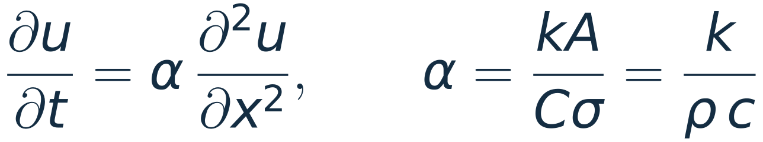
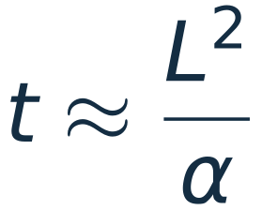
One equation, one number: the diffusivity α
in m²/s, with σ = ρA and C = c:
conductivity over heat capacity per volume
Material | α, mm²/s | 1 mm | 1 cm | 10 cm
copper | 116 | 8.6 ms | 0.86 s | 86 s
aluminium | 98 | 10 ms | 1 s | 1.7 min
silicon | 92 | 11 ms | 1.1 s | 1.8 min
air | 22 | 46 ms | 4.6 s | 7.6 min
stainless steel | 3.75 | 0.27 s | 27 s | 44 min
glass | 0.500 | 2 s | 3.3 min | 5.6 h
water | 0.144 | 7 s | 12 min | 19 h
the time for heat to cross a distance L
KEY IDEA
Ten times the distance takes a hundred times as long. This is the L² in every decay rate of Section 6.
Still air conducts poorly but has almost no heat capacity, so its α is larger than that of steel.
Notes:
Two minutes. Section 4 of the notes sets the global factor to 1; here it is put back. Alpha is k over the heat capacity per volume; in the symbols of the notes, whose k is the handbook k times the area, it is k/(C sigma). The decay rates of Section 6 are alpha times (pi/L) squared times a number, so times scale as L squared over alpha. Read the copper row: 9 ms, 0.9 s, 86 s. Then water: 7 s, 12 min, 19 h, which is why an egg takes minutes and a roast takes hours.

Slide 10
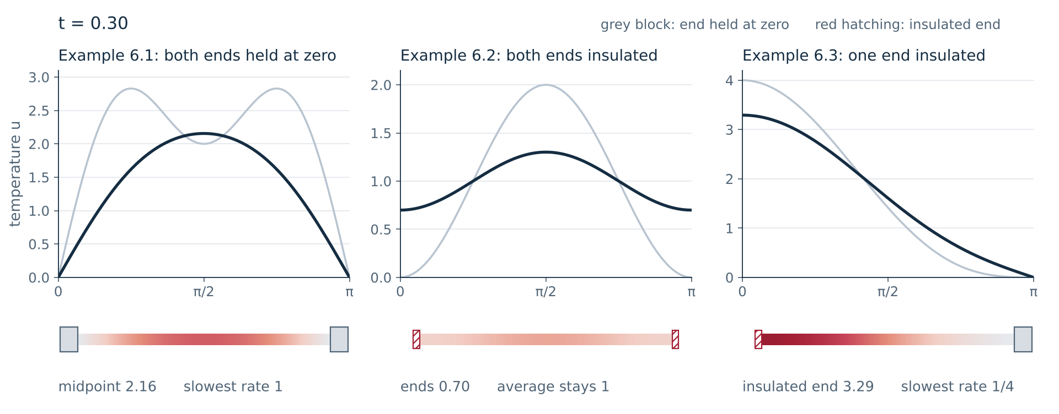
The three rods of the notes, in motion
Examples 6.1 to 6.3 on one clock. The ends decide the modes, the decay rates and the final state.
Notes:
Two minutes. Click to play. Left: Example 6.1, the dip at the midpoint fills in by t = 0.14 and the arch then decays at rate 1. Middle: Example 6.2, total heat is conserved and the rod settles at 1. Right: Example 6.3, four times slower. The pale curve is the initial temperature in each panel. The video plots the three formulas of the notes; nothing is solved numerically.

Slide 11
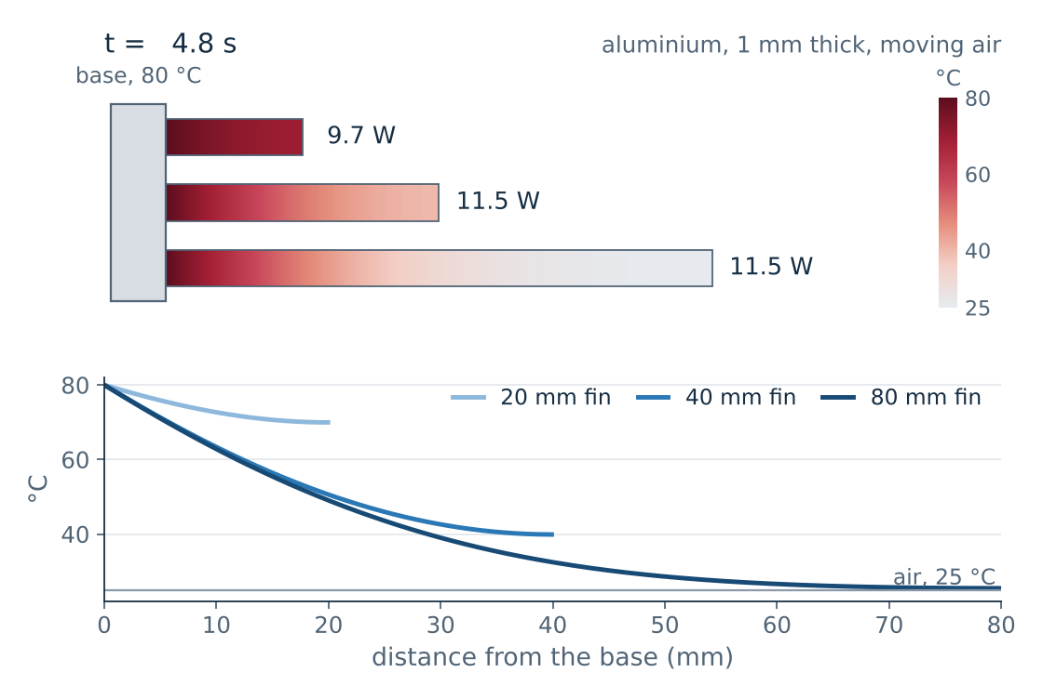
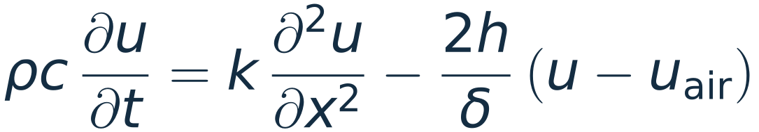
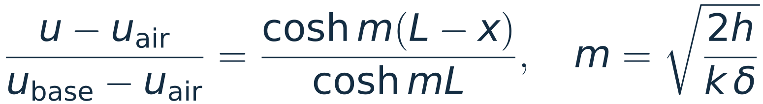
A cooling fin is a rod that leaks from its sides
Conduction along the fin, and a loss to the air from its two faces:
Steady state, base held hot, tip insulated:
Given an aluminium alloy, k = 200 W/(m K), δ = 1 mm, h = 50 W/(m² K). Find the heat removed by fins of 20, 40 and 80 mm.
1/m = 45 mm. 10.3 W, 17.6 W and 23.3 W, and never more than 24.6 W.
KEY IDEA
A fin of length 1/m removes 76% of what an endless fin would. Past 2/m, more length adds almost nothing.
The mirror image of Example 6.3, with a loss term. δ: thickness. h: heat transfer coefficient. Fins 100 mm wide.
Notes:
Three minutes. The fin is the rod of Example 6.3, mirrored so that the held end comes first, with one more term: each piece also loses heat to the air through its two faces. Click 1: the equation. Click 2: its steady solution, a hyperbolic cosine with decay length 1/m. Click 3: the video, three fins whose base is suddenly held at 80 °C in air at 25 °C. Click 4 and 5: the numbers. The heat removed is proportional to tanh(mL), which is 0.76 at L = 1/m and 0.96 at L = 2/m. Doubling the fin from 40 to 80 mm adds a third more heat, not twice. Click 6: the design rule. This is one reason coolers have many short thin fins. The alloy is 6063, k = 200 W/(m K), a little below the 237 of pure aluminium on slide 6.

Slide 12
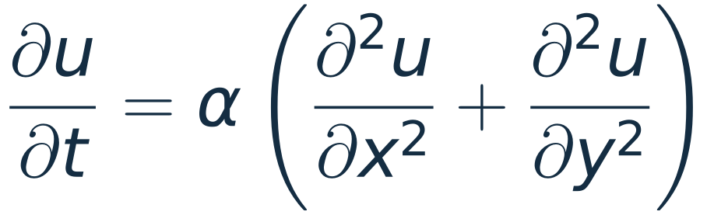
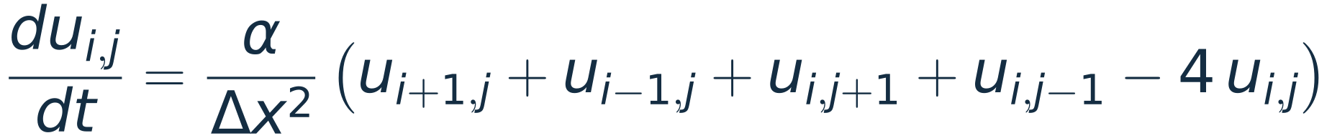
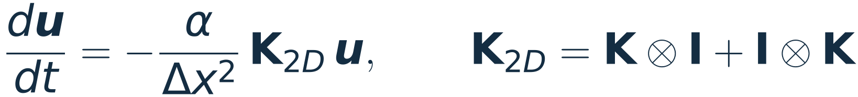
Two dimensions: the same idea, four neighbours
1
On a grid of spacing Δx, with the 1, −2, 1 stencil in x and in y:
1
−4
1
that is, 4α/Δx² times (the average of the four neighbours minus the value itself).
1
As a matrix acting on all n² unknowns:
sparse, symmetric,
positive definite
the five-point stencil
KEY IDEA
Every point moves towards the average of its neighbours: two on a rod, four on a plate.
Lecture 17 returns to this matrix. With insulated edges K becomes B, and the matrix is only semidefinite.
Notes:
Two minutes. The two-dimensional heat equation from the aside in Section 4 of the notes. Click 1: the five-point stencil and its reading as an average of four neighbours. Click 2: the matrix is a Kronecker sum of the one-dimensional matrix with itself, with at most five non-zeros in a row. Students do not need the Kronecker product today; the point is that the matrix is sparse, symmetric and positive definite when the edges are held at a fixed temperature.

Slide 13
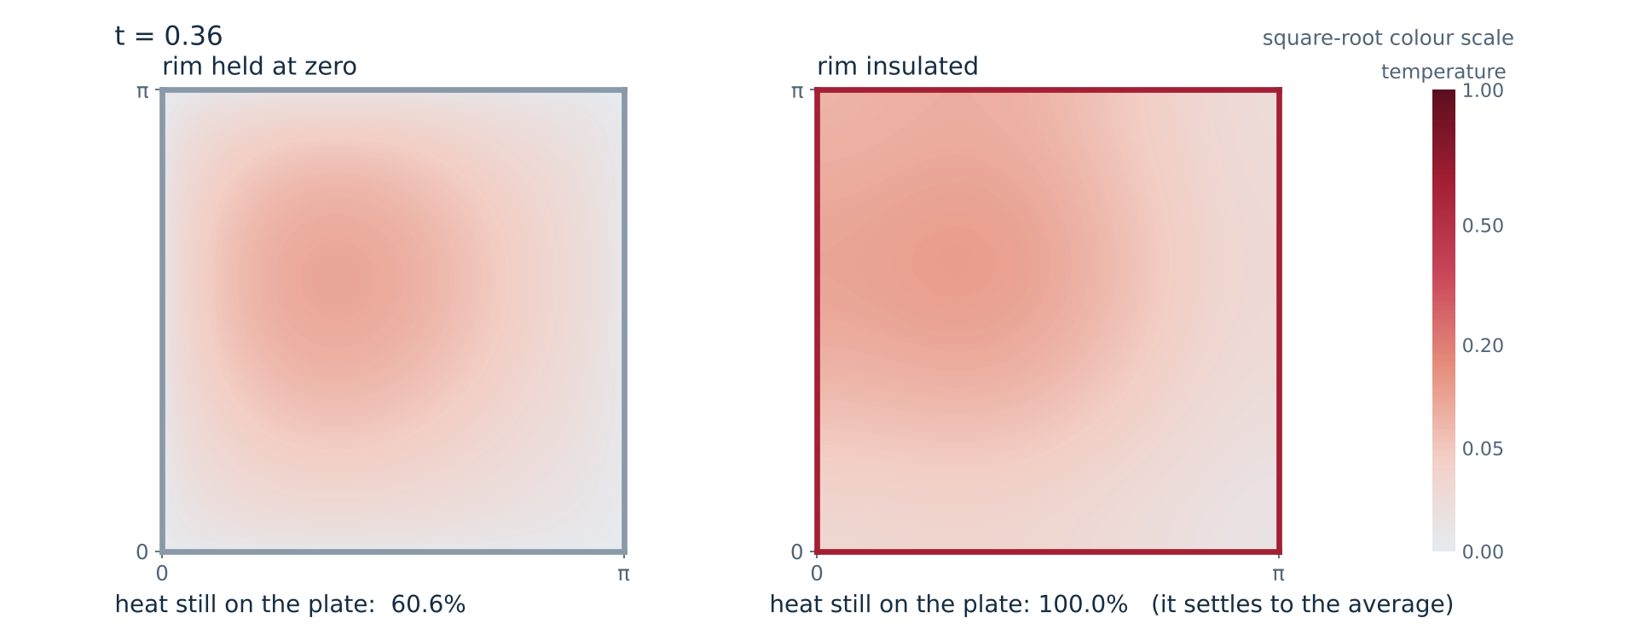
A hot spot on a plate: cold rim and insulated rim
Examples 6.1 and 6.2 in two dimensions. Through a cold rim the heat leaves; behind an insulated rim all of it stays.
Notes:
Two minutes. Click to play. The same initial hot spot on two square plates. Left: the rim is held at zero, and the heat on the plate falls to 46% at t = 0.5 and 2% at t = 2. Right: the rim is insulated, the readout stays at 100%, and the plate ends at a uniform temperature, the average. The colour scale is a square root so that the late, faint temperatures stay visible. Grid 120 by 120, backward Euler.

Slide 14
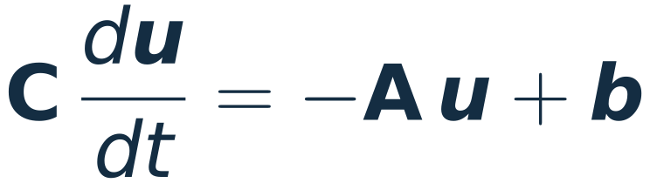
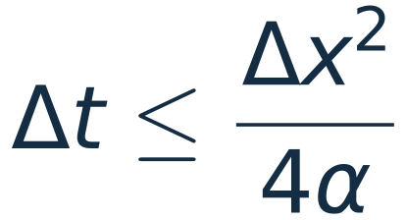
The computation: factor once, step many times
Cell by cell, continuity and Fourier's law give a linear system of differential equations:
lu = splu(sp.diags(cap) + dt * A) # factor once
for n in range(steps): # then, at every step,
u = lu.solve(cap * u + dt * b) # two triangular solves
C: heat capacities (diagonal)
A: conductances (sparse, symmetric, no negative eigenvalues)
b: heat generated or supplied
The matrix never changes, so it is factored once (Lecture 3). The heatsink of slide 18 has 25 600 unknowns and takes 1440 steps with two factorisations.
Backward Euler, one time step:
An explicit step would need
0.13 ms for copper on a 0.25 mm grid
KEY IDEA
Backward Euler is stable for every step size. No eigenvalue λ of C⁻¹A is negative, so each mode is multiplied by 1/(1 + Δt λ), which is never more than 1.
Scripts: L09_heat_1d.py and L09_heat_2d.py (numpy and scipy). The appendix shows the core of each.
Notes:
Two minutes; can be skipped. This is the computational content of the lecture. The stack, the fins and every two-dimensional simulation in the deck use these three lines. Click 1: backward Euler. Click 2: the code, and the cost. Click 3: the explicit alternative and its step limit. Click 4: why the implicit step is stable, in the language of Lecture 8: A is positive definite when heat can leave and semidefinite when every edge is insulated, so no mode grows. The constant mode of an insulated plate has lambda = 0 and is multiplied by 1.

Slide 15
The cooling problem: 100 W per square centimetre
Core i9-14900K. Up to 253 W from a die of about 2.57 cm². Limit: 100 °C.
GeForce RTX 5090. A card rated at 575 W, most of it from a die of 7.5 cm².
Per unit area that is about ten times a kitchen hob.
KEY IDEA
The chip must stay below 90 to 100 °C and the room is at 25 °C. The design problem is to pass this flux with about 70 K of temperature difference.
Power and limits: Intel and NVIDIA specifications. Die areas: published measurements. Hob: a 2 kW ring 18 cm across.
Notes:
Two minutes. The numbers: Intel lists 125 W base power, 253 W maximum turbo power and a 100 °C junction limit for the Core i9-14900K; the die is about 257 mm². The GeForce RTX 5090 is rated at 575 W for the whole card, with a 750 mm² die, so 77 W/cm² is an upper bound for the chip. Both are near 100 W/cm² at full load, about ten times a kitchen hob and between one and two per cent of the flux at the surface of the Sun. Sources: Intel product specifications for the Core i9-14900K; TechSpot review of the GeForce RTX 5090 (575 W, 750 mm²); Hardwareluxx wafer measurement of the Raptor Lake die (257 mm²).

Slide 16
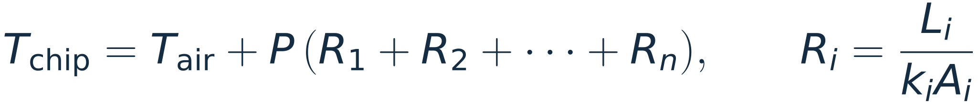

Thermal resistance: Ohm's law for heat
transistors
die
paste
lid
paste
heatsink
air, 25 °C
the heat flow P crosses every layer in turn, so the temperature drops add
Given 253 W, air at 25 °C and a limit of 100 °C. Find the largest total resistance the cooling may have.
For comparison, the model heatsink of slide 18:
0.20 K/W with its fan on
0.84 K/W with its fan off
KEY IDEA
Resistances in series add, as in a circuit. Each metal layer is a few hundredths of a K/W. The step from metal to air is the largest single part, so a cooler is mostly surface area.
For a surface in air the resistance is 1/(hA), with h the heat transfer coefficient and A the area.
Notes:
Two minutes. The circuit picture: heat flow is the current, temperature the voltage, and each layer a resistor L/(kA). Click 1: with Intel's numbers the total must stay under 0.30 K/W. Click 2: the simulated heatsink of slide 18 reaches 0.20 K/W with the fan and 0.84 K/W without; both come from a simple model and are optimistic. Click 3: the metal layers are hundredths of a K/W each, and the transfer to air is the largest single resistance.

Slide 17
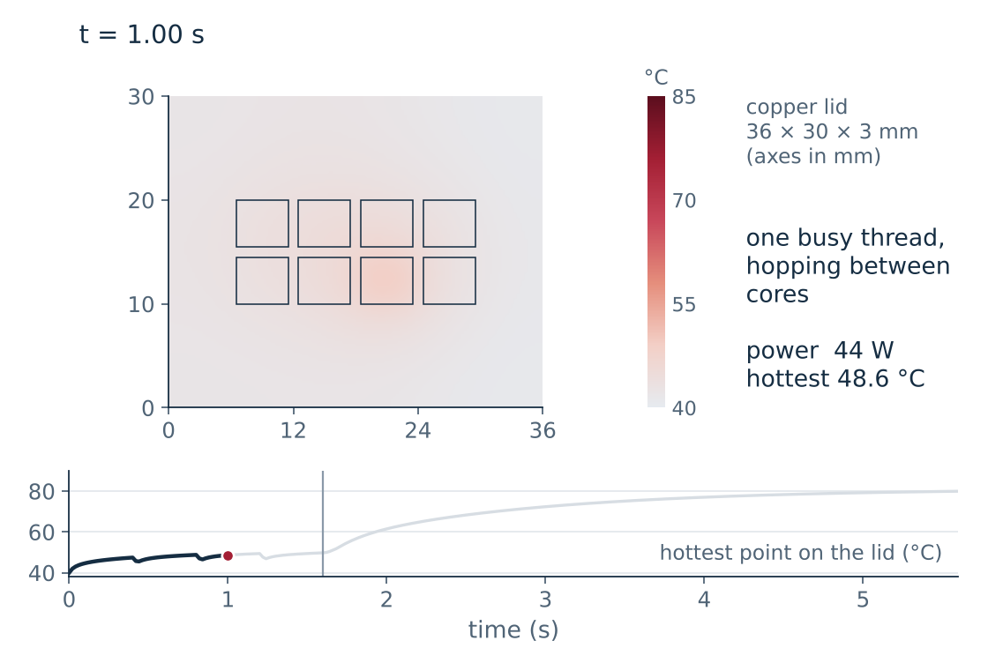
Under the lid: eight cores, eight hot spots
A model processor: eight cores under a copper lid 3 mm thick. A busy core gives 30 W, an idle one 2 W.
One busy thread. A hot spot near 50 °C follows the thread from core to core.
All eight cores, 240 W. The hottest point of the lid settles at 81 °C; the lid averages 69 °C.
KEY IDEA
Copper carries heat a few millimetres sideways in a tenth of a second. The lid turns eight hot spots into one warm plate.
Thin-plate model, cooler at 40 °C, 0.12 K/W between lid and cooler. The core layout is illustrative.
Notes:
Two minutes. Click 1 plays the video: the temperature of the lid seen from above. For 1.6 s one busy thread hops between four cores, as an operating system does; then all eight cores are loaded. The video stops after four seconds of full load, at 80 °C; the steady values are 81 °C at the hottest point and 69 °C on average. Click 2 and 3: the numbers. These are lid temperatures. The transistors under a busy core are about 18 K hotter, by the drops across die and paste of slide 8 at 133 W/cm². Click 4: the sideways spreading time is L squared over alpha, about 80 ms for 3 mm of copper. Model: the lid is a thin plate; each cell loses heat upward to a cooler held at 40 °C. The layout is not a real floor plan.

Slide 18
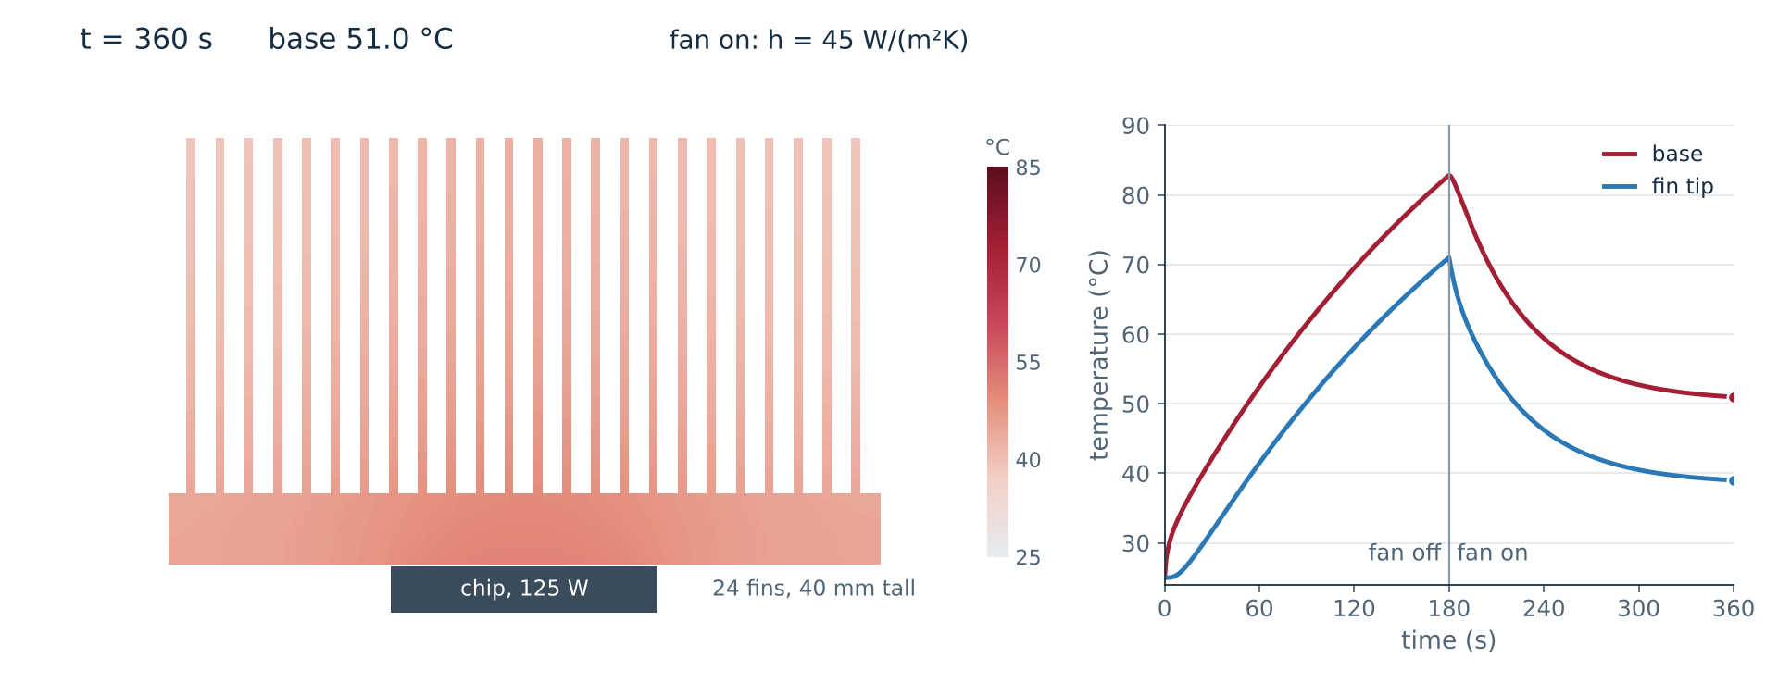
A finned heatsink: fan off, then fan on
125 W into a 24-fin aluminium heatsink, in cross-section. Model: one h on every face, air at 25 °C throughout.
Notes:
Two minutes. Click to play. A cross-section of a straight-fin aluminium heatsink, 80 mm wide and 80 mm deep, with 125 W entering under the middle of the base. For the first 180 s the air is still, h = 8 W/(m² K): the metal warms almost as one block, at about 0.4 K per second, heading for 130 °C. At 180 s the fan starts, h = 45: the temperature falls to 50 °C with a time constant near one minute. Look at the fins after the fan starts: the tips are 12 K cooler than the base, the fin effect of slide 11. Model: every exposed metal face loses h times its area times its excess over 25 °C air. This is optimistic: in a real heatsink the air warms as it passes between the fins, and h is lower deep in the channels. Steady values of the model: 130 °C without the fan, 50 °C with it.

Slide 19
Two clocks: milliseconds and minutes
Fast clock. Heat crosses 0.5 mm of silicon in 3 ms and 3 mm of copper in 78 ms (L²/α). After one second the chip is about 17 K warmer than the air.
Slow clock. The heatsink is one heat capacity behind one resistance: τ = RC = 0.20 K/W × 311 J/K = 62 s.
KEY IDEA
A short burst is absorbed by the heat capacity of the heatsink. The drop across die, paste and lid appears within a second.
One-dimensional chip column feeding a heatsink treated as a single mass. Final temperature 66 °C.
Notes:
Two minutes; can be skipped. The step response has two plateaus. The first, reached in about a second, is the chip sitting about 16 K above a heatsink that has not yet warmed: 125 W times the 0.13 K/W of die, paste, lid and contact. The second, reached after a few minutes, adds the 25 K rise of the heatsink above the air. The same two time scales are in the videos of slides 17 and 18: tenths of a second under the lid, minutes for the heatsink. This is one reason a processor can run above its sustained power for a short time.

Slide 20
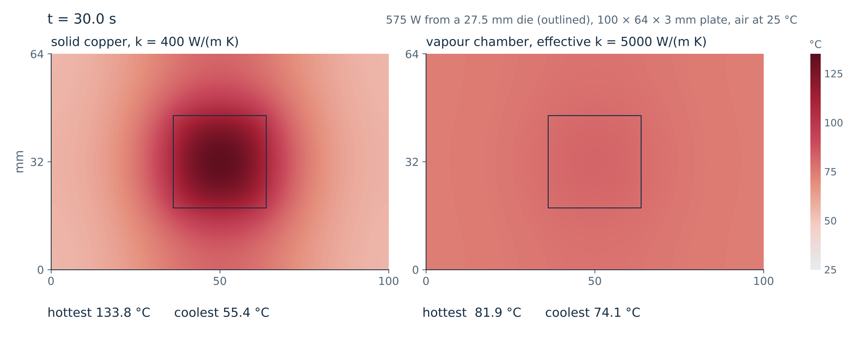
The graphics card: 575 W and a vapour chamber
Same fins, same air. Only the plate differs: 134 °C at the die with copper, 82 °C with a vapour chamber.
Notes:
Two minutes. Click to play. The plate between a graphics chip and its fins, seen from above, with 575 W entering through the outlined die. 575 W is the rating of the whole card, so it is an upper bound for the die. Both panels have the same fins above them, 0.09 K/W in total. Left: solid copper. The heat does not spread far enough, about 26 mm (slide 21): the die reaches 134 °C and the corners stay at 56 °C, so the outer fins do little. Right: a vapour chamber, modelled as a plate with an effective conductivity of 5000 W/(m K). The plate is within 8 K of uniform and every fin works. Only the final state is meaningful: the fins have no heat capacity in this model, so the warm-up is faster than in a real card. A vapour chamber is a flat sealed box in which water evaporates over the chip and condenses under the fins. Electronics Cooling (2010) quotes effective conductivities of 1000 to 1500 W/(m K) for a chamber used as a spreader and 5000 to 10 000 when heat is carried over a distance; with 1000 to 1500 this model gives 102 to 94 °C at the die. Reviews of this card measured 73 to 77 °C at the chip; the fin resistance here was chosen so that perfect spreading gives 77 °C.

Slide 21
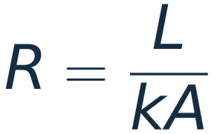
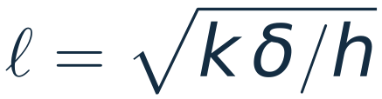
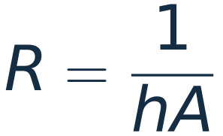
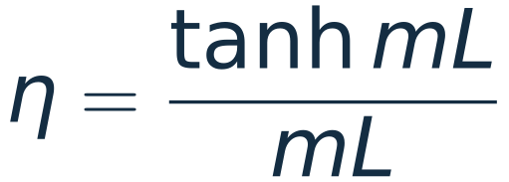
What the equations tell the designer
1
2
3
4
Short paths
Spread first
Area in the air
Short, thin fins
Thin die, thin paste, and the cooler pressed straight onto the lid.
Under the fins of slide 20 copper spreads heat over 26 mm, a vapour chamber over 93 mm.
Air is the weak link. The 24 fins of slide 18 give it 0.16 m².
η compares a fin with one that is at base temperature all along. Long fins waste metal.
Each rule is the two laws applied to a geometry: count the heat, and let it flow down the gradient.
ℓ: how far heat spreads sideways in a plate of thickness δ. h: conductance per unit area to whatever cools it.
Notes:
Two minutes. One click per card. Card 2: the spreading length is the plate version of the fin length 1/m, with the heat leaving through one face; 26 mm and 93 mm are the values for the graphics card plate of slide 20, where the fins above act as h = 1700 W/(m² K) per unit area of plate. Card 3: for the heatsink, 1/(hA) with h = 45 and A = 0.16 m² is 0.14 K/W before the fin efficiency is counted. Card 4: the efficiency of the fins of slide 11 is 0.94, 0.80 and 0.53 for 20, 40 and 80 mm.

Slide 22
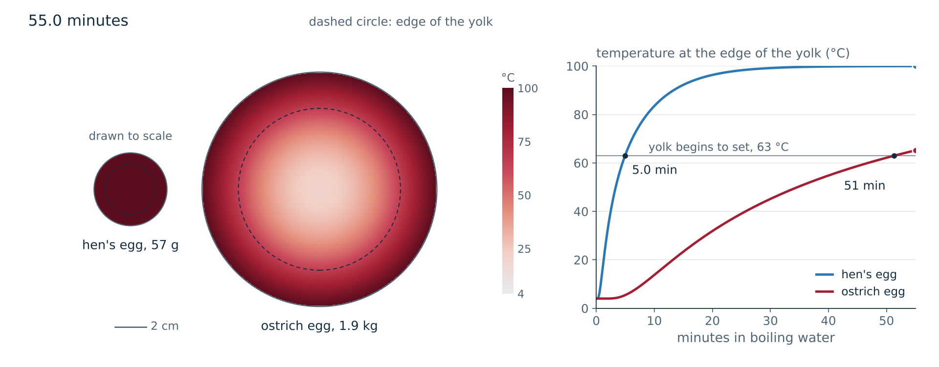
Boiling an egg is Example 6.1 in a sphere
Edge of the yolk at 63 °C: 5.0 min for a hen's egg, 51 min for an ostrich egg. One cook reports 45 to 50 min for the ostrich.
Notes:
Two minutes. Click to play. Two eggs from the fridge, 4 °C, put into boiling water and drawn to scale: a 57 g hen's egg and a 1.9 kg ostrich egg. The surface is held at 100 °C, a fixed end; the heat diffuses inward. The curve is the temperature at the edge of the yolk, taken at 0.69 of the radius. It passes 63 °C after 5.0 minutes for the hen's egg and 51 minutes for the ostrich egg. One account (Tastes of History) gives 45 to 50 minutes for soft-boiled. Model: a uniform sphere with one set of properties throughout.

Slide 23
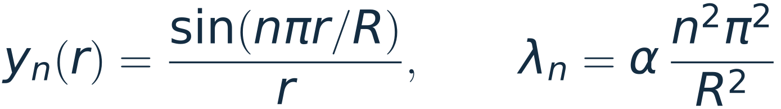
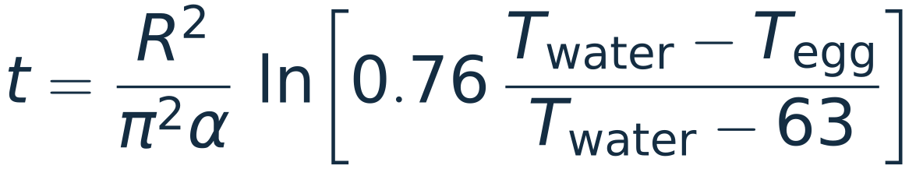
The slowest mode sets the cooking time
Given eggs of 57 g and 1.9 kg, taken from 4 °C into boiling water. Find when the edge of the yolk reaches 63 °C.
hen's egg
ostrich egg
4.5 min
47 min
Modes of a sphere with its surface held fixed:
57 g, R = 2.36 cm
all modes: 5.0 min
1.9 kg, R = 7.59 cm
all modes: 51 min
Keep only n = 1 and solve for the time:
KEY IDEA
The time grows as R², that is as the mass to the power 2/3. An egg 33 times heavier takes 10 times as long, not 33 times.
Formula and constants: C. D. H. Williams, University of Exeter. The video keeps all the modes.
Notes:
Two minutes. The modes of a sphere are sin(n pi r/R)/r: the one-dimensional sines of Example 6.1 divided by r. The decay rates have the same form, alpha n² pi² / R². After the first minutes only n = 1 matters much, and solving for the time gives Williams's formula. In this model the factor 0.76 is twice the first mode at r = 0.69 R, which is where the video places the edge of the yolk. Click 2: the formula gives 4.5 and 47 minutes; with every mode kept the times are 5.0 and 51 minutes, so one mode is within 9 per cent. Click 3: the scaling. (1.9/0.057) to the power 2/3 is 10.4. Alpha is 0.14 mm²/s, close to water.

Slide 24
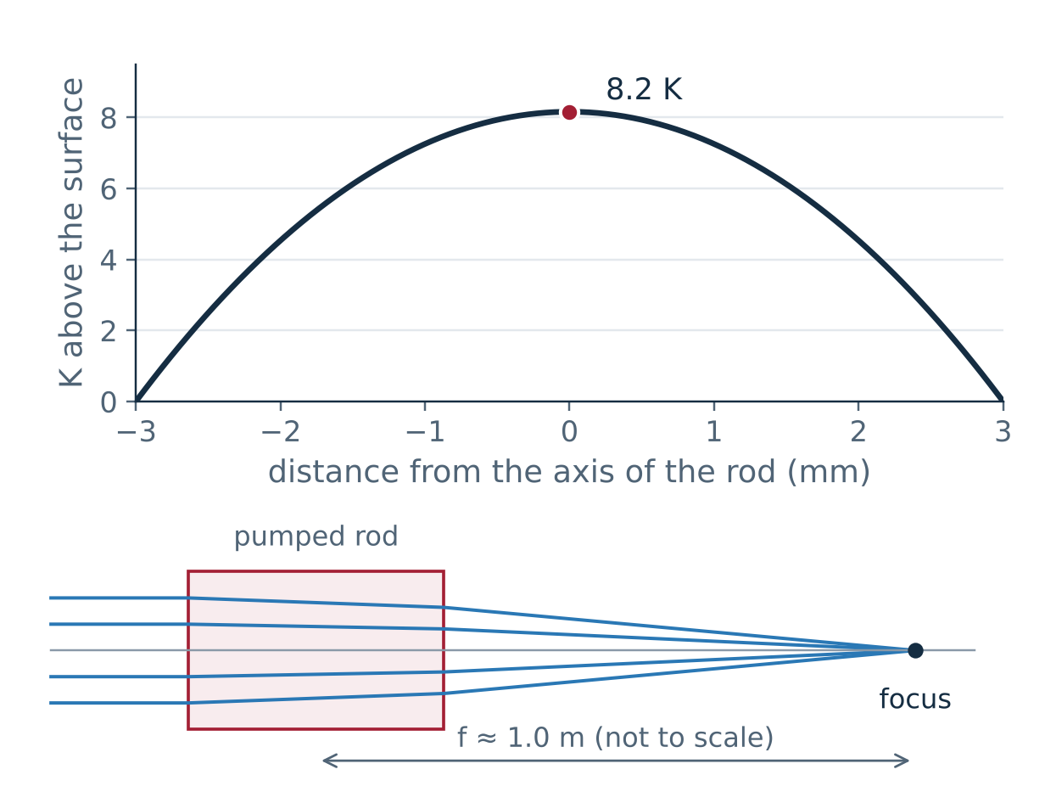
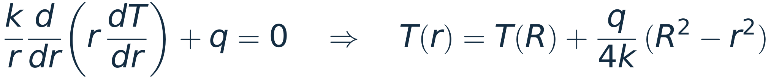
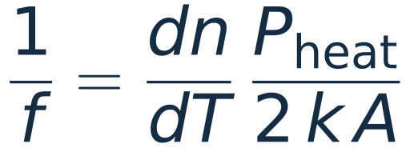
Optics: a pumped laser rod becomes a lens
Given a Nd:YAG laser rod 6 mm across and 75 mm long, with 100 W of heat generated uniformly inside it. Find how much warmer its axis is than its surface, and its focal length as a lens.
Steady state, radial flow, source q per unit volume:
A parabola. The refractive index rises with temperature, and a parabolic index profile is a lens:
A: cross-section of the rod
ANSWER
The axis is 8 K warmer than the surface, and the focal length is about 1 m.
k = 13 W/(m K), dn/dT = 7.3 × 10⁻⁶ per kelvin, within the ranges quoted for Nd:YAG. Stress and end-face bulging are left out.
Notes:
One minute; can be skipped. The steady heat equation in a cylinder with a uniform source. The solution is a parabola, 8.2 K from axis to surface for these numbers. Because the refractive index rises with temperature, the rod is optically thicker on its axis and acts as a converging lens, about 1 m here. This thermal lens has to be allowed for in the design of high-power solid-state lasers. The lens formula is for uniform pumping and purely radial heat flow.

Slide 25
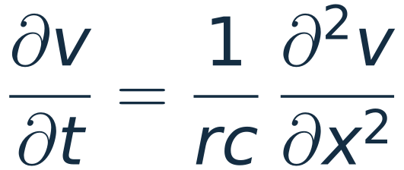
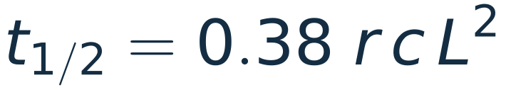
Circuits: a long cable obeys the heat equation
A cable with resistance r and capacitance c per unit length:
The voltage diffuses. Drive one end and leave the other open: the mirror image of Example 6.3.
The far end reaches half the step after
KEY IDEA
Twice the length, four times the delay. Kelvin found this law of squares in 1855, for the Atlantic telegraph cable.
The driven end is a fixed end and the open end is an insulated end, with α = 1/(rc).
Notes:
One minute; can be skipped. A cable with distributed resistance and capacitance, with no inductance, obeys the heat equation with alpha = 1/(rc). The driven end is a fixed end and the open end is an insulated end, so the modes are those of Example 6.3, mirrored. The far end reaches half the applied step at 0.38 r c L². William Thomson, later Lord Kelvin, published this in 1855; it predicted that a transatlantic cable would be slow. The same scaling limits long wires on a chip.

Slide 26
The same three ideas in every example
Example | What is at work | The number
Copper segment | continuity | 2 W stored gives 0.58 K/s
Gap under a cooler | Fourier's law | 6 K with paste, 1150 K with air
Three rods | heat equation, 1D | slowest rates 1, 0 and 1/4
Cooling fin | 1D with a loss term | useful length 1/m = 45 mm
Processor lid | 2D, thin plate | 81 °C at the hottest point of the lid
Heatsink | 2D, cross-section | 0.20 K/W with the fan, 0.84 without
Graphics card | 2D, thin plate | 134 °C copper, 82 °C vapour chamber
Egg | modes of a sphere | 5.0 min and 51 min
KEY IDEA
Count the heat. Let it flow down the gradient. The geometry and the ends decide the rest.
Notes:
One minute. Every row is the continuity equation plus Fourier's law. What changes from row to row is the geometry, the boundary conditions and the material.

Slide 27
Questions for the room
1
A rod is twice as long as another of the same metal. How much longer does it take to warm through?
2
Paste conducts 80 times worse than copper. Why put any in a cooler?
Four times. The time is L²/α.
It replaces air, which is 200 times worse still.
3
A fin is made twice as long, from 40 to 80 mm. Does it remove twice the heat?
4
Both ends of a rod are insulated. What is its temperature after a long time?
No: 17.6 W becomes 23.3 W. The heat removed follows tanh(mL), which levels off.
The average of the initial temperature. No heat has left.
Notes:
Four minutes. One click per answer. 1: time goes as length squared. 2: k is 400 for copper, 5 for paste and 0.026 for air; the paste layer is tens of micrometres thick. 3: slide 11. 4: Example 6.2.

Slide 28
Appendix A: L09_heat_1d.py, the solver for a line
class Line:
"""Cells of width dx, conductivity k, heat capacity per volume rc."""
def __init__(self, dx, k, rc, loss=0.0, t_ref=0.0, left=("insulated",), right=("insulated",)):
self.dx = np.asarray(dx, float) # cell widths
n = self.dx.size # number of cells
self.k = np.broadcast_to(np.asarray(k, float), (n,)).copy()
self.rc = np.broadcast_to(np.asarray(rc, float), (n,)).copy()
self.x = np.cumsum(self.dx) - self.dx / 2 # cell centres
self.cap = self.rc * self.dx # heat capacity of each cell
# Fourier's law between neighbours: two half-cells in series
g = 1.0 / (self.dx[:-1] / (2 * self.k[:-1]) + self.dx[1:] / (2 * self.k[1:]))
self.g = g # interface conductances
diag = np.zeros(n)
diag[:-1] += g # each interface pulls on
diag[1:] += g # the two cells it joins
b = np.zeros(n) # right-hand side (sources)
lossv = np.broadcast_to(np.asarray(loss, float), (n,)) * self.dx
diag += lossv # side losses, like a fin
b += lossv * t_ref # ... towards the air at t_ref
for side, bc in ((0, left), (n - 1, right)):
if bc[0] == "flux": # prescribed heat flux in
b[side] += bc[1]
elif bc[0] == "temp": # face held at a temperature
gb = 2 * self.k[side] / self.dx[side] # half a cell to the face
diag[side] += gb
b[side] += gb * bc[1]
self.A = sp.diags([-g, diag, -g], [-1, 0, 1], format="csc")
self.b = b
def steady(self):
"""Solve A u = b: the steady temperature."""
return spla.spsolve(self.A, self.b)
def march(self, u0, dt, nsteps, every=1):
"""Backward Euler: (C + dt A) u_new = C u_old + dt b."""
lu = spla.splu((sp.diags(self.cap) + dt * self.A).tocsc())
u = np.array(u0, float)
out = [u.copy()]
for n in range(1, nsteps + 1):
u = lu.solve(self.cap * u + dt * self.b)
if n % every == 0:
out.append(u.copy())
return np.array(out)
Notes:
The core of the one-dimensional script: assemble the tridiagonal matrix from Fourier's law between neighbouring cells, then backward Euler with one factorisation. Running the script prints the numbers on slides 4, 7, 8, 9, 11, 19, 23, 24 and 25.

Slide 29
Appendix B: L09_heat_2d.py, cells and neighbours
def laplacian(mask):
"""Graph Laplacian of the solid cells: (L u)_p = sum over q of (u_p - u_q).
For a full rectangle this is the five-point matrix with insulated edges,
kron(B, I) + kron(I, B), with B the free-free matrix of Lecture 2.
"""
idx = -np.ones(mask.shape, int)
idx[mask] = np.arange(mask.sum()) # number the solid cells
east = mask[:, :-1] & mask[:, 1:] # solid pairs side by side
north = mask[:-1, :] & mask[1:, :] # solid pairs one above the other
p = np.concatenate([idx[:, :-1][east], idx[:-1, :][north]])
q = np.concatenate([idx[:, 1:][east], idx[1:, :][north]])
rows, cols = np.concatenate([p, q]), np.concatenate([q, p])
n = int(mask.sum())
w = sp.coo_matrix((np.ones(rows.size), (rows, cols)), shape=(n, n))
deg = np.asarray(w.sum(axis=1)).ravel() # number of solid neighbours
return (sp.diags(deg) - w).tocsc()
class Stepper:
"""Backward Euler for C dT/dt = -A T + b: factor once, solve many times."""
def __init__(self, cap, A, dt):
self.cap, self.dt = cap, dt
t0 = time.perf_counter()
self.lu = spla.splu((sp.diags(cap) + dt * A).tocsc())
self.factor_seconds = time.perf_counter() - t0
def step(self, temp, b):
return self.lu.solve(self.cap * temp + self.dt * b)
def plate_demo(edges, n=120, dt=1e-3, t_end=2.0):
"""edges = "cold" (u = 0 on the rim) or "insulated"."""
h = np.pi / n
x = (np.arange(n) + 0.5) * h # cell centres
X, Y = np.meshgrid(x, x)
u = np.exp(-((X - 1.1) ** 2 + (Y - 1.9) ** 2) / (2 * 0.3 ** 2)).ravel()
A = laplacian(np.ones((n, n), bool)) / h ** 2 # insulated rim
if edges == "cold":
# the rim is half a cell away from the outer cells
A = A + sp.diags(2.0 * edge_faces((n, n)) / h ** 2)
stepper = Stepper(np.ones(n * n), A, dt)
frames, times = [u.reshape(n, n).copy()], [0.0]
heat = [u.sum() * h * h]
for k in range(1, int(round(t_end / dt)) + 1):
u = stepper.step(u, 0.0)
frames.append(u.reshape(n, n).copy())
heat.append(u.sum() * h * h)
times.append(k * dt)
return x, np.array(times), np.array(frames), np.array(heat)
Notes:
The core of the two-dimensional script. Left: the graph Laplacian of the solid cells, which for a full rectangle is the five-point matrix with insulated edges, and the backward Euler stepper. Right: the plate of slide 13. The processor lid, the heatsink and the graphics card plate use the same two pieces with different conductances, capacities and sources. With a cold rim the rim lies half a cell beyond the outer cell centres, so the one-dimensional factor has 3, not 2, at the two ends of its diagonal: close to the K of Lecture 2 but not identical to it.

Slide 30
Appendix C: what the two scripts print
$ python L09_heat_1d.py (excerpt)
The stack at 60 W/cm^2 (steady drops f L / k):
silicon die 2.0 K
thermal paste 6.0 K
copper lid 4.5 K
solver: transistors at 62.50 C in steady state (exact 62.50 C)
t = 10 ms die at 55.62 C
t = 50 ms die at 60.58 C
t = 100 ms die at 61.95 C
t = 300 ms die at 62.48 C
Fin: aluminium 6063, 1 mm thick, h = 50 W/(m^2 K), m = 22.36 per metre
L = 20 mm mL = 0.447 efficiency 0.938 tip 74.9 C heat 10.3 W
L = 40 mm mL = 0.894 efficiency 0.798 tip 63.5 C heat 17.6 W
L = 80 mm mL = 1.789 efficiency 0.529 tip 42.9 C heat 23.3 W
an infinitely long fin removes 24.6 W
$ python L09_heat_2d.py (excerpt)
CPU lid: 17280 unknowns, h_eff = 7716 W/(m^2 K)
t = 0.4 s power 44 W hottest 47.4 C mean 41.4 C
t = 1.6 s power 44 W hottest 49.8 C mean 43.7 C
t = 2.6 s power 240 W hottest 69.3 C mean 56.9 C
t = 5.6 s power 240 W hottest 79.9 C mean 67.5 C
all eight cores, steady state: hottest 81.2 C, mean 68.8 C (= 40 + 240 W x 0.12 K/W)
Heatsink: 25600 unknowns, area in air 0.161 m^2, heat capacity 311 J/K
the LU factors hold 671058 non-zeros
t = 60 s base 52.4 C fin tip 41.5 C
t = 120 s base 69.5 C fin tip 58.0 C
t = 180 s base 82.8 C fin tip 71.0 C
t = 240 s base 59.4 C fin tip 46.2 C
t = 300 s base 52.7 C fin tip 40.5 C
t = 360 s base 51.0 C fin tip 39.0 C
energy check: in 45000 J, lost + stored 45000 J
steady, fan off: base 130.3 C (R = 0.843 K/W), coolest metal 117.3 C
steady, fan on : base 50.3 C (R = 0.203 K/W), coolest metal 38.5 C
Graphics card plate, 575 W, steady state
copper k = 400 hottest 134.1 C coolest 55.7 C spreads over 26.3 mm
vapour chamber k = 5000 hottest 82.2 C coolest 74.4 C spreads over 93.0 mm
perfect spreading: 25 + 575 W x 0.09 K/W = 76.8 C
Notes:
Printed output of the two scripts, for checking the numbers on the slides. A third script, L09_make_videos.py, renders the nine videos with matplotlib and ffmpeg.

