Slide 1
Least squares in practice
Lecture 11 companion · five points by hand, the normal equations, four animated experiments and six fits from the lab
Notes:
Companion deck to the Lecture 11 notes (L11_v3). Slides 3 to 11 follow Examples 2.1 and 3.1 of the notes with the same five points, and slides 14 and 15 are Example 4.1 (the glider), so students can read along. Slides 14 to 18 are animated: the experiments run when the slide opens. Pacing: about 60 minutes in full. For about 45 minutes, skip slides 10, 11, 13, 16, 21 and 23. Data: the five points, the time-stamp fit, the glider, the spring, the stopping voltages and five of the six lab fits are synthetic and labelled as such; the hydrogen and mercury wavelengths, the N-BK7 indices (SCHOTT) and the tidal constants (NOAA) are real.

Slide 2
Plan
1
2
3
4
5
Five points by hand
On the computer
Four experiments
Six fits from the lab
Wrap-up
Set-up, the picture, the normal equations, the best line, centring.
Raw time stamps: one fit, two answers. What to write instead.
Glider on springs, mass on a spring, Bohr's hydrogen atom, the photoelectric effect. Animated.
Circuits, optics, EM, tides, nonlinear optics, structured light.
Summary, questions for the room, Python appendix.
Slides 3–11
Slides 12–13
Slides 14–18
Slides 19–25
Slides 26–35
The data, numbers and notation match Examples 2.1, 3.1 and 4.1 of the Lecture 11 notes.
Notes:
One minute. The first block is the notes' worked example taken slowly, with builds. The second is a short warning about computing with raw columns. The third is four experiments, each animated; the fourth is six fits from fields where least squares is used every day. Each experiment or fit takes about two minutes.

Slide 3
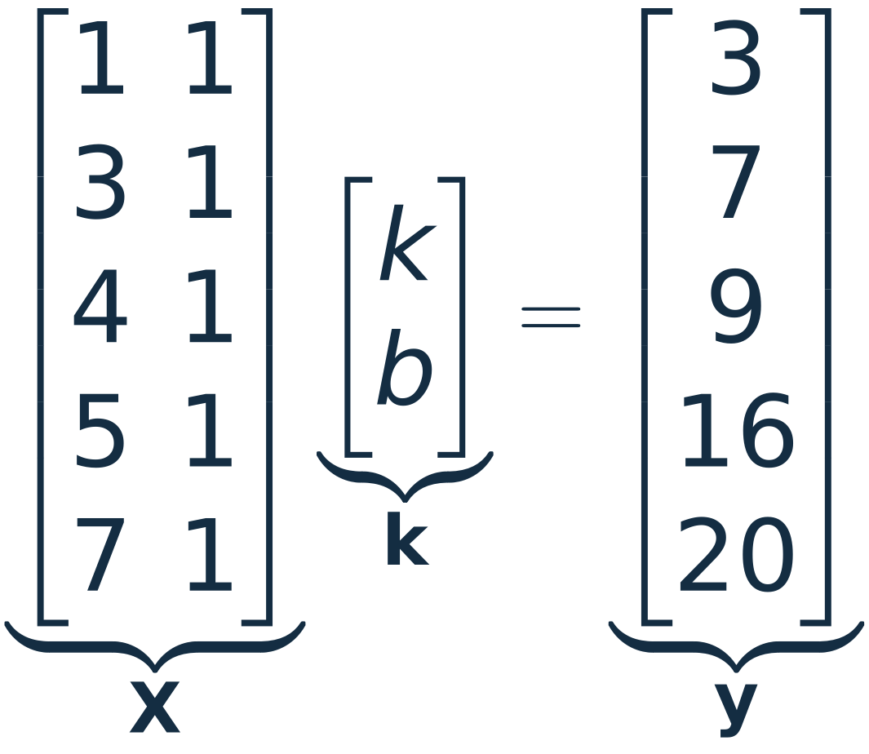
Five points, two unknowns, no exact line
Five equations, two unknowns: no k and b satisfy all five.
The first three points force k = 2, b = 1: the dashed line y = 2x + 1.
It misses (5, 16) and (7, 20) by 5 each. Which line is best?
Notes:
About 2 minutes. Example 2.1 of the notes. Write the five equations k x_i + b = y_i as X k = y: one row per data point, the column of ones carries the intercept. Click 1: the first three points lie exactly on y = 2x + 1, a natural guess. Click 2: it misses the last two by 5 each, so we need a rule for 'best' before we can solve anything.

Slide 4
Score a line by its total squared error
i | x_{i} | y_{i} | 2x_{i} + 1 | e_{i} | e_{i}²
1 | 1 | 3 | 3 | 0 | 0
2 | 3 | 7 | 7 | 0 | 0
3 | 4 | 9 | 9 | 0 | 0
4 | 5 | 16 | 11 | 5 | 25
5 | 7 | 20 | 15 | 5 | 25
 |  |  |  | sum | 50
KEY IDEA Least squares chooses k to make e^{T}e as small as possible.
Notes:
About 2 minutes. Each error is e_i = y_i - (k x_i + b); squaring makes every miss count positively. Click 1: the table for the guess, total 50. Click 2: the criterion. Ask the room for a line with error below 50 before moving on.

Slide 5
All the data enter through three sums
x_{i} | y_{i} | x_{i}² | x_{i}y_{i} | y_{i}²
1 | 3 | 1 | 3 | 9
3 | 7 | 9 | 21 | 49
4 | 9 | 16 | 36 | 81
5 | 16 | 25 | 80 | 256
7 | 20 | 49 | 140 | 400
20 | 55 | 100 | 280 | 795
The boxed formula of Section 2 needs only these sums.
Last row: the sums over the m = 5 points.
KEY IDEA As a function of k, the error depends on the data only through these three quantities; y^{T}y changes the smallest error, not the k̄ where it occurs.
Notes:
About 2.5 minutes. The table is the hand computation: five rows, then sums. Click 1: the sums are the entries of X^T X, X^T y and y^T y. Click 2: plug the guess k = (2, 1) into the box: 100*4 + 2*20*2*1 + 5*1 = 485, y^T X k = 280*2 + 55 = 615, and 485 - 1230 + 795 = 50, the same 50 as the table on the previous slide. Click 3: m = 5 has left the problem; with a million points the work after the sums is still a 2 by 2 problem.

Slide 6
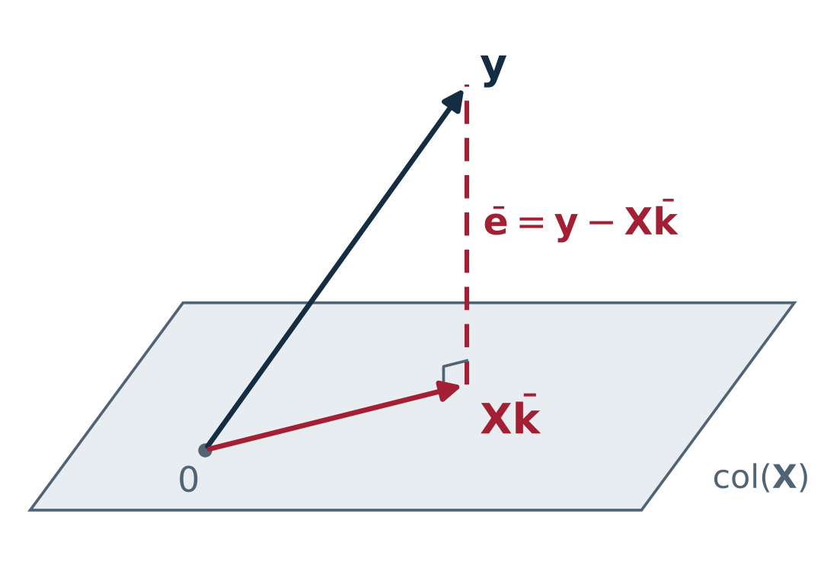
The picture: drop a perpendicular onto col(X)
y lives in ℝ⁵: one coordinate per data point, not per unknown.
Xk runs over a plane in ℝ⁵, the column space, spanned by (1, 3, 4, 5, 7) and (1, 1, 1, 1, 1).
The closest point Xk̄ is the foot of the perpendicular, so the residual ē is orthogonal to col(X).
KEY IDEA Least squares is a projection: given a plane and a point off it, drop a perpendicular.
Notes:
About 2 minutes. Section 3 of the notes. The space is R^5 because there are five data points; the unknowns k and b only pick a point in the plane spanned by the two columns. Click 1: the plane. Click 2: the best point is the foot of the perpendicular. Click 3: the normal equations on the next slide are bookkeeping for that perpendicular.

Slide 7
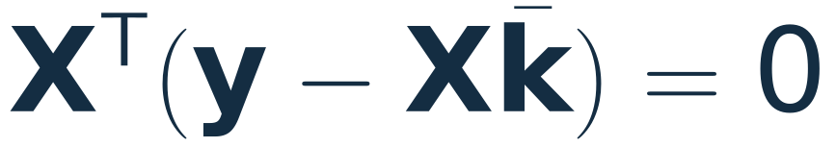

The right angle gives the normal equations
Orthogonal to col(X) means orthogonal to every column of X, that is, to every row of X^{T}:
Multiply out:
the normal equations
Built from the same X^{T}X and X^{T}y as slide 5.
Independent columns make X^{T}X symmetric positive definite, so it is invertible. For a line this fails only when all the xᵢ are equal.
Notes:
About 2 minutes. Section 3 of the notes, 'The normal equations'. No calculus: the right angle in the picture says the residual has zero dot product with each column of X, and those dot products are X^T(y - X k-bar). Click 1: multiply out to get the boxed normal equations; the sums of slide 5 are exactly X^T X and X^T y. Click 2: why X^T X is invertible: v^T X^T X v = |Xv|^2, which is positive when the columns are independent.

Slide 8
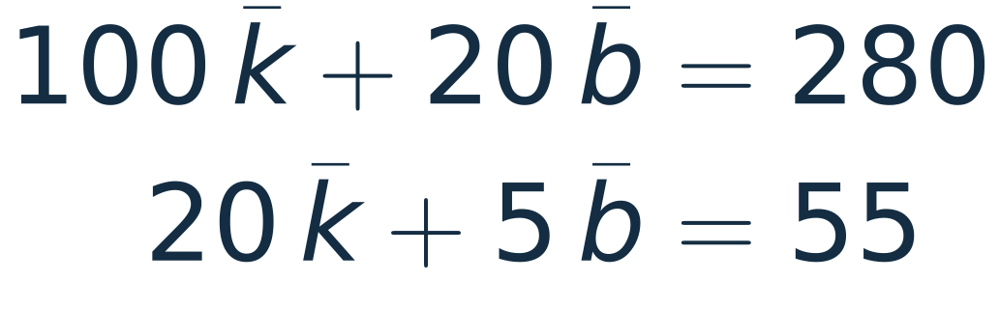
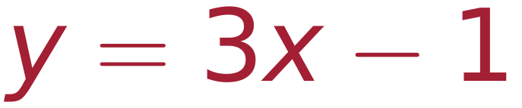
Solving them: the best line
with the sums of slide 5
the best line
It passes through (7, 20) exactly and misses the other four points by 1 or 2. The guess y = 2x + 1 is dashed.
Notes:
About 2 minutes. Example 3.1(a). The two normal equations use the sums of slide 5. Click 1: eliminate: subtract 1/5 of the first from the second, (5 - 4) b = 55 - 56, so b = -1; then 100 k = 300. Click 2: the best line y = 3x - 1 with its residuals in red.

Slide 9
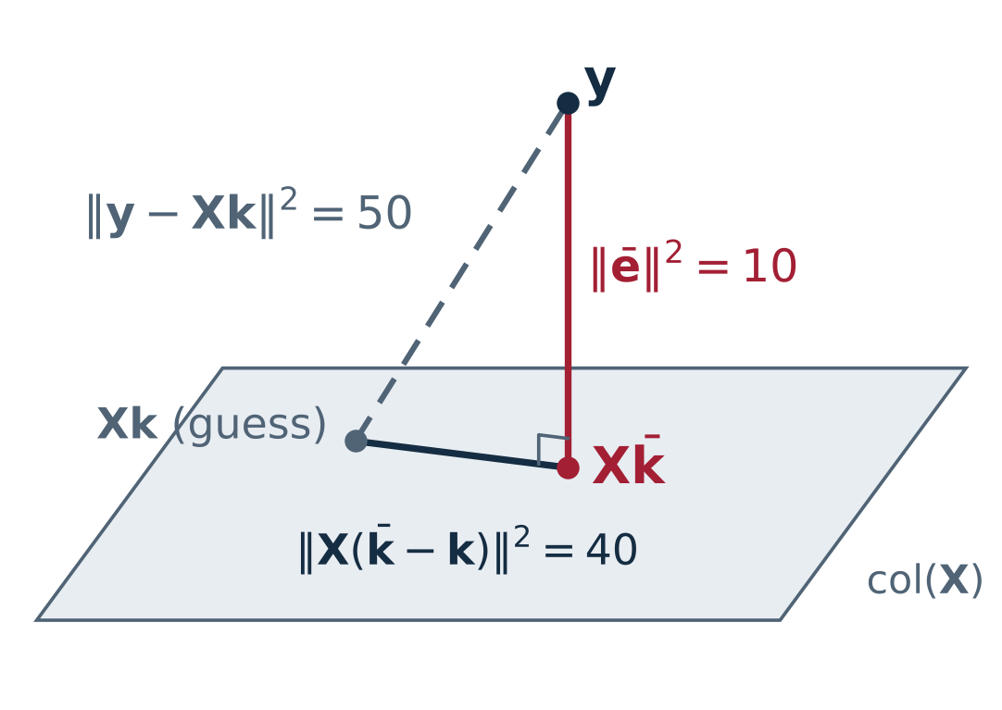

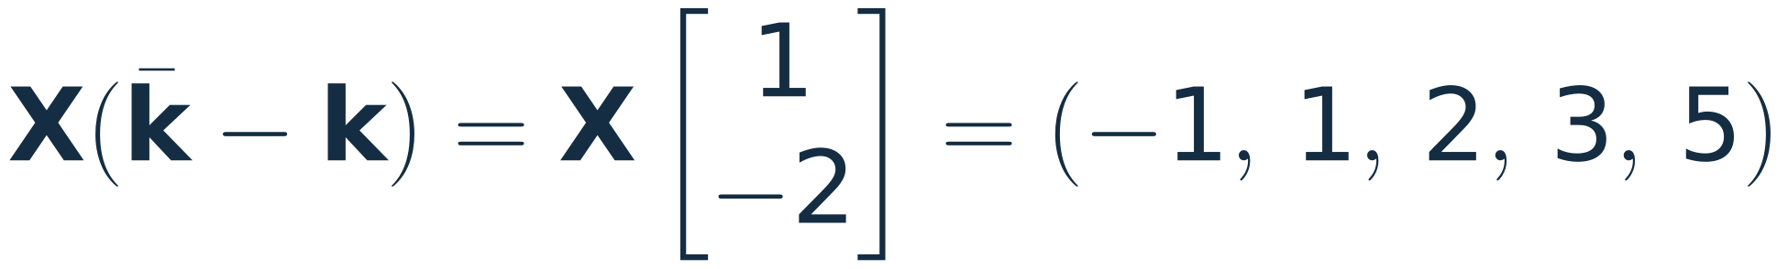
The residual is perpendicular to the plane
Notes:
About 2.5 minutes. Example 3.1(b), and one step beyond the notes. Click 1: e-bar is orthogonal to both columns, hence to every combination of them, which is all of col(X). Click 2: its squared length is 10, against 50 for the guess. Click 3: the guess's error is e-bar plus a vector in the plane; the two are perpendicular, so 50 = 10 + 40. Any other line pays 10 + |X(k-bar - k)|^2, more than 10 because the columns are independent: the picture's closest point is the least squares answer.

Slide 10
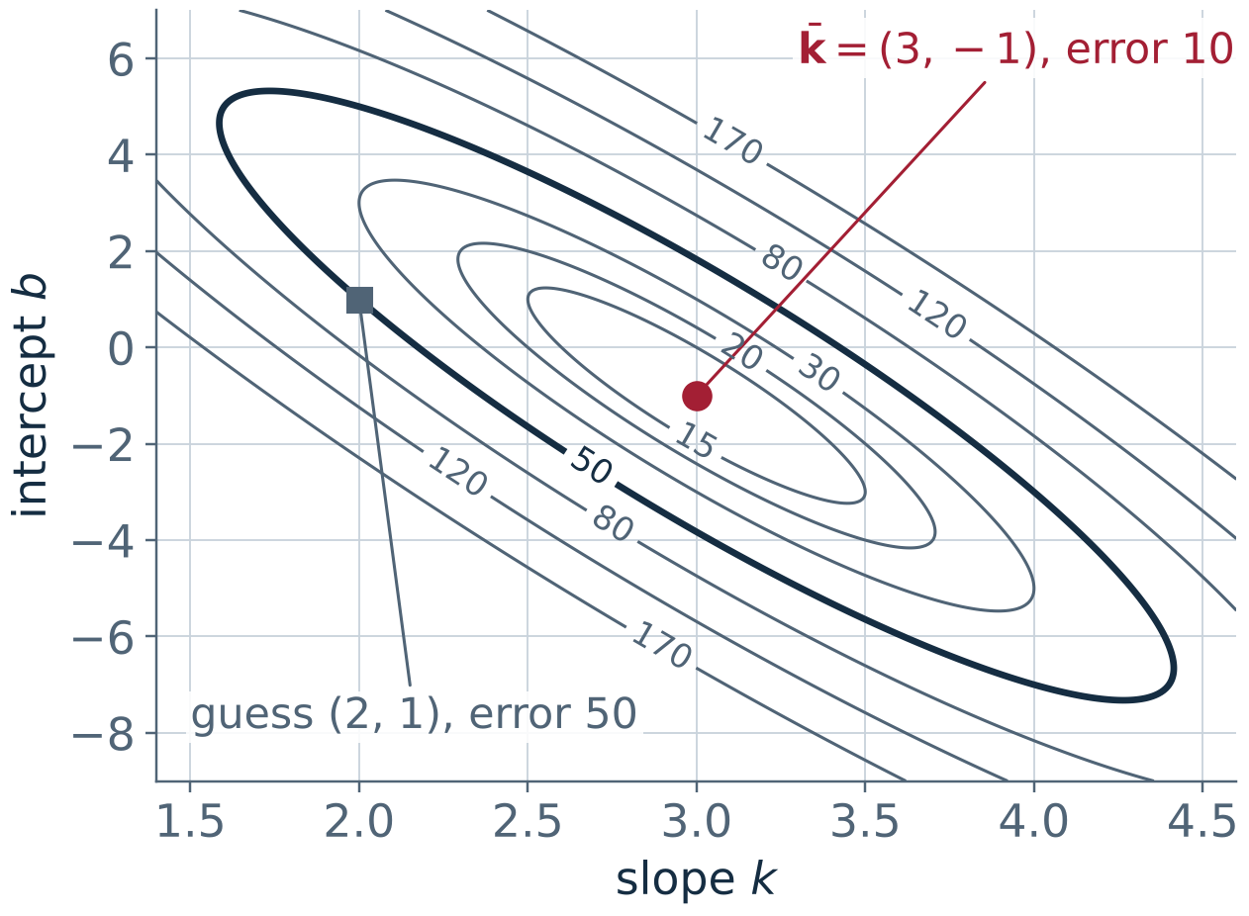

Every other line costs more: the error landscape
A bowl over the (k, b) plane, lowest at k̄ = (3, −1); its level sets are ellipses.
Their shape comes from X^{T}X, with eigenvalues 104.0 and 0.96: the bowl is long and narrow.
Along the long axis of the ellipses, the eigenvector (1, −4.95) of X^{T}X, the slope rises while the intercept falls, and the error changes little.
Notes:
About 2 minutes; skip if short of time. From the previous slide the error is 10 + |X(k-bar - k)|^2 = 10 + (k-bar - k)^T X^T X (k-bar - k), a quadratic bowl whose level sets are ellipses. Click 1: eigenvalues 104.04 and 0.961 (Lecture 7); the ellipse axes are their eigenvectors. Click 2: the small-eigenvalue direction is about (1, -4.95): raising k by 1 and lowering b by 4.95 changes the line by x - 4.95, which is small across the data. (The valley floor, the best b for each k, runs along (1, -4) instead: that line turns about the mean x = 4, as on the next slide.) The guess (2, 1) sits on the 50 contour.

Slide 11
Centre the data: the columns become orthogonal
The best line passes through the mean point (diamond), (x̄, ȳ) = (4, 11).
With centred columns X^{T}X = diag(20, 5): each normal equation has one unknown, so the slope and the intercept decouple.
Notes:
About 2 minutes; optional. Shift x by its mean 4: the new column (-3,-1,0,1,3) is orthogonal to the ones. Click 1: each unknown is one dot product: k = 60/20 = 3, c = mean of y = 11, so y = 3x - 1 again. Click 2: the line passes through (4, 11), and X^T X = diag(20, 5). The glider experiment next uses the same idea: symmetric positions make two entries of X^T X vanish.

Slide 12
Raw time stamps: one fit, two answers
Given. A sensor logs a temperature once a minute for an hour. The time stamps are Unix seconds, t ≈ 1.79 × 10⁹ s. Fit T = kt + b two ways (61 points, synthetic).
Columns | Route | Slope (K/min) | Rel. error
t, 1 | normal equations | 0.019982 | 2 × 10⁻⁴
t, 1 | lstsq, rcond=None | 7.2 × 10⁻⁷ | ≈ 1 (wrong)
cond(X)
= √(λmax/λmin) of XᵀX; 10.4 for the five points
raw t
3.0 × 10¹⁵
Columns | Route | Slope (K/min) | Rel. error
t − t₀, 1 | normal equations | 0.019978 | 1 × 10⁻¹⁴
t − t₀, 1 | lstsq, rcond=None | 0.019978 | reference
t − t₀
4.1 × 10³
KEY IDEA Subtract the first time stamp before fitting: one line of code, and both routes agree to 14 digits.
Notes:
About 2.5 minutes. The same fit as the five points, but with a column of numbers near 1.79e9 next to a column of ones. Read the first table: the normal equations keep about 4 digits, and numpy's lstsq with rcond=None returns a slope of 7e-7 K/min, which is wrong. cond(X) is the square root of the ratio of the largest to the smallest eigenvalue of X^T X; for the five points it is 10.4. Click 1: subtract t0 (the first time stamp): cond(X) drops from 3.0e15 to 4.1e3 and both agree. Click 2: the rule. Data are synthetic: 21 C, drift 0.02 K/min, 0.01 K noise, seed 11; the reference slope 0.019978 K/min differs from 0.02 because of the noise.

Slide 13
Why the routes differ, and what to write
1
Scale. A column near 1.79 × 10⁹ sits next to a column of ones. With both columns scaled to length 1, cond(X) ≈ 3.4 × 10⁶.
Python
t = t - t[0] # shift the time stamps
X = np.column_stack([t, np.ones_like(t)])
k = np.linalg.lstsq(X, y, rcond=None)[0] # SVD
2
Squaring. With the columns scaled, X^{T}X has condition number ≈ (3.4 × 10⁶)² ≈ 10¹³: the normal equations keep about 4 digits of 16.
MATLAB
t = t - t(1); % shift the time stamps
X = [t, ones(size(t))];
k = X \ y; % least squares
3
Cut-off. lstsq (an SVD solver) ignores directions that X stretches by less than about 61 ε times its largest stretch. Here the ratio is 3 × 10⁻¹⁶, so it fits as if X had rank one.
KEY IDEA Shift the columns, and scale them if their sizes differ. Then solve (normal equations, lstsq or backslash) without forming inv(XᵀX).
Notes:
About 2 minutes; optional. Point 1: most of the 3e15 is the scale difference between the columns; scaled to unit length the condition number is about 3.4e6. Click 1: forming X^T X squares it to about 1e13, which matches the 4 digits the normal equations kept. Click 2: lstsq (numpy, LAPACK gelsd, an SVD) drops singular values below rcond times the largest; the default rcond is machine epsilon times max(m, n) = 61 here, and sigma2/sigma1 = 3.3e-16 is below it (with numpy 1.x and no rcond the cut-off was epsilon alone and the result differed). Click 3: the fix, in both languages. MATLAB's backslash returns the least-squares solution for a tall X and also uses a rank tolerance; on the raw time stamps it would very likely warn that X is rank deficient and return a wrong slope, like lstsq (checked with the same tolerance in scipy; not run in MATLAB). The singular values are only needed for point 3; skip it if the SVD has not come up yet. The photoelectric slide (18) measures frequency in units of 1e14 Hz for the same reason.

Slide 14
Experiment: a glider on springs
slowed down 4×
photogates
0.50 kg
−20
−10
0
10
20 cm
Given. Kinetic energy y at five positions x:
x (cm) | −20 | −10 | 0 | 10 | 20
y (mJ) | 274 | 673 | 887 | 861 | 680
Find. ℓ, m, b, then κ, x₀ and A (next slide).
Points: the data of Example 4.1 (constructed: 20 N/m, x₀ = 5 cm, A = 30 cm, errors under 2%). Curve (click): the fit.
Notes:
About 2 minutes. Example 4.1 of the notes. The glider runs by itself when the slide opens: it swings between x = -25 and 35 cm, slowed down 4 times (real period about 1 s for 0.50 kg on 20 N/m). The springs stretch and compress as it moves; the photogates sit at -20 to 20 cm. Energy conservation makes the kinetic energy a downward parabola in x, so the model y = l x^2 + m x + b is linear in l, m, b. Click 1: the fitted parabola. The next slide computes it.

Slide 15
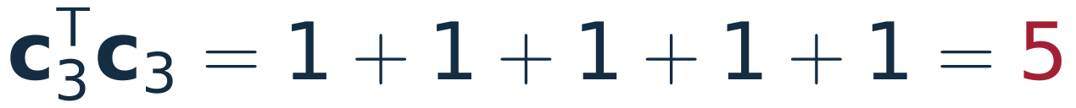
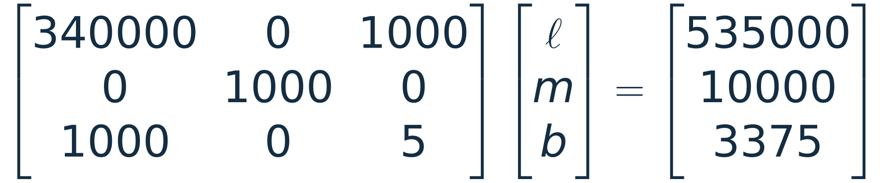
The glider: XᵀX and Xᵀy, step by step
column i of X times column j; column i times the data
Notes:
About 3 minutes. Example 4.1(a) to (c) of the notes, with every product written out. The rows of X^T are the columns c1, c2, c3 of X, so each entry is a dot product of two columns. Click 1: the six distinct entries of X^T X (it is symmetric). The two zeros come from the symmetric positions: the terms for x and -x cancel. Click 2: the three entries of X^T y. Click 3: the normal equations. Click 4: the middle equation stands alone (m = 10); subtracting 200 times the third from the first gives l = -1, then b = 875. Matching y = -(kappa/2) x^2 + kappa x0 x + (kappa/2)(A^2 - x0^2): kappa = -2 l = 2 mJ/cm^2 = 20 N/m, x0 = 5 cm, peak 900 mJ, A = 30 cm.

Slide 16
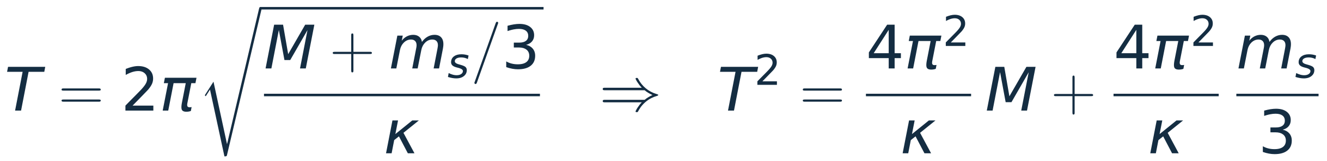
Experiment: a mass on a spring
M (g) | T (s)
50 | 0.486
100 | 0.659
150 | 0.794
200 | 0.910
250 | 1.013
300 | 1.105
Period from 10 oscillations.
Animation slowed down 4×.
M
Given. Six masses M hang in turn on a spring of mass mₛ (synthetic data).
Find. The spring constant κ and the spring's own mass mₛ.
Answer. Columns M and 1 for T². Slope 3.941 s²/kg gives κ = 4π²/slope = 10.02 N/m.
Intercept 0.0396 s² = slope × mₛ/3, so mₛ = 30.2 g (30 g in the simulation).
The fitted line meets T² = 0 at M = −10.1 g = −mₛ/3. Synthetic: κ = 10 N/m, mₛ = 30 g, 0.4% timing noise, seed 29.
Notes:
About 2 minutes; skip if short of time. The mass bobs when the slide opens (slowed down 4 times). T^2 is linear in M, with the spring's own mass entering as m_s/3 (a standard result for a uniform spring). Click 1: the line and the slope, which gives kappa. Click 2: the intercept, which gives the spring's mass: the line crosses T^2 = 0 at M = -m_s/3. The intercept is the less certain of the two numbers; with 0.4% timing noise it moves by a few grams from run to run.

Slide 17
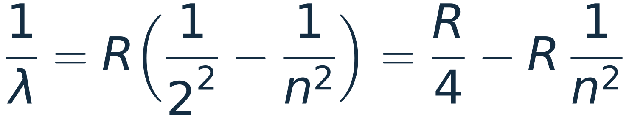
Experiment: the hydrogen atom, Bohr's model
n = 4
Click: the electron drops from n = 3 to n = 2 and emits a photon.
n = 3
n = 2
Hα, 656 nm
Given. Five Balmer lines (n = 3 to 7 → 2) in air: 656.28, 486.13, 434.05, 410.17, 397.01 nm, converted to vacuum.
Find. R, and is the intercept R/4, as Bohr predicts?
Answer. Columns 1 and 1/n². Slope: R = 1.096775 × 10⁷ m⁻¹ (hydrogen, accepted 1.096776 × 10⁷).
4 × intercept = 1.096785 × 10⁷ m⁻¹, the same to 1 part in 10⁵. The intercept is the series limit, 364.70 nm.
Air wavelengths: Tatum, Stellar Atmospheres §7.3; vacuum by Edlén's formula. The line meets 1/n² = 0 at the series limit.
Notes:
About 2.5 minutes. When the slide opens the electron circles the n = 3 orbit (radii in the ratio 4 : 9 : 16, orbital periods in the ratio 8 : 27, both from Bohr's model). Click 1: it drops to n = 2 and a photon leaves: H-alpha, 656 nm. Bohr's model gives 1/lambda = R (1/4 - 1/n^2), a straight line in 1/n^2 with slope -R and intercept R/4. Fitting slope and intercept separately tests the model. Click 2: R = 1.096775e7 per metre from real wavelengths; the accepted value for hydrogen is 1.096776e7 (R_infinity corrected for the proton's finite mass). Click 3: 4 x intercept agrees to 1 part in 10^5. Air wavelengths are 0.03% shorter than vacuum ones; skipping that conversion gives R = 1.0971e7, a visible error.

Slide 18
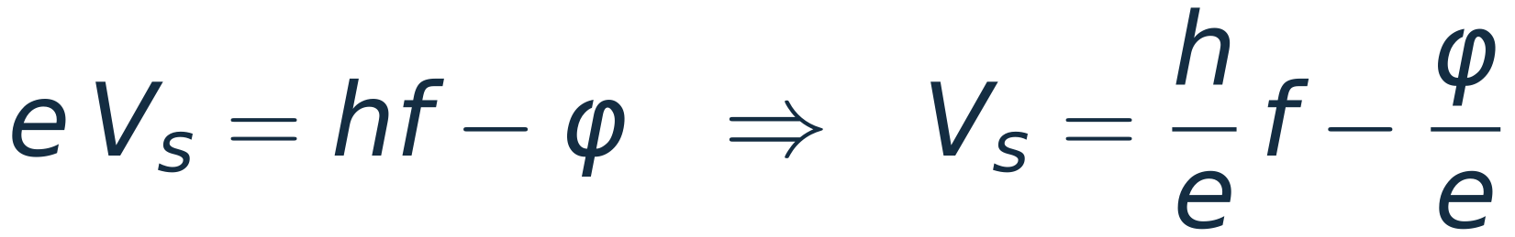
Experiment: the photoelectric effect
−Vₛ on the collector turns the fastest electrons back just in time.
Hg lamp light
metal (φ)
collector
Given. Mercury lines 365.0, 404.7, 435.8, 546.1 nm; stopping voltages 1.510, 1.175, 0.944, 0.380 V (synthetic).
Find. Planck's constant h and the work function φ.
Answer. Columns f and 1, with f in units of 10¹⁴ Hz (slide 12). Slope: h = 6.65 × 10⁻³⁴ J s (6.626 × 10⁻³⁴).
Intercept: φ = 1.90 eV. Light beyond 654 nm ejects no electrons.
Hg wavelengths: RP Photonics, standard spectral lines. Synthetic: φ = 1.90 eV, 15 mV noise, seed 32.
Notes:
About 2 minutes. Photons from the lamp eject electrons from the metal; a reverse voltage on the collector slows them, and at the stopping voltage the fastest ones turn back just before arriving (the animation shows them slowing and returning). Einstein: e Vs = h f - phi, linear in h/e and phi/e. Click 1: the slope gives h within 0.4% of 6.626e-34 J s. Frequencies near 1e14 Hz next to a column of ones are the time-stamp problem of slide 12 again; measuring f in units of 1e14 Hz avoids it. Click 2: the intercept gives the work function, and the line meets Vs = 0 at the threshold frequency.

Slide 19
Six fits from the lab
1
Circuits
RC discharge
2
Optics
Dispersion of N-BK7
3
Electromagnetism
WR-90 waveguide
ln V = ln V₀ − t/τ
n = A + B/λ²
f² = f_{c}² + c²/λ_{g}²
columns of X: t, 1
columns of X: 1, 1/λ²
columns of X: 1/λ_{g}², 1
4
Water waves
Tides at Boston
5
Nonlinear optics
Second-harmonic power
6
Structured light
Centre of a ring beam
h = Z₀ + Σ (p cos ωt + q sin ωt)
log P₂ = log η + p log P
x² + y² = 2ax + 2by + c
columns of X: 1, cos ωt, sin ωt
columns of X: log P, 1
columns of X: 2x, 2y, 1
After a change of variables each model is linear in its unknowns: ln V₀ and 1/τ; A and B; f_{c}² and c²; the cos and sin coefficients; log η and p; a, b and c.
Notes:
One minute. Six fits from fields where least squares is routine. In every case the trick is the same: rewrite the model so the unknowns multiply known columns. Each of the next six slides is Given, Find, Answer, about two minutes each.

Slide 20
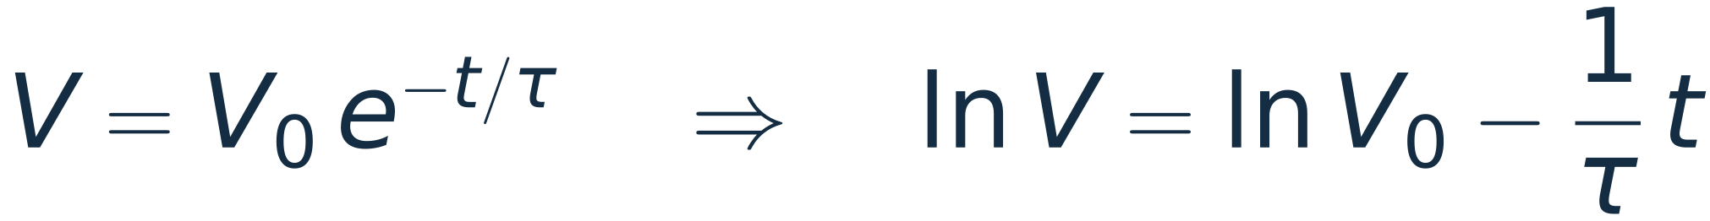
Circuits: the time constant of an RC discharge
Given. A 4.7 µF capacitor discharges through 10 kΩ; 16 voltage samples over 150 ms, 1% noise (synthetic).
Find. τ and V₀ from a straight-line fit.
Answer. Columns t and 1 for ln V. Slope −21.288 s⁻¹, so τ = 46.98 ms (47.00 nominal), V₀ = 4.992 V.
The noise is 1% of V, so after the log every point has the same error size and equal weights are right.
Synthetic data: V₀ = 5 V, τ = 47 ms, 1% multiplicative noise, seed 3.
Notes:
About 2 minutes. The model is not linear in tau, but ln V is linear in ln V0 and 1/tau. Click 1: the fit. Click 2: taking logs changes how errors are weighted; it is right here because the noise is a percentage. With a fixed noise in volts the late, small voltages would be over-weighted after the log.

Slide 21
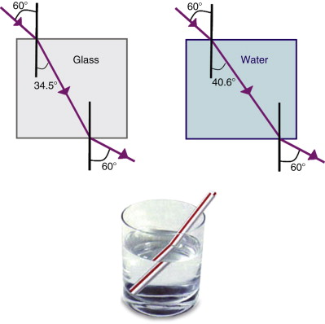
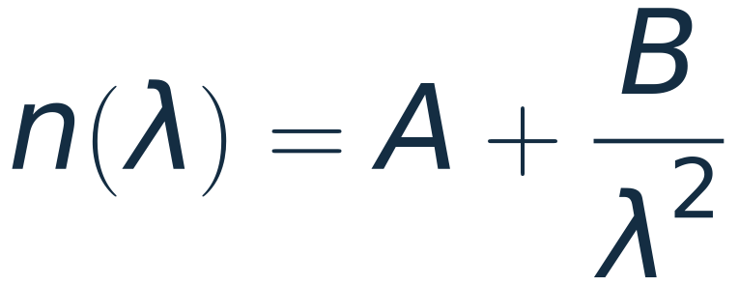
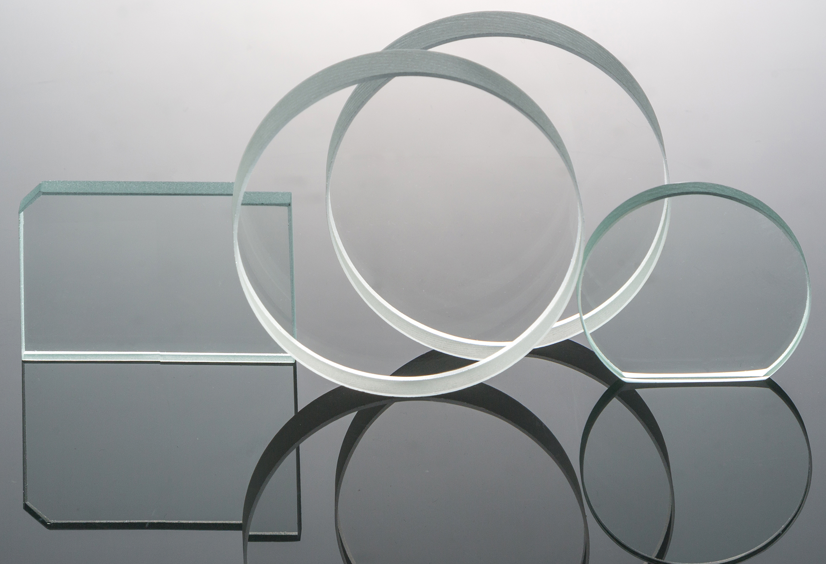
Optics: Cauchy's equation for N-BK7
Given. SCHOTT's N-BK7 indices at 11 spectral lines from 404.7 to 706.5 nm.
Find. A and B in n = A + B/λ²; how well does it fit, and does it hold at 1060 nm?
Answer. Columns 1 and 1/λ²: A = 1.50457, B = 0.00421 µm²; rms misfit 4.3 × 10⁻⁵.
At 1060 nm Cauchy gives 1.50831, the data sheet 1.50669: off by 1.6 × 10⁻³, about 40 times the misfit. A fit says little outside its data.
Data: SCHOTT N-BK7 data sheet (1 Feb 2014), via Edmund Optics.
Notes:
About 2.5 minutes. Real data. The model is a curve in lambda but linear in A and B: the columns are 1 and 1/lambda^2. Click 1: the fit, rms misfit 4.3e-5 across the visible. Click 2: extrapolate to 1060 nm, near the Nd:YAG line at 1064 nm: off by 1.6e-3, about 40 times the misfit inside the range. SCHOTT's own formula is the three-term Sellmeier equation, which matches its table to about 1e-5 from 0.3 to 2.3 um. Do not add a 1/lambda^4 column here: polynomial-type models are left for the problem set.

Slide 22
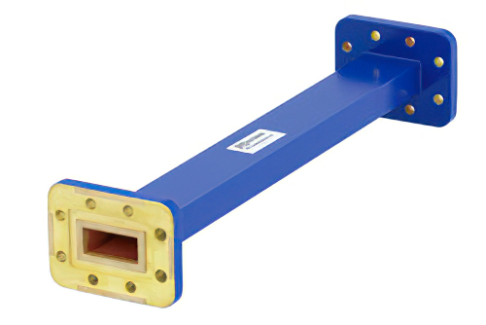
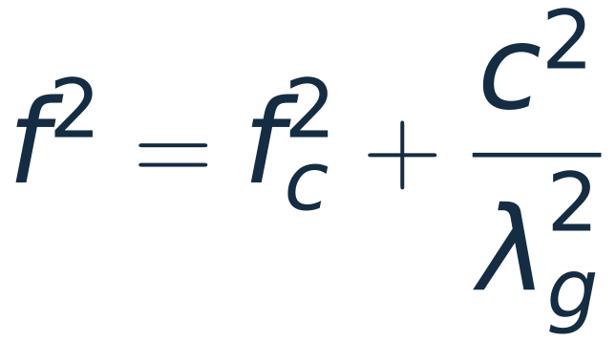
Electromagnetism: the WR-90 cut-off
Given. X-band guide, broad wall a = 22.86 mm. Guide wavelength λ_{g} read with a slotted line at 8 frequencies, 8.2 to 12.4 GHz, 0.3% reading error (synthetic).
Find. The cut-off f_{c} and the speed of light c in the air-filled guide.
Answer. Plot f² against 1/λ_{g}²: a straight line. The slope c² gives c = 2.994 × 10⁸ m/s; the intercept gives f_{c} = 6.565 GHz.
Theory: f_{c} = c/2a = 6.557 GHz for the TE₁₀ mode. Change variables until the unknowns enter linearly.
Synthetic: exact TE₁₀ dispersion plus 0.3% noise, seed 5.
Notes:
About 2 minutes. The dispersion relation of the TE10 mode, f^2 = fc^2 + c^2/lambda_g^2, with f^2 and 1/lambda_g^2 as the plotted variables. Click 1: slope c^2, intercept fc^2; c comes out 0.14% low because of the 0.3% reading error. Click 2: fc = c/(2a) = 6.557 GHz for a = 22.86 mm. Compare the WR-90 slide in the Lecture 7 deck, where the same cut-offs came from eigenvalues.

Slide 23
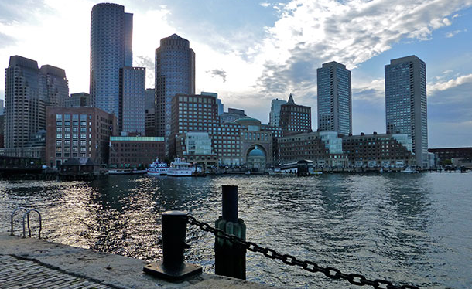
The tide at Boston

Slide 24
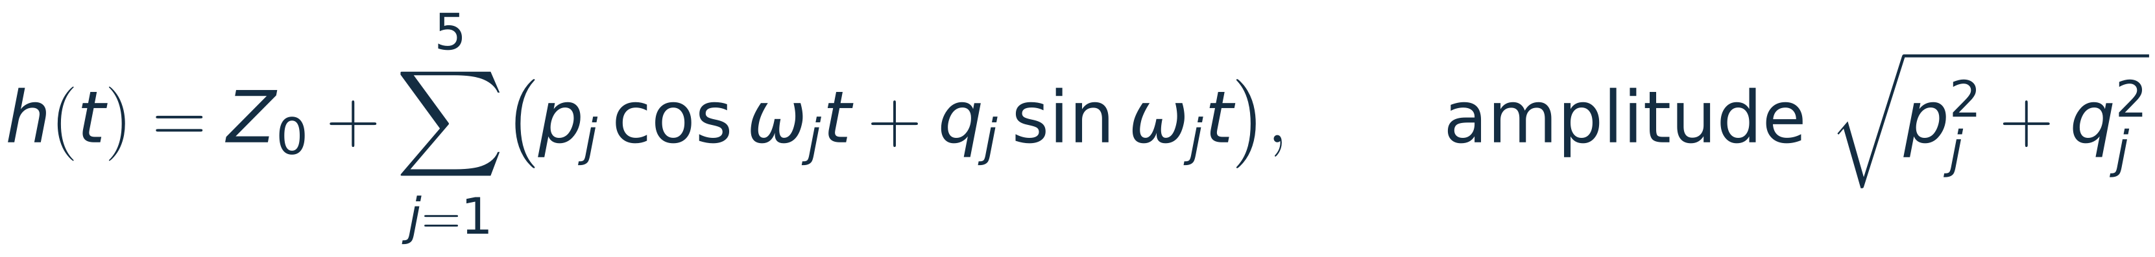
Water waves: harmonic analysis of the tide at Boston
Given. 29 days of hourly heights (696 values), built from NOAA's five largest constituents at Boston plus 8 cm of random noise.
Find. The amplitude and phase of each constituent.
Answer. 696 equations, 11 unknowns (a cos and a sin column per constituent). M2 comes out 1.365 m against NOAA's 1.371 m.
 | Period (h) | Amplitude (m) fit / NOAA | Phase (°) fit / used
M2 | 12.42 | 1.365 / 1.371 | 323.9 / 324.2
S2 | 12.00 | 0.206 / 0.208 | 355.4 / 356.2
N2 | 12.66 | 0.305 / 0.305 | 294.8 / 294.5
K1 | 23.93 | 0.148 / 0.143 | 131.7 / 130.4
O1 | 25.82 | 0.116 / 0.116 | 116.1 / 117.4
With its columns scaled to equal length, cond(X) = 1.06: over 29 days these 11 columns are nearly orthogonal, so M2, S2 and N2 separate.
Amplitudes: NOAA station 8443970 (Boston), converted from feet. Record synthetic, seed 29.
Notes:
About 2.5 minutes; skip if short of time. Tide prediction is least squares with cos and sin columns at known astronomical frequencies (NOAA publishes the constants). Click 1: the fit and the table; M2 1.365 m against 1.371 m, every amplitude within 6 mm. Click 2: 29 days is long enough to separate M2 (12.42 h) from S2 (12.00 h) and N2 (12.66 h), so the 11 columns are nearly orthogonal and cond(X) is 1.46 (1.06 with the columns scaled; the ones column is longer than the cos and sin columns by sqrt 2). With 3 days of data they would not separate (cond about 73). This holds for a record built from these five constituents: a real 29-day record cannot separate K2 from S2 or P1 from K1, which needs about six months or inference from a nearby station. Simplifications: no nodal corrections, phases relative to t = 0, white noise in place of weather.

Slide 25
Nonlinear optics: the second-harmonic exponent
Given. Second-harmonic power at 16 pump powers from 0.01 to 4 W, 3% noise (synthetic, with pump depletion at the top).
Find. The exponent p in P₂ ∝ P^{p}.
Answer. Columns log P and 1. The 10 points below 0.4 W give slope 1.99: a second-order process.
All 16 points give 1.93. At 4 W, 58% of the pump is converted, so P₂ grows more slowly. Fit only where the model holds.
Synthetic: P₂ = P tanh²(√(0.25 P)), 3% noise, seed 7.
Notes:
About 2 minutes. A log-log plot turns a power law into a straight line whose slope is the exponent. Click 1: the low-power points give 1.99, the signature of a second-order process (the same check is used for two-photon absorption, slope 2, and third-harmonic generation, slope 3). Click 2: including the depleted points pulls the slope down to 1.93. The model here is the undepleted-to-depleted SHG law P2 = P tanh^2(sqrt(eta P)) with eta = 0.25 per W.

Slide 26
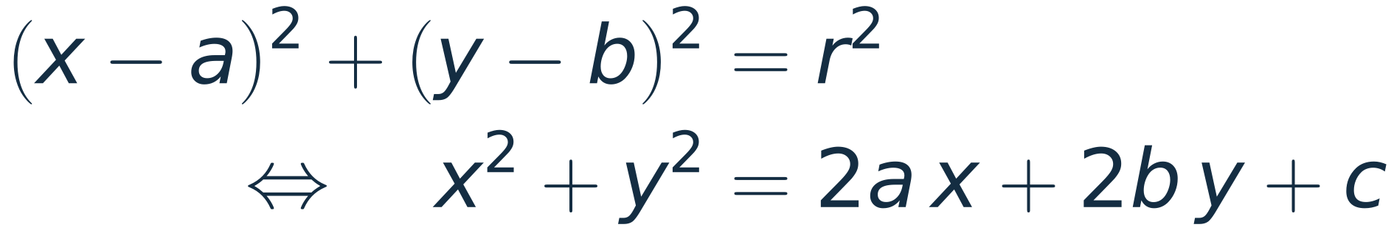
Structured light: the centre of a ring beam
Given. 36 edge points of a ring-shaped (Laguerre–Gauss) beam on a camera, at uneven angles, 1.5 px noise (synthetic).
Find. The centre and the radius.
Answer. With c = r² − a² − b² the unknowns a, b, c enter linearly: columns 2x, 2y, 1. Centre (312.6, 240.8) px, radius 84.5 px (true 312.4, 240.7 and 85).
The mean of the points, (325.2, 230.3), is 16.5 px off: the points are not spread evenly around the ring.
Synthetic: centre (312.4, 240.7) px, radius 85 px, seed 13.
Notes:
About 2 minutes; skip if short of time. Expanding the circle equation moves the unknowns into a, b and c = r^2 - a^2 - b^2, which enter linearly: this is the algebraic (Kasa) circle fit, a common first step for locating beams, pupils and rings. Click 1: the fit, within 0.3 px of the true centre. Click 2: the naive answer, the mean of the points, is 16.5 px off. Two independent variables (x and y), so this is the multivariate case of Section 6.

Slide 27
Summary
Example | Columns of X | Result | Lesson
Five points | x, 1 | y = 3x − 1, ēᵀē = 10 | the right angle gives the normal equations
Time stamps | t − t₀, 1 | 0.01998 K/min | shift the columns first
Glider on springs | x², x, 1 | κ = 20 N/m, x₀ = 5 cm | a parabola is still linear in ℓ, m, b
Mass on a spring | M, 1 | κ = 10.02 N/m, mₛ = 30.2 g | the intercept has a meaning
Hydrogen (Bohr) | 1, 1/n² | R = 1.096775 × 10⁷ m⁻¹ | fit both parameters to test a model
Photoelectric | f, 1 | h = 6.65 × 10⁻³⁴ J s | choose sensible units
RC discharge | t, 1 | τ = 46.98 ms | logs make it linear
N-BK7 | 1, 1/λ² | A = 1.5046 | do not extrapolate
WR-90 | 1/λ_{g}², 1 | f_{c} = 6.565 GHz | change variables
Tides | 1, cos ωt, sin ωt | M2: 1.365 m | orthogonal columns
SHG | log P, 1 | p = 1.99 | choose the range
Ring beam | 2x, 2y, 1 | (312.6, 240.8) px | linear in a, b, c
Notes:
About 1.5 minutes. Read down the last column: each example adds one habit. The common thread is the notes' Key idea in Section 4: least squares only needs the unknowns to enter linearly, and every fit here solves the same normal equations.

Slide 28
Questions for the room
1
Add 2 to every yᵢ in the five points. What happens to k̄ and b̄?
2
A sixth point (4, 11) is added. Does the best line change?
k̄ = 3 still and b̄ = 1: the shift lies in col(X) (it is 2 times the column of ones), so ē is unchanged.
No. It lies on y = 3x − 1, so the old k̄ still satisfies the new normal equations; ēᵀē stays 10.
3
With raw time stamps, what goes wrong, and what one line fixes it?
4
Is V = V₀ exp(−t/τ) linear in its unknowns?
The normal equations keep 4 digits and lstsq treats X as rank one. Subtract the first time stamp.
Not in τ. ln V = ln V₀ − t/τ is linear in ln V₀ and 1/τ; the log also reweights the errors.
Notes:
About 4 minutes. Answers appear one click each. Q1: X^T(y + 2*ones) = X^T y + 2 X^T a2, so the solution moves by (0, 2): only the intercept changes. Q2: the new point has zero residual at the old k-bar, so the old k-bar still solves the enlarged normal equations. Q3: slides 12 and 13. Q4: slide 20; the log turns multiplicative noise into additive noise, which is right for percentage errors only.

Slide 29
Appendix A: the five points
import numpy as np # arrays and linear algebra
x = np.array([1.0, 3.0, 4.0, 5.0, 7.0]) # the five x values
y = np.array([3.0, 7.0, 9.0, 16.0, 20.0]) # the five measurements
X = np.column_stack([x, np.ones_like(x)]) # columns: x, then ones
XtX = X.T @ X # [[sum x^2, sum x], [sum x, m]]
Xty = X.T @ y # [sum x y, sum y]
k = np.linalg.solve(XtX, Xty) # normal equations X^T X k = X^T y
e = y - X @ k # residual at the best line
guess = y - X @ np.array([2.0, 1.0]) # error of the guess y = 2x + 1
r = lambda v: np.round(v, 10) + 0.0 # round off last-digit noise
print("X^T X =", r(XtX).tolist()) # [[100, 20], [20, 5]]
print("X^T y =", r(Xty)) # [280, 55]
print("k, b =", r(k)) # [3, -1]: y = 3x - 1
print("residual =", r(e)) # [1, -1, -2, 2, 0]
print("X^T e =", r(X.T @ e)) # [0, 0]: e is perpendicular to col(X)
print("e.e =", r(e @ e)) # 10, the smallest possible
print("guess e.e =", r(guess @ guess)) # 50 = 10 + 40
L11_least_squares.py: numpy only, every line commented; it prints the numbers on these slides.
Notes:
Reference slide, not presented. Lines from L11_least_squares.py.

Slide 30
Appendix B: raw time stamps
import numpy as np # arrays and linear algebra
t0 = 1792573200.0 # 21 Oct 2026, 09:00 UTC, in Unix seconds
t = t0 + 60.0 * np.arange(61) # one reading a minute for an hour
rng = np.random.default_rng(11) # fixed seed, same numbers every run
y = 21.0 + (0.02 / 60) * (t - t0) \
+ 0.01 * rng.standard_normal(t.size) # 21 C, drifting 0.02 K/min, 0.01 K noise
def routes(X): # solve the same fit two ways
return {"normal equations": np.linalg.solve(X.T @ X, X.T @ y),
"lstsq": np.linalg.lstsq(X, y, rcond=None)[0]}
X_raw = np.column_stack([t, np.ones_like(t)]) # columns: raw time stamps, ones
X_new = np.column_stack([t - t0, np.ones_like(t)]) # columns: seconds since t0, ones
k_ref = routes(X_new)["lstsq"][0] # reference slope from the shifted fit
for name, X in [("raw t", X_raw), ("t - t0", X_new)]:
print(f"{name}: cond(X) = {np.linalg.cond(X):.1e}") # 3.0e+15, then 4.1e+03
for route, k in routes(X).items(): # each route's slope and its error
err = abs(k[0] - k_ref) / abs(k_ref) # relative error in the slope
print(f" {route:16s} slope {60 * k[0]:.6g} K/min rel. error {err:.0e}")
L11_conditioning.py: numpy only, every line commented; it prints the numbers on these slides.
Notes:
Reference slide, not presented. Lines from L11_conditioning.py.

Slide 31
Appendix C: RC discharge and N-BK7
import numpy as np # arrays and linear algebra
def fit(columns, rhs): # least squares for X k = rhs
X = np.column_stack(columns) # build X from its columns
return np.linalg.lstsq(X, rhs, rcond=None)[0] # numpy least-squares solver
# 1. Circuits: RC discharge, V = V0 exp(-t/tau), so ln V = ln V0 - t/tau
t = np.linspace(0.0, 0.15, 16) # 16 samples over 150 ms
rng = np.random.default_rng(3) # fixed seed (synthetic data)
V = 5.0 * np.exp(-t / 0.047) \
* (1 + 0.01 * rng.standard_normal(t.size)) # 10 kOhm, 4.7 uF, 1% noise
s, c = fit([t, np.ones_like(t)], np.log(V)) # straight line through (t, ln V)
print(f"RC: tau = {-1e3 / s:.2f} ms (47.00), V0 = {np.exp(c):.3f} V (5.000)")
# 2. Optics: Cauchy's equation n = A + B / lambda^2 for N-BK7 (SCHOTT data sheet)
lam = np.array([404.7, 435.8, 480.0, 486.1, 546.1, 587.6,
589.3, 632.8, 643.8, 656.3, 706.5]) / 1e3 # wavelength in um
n = np.array([1.53024, 1.52668, 1.52283, 1.52238, 1.51872, 1.51680,
1.51673, 1.51509, 1.51472, 1.51432, 1.51289]) # refractive index
A, B = fit([np.ones_like(lam), 1 / lam**2], n) # columns 1 and 1/lambda^2
rms = np.sqrt(np.mean((n - A - B / lam**2) ** 2)) # size of the misfit
print(f"BK7: A = {A:.5f}, B = {B:.5f} um^2, rms misfit {rms:.1e}")
print(f" at 1.060 um: Cauchy {A + B / 1.06**2:.5f}, data sheet 1.50669")
L11_applications.py: numpy only, every line commented; it prints the numbers on these slides.
Notes:
Reference slide, not presented. Lines from L11_applications.py.

Slide 32
Appendix D: WR-90 and the tides
# 3. EM: WR-90 waveguide, f^2 = fc^2 + c^2 / lambda_g^2
c0, a = 299792458.0, 22.86e-3 # speed of light; broad wall 22.86 mm
f = np.linspace(8.2e9, 12.4e9, 8) # 8 frequencies across X band
lg = c0 / np.sqrt(f**2 - (c0 / (2 * a)) ** 2) \
* (1 + 0.003 * np.random.default_rng(5).standard_normal(f.size)) # 0.3% reading error
s, c = fit([1 / lg**2, np.ones_like(f)], f**2) # slope c^2, intercept fc^2
print(f"WR-90: c = {np.sqrt(s):.4e} m/s, fc = {np.sqrt(c) / 1e9:.3f} GHz (6.557)")
# 4. Water waves: tides at Boston, 29 days of hourly heights, five constituents
h_t = np.arange(29 * 24.0) # time in hours
speed = {"M2": 28.984104, "S2": 30.0, "N2": 28.43973,
"K1": 15.041069, "O1": 13.943035} # degrees per hour (NOAA)
amp = {"M2": 1.371, "S2": 0.208, "N2": 0.305,
"K1": 0.143, "O1": 0.116} # metres (NOAA 8443970, from feet)
phase = {"M2": 324.2, "S2": 356.2, "N2": 294.5,
"K1": 130.4, "O1": 117.4} # degrees (NOAA local phases)
h = sum(amp[k] * np.cos(np.radians(speed[k] * h_t - phase[k])) for k in speed) \
+ 0.08 * np.random.default_rng(29).standard_normal(h_t.size) # 8 cm of weather
cols = [np.ones_like(h_t)] # first column: mean level
for k in speed: # two columns per constituent
cols += [np.cos(np.radians(speed[k] * h_t)), np.sin(np.radians(speed[k] * h_t))]
coef = fit(cols, h) # 696 equations, 11 unknowns
print(f"Tides: cond(X) = {np.linalg.cond(np.column_stack(cols)):.2f}")
for j, k in enumerate(speed): # amplitude and phase of each
p, q = coef[1 + 2 * j], coef[2 + 2 * j] # cos and sin coefficients
print(f" {k}: {np.hypot(p, q):.3f} m ({amp[k]:.3f}), "
f"{np.degrees(np.arctan2(q, p)) % 360:.1f} deg ({phase[k]})")
L11_applications.py: numpy only, every line commented; it prints the numbers on these slides.
Notes:
Reference slide, not presented. Lines from L11_applications.py.

Slide 33
Appendix E: second harmonic and the ring beam
# 5. Nonlinear optics: second-harmonic power P2 = eta P^2 at low pump power
P = np.geomspace(0.01, 4.0, 16) # pump power in W
P2 = P * np.tanh(np.sqrt(0.25 * P)) ** 2 \
* (1 + 0.03 * np.random.default_rng(7).standard_normal(P.size)) # with depletion
low = P < 0.4 # the undepleted range
for name, m in [("P < 0.4 W", low), ("all points", P > 0)]:
p, q = fit([np.log10(P[m]), np.ones(m.sum())], np.log10(P2[m])) # log-log line
print(f"SHG {name}: slope {p:.2f}, eta = {10**q:.3f} /W")
# 6. Structured light: centre of a ring beam, x^2 + y^2 = 2 a x + 2 b y + c
rng = np.random.default_rng(13) # fixed seed (synthetic data)
th = np.sort(rng.uniform(0, 2 * np.pi, 36)) # 36 edge points, uneven angles
xs = 312.4 + 85 * np.cos(th) + 1.5 * rng.standard_normal(th.size) # pixels
ys = 240.7 + 85 * np.sin(th) + 1.5 * rng.standard_normal(th.size) # pixels
a, b, c = fit([2 * xs, 2 * ys, np.ones_like(xs)], xs**2 + ys**2) # linear in a, b, c
print(f"Ring: centre ({a:.1f}, {b:.1f}) px, radius {np.sqrt(c + a*a + b*b):.1f} px")
print(f" mean of the points ({xs.mean():.1f}, {ys.mean():.1f}) px")
L11_applications.py: numpy only, every line commented; it prints the numbers on these slides.
Notes:
Reference slide, not presented. Lines from L11_applications.py.

Slide 34
Appendix F: the glider and the spring
import numpy as np # arrays and linear algebra
def fit(columns, rhs): # least squares for X k = rhs
X = np.column_stack(columns) # build X from its columns
return np.linalg.solve(X.T @ X, X.T @ rhs) # normal equations X^T X k = X^T y
# 1. Glider on springs (notes, Example 4.1): kinetic energy y against position x
x = np.array([-20.0, -10.0, 0.0, 10.0, 20.0]) # photogate positions, cm
y = np.array([274.0, 673.0, 887.0, 861.0, 680.0]) # kinetic energy, mJ
l, m, b = fit([x**2, x, np.ones_like(x)], y) # columns x^2, x, 1
print(f"Glider: y = {l:.3f} x^2 + {m:.3f} x + {b:.1f}")
print(f" kappa = {-2 * l * 10:.1f} N/m, x0 = {-m / (2 * l):.2f} cm, "
f"A = {np.sqrt((b - m**2 / (4 * l)) / -l):.1f} cm") # 1 mJ/cm^2 = 10 N/m
# 2. Mass on a spring: T^2 = (4 pi^2 / kappa) (M + ms/3), synthetic
M = np.array([0.05, 0.10, 0.15, 0.20, 0.25, 0.30]) # hanging mass, kg
T = np.round(2 * np.pi * np.sqrt((M + 0.010) / 10.0)
* (1 + 0.004 * np.random.default_rng(29).standard_normal(6)), 3) # period, s
s, c = fit([M, np.ones_like(M)], T**2) # columns M, 1
print(f"Spring: T = {T.tolist()} s")
print(f" kappa = {4 * np.pi**2 / s:.2f} N/m, spring mass = {3 * c / s * 1e3:.1f} g")
L11_experiments.py: numpy only, every line commented; it prints the numbers on these slides.
Notes:
Reference slide, not presented. Lines from L11_experiments.py.

Slide 35
Appendix G: hydrogen and the photoelectric effect
# 3. Bohr model: hydrogen Balmer lines, 1/lambda = R/4 - R/n^2
air = np.array([656.28, 486.13, 434.05, 410.17, 397.01]) # nm, in air (Tatum, NIST)
n = np.array([3, 4, 5, 6, 7]) # upper level of each line
vac = air.copy()
for _ in range(5): # Edlen (1966): air -> vacuum
s2 = (1e3 / vac) ** 2 # wavenumber squared, um^-2
vac = air * (1 + 1e-8 * (8342.54 + 2406147 / (130 - s2) + 15998 / (38.9 - s2)))
A, B = fit([np.ones(5), 1.0 / n**2], 1e9 / vac) # columns 1 and 1/n^2
print(f"Bohr: R = {-B:.6e} 1/m, 4A = {4 * A:.6e} 1/m")
print(f" series limit {1e9 / A:.2f} nm")
# 4. Photoelectric effect: e Vs = h f - phi, mercury lines, synthetic stopping voltages
lam = np.array([365.0146, 404.6561, 435.8328, 546.074]) # Hg lines, nm
f = 299792458.0 / (lam * 1e-9) / 1e14 # frequency in units of 1e14 Hz
Vs = np.round(6.62607015e-34 / 1.602176634e-19 * f * 1e14 - 1.90
+ 0.015 * np.random.default_rng(32).standard_normal(4), 3) # volts
p, q = fit([f, np.ones_like(f)], Vs) # columns f, 1
print(f"Photo: Vs = {Vs.tolist()} V")
print(f" h = {p * 1e-14 * 1.602176634e-19:.4e} J s, phi = {-q:.3f} eV, "
f"threshold {299792458.0 / (-q / p * 1e14) * 1e9:.0f} nm")
L11_experiments.py: numpy only, every line commented; it prints the numbers on these slides.
Notes:
Reference slide, not presented. Lines from L11_experiments.py.

Slide 36
Appendix H: printed output
L11_least_squares.py
X^T X = [[100.0, 20.0], [20.0, 5.0]]
X^T y = [280. 55.]
k, b = [ 3. -1.]
residual = [ 1. -1. -2. 2. 0.]
X^T e = [0. 0.]
e.e = 10.0
guess e.e = 50.0
L11_applications.py
RC: tau = 46.98 ms (47.00), V0 = 4.992 V (5.000)
BK7: A = 1.50457, B = 0.00421 um^2, rms misfit 4.3e-05
at 1.060 um: Cauchy 1.50831, data sheet 1.50669
WR-90: c = 2.9937e+08 m/s, fc = 6.565 GHz (6.557)
Tides: cond(X) = 1.46
M2: 1.365 m (1.371), 323.9 deg (324.2)
S2: 0.206 m (0.208), 355.4 deg (356.2)
N2: 0.305 m (0.305), 294.8 deg (294.5)
K1: 0.148 m (0.143), 131.7 deg (130.4)
O1: 0.116 m (0.116), 116.1 deg (117.4)
SHG P < 0.4 W: slope 1.99, eta = 0.234 /W
SHG all points: slope 1.93, eta = 0.200 /W
Ring: centre (312.6, 240.8) px, radius 84.5 px
mean of the points (325.2, 230.3) px
L11_conditioning.py
raw t: cond(X) = 3.0e+15
normal equations slope 0.0199823 K/min rel. error 2e-04
lstsq slope 7.22962e-07 K/min rel. error 1e+00
t - t0: cond(X) = 4.1e+03
normal equations slope 0.0199783 K/min rel. error 1e-14
lstsq slope 0.0199783 K/min rel. error 0e+00
L11_experiments.py
Glider: y = -1.000 x^2 + 10.000 x + 875.0
kappa = 20.0 N/m, x0 = 5.00 cm, A = 30.0 cm
Spring: T = [0.486, 0.659, 0.794, 0.91, 1.013, 1.105] s
kappa = 10.02 N/m, spring mass = 30.2 g
Bohr: R = 1.096775e+07 1/m, 4A = 1.096785e+07 1/m
series limit 364.70 nm
Photo: Vs = [1.51, 1.175, 0.944, 0.38] V
h = 6.6523e-34 J s, phi = 1.903 eV, threshold 654 nm
Notes:
Reference slide. Exactly what the four scripts print (numpy 2.x).

