Slide 1
Chang Gung University RNA seq workshop Aug 2023 Mechanics
Windows subsystem for Linux (WSL)
This is Linux running on a Microsoft Windows PC
Rstudio server
http://127.0.0.1:8787
123qwe

Slide 2
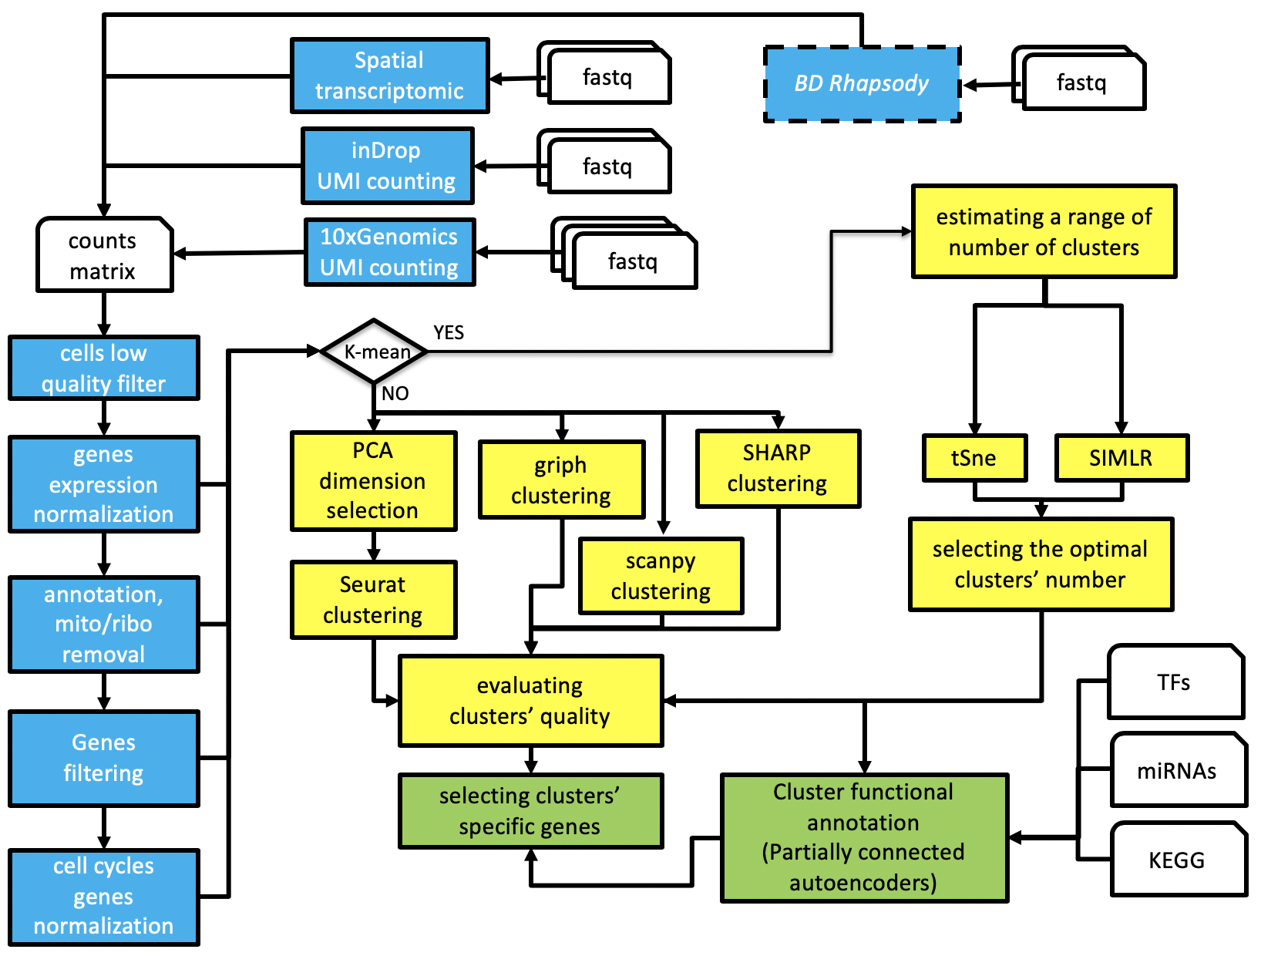
Another single cell RNA seq workflow
https://kendomaniac.github.io/rCASC/articles/rCASC_vignette.html

Slide 3
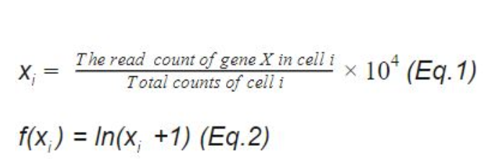
Normalization of UMI counts
“LogNormalize” (default in Seurat function NormalizeData)
https://satijalab.org/seurat/reference/normalizedata
https://blog.bioturing.com/2022/01/27/a-guide-to-scrna-seq-normalization/
Problems with this approach shown in
https://genomebiology-biomedcentral/articles/10.1186/s13059-019-1874-1
which offers alternative sctransform
sctransform handles UMI count normalization and identification of highly variable transcripts

