Slide 1
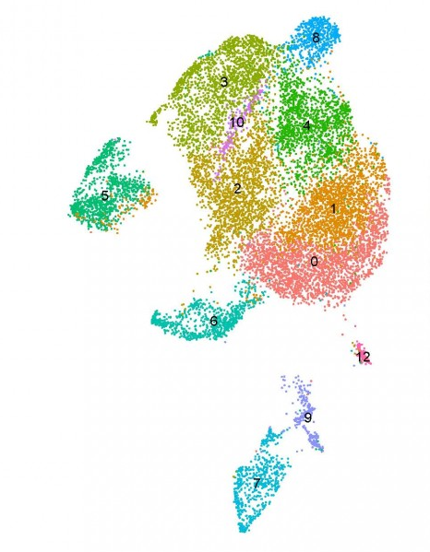

Single cell RNA-seq analysis workshop at Chang Gung University Molecular Medicine Research Center
Steven G. Rozen
with contributions from Ian Zhang, Chen-Yang Huang, Yinuo Zhang, and Yi Xie
steverozen@pm.me
August 29 to September 5, 2023
https://github.com/Rozen-Lab/Taiwan_RNAseq_Workshop
Notes:
25 minute talk

Slide 2




Thank you for sponsoring my visit and this workshop
| Graduate Institute of Biomedical Sciences
Dean Chun-Yen Lin 林俊彥教授, Dean of College of Medicine, CGU
Professor Ming-Ling Kuo 郭敏玲教授, Director, Graduate Institute of Biomedical Sciences, CGU
Dr Ian Y. F. Zhang 張益峯, Molecular Medicine Research Center, CGU

Slide 3
Chang Gung University RNA seq workshop Aug 2023 Mechanics
Windows subsystem for Linux (WSL)
This is Linux running on a Microsoft Windows PC
Rstudio server
http://127.0.0.1:8787
123qwe
github repo for workshop:
https://github.com/Rozen-Lab/Taiwan_RNAseq_Workshop

Slide 4
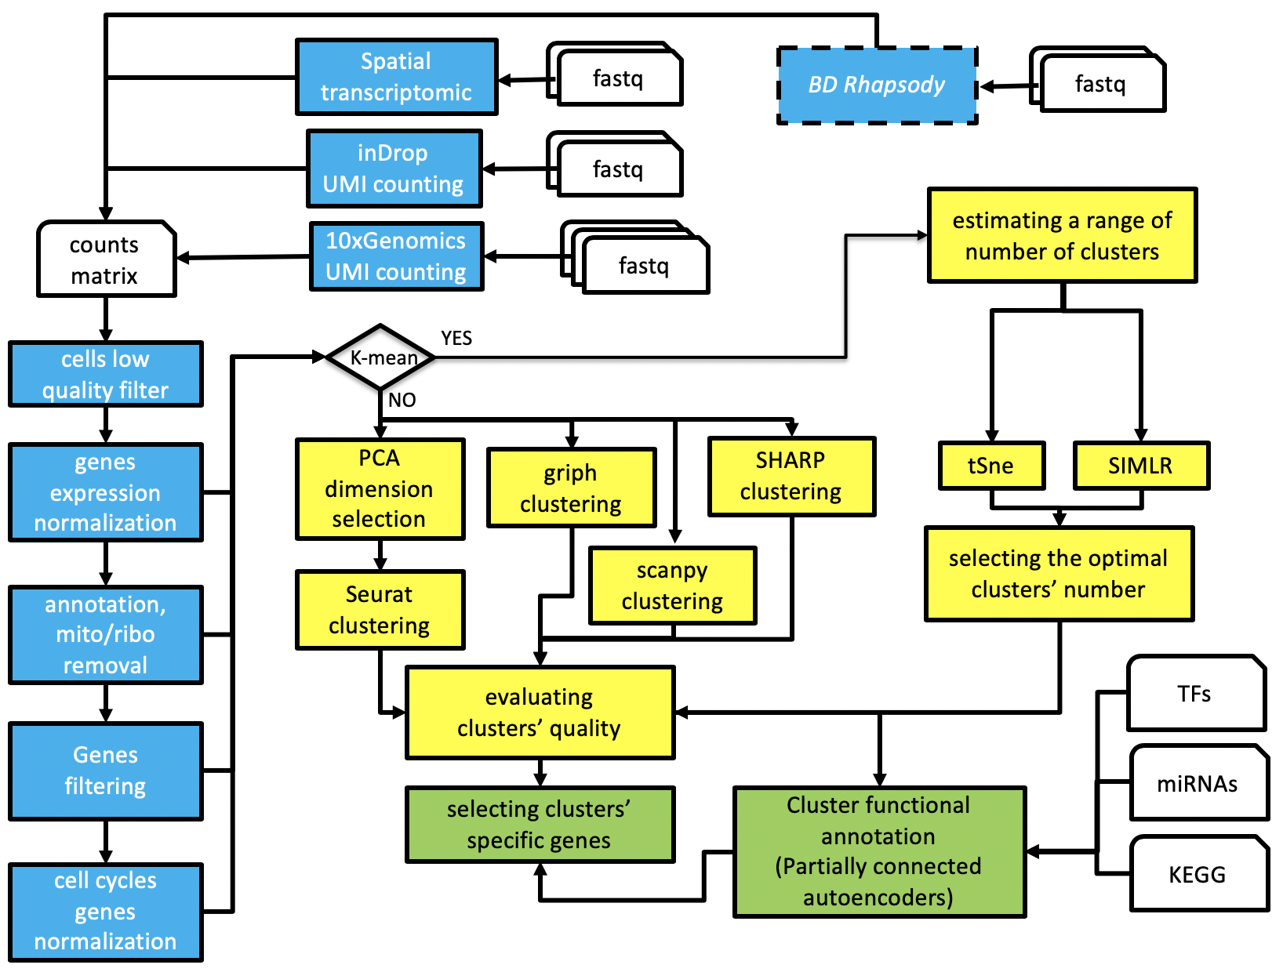
Another single cell RNA seq workflow
https://kendomaniac.github.io/rCASC/articles/rCASC_vignette.html

Slide 5
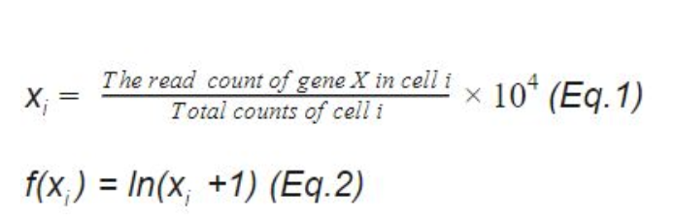
Normalization of UMI counts
“LogNormalize” (default in Seurat function NormalizeData)
https://satijalab.org/seurat/reference/normalizedata
https://blog.bioturing.com/2022/01/27/a-guide-to-scrna-seq-normalization/
Problems with this approach shown in
https://genomebiology-biomedcentral/articles/10.1186/s13059-019-1874-1
which offers alternative sctransform
sctransform handles UMI count normalization and identification of highly variable transcripts

Slide 6
Single cell RNA-seq Resources
Seurat tutorials: https://satijalab.org/seurat/articles/get_started
https://github.com/Rozen-Lab/Taiwan_RNAseq_Workshop/blob/main/chapter3-end.pdf
https://github.com/Rozen-Lab/Taiwan_RNAseq_Workshop/blob/main/chapter4.pdf

Slide 7
R Resources
R: 1 hour video: https://posit.co/resources/videos/a-gentle-introduction-to-tidy-statistics-in-r/
R: tutorial https://moderndive.netlify.app/
Another R tutorial based all on videos: https://rladiessydney.org/courses/ryouwithme/
Rstudio now (also) called Posit: https://posit.co/download/rstudio-desktop/
Rstudio is an IDE == “integrated development environment” (other IDE Vscode, Jupyter)

Slide 8
R in-class exercises
1. Load” the dplyr, nycflights13, and knitr packages
2. Write a function called huh that takes 3 arguments and prints their product and their sum; then run the function
syntax for function definition:
some.name <- function(….. arguments ….) {
# do something with arguments (# means ignore everything after it on the line)
}
product: x*y sum: x+y
power: x^y
bmi <- function(height=180, weight=80){
print(weight)
print(height)
print( weight / (height/100)^2 )
}

Slide 9
R exercise: new data, same pipeline through QC
new data are in ~/filtered_gene_bc_matrices/hg19/

