Slide 1
Frequent Patterns and Association Rules
Shen, Chih-Ya (沈之涯)
Assistant Professor
Department of Computer Science
National Tsing Hua University

Slide 2
PART
Frequent Pattern Analysis
01

Slide 3

1
Frequent Pattern Analysis
Frequent pattern: a pattern (a set of items, subsequences, substructures, etc.) that occurs frequently in a data set
Motivation: Finding inherent regularities in data
What products were often purchased together?
What are the subsequent purchases after buying a PC?
What kinds of DNA are sensitive to this new drug?
Can we automatically classify web documents?

Slide 4

1
What Is Frequent Pattern Analysis?
Applications
Basket data analysis
cross-marketing
catalog design
sale campaign analysis
Web log (click stream) analysis
DNA sequence analysis

Slide 5
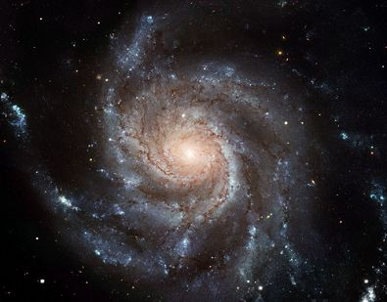
1
Why Is Freq. Pattern Mining Important?
An intrinsic and important property of datasets

Slide 6
1
Foundation for many essential data mining tasks
Association, correlation, and causality analysis
Sequential, structural (e.g., sub-graph) patterns
Pattern analysis in spatiotemporal, multimedia, time-series, and stream data
Classification: discriminative, frequent pattern analysis
Cluster analysis: frequent pattern-based clustering

Slide 7
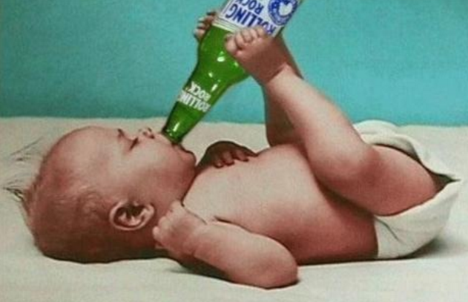
1
Beer
&
Diaper

Slide 8
1
Mining Association Rules
Transaction-id | Items bought
1 | A, B, D
2 | A, C, D
3 | A, D, E
4 | B, E, F
5 | B, C, D, E, F
Transaction data analysis. Given:
A database of transactions (Each tx. has a list of items purchased)
Minimum confidence and minimum support
Find all association rules: the presence of one set of items implies the presence of another set of items
Itemset: a set of items, e.g., {A, C} and {B, E, F} are two itemsets, and A itself is an item.
Diaper → Beer [0.5%, 75%]
(support, confidence)

Slide 9
1
Mining Strong Association Rules in Transaction Databases (1/2)
Measurement of rule strength in a transaction database.
X→Y [support, confidence]
How frequently itemsets X and Y appear together
How frequently itemset X appears when Y appears
Note: support(XUY) means support for occurrences of transactions X and Y both appear. “U” is NOT the logical OR here.

Slide 10
1
Example of Association Rules
Transaction-id | Items bought
1 | A, B, D
2 | A, C, D
3 | A, D, E
4 | B, E, F
5 | B, C, D, E, F
Let min. support = 50%, min. confidence = 50%
Frequent patterns: {A:3, B:3, D:4, E:3, AD:3}
Association rules:
A → D (support = 60%, confidence = 100%)
D → A (support = 60%, confidence = 75%)

Slide 11
1
Mining Strong Association Rules in Transaction Databases (2/2)
We are often interested in only strong associations, i.e.,
support ≥ min_sup
confidence ≥ min_conf
Examples:
milk → bread [5%, 60%]
tire and auto_accessories → auto_services [2%, 80%].

Slide 12
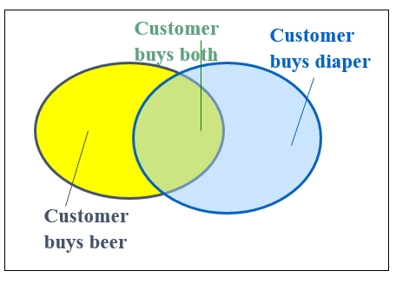
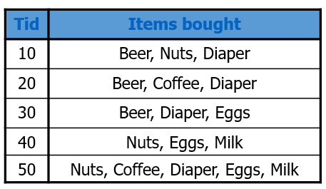
1
Illustration Example

Slide 13
1
This means “A and B” appear at the same time
support, s, probability that a transaction contains A ∪ B
confidence, c, conditional probability that a transaction having A also contains B

Slide 14
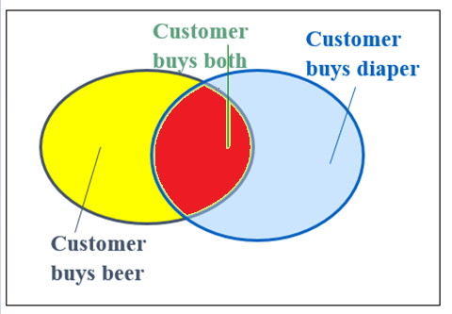
1
3
3
4
5
support(Beer ∪ Diaper)=3/5=60%
confidence(Beer=>Diaper)=3/3=100%

Slide 15
1
Basic Concepts: Frequent Patterns
Find all the rules X → Y with minimum support and confidence
Let minsup = 50%, minconf = 50%
Frequent Pattern: Beer:3, Nuts:3, Diaper:4, Eggs:3, {Beer, Diaper}:3, {Nuts, Diaper}:2
Association rules: (many more!)
Beer → Diaper (60%, 100%)
Diaper → Beer (60%, 75%)

Slide 16
1
Two Steps for Mining Association Rules
Determining “large (frequent) itemsets”
The main factor for overall performance
The downward closure property of frequent patterns
Any subset of a frequent itemset must be frequent
If {beer, diaper, nuts} is frequent, so is {beer, diaper}
i.e., every transaction having {beer, diaper, nuts} also contains {beer, diaper}
Generating rules

Slide 17
Apriori
A Candidate Generation-and-Test Approach
Scalable Frequent Itemset Mining Methods

Slide 18

1
Brute-Force Approach
List all items

Slide 19
1
Brute-Force Approach
List all items
But…
1) Unnecessary itemset examination, i.e., constructing too many non-frequent itemsets

Slide 20
1
Brute-Force Approach
List all items
But…
1) Unnecessary itemset examination, i.e., constructing too many non-frequent itemsets
2) Generating duplicate itemsets

Slide 21
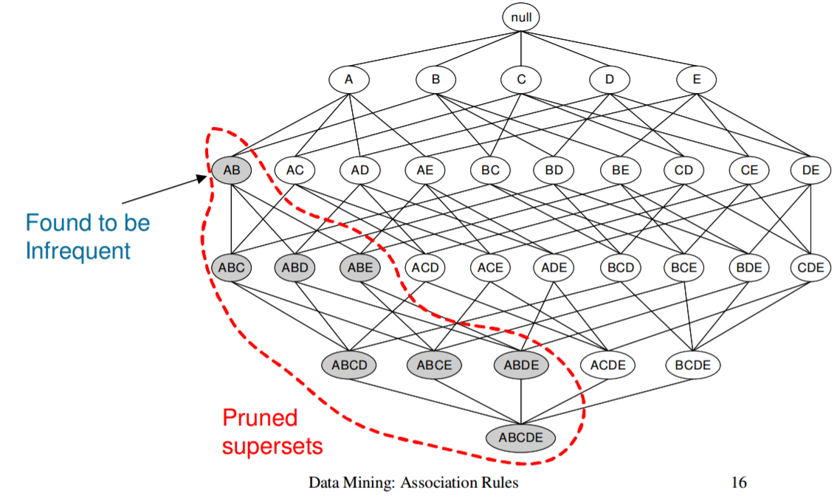
1
To Avoid Unnecessary Examination
Apriori Pruning Principle, a.k.a Downward Closure Property
If there is any itemset which is infrequent, its superset should not be generated/tested!

Slide 22
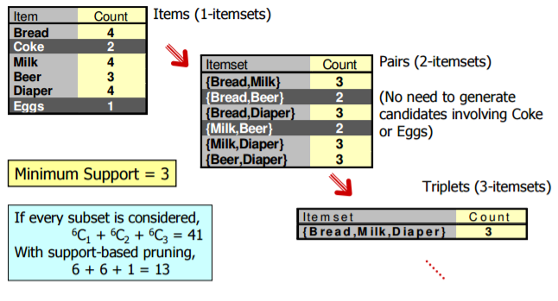
1

Slide 23
1
To Avoid Generating Duplicate Itemsets
Join
Joining 2 k-itemsets: 2 k-itemsets I1, I2 could be joined into a (k+1)-itemset if I1 and I2 have the same first (k-1) items
E.g., {A, B, C, D, E} join {A, B, C, D, F} = {A, B, C, D, E, F}
However, {A, B, C, D, E} cannot join {A, B, C, E, F}

Slide 24
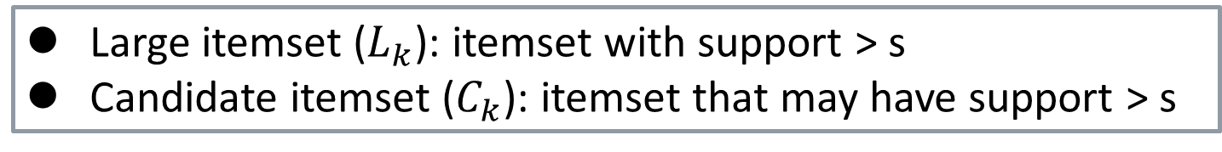
• Start with all 1-itemsets (C₁)
• Go through data and count their support and find all “large” 1-itemsets (L₁)
• Join them to form “candidate” 2-itemsets (C₂)
• Go through data and count their support and find all “large” 2-itemsets (L₂)
• Join them to form “candidate” 3-itemsets … (C₃)
…
1
C₂
C₁
L₁
Itemset | sup
{A, B} | 1
{A, C} | 2
{A, E} | 1
{B, C} | 2
{B, E} | 3
{C, E} | 2
Itemset | sup
{A} | 2
{B} | 3
{C} | 3
{D} | 1
{E} | 3
Itemset | sup
{A} | 2
{B} | 3
{C} | 3
{E} | 3
…
Large itemset ($L_{k}$): itemset with support > s
Candidate itemset ($C_{k}$): itemset that may have support > s

Slide 25
1
min. support =2 tx’s (50%)
The Apriori Algorithm—An Example
Database TDB
C₁
L₁
Itemset | sup
{A} | 2
{B} | 3
{C} | 3
{D} | 1
{E} | 3
Itemset | sup
{A} | 2
{B} | 3
{C} | 3
{E} | 3
Tid | Items
100 | A, C, D
200 | B, C, E
300 | A, B, C, E
400 | B, E
1st scan
C₂
C₂
Itemset
{A, B}
{A, C}
{A, E}
{B, C}
{B, E}
{C, E}
L₂
Itemset | sup
{A, B} | 1
{A, C} | 2
{A, E} | 1
{B, C} | 2
{B, E} | 3
{C, E} | 2
2nd scan
Itemset | sup
{A, C} | 2
{B, C} | 2
{B, E} | 3
{C, E} | 2
C₃
Itemset
{B, C, E}
3rd scan
L₃
Itemset | sup
{B, C, E} | 2

Slide 26
1
min. support =2 tx’s (50%)
The Apriori Algorithm—An Example
Database TDB
C₁
L₁
Itemset | sup
{A} | 2
{B} | 3
{C} | 3
{D} | 1
{E} | 3
Itemset | sup
{A} | 2
{B} | 3
{C} | 3
{E} | 3
Tid | Items
100 | A, C, D
200 | B, C, E
300 | A, B, C, E
400 | B, E
1st scan
If {A,B,C} is a frequent item set, then {A,C}, {A,B} must exist in L2 as well.
Here, {A,B} does not exist in L2, so no bother checking!
C₂
C₂
Itemset
{A, B}
{A, C}
{A, E}
{B, C}
{B, E}
{C, E}
L₂
Itemset | sup
{A, B} | 1
{A, C} | 2
{A, E} | 1
{B, C} | 2
{B, E} | 3
{C, E} | 2
2nd scan
Itemset | sup
{A, C} | 2
{B, C} | 2
{B, E} | 3
{C, E} | 2
C₃
Itemset
{B, C, E}
3rd scan
L₃
Itemset | sup
{B, C, E} | 2

Slide 27
1
Database TDB
From Large Itemsets to Rules
Tid | Items
100 | A, C, D
200 | B, C, E
300 | A, B, C, E
400 | B, E
Recall that confidence is defined as:
For each large itemset l
For each subset s of l, if ( sup(l) / sup(s) ≥ min_conf )
output the rule s=> (l-s)
conf. = sup(l)/sup(s)
support = sup(l)
E.g., l={B, C, E} with support =2 is a frequent 3-item set, assume min_conf=80%
Let s={C,E}, sup(l) / sup(s) =2/2=100%>80%
Therefore, {C,E}=>{B} is an association rule with support = 50%, confidence = 100%
L₂
Itemset | sup
{A, C} | 2
{B, C} | 2
{B, E} | 3
{C, E} | 2
L₃
Itemset | sup
{B, C, E} | 2

Slide 28
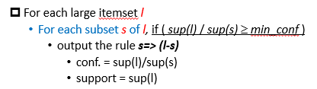
1
Redundant Rules
For the same support and confidence, if we have a rule {a,d} →{c,e,f,g}, do we have:
{a,d} →{c,e,f} ?
{a} →{c,e,f,g} ?
Consider the example in previous page
l={B, C, E}, s={C,E}, then {C,E}->{B} is an association rule
However, l={B, C, E}, s={C}, i.e., {C}->{B} is not
{a,d,c} →{e,f,g} ?
{a} →{c,d,e,f,g} ?
Yes!
No!
Yes!
No!
Notes:
Given {a,d}->{c,e,f,g}
This is generated from the large itemset
s={a,d}, l-s = {c,e,f,g} l = {a,c,d,e,f,g};
Since {a,d}->{c,e,f,g} is an association rule, we have:
conf. = sup(l) / sup(s) >= min_conf
sup. = sup(l) >= min_sup
1) Then, for {a,d} and {c,e,f}
Sup({a,c,d,e,f})>= min_sup because of sup(l) (downward closure property}
=> {a,d} -> {c,e,f} YES
2) For {a}->{c,e,f,g}
s = {a}, l-s = {c,e,f,g}
sup({a,c,e,f,g}) >= min_sup because of sup(I)
conf ({a,c,e,f,g}) = sup({a,c,e,f,g}) / sup({a}) => 不一定喲

Slide 29
Further Improvement of the Apriori Method
Major computational challenges
Multiple scans of transaction database
Huge number of candidates (especially C2)
Tedious workload of support counting for candidates
Improving Apriori: general ideas
Reduce passes of transactional database scans
Shrink number of candidates
Facilitate support counting of candidates

Slide 30
Transaction Reduction
Min_sup = 2
Tid | Items
100 | A, C, D
200 | B, C, E
300 | A, B, C, E
400 | B, E
500 | X, Y
Reducing future transaction scans
Idea:
A transaction that does not contain any frequent k-itemsets -> does not contain any frequent (k+1)-itemsets
Such transactions can be marked or removed to avoid future consideration
E.g., transaction 500 can be removed from further examination
L₂
Itemset | sup
{A, C} | 2
{B, C} | 2
{B, E} | 3
{C, E} | 2
L₃
Itemset | sup
{B, C, E} | 2

Slide 31
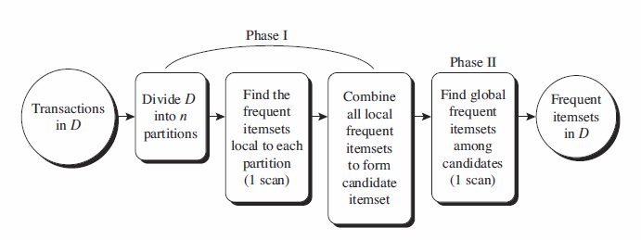
Partition: Scan Database Only Twice
Partition original DB into k small DB
Any itemset that is potentially frequent in DB (in respect of min_sup) must be locally-frequent in at least one of the partitions of DB (in respect of min_sup_{i} for partition i)
Scan 1: partition database and find local frequent patterns
Scan 2: consolidate global frequent patterns
If the minimum support ratio is min_sup, the min support count for a partition DB_{i}, i.e., min_sup_count_{i}, is set to #tx·(min_sup)
Notes:
就是拿global support ratio去乘parition大小，得出新的min support count
因為我們說，10個東西的平均>=x的話，至少有一個東西>=x

Slide 32
Partition: Scan Database Only Twice
Local frequent itemset: may or may not be frequent in the entire DB
However, any itemset which is frequent:
Must occur as a locally frequent itemset in at least on of the partitions
Frequent itemsets from all partitions forms the global candidate itemsets for the whole database
Phase II determines the actual supports and generate the global frequent itemsets

Slide 33
2020
THANK YOU!

