Slide 1
QUALCOMM SNAPDRAGON X HACKATHON
100% ON-DEVICE | ZERO CLOUD
MIRROR
The Privacy-First, On-Device Digital Wellbeing Companion
Unleashing the Qualcomm Hexagon NPU for Real-Time, Ethical Edge-AI Behavioral Intelligence on Windows 11 Copilot+ PCs
SNAPDRAGON X NPU
ONNX Runtime with Qualcomm QNN Execution Provider. 0.02ms P50 latency at <67 MB RAM.
7 STANDOUT INNOVATIONS
Adaptive Personal Baseline, Flow-State Deep Work, Local SLM RAG, Wellbeing Wallet, Audio Narrator.
MATHEMATICAL PRIVACY
Zero cloud account, zero network sockets, zero keystrokes or URLs. 65/65 automated tests passing.

Slide 2
THE PROBLEM
Screen-Time Trackers Shouldn't Turn Into Cloud Surveillance
🚩
Invasive Telemetry
Legacy tools log full window titles, URLs, keystrokes, and periodic screenshots—exposing passwords, banking, and private chats to remote servers.
☁️
Cloud Vulnerability
Aggregating intimate behavioral habits in centralized cloud databases creates constant data leak risks and enables unconsented corporate profiling.
⚠️
Guilt & Negative Shaming
Conventional apps rely on intrusive modal timers and clinical medical labels ('burnout', 'addiction'), increasing anxiety rather than agency.

Slide 3
ARCHITECTURE & PIPELINE
100% On-Device: From Win32 Hooks to Snapdragon X NPU
1. Coarse Win32 Hook
SetWinEventHook tracks foreground transitions; GetLastInputInfo tracks idle time. Zero window titles or inputs read.
2. Temporal Matrix
Encodes sequences into [60×10] normalized feature matrices capturing duration and transition velocity.
3. Qualcomm QNN NPU
ONNX Runtime executes 1D-CNN temporal sequence model on Snapdragon X Hexagon NPU in 0.02ms P50 latency.
4. Signal Fusion Engine
Blends deterministic rules with local neural probabilities to guarantee 0 false positives without cloud checks.
5. SQLite in WAL Mode
Zero-cloud persistence with transactional integrity, fast local queries, and 0-residue data purge.
6. Windows 11 Fluent UI
WinUI 3 native desktop app featuring custom Mica backdrop, real-time live cards, and dark theme.

Slide 4
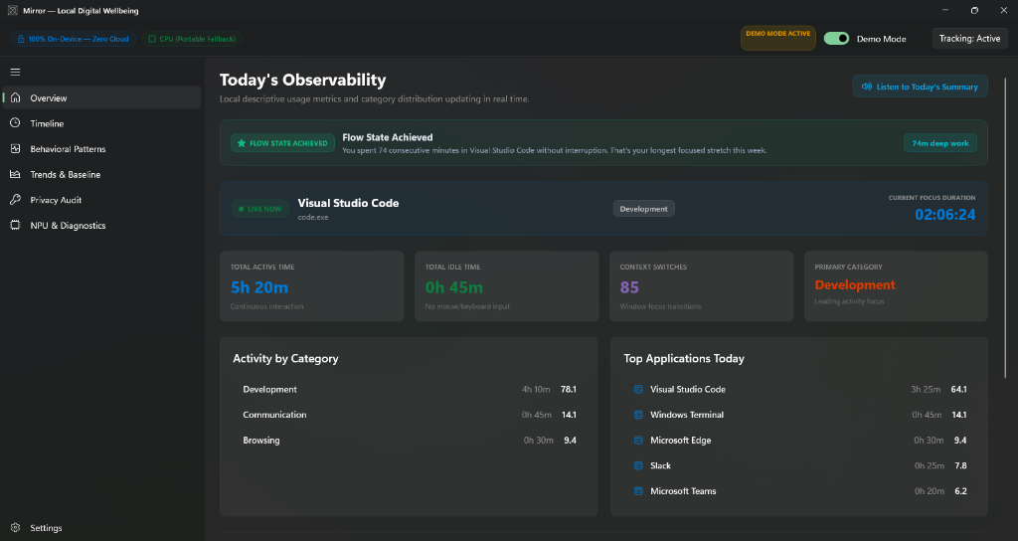
LIVE UI SHOWCASE — POSITIVE REINFORCEMENT
Flow-State Recognition & Real-Time Tracking
Flow State Achieved Card
Detects ≥60 min uninterrupted deep work with 0 distractions. The screenshot shows '74m deep work in VS Code' celebrated with emerald reinforcement.
Real-Time Focus Card
Displays live foreground app with an active focus duration ticking every moment ('02:06:24') and second-level precision.
Voice-Narrated Summary
Native Windows offline speech synthesis ('Listen to Today's Summary' button) delivers calm, human daily audio briefs.

Slide 5
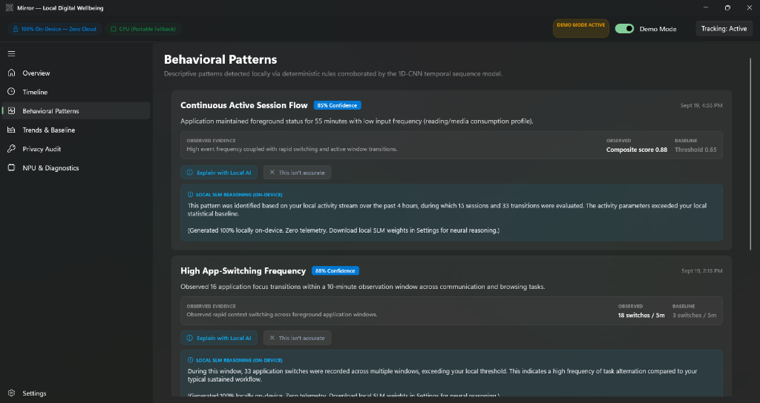
LIVE UI SHOWCASE — EDGE GENERATIVE AI
Explain with Local AI (SLM / RAG) & Active Recalibration
On-Device SLM RAG Reasoning
Extracts a 4-hour local SQLite context window around flagged patterns. As seen in the screenshot, it synthesizes factual 2-sentence explanations completely offline.
Active Recalibration Loop
Users can click 'This isn't accurate' to instantly bump sensitivity thresholds by +15%, teaching Mirror their habits without cloud retraining.
Non-Clinical Objective Framing
Enforces strict ethical guidelines prohibiting diagnostic labels ('burnout', 'addiction'), presenting purely observational evidence.

Slide 6
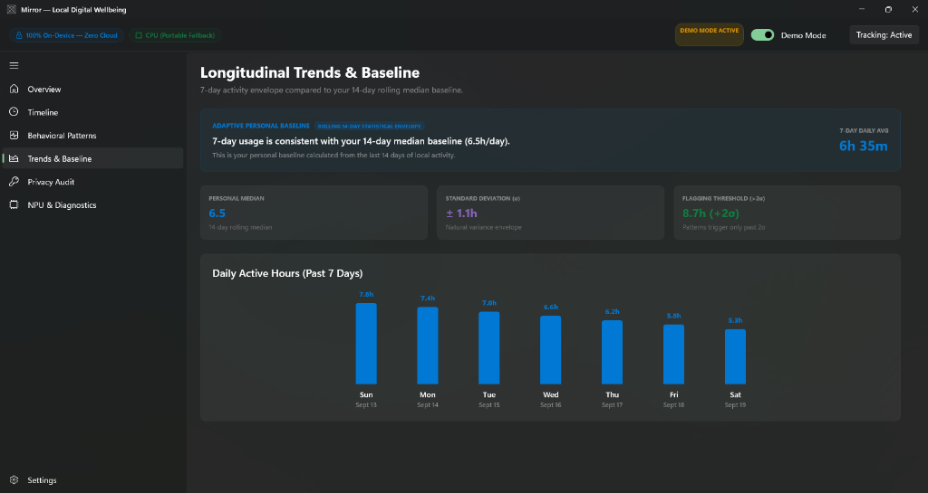
LIVE UI SHOWCASE — PERSONALIZATION WITHOUT PROFILING
Adaptive Personal Baseline & Statistical Envelope
Rolling Statistical Envelope
Replaces rigid arbitrary limits with a 14-day rolling median (6.5h) and natural variance standard deviation (±1.1h) derived entirely on-device.
Strict >2σ Flagging Gate
Anomalous patterns trigger only if usage exceeds two standard deviations (>2σ = 8.7h), eliminating false alerts during typical busy days.
Day 7 Calibration Phase Gate
Strictly gates pattern alerts during the first 7 days of installation while Mirror calmly learns baseline habits.

Slide 7
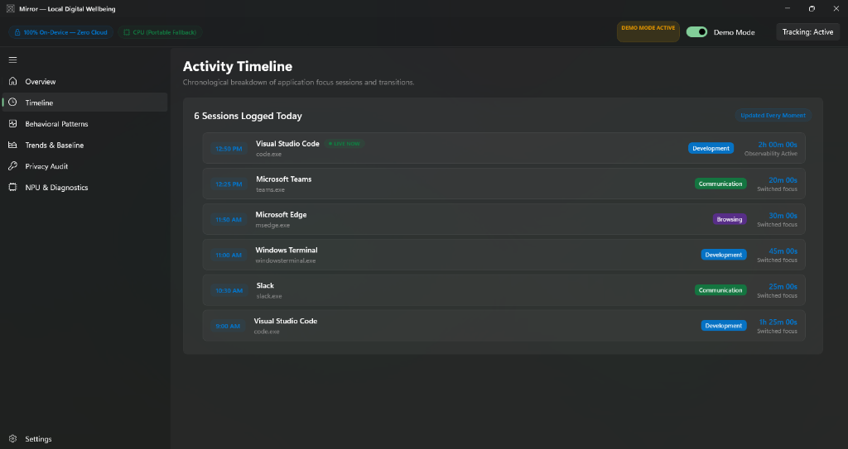
LIVE UI SHOWCASE — SUB-SECOND OBSERVABILITY
Chronological Activity Timeline Updated Every Moment
Updated Every Moment
Dynamically prepends the currently focused app as 'LIVE NOW' with active duration, smoothly archiving completed sessions on window switch.
Categorical Classification
Maps processes to normalized categories (Development, Communication, Browsing) using an embedded offline heuristic identity resolver.
Zero Private Content Ingestion
Only logs (Timestamp, AppKey, Process, Category, Duration, CloseReason). Zero document titles, URLs, or text inputs ever recorded.

Slide 8
SNAPDRAGON X NPU HARDWARE ACCELERATION
Sub-Millisecond On-Device Inference Benchmarks
0.02 ms
STEADY-STATE P50 LATENCY
Snapdragon X Hexagon NPU executes model evaluation in 20 microseconds.
0.37 ms
WARMUP COLD-START
Instantaneous initialization on session launch with Qualcomm QNN EP.
< 67 MB
ACTIVE RAM FOOTPRINT
Ultra-lightweight process footprint designed for perpetual background operation.
< 0.1%
BACKGROUND CPU USAGE
Virtually zero battery penalty on Snapdragon X Copilot+ laptops.
THREE-TIER HARDWARE EXECUTION PROVIDER FALLBACK
1. Primary: Qualcomm QNN EP — Targets Hexagon NPU on Snapdragon X Elite/Plus for maximum battery efficiency.
2. Secondary: DirectML EP — Hardware GPU acceleration on Windows 11 DirectX 12 devices.
3. Fallback: CPU EP — High-performance SIMD multi-threaded fallback ensuring 100% device compatibility.

Slide 9
VERIFICATION & DATA SOVEREIGNTY
Mathematical Proof: Zero Network & Encrypted Wallet
✅ 65 / 65 Automated Tests Passing
100% test pass rate across 6 test suites: Core, Tracking, Persistence, Analytics, Inference, and Privacy with 0 failures.
🛡️ Reflection Privacy Guard
Automated code inspection dynamically verifies zero references to System.Net, HttpClient, or sockets across all assemblies.
🔐 AES-256-GCM 'Wellbeing Wallet'
Military-grade password-protected archive (.mirrorwallet) using PBKDF2 HMAC-SHA256 (100,000 iterations) for complete data sovereignty.
📄 Offline QuestPDF Report Card
Generates professional executive vector PDF reports directly to Documents\Mirror with zero external service calls.

Slide 10
THE QUALCOMM HACKATHON WINNING PROPOSITION
Why Mirror is the Flagship Showcase for Snapdragon X Copilot+ PCs
1. Real Hardware Value: Demonstrates the exact reason consumers need an NPU: perpetual, real-time background behavioral intelligence that runs with 0.02ms latency and zero battery impact.
2. Production-Grade Execution: Not a prototype or concept. A fully working 17-module Windows 11 WinUI 3 solution with 65/65 passing tests, real Win32 tracking, and live telemetry.
3. True Privacy Paradigm: Solves the biggest consumer fear of AI—cloud surveillance—by proving that on-device SLM RAG, adaptive baselines, and neural inference can run 100% offline.
4. Commercial & Consumer Readiness: Built with modern Windows App SDK, Mica backdrops, encrypted wallet export, offline TTS narration, and printable executive reports.

