Slide 1
MODEL-ZOO / HEAVY-TAILED SELF-REGULARIZATION
Model weights
as evidence
Exploratory audit: weight grouping, base retrieval, and performance controls
10,946
17
3.21
lineage models
weight-derived groups
non-alpha modern MAE
Phase 2 + ablation
selected without labels
near-group held-out audit
Exploratory reassessment: reassessment_0063666fd5733b453c38

Slide 2
STUDY BOUNDARY
Keep predictor inputs separate from evaluation labels
Unlabeled discovery
Known base candidates
Performance
INPUT
complete core + calibrated partial roles
INPUT
profiles + fixed candidate list
INPUT
matrix summaries + training scores
FROZEN OUTPUT
clusters + representative models
FROZEN OUTPUT
ranked candidate bases
FROZEN OUTPUT
held-out score estimates
EVALUATION ONLY | declared source roots and family labels score frozen lineage predictions; held-out benchmark scores score predictions
Collection metadata shaped selection; collection IDs define one holdout. IDs join records and break ties, not predictor features. This is exploratory reuse, not untouched confirmation.
Sources: reassessment_0063666fd5733b453c38/protocol.json; parent prediction freezes
02

Slide 3
STUDY MAP
Four phases, each ending in a checked output
1
Assemble model lists
2
Analyze weights
3
Make predictions
4
Validate
Phase 2 and ablation IDs
canonicalize and remove duplicates
read checkpoint matrices
compute alpha by layer and role
form groups · rank known bases
estimate benchmark scores
score against declared source links
measure held-out benchmark error
19,713 selected records
10,946 lineage / 11,801 performance
predictions saved before labels
reported results and limits
Predictor features come from saved weights; score fitting uses training outcomes. Collection metadata shaped curation and one holdout, so the full process is not metadata-free.
Sources: collection code, parent weight-only run, and exploratory reassessment protocol.
03

Slide 4
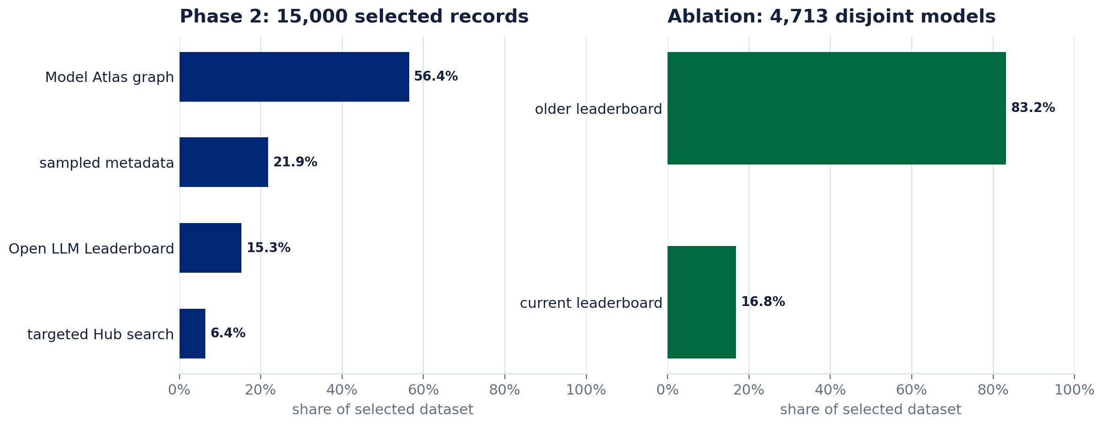
DATASET CURATION
Two collections were built for different jobs
PHASE 2 · BROAD MODEL ZOO
1 Combine the Model Atlas graph, sampled records, leaderboard rows, and targeted Hub searches.
2 Normalize repository IDs and declared revision fields; the analyzed checkpoint revision is not verified.
3 Fill model-type quotas while balancing score and lineage availability; favor rows with existing weight results.
ABLATION · DISJOINT SCORE TEST
11,836 leaderboard candidates
4,713 selected
Collection metadata shapes coverage. Predictor features exclude these labels, but source selection and joins remain part of the evidence boundary.
Removed: 4,177 Phase 2 overlaps · 2,674 inaccessible repositories · 272 lower-priority duplicates
Keep score coverage high, rotate across model types, cap missing scores at 15%, and stop below 5,000 when no more rows pass.
Sources: fetch_data/build_phase2_zoo.py, fetch_data/build_ablation_dataset.py, and ablation_source_manifest.json
04

Slide 5
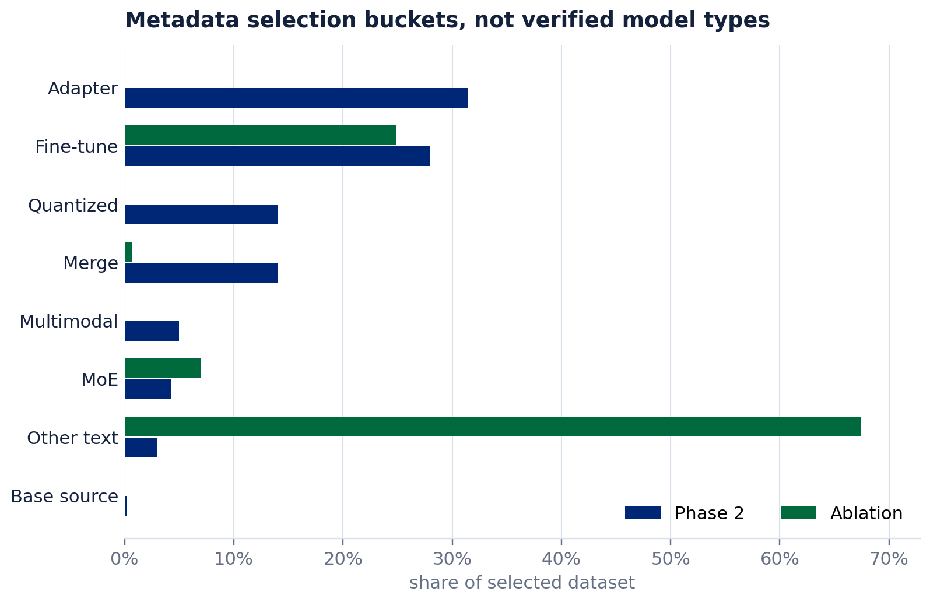
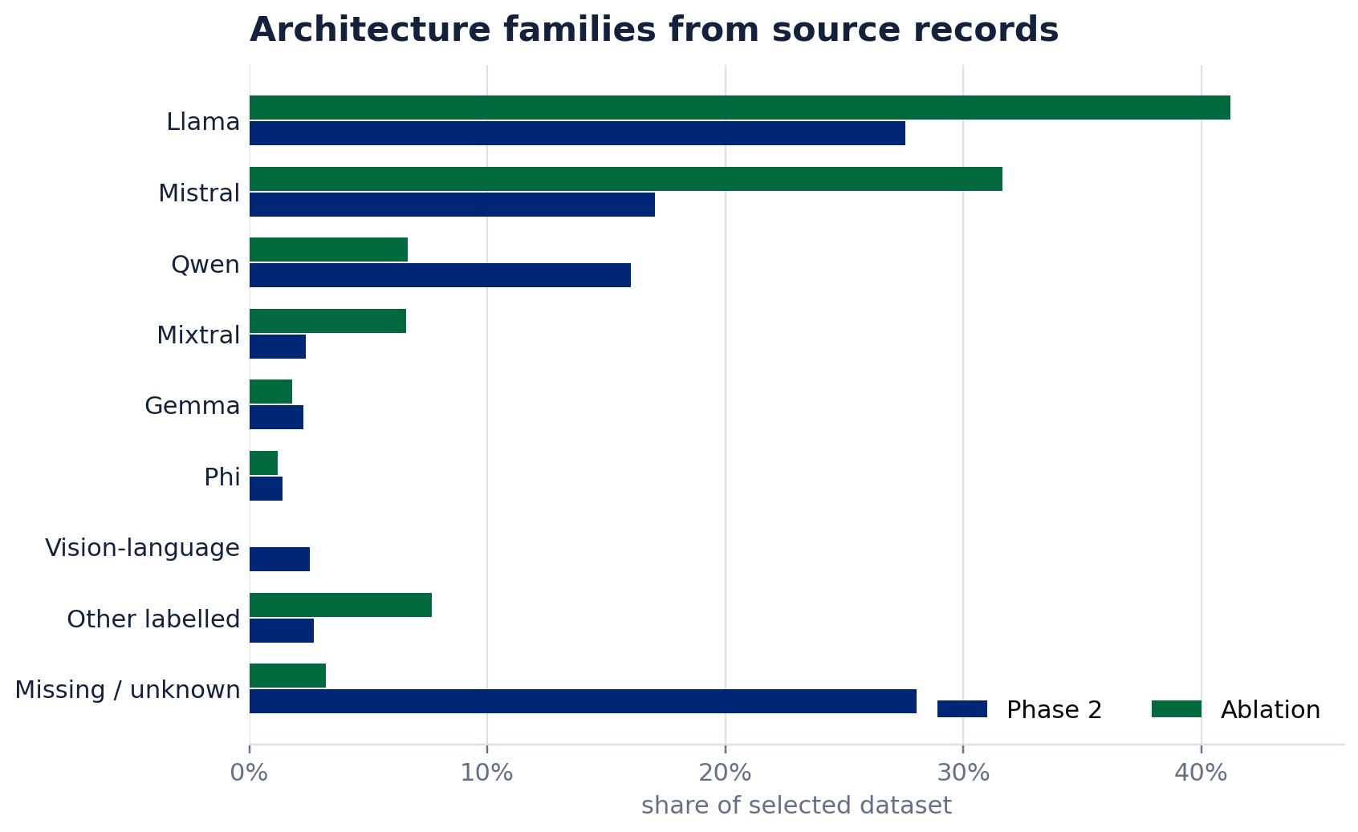
DATASET DISTRIBUTION
Selection buckets describe curation; ablation is benchmark-heavy
PHASE 2 · 15,000
2,922 average-score records · 13,301 declared source links
10,793 architecture labels · 2,284 parameter counts
ABLATION · 4,713
4,662 average-score records · 291 declared source links
4,561 architecture labels · 4,349 parameter counts
Type-chart categories are selection buckets, not verified model types. Source links are declared, not verified ancestry; architecture labels are descriptive.
Sources: completed run's Phase 2 and ablation source tables; architecture graph used descriptively after selection.
05

Slide 6
DATA FLOW
Shared weight checks lead to task-specific coverage
PHASE 2
15,000 listed
8,892
weight results found
7,802
lineage models
11,801
performance profiles
ABLATION
4,713 listed
3,661
weight results found
3,144
lineage models
Strict seven-role core: 10,431 models. Reliable missing-role patterns add 515 lineage assignments. Performance uses the label-free cutoff of at least 4 observed roles.
These are parent role-profile counts. The reassessment also uses all-matrix summaries; source IDs define the collection holdout, not predictor features.
Sources: weight_only_2a5abfeb98dc33d9662c/population_ledger.csv; source-run provenance.json and exclusions.csv
06

Slide 7
WEIGHT ANALYSIS
Compare models using the layer roles that are actually observed
W
W^T W
alpha
1-7 roles
role ranks
weight matrix
eigenvalues
DKS tail fit
ordered layers
observed-role summary
Attention: query · key · value · output
Feed-forward: gate · up · down
THIS STUDY
REFERENCE PAPER
Custom stored DKS alpha, not a WeightWatcher run · depth scaled to [0,1] · 32 positions per observed role · within-role ranks for grouping
Fixed-tail Hill alpha, k=n/2 · raw-alpha clustering · role-wise Spearman similarity · order-preserving DP for unequal depths · MoE experts averaged
Ranks discard alpha offsets, scales, and spacing, but retain order. Absolute alpha and other saved matrix statistics can still carry performance signal.
Sources: stored DKS alpha values by layer; archive/reference-work/Spectral Signatures of Large Language Models.html
07

Slide 8
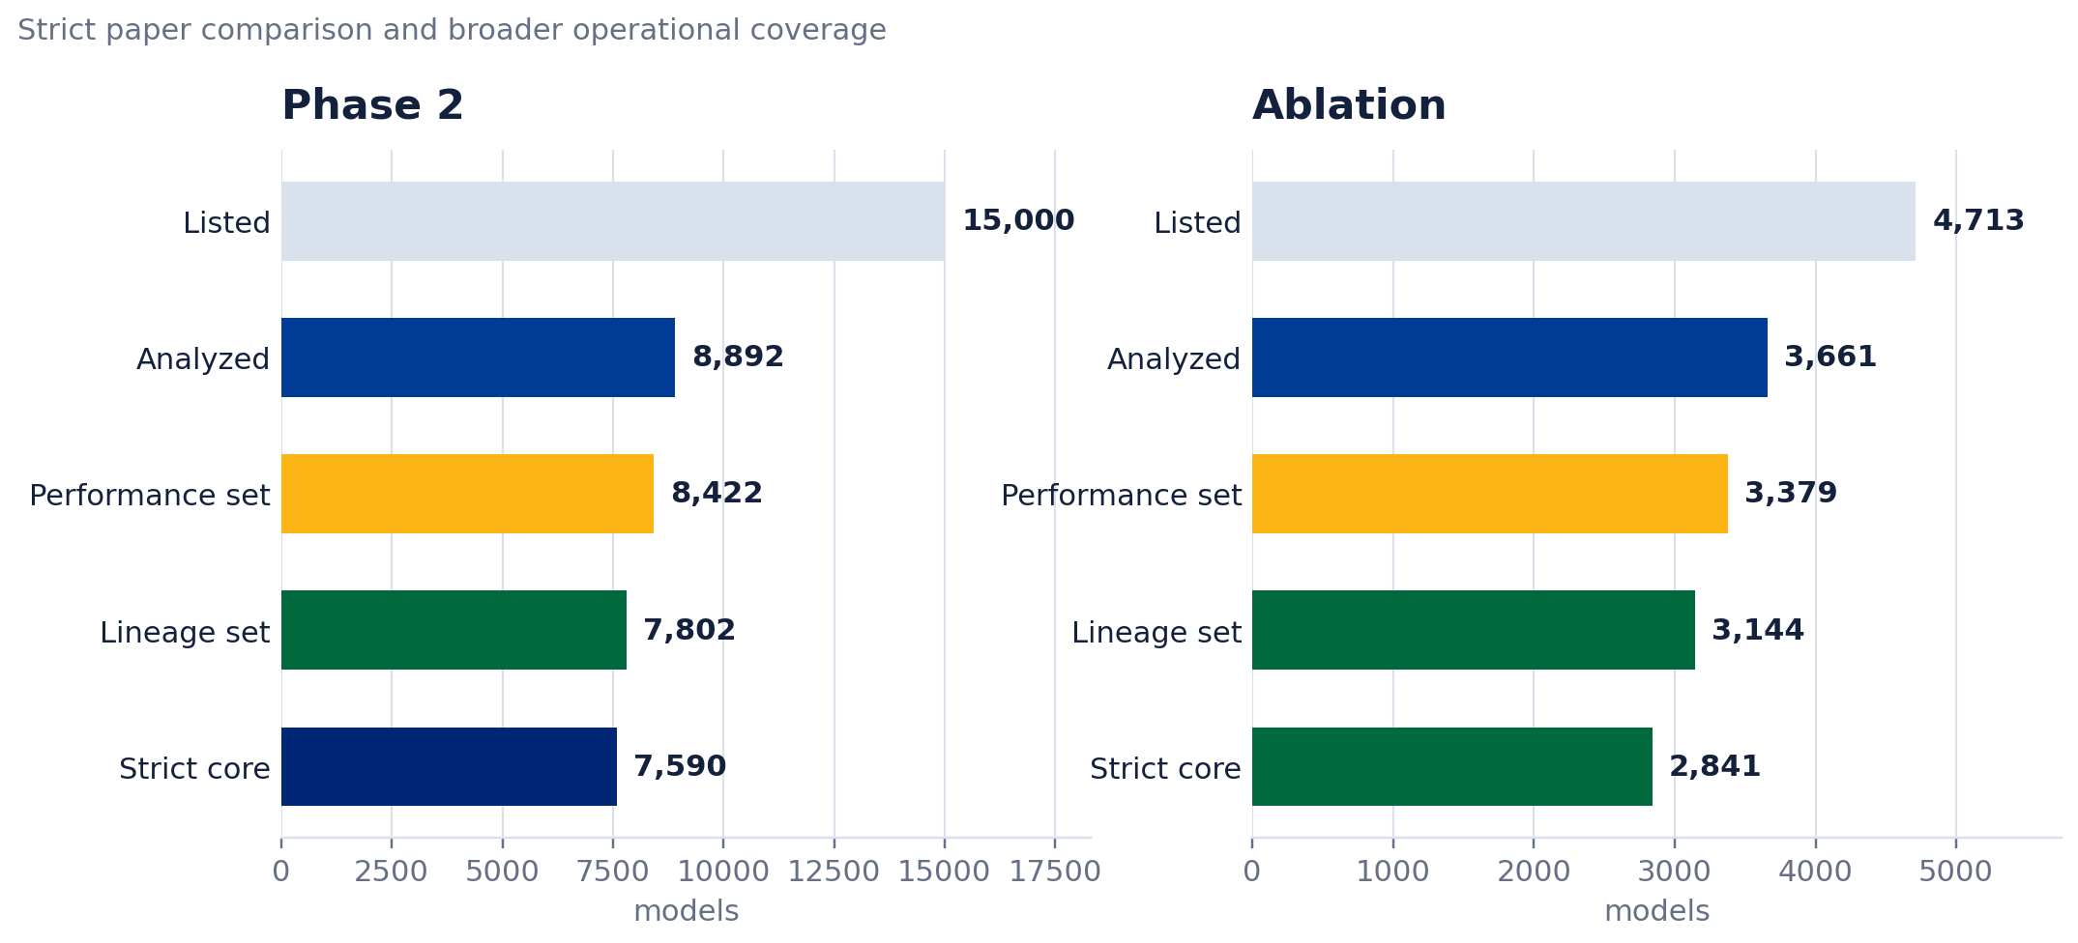
DATA
Role coverage and all-matrix coverage answer different questions
10,431
strict seven-role core
10,946
lineage assignments
12,365
all-matrix alpha eligible
Broader eligibility does not imply better grouping. All-matrix family ARI 0.258 vs rank 0.913 on human-reviewed labels; populations differ.
Sources: parent population_ledger.csv; reassessment_0063666fd5733b453c38/metadata.json and all_matrix_cluster_validation.csv
08

Slide 9
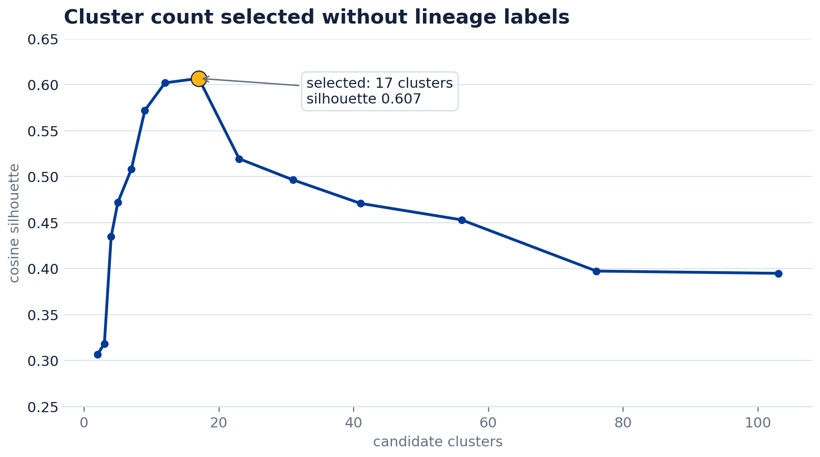
LINEAGE DISCOVERY
17 core groups give the clearest separation without family labels
0.607
0.944
group separation
repeat-run agreement
higher is better
average of 3 reruns
0.883
1.541
lowest rerun agreement
within/between spread
lower is better
HOW 17 WAS CHOSEN
Fit candidate counts on
10,431 complete profiles
Keep the count with
the best separation
515 partial profiles are attached only after label-free masking checks pass.
Sources: weight_only_2a5abfeb98dc33d9662c/lineage_cluster_selection.csv and lineage_internal_metrics.csv
09

Slide 10
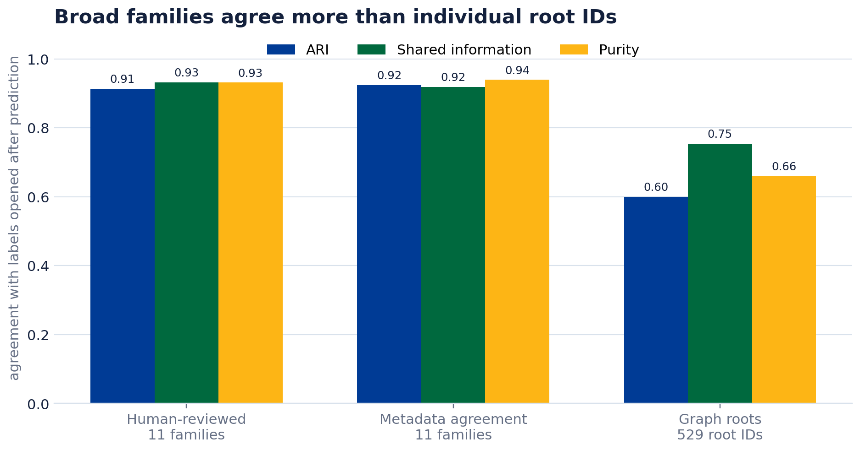
VALIDATION AFTER PREDICTION
Validate grouping against overlapping, imperfect label views
LABELS OPENED AFTER GROUPING
Human-reviewed
174 models assigned to 11 broad base families by manual review.
Metadata agreement
2,981 models assigned to 11 broad families when metadata rules agree.
Declared roots
5,013 models linked to 529 graph-component roots; not verified historical ancestry.
ARI
Pairwise grouping agreement, corrected for chance. 1 means identical grouping.
Shared information
How much knowing one grouping tells us about the other. 1 is complete.
Purity
Majority-label share inside each predicted group. It can favor too many small groups.
Sources: parent lineage_validation_metrics.csv; reassessment_0063666fd5733b453c38/all_matrix_cluster_validation.csv
10

Slide 11
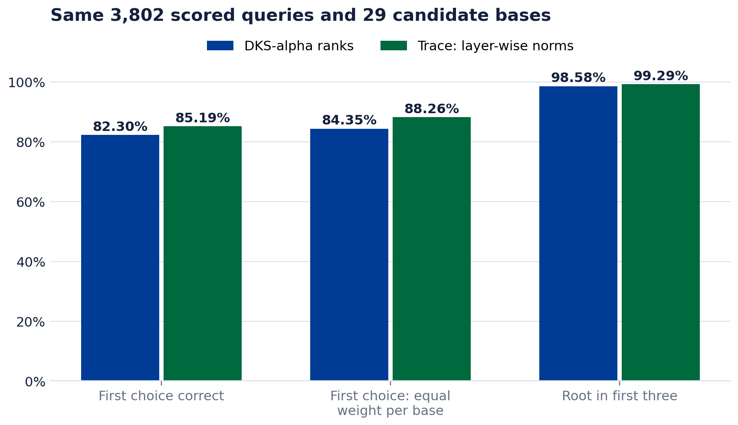
KNOWN-CANDIDATE LINEAGE TEST
Base matching depends on the comparison and treatment of ties
29 / 38
3,802
available / supplied bases
matched known-root queries
82.30%
85.19%
rank top-1
Trace top-1
Trace compares weight magnitude through layers, averaging seven role-wise correlations. Its first-choice gain is sensitive to tied candidates; the full and tie-excluded subsets answer different questions.
757 other labeled queries have a root absent from the supplied list; 278 have a listed root without usable measurements. These are queries, not additional candidate bases.
After excluding exact ties in either method: rank 85.88%, Trace 84.73%. This changes the model/root mix; equal-weight-per-root accuracy still favors Trace.
Sources: reassessment_0063666fd5733b453c38/lineage_gallery_metrics.csv; audit/gallery_tie_sensitivity.csv. Trace: arxiv.org/html/2608.07786v1
11

Slide 12
PAPER COMPARISON
Our larger study is not an exact replication
Dimension
Spectral Signatures paper
Exploratory reassessment
Prediction boundary
Weight similarities; training scores for prediction
Weight features; training-only score fitting
Alpha estimator
Fixed-tail Hill, k = n/2
Custom stored DKS; not WeightWatcher or fixed Hill
Grouping / similarity
Flattened raw alpha / role-wise Spearman
Rank grouping retained; separate Trace base test
Unequal depth
Z-score + order-preserving matching
Ranks: 32-point interpolation; Trace: pair-max depth
Performance setup
Five folds stated; 100 half-splits in results
Five fixed near-group parts; explicit stress splits
Scope of comparison
Different candidates, cohorts and targets
No matched replication; no claim to beat the paper
The paper's split-description discrepancy is unresolved. Neither its accuracy nor our MAE establishes superiority across different populations and protocols.
Sources: arxiv.org/html/2607.03377v1, Sec. 4.2 and 5.3; reassessment_0063666fd5733b453c38/protocol.json
12

Slide 13
PERFORMANCE METHOD
Keep similar models together in five test parts
BUILD FIVE TEST PARTS
Connect near profiles
similarity >= 0.995
Keep each group intact
in five fixed parts
Freeze the same splits
for predictor contrasts
REPEAT FIVE TIMES
Hold out
1 part
Use the other
4 parts
Fit preprocessing
on training rows only
Fit fixed trees / ridge
or rank 3-neighbor model
Open the held-out
score and measure error
Fixed trees: 200 iterations, 15 leaves, rate 0.05, L2=10, minimum leaf=20. Ridge penalty=100; no held-out tuning.
Controls: shape, non-alpha spectra, combined spectra, and rank neighbors. Average-score targets and individual tasks are evaluated separately.
Training scores are permitted; held-out scores are for evaluation. Collection labels define one stress split. Previously studied data: exploratory, not untouched confirmation.
Sources: reassessment_0063666fd5733b453c38/protocol.json, splits.csv and performance_predictions.csv
13

Slide 14
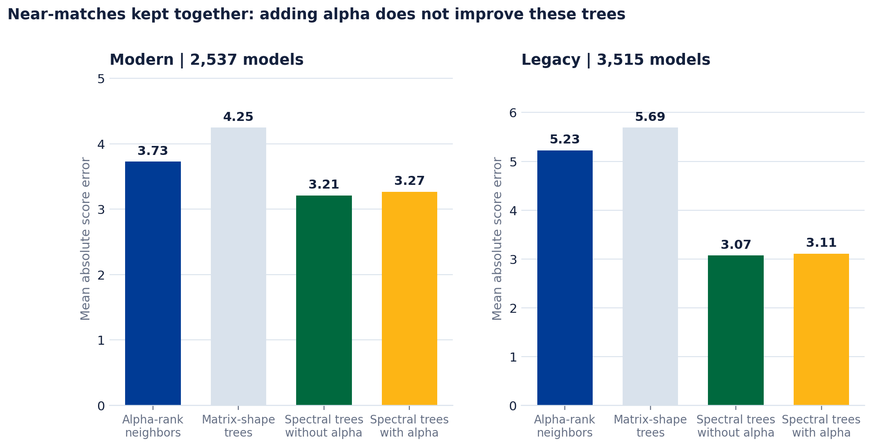
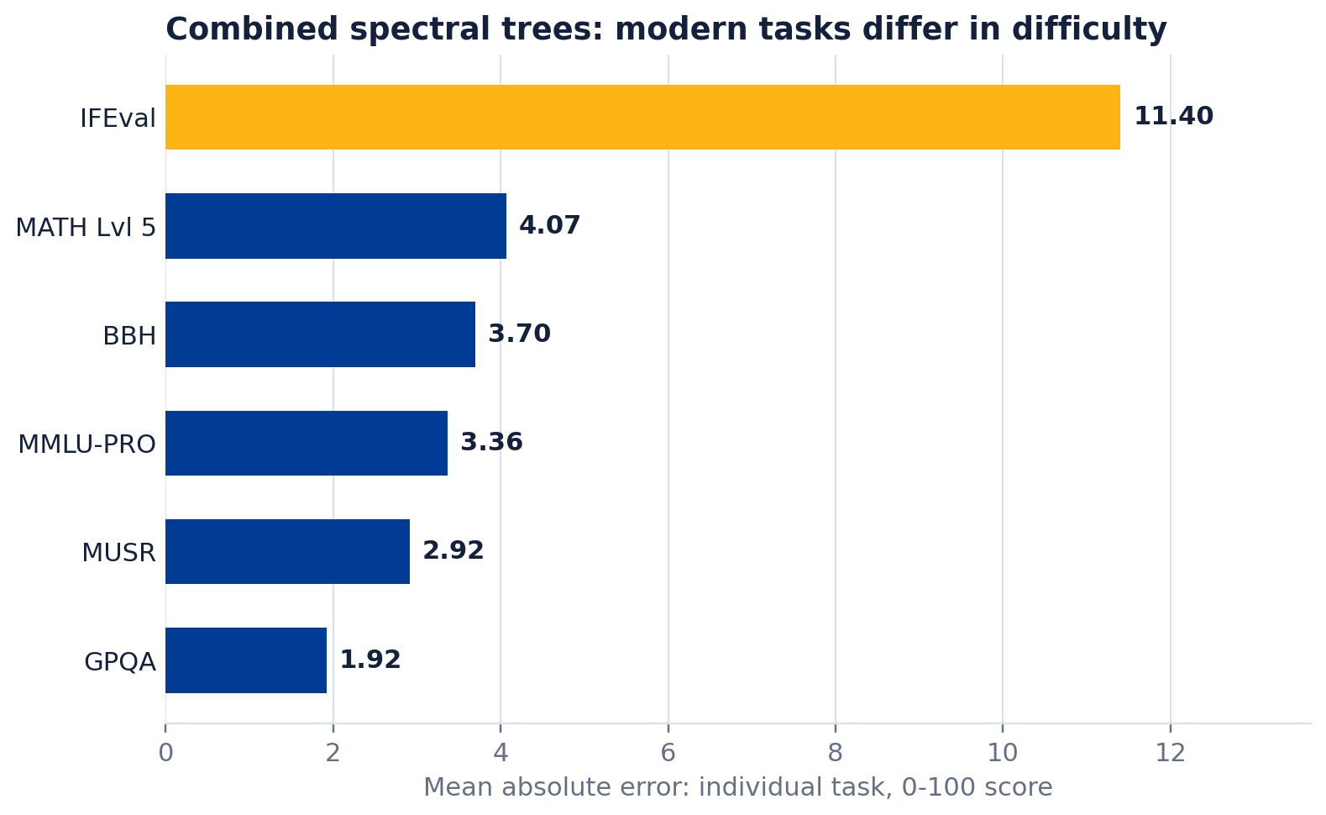
PERFORMANCE CONTROLS
Alpha does not improve the key performance controls
AVERAGE-SCORE MAE: MODERN / LEGACY
Non-alpha trees 3.211 / 3.068
Combined trees 3.266 / 3.109
Shape 4.249 / 5.693 · rank 3.726 / 5.227
2,537 modern / 3,515 legacy rows; same near-group splits.
Alpha-specific gain is not established. Combined = alpha plus other matrix measurements; individual-task checks do not replace the controls.
Sources: reassessment_0063666fd5733b453c38/performance_metrics.csv and performance_task_metrics.csv; near_group_0995, matched_role_population
14

Slide 15
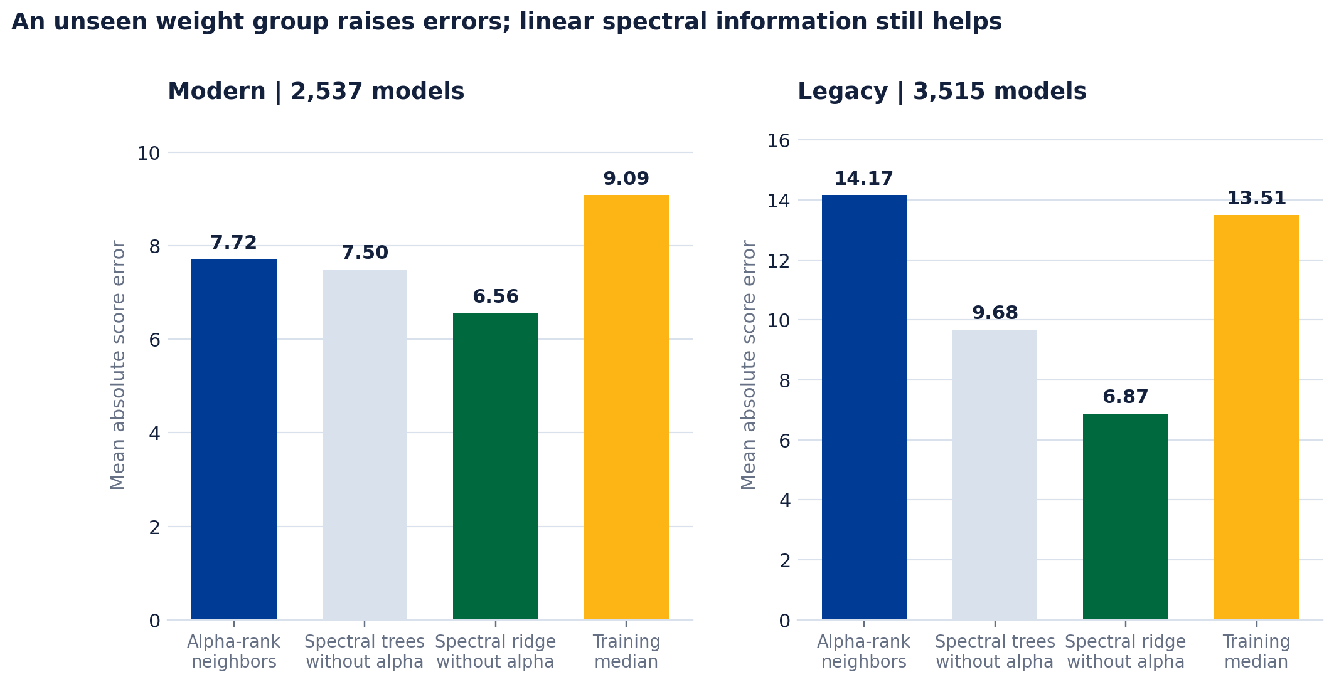
NEW-REGION STRESS TEST
Unseen groups and collections expose larger errors
NON-ALPHA RIDGE · WHOLE-GROUP MAE
6.561
6.873
modern
legacy
Whole weight clusters are held out together. This is a shift test, not the near-group interpolation test; compare each method with the training median.
COLLECTION-HOLDOUT WARNING
Combined ridge produces 26 modern predictions outside 0-100. These are range failures, not plausible benchmark forecasts.
Errors change across held-out groups and collections. Inspect the score range and coverage, not only average error.
Sources: reassessment_0063666fd5733b453c38/performance_metrics.csv; audit prediction_metrics_audit.csv and collection_direction_metrics.csv
15

Slide 16
CONCLUSION
Keep rank grouping, test Trace bases, and retain non-alpha controls
Retain
Interpretation
Remaining uncertainty
Keep layer-wise grouping: all-matrix summaries cover more models but separate families poorly
Ranks discard magnitude; direct measurements predict scores better
Repository-ID source joins do not verify the analyzed checkpoint revision
Trace as a base-retrieval comparison, with fixed gallery and tie diagnostics
Adding alpha did not improve the key spectral controls
Missing bases and near-tied candidates limit exact-ID retrieval
Non-alpha trees as baseline: MAE 3.211 modern / 3.068 legacy
Local prediction and broad grouping are distinct from historical ancestry
Whole-group shifts worsen errors; collection-shift ridge can leave 0-100
Exploratory evidence, not an untouched replication. Before deployment: verify checkpoint revisions, test external roots, and calibrate rejection on separate data.
Sources: reassessment_0063666fd5733b453c38/protocol.json, audit tables, and frozen lineage evaluation
16

Slide 17
APPENDIX
Methods and definitions
Operational details, next weight-based methods, and terms used in the main results
A1
Collection and GPU scheduling
A2
Matrix analysis and storage
A3
Future direct weight comparison
A4
Terms and evidence guide
17

Slide 18
APPENDIX A1 · COLLECTION
One scheduler assigns jobs to available graphics processors
Curated model list
Scheduler
checks GPU memory and reservations
CONFIGURABLE CONTROLS
which GPU IDs may be used
GPUs per job and jobs at once
Job 1
model A
Job 2
model B
Job 3
model C
Job 4
model D
memory threshold before assignment
retry count and stale-job timeout
assigned
GPU(s)
assigned
GPU(s)
assigned
GPU(s)
assigned
GPU(s)
reload, drain, or stop while running
Each job uses its own download cache. Removing it after the job prevents storage growth, at the cost of downloading shared files again.
The memory check and internal reservation avoid overlap among these jobs; they are not a cluster-wide lock against unrelated users.
Sources: Model-Zoo/esd_experiment/gputracker and Model-Zoo/docs/operations/analysis.md
18

Slide 19
APPENDIX A2 · MODEL ANALYSIS
From weight matrices to saved spectral measurements
W
s
s²
alpha
record
weight matrix
singular values
eigenvalues of WᵀW
power-law tail fit
metrics + layer role
PLUG-IN ANALYSIS CHOICES
STRUCTURED OUTPUTS
DKS
choose the tail start that best fits
Fixed rules
use a specified part of the tail
CSV / HDF5
per-layer metrics and model fields
Optional eigenvalues
larger files; useful for later re-fitting
Logs and status
progress, failures, retries, and timing
Matrix work can be split across several GPUs. This lowers wall-clock time when matrix operations dominate, but does not guarantee fewer total GPU-seconds.
Analysis continues past inaccessible or repeatedly failing models after the configured retry limit. Completed records remain available for aggregation.
Sources: Model-Zoo/esd_experiment/src/worker.py and Model-Zoo/README.md
19

Slide 20
APPENDIX A3 · NEXT EVIDENCE
Add direct weight-matrix comparisons for within-family verification
STAGE 1
rank grouping + Trace retrieval
10,946 rank assignments
STAGE 2
direct weight-matrix check
small candidate set
OUTPUT
relatedness evidence
calibrate on separate pairs
arXiv:2608.07786
arXiv:2608.14929
AWM · arXiv:2510.06738
Spectral energy + subspace alignment
Centered residual signatures
Assignment + centered alignment
Trace tested from sqrt(norm). Fine directional comparison requires top singular vectors, not scalar summaries.
Center Wout Win by subtracting trace(M) I/d. Requires compatible blocks; symmetric similarity is not ancestry direction.
Embedding assignment and sign alignment, then Q/K unbiased CKA. Requires direct weights; not tested in this audit.
Trace is feasible from saved scalar norms and was tested. Directional, residual, and AWM checks still require unavailable direct-weight information; none alone proves historical ancestry.
Primary sources: https://arxiv.org/html/2608.07786v1; https://arxiv.org/html/2608.14929v1; https://arxiv.org/html/2510.06738v3
20

Slide 21
APPENDIX A4 · DEFINITIONS
Measures used in this study
Alpha
Exponent fitted to the upper eigenvalue distribution of a weight matrix.
MAE
Mean absolute error: the average size of a score prediction error.
DKS
Chooses the tail start that minimizes the Kolmogorov-Smirnov fit distance.
Near-group test
Keep near-profile groups intact in five fixed parts; fit scores using the other four.
ARI
Adjusted Rand Index: grouping agreement corrected for chance; 1 is exact.
Trace
Mean role-wise Pearson of Frobenius depth profiles; resample to pair-max depth.
Spearman
Agreement in rank order; 1 means the two rankings match.
Representative
The observed core model closest to its group mean; not necessarily its historical base.
Evidence boundary: saved weight features plus training scores form predictions. Declared source links evaluate frozen retrieval; collection metadata shaped selection and one holdout. Checkpoint revision remains unverified.
Definitions follow the analysis code and cited reference methods.
21

