Slide 1
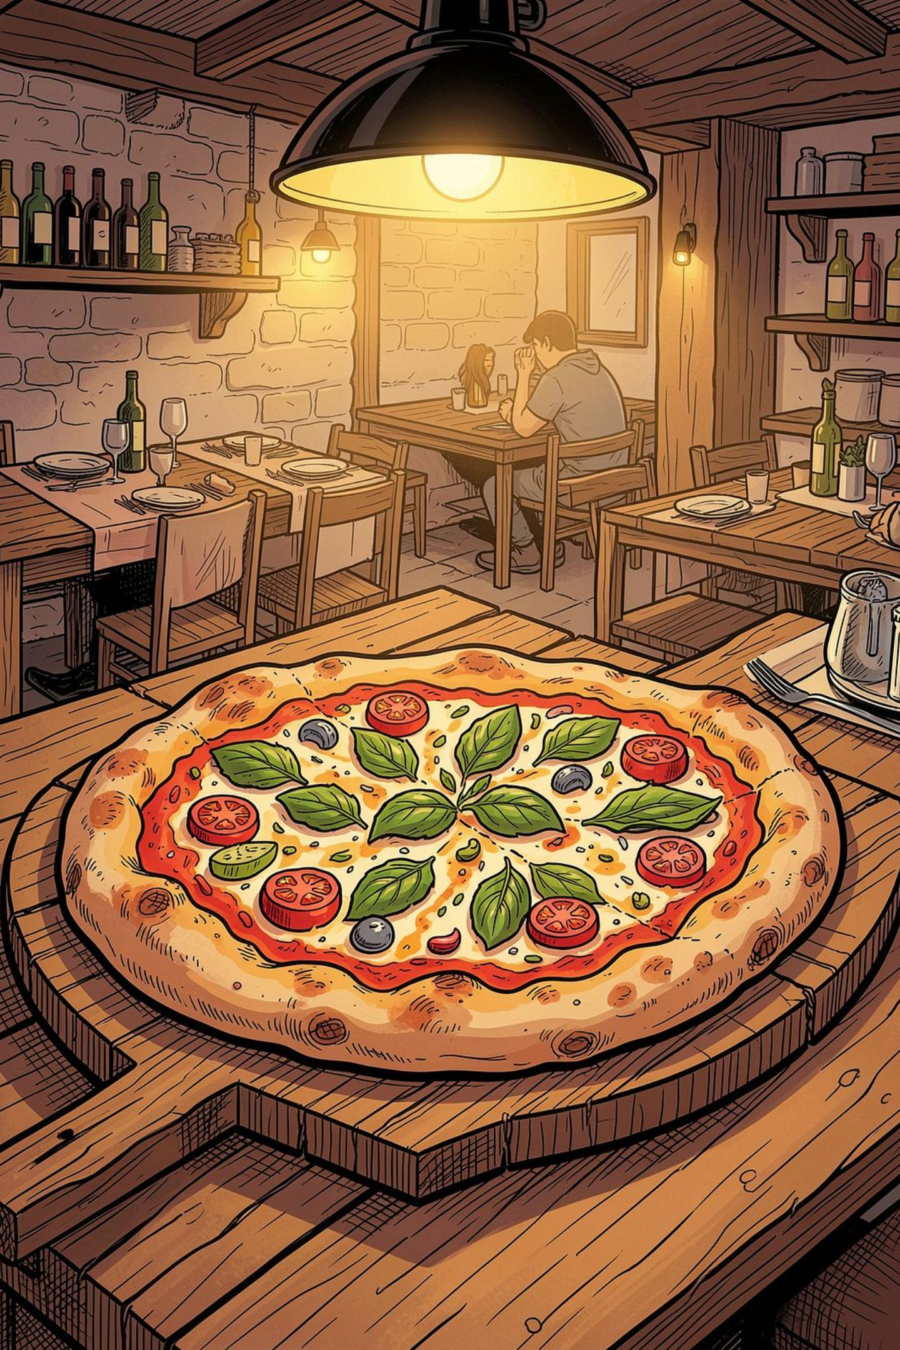
Pizza Sales Analysis
Data Analysis & Power BI Dashboard Report · January 1 – December 31, 2015
48,620 LINE ITEMS
21,350 ORDERS
REPORT DATE: AUG 25, 2026

Slide 2
Executive Summary
One full year of pizzeria transaction data analyzed via pizza_sales.sql and mirrored in the Pizza_Sales_dashboard.pbix Power BI report (Home + Best & Worst Sellers pages).
$817,860
49,574
21,350
Total Revenue
Pizzas Sold
Total Orders
$38.31
2.32
Avg Order Value
Avg Pizzas/Order
Classic category leads revenue and volume; Large pizzas dominate sizing; demand peaks Fridays. Thai Chicken, Barbecue Chicken, and California Chicken are top revenue performers; Brie Carre underperforms on every measure.

Slide 3
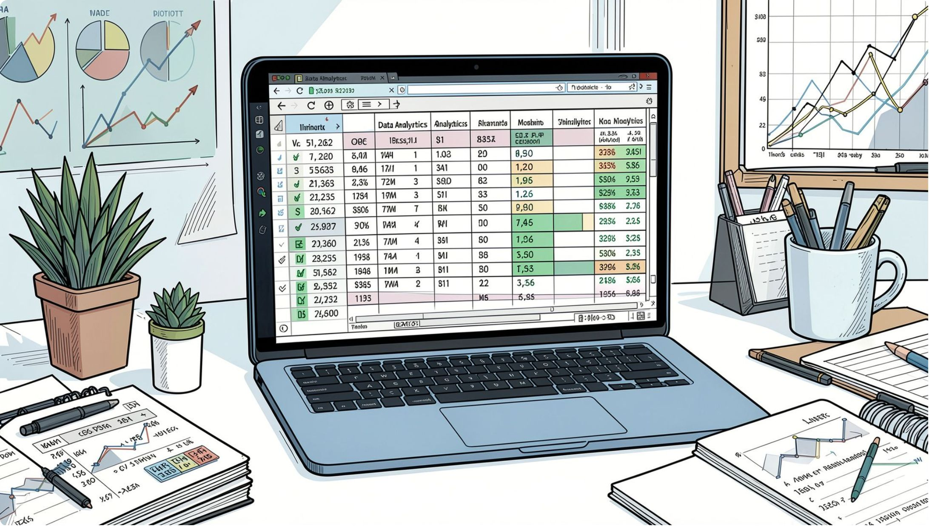
About the Dataset
Source: pizza_sales.csv — one row per pizza sold within an order. 48,620 rows, no missing values.
order_id
Shared across pizzas in same order
quantity
Number of that pizza sold
unit_price / total_price
Price per pizza and line total (USD)
pizza_size
S, M, L, XL, or XXL
pizza_category
Classic, Chicken, Supreme, or Veggie
The SQL script loads this CSV into a database table and runs aggregate queries for KPIs, trends, and rankings — all reproduced here directly against the raw file.

Slide 4

Power BI Dashboard Overview
Pizza_Sales_dashboard.pbix is a two-page report with shared KPI measures and Month/Category slicers on every page.
🏠 Home Page
KPI scorecard · Daily & Monthly trends · % Sales by Category & Size · Pizzas Sold by Category funnel
🏆 Best & Worst Sellers
Top 5 / Bottom 5 by Revenue · Quantity · Orders — all with Month & Category slicers

Slide 5
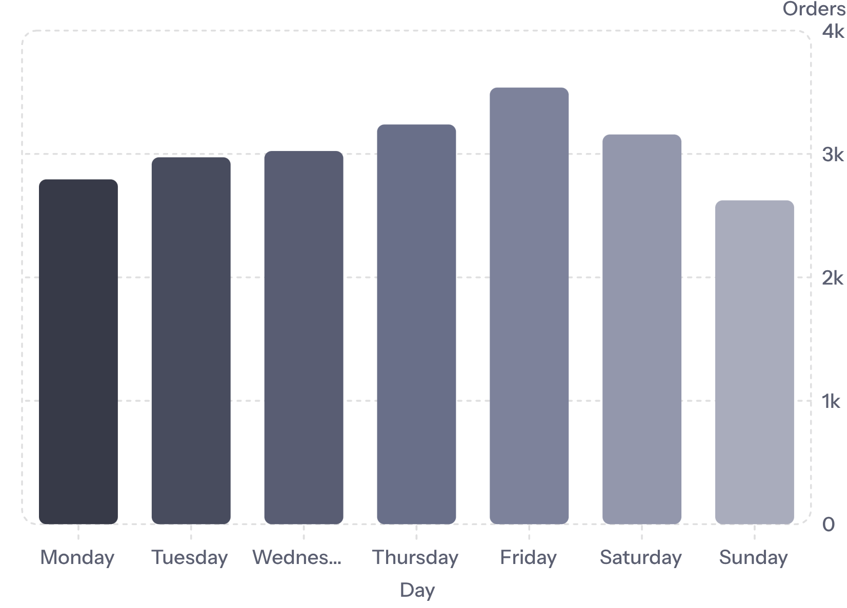
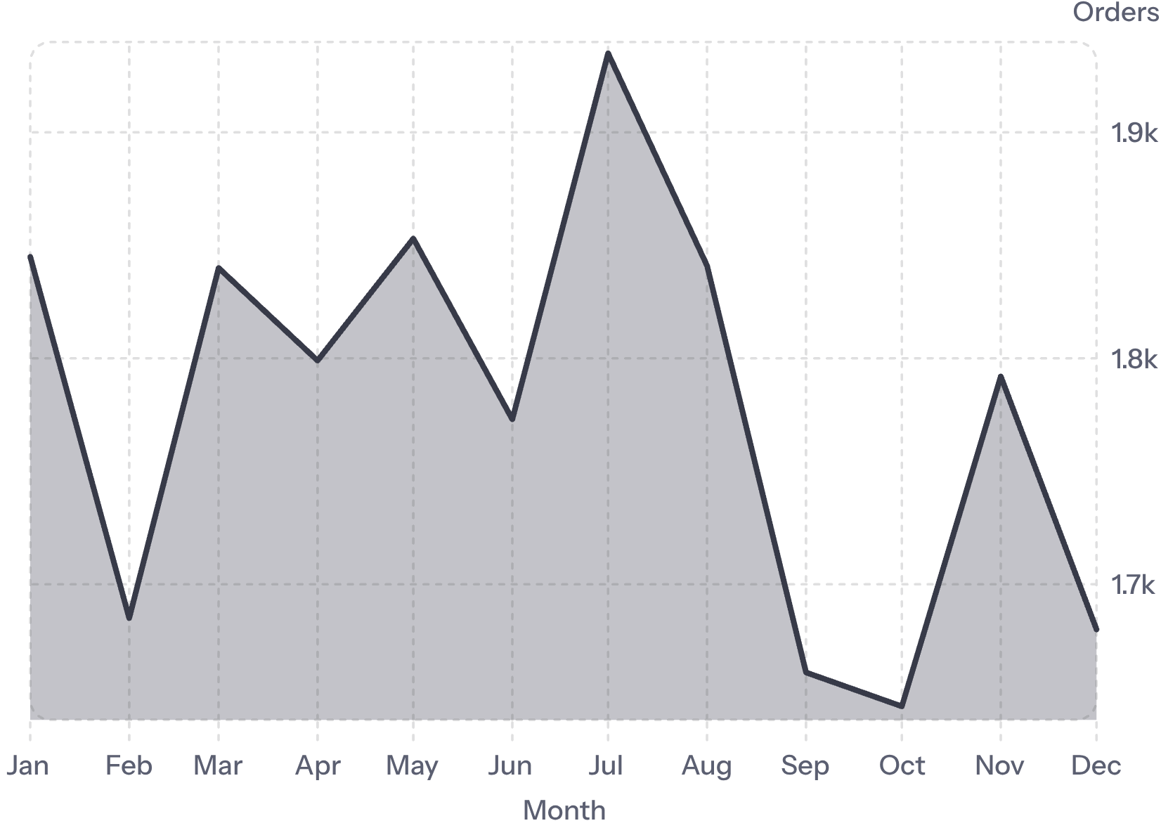
Home Page — Order Trends
Daily Orders (Day of Week)
Monthly Orders
Orders climb through the week, peaking Friday (3,538) — 27% above the Sunday low. July leads monthly volume (1,935 orders); the ~17% gap between busiest and quietest month shows demand is driven more by day-of-week patterns than strong seasonality.

Slide 6
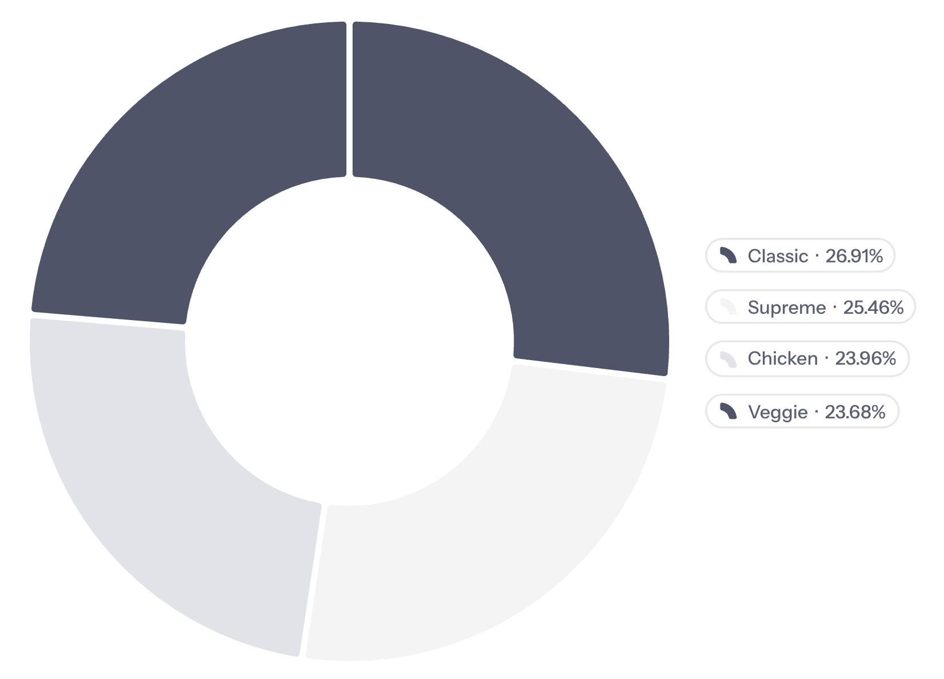
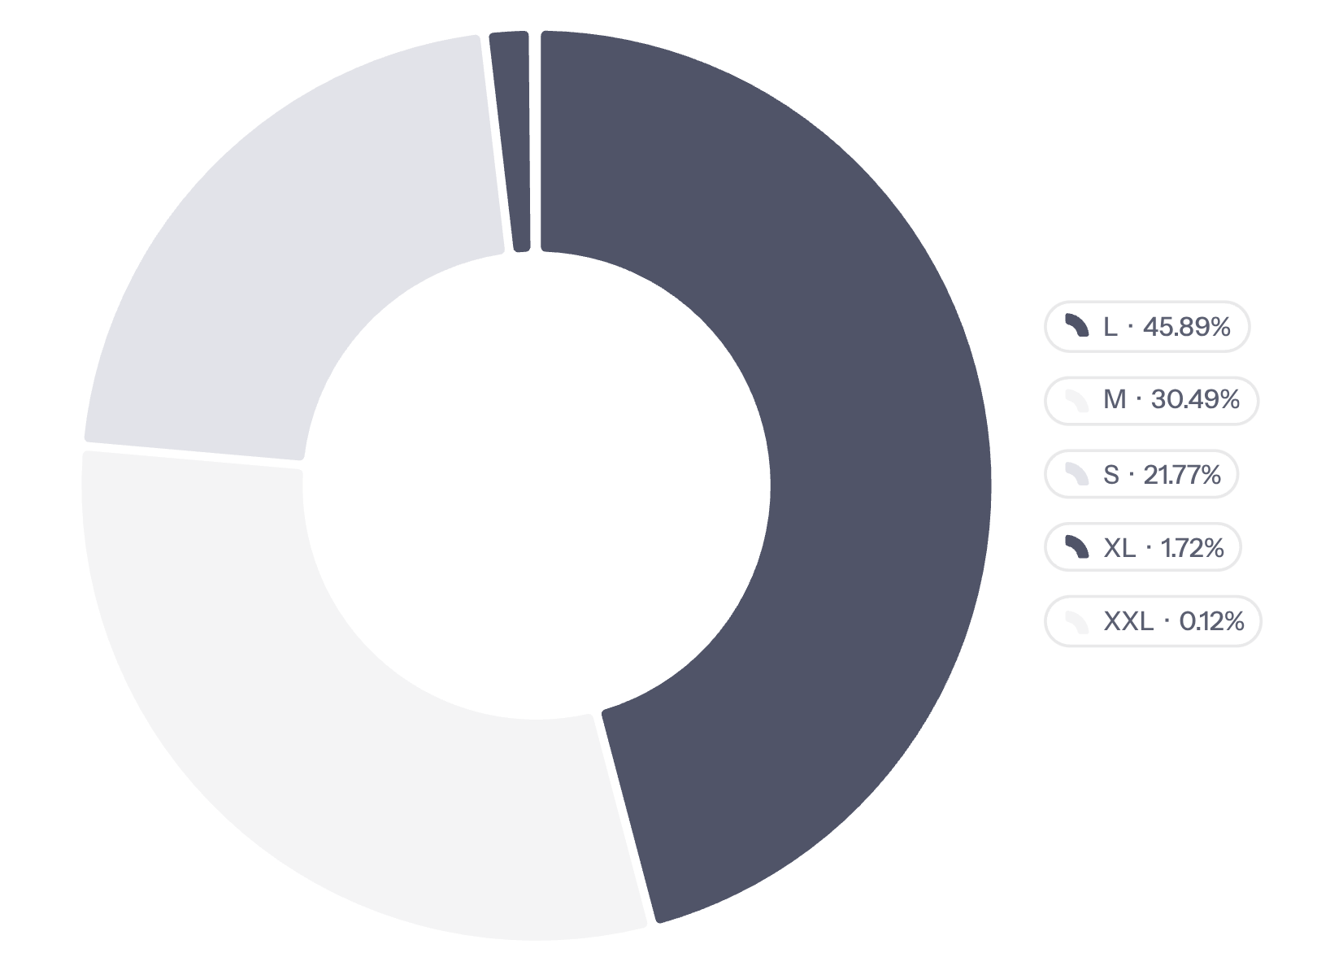
Home Page — Category & Size Breakdown
% Revenue by Category
% Revenue by Size
Classic leads revenue (26.9%) and units (14,888). Large pizzas alone generate 45.9% of all revenue; XL and XXL together contribute under 2% — a niche offering, not a growth lever.

Slide 7
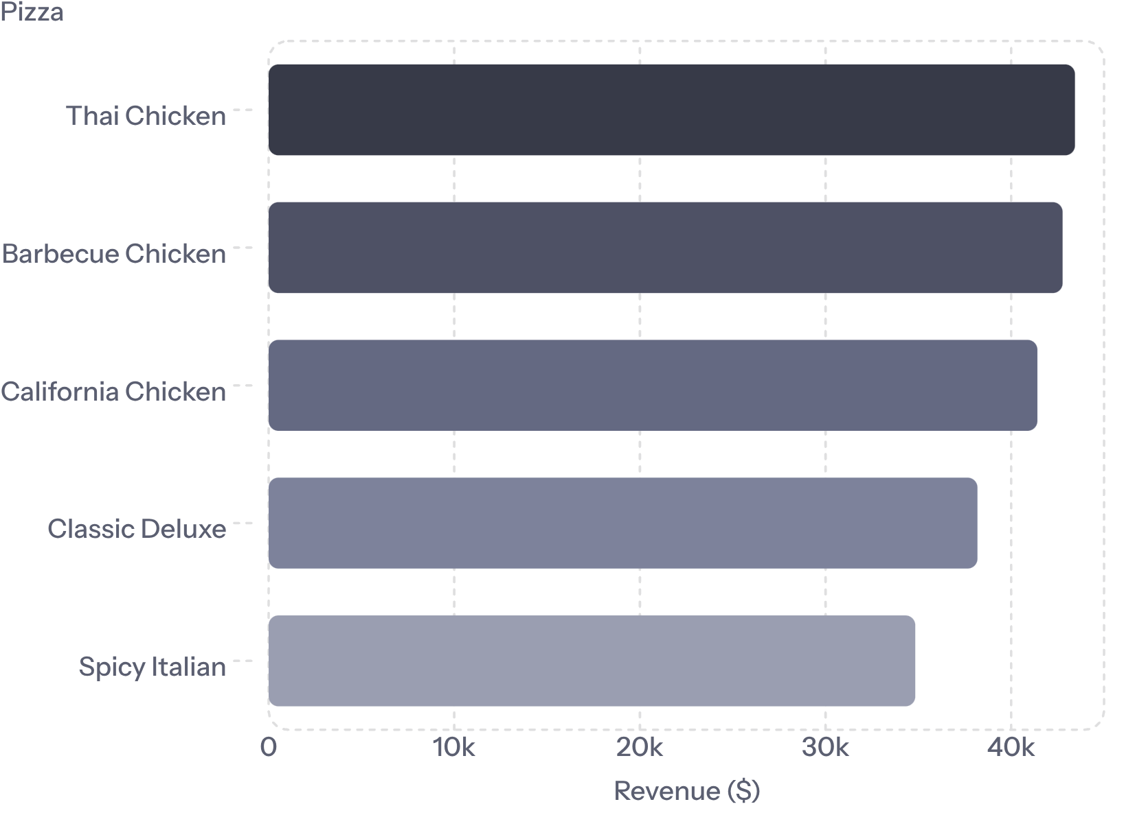
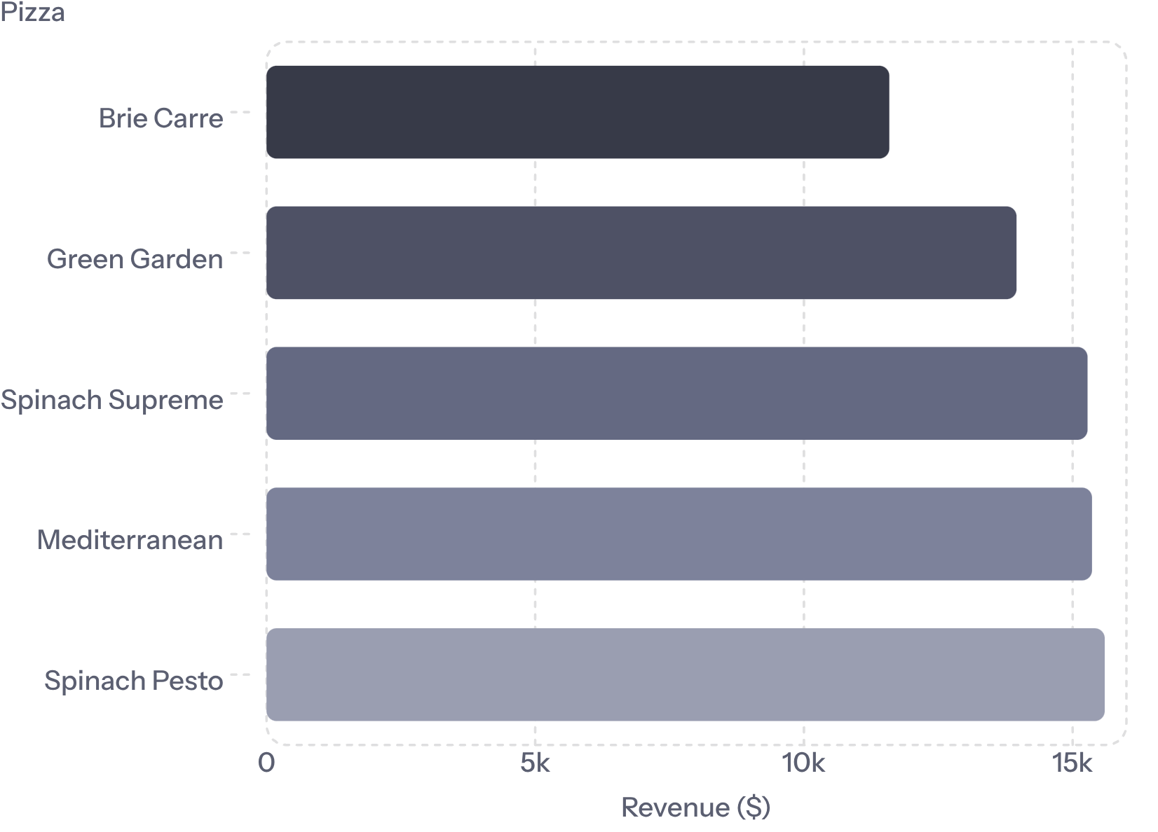
Best & Worst Sellers — By Revenue
Top 5 by Revenue
Bottom 5 by Revenue
Premium Chicken pizzas dominate the top. Brie Carre earns under a third of the next-lowest performer's revenue — the clearest candidate for menu, pricing, or recipe review.

Slide 8
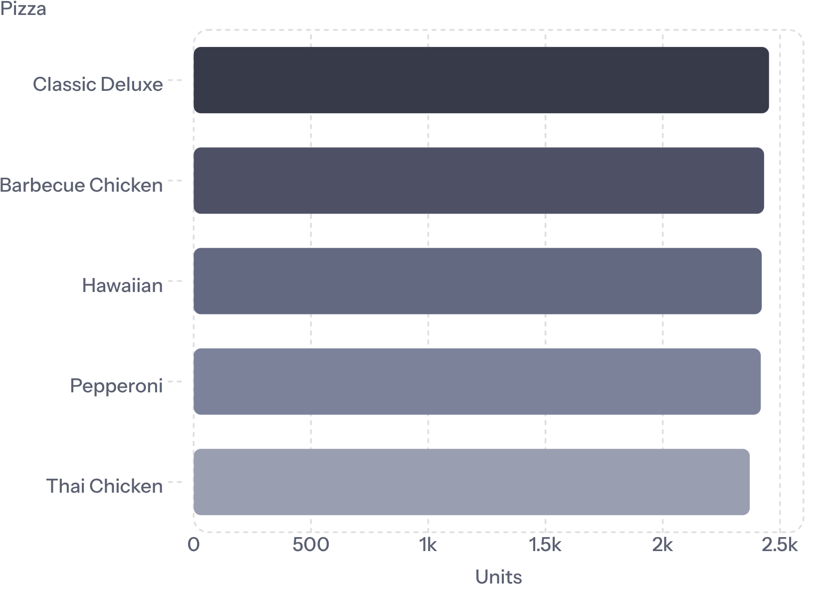
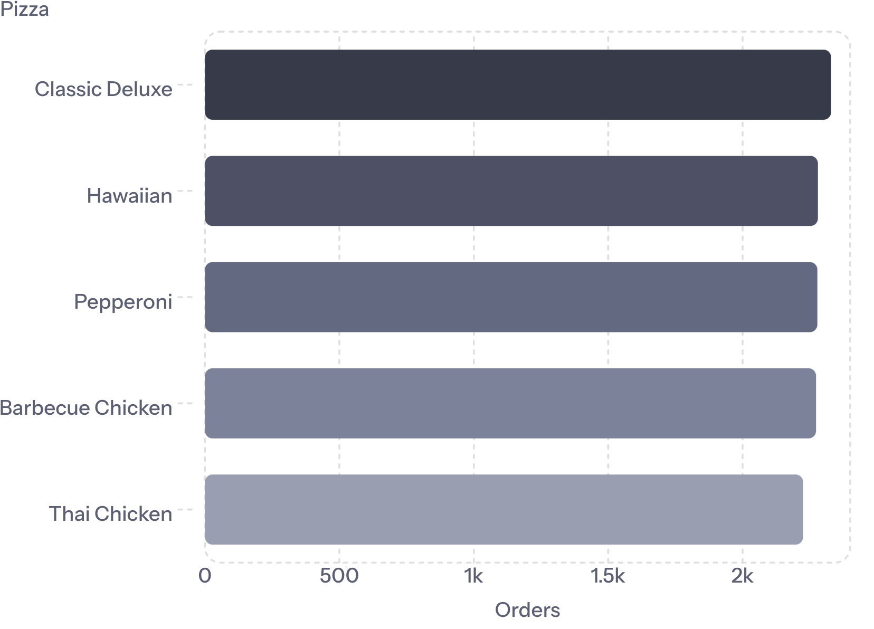
Best & Worst Sellers — By Quantity & Orders
Top 5 by Quantity Sold
Top 5 by Number of Orders
Classic Deluxe, Hawaiian, and Pepperoni are the most frequently ordered — natural combo anchors. Chicken pizzas earn more per unit, positioning them as premium upsells. Bottom-five lists by quantity and orders closely mirror revenue, confirming weak fundamental demand for Brie Carre, Mediterranean, and Calabrese.

Slide 9
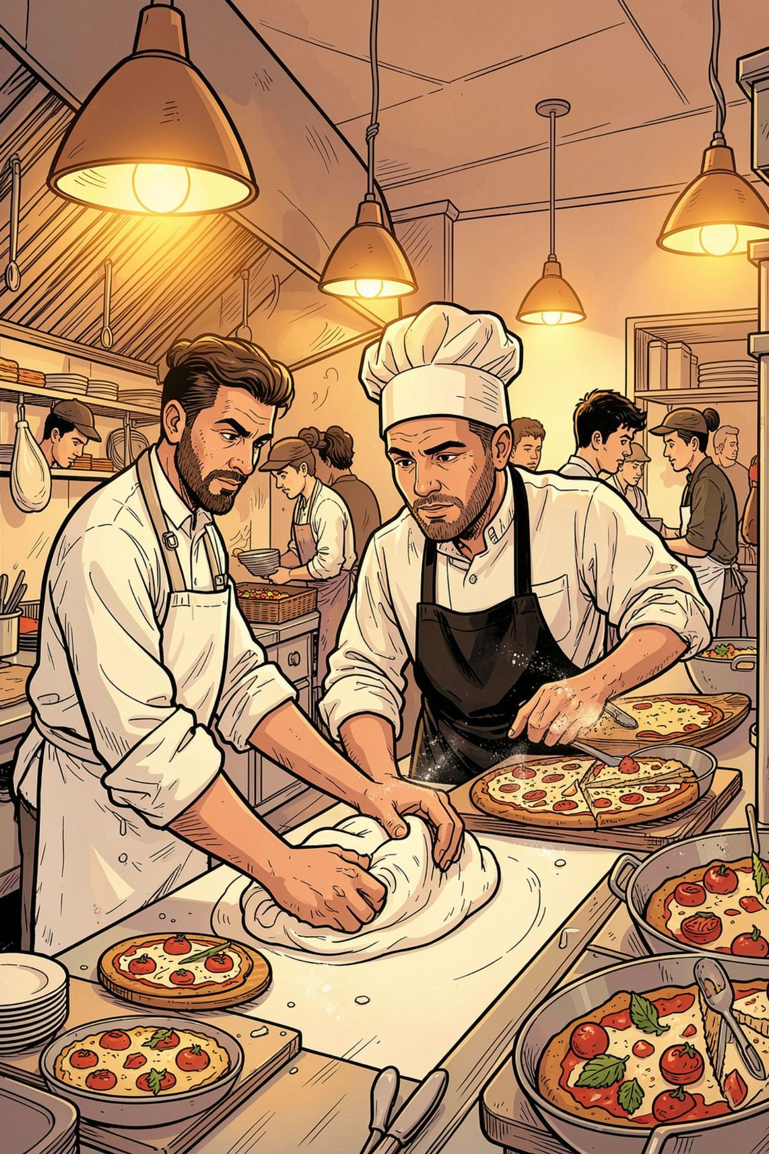

Key Insights & Recommendations
Staff for the Friday Peak
Friday is 27% busier than Sunday. Align staffing, prep, and delivery to a Thursday–Saturday peak schedule.
Promote Large Upsells
Large pizzas drive 45.9% of revenue. A modest Medium→Large upsell has outsized revenue potential.
Anchor Combos on Classics
Classic Deluxe, Hawaiian, Pepperoni = most-ordered. Position Chicken pizzas as premium add-ons.
Review Brie Carre
490 units / $11,588 / 480 orders — under a quarter of the next-lowest. Investigate pricing, visibility, or recipe before deciding to keep or retire.

Slide 10

Methodology & Data Notes
Reproducibility
Source Files
All figures re-run from pizza_sales.sql against pizza_sales.csv (48,620 rows, no missing values). Dates parsed from M/D/YYYY format; currency rounded to 2 decimals per source SQL.
pizza_sales.csv
pizza_sales.sql
Raw transaction data
Aggregation queries
Charts in Sections 5–6 match the live Power BI dashboard value-for-value, using identical query logic and chart types (column, area, donut, funnel, horizontal bar).
Pizza_Sales_dashboard.pbix
Power BI report

