Slide 1
Networking
CS422/522 Lecture 13
5 November 2014
Last updated: 7 November 2014

Slide 2
Outline
Recap
Introduction
Application
Transport
Network / Data Link
Packets Format
Example
Wrap-Up

Slide 3
Recap
DMA vs PIO
IO Protection
File system caches: blocks and inodes

Slide 4
Outline
Recap
Introduction
Application
Transport
Network / Data Link
Packets Format
Example
Wrap-Up

Slide 5
Case Study
What happens we we enter www.google.com in our browser's address bar?

Slide 6
Networking
Most common type of IPC
Simple, portable:
  Works locally or across network
  Compatible across almost all OS
Naming
Routing
Stream vs datagram -- connection vs connectionless
Blocking vs non-blocking
Synchronous vs asynchronous

Slide 7
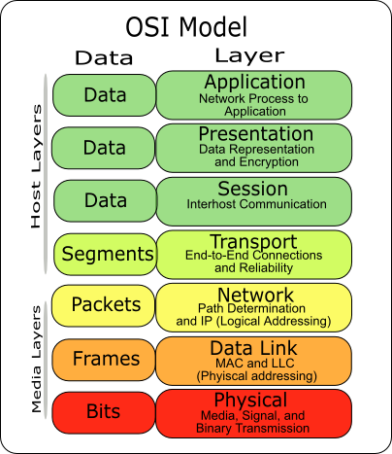
Network Layout

Slide 8
Naming
Everything in a computer has a name. Examples?
Application layer -- URL
Transport -- UDP / TCP Ports
Network -- Internet Protocol (IP) address
Data Link -- Ethernet / MAC (media access control) address
Each address must be unique at its layer
DNS converts IP to name and name to IP

Slide 9
Case Study
What happens we we enter www.google.com in our browser's address bar?
Translate www.google.com into network address
Connect to the service hosting www.google.com
Request file contents and display in browser

Slide 10
Outline
Recap
Introduction
Application
Transport
Network / Data Link
Packets Format
Example
Wrap-Up

Slide 11
URLs
Example: http://www.example.com:80/index.html?query=hello&foo=bar
scheme: http
domain name: www.exmaple.com
port number: 80
path index.html
query string : query=hello&foo=bar

Slide 12
Name Resolution
How do we know who to talk to?
Convert www.google.com into an addressable machine
Use the OS resolver library (gethostbyname)
Consult nsswitch.conf for resolving order:
hosts: files dns myhostname
Check the hosts file:
#<ip-address> <hostname.domain.org> <hostname>
127.0.0.1 localhost.localdomain localhost
If not found, check via DNS server
Add the mapping to a cache
Return result

Slide 13
DNS -- Domain Name System
Name made up of several components or domains
Example: www.google.com:
  Top-level domain: com
  google is a subdomain of com
  www is a subdomain of google.com
Each (sub)domain is handled by a (set) name server(s): authorative name server
DNS name servers form a tree root servers delegate to top-level to subdomains, etc
Recursive vs iterative

Slide 14
Naming -- From Your Machine
You specify you want to access www.google.com
It checks the hosts file, no match
It scans your system for a list of DNS servers
Send a DNS request to a server
If server sends back a useful answer, stop, else repeat
We can talk to machine that owns that URL using HTTP
Difference between: recursive vs iterative

Slide 15
HTTP -- Hypertext Transfer Protocol
Used to communicate across the Web
Embeds the entire url:
  GET /index.html?query=hello&foo=bar HTTP/1.1
  Host: www.example.com
The protocol itself is stateless
A session is maintained:
  Client is either in cookies or a comonent of the URL
  Server is in a database
Not secure by default

Slide 16
Case Study
What happens we we enter www.google.com in our browser's address bar?
Use DNS to resolve www.google.com to an address
Send an HTTP message to that address of the form: GET /
Host: www.google.com
We need to build DNS and HTTP on top of a transport...

Slide 17
Outline
Recap
Introduction
Application
Transport
Network / Data Link
Packets Format
Example
Wrap-Up

Slide 18
Datagram -- UDP
User datagram protocol
Unconnected
Unreliable
Each message sent / received fully -- like a memory page

Slide 19
Stream -- TCP
Transmission Control Protocol
Establish an explicit connection to a remote peer
Reliable and ordered
Sends and receives come as segments
Stream oriented

Slide 20
TCP -- Connected
Server listens on a specific port
Client dynamically allocates a port
Picks a sequence number and sends a syn packet to server
Server picks a sequence number and syn-acks clients packet
Client acks servers syn-ack
Sequence numbers (bytes) are acked

Slide 21
TCP -- Reliable / Ordered
Segments 1, 2, 3 sent
Segments 1, 3 received, acks 1 and 3
Only segment 1 is delivered to application
Sender's stack resends 2
Segment 2 received
Segments 2 and 3 delivered to application

Slide 22
TCP -- Stream
Segments 1, 2, 3 sent
Segments need not be a fixed size
Receives read the next bytes available
There is no notion of packets
Must implemented your own mechanism

Slide 23
Application Usage
What type of applications would use TCP or UDP?
Real time applications
DNS
The Web
Skype
Games
BitTorrent

Slide 24
Case Study
What happens we we enter www.google.com in our browser's address bar?
DNS request using UDP to a server on port 53
Response containing the network address
Contact that server on port 80 using TCP
Perform TCP 3 way handshake
Perform an HTTP get request for /
HTTP response containing data for /
Next up ... network address and routing

Slide 25
Outline
Recap
Introduction
Application
Transport
Network / Data Link
Packets Format
Example
Wrap-Up

Slide 26
Ethernet Routing
Ethernet device has address
No applications directly use Ethernet
IP builds on top of Ethernet
Broadcast Ethernet FF:FF:FF:FF:FF:FF
Machines route "directly" to each other in a LAN

Slide 27
IP within a LAN
LAN -- Local Area Network
LAN typically denotes within the same subnet
Subnet: 192.168.1.1-255, 192.168.1/24, netmask: 255.255.255.0
Find each other through ARP (address resolution protocol):
  Send a broadcast Ethernet packet looking for IP
  Owner of IP responds and embeds his Ethernet address
Typically has a gateway (router) to other networks

Slide 28
IP within a WAN
WAN -- Wide Area Network -- The Internet
Why not ARP?
Long distance routing protocols: BGP, OSPF:
broadcast scalability
  Dedicated service
  Pre-configured with addresses within their LAN
  Share these with other services
  Each service produces an IP to next host (route) maplability

Slide 29
Case Study
DNS request to a nameserver (8.8.8.8:53) using UDP
Cannot directly send to 8.8.8.8, redirect to gateway
Obtain gateway Ethernet via ARP
Forward packet through gateway: its Ethernet, but 8.8.8.8 IP Address
Gateway checks for next hop and forwards
Repeat until arrived
...
DNS receives request, sends back answer
It has no direct connection, sends to default gateway...
...

Slide 30
Case Study (2)
Web browser has IP
Web browser begins TCP connection to that IP at port 80, default http
Sends HTTP Get request
No direct connection...
...

Slide 31
Outline
Recap
Introduction
Application
Transport
Network / Data Link
Packets Format
Example
Wrap-Up

Slide 32
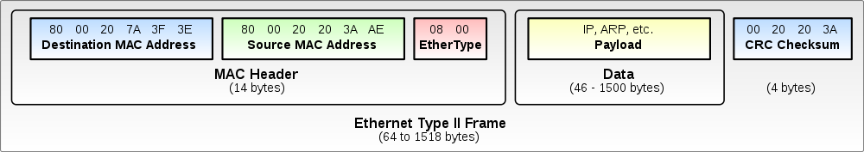
Ethernet Packet

Slide 33
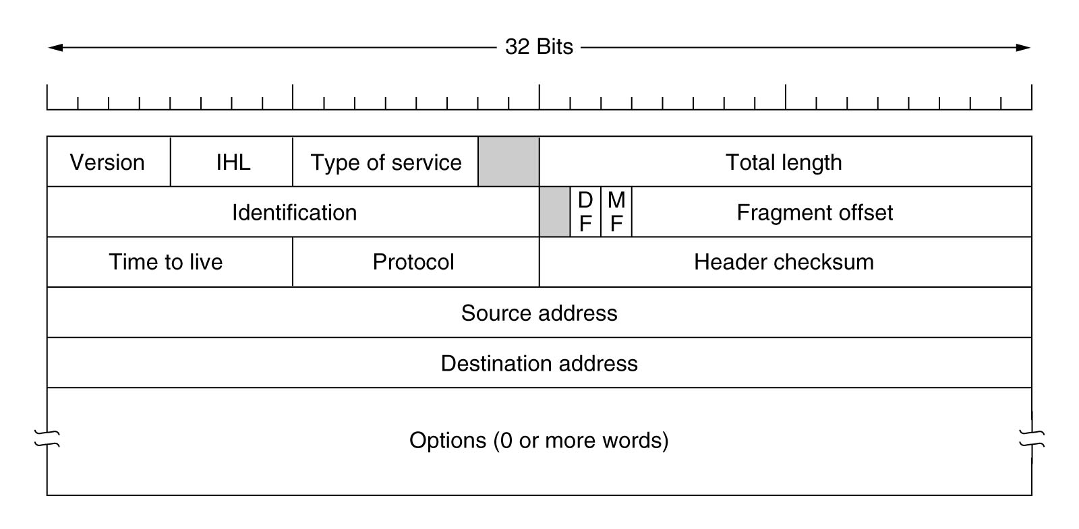
IP Packet

Slide 34
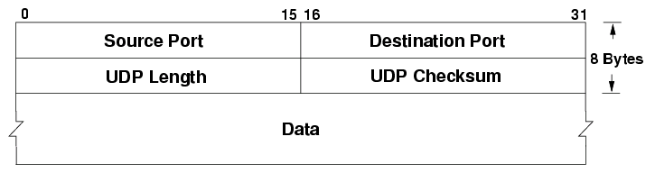
UDP Packet

Slide 35
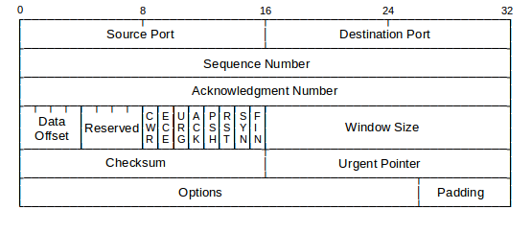
TCP Packet

Slide 36
Outline
Recap
Introduction
Application
Transport
Network / Data Link
Packets Format
Example
Wrap-Up

Slide 37
Blocking vs Non-Blocking
By default all calls are blocking
Receives only complete if data is available
Sends only complete if the data can be written to a socket buffer
Inefficient, when?
Can use poll / select on non-blocking sockets
Returns a list of sockets that may be available for performing an operation

Slide 38
Synchronous vs Asynchronous
Synchronous occur in the same execution context
Asynchronous occur in a callback
Asynchronous compares to Non-Blocking, main thread does not wait
Good for infrequent operations that might block main thread, such as?

Slide 39
Network Communication
Not all machines read integers in the same order
Network order is defined to be big endian
Alternatively use serialization

Slide 40
UDP Client Example
struct sockaddr_in saddr;
char buf[BUFSIZE];
struct hostent *srv = gethostbyname(hostname);
int sockfd = socket(AF_INET, SOCK_DGRAM, 0);
saddr.sin_family = AF_INET;
memcpy(srv->h_addr, saddr.sin_addr.s_addr, srv->h_length);
saddr.sin_port = htons(portno);
printf("Please enter msg: ");
fgets(buf, BUFSIZE, stdin);
int sl = sizeof(saddr);
int n = sendto(sockfd, buf, strlen(buf), 0, &saddr, sl);
n = recvfrom(sockfd, buf, strlen(buf), 0, &saddr, &sl);
printf("Echo from server: %s", buf);

Slide 41
UDP Server Example
struct sockaddr_in saddr, caddr;
int clen = sizeof(caddr);
char buf[BUFSIZE]; /* message buf */
int sockfd = socket(AF_INET, SOCK_DGRAM, 0);
saddr.sin_family = AF_INET;
saddr.sin_addr.s_addr = htonl(INADDR_ANY);
saddr.sin_port = htons(portno);
bind(sockfd, (struct sockaddr *) &saddr, sizeof(saddr));

Slide 42
UDP Server Example (2)
while (1) {
int n = recvfrom(sockfd, buf, BUFSIZE, 0, &caddr, &clen);
struct hostent *hostp = gethostbyaddr(
(const char *)&caddr.sin_addr.s_addr,
sizeof(caddr.sin_addr.s_addr), AF_INET);
char *hostaddrp = inet_ntoa(caddr.sin_addr);
printf("Datagram from %s (%s) %d/%d bytes: %s\n",
hostp->h_name, hostaddrp, strlen(buf), n, buf);
n = sendto(sockfd, buf, strlen(buf), 0, &caddr, clen);
}

Slide 43
TCP Client Example
struct sockaddr_in saddr;
char buf[BUFSIZE];
struct hostent *srv = gethostbyname(hostname);
sockfd = socket(AF_INET, SOCK_STREAM, 0);
saddr.sin_family = AF_INET;
memcpy(srv->h_addr, &saddr.sin_addr.s_addr, srv->h_length);
saddr.sin_port = htons(portno);
printf("Please enter msg: ");
fgets(buf, BUFSIZE, stdin);
connect(sockfd, &saddr, sizeof(saddr));
int n = send(sockfd, buf, strlen(buf), 0);
n = recv(sockfd, buf, BUFSIZE, 0);
printf("Echo from server: %s", buf);

Slide 44
TCP Server Example
struct sockaddr_in saddr, caddr;
int clen;
char buf[BUFSIZE]; /* message buffer */
int lfd = socket(AF_INET, SOCK_STREAM, 0);
saddr.sin_family = AF_INET;
saddr.sin_addr.s_addr = htonl(INADDR_ANY);
saddr.sin_port = htons((unsigned short)portno);
bind(lfd, (struct sockaddr *) &saddr, sizeof(saddr));
listen(lfd, 5);

Slide 45
TCP Server Example (2)
while (1) {
int afd = accept(lfd, (struct sockaddr *) &caddr, &clen);
struct hostent *hostp = gethostbyaddr(
(const char *)&caddr.sin_addr.s_addr,
sizeof(caddr.sin_addr.s_addr), AF_INET);
char *hostaddrp = inet_ntoa(caddr.sin_addr);
int n = recv(afd, buf, BUFSIZE, 0);
printf("Connection from %s (%s) %d/%d bytes: %s\n",
hostp->h_name, hostaddrp, strlen(buf), n, buf);
int n = send(afd, buf, strlen(buf), 0);
close(afd); }

Slide 46
Outline
Recap
Introduction
Application
Transport
Network / Data Link
Packets Format
Example
Wrap-Up

Slide 47
Labs
Lab 6b has been assigned
Lab 7

Slide 48
Next Time
Virtualization
Monday 1:00PM

